Slide 1
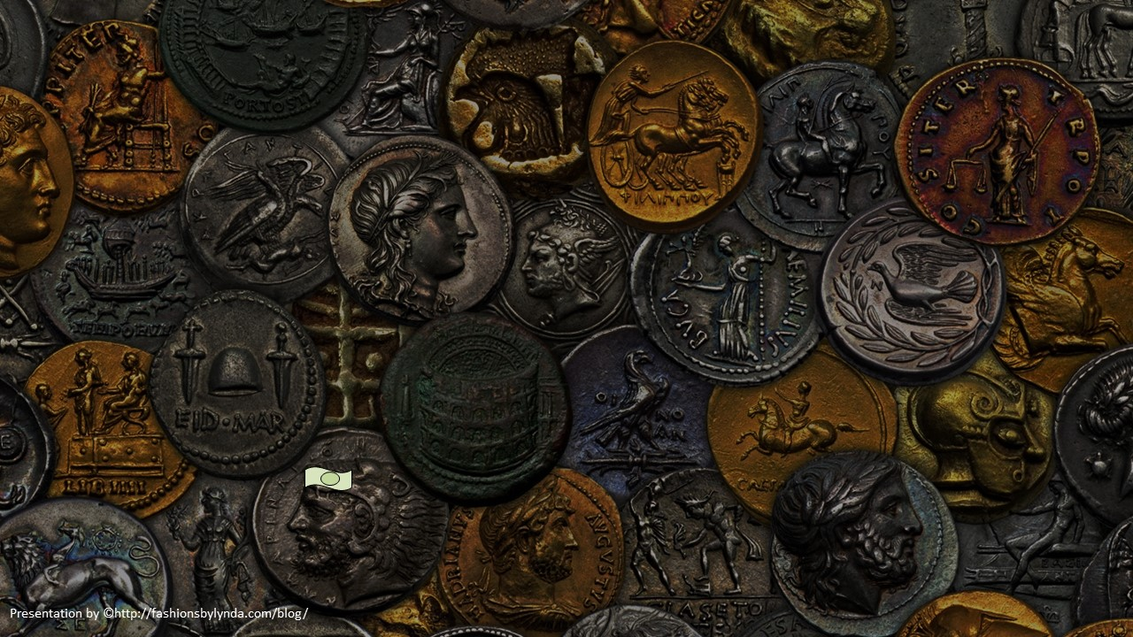
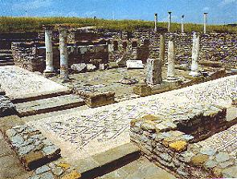
Lesson 116
Offerings For The Poor
2 Corinthians 8-9
He hath dispersed, he hath given to the poor; his righteousness endureth for ever; his horn shall be exalted with honour.
Psalms 112:9

Slide 2
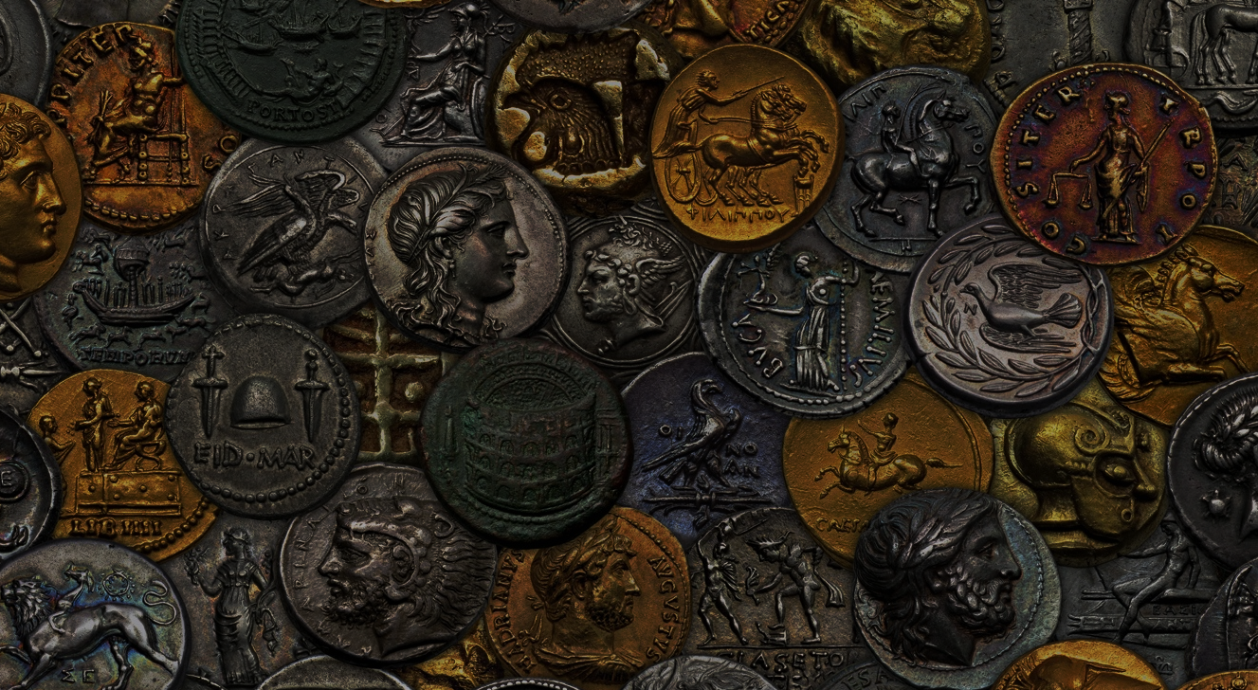
“Down through history, poverty has been one of humankind’s greatest and most widespread challenges.
Its obvious toll is usually physical, but the spiritual and emotional damage it can bring may be even more debilitating.”

Slide 3
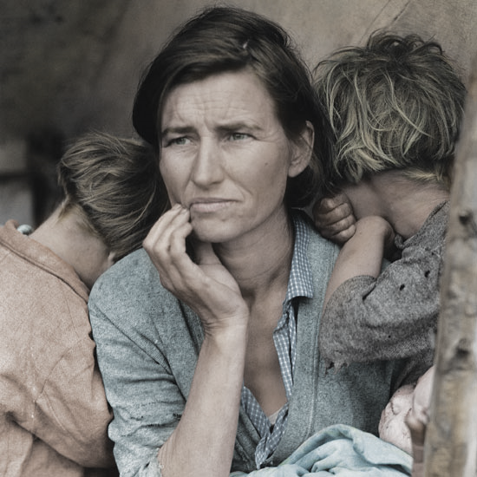
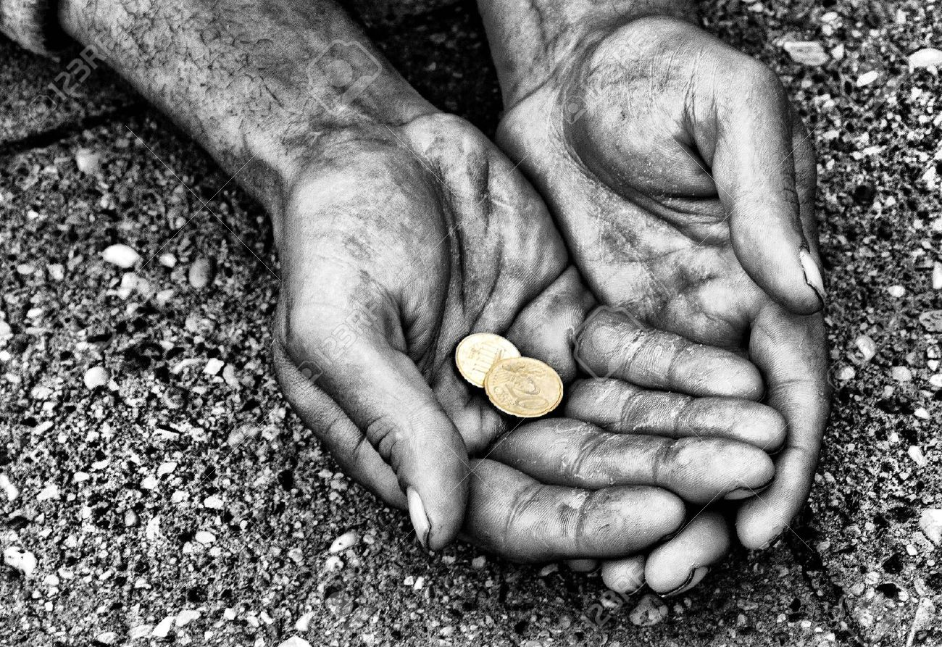
POVERTY
The condition of having little or no money, goods, or means of support.

Slide 4
Macedonia--Generous
Paul told the Corinthian Saints that Church members in Macedonia had given generously to help the poor in their temporal needs.
Macedonia
Black Sea
Rome
Italy
Adriatic Sea
The Macedonian members did so because they desired to do the will of God.
Paul encouraged the Saints of Corinth to follow this example of providing for the needs of others out of sincere love.
Mysia
Sicily
Corinth
Crete
Mediterranean Sea
2 Corinthians 8:1-8

Slide 5
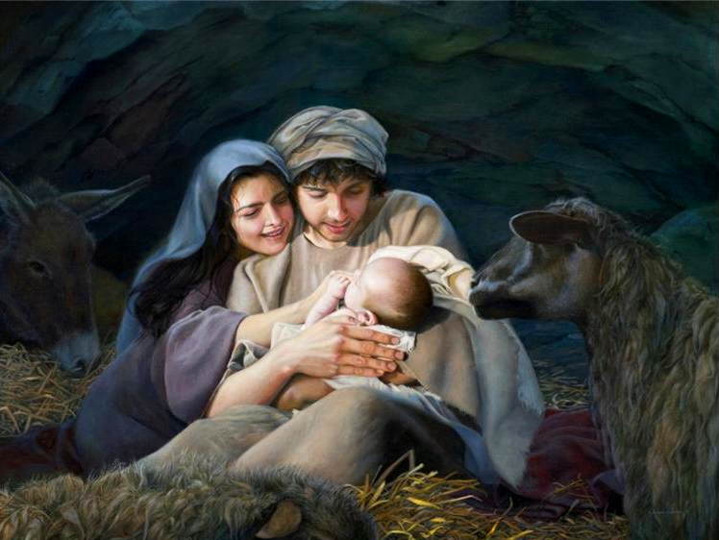
Rich VS Poor
In what ways was Jesus Christ rich in the premortal life?
In what ways might He have been considered poor during His time in mortality?
Jesus Christ was the Firstborn of the Father in the spirit and even before He was born in mortality. Jesus Christ was a God who stood next to Heavenly Father in authority, power, and glory and created many worlds under the direction of the Father.
He left His position of glory to be born in and live among lowly circumstances on earth
2 Corinthians 8:9

Slide 6
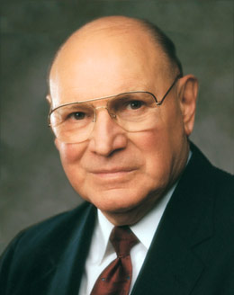
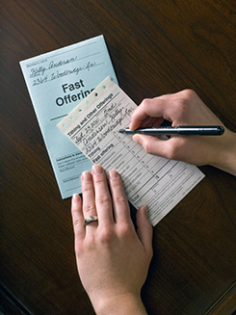
Fast Offering
What is the 2nd Great Commandment?
Thou shalt love thy neighbor as thyself
In The Church of Jesus Christ of Latter-day Saints, members are encouraged to fast whenever their faith needs special fortification and to fast regularly once each month on fast day. On that day, we go without eating or drinking for two consecutive meals, commune with our Heavenly Father, and contribute a fast offering to help the poor. The offering should be at least equal to the value of the food that would have been eaten. (2)
2 Corinthians 8:10-11

Slide 7
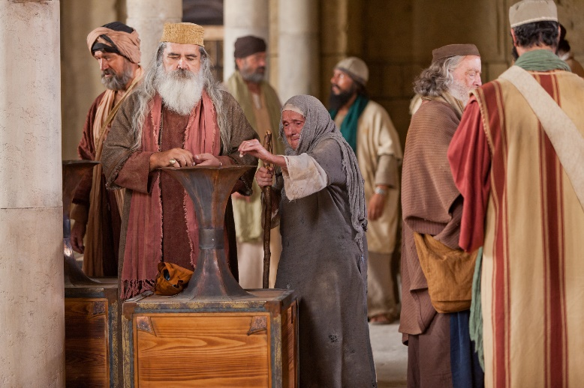
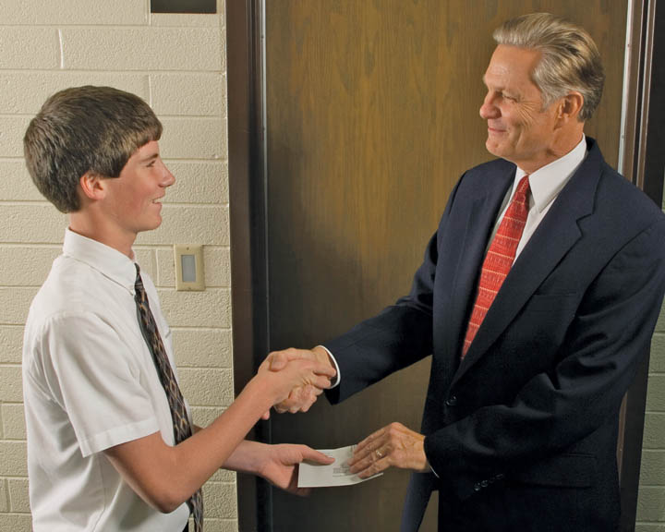
Do Unto Others
Paul admonished the Saints to fulfill their previous commitment to give what they could to the poor Saints, just as the Savior had given eternal riches to them.
"Those who abound in faith and the attributes of godliness are the ones who impart liberally of their substance for the temporal welfare of their brethren in the kingdom." (3)
As we come to understand all the Savior has given us, we will be more willing to give of our substance to others
2 Corinthians 8:10-11

Slide 8
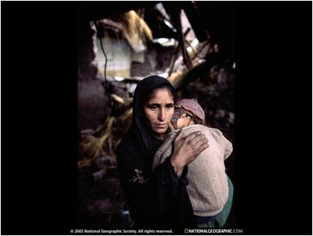
“Rich or poor, we are to ‘do what we can’ when others are in need” (4)
“…that now at this time your abundance may be a supply for their want, that their abundance also may be a supply for your want: that there may be equality.”
Paul was asking the Corinthian Saints to help those in Jerusalem who were less fortunate.
2 Corinthians 8:12-15

Slide 9
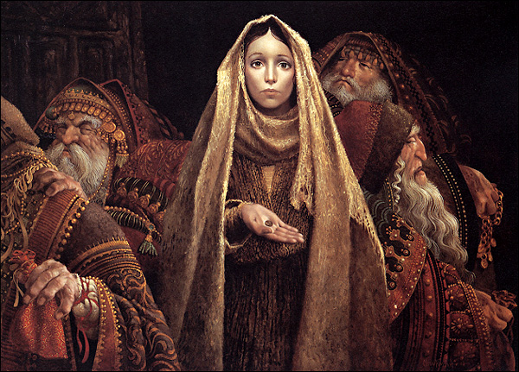
Willing to Give
God wants us to be willing to give even when we may not have anything to give
“I don’t know exactly how each of you should fulfill your obligation to those who do not or cannot always help themselves.
But I know that God knows, and He will help you and guide you in compassionate acts of discipleship if you are conscientiously wanting and praying and looking for ways to keep a commandment He has given us again and again”
James C. Christensen
2 Corinthians 8:12-15

Slide 10
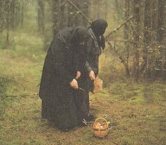
The Earth is full and there is enough and to spare…
“As it is written, He that had gathered much had nothing over; and he that had gathered little had no lack.”
Everything on the earth belongs to the Lord.
Read D&C 104:12-18
2 Corinthians 8:15

Slide 11
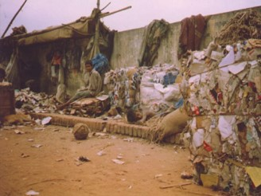
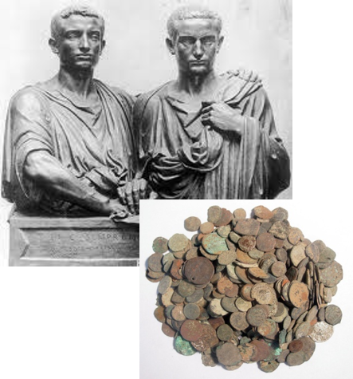
Remember the Poor
“If thou lovest me…thou will remember the poor, and consecrate of thy properties for their support”
“And remember in all things, the poor and the needy, the sick and the afflicted, for he that doeth no these things, the same is not my disciple.”
D&C 42:30; D&C 52:40

Slide 12
Enoch Built a Zion Society
“And the Lord called his people Zion, because they were of one heart and one mind, and dwelt in righteousness; and there was no poor among them”
Moses 7:18

Slide 13
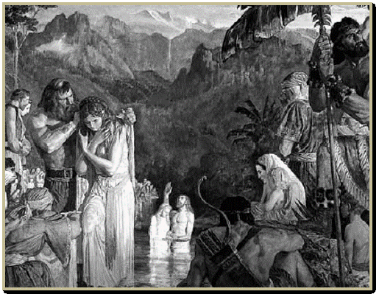
Prosperous In Their Circumstance
An account of Alma, son of Alma and the people.
“And they did impart of their substance, every man according to that which he had, to the poor, and the needy, and the sick, and the afflicted, and they did not wear costly apparel, yet they were neat and comely.”
1 Alma 1:27

Slide 14
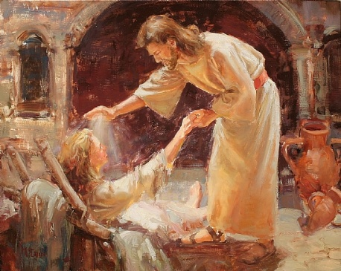
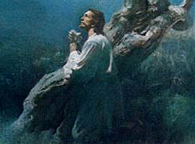
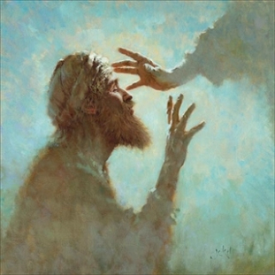
The Savior’s Two Great Missions
2. The work He did among His brethren and sisters in the flesh by way of relieving their sufferings.
The Messiahship---the atonement for the fall---the fulfillment of the law
(5)

Slide 15
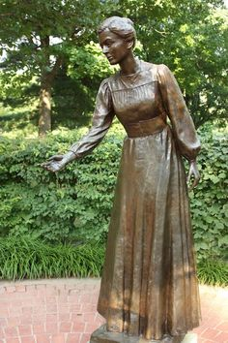
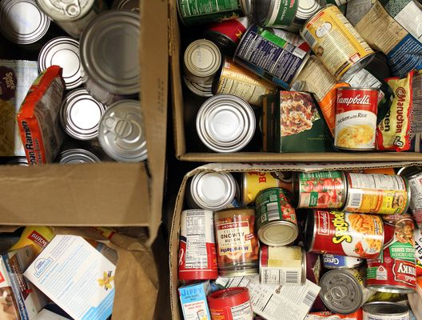
A Law Of Consecration
"In the early part of both this and the meridian dispensations, the saints attempted to live the full law of consecration.
That is, they consecrated their temporal means and spiritual abilities to the Lord's work.
All of their talents, strength, time, properties, and monies were made available for use in the establishment of the Lord's earthly Church and kingdom.
In this dispensation the organizational arrangement where under the principles of consecration operated was the United Order.
The New Testament contains only passing allusions of how the system operated in that day.
(3)
2 Corinthians 9:6-7

Slide 16
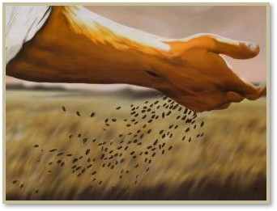
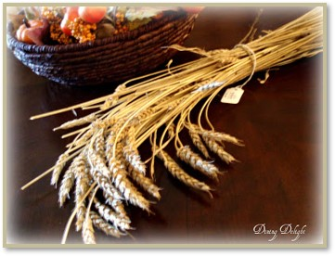
Soweth Bountifully---Reap Bountifully
“Every man according as he purposeth in his heart, so let him give…
…not grudgingly, or of necessity; for God loveth a cheerful giver
If we give to those in need with a cheerful heart, God will generously bless us
2 Corinthians 9:7

Slide 17
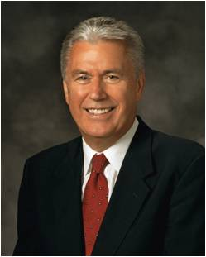
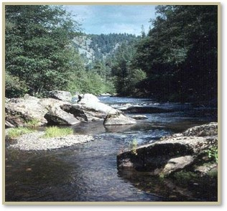
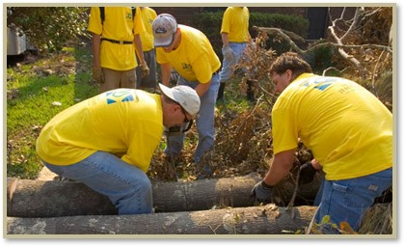
Priesthood Organization—Welfare Program
“The Lord’s way is not to sit at the side of the stream and wait for the water to pass before we cross…
…it is to come together, roll up our sleeves, go to work, and build a bridge or a boat to cross the waters of our challenges.”
(6)

Slide 18
Not Only Tithing and Fast Offerings do we contribute:
Our Time
Our Talents
Our Means
Ourselves
1
Food

Slide 19
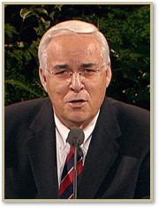
“The Savior wants us to love others as He loves them.
It is not necessary for us to lay down our life for others as He did.
But like the Savior, we should bless the lives of others by giving of what our life is made up of—our time, our talents, our means, and ourselves.”
(7)

Slide 20
Sources:
Suggested Hymn: #223 Have I Done Any Good?
Video:
They Gave Up Their Christmas (4:45)
New Testament Institute Student Manual Chapter 39
Elder Joseph B. Wirthlin The Law of the Fast April Gen. Conf. 2001
Elder Bruce R. McConkie (Doctrinal New Testament Commentary, 3 vols. [Salt Lake City: Bookcraft, 1965-1973], 2:433; 2:57)
Elder Jeffrey R. Holland (“Are We Not All Beggars?” 41).
J. Reuben Clark Jr. Conference Report April 1937
Dieter F. Uchtdorf Conference Report October 2011 “Providing in the Lord’s Way”
Elder Robert J. Whetten “How Can I Help?” April 1999 Conference “True Followers”
If we give to those in need with a cheerful heart, God will generously bless us
Presentation by ©http://fashionsbylynda.com/blog/

Slide 21
Second Letter of Paul to the Saints at Corinth— Written from Macedonia
Saints Impart Substance to Poor | 8:1–24
The Blessings of True Charity | 9:1–15
Providing 2 Corinthians 8:14:
“This very hour there are many members of the Church who are suffering. They are hungry, stretched financially, and struggling with all manner of physical, emotional, and spiritual distress. They pray with all the energy of their souls for succor, for relief.
“Brethren, please do not think that this is someone else’s responsibility. It is mine, and it is yours. We are all enlisted. ‘All’ means all—every Aaronic and Melchizedek Priesthood holder, rich and poor, in every nation. In the Lord’s plan, there is something everyone can contribute” (“Providing in the Lord’s Way,” Ensign or Liahona, Nov. 2011, 54).
Life and Teachings of Jesus and His Apostles Chapter 37
Give to the Poor 2 Corinthians 8:10-11:
“‘I am a firm believer that you cannot give to the Church and to the building up of the kingdom of God and be any poorer financially. I remember … when Brother [Melvin J.] Ballard laid his hands on my head and set me apart to go on a mission. He said in that prayer of blessing that a person could not give a crust to the Lord without receiving a loaf in return. That’s been my experience. If the members of the Church would double their fast-offering contributions, the spirituality in the Church would double. We need to keep that in mind and be liberal in our contributions.’ Marion G. Romney (Welfare Agricultural Meeting, 3 Apr. 1971, p. 1.)” (in L. Tom Perry, “The Law of the Fast,” Ensign, May 1986, 32).
Welfare Donations to Jerusalem 2 Corinthians 9:1-15:
"Paul explains at some length that his purpose in going to Judea was to take a welfare donation from Macedonia and Achaia to the 'poor saints which are at Jerusalem.' ...in 2 Corinthians 9:1-15...Paul urges the Corinthian saints to get their donation ready beforehand so that he could obtain it when he arrived. The emphasis on these things brings us to another significant feature. Acts 11:27-30 makes scant reference to Paul as a welfare worker and mentions one occasion when with Barnabas he took a donation to the saints in Jerusalem. This was about A.D. 41 or 44 and was possibly Paul's earliest experience with welfare as a Church program. However, as indicated above, his epistles give evidence that in the years that followed he became a diligent welfare worker, collecting donations throughout Galatia (see 1 Cor. 16:1), Macedonia (see Rom. 15:25-26), and Greece (see 2 Cor. 9:1-5) for the Judean saints." (Robert J. Matthews, "St. Paul Writes about the Church," New Era, Apr. 1977, 33, 35)
Lesson in Giving What We Can:
"The widow's mite, how large it is on the ledgers of heaven!
"Out of their surplus, without sacrifice, often with selfish motives, frequently amid the blare of trumpets, rich men are sometimes wont to give to worthy causes. Meanwhile, the poor, out of their penury, unknown to their fellowmen, but because their hearts are right, sometimes give unheralded 'mites' to like worthy causes.
"Gift giving...must be measured in terms of capacity to give. The widow who cast in less than a half cent in American coinage, proportionately gave more than all the rich whose surpluses crammed the coffers in the temple court. See Luke 14:25-33.
"This episode in Jewish life-and Jesus deliberately took occasion to call attention to it that it's lesson might be preserved-teaches that the giver is greater than the gift; that sacrifice of all, though such be small in amount, is greater than the largess of kings who neither miss nor need that which they give away; and that it is the intent of the heart, not the value of the gift, which counts on the eternal ledgers. 'For if there be first a willing mind, it is accepted according to that a man hath, and not according to that he hath not.' (2 Cor. 8:12.)" Elder Bruce R. McConkie (Doctrinal New Testament Commentary, 3 vols. [Salt Lake City: Bookcraft, 1965-1973], 1: 628.)
Cheerfulness Giving 2 Corinthians 9:7:
"We say to the Saints, do not pay Tithing, unless you want to; do not help to build up this Temple unless you want to; do not put forth your hands to one day's work, unless you want to. . . . If you grudgingly put forth your means to help to gather the Saints, it will be a curse to you.“ President Brigham Young (Hugh Nibley, Brother Brigham Challenges the Saints, p. 460)
"The Lord loveth a cheerful giver-one who can go to the bishop and say: 'Bishop, I feel all right. I want to help the Church. I am going to do all I can. Here is my tithing, my full tithing. I want to build up this work and be the means of helping it.' If he goes in that spirit, thankful for what he has received, he will obtain the blessing. But let him not give something merely in the hope of getting more in return, for that spirit will not do at all. Let him give in this spirit: 'Lord, thou hast blessed me. Here is thy portion. Of all that thou wilt give unto me, I will surely give a tenth unto thee.'" Charles W. Nibley (Conference Report, October 1927, Afternoon Meeting. 90 - 91.)

Slide 22
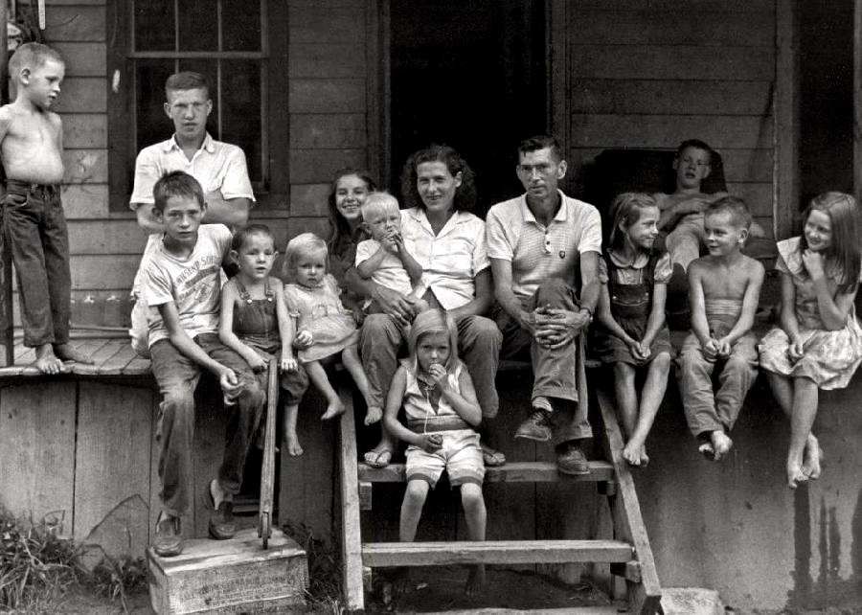
Something of Interest
Apalachia was a pocket of poverty in America. This photograph was taken in Leatherwood, Perry County, Kentucky, in 1964. It shows the Cornett family on the porch of their mountain cabinet. The parents Willie and Vivian Cornett had twelve children. Here we have a question of what is poverty. The children look well fed and they have adequate if shabby shelter. We suspect that they also had a car, refrigerator, and television set.
Yet most Americans would classify the family as living in poverty.
2011
http://histclo.com/eco/cou/na/us/use-pov.html

Slide 23
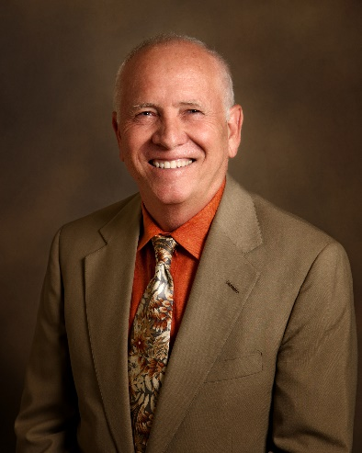
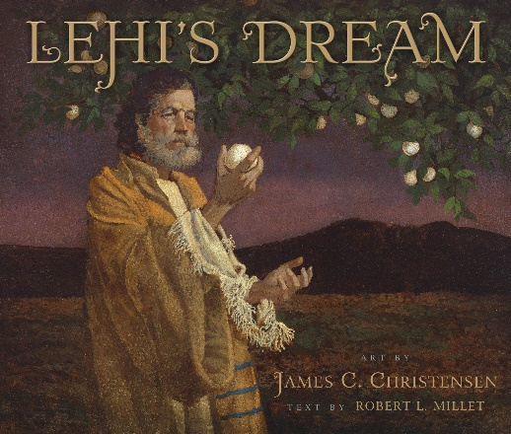
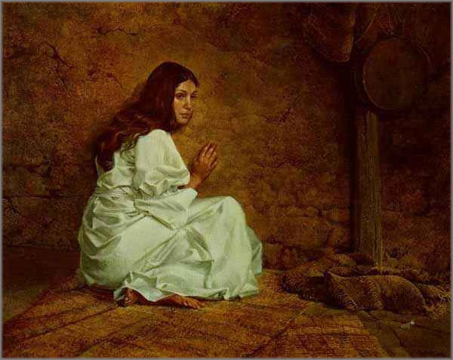
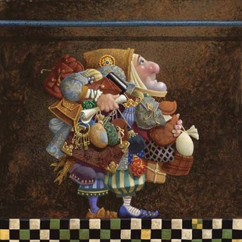
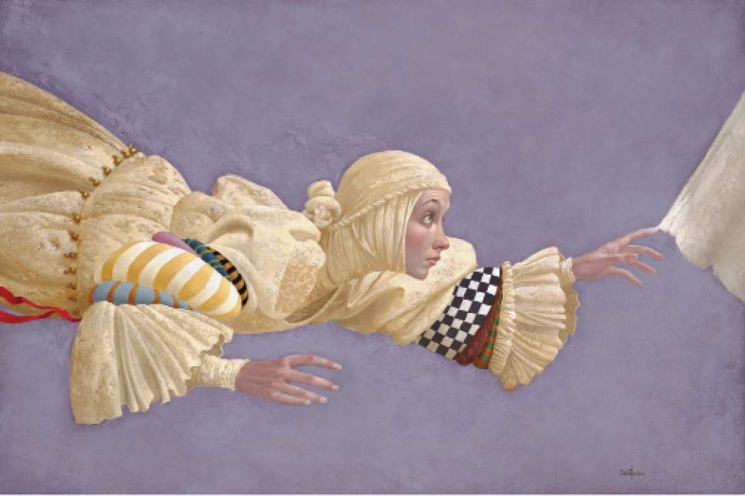
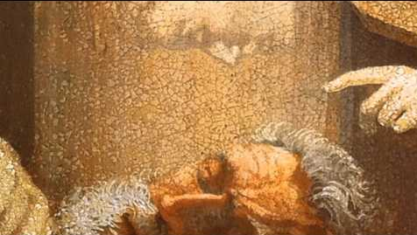
Something of Interest:
In searching for artwork I find inspiration in these artists. One of my favorite artists was James C. Christensen. Author of Website—L.B.
Mormon artist James C. Christensen dead at 74
The Salt Lake Tribune
James C. Christensen, a painter renowned for religious- and fantasy-based imagery, and a former art professor at Brigham Young University, died Sunday, January 8, 2017, in Orem from the effects of cancer. He was 74.
Christensen was born Sept. 26, 1942, and was raised in Culver City, Calif. He served a two-year mission to Uruguay for The Church of Jesus Christ of Latter-day Saints, then attended the University of California at Los Angeles for a time before moving to Utah and graduating from BYU.
He taught at the LDS Church-owned Provo school for 21 years, and had his work featured in shows throughout the West, as well as in publications such as Spectrum, American Illustration Annual and Japan's Outstanding American Illustrators.
His works were often based on myths, fables and spirituality, though he told The Salt Lake Tribune in 2008 that connections between his faith and his art were not always overt.
"When you live your religion," he said, "it permeates your life and influences what you choose to do and not to do."
Christensen published three books of his work. He also received myriad honors throughout his life, including from the World Science Fiction and Fantasy Convention as well as from the Association of Science Fiction and Fantasy Arts. He received the Governor's Award for Art by the Utah Art Council and was named one of Utah's Top 100 Artists by the Springville Museum of Art.
"The passing of my friend and mentor James Christensen has rekindled fond memories of his positivity and enthusiasm in the classroom and on study abroad where, with his encouragement and because of his example, I made a commitment at age 24 to pursue a life in art," fellow Provo artist Kent Christensen (no relation) wrote on Facebook. "I drew Jim on May 15th, 1981, the way I always think of him: sketching curbside in some European city. That day it was Segovia. Those weeks spent with him changed my life."
Christensen is survived by his wife, Carole, and their five children.

