Slide 1
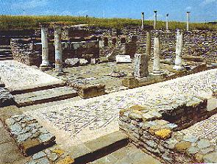
Lesson 117
Trial of Your Faith
2 Corinthians 10-13
I have heard their prayers, and will accept their offering; and it is expedient in me that they should be brought thus far for a trial of their faith.
D&C 105:19

Slide 2
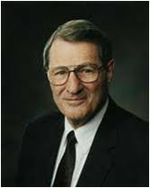
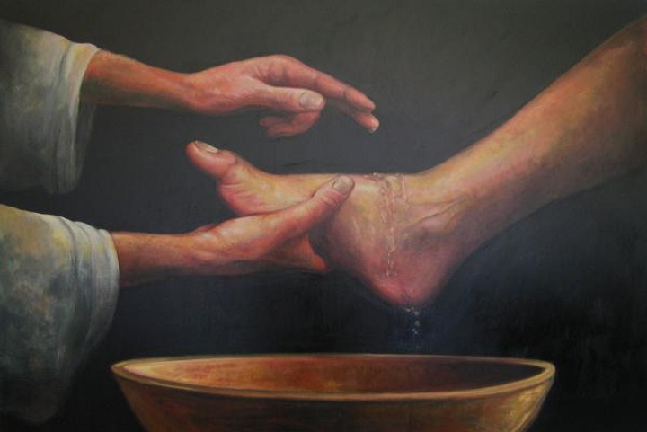
Meekness
“The Greek rendition of the word meek in the New Testament, by the way, is 'gentle and humble.‘”
“One cannot develop those other crucial virtues-faith, hope, and charity-without meekness.”
Wherefore, if a man have faith he must needs have hope; for without faith there cannot be any hope.
And again, behold I say unto you that he cannot have faith and hope, save he shall be meek, and lowly of heart.
Moroni 7:42-43
2 Corinthians 10:1
(2)

Slide 3
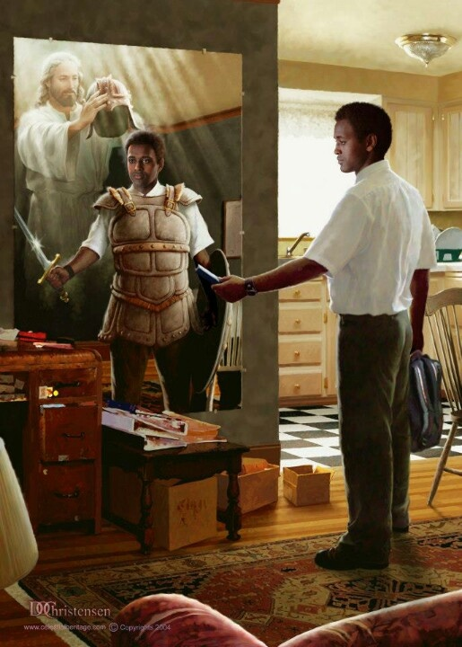
Spiritual Warfare
A war of words, a war of ideas, a war of testimony, and a war of faith.
We do not go against our principles, and the covenants (baptisms) we have taken.
Doc Christensen
Doc Christensen
Our fight is fought with words, faith, testimony, and the Spirit. It is a fight to the death-to the spiritual death of Satan and his forces.
And yet, ironically, while our enemy fights to increase the spiritual casualties on both sides of the conflict, our goal is to destroy only Satan and to save the rest of enemy from becoming 'angels to a devil‘ (3)
2 Corinthians 10:3-6

Slide 4
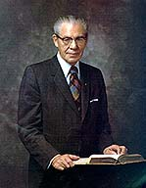
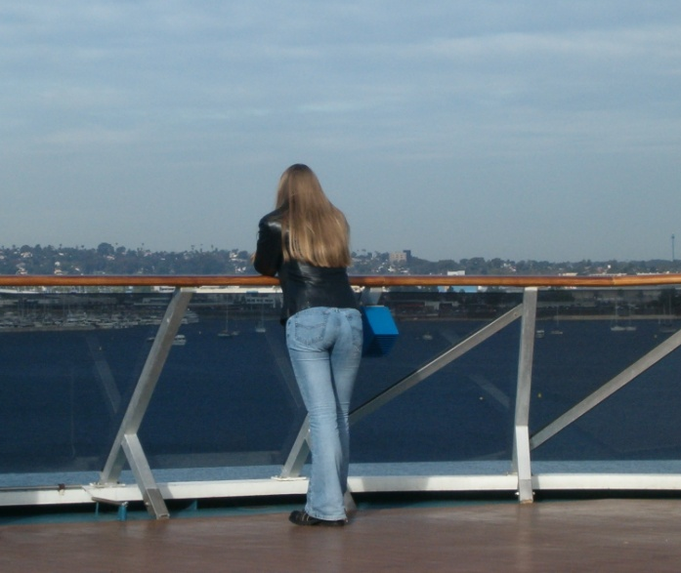
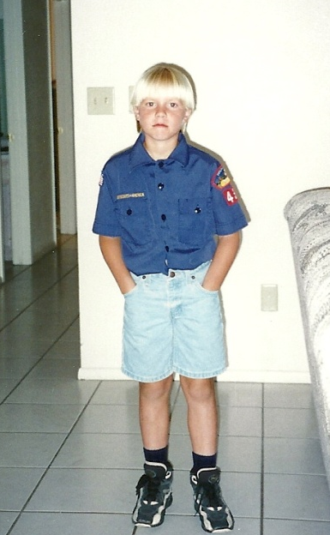
“It is important that we make up our minds early in life as to what we will do and what we will not do.
Long before the moment of temptation comes we should have determined that we will resist anything that will keep us from enjoying the companionship of the Spirit of the Lord.”
(4)

Slide 5
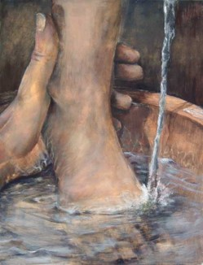
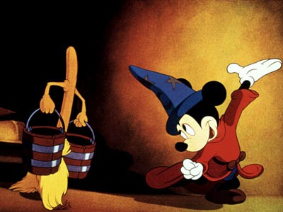
Casting Down Imaginations
humble yourselves
and control your thoughts and actions
As we control our thoughts in obedience to Jesus Christ, we will be more successful in the war against Satan
2 Corinthians 10:5

Slide 6
“And having in a readiness to revenge all disobedience, when your obedience is fulfilled.”
“For as he thinketh in his heart, so is he…”
—Proverbs 23:7
2 Corinthians 10:6

Slide 7
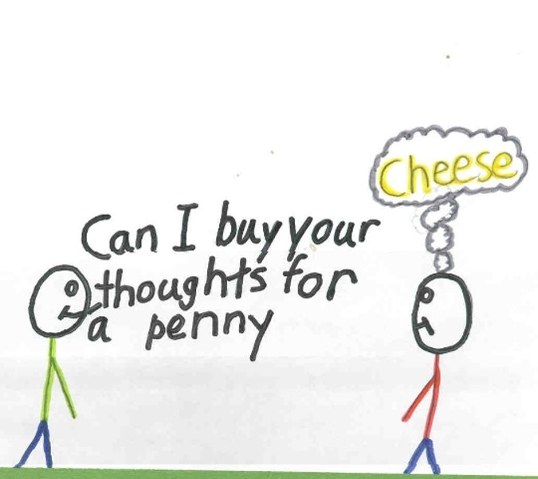
“Yea, I tell thee, that thou mayest know that there is none else save God that knowest thy thoughts and the intents of thy heart.”
D&C 6:16

Slide 8
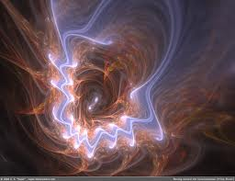
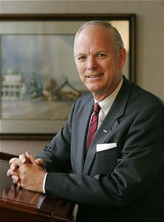
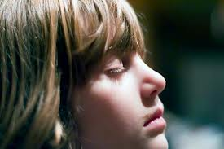
“Look unto me in every thought; doubt not, fear not.”
“…learn to control your thoughts…there will always be temptations.”
D&C 6:36
(5)

Slide 9
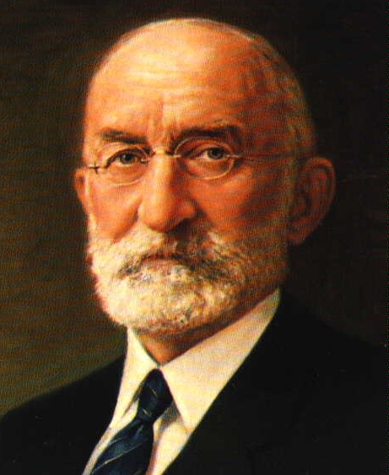
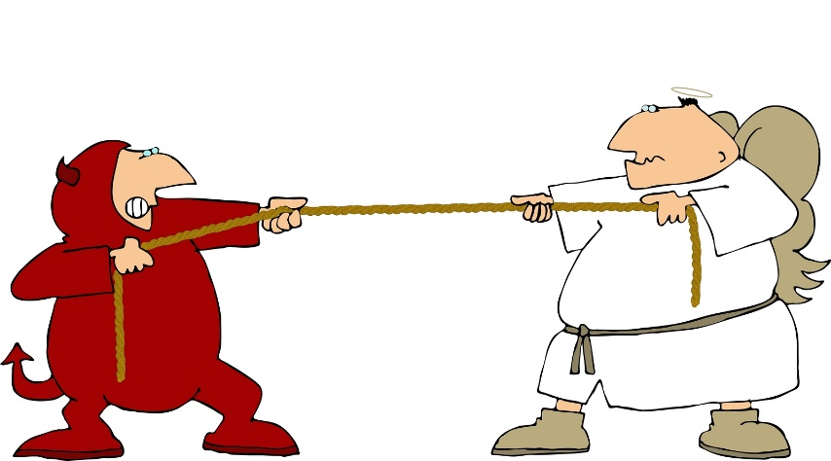
“There is a line of demarcation well defined between the Lord’s territory and the devil’s territory. If you will remain on the Lord’s side of the line, the adversary cannot come there to tempt you.
…But …if you cross onto the devil’s side of the line, you are in his territory…and he will work on you to get you just as far from that line as he possibly can…
(6)

Slide 10
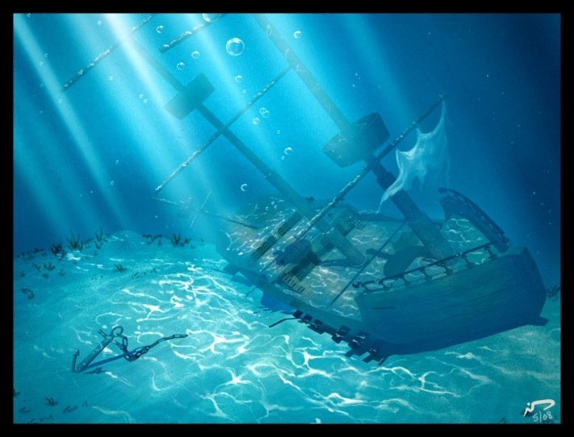
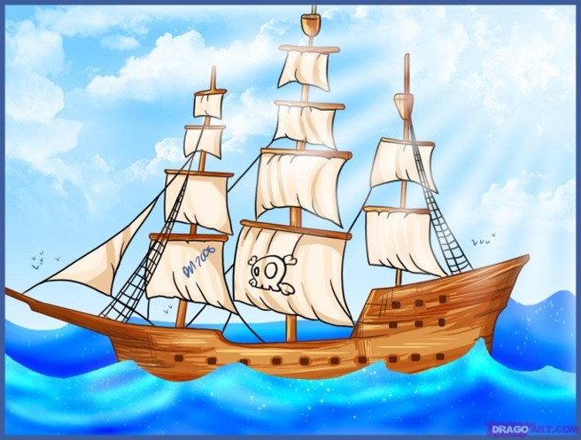
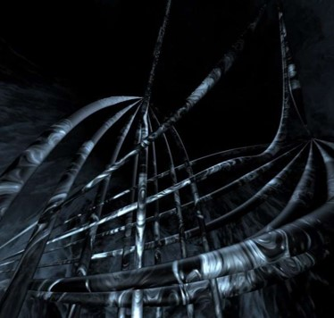
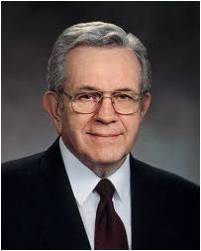
“All the water in the world,
However hard it tried,
Could never sink the smallest ship
Unless it gets inside…
…And all the evil in the world,
The blackest kind of sin,
Can never hurt you the least bit
Unless you let it in.”
(7)

Slide 11
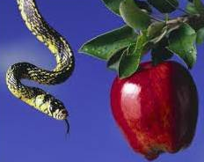
Satan’s Power to Deceive
“But I fear, lest by any means, as the serpent beguiled Eve through his subtilty, so your minds should be corrupted from the simplicity that is in Christ.”
2 Corinthians 11:3

Slide 12
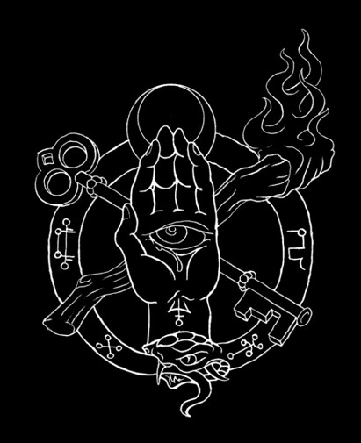
Another Spirit
“For if he (Satan) that cometh preacheth another Jesus, who we have not preached, or if ye receive another spirit, which ye have not received…
…or another gospel, which ye have not accepted, ye might well bear with him.”
2 Corinthians 11:4

Slide 13
Satan Transforms
Satan can transform himself into an angel of light in order to deceive.
Hebrew word for "serpent“ is
"luminous"
or "shining."
Lucifer was seeking to usurp the role
of Christ
by appearing to
Adam and Eve
as the "Messiah.”
2 Corinthians 11:14

Slide 14
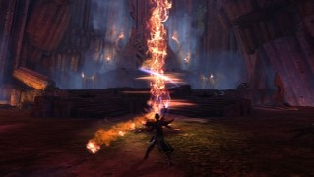
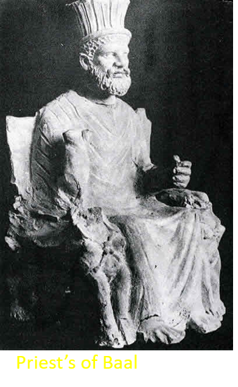
Ministers of Righteousness
--those who deceive--
Without the proper priesthood authority, those who follow Satan may pretend to be ministers of light for the same purpose.
“…it is no great thing if his ministers also be transformed as the ministers of righteousness; whose end shall be according to their works.”
2 Corinthians 11:15

Slide 15
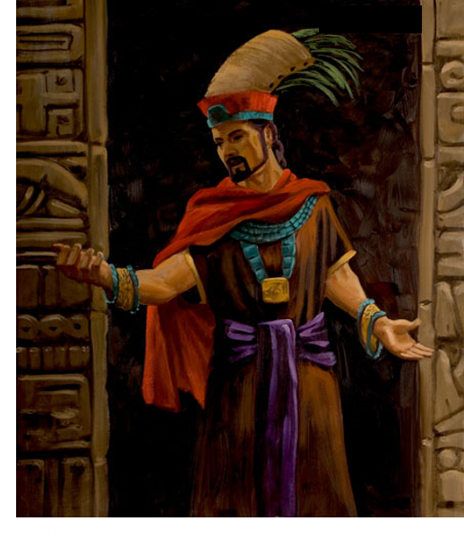
Book of Mormon--Korihor
Korihor deceives many Nephites
“…But the devil hath deceived me; for he appeared unto me in the form of an angel…”
Alma 30:50-53

Slide 16
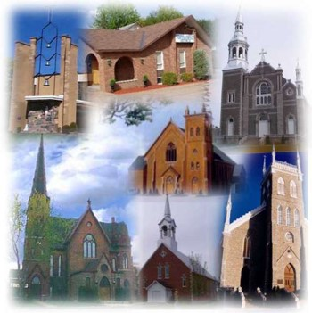
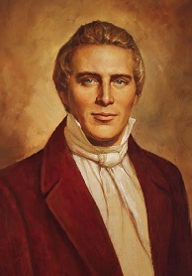
Looking At The Future
“For many shall come in my name, saying, I am Christ; and shall deceive many.”
“No man nor sect of men without the regular constituted authorities, the Priesthood and discerning of spirits, can tell true from false spirits.”
Mark 13:6
(8)

Slide 17
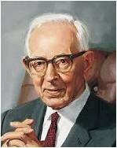
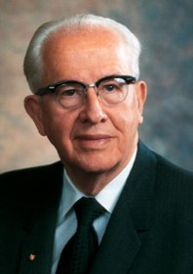
“Many men are depending upon their own research to find out God…they are not seeking for the Spirit of the Lord; they are not striving to know God in the manner in which he has marked out by which he may be know; but they are walking in their own way, believing in their own man-made philosophies, teaching the doctrines of devils and not the doctrines of the Son of God.” (9)
“Today the world is full of alluring and attractive ideas that can lead even the best of our members into error and deception.” (10)

Slide 18
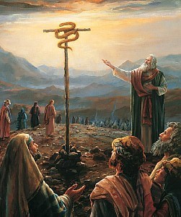
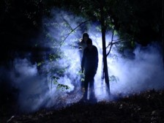
Wise as Serpents
“Therefore, be ye as wise as serpents and yet without sin; and I will order all things for your good, as fast as ye are able to receive them. Amen”
“We wrestle against the rulers of darkness….against spiritual wickedness in high places.”—Ephesians 6:12
D&C111:11
2 Corinthians 11:15

Slide 19
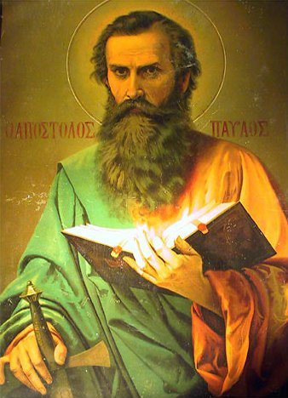
The Holy Spirit As Our Guide
Using the scriptures and the prophets and the Holy Spirit as a guide can help eliminate the many deceptions that Satan has revealed to us.
Paul was teaching the saints how to discern between false prophets and the true living gospel of Christ.
2 Corinthians 11:15

Slide 20
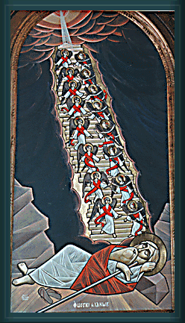
The Third Heaven
The man whom Paul knew was Paul himself.
“Paul ascended into the third heavens, and he could understand the three principal rounds of Jacob’s ladder—the telestial, the terrestrial, and the celestial glories or kingdoms, where Paul saw and heard things which were not lawful for him to utter.” (8)
Paul reinforced his authority as an Apostle of Jesus Christ
Read Genesis 28:10-15
2 Corinthians 12

Slide 21
The Ladder is Not An Escalator
A Ladder requires climbing
You must make the effort to climb it
The ladder to Heaven is on the ground right next to where you are standing, but you have to take hold of it, step up on it, and ascend.
You are not supposed to just stand still.
http://www.clarion-call.org/yeshua/jacob/ladder.htm

Slide 22
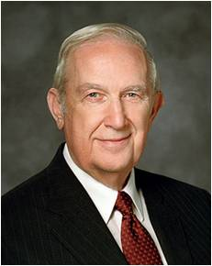
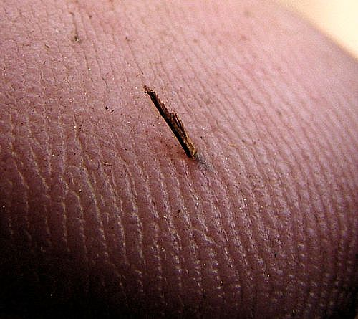
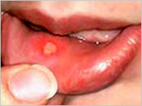
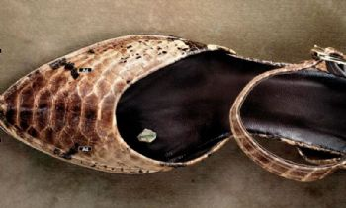
Thorn in the Flesh
A thorn or splinter that causes significant irritation
HOWEVER
“…some challenges in life will not be resolved here on earth.
Paul pled thrice that ‘a thorn in the flesh’ be removed. The Lord simply answered, ‘My grace is sufficient for thee: for my strength is made perfect in weakness’ .
He gave Paul strength to compensate so he could live a most meaningful life. He wants you to learn how to be cured when that is His will and how to obtain strength to live with your challenge when He intends it to be an instrument for growth. In either case the Redeemer will support you.”
Small, non lasting irritations
Sliver in the skin
Canker in the mouth
Pebble in a shoe
The Lord may allow us to experience weaknesses and trials so we can learn to be humble
Ringing in the Ear
2 Corinthians 12:7-8
(11)

Slide 23
God is willing for us to undergo that challenge. Yet He promises us that His grace is sufficient for us.
He even indicates that some of the weaknesses and infirmities given to us can actually become a strength to us.
It is in our weakness and extremity that God's power is fully felt.
Only when, of ourselves, we are helpless is His help truly appreciated."
2 Corinthians 12:9-10; Ether 12:26-27
(2)

Slide 24
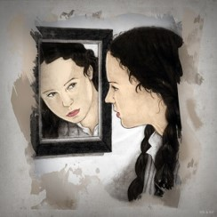
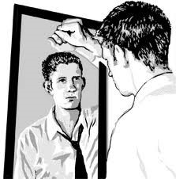
Trial of Your Faith
“Examine yourselves, whether ye be in the faith; prove your own selves. Know ye not your own selves, how that Jesus Christ is in you, except ye be reprobates?”
Reprobates: Corrupt or Immoral; Those who are unworthy
2 Corinthians 13:5

Slide 25
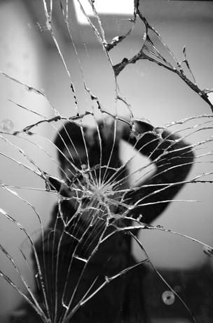
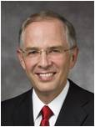
Fiery Trials
“…think it not strange concerning the fiery trial which is to try you, as though some strange thing happened unto you:”
The Fiery Trials are to make you stronger, but they have the potential to diminish or even destroy your trust in the Son of God, and to weaken your resolve to keep your promises to Him.
2 Corinthians 13:5; 1 Peter 4:12
(12)

Slide 26
Gift of Faith
“The gift of faith is a priceless spiritual endowment.”
“Our faith is centered in God, our Father, and in His Son, Jesus Christ, our Savior and Redeemer.”
2 Corinthians 13:5
(12)

Slide 27
1. Immerse yourself in the very things that helped build your core of faith.
8. Ask for a Priesthood blessing to ease your trial.
2. Don’t step away from the Church…this is your sanctuary to protect your faith.
Remaining Faithful during trials:
7. If you are able to partake of sacrament, do so with the atonement in mind.
3. Pray to find answers.
6. Share or read your testimony, the one that converted you.
4. Read and ponder scriptures and what the Savior teaches.
5. Serve one another. Service helps take your mind off of yourself.
2 Corinthians 13:5
(12)

Slide 28
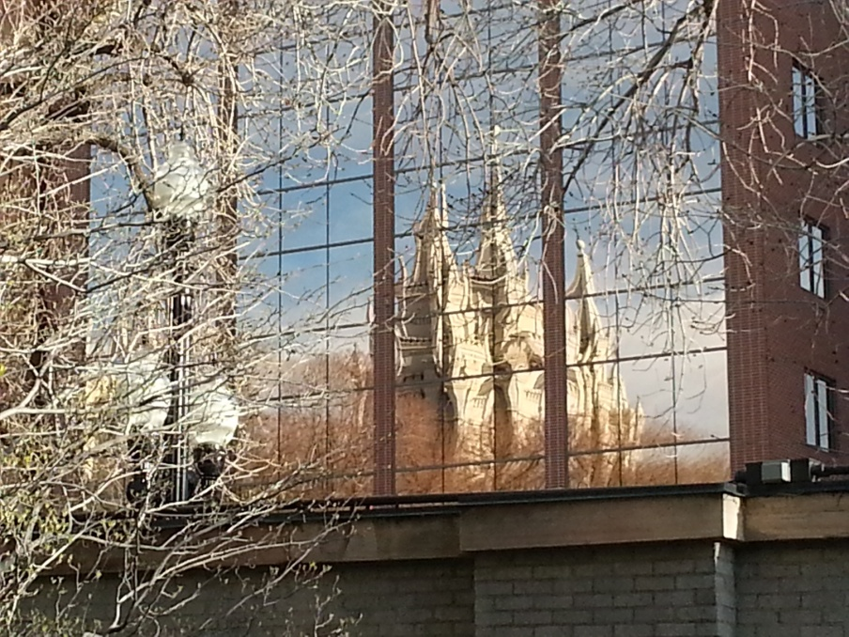
Overcome
“When you are faced with a test of faith, stay within the safety and security of the household of God.”
(12)

Slide 29
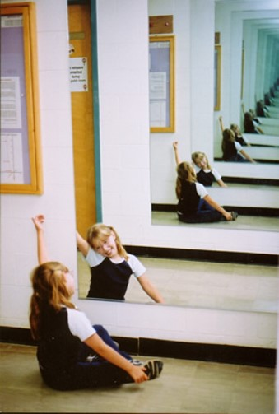
Peace
“Peace I leave with you, my peace I give unto you: not as the world giveth, give I unto you. Let not your heart be troubled, neither let it be afraid.”
“No trial is so large we can’t overcome it.
2 Corinthians 13:11; John 14:27

Slide 30
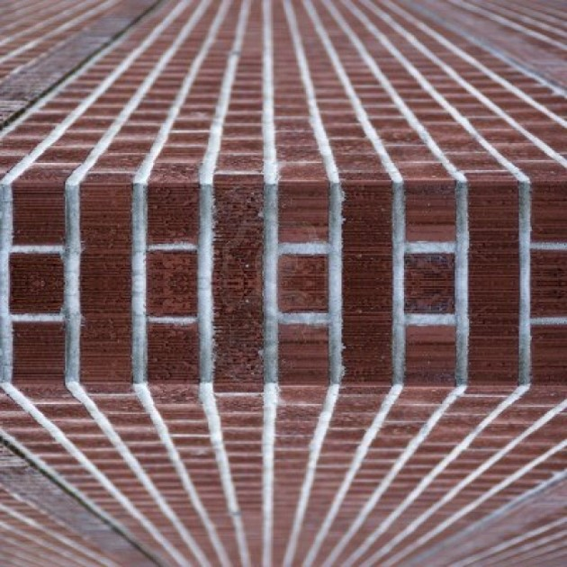
Wall of Faith
“Every (person) eventually is backed up to the wall of faith, and there…must make his stand.”
(12)

Slide 31
Covenants
“There may be anguish, confusion, sleepless nights, and pillows wet with tears.
But our trials need not be spiritually fatal.
They need not take us from our covenants or from the household of God.”
(12)

Slide 32
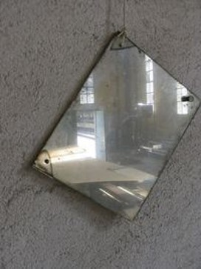
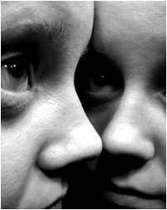
Submit to all things
“As it must be with anyone who seeks sainthood, Paul had to be ‘willing to submit to all things which the Lord seeth fit to inflict upon him.’”
Read Mosiah 3:19
(2)

Slide 33
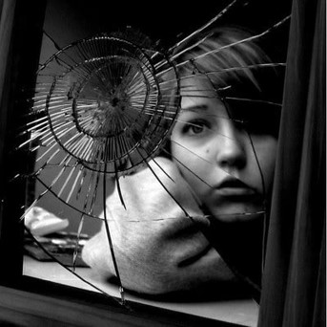
Moroni
“…I would show unto the world that faith is things which are hoped for and not seen; wherefore, dispute not because ye see not for ye receive no witness until after the trial of your faith.”
Ether 12:6

Slide 34
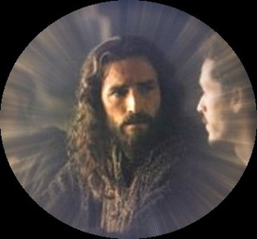
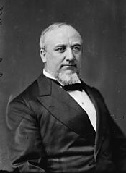
Passing Through
“Hold on… , fear not…, for God shall be with you forever and ever.”
“We may pass through the fiery furnace…we shall emerge from all these trials and difficulties the better and purer for them, if we only trust in our God and keep His commandments.”
D&C 122:9
(13)

Slide 35
Sources:
Suggested Hymn: #138 Cast Thy Burden Upon the Lord
Video:
Our Hands, His Hands; Our Hearts, His Heart (6:50)
New Testament Institute Student Manual Chapter 39
Elder Neal A. Maxwell ("Meekness-A Dimension of True Discipleship," Ensign, Mar. 1983, 70) ;(All These Things Shall Give Thee Experience [Salt Lake City: Deseret Book Co., 1979], 31.
Gospeldoctrine.com
N. Eldon Tanner “Put on the Whole Armor of God” 1979 April General Conference
W. Dahlquist II “Who’s on the Lord’s Side?” 2007 April General Conference
George Albert Smith Oct. Conference Report 1945
Boyd K. Packer Nov. Ensign 1999 “The Spirit of Revelation”
Joseph Smith “Teachings of the Prophet Joseph Smith” page 213; 304–5
Joseph Fielding Smith “Doctrines of Salvation” vol. 3 pg. 275
Ezra T. Benson “The Teachings of Ezra Taft Benson” pg. 302, 303
Elder Richard G. Scott (“To Be Healed,” Ensign, May 1994, 7).
Elder Neil L. Anderson “Trial of Your Faith” 2012 October General Conference
Ezra T. Benson Teaching of Presidents of the church: Joseph Smith (2007)
14. George Q. Cannon (Remarks: Deseret Evening News, Mar. 7 1891) also found in: Jeffrey R. Holland “Come unto Me,” Ensign April 1998
Presentation by ©http://fashionsbylynda.com/blog/

Slide 36
Second Letter of Paul to the Saints at Corinth— Written from Macedonia
Paul Glories in the Lord | 10:1–18; 11:1–11
Satan’s False Apostles | 11:12–15
Paul’s Sufferings for Christ | 11:16–33
The Third Heaven | 12:1–6
Strength in Weakness | 12:7–10
Signs of an Apostle | 12:11–21; 13:1–4
Saints Should Prove Themselves | 13:5–14
Compare and Measure Ourselves 2 Corinthians 10:12, 18:
“At its core, pride is a sin of comparison, for though it usually begins with ‘Look how wonderful I am and what great things I have done,’ it always seems to end with ‘Therefore, I am better than you.’
“When our hearts are filled with pride, we commit a grave sin, for we violate the two great commandments [see Matthew 22:36–40]. Instead of worshipping God and loving our neighbor, we reveal the real object of our worship and love—the image we see in the mirror.
“Pride is the great sin of self-elevation. …
“This sin has many faces. It leads some to revel in their own perceived self-worth, accomplishments, talents, wealth, or position. They count these blessings as evidence of being ‘chosen,’ ‘superior,’ or ‘more righteous’ than others. This is the sin of ‘Thank God I am more special than you.’ At its core is the desire to be admired or envied. It is the sin of self-glorification.” President Dieter F. Uchtdorf (“Pride and the Priesthood,” Ensign or Liahona, Nov. 2010, 56).
Life and Teachings of Jesus and His Apostles Chapter 37
Control Your Thoughts and Actions 2 Corinthians 10:3-6:
“Young Latter-day Saints, shape up! Face up! Take hold of your lives!
Take control of your mind, your thoughts!
If you have friends that are not a good influence, make changes, even if you face loneliness, even rejection.
If you have already made bad mistakes, there are ways to fix things up, and eventually it will be as though they never happened.
Sometimes guilt controls our minds and takes us prisoner in our thoughts. How foolish to remain in prison when the door stands open. Now, don’t tell yourself that sin really doesn’t matter. That won’t help; repentance will.
Take charge of yourself. How wonderful to be a young Latter-day Saint in this wonderful, challenging time.” Boyd K. Packer Nov. Ensign 1999 “The Spirit of Revelation.”
Satan as an Angel 2 Corinthians 11:14:
"When the Prophet Joseph Smith and a company of brethren were journeying to Kirtland from Missouri, they camped at McIlwaine's Bend on the Missouri River. There Elder William W. Phelps 'in open vision by daylight, saw the destroyer in his most horrible power, ride upon the face of the waters; others heard the noise, but saw not the vision.' (D.H.C., Vol. 1, p. 203.) The Savior declared that Satan had the power to bind bodies of men and women and sorely afflict them. (Matthew 7:22-23; Luke 13:16.) If Satan has power to bind the bodies, he surely must have power to loose them. It should be remembered that Satan has great knowledge and thereby can exercise authority and to some extent control the elements, when some greater power does not intervene. Paul, writing to the Ephesian Saints called Satan 'The prince of the power of the air, the spirit that now worketh in the children of disobedience.' (Ephesians 2:2.)" Joseph Fielding Smith (Answers to Gospel Questions, 5 vols. [Salt Lake City: Deseret Book Co., 1957-1966], 1: 178.)
Angel of Light (Satan) 2 Corinthians 11:14:
"There have also been ministering angels in the Church which were of Satan appearing as an angel of light. A sister in the state of New York had a vision, who said it was told her that if she would go to a certain place in the woods, an angel would appear to her. She went at the appointed time, and saw a glorious personage descending, arrayed in white, with sandy colored hair; he commenced and told her to fear God, and said that her husband was called to do great things, but that he must not go more than one hundred miles from home, or he would not return; whereas God had called him to go to the ends of the earth, and he has since been more than one thousand miles from home, and is yet alive. Many true things were spoken by this personage, and many things were false. How, it may be asked, was this known to be a bad angel? By the color of his hair; that is one of the signs that he can be known by, and by his contradicting a former revelation." Joseph Smith(History of The Church of Jesus Christ of Latter-day Saints, 7 Vols. 4:581)

Slide 37
Trials of Paul 2 Corinthians 11:24:
In Deuteronomy 25:1–3, Moses set down the principle that a guilty man could be lashed forty times. The Jewish rabbis had reduced that to thirty-nine, lest there should be a miscount and he be whipped more than forty times. (Moses warned against exceeding that number, and so the extra caution.) By Paul’s time this had developed into a brutally painful punishment meted out with great precision. To anyone familiar with the Jewish scourging, Paul’s claim that he endured such punishment five times is an impressive claim indeed, for often the victim died under the lashing. Farrar has given us a detailed description of the practice.
“Both of [the victim’s] hands were tied to … a stake a cubit and a half high. The public officer then tore down his robe until his breast was laid bare. The executioner stood on a stone behind the criminal. The scourge consisted of two thongs, one of which was composed of four strands of calf-skin, and one of two strands of ass’s-skin, which passed through a hole in a handle. … The prisoner bent to receive the blows, which were inflicted with one hand, but with all the force of the striker, thirteen on the breast, thirteen on the right, and thirteen on the left shoulder. While the punishment was going on, the chief judge read aloud [Deuteronomy 28:58, 59; 24:9; and Psalms 78:38, 39 which dealt with God’s commandments, the punishment for their nonobservance, and the Lord’s compassion on the sinner] … If the punishment was not over by the time that these three passages were read, they were again repeated, and so timed as to end exactly with the punishment itself. Meanwhile a second judge numbered the blows, and a third before each blow exclaimed ‘Hakkehu’ (strike him).” (Farrar, The Life and Works of St. Paul, pp. 715–16.)
“To have refused to undergo it by sheltering himself under the privilege of his Roman citizenship would have been to incur excommunication, and finally to have cut himself off from admission into the synagogue.” (Farrar, St. Paul, p. 717).
2 Corinthians 12:7–9 “There Was Given to Me a Thorn in the Flesh”
The word Paul uses here literally means “a Pale” (as in impaled) or “a stake.” It was used to refer to sharpened stakes, to surgical instruments, or to fishhooks. The very term suggests something that was extremely painful and troublesome to Paul. There have been endless debates on what such an infirmity might be, and the suggestions have included a bitter and shrewish wife who turned against Paul at his conversion, epilepsy, a serious eye affliction, malaria, and some spiritual weakness with which he was constantly troubled. There is no way of knowing from the present records what Paul meant. What we can be sure of is that each of us has weaknesses, spiritual as well as physical, which Satan will use to challenge us.
Elder Harold B. Lee said: “The Lord has told us in the scriptures that Satan is an enemy of all righteousness; because of that fact, those who are standing in high places in our Father’s kingdom will become the objects of his attacks. You may well expect, as the Apostle Paul understood, that you who preside in the various places in our Father’s kingdom will be subject to the devil’s onslaughts.
“… Sometimes there is given infirmity, difficulty, hardship upon you to try your souls; and the powers of Satan seem to be enrolled against you, watching and trying to break down your powers of resistance: but your weakness, through those infirmities, will give you the power of God that shall rest upon you even as the Apostle Paul was reconciled and comforted by the thought that through his trials the power of God might rest upon him.” (CR, Oct. 1949, 57.)
To Be Healed 2 Corinthians 12:9-10:
“Although the Savior could heal all whom He would heal, this is not true of those who hold His priesthood authority. Mortal exercises of that authority are limited by the will of Him whose priesthood it is. Consequently, we are told that some whom the elders bless are not healed because they are ‘appointed unto death’ (D&C 42:48). Similarly, when the Apostle Paul sought to be healed from the ‘thorn in the flesh’ that buffeted him (2 Corinthians 12:7), the Lord declined to heal him.”
“The healing power of the Lord Jesus Christ—whether it removes our burdens or strengthens us to endure and live with them like the Apostle Paul—is available for every affliction in mortality.” Elder Dallin H. Oaks (“He Heals the Heavy Laden,” Ensign or Liahona, Nov. 2006, 7).
2 Corinthians 12:2–4 “I Knew a Man in Christ … Caught up to the Third Heaven”
The man whom Paul knew was Paul himself. Joseph Smith reports: “Paul ascended into the third heavens, and he could understand the three principal rounds of Jacob’s ladder—the telestial, the terrestrial, and the celestial glories or kingdoms, where Paul saw and heard things which were not lawful for him to utter.” (Teachings, pp. 304–5.)

