Slide 1
Lesson 118
Only One Gospel
Galatians 1-4
“ Knowing that a man is not justified by the works of the law, but by the faith of Jesus Christ…” (Galatians 2:16)

Slide 2
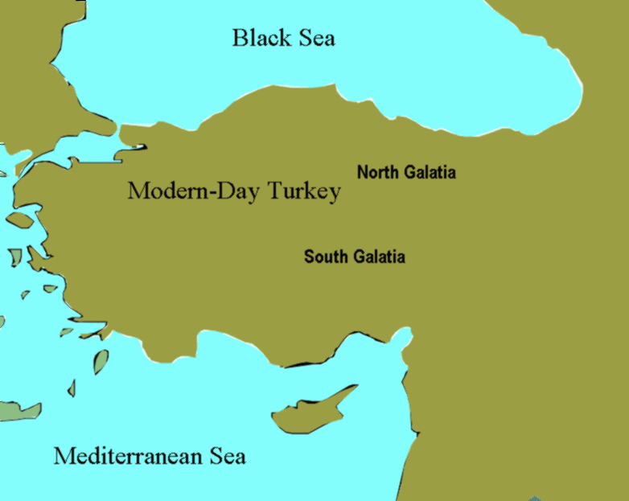
Galatians
Paul is the author of Galatians
Paul had baptized the Saints in the southern region during his 1st missionary journey, and the northern Saints during his 2nd missionary journey.
It is unclear as to which region these letters were to.
Paul likely wrote his Epistle to the Galatians while traveling through Macedonia during his third missionary journey, about AD 57; but the letter also may have been written as early as A.D. 48

Slide 3
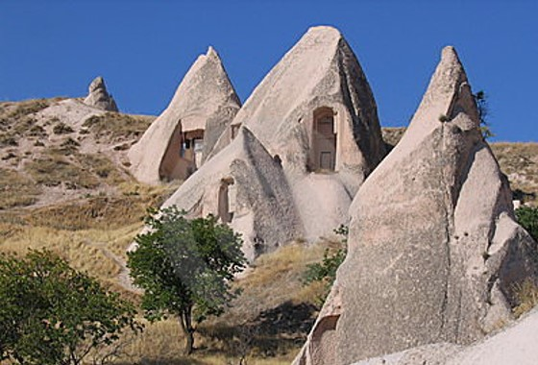
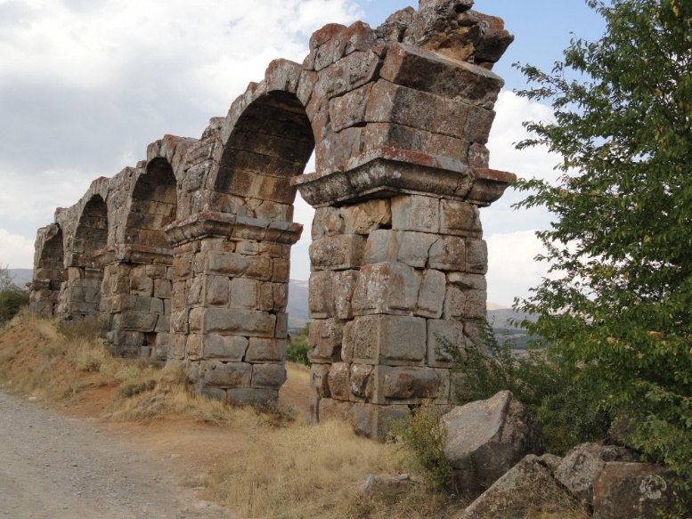
Galatia
Galatian Hoodoo Houses
“build their houses on the sand”- Matthew 7:26
Galatia was a region in north-central Asia Minor, whose population had immigrated from western Europe (modern France), where they had been known as Gauls.
Ruins in Antioch in Pisidia
Paul visited the Galatian churches on his second and third missionary journeys (see Acts 16:6; 18:23).

Slide 4
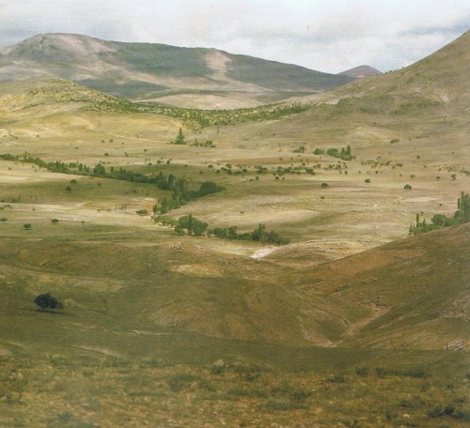
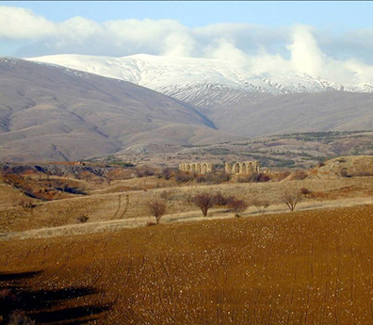
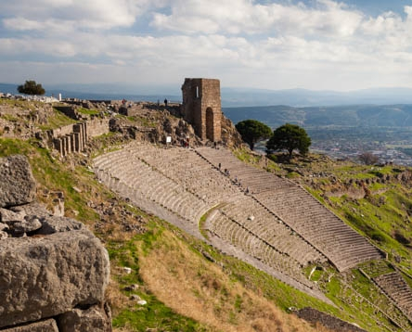
Paul’s main purposes in writing the Epistle to the Galatians included:
(1) defending himself against the accusations of the false teachers who opposed him;
(2) teaching that all people, whether Jew or Gentile, are saved by the Atonement of Jesus Christ by placing their faith in Jesus Christ, not by performing the works of the law of Moses;
(3) clarifying the role of the law of Moses in God’s plan;
(4) distinguishing between the old covenant God made through Moses and the new covenant in Christ; and
(5) calling upon the Saints to live by the Spirit.
(1)

Slide 5
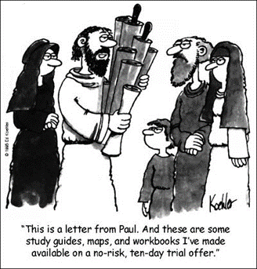
Preaching Another Gospel
“But though we, or an angel from heaven, preach any other gospel unto you than that which we have preached unto you, let him be accursed.”
These false teachers were Jewish Christians who claimed that the Galatian Saints had to be circumcised
“…if any man preach any other gospel unto you than that ye have received, let him be accursed.”
Galatians 1:8-9

Slide 6
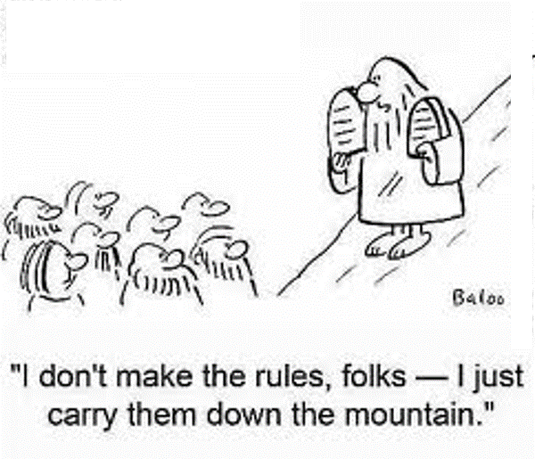
Revealing the True Gospel
Followers of Jesus Christ, both Jews and Gentiles, are justified not by the works and rituals of the law of Moses “but by the faith of Jesus Christ”
Jesus Christ reveals true doctrine to His prophets
Galatians 1:10-12

Slide 7
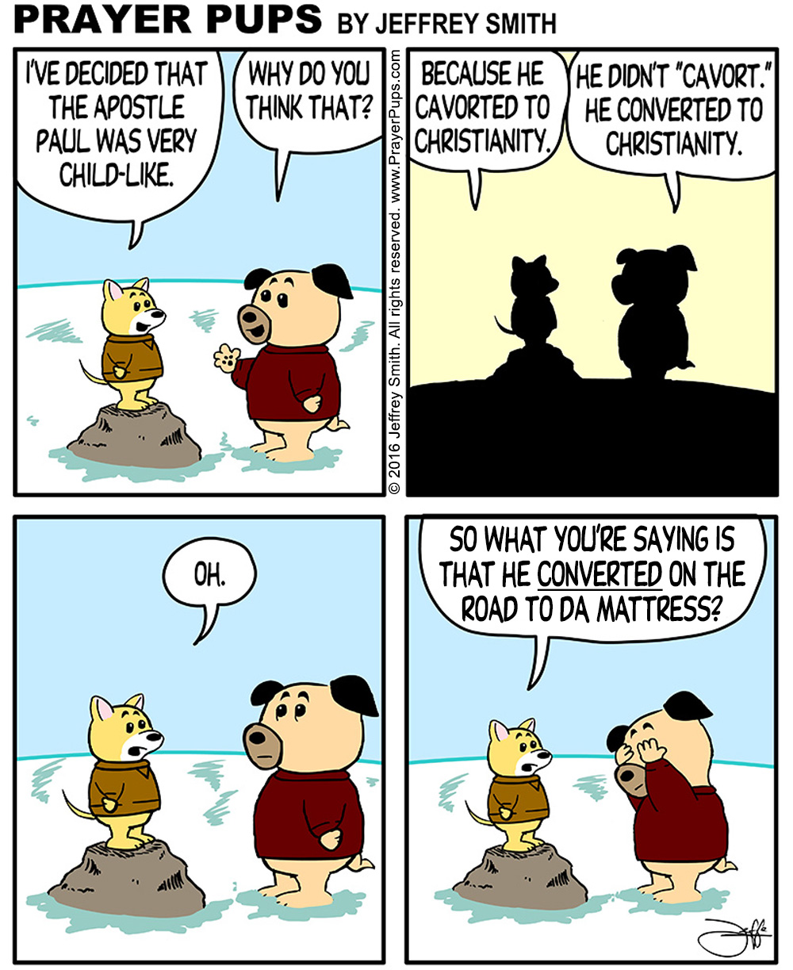
Reviewing Paul’s Conversion
Galatians 1:11-2:10

Slide 8
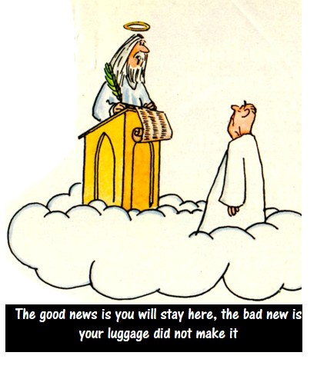
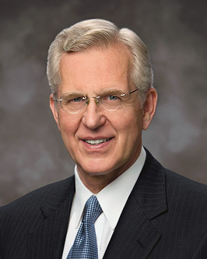
Justified, Pardoned, And Sanctified
Paul identified the essential truth that made clear why the Gentile Saints should not be excluded from dining with Jewish Saints. Both groups were justified (pardoned from punishment for sin) by placing their faith in Jesus Christ, not by performing the works of the law of Moses.
“We may appropriately speak of one who is justified as pardoned, without sin, or guiltless.
“To be sanctified through the blood of Christ is to become clean, pure, and holy. If justification removes the punishment for past sin, then sanctification removes the stain or effects of sin.” (2)
Galatians 2:15-16

Slide 9
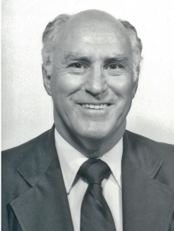
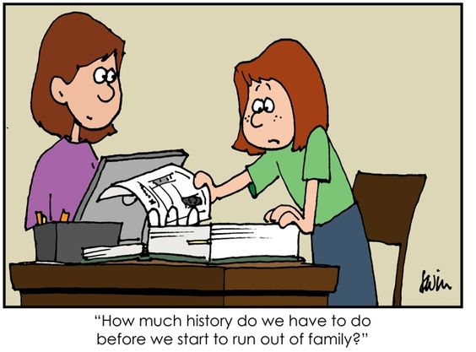
Who is the Seed of Abraham?
“blessed with faithful Abraham” refers to being a beneficiary of the covenant God made with Abraham that through him all people could enjoy the blessings of the gospel.
-- Abraham 2:11
"A major part of the covenant with Abraham is the promise that through Abraham and his seed all the families of the earth would be blessed.
Paul explains that the Lord Jesus Christ was born into the world through Abraham's lineage, and since Jesus is the Savior for all mankind, all are thus blessed through Abraham's seed.
This is one application of the promise. Another way in which all people are or will be blessed is that the descendants of Abraham, Isaac, and Jacob are mixed and intermingled with all nations; thus today the descendants of these patriarchs are found more or less among all nations and among all people, making them heirs to the promise that the gospel would be offered to them.
Furthermore, the descendants of Abraham bear the holy priesthood and minister the gospel to all nations."
Galatians 3:8-10
(3)

Slide 10
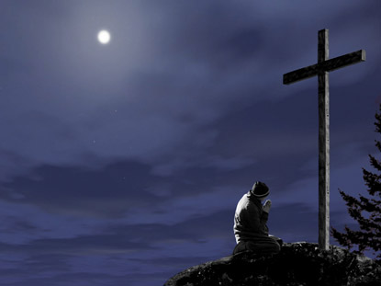
A Curse For Us
Some Jews believed that Jesus could not be the Messiah because he had been crucified or, in other words, hung on a tree.
They referred to a passage in Deuteronomy stating that a criminal who was put to death by being hung on a tree was “accursed of God.”
According to this way of thinking, Jesus had to be regarded as cursed by God. But Paul showed another way of looking at the concept of being “cursed” as applied to the Savior.
He explained that Jesus willingly took our sins upon Himself in order to perform the work of redemption, thus becoming “cursed” in our place: “Christ hath redeemed us from the curse of the law, being made a curse for us: for it is written, Cursed is every one that hangeth on a tree” (1)
Galatians 3:13; Acts 5:30; 10:39; 1 Peter 2:24; Deuteronomy 21:22-23

Slide 11
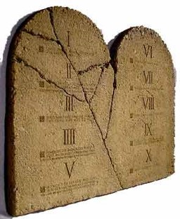
Paul explains the Purpose of the
Law of Moses to the Galatians
“Wherefore then serveth the law?”
What is the purpose of the Law of Moses?
Galatians 3:19

Slide 12
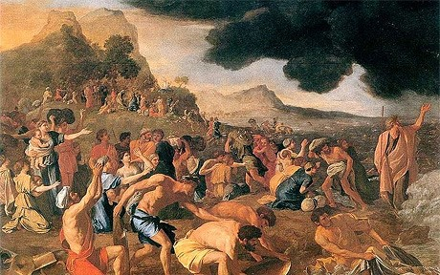
Adding to the Commandments
“It was added because of transgressions,
Because the people were not keeping the commandments
Galatians 3:19

Slide 13
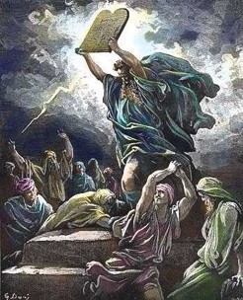
Not Understanding the Law
And now, did they understand the Law? I say unto you, Nay, they did not all understand the law…
…and this because of the hardness of their hearts; for they understood not that there could not any man be saved except it were through the redemption of God.”
Mosiah 13:32

Slide 14
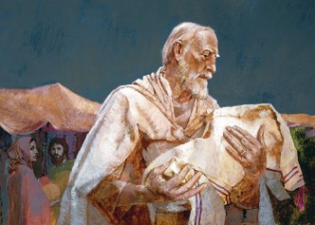
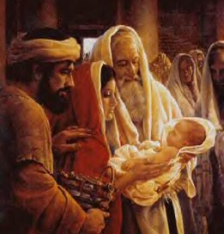
How long shall they be under the Law of Moses?
“till the seed should come to whom the promise was made;”
Till Christ comes and brings in the full gospel
Galatians 3:19

Slide 15
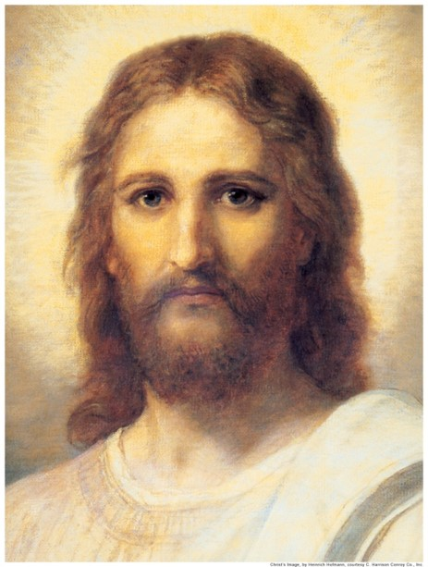
Who is the mediator?
“Now a mediator is not a mediator of one, but God is one.”
Jesus Christ is the mediator
Galatians 3:20

Slide 16
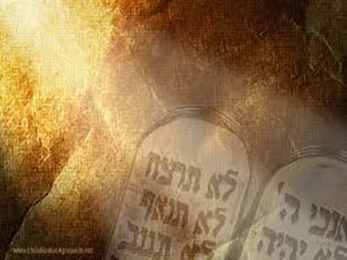
Promises of God
“Is the law then against the promises of God?”
The Law of Moses was a divine institution and was not opposed to God’s promises.
However…
Galatians 3:21

Slide 17
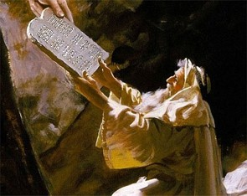
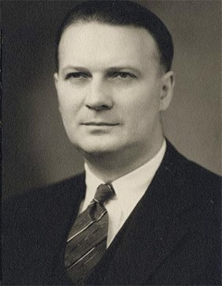
A Guidance—A Beginning
“The Law was given as a protection to the Jews as a moral guide to make them sin-and-guilt-conscious.”
Each one of us has started out with guidance since we were born.
(5)

Slide 18
Temporary Wheels
A bike with training wheels
“Yet the Lord God saw that his people were a stiffnecked people, and he appointed unto them a law, even the law of Moses.”
Mosiah 3:14

Slide 19
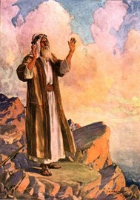
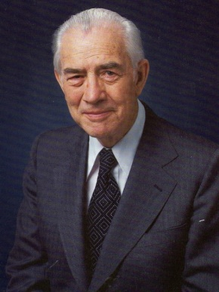
The Law of Training
Moses testified of Christ and other prophets, yet the people did not believe Moses therefore they were not prepared to receive Christ.”
Lower Law= The Law of Moses
Higher Law=Yet to come in the event of Jesus Christ
(6)

Slide 20
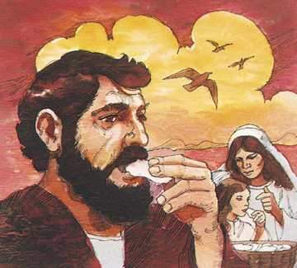
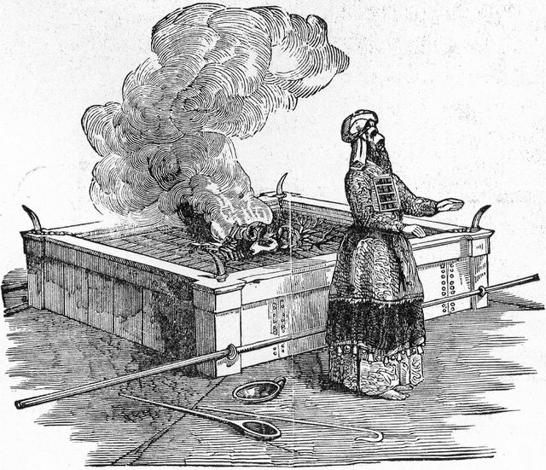
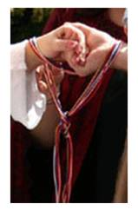
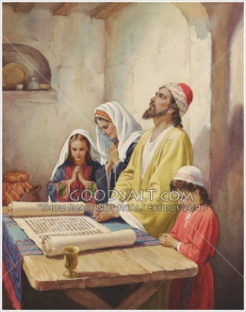
Types of Laws
How to eat
How to celebrate an occasion
Rituals such as sacrifices
How to Pray
“Behold, I am he that gave the law, and I am he who covenanted with my people Israel…

Slide 21
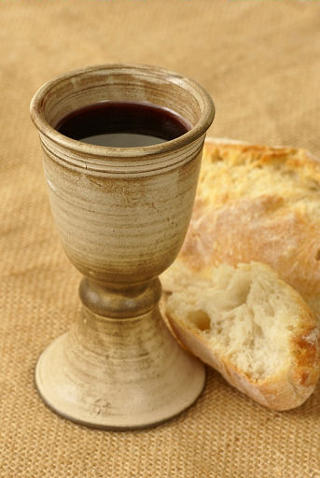
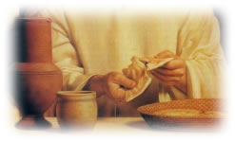
Law Fulfilled
“Behold, I am he that gave the law, and I am he who covenanted with my people Israel…
…therefore, the law in me is fulfilled, for I have come to fulfil the law; therefore it hath an end.”
3 Nephi 15:5

Slide 22
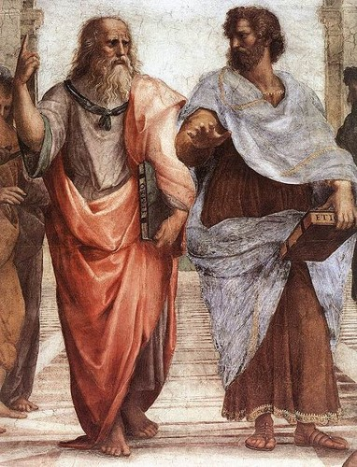
Schoolmaster
“When Christ came there was no need for a tutor (law) for it had filled its purpose”
“Wherefore the law was our schoolmaster to bring us unto Christ, that we might be justified by faith.”
Galatians 3:24

Slide 23
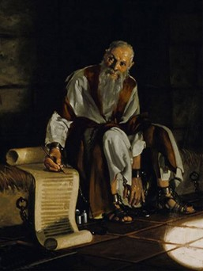
Superior Law
Paul wanted the Galatian Saints to understand that the blessings of the gospel are superior to what the law Moses offered.

Slide 24
Higher Gospel Law
The Bike
“But after that faith is come, we are no longer under a schoolmaster.
Galatians 3:25

Slide 25
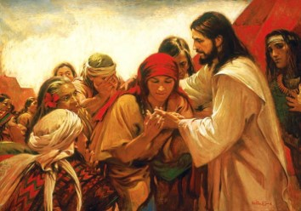
Nephites look for the law to be fulfilled
“And, notwithstanding we believe in Christ, we keep the law of Moses, and look forward with steadfastness unto Christ, until the law shall be fulfilled.”
“For, for this end was the law given; wherefore the law hath become dead unto us, and we are made alive in Christ because of our faith; yet we keep the law because of the commandments.”
2 Nephi 25:24-25

Slide 26
The Law of Moses was given to a righteous people (Galatians 3:19)
The law of Moses was intended to last forever (Galatians 3:19)
Abraham knew that Jesus Christ would come. (JST Galatians 3:20)
The law of Moses removed the need for the promised Savior. (Galatians 3:21)
Everyone sins; everyone needs Jesus Christ and His Atonement.
The law of Moses, by itself, limited spiritual growth (Galatians 3:23)
Yes No
Yes No
Yes No
Yes No
Yes No
Yes No

Slide 27
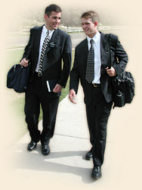
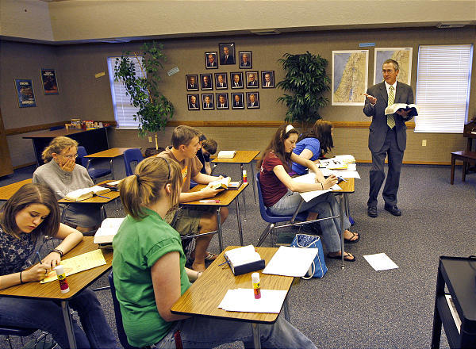
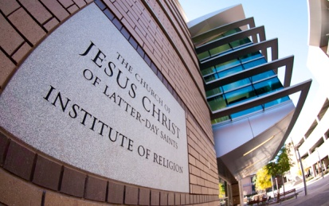
Spiritual Training Wheels of Today
Parents
Primary
Seminary
Institute
Mission

Slide 28
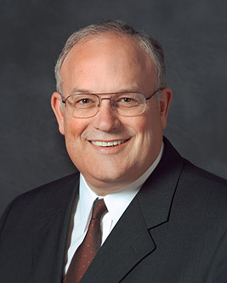
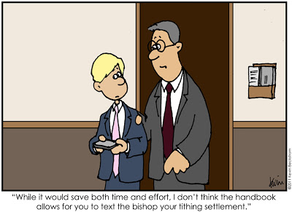
No Longer Under a Schoolmaster
“Our willingness to accept change in the kingdom helps the Lord hasten His work.
In the last half of the New Testament a major challenge the Church faced was the issue of gentile converts being assimilated as Christians.
The problem stemmed from the fact that many Jewish Christians felt that gentile converts should be required to adhere to the ceremonial law of Moses.
Even after a special council in Jerusalem decided that the gentile converts need not be subject to the law and an epistle was written explaining this decision, the issue remained a source of contention and division.
This was a major change for the Church, and many members struggled with it. (4)
Galatians 3:24-25; Acts 15

Slide 29
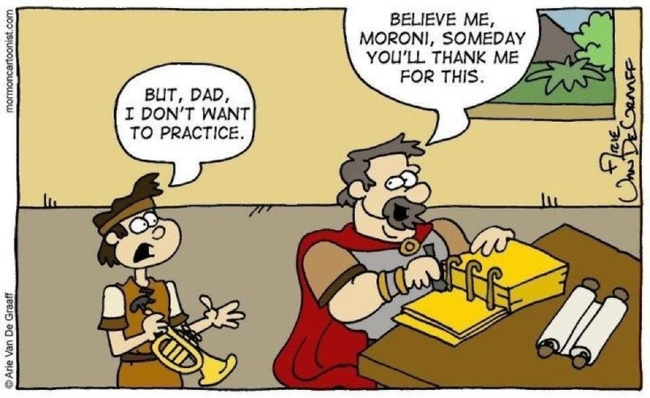
Exercising Faith in Jesus Christ
An Heir
Paul taught the Galatians that our relationship with God is better understood as that of a child to a father
All those who exercise faith in Jesus Christ and enter the gospel covenant will become one in Christ and heirs of God
He declared to the Galatians that being a “son” in the gospel covenant was far better than being a servant to the false gods they had worshipped before they accepted the truth.
Galatians 4:1-9

Slide 30
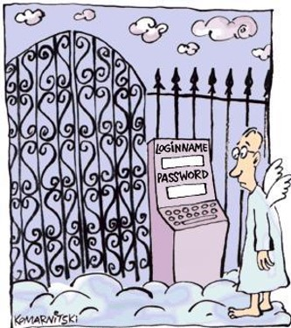
Only One True Gospel
There is only one true gospel on the earth that has all the teachings, ordinances, and covenants we need to return to Heavenly Father and live like Him in His kingdom.
NT Resource manual

Slide 31
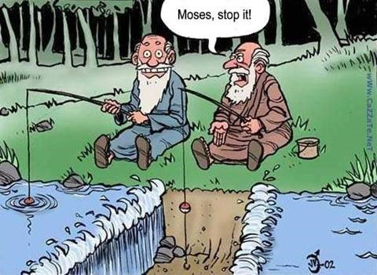
Sources:
Suggested Hymn: #84 Faith of Our Father’s
Video: Rescue from Incarceration (3:10)
New Testament Institute Student Manual Chapter 43 and 31 (Chart on Paul’s Life and Events)
Elder D. Todd Christofferson (“Justification and Sanctification,” Ensign, June 2001, 20, 22; see also Moses 6:59–60).
Robert J. Matthews, "Our Covenants with the Lord," Ensign, Dec. 1980, 37
Elder Paul V. Johnson (“Responding Appropriately to Change” [address to CES religious educators, Feb. 8, 2013], 1; si.lds.org).
5. Dr. Sidney B. Sperry “Paul’s Life and Letters” page 163, 169
6. Mark E. Peterson “The Way of the Master” Page 75
All those who exercise faith in Jesus Christ and enter the gospel covenant will become one in Christ and heirs of God
Presentation by ©http://fashionsbylynda.com/blog/

Slide 32
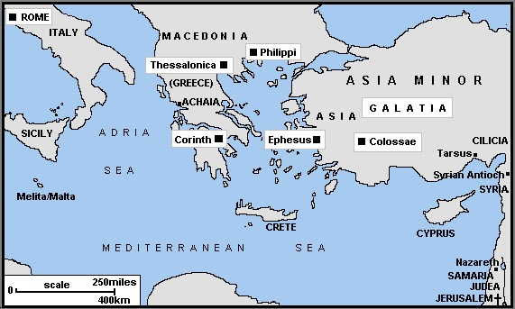
Letter from Paul during his second and third mission Written most likely from Macedonia about AD 48-AD 57
A Warning Against False Preachers | 1:1–10
Paul’s Call to the Ministry | 1:11–24
The Meeting at Jerusalem | 2:1–10
Peter and Paul of Antioch | 2:11–14
Salvation Comes Through Christ | 2:15–21
The Spirit Comes by Faith | 3:1–5
How the Mission of Abraham Is Extended to the Gentiles | 3:6–18
The Purpose of the Law | 3:19–22
Saints Are God’s Children by Faith | 3:23–29
How Saints Become Sons of God | 4:1–8
Galatians Called Back to Assist | 4:9–20
The Two Covenants: Hagar and Sarah | 4:21–31
Paul’s Confrontation with Peter in Jerusalem Galatians 12:11-14:
In order to emphasize to the Gentile converts in Galatia that they did not need to be circumcised, Paul recounted a confrontation with Peter, the chief Apostle. After a meeting in Jerusalem (see Galatians 2:1), Peter visited the Saints in Antioch (in Pisidia), where Paul was staying. While there, Peter began to dine with the Gentile Saints, but he stopped doing so when a group of Jewish Christians arrived from Jerusalem. He feared that the visitors would find his association with the Gentile Saints offensive (see Galatians 2:12). In many cultures of the ancient world, including the Jewish culture, dining with others affirmed a bond of fellowship and loyalty (see Mark 2:15–16; Acts 10:28). To some Jewish Christians, the cultural tradition of maintaining separation from Gentiles was more important than the Christian bond they shared with Gentile Saints. This was unacceptable to Paul. He taught that among the followers of Christ, there was to be “neither Jew nor Greek, … for ye are all one in Christ Jesus” (Galatians 3:28). Paul felt that Peter’s withdrawal from the Gentile Saints implied that they could not enjoy fellowship with Church members like Peter unless they lived “as do the Jews” (Galatians 2:14).
It is important to remember that we have only Paul’s account of this confrontation and that Paul acknowledged that Peter’s ministry was primarily to the Jews (see Galatians 2:7–8).
“In defense of the chief Apostle, however, one should recall that Peter was the leader of a relatively small church that was composed of two emotionally fragile factions; the situation was delicate. The Jewish Christians, on the one hand, did not appreciate the reluctance of some Gentiles to submit to the regulations of the Mosaic law, especially circumcision. Paul and his followers, on the other hand, were not worried about offending the feelings of the Jewish Christians who still held fast to the traditions of the law of Moses. Peter the prophet, naturally, loved and was concerned about both Jewish and Gentile members of the Church.
“It was a no-win situation for Peter. If he continued eating with the Gentiles, he would offend the visiting group of Jewish Christians. If he departed, he would offend Paul and the Gentile Christians in Antioch. No compromise was possible. Either way, he was going to hurt some feelings. Maybe Peter felt that an offended Paul would still remain true, while an offended group of Jewish Christians would potentially influence many others to dissent or leave the young church” (Frank F. Judd Jr., “The Jerusalem Conference: The First Council of the Christian Church,” Religious Educator, vol. 12, no. 1 [2011], 67; rsc.byu.edu).
Conspicuously absent from Galatians 2 is any reference to the Jerusalem conference held in A.D. 49 (see Acts 15). Paul was a participant in that conference, and he later shared the decision of that conference with those to whom he ministered (see Acts 15:30; 16:4). Since Paul made no mention of the conference or the letters describing the decision to take the gospel to the Gentiles, some experts believe that the experience described in Galatians 2:11–21 occurred prior to the Jerusalem conference. (1)
Life and Teachings of Jesus and His Apostles Chapter 38

Slide 33
CHRONOLOGY OF EVENTS IN PAUL’S LIFE AND MINISTRY
About A.D. 1–3 | Born in Tarsus of the tribe of Benjamin—a Pharisee and a Roman citizen by birth | Acts 9:11; 22:3, 27–28; Philippians 3:5
About A.D. 19–29 | Taught by Gamaliel in Jerusalem | Acts 22:3
A.D. 33 | Witnessed the martyrdom of Stephen and persecuted Christians in the Jerusalem area | Acts 7:54–8:4; Philippians 3:6
A.D. 33 | On the road to Damascus, saw a vision of Jesus Christ, was converted, and preached of Christ in Damascus | Acts 9:1–25
A.D. 33–35 | Fled Damascus to Arabia | Galatians 1:17
A.D. 35 | Returned to Damascus and briefly preached the gospel | Galatians 1:17
A.D. 35 | After three years visited Jerusalem and spoke with Peter and James, the Lord’s brother | Acts 9:26–29; Galatians 1:18–19
A.D. 35–49 | Spent 14 years in Syria-Cilicia (part of that time on his mission with Barnabas). Tarsus, Paul’s hometown, was located in Cilicia. | Acts 9:30; 11:19–26; Galatians 2:1, 21
A.D. 46–49 | First missionary journey (with Barnabas) | Acts 13:1–14:28
A.D. 49 | Attended the Jerusalem Conference | Acts 15:12; Galatians 2:1–2
A.D. 49–53 | Second missionary journey | Acts 15:36–18:20
A.D. 53 | Visited Jerusalem | Acts 18:21–22
About A.D. 54–58 | Third and final mission | Acts 18:23; 19:1–20:38
About A.D. 58 | Farewell visit to Greece; traveled to Jerusalem to deliver offerings for the poor | Acts 21:1–16
Spring A.D. 58 | Reported to presiding Brethren in Jerusalem, had misunderstandings at the temple, and was arrested | Acts 21:17–23:22
Spring A.D. 58–60 | Imprisoned in Caesarea | Acts 23:23–26:32
(1)

Slide 34
Unity of Faith Galatians 3:26-27:
“As we move into more and more countries in the world, we find a rich cultural diversity in the Church. Yet everywhere there can be a ‘unity of the faith’ [Ephesians 4:13]. Each group brings special gifts and talents to the table of the Lord. We can all learn much of value from each other. But each of us should also voluntarily seek to enjoy all of the unifying and saving covenants, ordinances, and doctrines of the gospel of the Lord Jesus Christ. …
“We do not lose our identity in becoming members of this church. We become heirs to the kingdom of God, having joined the body of Christ and spiritually set aside some of our personal differences to unite in a greater spiritual cause. We say to all who have joined the Church, keep all that is noble, good, and uplifting in your culture and personal identity. However, under the authority and power of the keys of the priesthood, all differences yield as we seek to become heirs to the kingdom of God, unite in following those who have the keys of the priesthood, and seek the divinity within us.” President James E. Faust (“Heirs to the Kingdom of God,” Ensign, May 1995, 62).

