Slide 1


Lesson 119
Freedom From the Yoke of Bondage
Galatians 5-6
O that ye would awake; awake from a deep sleep . . . and shake off the awful chains by which ye are bound, which are the chains which bind the children of men, that they are carried away captive down to the eternal gulf of misery and woe.
2 Ne. 1:13

Slide 2


Tug of War
How do you win at tug of war?
In what ways are our lives similar to a tug-of-war?
Porn
Unchaste and immoral behavior
Our struggle against temptation

Slide 3
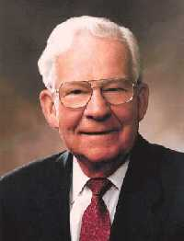

Burdens of the Law of Moses
'Stand fast therefore in the liberty wherewith Christ hath made us free, and be not entangled again with the yoke of bondage.'
Some Jewish Christians had misled the Saints in Galatia by teaching them that they needed to live the law of Moses and be circumcised in order to be saved.
Too often we are inclined to be impressed with the loud, noisy, and dramatic.
Students and members in general are sometimes led away from the paths of success because they are swayed by the sensational and artificial light.
Very often in today’s busy world we ignore the quiet promptings of our leaders and those who guide with soft words. (2)
To be easily swayed
Galatians 5:1

Slide 4
Free From Bondage?
Paul chastened the Galatian Saints for being so easily swayed away from the liberty of the gospel of Jesus Christ and returning instead to the bondage of the law of Moses.
He then clarified that even though followers of Christ had been freed from the bondage of the law of Moses, that did not mean they had the freedom to indulge freely in sin.
But when the righteous turneth away from his righteousness, and committeth iniquity, and doeth according to all the abominations that the wicked man doeth, shall he live? All his righteousness that he hath done shall not be mentioned: in his trespass that he hath trespassed, and in his sin that he hath sinned, in them shall he die.
Ezekiel 18:24
Galatians 5:2-15

Slide 5
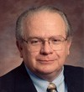
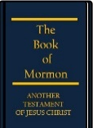
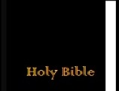
"As Paul points out, trying to keep the commandments is a long way from actually keeping them.
According to him, anyone stupid enough to trust his own ability to keep all the rules makes the atonement of Christ ineffectual in his own life.
Moreover, anyone who wants to trust entirely in his own righteousness needs to be reminded that righteousness through law requires perfect performance...
Paul points out that any claim to righteousness based on one's own efforts to keep the commandments requires a perfect record.
One slip and you are no longer perfect, you have become a sinner-and in this sense we are all sinners."
Galatians 5:4
(3)

Slide 6
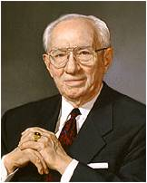
To Be Free
Paul taught that the liberty of Christ meant that disciples were free to be led by the Spirit and were not constrained by the law. (1)
Obedience
“True freedom lies in obedience to the counsels of God. …
The gospel is not a philosophy of repression, as so many regard it.
It is a plan of freedom that gives discipline to appetite and direction to behavior. Its fruits are sweet and its rewards are liberal.” (4)
Galatians 5:16-17

Slide 7

4 Categories of Sin
(1) Sexual sins. “Fornication” refers to any immoral sexual relationship; “lasciviousness” refers to unbridled or excessive lust.
(2) Sins from the religious realm, such as idolatry and witchcraft.
(3) Sins against other persons. “Variance” can be interpreted as discord and is an outgrowth of “hatred”; “emulations” are actions carried out in order to equal or be superior to another, often out of jealousy.
(4) Sins associated with alcohol: “drunkenness” and “revellings.” Paul warned that those who habitually participate in these sins “shall not inherit the kingdom of God” (1)
Unchaste and immoral behavior
Galatians 5:19-21

Slide 8
Competing Forces
Walk in the Spirit
Fulfill the lust of the flesh
To live worthy of and follow the Holy Ghost
Temptations to sin
As we walk in the Spirit, we will overcome the temptations of the flesh
Galatians 5:16-25

Slide 9

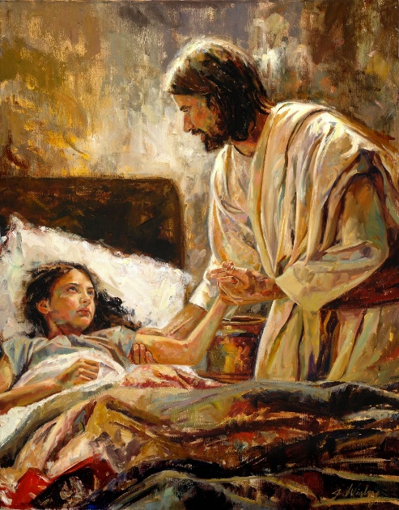
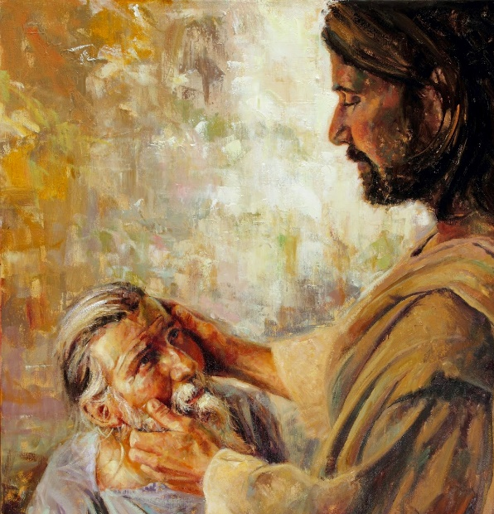
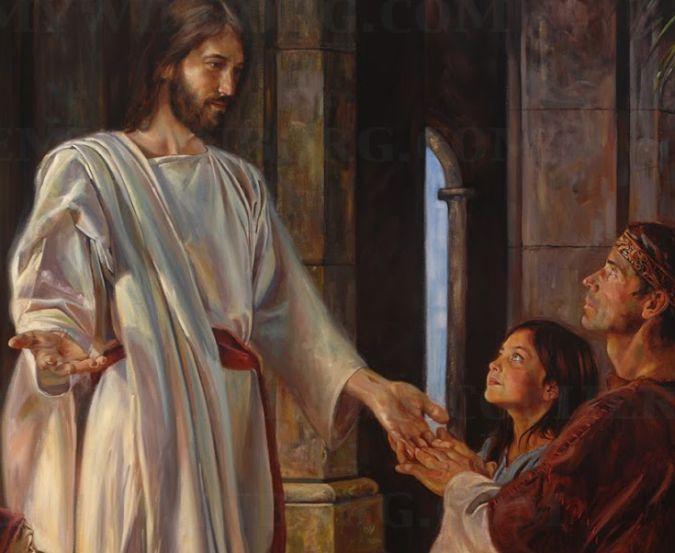
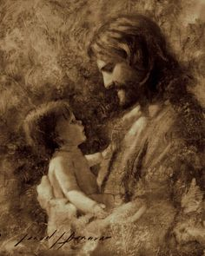
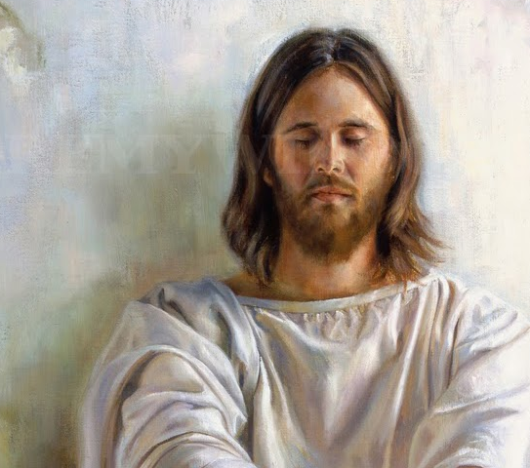
Fruit of the Spirit
Joy and Peace
Gentleness Goodness Meekness
Faith
Love
Long Suffering and temperance
Galatians 5:2-15
Jeremy Winborg artist

Slide 10
When We Walk in the Spirit
Unchaste and immoral behavior
They cease to be a part of our lives
"You recognize the promptings of the Spirit by the fruits of the Spirit-that which enlighteneth, that which buildeth up, that which is positive and affirmative and uplifting and leads us to better thoughts and better words and better deeds is of the Spirit of God. That which tears us down, which leads us into forbidden paths-that is of the adversary. I think it is just that plain, just that simple." (4)
"'If we live in the Spirit, let us also walk in the Spirit'
Galatians 5:24-25

Slide 11
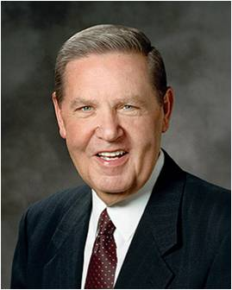
Bearing One’s Burden
How should members of the Church respond to someone who has sinned?
“Restore” the person, or help him or her return to the gospel path.
'The law of Christ, which it is our duty to fulfil, is the bearing of the cross. My brother's burden which I must bear is not only his outward lot [and circumstance], ... but quite literally his sin.
And the only way to bear that sin is by forgiving it in the power of the cross of Christ in which [we] now share.
Thus the call to follow Christ always means a call to share [in] the work of forgiving men their sins. Forgiveness is the Christlike suffering which it is the Christian's duty to bear.‘ (5)
Galatians 6:2-5

Slide 12
Sowing and Reaping
What you sow, or plant, is what you reap, or harvest.
This is called the law of the harvest.
Paul taught that God cannot be mocked, for the law of the harvest applies to spiritual things as well as physical.
He admonished that we “not be weary in well doing” for we will reap the blessings of our righteous actions, as well as the spiritually destructive results of sinful choices. (1)
If we are diligent in well doing, we will reap the blessings of our actions
Galatians 6:7-9

Slide 13
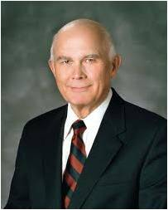
“If we indulge in drugs or pornography or other evils that the Apostle [Paul] called sowing to the flesh, eternal law dictates that we harvest corruption rather than life eternal.
That is the justice of God, and mercy cannot rob justice.
If an eternal law is broken, the punishment affixed to that law must be suffered.
Some of this can be satisfied by the Savior’s Atonement, but the merciful cleansing of a soiled sinner comes only after repentance, which for some sins is a prolonged and painful process.”
Galatians 6:7-9
(6)

Slide 14
Sources:
Suggested Hymn: #66 How Firm A Foundation
Video:
Feeling the Holy Ghost (3:18)
The Law of the Harvest (3:14)
New Testament Institute Student Manual Chapter 44
Elder Marvin J. Ashton A Still Voice of Perfect Mildness February 20, 1990 BYU Speeches
(Stephen E. Robinson, Believing Christ: The Parable of the Bicycle and Other Good News [Salt Lake City: Deseret Book Co., 1992], 40.)
President Gordon B. Hinckley (in Conference Report, Apr. 1965, 78). Teachings of Gordon B. Hinckley [Salt Lake City: Deseret Book Co., 1997], 261
Elder Jeffrey R. Holland (Dietrich Bonhoeffer, The Cost of Discipleship, 2d ed., New York: Macmillan, 1959, p. 100.)" ("I Stand All Amazed," Ensign, Aug. 1986, 72)
Elder Dallin H. Oaks (“Be Not Deceived,” Ensign or Liahona, Nov. 2004, 45).
Presentation by ©http://fashionsbylynda.com/blog/

Slide 15
Letter from Paul during his second and third mission Written most likely from Macedonia about AD 48-AD 57
Christian Liberty | 5:1–12
Liberty and Charity | 5:13–15
Walk in the Spirit | 5:16–26
Bear One Another’s Burdens | 6:1–6
“As Ye Sow, So Shall Ye Reap” | 6:7–18
Freedom Galatians 5:13:
"Occasionally, I hear of some young people who rejoice when they leave home for the first time and who feel inclined to experiment with worldly influences once they are beyond the sight of parents or other authority figures. They regard their 'freedom' as license to stretch the commandments, test the waters of sin, and engage in questionable practices. Usually, those who use 'liberty for an occasion to the flesh' do so thinking, I will only do it once or twice, and I can repent later. Such misled people, however, fail to recognize the binding nature of drugs, other stimulants, and undesirable habits. They forget that fire from any source burns or destroys and leaves ugly and sometimes irreparable scars.“ Carlos E. Asay (In the Lord's Service: A Guide to Spiritual Development [Salt Lake City: Deseret Book Co., 1990], 51.)
Sin is Sin Galatians 5:13:
"You must be honest with yourself and remain true to the covenants you have made with God. Do not fall into the trap of thinking you can sin a little and it will not matter. Remember, 'the Lord cannot look upon sin with the least degree of allowance.' (D&C 1:31.) Some young men and women in the Church talk openly about sexual transgression. They seem to forget that the Lord forbids all sexual relations before marriage, including petting, sex perversion of any kind, or preoccupation with sex in thought, speech, or action. Some youth foolishly rationalize that it is 'no big deal' to sin now because they can always repent later when they want to go to the temple or on a mission. Anyone who does that is breaking promises made to God both in the premortal life and in the waters of baptism. The idea of sinning a little is self-deception. Sin is sin! Sin weakens you spiritually, and it always places the sinner at eternal risk. Choosing to sin, even with the intent to repent, is simply turning away from God and violating covenants." ("Keeping Covenants," Ensign, May 1993, 7) Elder M. Russell Ballard
Life and Teachings of Jesus and His Apostles Chapter 38
"President Gordon B. Hinckley has counseled against surrendering to sin:
'Today there are persons numbered in the millions, who, in a search for freedom from moral restraint and peace from submerged conscience, have opened a floodgate of practices that enslave and debauch. These practices, if left unchecked, will not only destroy these individuals but also the nations of which they are a part. . . . Nations and civilizations have flowered, then died, poisoned by their own moral sickness. As one commentator has remarked, Rome perished before the Goths poured over its walls. But it was not that the walls were low. It was that Rome itself was low.' (Teachings of Gordon B. Hinckley, pp 380-382.)
"If we yield to sin, we are, in effect condemning not just ourselves but our communities and our countries. We may think we are merely 'exercising our agency' when we choose not to follow the Lord's commandments, but in reality we are worshiping the devil and giving him veto power over our souls." (The Spirit of Freedom, LDS Church News, 1998, 07/04/98)
Sin of Today Galatians 5:19:
"Today the dealers of pornography, sex, alcohol, tobacco, narcotics, and other forms of vice hate the souls of youth but love their money and resources. Such despisers of youth would make slaves of the young by drowning them in the addictive works of the flesh. So they raise their voices high and seek to entice young people to get lost down strange roads with dead ends. Their contempt for you is evidenced in the trail of broken hearts, broken promises, and broken health (physical and spiritual) they leave behind." (The Road to Somewhere: A Guide for Young Men and Women [Salt Lake City: Bookcraft, 1994], 127.)
Our Yoke Galatians 5:2-15:
“In our day, our yoke, our law of Moses, is anything that prevents or impedes our total commitment to Christ and His gospel.” (Gaye Strathearn, “Law and Liberty in Galatians 5–6” in Go Ye into All the World: Messages of the New Testament Apostles [2002], 70–71; rsc.byu.edu).

Slide 16
Enlightens the Mind | D&C 6:15
Leadeth to do good--…to do justly, to walk humbly, to judge righteously | D&C 11:12
Fills the soul with joy | D&C 11:13: Mosiah 4:20
Reveals the ‘truth of all things’ | Moroni 10:5
Bears record of Father and Son | D&C 20:27
Knows all things | D&C 42:17
Convinces | D&C 100:8
Gives Knowledge | D&C 121:26
Speaks in a ‘still small voice’ | 1 Nephi 17:45
Teaches a man to pray | 2 Nephi 32:8
Brings about mighty change | Mosiah 5:2
Gives assurances | Alma 58:11
Fills with ‘hope and perfect love’ | Moroni 8:26
Gives liberty | 2 Corinthians 3:17
Comforts | John 14:16
Speaks peace | Alma 58:11
Is available to all | D&C 6:14
Examples of the
“fruit of the Spirit”
Elder Dennis E. Simmons
(“His Peace,” Ensign, May 1997, 32).

