Slide 1
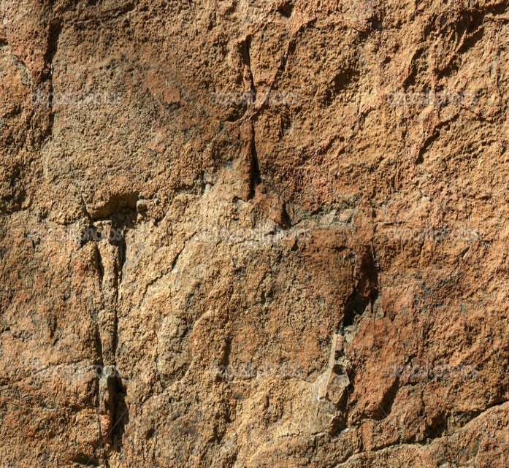
Lesson 120
Spiritual Blessings in Heavenly Places
Ephesians 1
Blessed be the God and Father of our Lord Jesus Christ, who hath blessed us with all spiritual blessings in heavenly places in Christ:
Ephesians 1:3

Slide 2
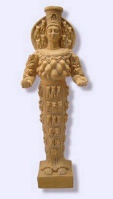
Ephesus
The city was the site of a famous temple for the fertility goddess Diana. Paul was succesful in turning the people away from their idols.
Paul concentrated on turning people from idol worship to worship of Jesus Christ.
Craftsmen of the city saw a threat to the sale of their pagan statues.
For about 3 years Ephesus was a central point for Paul’s ministry.
Paul was under house arrest (prisoner) in Rome while he wrote the Epistle to the Ephesians…
However he was able to preach and receive visitors.
Macedonia
Black Sea
Rome
Italy
Adriatic Sea
Mysia
Ephesus
Cilicia
Sicily
Antioch
Syria
Crete
Cyprus
Mediterranean Sea
Jerusalem
This may have been his first imprisonment in Rome.
Ephesians 3:1; 4:1; 6:20

Slide 3
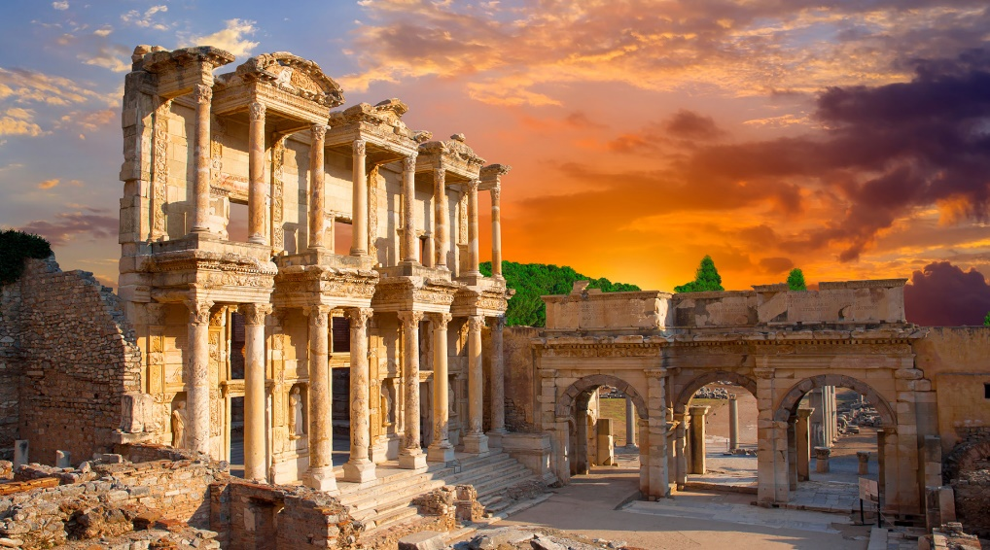
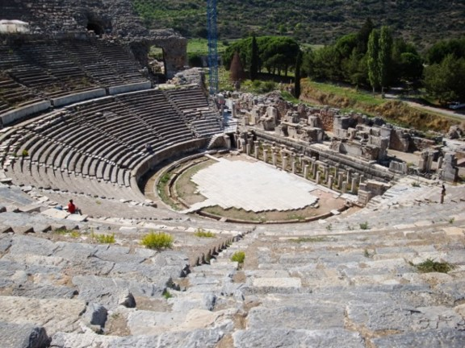
Ephesus
Ephesus was an important city in western Asia Minor (modern-day Turkey).
Major trade routes was a center for commercial trade.
Paul may not have written the epistle specifically to the Ephesians but to several congregations of Saints, including those in Ephesus. Ephesus served as Paul’s headquarters during his third missionary journey.
Following Peter’s death, John the Revelator became the President of the Church, and when John moved from Jerusalem to Ephesus, the headquarters of the Church also moved to Ephesus.
According to Christian tradition, Mary, the mother of Jesus, spent the remaining years of her life at Ephesus under John’s care (see John 19:27).
Ephesus was the first of the seven cities that John wrote to in the book of Revelation.

Slide 4
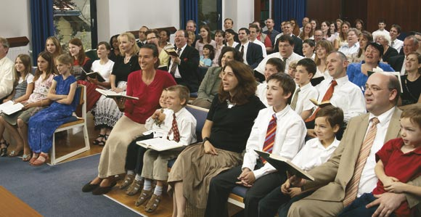
The Saint
Paul frequently referred to Church members as “saints.”
“Saint is a translation of a Greek word also rendered ‘holy,’ the fundamental idea being that of consecration or separation for a sacred purpose.
By referring to members of the Church as Saints, Paul was teaching that every follower of Jesus Christ is made holy—set apart from the world—through the Atonement and should therefore strive to be a holy person.
Ephesians 1:1
(2)

Slide 5
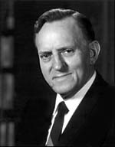
Predestinated
The adoption of children by Jesus Christ to himself
Ephesians contains the only passages in the New Testament that use the phrase translated as “heavenly places” to refer to multiple realms in heaven.
"...many of the noble and valiant spirits of the pre-existence have been withheld as to birth into mortality until this particular time that they may be here upon the earth, either born under the covenant or converted to the gospel of Jesus Christ, that there will be strength within the Church to fulfill the divine commitments which the Lord has placed upon us as a people.
These choice spirits so withheld, as could be expected, respond more readily to the gospel message here in life when they hear it." (3)
God’s children were foreordained to receive the blessings of the gospel
Ephesians 1:3-8

Slide 6
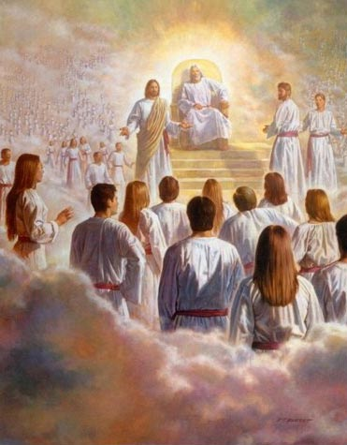
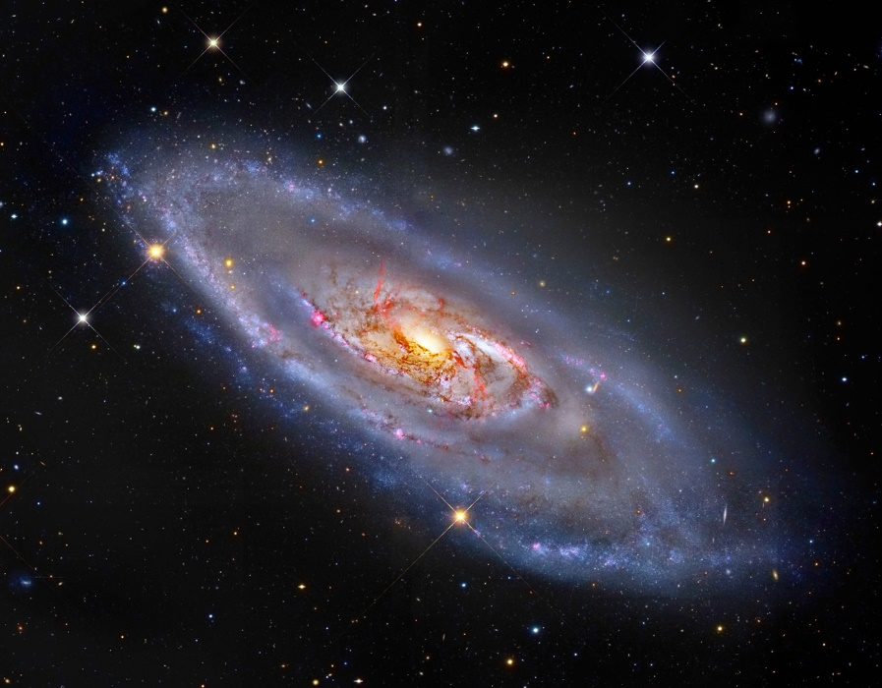
Premortal Spirit World
“In the premortal spirit world, God appointed certain spirits to fulfill specific missions during their mortal lives. This is called foreordination.
“Foreordination does not guarantee that individuals will receive certain callings or responsibilities. Such opportunities come in this life as a result of the righteous exercise of agency, just as foreordination came as a result of righteousness in the premortal existence. …
“The doctrine of foreordination applies to all members of the Church, not just to the Savior and His prophets. Before the creation of the earth, faithful women were given certain responsibilities and faithful men were foreordained to certain priesthood duties. Although you do not remember that time, you surely agreed to fulfill significant tasks in the service of your Father. As you prove yourself worthy, you will be given opportunities to fulfill the assignments you then received.” (4)
Ephesians 1:3-8

Slide 7
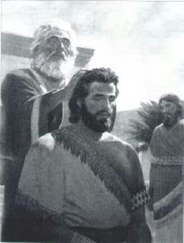
High Priests called because of faith
“And his is the manner after which they were ordained—being called and prepared from the foundation of the world according to the foreknowledge of God…
…on account of their exceeding faith and good works;
…in the first place being left to choose good or evil; therefore they having chosen good, and exercising exceedingly great faith are called with a holy calling…”
Alma 13:3

Slide 8
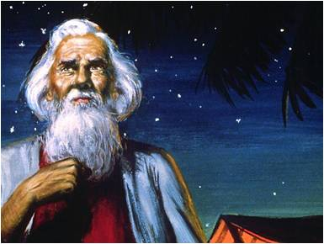
Abraham learns of pre-earth life
“And God saw these souls that they were good, and he stood in the midst of them, and he said:…
…These I will make my rulers; for he stood among those that were spirits, and he saw that they were good; and he saith unto me: Abraham, thou art one of them; thou wast chosen before thou wast born.”
Abraham 3:23

Slide 9
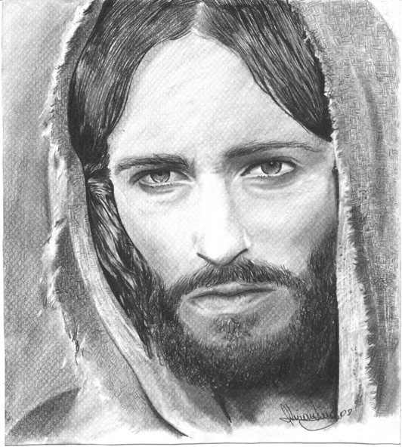
Jesus is Chosen
“But, behold, my Beloved Son, which was my Beloved and Chosen from the beginning, said unto me—Father, thy will be done, and the glory be thine forever.”
Moses 4:2

Slide 10
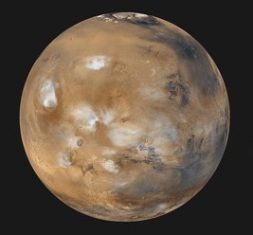
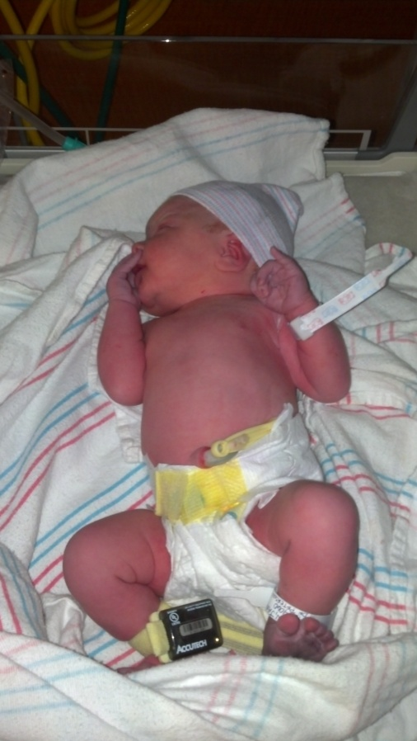
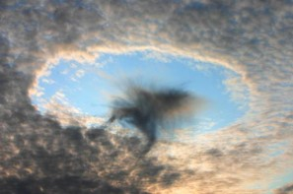
How Does That Apply to Us?
Have you ever wondered why you were born at this time and this place?
Do you think you were foreordained to do something special for Heavenly Father?
Why Did We Have to Forget?
A forgetfulness separates premortal life from earth life.

Slide 11
Some people have difficulty understanding that their existence before this earth life could be forgotten.
Because we do not recall the first few years of early childhood does not mean that we didn’t exist, that we didn’t eat, play, laugh, and interact with family and friends. So it is with our premortal estate.
We lived and associated, grew and learned; yet we cannot recall those former activities for reasons that the Lord in His eternal wisdom has not fully revealed to us.
(7)

Slide 12
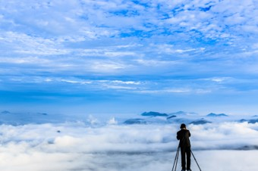
Remembering VS Not Knowing
If you could remember what it was like before you came to earth do you think you would live differently or the same?
We may not know many details about our individual premortal existence.
“And hath made of one blood all nations of men for to dwell on all the face of the earth, and hath determined the times before appointed, and the bounds of their habitation;”
Acts 17:26

Slide 13
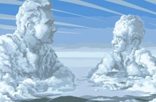
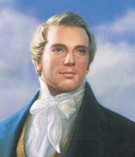
Premortal Selection
Fore---before
Ordained--selected
God’s premortal selection of His valiant spirit children to fulfill certain missions during their mortal lives.
“…because God hath from the beginning chosen you to salvation through sanctification of the Spirit and belief of the truth.”
“Every man who has a calling to minister to the inhabitants of the world was ordained to that very purpose in the Grand Council of heaven before this world was.
I suppose I was ordained to this very office in that Grand Council.” (8)
2 Thessalonians 2:13

Slide 14
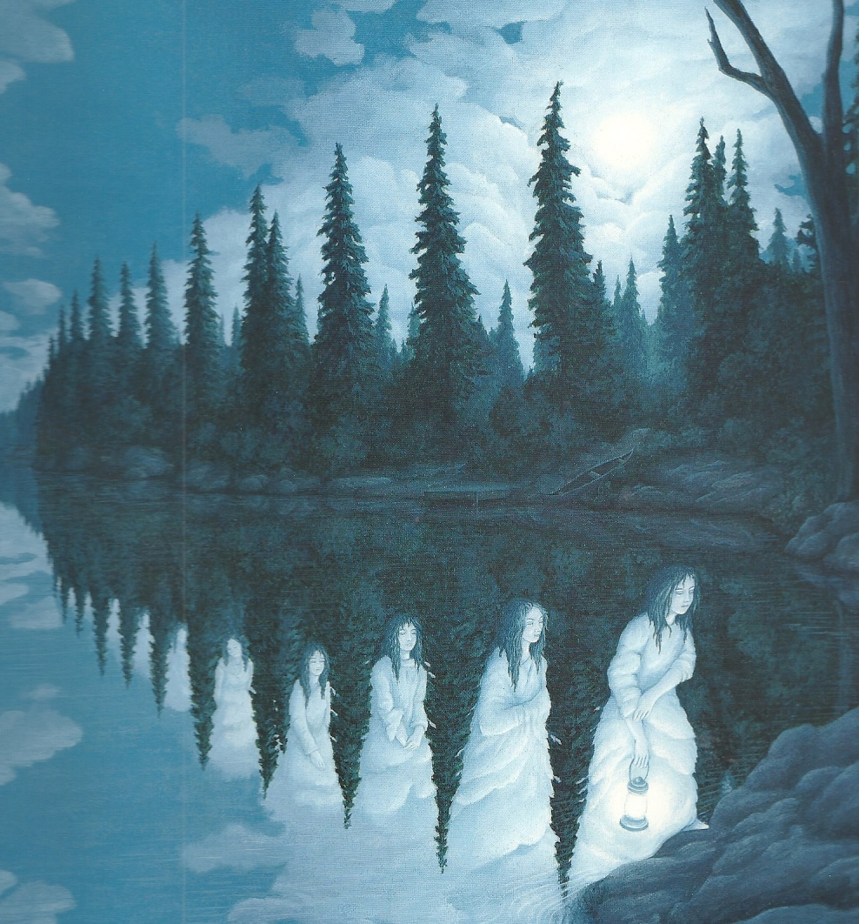
What About Me?
Do I have a foreordained calling?
As you serve faithfully in the church, Heavenly Father will place us where we need to be in order to fulfill our foreordained callings.

Slide 15
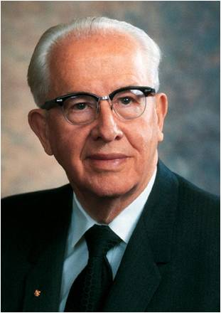
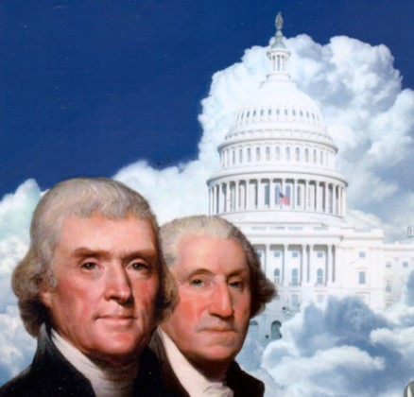
Valiant Servants
“Our Heavenly Father foreordained certain valiant spirit children and assigned them to come to earth at specific times and places to fulfill their appointments.”
“Other good and valiant spirits were foreappointed to lay the foundation for man’s liberty through their service in political matter.
(9)

Slide 16
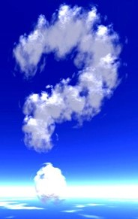
What were you foreordained to do?

Slide 17
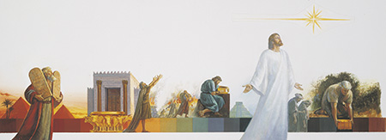
Dispensation of The Fulness of Times
Paul taught that God would “gather together in one all things in Christ” during the dispensation of the fulness of times.
“A dispensation of the gospel is a period of time in which the Lord has at least one authorized servant on the earth who bears the holy priesthood and the keys, and who has a divine commission to dispense the gospel to the inhabitants of the earth.
When this occurs, the gospel is revealed anew so that people of that dispensation do not have to depend basically on past dispensations for knowledge of the plan of salvation.
There have been many gospel dispensations since the beginning. (2)
Ephesians 1:9-11

Slide 18
Dispensation of the Fulness of Times
Noah
3100 BC
Moses
1400 BC
Joseph Smith
AD 1830
Adam
4000 BC
Flood
Apostasy
Enoch
3300 BC
Abraham
2000 BC
Jesus
AD 1
The Bible suggests at least one dispensation identified with Adam, another with Enoch, another with Noah, and so on with Abraham, Moses, and Jesus with His Apostles in the meridian of time”
D&C 27:14

Slide 19
The 7th Dispensation
The seventh dispensation, in which we live, is the last dispensation which will not fall into an apostasy but will eventually be completed with the coming of Christ.
After restoring His priesthood authority to the Prophet Joseph Smith, the Lord said:
"Unto whom I have committed the keys of my kingdom, and a dispensation of the gospel for the last times; and for the fulness of times, in the which I will gather together in one all things, both which are in heaven, and which are on earth" (D&C 27:13).
During the dispensation of the fulness of times, all things from former dispensations will be restored
(1)

Slide 20
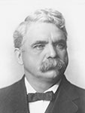
“This is the dispensation of the fullness of times, and we see running into it, as mighty streams rush into the ocean, all the former dispensations, putting us in touch with them, putting them in touch with us; and we see that God has had but one great purpose in view from the beginning, and that has been the salvation of His children.
And now has come the final day, the final dispensation, when truth and light and righteousness must flood the earth.”
(5)

Slide 21
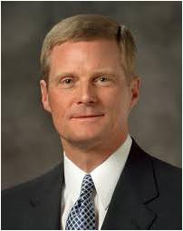
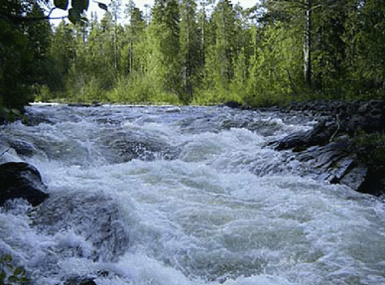
Trickle Into A Flood
“My beloved brothers and sisters, what has been accomplished thus far in this dispensation communicating gospel messages through social media channels is a good beginning—but only a small trickle.
I now extend to you the invitation to help transform the trickle into a flood…
…I exhort you to sweep the earth with messages filled with righteousness and truth—messages that are authentic, edifying, and praiseworthy—and literally to sweep the earth as with a flood.”
Ephesians 1:11
(6)

Slide 22
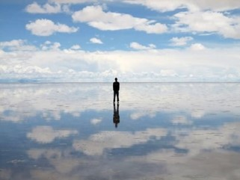
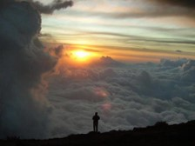
To Be Trusted --Responsibilities
Heavenly Father foreordained some of His children to receive certain responsibilities and blessings on this earth.
We receive these blessings according to our faithfulness.
Ephesians 1:11
Ephesians 1:13

Slide 23
The Holy Spirit of Promise
The Holy Ghost “witnesses to the Father that the saving ordinances have been performed properly and that the covenants associated with them have been kept.”
Remember
The Spirit is “the earnest of our inheritance.”
The presence of the Holy Ghost in our lives is a token, reminder, and indication from God that if we continue faithful we will receive eternal life.
Ephesians 1:13-23
(10)

Slide 24
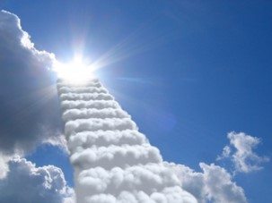
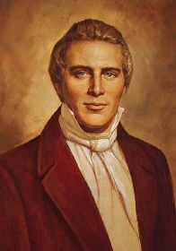
The Spirit of Revelation
“Revelation is communication from God to His children on the earth and one of the great blessings associated with the gift and constant companionship of the Holy Ghost.”
‘The Holy Ghost is a revelator,’ and ‘no man can receive the Holy Ghost without receiving revelations’ (8)
“The spirit of revelation is available to every person who receives by proper priesthood authority the saving ordinances of baptism by immersion for the remission of sins and the laying on of hands for the gift of the Holy Ghost—and who is acting in faith to fulfill the priesthood injunction to ‘receive the Holy Ghost.’”
We can come to know Heavenly Father through the spirit of revelation
Ephesians 1:17-18
(6)

Slide 25
Sources:
Suggested Hymn: #242 Praise God, from Whom All Blessings Flow
New Testament Institute Student Manual Chapter 44
Bible Dictionary
Alvin R. Dyer (Conference Report, April 1962, First Day-Morning Meeting 10.)
True to the Faith: A Gospel Reference [2004], 69–70).
Elder B.H. Roberts (in Conference Report, Oct. 1904, 73).
Elder David A. Bednar (“To Sweep the Earth as with a Flood” [Brigham Young University Campus Education Week devotional, Aug. 19, 2014], LDS.org). (“The Spirit of Revelation,” Ensign or Liahona, May 2011, 87).
Chapter 6: Our Premortal Life Doctrines of the Gospel Student Manual, (2000), 13–15
Prophet Joseph Smith “Teachings of the Prophet Joseph Smith” p 365. Teachings of Presidents of the Church: Joseph Smith [2007], 132
Ezra Taft Benson “The Teachings of Ezra Taft Benson” p. 21
“Guide to the Scriptures”
Presentation by ©http://fashionsbylynda.com/blog/

Slide 26
PAUL’S LETTERS TO THE SAINTS AT EPHESUS AND TO PHILEMON OF COLOSSAE WRITTEN FROM HIS IMPRISONMENT IN ROME, CA. A.D. 61–63 (EPHESIANS; PHILEMON)
Saints Foreordained to Receive Gospel | 1:1–8
Gospel to Be Restored in Last Days | 1:9–12
Saints Sealed by the Holy Spirit of Promise | 1:13–14
The Godhead Is Known by Revelation | 1:15–23
Heavenly Priesthood Ephesians 1:10:
"The heavenly priesthood will unite with the earthly to bring about those great purposes. And whilst we are thus united in the one common cause to roll forth the kingdom of God, the heavenly priesthood are not idle spectators. The spirit of God will be showered down from above; it will dwell in our midst. The blessings of the Most High will rest upon our tabernacles, and our name will be handed down to future ages. Our children will rise up and call us blessed, and generations yet unborn will dwell with peculiar delight upon the scenes that we have passed through, the privations that we have endured, the untiring zeal that we have manifested, the insurmountable difficulties that we have overcome in laying the foundation of a work that brought about the glory and blessings which they will realize, a work that God and angels have contemplated with delight for generations past, that fired the souls of the ancient patriarchs and prophets, a work that is destined to bring about the destruction of the powers of darkness, the renovation of the earth, the glory of God, and the salvation of the human family.“ Joseph Smith (Kent P. Jackson, From Apostasy to Restoration [Salt Lake City: Deseret Book Co., 1996], 258.)
Life and Teachings of Jesus and His Apostles Chapter 43
Heavenly Places Ephesians 1:3:
In the latter days, the Lord revealed that heaven consists of three realms (see D&C 76:50–112; 88:14–47). Elsewhere Paul wrote about varying degrees of resurrected glory (see 1 Corinthians 15:40–42) and about his experience of being “caught up to the third heaven” (2 Corinthians 12:2). (1)
Calling and Election Sure Ephesus 1:13-14:
"Paul exhorts us to make our calling and election sure. This is the sealing power spoken of by Paul in other places. 'In whom ye also trusted, after that ye heard the word of truth, the gospel of your salvation: in whom also after that ye believed, ye were sealed with that Holy Spirit of promise, Which is the earnest of our inheritance until the redemption of the purchased possession, unto the praise of his glory' ("Eph. 1:13"Eph. 1:14Eph. 1:13-14), that we may be sealed up unto the day of redemption.
"This principle ought (in its proper place) to be taught, for God hath not revealed anything to Joseph, but what he will make known unto the Twelve, and even the least Saint may know all things as fast as he is able to bear them, for the day must come when no man need say to his neighbor, Know ye the Lord; for all shall know him (who remain) from the least to the greatest. How is this to be done? It is to be done by this sealing power, and the other Comforter spoken of, which will be manifest by revelation. (HC 3:379-80.)" (Discourses of the Prophet Joseph Smith, compiled by Alma P. Burton [Salt Lake City: Deseret Book Co., 1977], 150 - 151.)
Dispensation Ephesians 1:9-11:
The dispensation of the fulness of times is a period of restoration and fulfillment of all the plans, purposes, and promises that God has revealed since the world began. It “will bring to light the things that have been revealed in all former dispensations; also other things that have not been before revealed. He shall send Elijah, the Prophet, etc., and restore all things in Christ” (Teachings of Presidents of the Church: Joseph Smith [2007], 510–11).
“it is necessary in the ushering in of the dispensation of the fulness of times, which dispensation is now beginning to usher in, that a whole and complete and perfect union, and welding together of dispensations, and keys, and powers, and glories should take place, and be revealed from the days of Adam even to the present time” (D&C 128:18). The dispensation of the fulness of times is the final dispensation, which will prepare the earth for the Second Coming of Jesus Christ.
Mystery of His Will Ephesians 1:9:
"Isn't that something to think about, when you hear that the Lord will reveal the mystery of His will? And that the mystery of His will has been revealed to His modern prophets of this day?
"And we have truths that no other church in this world knows anything about-we are the only church in the world that has a program to unite all that is in the kingdom of heaven with the kingdom of God here on this earth, looking to the final winding-up scenes when all the kingdoms of this world and the world to come will be under the supervision of our great King, the Savior of the world." ("God Moves in a Mysterious Way His Wonders to Perform," Ensign, May 1977, 62)
Spirit of Revelation Ephesians 1:17:
"...those who possess the light of Christ, the spirit of revelation and the knowledge of God, rise above all these vagaries in the world; they know of this doctrine, that it is of God and not of man." Joseph F. Smith (Conference Report, October 1909, 8 - 9.)

