Slide 1
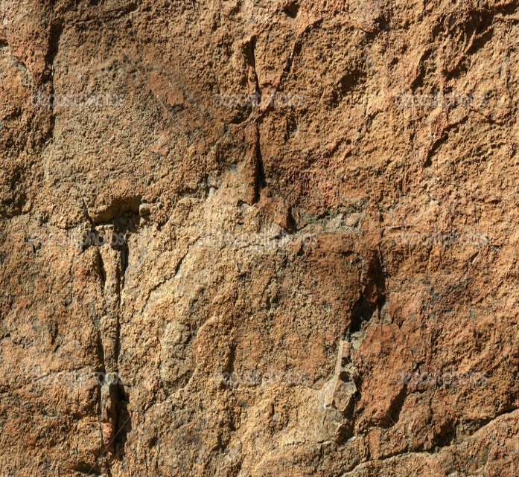
Lesson 120
Saved By Grace
Ephesians 2-3
Behold, how good and how pleasant it is for brethren to dwell together in unity!
Psalm 133:1

Slide 2
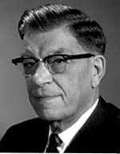
Prince of Power of the Air
The Spirit that works in the children of disobedience
Half truths
Complete Lies
The Work of the Adversary
Persuasion
Wherefore, he maketh war with the saints of God, and encompasseth them round about. D&C 76:29
The Adversary Makes War
Subtle Deceit
Enticing
Fear
Force
Eat, drink, and be merry; nevertheless, fear God—he will justify in committing a little sin; yea, lie a little, take the advantage of one because of his words, dig a pit for thy neighbor; there is no harm in this; and do all these things, for tomorrow we die; and if it so be that we are guilty, God will beat us with a few stripes, and at last we shall be saved in the kingdom of God. 2 Nephi 28:8
Ephesians 2:1-3
(3)

Slide 3
Heavenly Places
Quickened = made alive
Heavenly places = to realms in heaven that people inherit
After Conversion:
The Lord had quickened them, or made them alive, from their spiritually dead and sinful state
Because of the grace of Jesus Christ, all mankind can be saved through faith in Him
James C. Christensen
Grace = help or strength, given through the bounteous mercy and love of Jesus Christ.
Ephesians 2:4-6
(3)

Slide 4
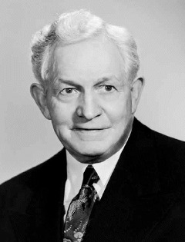
Not By Works Alone
“‘He who would ascend the stairway leading upward to eternal life must tread it step by step from the base stone to the summit of its flight.
Not a single stair can be missed, not one duty neglected, if the climber would avoid danger and delay and arrive with all safety and expedition at the topmost landing of the celestial exaltation.’
The responsibility is upon each individual to choose the path of righteousness, of faithfulness and duty to fellow men.
If he choose otherwise and as a result meets failure, misery, and death, he alone is to blame.”
Ephesians 2:8-10
(5)

Slide 5
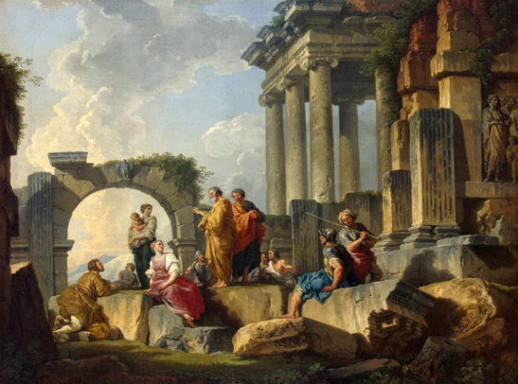
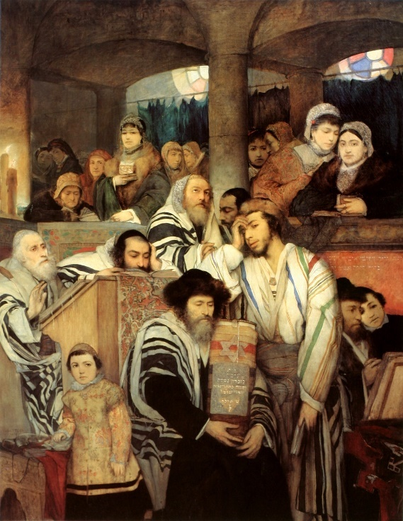
Jews VS Gentiles
Is one group more favored than another?
Some Jews believed that because they were Israelites by birth and had been circumcised, they were more favored by God and superior to Gentile converts
Gentiles who accepted the gospel were no longer to be regarded as aliens, strangers, and foreigners—they were now of “the household of God,” part of God’s covenant people. (1)
Ephesians 2:12-18

Slide 6
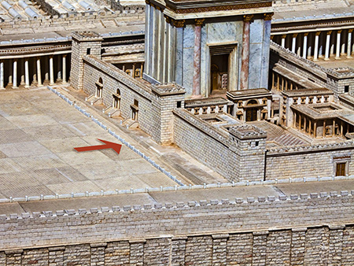
Middle Wall Partition
In the great temple of Jerusalem, the temple proper was shielded from gentile influences.
A special barrier was erected, and if a gentile passed beyond it, he could be put to death.
Archaeologists have even found one of the marble blocks of this barrier with this inscription: “let no foreigner enter within the screen and enclosure surrounding the sanctuary. Whosoever is taken so doing will be the cause that death overtaketh him.”
It will be remembered that it was the accusation that Paul had ignored this warning and brought gentiles beyond the barrier that led to the riot and his arrest (Acts 21:28).
Ephesians 2:14
(2)

Slide 7
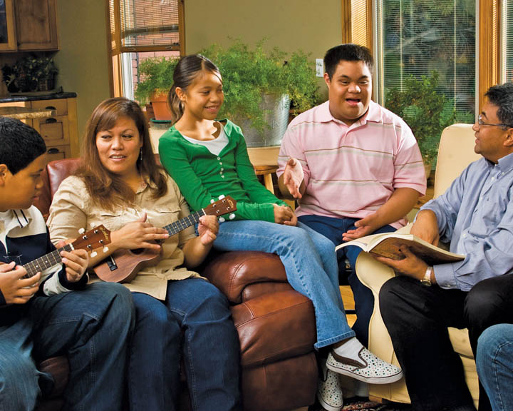
Unified
As we come unto Jesus Christ and partake of His grace, we become unified with the Saints of God.
"To be a fellowcitizen with the Saints has great meaning. All can receive that citizenship through the ordinance of baptism, if they will repent and prepare themselves. Then, as members of The Church of Jesus Christ of Latter-day Saints, they never need be alone.
"In this church the individual is regarded as a son or daughter of God. Family members are taught to sustain one another.
In such families there is some fulfillment of the statement, 'The Saints securely dwell.' Then the family structure is marvelously fitted into the setting of Church organization."
Ephesians 2:15
(6)

Slide 8
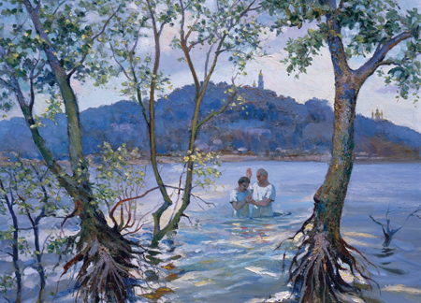
Access to God
By accepting the gospel of Jesus Christ through faith, repentance, baptism, and the gift of the Holy Ghost, both Jewish and Gentile members of the Church had access to God. (1)
In modern times, we enjoy the same blessings when we are baptized and live worthily.
The “walls” between us and the Lord are removed, and we gain full access to God’s blessings. We also become members of “the household of God”.
This painting depicts a man being baptized in the Dnieper River near Kyiv, Ukraine
Ephesians 2:20

Slide 9
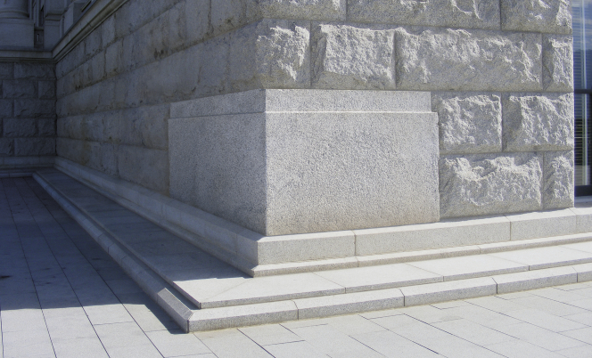
Building a Foundation
Cornerstone = A large stone laid at the corner of a foundation to give strength and stability to the entire structure.
“The apostolic and prophetic foundation of the Church was to bless in all times, but especially in times of adversity or danger, times when we might feel like children, confused or disoriented, perhaps a little fearful, times in which the devious hand of men or the maliciousness of the devil would attempt to unsettle or mislead. …
In New Testament times, in Book of Mormon times, and in modern times these officers form the foundation stones of the true Church, positioned around and gaining their strength from the chief cornerstone, ‘the rock of our Redeemer, who is [Jesus] Christ, the Son of God’
Jesus Christ is the Chief cornerstone
… Such a foundation in Christ was and is always to be a protection in days ‘when the devil shall send forth his mighty winds, yea, his shafts in the whirlwind, yea, when all his hail and his mighty storm shall beat upon you.’”
Ephesians 2:20
(7)

Slide 10
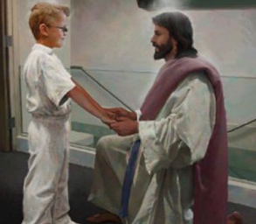
The Mysteries of God
Mystery = a sacred truth made known by revelation.
The mystery Paul wrote about is that both Jews and Gentiles can become heirs of the gospel covenant through Christ. This was a doctrine that “in other ages was not made known unto the sons of men”
Paul taught that all those who follow Christ take upon themselves His name and become His seed and “heirs of the kingdom of God.”
Doc Christensen
His prayer for the Ephesian Saints was that Christ would “dwell in [their] hearts by faith” and that they would come to know the love of Christ.
Ephesians 3:3-6; 17
(1)

Slide 11
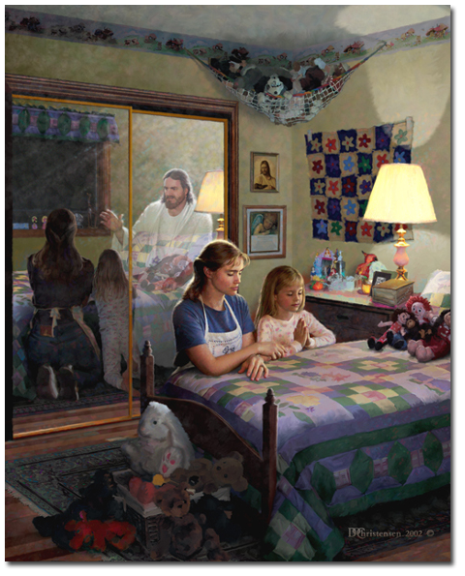
Seeking God’s Help
Paul taught that through Jesus Christ and our faith in Him, we can “have boldness and access [to God] with confidence.”
The word “boldness” can be understood as confidence in the presence of God.
Because of the Savior, in this life we can freely approach God the Father through prayer in the name of Jesus Christ, and in the next life we can enter God’s presence with confidence.
Doc Christensen
Ephesians 3:11-12
(1)

Slide 12
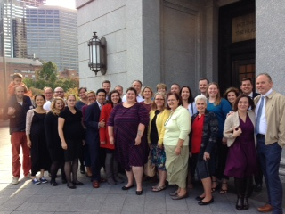
The Whole Family
"So we see that there is a family organization in heaven, and part of it on earth, but in both places it is named after God the Father of Jesus Christ. And why not, since those in heaven and all on earth who have made the covenant are his heirs?" (8)
"...people are more important than organizations. We are trying to teach principles and guidelines more than programs as we seek to strengthen the inner person with the Spirit of God. Our effectiveness can be judged best by the way that inner strength is translated into action. What our religion really is can best be judged by our lives. (9)
West Chester Ward Family
Ephesians 3:15
(1)

Slide 13
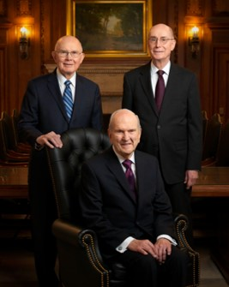
The First Presidency
The First Presidency is the highest governing body of the Church. Its members are special witnesses of the name of Jesus Christ, called to teach and testify of Him throughout the world. Members of the First Presidency travel around the world to speak to members and local leaders; when not traveling, they counsel together and with other general Church leaders on matters affecting the worldwide Church, such as missionary work, temple building and spiritual and temporal welfare.
The current First Presidency is:
President Russel M. Nelson (President)
President Dallin H. Oaks (First Counselor)
President Henry B. Eyring (Second Counselor)
2019

Slide 14
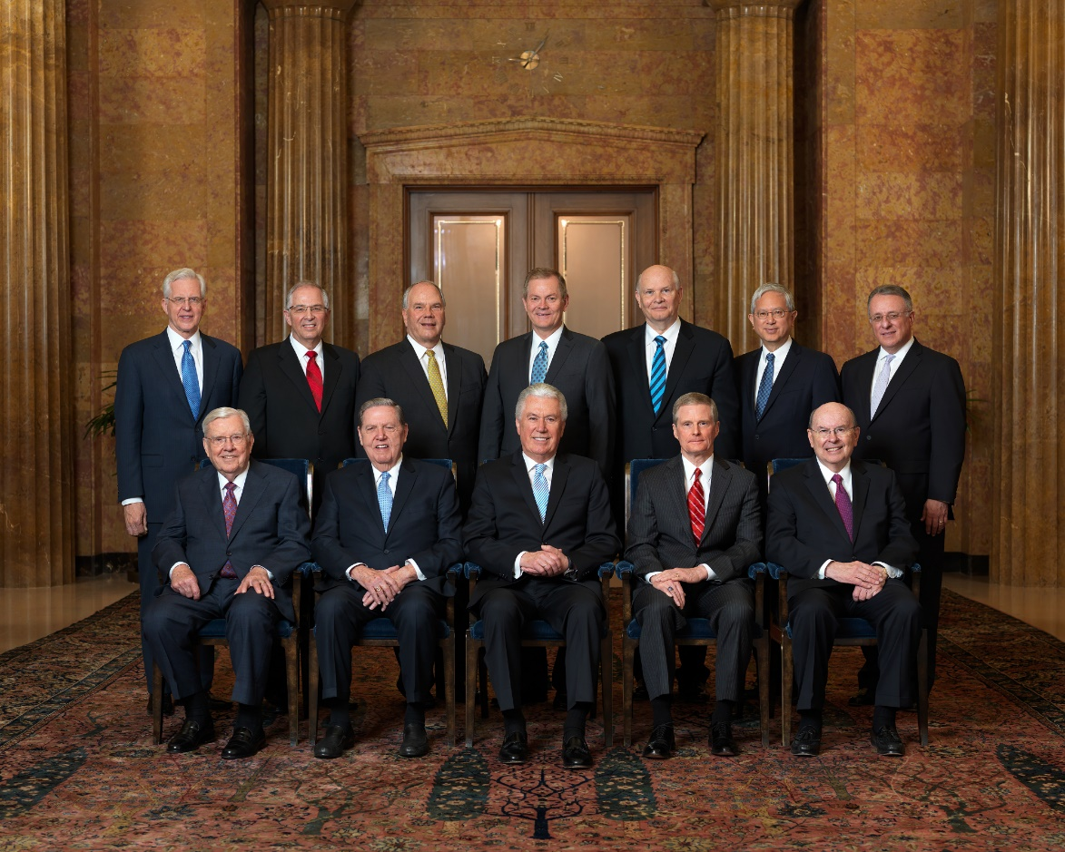
Quorum of the Twelve Apostles
The Quorum of the Twelve Apostles is the second-highest presiding body in the government of the Church. Its members travel the world as special witnesses of the name of Christ and serve under the direction of the First Presidency.
The current Quorum of the Twelve Apostles is:
President M. Russell Ballard
Elder Robert D. Hales
Elder Jeffrey R. Holland
Elder Dieter F. Uchtdorf
Elder David A. Bednar
Elder Quentin L. Cook
Elder D. Todd Christofferson
Elder Neil L. Andersen
Elder Ronald A. Rasband
Elder Gary E. Stevenson
Elder Dale G. Renlund
Elder Gerrit W. Gong
Elder Ulisses Soares
2019

Slide 15
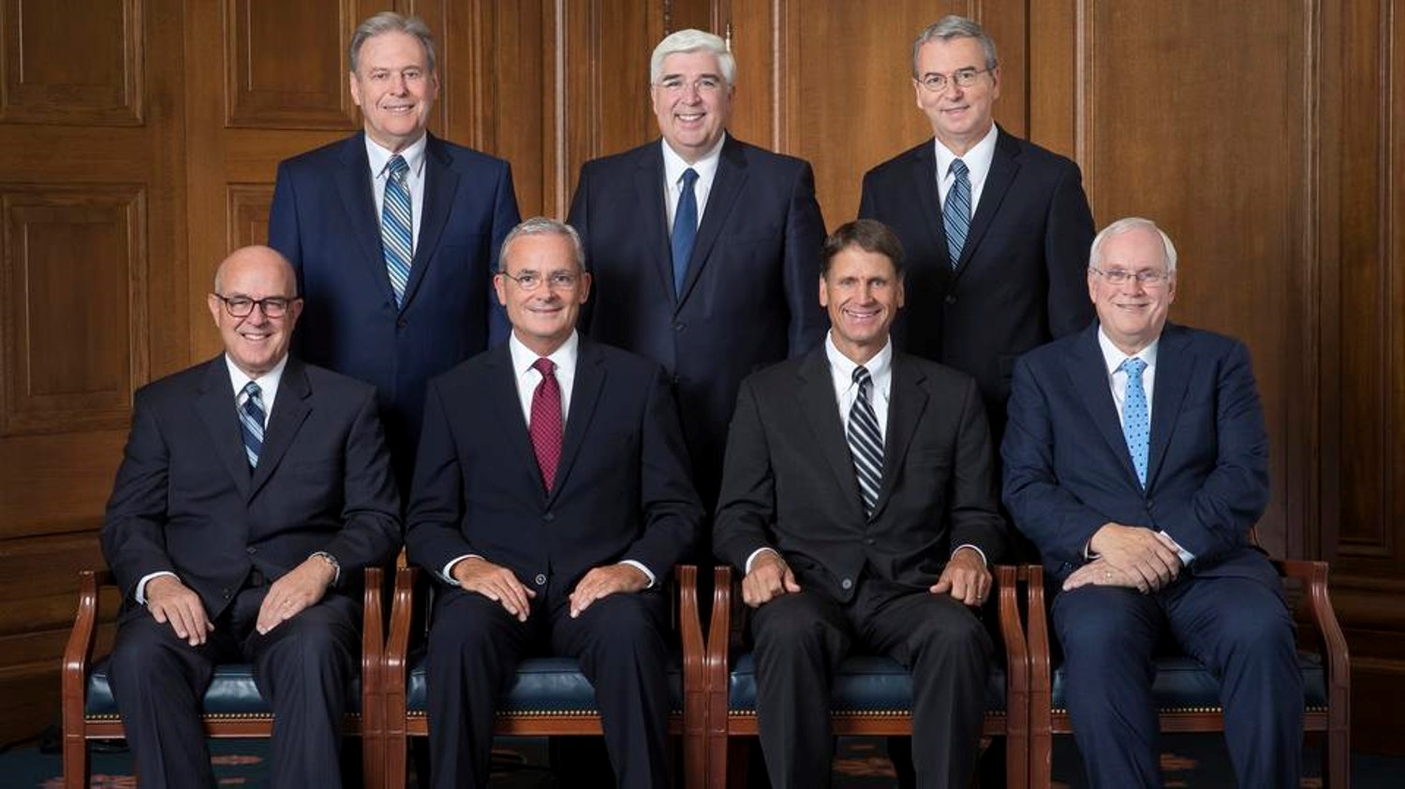
Presidency of the Seventy
The Presidency of the Seventy consists of seven General Authority Seventies who are called by the First Presidency and given authority to preside over the various Quorums of the Seventy.
The current Presidency of the Seventy is:
Elder L. Whitney Clayton
Elder Patrick Kearon
Elder Carl B. Cook
Elder Robert C. Gay
Elder Terence M. Vinson
Elder José Teixeira
Elder Carlos A. Godoy
2019

Slide 16
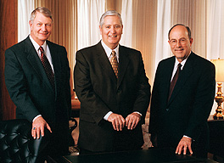
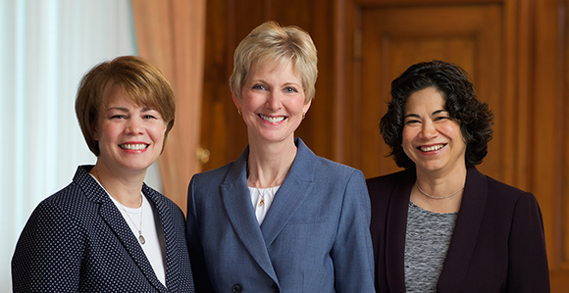
Under the direction of the First Presidency, the Relief Society presidency oversees the activities of all Mormon women ages 18 and over. These leaders travel frequently to help guide and support the women of the Church. The Relief Society is one of the oldest and largest women’s organizations in the world.
The current Relief Society general presidency is:
Sister Jean B. Bingham (President)
Sister Sharon Eubank (First Counselor)
Sister Reyna I. Aburto (Second Counselor)
The Presiding Bishopric consists of the Presiding Bishop and his two counselors. Each holds the office of bishop, and they serve under the direct supervision of the First Presidency. The Presiding Bishopric is responsible for many of the Church’s temporal affairs.
The current Presiding Bishopric is:
Bishop Richard C. Edgley (Bishop)
Bishop H. David Burton (First Counselor)
Bishop Keith B. McMullin (Second Counselor)
2019

Slide 17
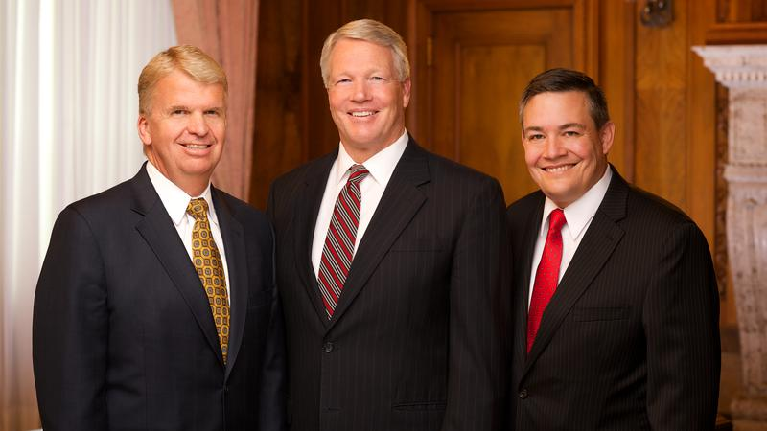
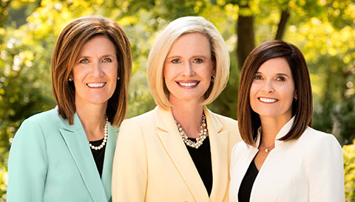
The Young Women presidency provides instruction, encouragement and support in living the gospel of Jesus Christ for female Church members ages 12 through 17. These leaders serve under the direction of the First Presidency and travel frequently to help guide and support the young women of the Church.
The current Young Women general presidency is:
Sister Bonnie H. Cordon (President)
Sister Michelle D. Craig (First Counselor)
Sister Becky Craven (Second Counselor)
The Young Men presidency provides instruction, encouragement and support in living the gospel of Jesus Christ for male Church members ages 12 through 18. These leaders serve under the direction of the First Presidency and travel frequently to help guide and support the young men of the Church.
The current Young Men general presidency is:
Brother Stephen W. Owen (President)
Brother Douglas D. Holmes (First Counselor)
Brother M. Joseph Brough (Second Counselor
2019

Slide 18
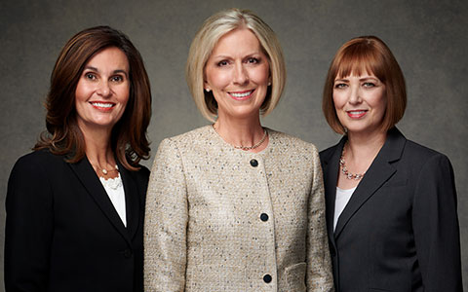
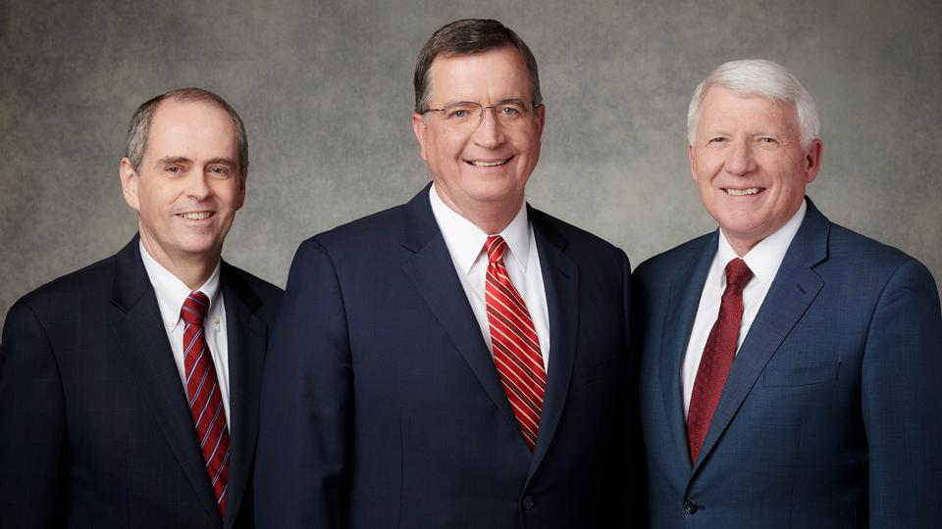
The current general president of the Sunday School Presidency is:
Brother Mark L. Pace (President)
Brother Milton Camargo (First Counselor)
Brother Jan E. Newman (Second Counselor)
The Primary presidency oversees the Church’s organization that teaches children ages 18 months to 11 years the gospel of Jesus Christ and helps them live its principles. These leaders serve under the direction of the First Presidency and travel frequently to help guide and support the children and their local leaders.
The current Primary general presidency is:
Sister Joy D. Jones (President)
Sister Lisa L. Harkness (First Counselor)
Sister Christina B. Franco (Second Counselor)
2019

Slide 19
Apostles and prophets seek to help God’s children know and feel the love of Jesus Christ.

Slide 20
Doctrinal Mastery
Ephesians 2:19-20
Now therefore ye are no more strangers and foreigners, but fellow citizens with the saints, and of the household of God;
And are built upon the foundation of the apostles and prophets, Jesus Christ himself being the chief corner stone;
2017

Slide 21
Sources:
Suggested Hymn: #117 Come Unto Jesus
Video:
Ye Are No More Strangers (2:28)
New Testament Institute Student Manual Chapter 44
Life and Teachings of Jesus Christ and His Apostles Chapter 43
Elder ElRay L. Christiansen The Adversary Sept. 1975 New Era
Bible Dictionary
David O. McKay in CR, Apr. 1957, p. 7
Elder Boyd K. Packer (Let Not Your Heart Be Troubled [Salt Lake City: Bookcraft, 1991], 183.)
Elder Jeffrey R. Holland (“Prophets, Seers, and Revelators,” Ensign or Liahona, Nov. 2004, 7).
President Joseph Fielding Smith The Way to Perfection [Salt Lake City: Genealogical Society of Utah, 1949], 256.
President James E. Faust (Church Section, Deseret News, May 25, 1974, p. 2.)" (To Reach Even unto You [Salt Lake City: Deseret Book Co., 1980], 12.)
Presentation by ©http://fashionsbylynda.com/blog/

Slide 22
PAUL’S LETTERS TO THE SAINTS AT EPHESUS AND TO PHILEMON OF COLOSSAE WRITTEN FROM HIS IMPRISONMENT IN ROME, CA. A.D. 61–63 (EPHESIANS; PHILEMON)
Salvation Through Grace and Faith | 2:1–10
Jew and Gentile Reconciled Through Christ | 2:11–18
Gentile Converts Become Fellow Heirs | 2:19–22; 3:1–13
Love Christ and Gain God’s Fulness | 3:14–21
The War With Satan: Ephesians 2:1-3
In this war against the Saints, Satan does not hesitate to use power. “Force,” President David O. McKay has said, “emanates and comes from Lucifer himself.” (Gospel Ideals [Improvement Era publication, 1953], p. 302.) Satan often rules people through dictatorships and other forms of compulsion and force. When Satan’s power is strong in government, severe restrictions are imposed on worship, travel, communications, and other precious rights and activities. Even where more democratic governments operate he remains active in sponsoring criminal gangs, witchcraft, Satan worship, evil and secret organizations, and other groups that run counter to the principles of the gospel. These groups all attempt to use force and fear to achieve their ends.
However, if force will not achieve his ends, Satan is quick to use more subtle and enticing means. He presents his principles and arguments in the most approved style, with great charm and grace. He is very careful to integrate himself into the favor of the powerful and influential among mankind. He unites with popular movements and programs, only to use them as a means of doing that which ultimately oppresses and takes away God-given freedoms. (See Discourses of Brigham Young, [Deseret Book Co., 1954], p. 69.)
Satan will not ordinarily appear himself to do his dirty work. Rather, he will most often act through friends or acquaintances in whom we have confidence. Being disobedient themselves, they will attempt to persuade us to violate the standards of the Church and the commandments of God. Moreover, Satan will, as President Joseph Fielding Smith has written, “place thoughts in our minds and … whisper to us in unspoken impressions to entice us to satisfy our appetites or desires and in various ways he plays upon our weaknesses and desires.” (Answers to Gospel Questions [Deseret Book Co., 1972], 3:81.) This the prophet Nephi beheld in our day and, enlightened by the Spirit of God, wrote of it:
“And there shall also be many which shall say: Eat, drink, and be merry; nevertheless, fear God—he will justify in committing a little sin; yea, lie a little, take the advantage of one because of his words, dig a pit for thy neighbor; there is no harm in this; and do all these things, for tomorrow we die; and if it so be that we are guilty, God will beat us with a few stripes, and at last we shall be saved in the kingdom of God.
“And others will he pacify, and lull them away into carnal security, that they will say: All is well in Zion; yea, Zion prospereth, all is well—and thus the devil cheateth their souls, and leadeth them away carefully down to hell.” (2 Ne. 28:8, 21.)
The Adversary
by Elder ElRay L. Christiansen Sept. 1975 New Era
Life and Teachings of Jesus and His Apostles Chapter 43
Grace: Ephesians 2:4-6:
It is through the grace of the Lord Jesus, made possible by His atoning sacrifice, that mankind will be raised in immortality, every person receiving his body from the grave in a condition of everlasting life. It is likewise through the grace of the Lord that individuals, through faith in the Atonement of Jesus Christ and repentance of their sins, receive strength and assistance to do good works that they otherwise would not be able to maintain if left to their own means. This grace is an enabling power that allows men and women to lay hold on eternal life and exaltation after they have expended their own best efforts.
Divine grace is needed by every soul in consequence of the Fall of Adam and also because of man’s weaknesses and shortcomings. However, grace cannot suffice without total effort on the part of the recipient. Hence the explanation, “It is by grace that we are saved, after all we can do” (2 Ne. 25:23). It is truly the grace of Jesus Christ that makes salvation possible. This principle is expressed in Jesus’ parable of the vine and the branches (John 15:1–11). See also John 1:12–17; Eph. 2:8–9; Philip. 4:13; D&C 93:11–14. Bible Dictionary

Slide 23
The Gift of Grace Ephesians 2:7-10:
“Because we have all ‘sinned, and come short of the glory of God’ [Romans 3:23] and because ‘there cannot any unclean thing enter into the kingdom of God’ [1 Nephi 15:34], every one of us is unworthy to return to God’s presence. …
“… We cannot earn our way into heaven; the demands of justice stand as a barrier, which we are powerless to overcome on our own.
“But all is not lost.
“The grace of God is our great and everlasting hope.
“Through the sacrifice of Jesus Christ, the plan of mercy appeases the demands of justice [see Alma 42:15] ‘and [brings] about means unto men that they may have faith unto repentance’ [Alma 34:15].
“Our sins, though they may be as scarlet, can become white as snow [see Isaiah 1:18]. Because our beloved Savior ‘gave himself a ransom for all’ [1 Timothy 2:6], an entrance into His everlasting kingdom is provided unto us [see 2 Peter 1:11].
“The gate is unlocked! …
“To inherit this glory, we need more than an unlocked gate; we must enter through this gate with a heart’s desire to be changed—a change so dramatic that the scriptures describe it as being ‘born again; yea, born of God, changed from [our worldly] and fallen state, to a state of righteousness, being redeemed of God, becoming his sons and daughters’ [Mosiah 27:25]. …
“Grace is a gift of God, and our desire to be obedient to each of God’s commandments is the reaching out of our mortal hand to receive this sacred gift from our Heavenly Father.” President Dieter F. Uchtdorf (“The Gift of Grace,” Ensign or Liahona, May 2015, 108, 110).
Unity Ephesians 2:19:
"We all look upon one another as brothers and sisters, regardless of the land we call home. We belong to what may be regarded as the greatest society of friends on the face of the earth.
"When the emperor of Japan was in the United States some few years ago, I attended a luncheon for him in San Francisco. We sat at a table with three other couples who had had extensive experience in Japan and who had resided there at one time or another while working in government, business, or educational employment. One of the gentlemen said to me, 'I have never seen anything like your people. We had many Americans come to Japan while we were there, and most of them experienced a severe cultural adjustment and much loneliness and homesickness. But whenever we had a Mormon family come, they had many instant friends. Members of your church in Japan seemed to know when they were expected and were there to welcome them. They and their children were immediately integrated socially as well as into your religious community. There seemed to be no culture shock and no loneliness. My wife and I talked about it many times.'
"That is the way it should be. We must be friends. We must love and honor and respect and assist one another. Wherever Latter-day Saints go, they are made welcome, because Latter-day Saints are mutual believers in the divinity of the Lord Jesus Christ and are engaged together in his great cause.
"We speak of the fellowship of the Saints. This is and must be a very real thing. We must never permit this spirit of brotherhood and sisterhood to weaken. We must constantly cultivate it. It is an important aspect of the gospel. ("Fear Not to Do Good," Ensign, May 1983, pp. 79-80.)" (Teachings of Gordon B. Hinckley [Salt Lake City: Deseret Book Co., 1997], 223.)
Corner Stone Ephesians 2:20:
A cornerstone is a massive stone that is laid at the corner of a foundation to give strength and stability to the entire structure. A cornerstone can also be used to connect two adjoining walls to form a corner. Paul used this imagery to explain that Jesus Christ provides strength and stability to the whole Church and that through Jesus Christ, Jewish and Gentile members of the Church are bound together (see Jacob 4:15–16; Psalm 118:22; Isaiah 28:16). All members become united, “fitly framed together [growing] unto an holy temple in the Lord.” All of this is made possible through the Atonement of Jesus Christ, who is the “chief corner stone” (Ephesians 2:20–21).
(1)
Rooted and Grounded Ephesians 3:17:
"We must deepen our faith until it becomes the real thing. Otherwise, when the heat of the day comes, if we are not, to use Peter and Paul's words, 'grounded,' 'rooted,' 'established,' and 'settled,' we will wither under the scorching summer of circumstances." Neal A. Maxwell (We Talk of Christ, We Rejoice in Christ [Salt Lake City: Deseret Book Co., 1984], 10.)
Be Filled With Fulness of God Ephesians 3:19:
"All the prophets taught this truth about God, and their prime purpose was not to argue or try to prove the existence of God but to be his witnesses, to testify that he lives and to make his will known among men. Christ revealed the Father in his life and teachings and parables. Through his Son the Father was not only bringing salvation and making eternal life possible for all men, but was offering the ultimate opportunity for men to know God himself. Elder Marion D. Hanks "Trust in the Lord," Ensign, May 1975, 13-14)

