Slide 1
Lesson 122
One Lord, One Faith, One Baptism
Ephesians 4
So we, being many, are one body in Christ, and every one members one of another. Romans 12:5

Slide 2
Only One
In Paul’s day, as in ours, there is only one true Church of Jesus Christ upon the earth.
And also those to whom these commandments were given, might have power to lay the foundation of this church, and to bring it forth out of obscurity and out of darkness, the only true and living church upon the face of the whole earth, with which I, the Lord, am well pleased, speaking unto the church collectively and not individually— D&C 1:30
Ephesians 4:1-6

Slide 3
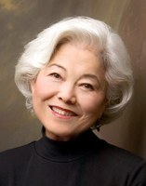
Unity of Spirit
"Yes, unity is important in the Church. But sometimes we misread these strong messages for unity as instructions to look alike, talk alike, dress alike, think alike, have the same number of children, keep house a certain way, have prayers at certain times,…
Complete conformity in our personalities and styles of living is not the same thing as unity of spirit, unity of testimony, and unity of faith in the Savior."
Ephesians 4:1-6
(2)

Slide 4
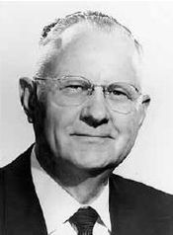
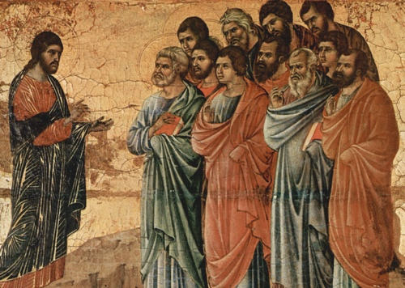
Unity of Doctrine
“After Jesus put his apostles in charge of the Church anciently, they preached the same unity of doctrine and practiced the same ordinances which Jesus had given them. …
“… As long as they remained on the earth, functioning under the authority Jesus gave them, unity of doctrine and uniformity of the ordinances prevailed.
The gospel message, which they were commanded to take to all the world, was the same to everyone everywhere.
People were not taught different gospels and then given a choice. There was only one plan for all.
Duccio Di Buoninsegna
Ephesians 4:1-6
(3)

Slide 5
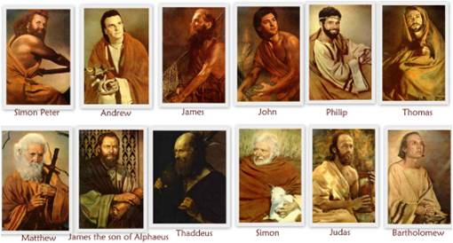
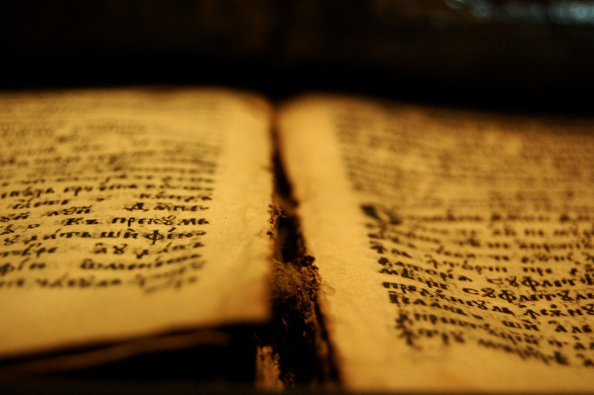
Unified
“One church, one authorized ministry, one orthodox gospel doctrine, and one Holy Ghost characterized the church of Jesus Christ in His time.
‘For God is not the author of confusion, but of peace, as in all churches of the saints.’
Thus God’s revelation to leaders of the Church of Jesus Christ was reasonable, consistent, and unified.
“It was only after the death of Christ’s apostles that revelation ceased.
The pure doctrines Christ taught became diluted with the philosophy of the world, and profane innovations appeared in the ordinances of the church.
Eventually, that which had once been clear and understandable became mythical and confusing.”
Ephesians 4:4-5; 1 Corinthians 14:33
(3)

Slide 6
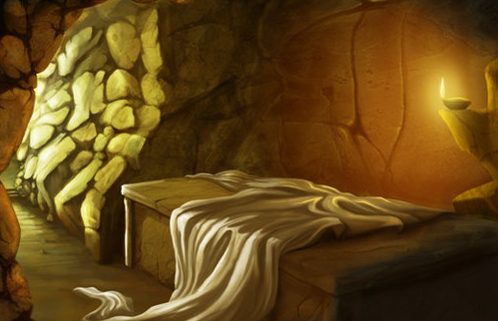
Captivity Captive
“[Jesus Christ] overcame death; all men were the captives of death until Christ captured the captivator and made death subject to him,…
Thou hast ascended on high, thou hast led captivity captive: thou hast received gifts for men; yea, for the rebellious also, that the Lord God might dwell among them.
Psalm 68:18
"Now that Christ is ascended to heaven, we understand that he first came to earth, descending below all things in suffering the pains of every creature which belongeth to the family of Adam.
"He is the same being that has now ascended to his rightful place at the right hand of the Father, who through the atonement, has taken the captivity of sin and death captive and given his gifts unto men, that he might fulfill all things which the Father hath given him."
Ephesians 4:8
(4)

Slide 7
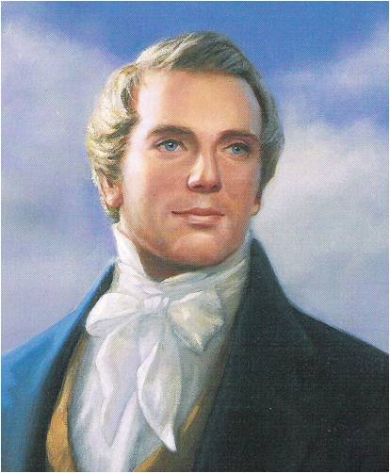
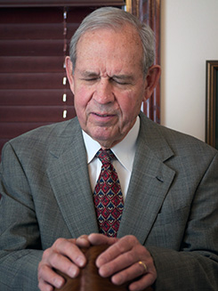
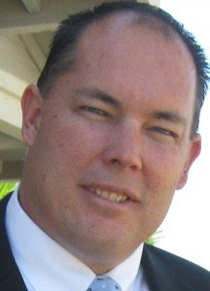
Evangelists and Pastors
Titles in Paul’s Day are not the same as the titles given today
“An evangelist is a Patriarch. … Wherever the Church of Christ is established in the earth, there should be a Patriarch for the benefit of the posterity of the Saints, as it was with Jacob in giving his patriarchal blessing unto his sons” (5)
A pastor is a shepherd or one who leads a flock—a fitting description of modern-day bishops, branch presidents, and stake and district presidents. (1)
Ephesians 4:11; 1 Peter 5:2-4

Slide 8
The Lord has called apostles, prophets, and other Church leaders to help perfect the Saints and protect them from false doctrine
Ephesians 4:12-14

Slide 9
Church Callings
Apostles
Prophets
Patriarchs
Bishops
Teachers
The work of a Hebrew prophet was to act as God’s messenger and make known God’s will.
A Bishop is an ordained office in the Aaronic Priesthood and a bishop is a common judge in Israel
…to preach repentance and remission of sins through Jesus Christ, by the endurance of faith on his name to the end. Amen. Moroni 3:3
To watch over the Church D&C 53:20
The calling of an Apostle is to be a special witness of the name of Jesus Christ in all the world, particularly of His divinity and of His bodily resurrection from the dead
A patriarch is called an evangelist in. As such, patriarch is an ordained office in the Melchizedek Priesthood.
(6)

Slide 10
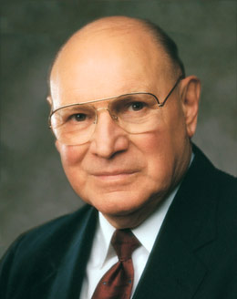
Tossed To and Fro
The winds of false doctrine that are blowing today both outside and a few within the Church are far more dangerous to the ultimate salvation of mankind than are earthquakes, hurricanes, typhoons, volcanic eruptions, and other natural disasters.
These winds can uproot people if their roots are not firmly anchored to the Rock of our salvation, which is the teachings and the gospel of Jesus Christ.
"We, as a people, are to live our religion and its principles and follow the leadership of our prophet, seer, and revelator regardless of what the world does."
How do the teachings of apostles, prophets, and other Church leaders help followers of God navigate these troubled waters and return safely to Heavenly Father?
Ephesians 4:14-15
(7)

Slide 11
Doctrinal Mastery
And he gave some, apostles; and some, prophets; and some, evangelists; and some, pastors and teachers;
For the perfecting of the saints, for the work of the ministry, for the edifying of the body of Christ:
Till we all come in the unity of the faith, and of the knowledge of the Son of God, unto a perfect man, unto the measure of the stature of the fulness of Christ:
That we henceforth be no more children, tossed to and fro, and carried about with every wind of doctrine, by the sleight of men, and cunning craftiness, whereby they lie in wait to deceive;
Ephesians 4:11-14
(7)

Slide 12
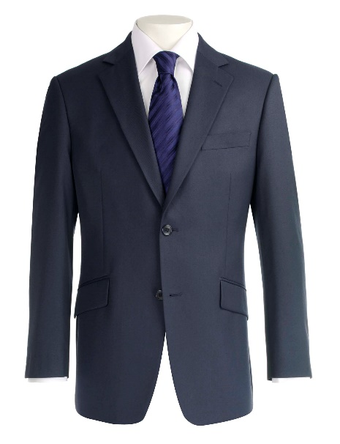
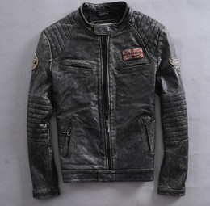
The unrighteous practices the Saints should abandon, and defining the higher, more saintly manner of living they should adopt
Put on the New Man
Setting aside old clothing and clothing oneself in righteousness.
Which outfits would be appropriate for a very nice event?
Ephesians 4:22-24
(1)

Slide 13
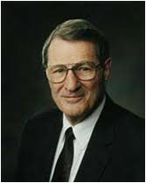
The old ways, so pleasing to the carnal man, are really hard to set aside. Actually, these ways are not really fulfilling and not really satisfying. But they are preoccupying, for pleasing the natural man is a full-time business. He sees to that!
"Of course, what is really to be jettisoned, put off, is anger, selfishness, malice, injustice, impatience, filthy communication, and so forth, while we put on kindness, meekness, long-suffering, and so on.”
Disciples of Jesus Christ put off their old, sinful ways and put on new, righteous ways.
Ephesians 4:14-15
(8)

Slide 14
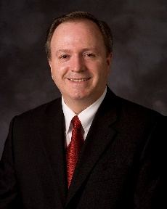
“Be ye angry, and sin not” = “Can ye be angry, and not sin?”
But I say unto you, That whosoever is angry with his brother without a cause shall be in danger of the judgment:
Matthew 5:22
“‘He made me mad.’ This is another phrase we hear, also implying lack of control or agency.
This is a myth that must be debunked. No one makes us mad. Others don’t make us angry.
There is no force involved. Becoming angry is a conscious choice, a decision; therefore, we can make the choice not to become angry.
We choose!”
“A cunning part of [Satan’s] strategy is to dissociate anger from agency, making us believe that we are victims of an emotion that we cannot control.
We hear, ‘I lost my temper.’ Losing one’s temper is an interesting choice of words that has become a widely used idiom.
To ‘lose something’ implies ‘not meaning to,’ ‘accidental,’ ‘involuntary,’ ‘not responsible’—careless perhaps but ‘not responsible.’
Ephesians 4:27-32 (JST)
(9)

Slide 15
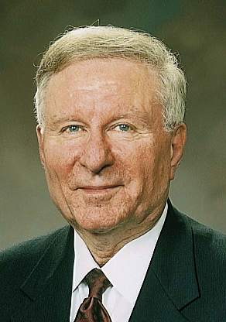
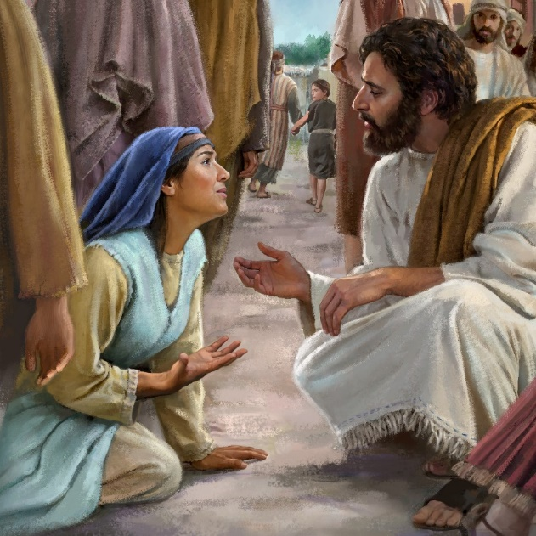
Communication—To Not Be Corrupted
Paul encouraged the Saints to avoid “corrupt communication,” which includes all forms of inappropriate speech: lying, deceit, vulgar or profane expressions, gossip, irreverent or disrespectful speech, and offensive, corrupt, degrading, belittling, or profane language, among others.
"Christlike communications are expressions of affection and not anger, truth and not fabrication, compassion and not contention, respect and not ridicule, counsel and not criticism, correction and not condemnation.
They are spoken with clarity and not with confusion. They may be tender or they may be tough, but they must always be tempered.“
Ephesians 4:29
(10)

Slide 16
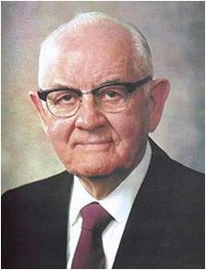
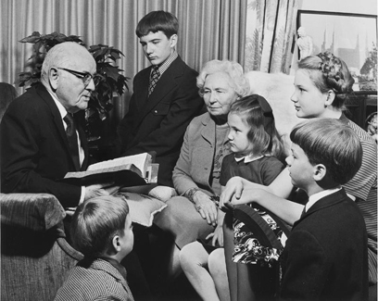
Therefore I Was Taught
"In such homes, where we are 'kind one to another, tenderhearted, forgiving one another,’ where we are holding our family meetings, discussions, and councils, where we are praying, working, and playing with love as our chief motive, where we are trying to share the gospel with others and fulfill the other purposes of the Lord-in those homes there will dwell a powerful spirituality and unity that will be a lifelong strength to all family members."
The Kimball’s with grandchildren
Ephesians 4:32
(11)

Slide 17
Sources:
Suggested Hymn: #3 Now Let Us Rejoice
New Testament Institute Student Manual Chapter 44
Chieko N. Okazaki (Aloha! [Salt Lake City: Deseret Book Co., 1995], 96.)
Elder Delbert L. Stapley (“What Constitutes the True Church,” Ensign, May 1977, 22).
Elder Bruce R. McConkie (Doctrinal New Testament Commentary, 2:509).
Teachings of Presidents of the Church: Joseph Smith [2007], 140
Bible Dictionary
Elder Joseph B. Wirthlin ("Deep Roots," Ensign, Nov. 1994, 77)
Elder Neal A. Maxwell (That Ye May Believe [Salt Lake City: Bookcraft, 1992], 18.)
Elder Lynn G. Robbins (“Agency and Anger,” Ensign, May 1998, 80).
Elder L. Lionel Kendrick ("Christlike Communications," Ensign, Nov. 1988, 24)
President Spencer W. Kimball ("Therefore I Was Taught," Ensign, Jan. 1982, 5)
Presentation by ©http://fashionsbylynda.com/blog/

Slide 18
PAUL’S LETTERS TO THE SAINTS AT EPHESUS AND TO PHILEMON OF COLOSSAE WRITTEN FROM HIS IMPRISONMENT IN ROME, CA. A.D. 61–63 (EPHESIANS; PHILEMON)
The Organization of Christ’s Church | 4:1–16
Christ’s People Live New Lives | 4:17–32; 5:1–21
Gifts Given, Evangelists and Pastors Ephesians 4:11:
"We now ask, all Christendom who profess to be Saints, whether they are perfect or imperfect? The general answer is, 'we are imperfect.' How do you expect to become perfect, if you do away out of your churches inspired apostles, prophets, and other officers? These are the only gifts and officers by which the Saints can be perfected. Have you got them in your midst? Millions answer 'no: we do not believe in prophets in our day.' But do you believe in 'pastors and teachers?' O yes, they are necessary. Who told you to reject the most important gifts of the church and to retain the rest? 'No one has told us to do this but our ministers, and they must be good men, and they say that apostles and prophets are no longer necessary, but that evangelists, pastors and teachers are'...Know assuredly that there never was any other plan adopted in the gospel to perfect the Saints than through apostles, prophets and other gifts." (Orson Pratt's Works [Salt Lake City: Deseret News Press, 1945], 163 - 165.)
Life and Teachings of Jesus and His Apostles Chapter 43
Authorities of the Church Ephesians 4:14:
“The authorities which the Lord has placed in his Church constitute for the people of the Church a harbor, a place of refuge, a hitching post, as it were. No one in this Church will ever go far astray who ties himself securely to the Church Authorities whom the Lord has placed in his Church. This Church will never go astray; the Quorum of the Twelve will never lead you into bypaths; it never has and never will. There could be individuals who would falter; there will never be a majority of the Council of the Twelve on the wrong side at any time. The Lord has chosen them; he has given them specific responsibilities. And those people who stand close to them will be safe. And, conversely, whenever one begins to go his own way in opposition to authority, he is in grave danger. I would not say that those leaders whom the Lord chooses are necessarily the most brilliant, nor the most highly trained, but they are the chosen, and when chosen of the Lord they are his recognized authority, and the people who stay close to them have safety.” (Spencer W. Kimball in CR, Apr. 1951, 104.)
Ministry Ephesians 4:14-15:
“The ministry of the Apostles—the First Presidency and the Twelve—is to bring about that unity of the faith and to proclaim our knowledge of the Master. Our ministry is to bless the lives of all who will learn and follow the ‘more excellent way’ of the Lord [1 Corinthians 12:31; Ether 12:11]. And we are to help people prepare for their potential salvation and exaltation” Elder Russell M. Nelson (“Salvation and Exaltation,” Ensign or Liahona, May 2008, 7–8).
“In the Church today, just as anciently, establishing the doctrine of Christ or correcting doctrinal deviations is a matter of divine revelation to those the Lord endows with apostolic authority” Elder D. Todd Christofferson (“The Doctrine of Christ,” Ensign or Liahona, May 2012, 86).
One Lord, One Faith Ephesians 4:5:
"Now, others may insist that this is not the true church. That is their privilege. But to claim that it does not exist anywhere, that it does not even need to exist, is to deny the scriptures.
"The New Testament teaches of 'one Lord, one faith, one baptism' and speaks of ' [all coming] in the unity of the faith' (Eph. 4:5, 13) and of a 'restitution of all things, which God hath spoken by the mouth of all his holy prophets since the world began' (Acts 3:21.)
"We did not invent the doctrine of the only true church. It came from the Lord. Whatever perception others have of us, however presumptuous we appear to be, whatever criticism is directed to us, we must teach it to all who will listen." Pres. Boyd K. Packer ("The Only True Church," Ensign, Nov. 1985, 82)

Slide 19
Apostle:
The word means “one sent forth.” It was the title Jesus gave (Luke 6:13) to the Twelve whom He chose and ordained (John 15:16) to be His closest disciples during His ministry on earth and whom He sent forth to represent Him after His Ascension into heaven.
Jesus is referred to as an Apostle in Heb. 3:1–2, a designation meaning that He is the personal and select representative of the Father.
Bishop:
Greek episkopos, meaning “overseer,” an office or position of responsibility. Hence, Jesus is called the “Bishop of your souls” (1 Pet. 2:21–25). Judas is also spoken of as having a “bishoprick,” reflecting the fact that the Twelve are overseers (Acts 1:20; D&C 114).
Bishop is also an ordained office in the Aaronic Priesthood (D&C 20:67), and a bishop is a common judge in Israel (D&C 107:74). The desirable qualifications of a bishop are listed in 1 Tim. 3:1–7; Titus 1:7–9.
Prophet:
The work of a Hebrew prophet was to act as God’s messenger and make known God’s will….It was therefore part of the prophetic office to preserve and edit the records of the nation’s history; and such historical books as Joshua, Judges, 1 and 2 Samuel, 1 and 2 Kings were known by the Jews as the former Prophets.
It was also the prophet’s duty to denounce sin and foretell its punishment and to redress, so far as he could, both public and private wrongs. He was to be, above all, a preacher of righteousness. When the people had fallen away from a true faith in Jehovah, the prophets had to try to restore that faith and remove false views about the character of God and the nature of the divine requirement.
In certain cases prophets predicted future events, such as the very important prophecies announcing the coming of Messiah’s kingdom; but as a rule a prophet was a forthteller rather than a foreteller. In a general sense a prophet is anyone who has a testimony of Jesus Christ by the Holy Ghost, as in Num. 11:25–29; Rev. 19:10.
Teacher:
…to preach repentance and remission of sins through Jesus Christ, by the endurance of faith on his name to the end. Amen. Moroni 3:3
A teacher’s duty is to watch over the church: (D&C 20:53)
The Ministry:
The work of the ministry is to do the work of the Lord on the earth—to represent the Lord among the people, preach the gospel, and administer the ordinances thereof. The chosen servants and appointed officers in the Church of Jesus Christ are put on earth by Him to conduct the work necessary for the salvation of mankind. A minister “called of God, as was Aaron” (Heb. 5:4), and endowed with the holy priesthood, represents the Lord when he is performing his official duties and is the Lord’s agent. Therefore, what he does “according to the will of the Lord is the Lord’s business” (D&C 64:29). The Lord has given apostles, prophets, evangelists, high priests, seventies, elders, bishops, priests, teachers, deacons, helps, and governments “for the perfecting of the saints, for the work of the ministry, for the edifying of the body of Christ” (the Church), until all have reached the spiritual stature of Christ, the whole body being “fitly joined together” by that which every part supplieth.
Patriarch:
A patriarch is called an evangelist in D&C 107:39–52. As such, patriarch is an ordained office in the Melchizedek Priesthood. The fathers from Adam to Jacob were all patriarchs of this kind. The word as used in the Bible seems to denote also a title of honor to early leaders of the Israelites, such as David (Acts 2:29) and the 12 sons of Jacob (Acts 7:8–9). The word is of Greek derivation and means father-ruler; the Hebrew word it translates is simply father.
Bible Dictionary

