Slide 1
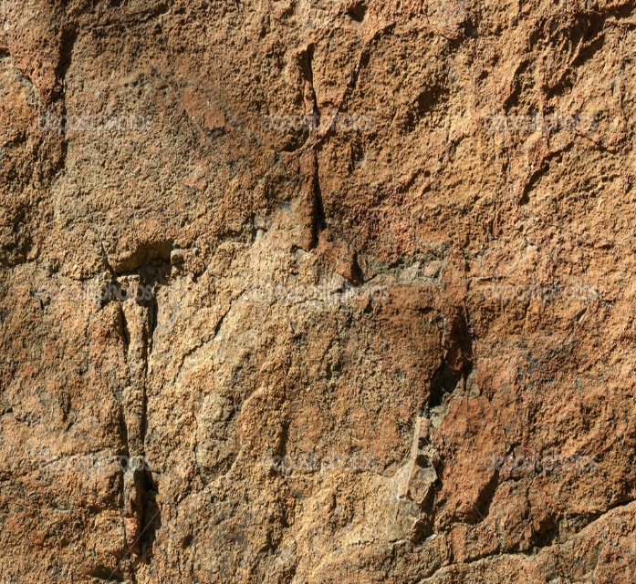
Lesson 123
By the word of truth, by the power of God, by the armour of righteousness on the right hand and on the left,
2 Corinthians 6-7

Slide 2
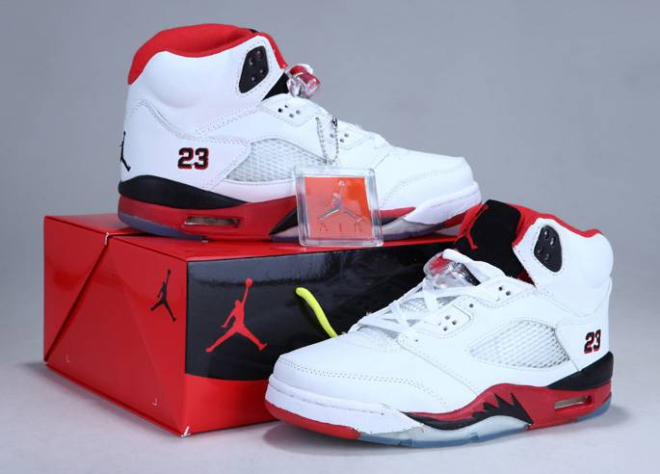
Something New
How do we typically treat things that are new?

Slide 3
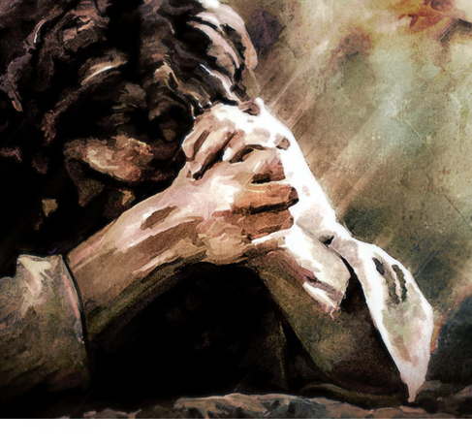
Sweet smelling Savour
Paul taught about how Christ had offered Himself as an offering and a sacrifice
And walk in love, as Christ also hath loved us, and hath given himself for us an offering and a sacrifice to God for a sweetsmelling savour.
And thou shalt burn the whole ram upon the altar: it is a burnt offering unto the Lord: it is a sweet savour, an offering made by fire unto the Lord.
Exodus 29:18
“Even as each sacrifice offered anciently, as it prefigured the coming sacrifice of the Lamb of God, was ‘a sweet savour … unto the Lord’, so was Christ’s offering of himself a pleasing thing to God.
The sweet smell of the burning sacrifices in Israel symbolized the pleasing blessings flowing from our Lord’s personal offering.”
Ephesians 5:2

Slide 4
The World’s Evil
Fornication = sexual intercourse between people not married to each other.
Covetousness = having or showing a great desire to possess something, typically something belonging to someone else.
Filthiness = unclean and impure in mind and body
Foolish talking or jesting = gossip, cruel joking, rudeness
Whoremonger or unclean person = guilty of sexual sin, in or out of marriage
Followers of Jesus do not partake of the world’s evils
Idolater = a worshiper of idols
Ephesians 5:3-7

Slide 5
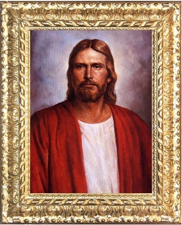
Walk As Children of Light
Household Codes
Wives should submit to their husbands “as unto the Lord”—this does not mean that the husbands are to rule over them with unrighteous desires.
Children should obey their parents “in the Lord”
Parents are instructed to raise their children “in the nurture and admonition of the Lord”
Husbands are to love their wives “as Christ also loved the church, and gave himself for it”
Ephesians 5:21-6:9

Slide 6
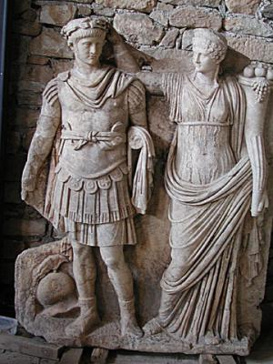
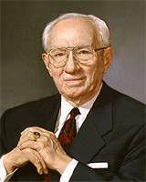
Husbands and Wives
“submit” = sustaining, supporting, and respecting her husband as she does the Lord.
A husband’s divinely appointed role = preside or watch over the family, just as the Savior watches over and leads His Church (1)
Paul’s counsel that wives should submit to their husbands does not justify male dominion.
People in Greco-Roman society regarded the father as being the head of the extended family and the absolute authority over the entire household. Therefore, Paul’s teachings represented a dramatic change to these traditional ideas because he defined husbands’ and fathers’ roles in terms of Christ’s love and sacrifice for the Church. (1)
“‘Happiness in marriage is not so much a matter of romance as it is an anxious concern for the comfort and well-being of one’s companion.
Any man who will make his wife’s comfort his first concern will stay in love with her throughout their lives and through the eternity yet to come’ (3)
Ephesians 5:22

Slide 7
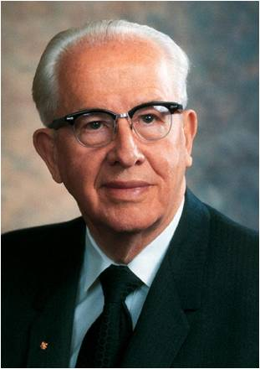
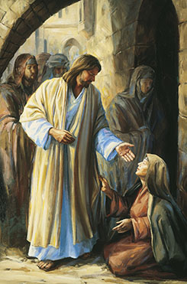
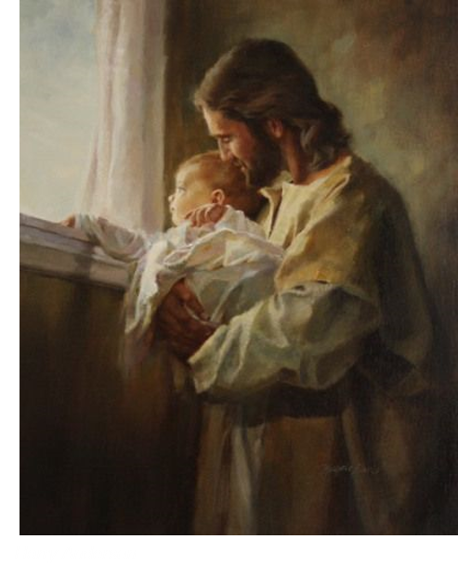
We do not find the Savior leading the Church with a harsh or unkind hand. We do not find the Savior treating His Church with disrespect or neglect.
We do not find the Savior using force or coercion to accomplish His purposes.
Nowhere do we find the Savior doing anything but that which edifies, uplifts, comforts, and exalts the Church.
… I say to you with all soberness, He is the model we must follow as we take the spiritual lead in our families.
Particularly is this true in your relationship with your wife.“ (4)
Judith Mehr
Ephesians 5:25

Slide 8
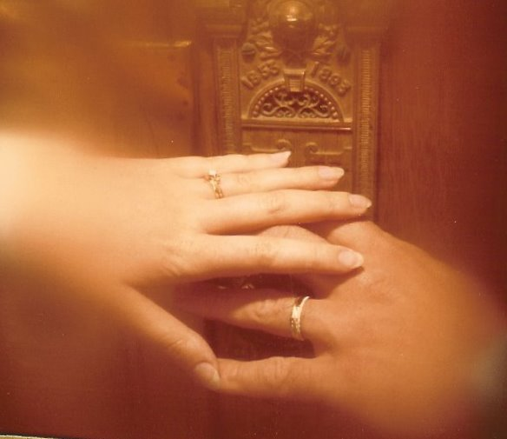
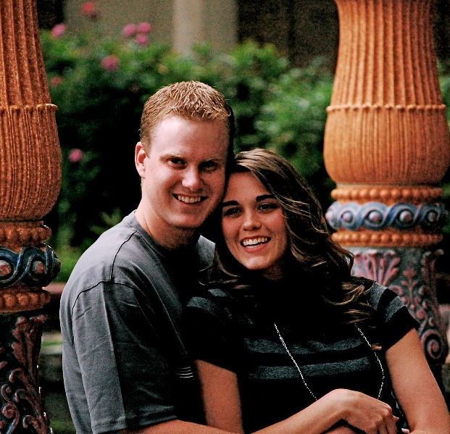
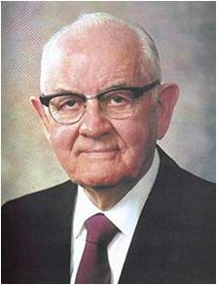
One Flesh
United Physically, Emotionally, and Spiritually
When we use the Savior’s relationship with the Church as our guide, we can strengthen our family relationships
'The Bible celebrates sex and its proper use, presenting it as God-created, God-ordained, God-blessed. It makes plain that God himself implanted the physical magnetism between the sexes for two reasons: for the propagation of the human race, and for the expression of that kind of love between man and wife that makes for true oneness.
His commandment to the first man and
woman to be one flesh was as important as
his command to be fruitful and multiply.' (5)
Ephesians 5:31

Slide 9
Servants and Masters
Masters are to deal with their servants while remembering their “Master also is in heaven.”
Paul’s words remind us that our relationship with Christ should guide and define our relationships with all others.
Paul taught that the cultural separations that existed between Jews and Gentiles, slaves and masters, or men and women should no longer divide people in the gospel of Jesus Christ. Each member’s covenant relationship with Jesus Christ creates unity among all members.
Ephesians 6:5-9; Galatians 3:28-29
(1)

Slide 10
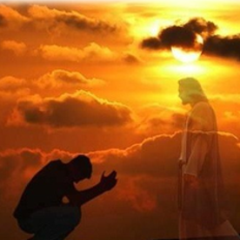
Moroni closes his record with an invitation--
“Yea, come unto Christ, and be perfected in him, and deny yourselves of all ungodliness…
…and if ye shall deny yourselves of all ungodliness, and love God with all your might, mind and strength…”
Moroni 10:32

Slide 11
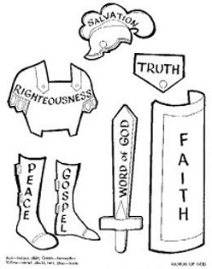
Paul’s 2nd half of Ephesians is similar--
“Finally, my brethren, be strong in the Lord, and in the power of his might.”
Be strong in the Savior’s doctrines, and obey divinely called leaders, and using God-given principles to protect from the attacks of Satan.
Ephesians 6:10

Slide 12
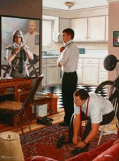
Standing against the wiles
“Put on the whole armour of God, that ye may be able to stand against the wiles of the devil.”
Are we at war?
Who are we at war with? (Revelations 12:9)
How much experience does our enemy have in this war?
Yes
Satan
Give examples
Ephesians 6:11

Slide 13
The Last Days
“And the dragon (Satan) was wroth (angry) with the woman (the church), and went to make war with the remnant of her seed (the Saints in the last days), which keep the commandments of god, and have the testimony of Jesus Christ(who make and keep covenants with God).”

Slide 14
Making War
“…For we beheld Satan, that old serpent, even the devil, who rebelled against God, and sought to take the kingdom of our God and his Christ…
…Wherefore, he maketh war with the saints of God, and encompasseth them round about.”
D&C 76:28-29

Slide 15
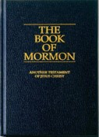
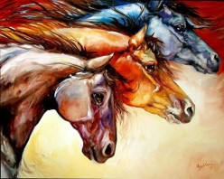
Internal Weaknesses
“For we wrestle not against flesh and blood, but against:
Principalities (Our own beliefs),
powers (pride),
the rulers of the darkness of this world (Secret Combinations),
spiritual wickedness (unrighteous government) in high places.”
Ephesians 6:12

Slide 16
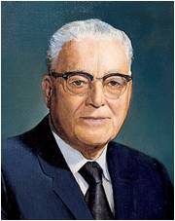
Who Is Our Enemy?
“Our most deadly contest in life is not with human enemies.”
Are we strong enough to defend ourselves on our own?
(6)

Slide 17
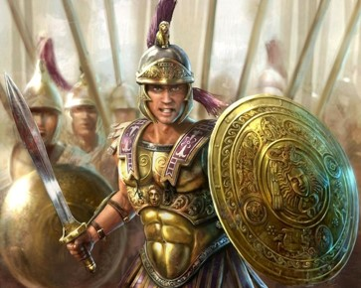
God’s Protection
“Wherefore take unto you the whole armour of God, that ye may be able to withstand in the evil day, and having done all, to stand.”
…Stand therefore, having your loins girt about with truth, and having on the breastplate of righteousness.”
Ephesians 6:13-14

Slide 18
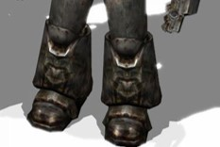
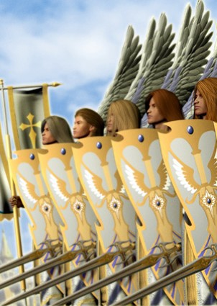
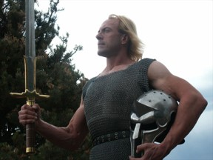
Feet, Shield, and Helmet
“And your feet shod with the preparation of the gospel of peace”
“Above all, taking the shield of faith, where with ye shall be able to quench all the fiery darts of the wicked.”
“And take the helmet of salvation, and the sword of the spirit, which is the word of God.”
Ephesians 6:15-17

Slide 19
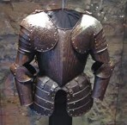
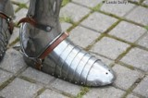
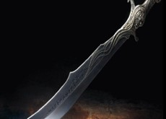
Physical Armor
Sash or belt
Breastplate
Footwear
Shield
Helmet
Sword
Spiritual Armor
Truth
Righteousness
The gospel of peace
Faith
Salvation
The word of God

Slide 20
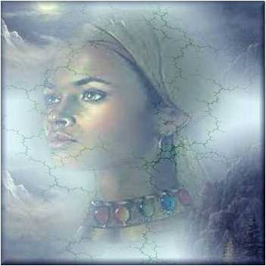
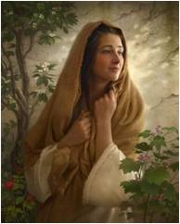
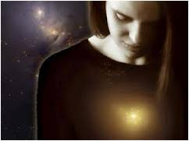
4 Areas that the armor protects:
Head—thoughts
Heart—feelings or attitudes
Loins—virtue and chastity
Feet—goals and the direction we are headed

Slide 21
Our Thoughts:
“..and let virtue garnish they thoughts unceasingly…”
“But this much I can tell you, that if ye do not watch yourselves, and your thoughts, and your words, and your deeds,…”-Mosiah 4:30
D&C 121:45

Slide 22
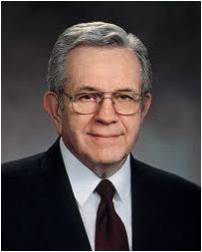
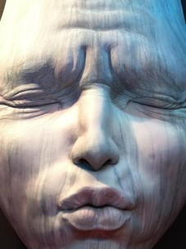
For as a man thinketh so is he.
“I have come to know that thoughts, like water, will stay on course if we make a place for them to go. Otherwise, our thoughts follow the course of least resistance, always seeking the lower levels.”
(7)

Slide 23
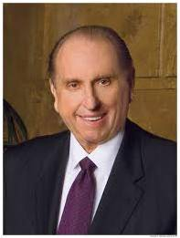
Our Hearts:
“Attitude can make all the difference in our lives, and we control our attitude. It can make us miserable or happy, content or dissatisfied.
To a great degree, it can make us strong or weak.”
(8)

Slide 24
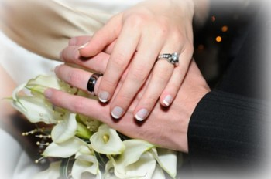
Our Virtue and Chastity:
Remaining pure and clean before marriage
“Moral purity is an eternal principle. The spirit of god “cannot dwell in an unclean tabernacle” (Mosiah 2:37)
“We covenant to live the law of chastity. The law of chastity is virtue and sexual purity.
(Thou shalt love thy wife will all thy heart, and shalt cleave unto her and none else. And he that looketh upon a woman to lust after her shall deny the faith, and shall not have the Spirit…)—D&C 42:22
(9)

Slide 25
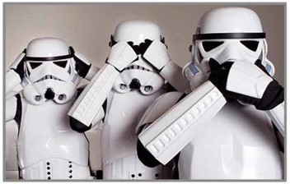
Our Goals and Direction:
“Use boldness, but not overbearance; and also see that ye bridle all your passions, that ye may be filled with love; see that ye refrain from idleness.”
“You can’t be right by doing wrong; you can’t be wrong by doing right.”
(8)

Slide 26
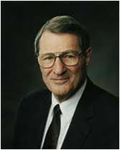
Final Piece of Armor?
“Praying always with all prayer and supplication in the Spirit, and watching thereunto with all perseverance and supplication for all saints.”
“There are no restrictive “office hours.” But it is we who must arise and go to Him!”
Ephesians 6:18
(10)

Slide 27
“It is Difficult, if not impossible, for the devil to enter a door that is closed. He seems to have no keys for locked doors. But if a door is slightly ajar, he gets his toe in, and soon this is followed by his foot, then by his leg and his body and his head, and finally he is in all the way.”
…Lucifer readily becomes the master when one succumbs to his initial blandishments (flattery). Soon then the conscience is stilled completely, the evil power has full sway, and the door to salvation is closed until a thorough repentance opens it again.”
(5)

Slide 28
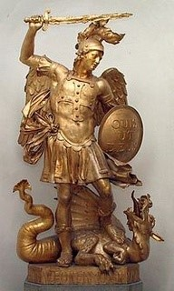
“The war goes on.
it is as it was in the beginning…
it is an ongoing battle.
We cannot be unclean and expect the help of the Almighty.
(3)

Slide 29
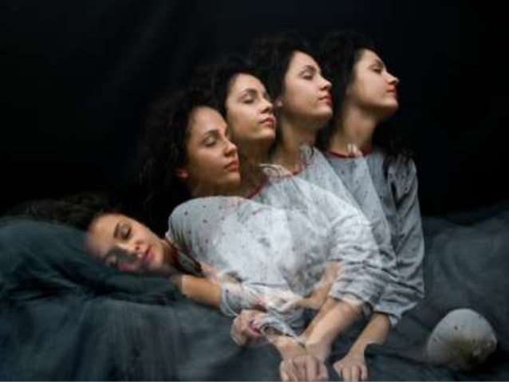
“You cannot afford of things that will weaken your minds and your bodies:
Cocaine
‘crack’
Alcohol
Tobacco
You cannot be involved in immoral activity
You cannot do these things and be valiant as warriors in the cause of the Lord.
(4)

Slide 30
“…We are engaged in a great eternal struggle that concerns the very souls of the sons and daughters of God.
We are not losing.
We are winning.
We will continue to win if we will be faithful and true.
We can do it.
We must do it.”
(4)

Slide 31
Sources:
Suggested Hymn: #251 Behold a Royal Army
Video:
The Whole Armor of God (14:30)
New Testament Institute Student Manual Chapter 44
Elder Bruce R. McConkie (Doctrinal New Testament Commentary, 2:516.
Gordon B. Hinckley (Anchorage, Alaska, regional conference, 18 June 1995)” (“Speaking Today: Excerpts from Recent Addresses of President Gordon B. Hinckley,” Ensign, Apr. 1996, 72); Gordon B. Hinckley Conference Report Oct. 1986, or Ensign Nov. 1986
President Ezra Taft Benson "To the Fathers in Israel," Ensign, Nov. 1987, 50.
5. President Spencer W. Kimball (Ensign, May, 1974, pp. 7-8; italics added.)" (R. Lanier Britsch and Terrance D. Olson, eds., Counseling: A Guide to Helping Others, 2 vols. [Salt Lake City: Deseret Book Co., 1983-1985], 2: 137.); “The Miracle of Forgiveness” p. 215-16
Harold B. Lee “Stand Ye in Holy Places” p. 330
Boyd K. Packer conference Report Oct 1973 or Ensign Jan. 1974
Thomas S. Monson “Teachings of Thomas S. Monson” p. 23
Ezra T. Benson “The Teachings of Ezra T. Benson” p. 278-279
Neal A. Maxwell “Lest Ye Be Wearied and Faint in Your Minds” May 1991 Ensign
Presentation by ©http://fashionsbylynda.com/blog/

Slide 32
PAUL’S LETTERS TO THE SAINTS AT EPHESUS AND TO PHILEMON OF COLOSSAE WRITTEN FROM HIS IMPRISONMENT IN ROME, CA. A.D. 61–63 (EPHESIANS; PHILEMON)
Love Between Husbands and Wives | 5:22–33
Relationships of Parents and Children | 6:1–4
The Judgment of Servants and Masters | 6:5–9
Girding for the Spiritual Battle | 6:10–24
Submit Ephesians 5:22:
"...when women forget their pettiness and selfishness and submit themselves to their own righteous husbands as unto the Lord, and when they are subject to their husbands as the Church is expected to be subject unto Christ, then will the divorce rate reduce, and families will grow, and children will be happy, laughing children. God created male and female with special talents, powers, responsibilities, and with the ability to perform their special tasks.
"When men come home to their families and women devote themselves to their children, the concept will return, that to be a mother is her greatest vocation in life. She is a partner with God. No being has a position of such power and influence. She holds in her hands the destiny of nations, for to her comes the responsibility and opportunity of molding the nation's citizens.
"In a California stake I heard a mother give this sermon: 'I am grateful that I am a woman. I am grateful that I am a wife. I am grateful that I am a mother. I am grateful that I am a Latter-day Saint.' This I thought was a powerful sermon. Motherhood is the greatest vocation." President Spencer W. Kimball ("Why Call Me Lord, Lord, and Do Not the Things Which I Say?" Ensign, May 1975, 7)
"Let this [Relief] Society teach women how to behave towards their husbands, to treat them with mildness and affection. When a man is borne down with trouble, when he is perplexed with care and difficulty, if he can meet a smile instead of an argument or a murmur-if he can meet with mildness, it will calm down his soul and soothe his feelings; when the mind is going to despair, it needs a solace of affection and kindness. . . .
"When you go home, never give a cross or unkind word to your husbands, but let kindness, charity and love crown your works henceforward." (Discourses of the Prophet Joseph Smith, compiled by Alma P. Burton [Salt Lake City: Deseret Book Co., 1977], 208.)
Life and Teachings of Jesus and His Apostles Chapter 43
Wives and Husbands Ephesians 5:22, 25, 28:
For wives, this means submitting themselves to their husbands as they would to the Lord; for husbands, this means loving their wives as Christ loved the Church and gave Himself for it. If couples are truly united, then any sacrifice made on behalf of one’s spouse inevitably brings blessings to oneself; thus, “he that loveth his wife loveth himself.” (1)
"A woman need have no fear of being imposed upon or of any dictatorial measures or of any improper demands when the husband is self-sacrificing and worthy. Certainly no intelligent woman would hesitate to give submission to her own truly righteous husband in everything. We are sometimes shocked to see the wife take over the leadership, naming the one to pray, the place to be, the things to do.
"Husbands are commanded: '... love your wives, even as Christ also loveth the church, and gave himself for it.' (Eph. 5:25.)
"Christ loved the church and its people so much that he voluntarily endured persecution for them, suffered humiliating indignities for them, stoically withstood pain and physical abuse for them, and finally gave his precious life for them.
"When the husband is ready to treat his household in that manner, not only the wife but all the family will respond to his leadership.
"Certainly if fathers are to be respected, they must merit respect-if they are to be loved, they must be consistent, lovable, understanding, and kind, and they must honor their priesthood." President Spencer W. Kimball ("Home: The Place to Save Society," Ensign, Jan. 1975, 5)

Slide 33
Husbands Ephesians 5:23:
"There is no higher authority in matters relating to the family organization, and especially when that organization is presided over by one holding the higher Priesthood, than that of the father. The authority is time honored, and among the people of God in all dispensations it has been highly respected and often emphasized by the teachings of the prophets who were inspired of God. The patriarchal order is of divine origin and will continue throughout time and eternity. There is, then, a particular reason why men, women and children should understand this order and this authority in the households of the people of God, and seek to make it what God intended it to be, a qualification and preparation for the highest exaltation of his children. In the home the presiding authority is always vested in the father, and in all home affairs and family matters there is no other authority paramount." (Brent A. Barlow, "Strengthening the Patriarchal Order in the Home," Ensign, Feb. 1973, 30)
"Holding the priesthood does not mean that a man is a power-broker, or that he sits on a throne, dictating in macho terms, or that he is superior in any way. Rather, he is a leader by authority of example. Paul's counsel to the Ephesians included, 'Husbands, love your wives, even as Christ also loved the church, and gave himself for it' (Eph. 5:25). As Christ lifts us all, so must we, rather than put down women or anyone.
"Nowhere does the doctrine of this Church declare that men are superior to women. Paul said to the Corinthians, 'Nevertheless neither is the man without the woman, neither the woman without the man, in the Lord' (1 Cor. 11:11). Each brings his or her own separate and unique strengths to the family and the Church. Women are not just cooks, stewards of our homes, or servants. They are much more. They are the enrichment of humanity." Pres. James E. Faust ("The Highest Place of Honor," Ensign, May 1988, 36)
"Many women carry heavy burdens raising children and attending to household responsibilities. They often accomplish near-miracles in balancing all the demands made upon them. A husband who is critical of his wife and communicates censure for what hasn't been done rather than thanks for what has been done fosters discouragement. But if he will give a word of praise or offer a little help, he will see his wife try ever harder to do her part. Criticism has a negative influence on the feelings of love for and interest in one's spouse. Women need love, affection, and emotional support from their husbands.
"Paul has counseled, 'Husbands, love your wives, even as Christ also loved the church, and gave himself for it.' (Eph. 5:25.) In commenting on this counsel, President Kimball provided this important insight:
'Can you think of how [Christ] loved the church? Its every breath was important to him. Its every growth, its every individual, was precious to him. He gave to those people all his energy, all his power, all his interest. He gave his life-and what more could one give? ... When the husband is ready to treat his household in that manner, not only his wife but also his children will respond to his loving and exemplary leadership. It will be automatic. He won't need to demand it. ...
'Certainly if fathers are to be respected, they must merit respect: If they are to be loved, they must be consistent, lovable, understanding, and kind-and they must honor their priesthood.' (Men of Example, pamphlet, Salt Lake City: Church Educational System, 1973, p. 5.)" H. Burke Peterson ("Unrighteous Dominion," Ensign, July 1989, 9)
Protecting Ourselves Ephesians 6:14-18:
“I like to think of this spiritual armor not as a solid piece of metal molded to fit the body but more like chain mail. Chain mail consists of dozens of tiny pieces of steel fastened together to allow the user greater flexibility without losing protection. I say that because it has been my experience that there is not one great and grand thing we can do to arm ourselves spiritually. True spiritual power lies in numerous smaller acts woven together in a fabric of spiritual fortification that protects and shields from all evil.” Elder M. Russell Ballard (“Be Strong in the Lord,” Ensign, July 2004, 8).
The Armour of God Ephesians 6:11:
“We have the four parts of the body that the Apostle Paul said [are] the most vulnerable to the powers of darkness. The loins, typifying virtue, chastity. The heart typifying our conduct. Our feet, our goals or objectives in life and finally our head, our thoughts” President Harold B. Lee (Feet Shod with the Preparation of the Gospel of Peace, Brigham Young University Speeches of the Year [Nov. 9, 1954], 2).
“The putting off of the natural man makes possible the putting on of the whole armor of God, which would not fully fit before! (see Eph. 6:11, 13)” (“Plow in Hope,” Elder Neal A Maxwell Ensign, May 2001, 60).
“Examine your armor. Is there an unguarded or unprotected place? Determine now to add whatever part is missing. …
“Through the great principle of repentance you can turn your life about and begin now clothing yourself with the armor of God through study, prayer, and a determination to serve God and keep his commandments.” Elder N. Eldon Tanner (“Put on the Whole Armor of God,” Ensign, May 1979, 46).

Slide 34
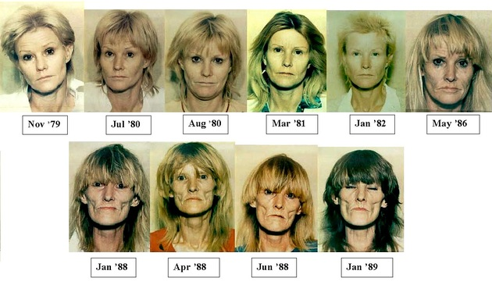
Something of Interest
The Cravings
The cravings for crystal meth are exceptionally strong, and the human body’s tolerance to its narcotic effects is developed relatively quickly. Someone intending to start out as only a casual user can quickly cross the line into a full-blown addict if they develop these strong cravings.
The Effects
Psychologically, crystal meth can increase feelings of grandiosity and invincibility which combined with the need to keep using and avoid a come down can lead users into increasingly dangerous situations. Many crystal meth users that we see report saying that they would never steal or lie or cheat in order to be able to use, but reporting that all of that behavior eventually happened as their need for the drug became paramount to their other interests.
Once you have become addicted to crystal meth, you may:
Neglect your family and job
Become distant from friends and relatives
Become engaged in deeper criminal behavior such as committing fraud, writing bad checks, selling drugs, continuing down the dark path that drugs create.
Cosmetic Effects
Crystal meth also has profound and upsetting cosmetic effects. Many agencies try to scare people out of using meth by showing ‘before-and-after’ photos of people prior to their meth use and during or after they have begun using meth. The appearances tend to be similar and scary:
‘Meth Mouth’ which consists of brittle and thin teeth, missing teeth or teeth that become the shape of the ‘pipe’ from the chemicals
Teeth grinding and tooth loss leading to a collapsed jaw
Dry skin and gums
Brittle or missing hair
Sores all over the body leading to scars from the constant ‘picking’ many meth users do
Sunken-in face
Crystal meth users turn to the drug for the effects it produces: euphoria, increased energy and alertness, increased self-confidence and feelings of power, and increased libido. Some women may take crystal meth due to its causing extreme weight loss, although this is a very temporary (and highly dangerous) solution to that particular goal. The high that crystal meth produces is also uncommonly long-lasting, producing all of those heightened feelings for up to twelve hours in some cases.
All of the perceived initial benefits of crystal meth tend to turn around on you as you use longer and harder. Brittle bones due to smoking, snorting or shooting up crystal meth can occur, painful joints, weight gain, hair loss, blood in urine, heart palpitations and decreased ability for the drug to be effective in its initial purpose are all reported problems with increased crystal meth use.
The crystal meth comedown is intense. It is characterized by:
Excessive sleeping and lethargy
Increased appetite (which is why the weight loss “virtue” is so temporary)
Heightened anxiety
Psychosis
Paranoia
Profound depression
This depression from crystal meth comedown and withdrawal both lasts longer and is far more severe than even cocaine withdrawal. Essentially, once a person takes crystal meth, you are going to want more – either due to the desire to replicate the high or the need to escape the meth comedown. Once you get on crystal meth and start to do it regularly, you can often eat and sleep like a ‘normal’ person. Many people on crystal meth can even work for a time, but if they stop using, they are in for the week of sleeping, lethargy and only being able to wake up (barely) to go to the bathroom and eat some food. The meth comedown is not as dangerous as say, a heroin withdrawal, but it is still uncomfortable and detrimental, and causes many meth users to continue using in fear of going through this withdrawal.
https://kleantreatmentcenters.com/addiction-info/crystal-meth/

