Slide 1
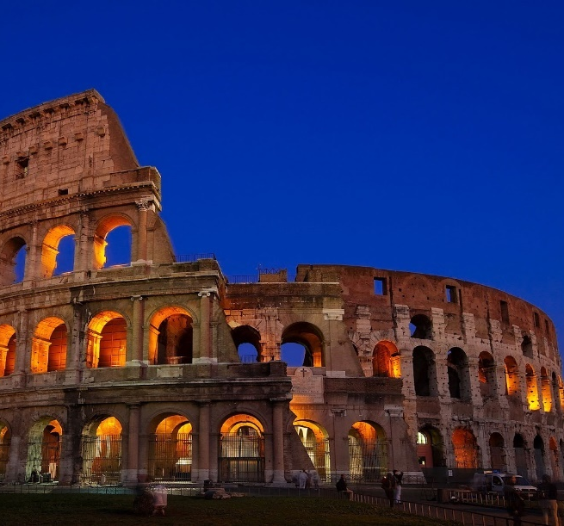
Lesson 124
Working Out Our Salvation
Philippians 1-3

Slide 2
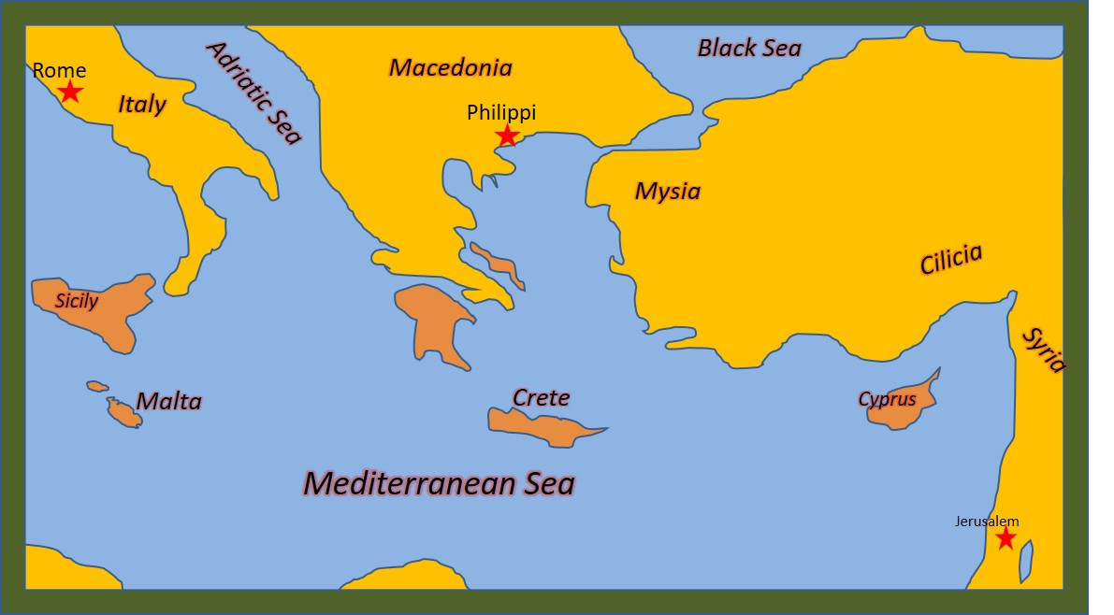
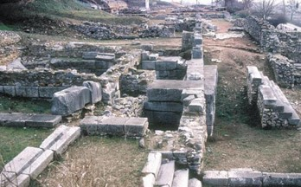
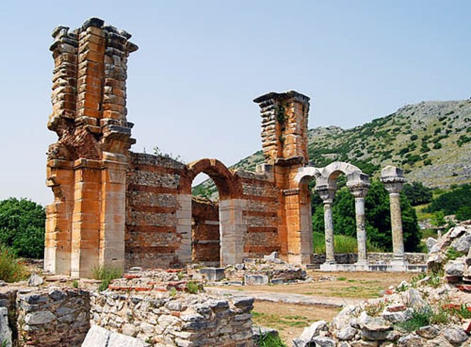
Philippi
This is Paul’s first imprisonment in Rome. From there he preached for 10 years to the Philippians.
Philippians was the first city in Europe to receive the gospel.
A Woman named Lydia and her household were Paul’s first converts.
The Philippians sent Paul gifts while he was in prison. Epaphroditus, the gift bearer, got ill and had to return home. Paul sent a letter of thanksgiving.
Timothy may have acted as Paul’s scribe, writing the letter under Paul’s direction.
Philippians is often called a prison Epistle, along with Ephesians, Colossians, and Philemon

Slide 3
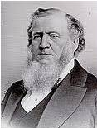
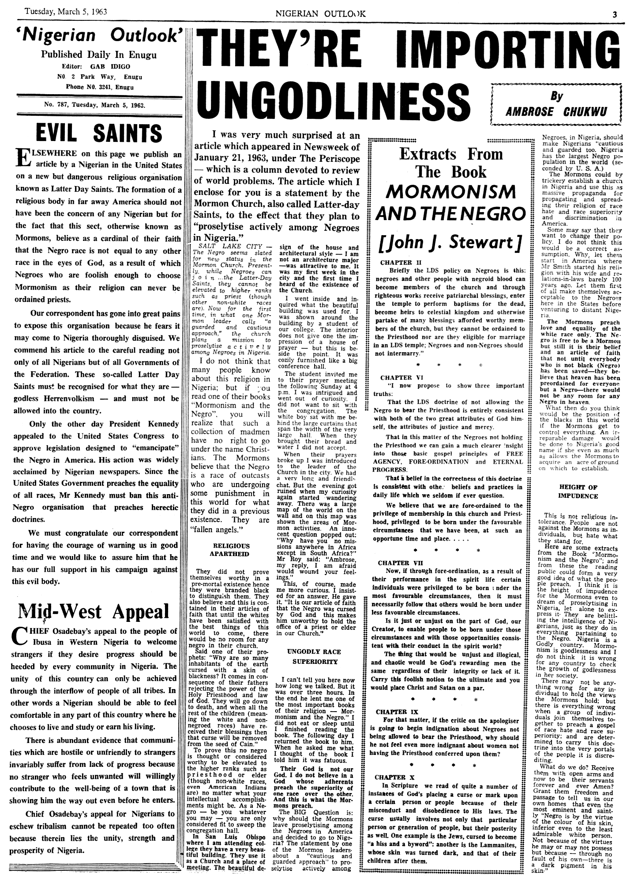
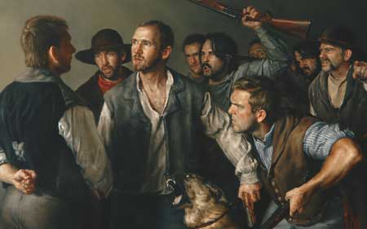
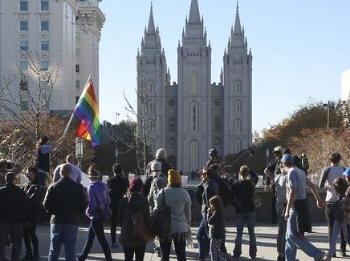
Opposition
“Every time you kick ‘Mormonism’ you kick it upstairs; you never kick it downstairs. The Lord Almighty so orders it.” (2)
What are some examples, either from history or from our day, of people kicking, or opposing, the Savior’s Church and His followers?

Slide 4
Selfishness VS Selfless
Paul taught that for the Philippian Saints to achieve unity, they must set aside selfishness and humbly consider the needs of others.
“There are those among us today who are completely selfless—as was [Jesus Christ].
A selfless person is one who is more concerned about the happiness and well-being of another than about his or her own convenience or comfort, one who is willing to serve another when it is neither sought for nor appreciated, or one who is willing to serve even those whom he or she dislikes.

Slide 5
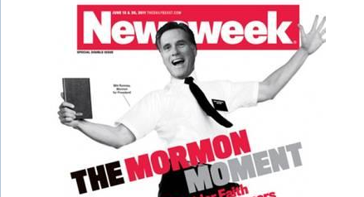
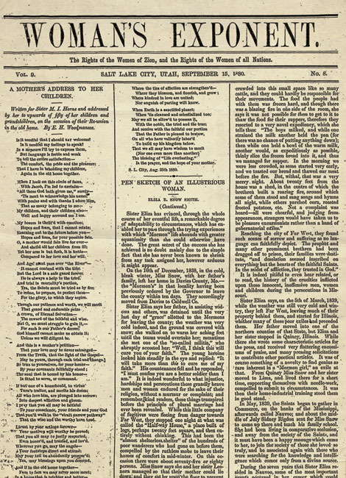
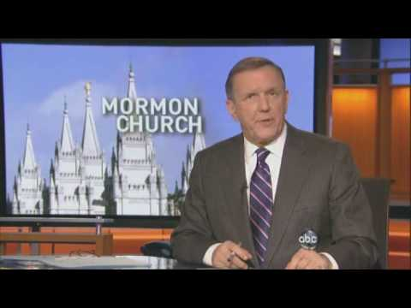
How Does This Further The Work?
Opposition we experience in following Jesus Christ can help further His work
From its beginnings, The Church of Jesus Christ of Latter-day Saints has used the power of the printed word to spread the message of the restored gospel throughout the world. The Lord, over the centuries, has had a hand in inspiring people to invent tools that facilitate the spreading of the gospel. The Church has adopted and embraced those tools, including print, broadcast media, and the Internet. (3)
Philippians 1:11-14

Slide 6
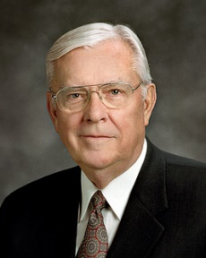
The Modern Printing Press
“Today we have a modern equivalent of the printing press in the Internet. The Internet allows everyone to be a publisher, to have his or her voice heard, and it is revolutionizing society. Before the Internet there were great barriers to printing. It took money, power, influence, and a great amount of time to publish. But today, because of the emergence of what some call “new media,” made possible by the Internet, many of those barriers have been removed.
“The emergence of new media is facilitating a worldwide conversation on almost every subject, including religion, and nearly everyone can participate.
“Now some of these tools—like any tool in an unpracticed or undisciplined hand—can be dangerous. The Internet can be used to proclaim the gospel of Jesus Christ and can just as easily be used to market the filth and sleaze of pornography.”
Philippians 1:11-14
(3)

Slide 7
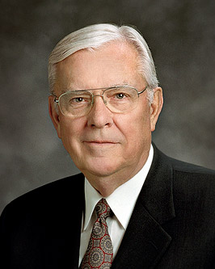
60 Minute Interview With A 6 Second Testimony
NBC television came to Salt Lake for an interview with me as part of a piece they were producing on the Church.
Reporter Ron Allen and I spent an hour together in the chapel in the Joseph Smith Memorial Building. We discussed the Church at length.
A few days later the story appeared, and in the four-minute segment that aired, there was one short quote of about six seconds from the one-hour interview.
That was just enough time for me to testify of our faith in Jesus Christ as the center of all we believe.
I repeat, just six seconds were used from a 60-minute interview. (3)
Elder M. Russell Ballard
Ron Allen

Slide 8
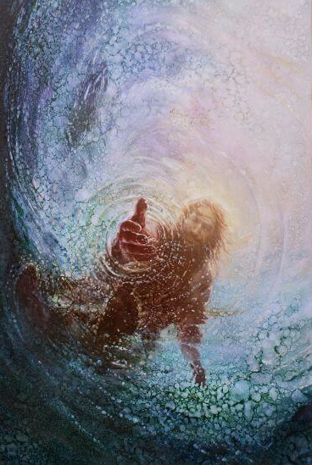
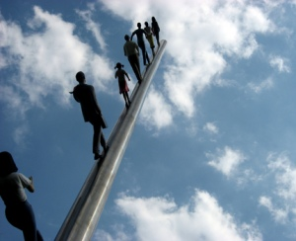
An Earned Salvation
Fear and Trembling = Awe and Reverence
“Work out your own salvation with fear and trembling”
Some people incorrectly use this verse to support the idea that we are saved by our own efforts and not by the grace of Jesus Christ.
However, Paul was not telling the Saints to work in order to earn salvation.
Instead, as Paul pointed out, the Saints should live the gospel so that the saving work God was already doing within them would be manifest in all they did.
Our efforts to work out our salvation are possible only because of the Lord’s grace within us. (1)
Yongsung Kim
God helps us desire and do what is required of us for salvation, which is made possible through the Atonement of Jesus Christ
Philippians 2:12

Slide 9
Sending A Messenger
Epaphroditus (Greek: Ἐπαφρόδιτος) is a New Testament figure appearing as an envoy of the Philippian and Colossian church to assist the Apostle Paul and also visited Paul in Prison.
Epaphroditus was the delegate of the Christian community at Philippi, sent with their gift to Paul during his first imprisonment at Rome or at Ephesus and taking back the Epistle to the Philippians.
Philippians 2:25-30

Slide 10
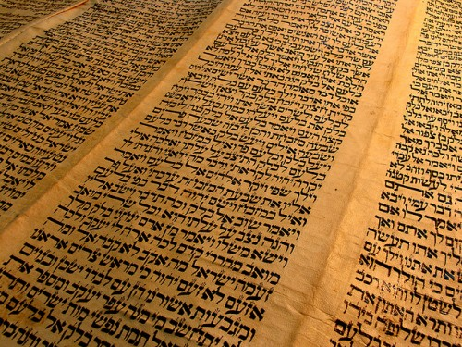
Dogs and Evil Workers
Paul was attacking the Judaizers—those Jewish Christians who demanded complete obedience to the Mosaic law as a condition for salvation.
He used the word dogs to imply that they were unclean and unholy.
His use of the words evil workers indicates those who thought they were righteous and in fact were not.
In sarcasm he used the word concision, which means “mutilation,” instead of circumcision, which is the normal adjective used to define Jews. (5)
Philippians 3:2-3

Slide 11
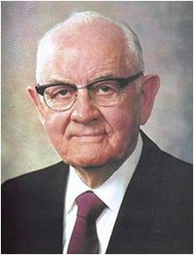
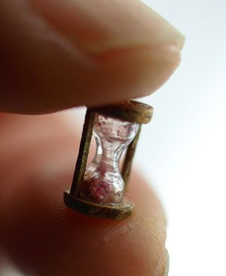
Blessings Come From Sacrifice
“We must lay on the altar and sacrifice whatever is required by the Lord. We begin by offering a ‘broken heart and a contrite spirit.’
We follow this by giving our best effort in our assigned fields of labor and callings.
We learn our duty and execute it fully.
Finally we consecrate our time, talents, and means as called upon by our file leaders and as prompted by the whisperings of the Spirit. …
And as we give, we find that ‘sacrifice brings forth the blessings of heaven!’ And in the end, we learn it was no sacrifice at all.”
Philippians 3:4-8
(6)

Slide 12
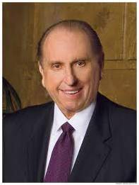
Toward the Mark
“reaching forth unto those things which are before”
Some of the imagery in these verses reflects the idea of a race, where runners continuously press on while always focusing on the finish line.
Paul declared that although he had not yet reached his final goal, he had left his past behind and was pressing forward toward the mark—the prize of salvation offered by Jesus Christ.
“There is no going back, but only forward. Rather than dwelling on the past, we should make the most of today, of the here and now, doing all we can.”
Philippians 3:12-14
(7)

Slide 13
Sources:
Suggested Hymn: #81 Press Forward Saints
Video:
You Can’t Close My Heart: Ghanaian Saints and the Freeze (10:07)—
New Testament Institute Student Manual Chapter 45
Discourses of Brigham Young, sel. John A. Widtsoe [1954], 351
Elder H. Burke Peterson (“Selflessness: A Pattern for Happiness,” Ensign, May 1985, 66).
Elder M. Russell Ballard Sharing the Gospel Using the Internet July 2008 Ensign
Life and Teachings of Jesus and His Apostles Chapter 44
President Spencer W. Kimball (“Becoming the Pure in Heart,” Ensign, May 1978, 81).
President Thomas S. Monson (“Finding Joy in the Journey,” Ensign or Liahona, Nov. 2008, 85).
Presentation by ©http://fashionsbylynda.com/blog/

Slide 14
A LETTER FROM PAUL TO THE SAINTS IN PHILIPPI, MACEDONIA WRITTEN WHILE UNDER ARREST IN ROME, CA. A.D. 60-62 (PHILIPPIANS)
Paul’s Experiences in Teaching Christ | 1:1–26
Be of One Spirit and One Mind | 1:27–30; 2:1–4
The Equality of Father and Son | 2:5–8
All Men Shall Bow and Confess Christ | 2:9–11
“Work Out Your Own Salvation” | 2:12–18
The Mission of Timothy and Epaphroditus | 2:19–30
The Way of Salvation | 3:1–21
Working Out Salvation Philippians 2:12:
“An outstanding doctrine of the Church is that each individual carries the responsibility to work out his own salvation, and salvation is a process of gradual development. The Church does not accept the doctrine that a mere murmured belief in Jesus Christ is all that is necessary. A man may say he believes, but if he does nothing to make that belief or faith a moving power to do, to accomplish, to produce soul growth, his professing will avail him nothing. ‘Work out your salvation’ is an exhortation to demonstrate by activity, by thoughtful, obedient effort the reality of faith. But this must be done with a consciousness that absolute dependence upon self may produce pride and weakness that will bring failure. With ‘fear and trembling’ we should seek the strength and grace of God for inspiration to obtain the final victory.
“To work out one’s salvation is not to sit idly by dreaming and yearning for God miraculously to thrust bounteous blessings into our laps. It is to perform daily, hourly, momentarily, if necessary, the immediate task or duty at hand, and to continue happily in such performance as the years come and go, leaving the fruits of such labors either for self or for others to be bestowed as a just and beneficent Father may determine.” (David O. McKay in CR, Apr. 1957, p. 7.)
Life and Teachings of Jesus and His Apostles Chapter 44
First Corinthians reveals the problems, pressures, and struggles of a church called out of a pagan society.
The oldest recorded title of this epistle is Pros Korinthious A, in effect, the “First to the Corinthians.” The A was no doubt a later addition to distinguish this book from Second Corinthians.
In Paul’s day the population of Corinth was approximately 700,000, about 2/3 of whom were slaves.
Greek philosophy influenced any speculative thought that was there. “Talk Thru the Bible” by Bruce Wilkinson and Kenneth Boa pp. 382-383
Philippians 1:12-18:
Brigham Young once said-so I am informed-that you cannot hurt Mormonism it is like a rubber ball: every time you kick it the farther it goes. It is my experience, and is history, that where men persecute the church, or the principles of it, and those who preside in Israel, they often make friends for the Latter-day Saints. Samuel O. Bennion (Conference Report, April 1913, Second Day-Morning Session 31.)
When men open their lips against these truths they do not injure me, but injure themselves. (Teachings of the Prophet Joseph Smith, 373)

