Slide 1
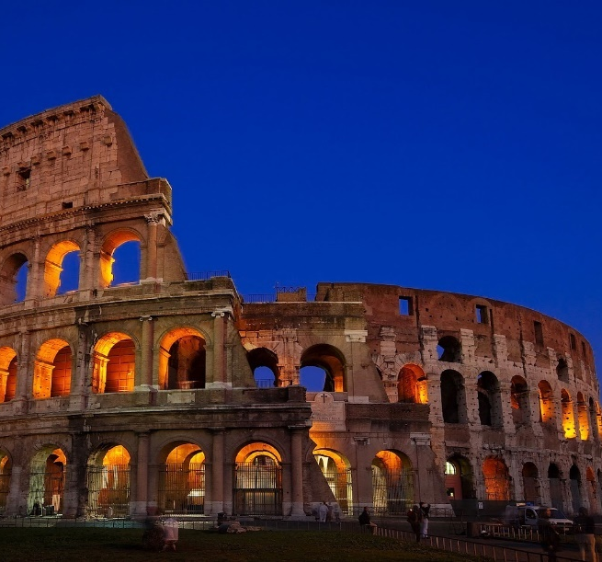
Lesson 125
Admonition of Paul
Philippians 4
We believe in being honest, true, chaste, benevolent, virtuous, and in doing good to all men; indeed, we may say that we follow the admonition of Paul—We believe all things, we hope all things, we have endured many things, and hope to be able to endure all things. If there is anything virtuous, lovely, or of good report or praiseworthy, we seek after these things.
Articles of Faith 1:13

Slide 2
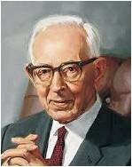
The Book of Life
“The book of life, or Lamb’s book of Life, is the record kept in heaven which contains the names of the faithful and an account of their righteous covenants and deeds.”
(2)
“We are not going to be saved in the kingdom of God just because our names are on the records of the Church. It will require more than that. We will have to have our names written in the Lamb’s Book of Life, and if they are written in the Lamb’s Book of Life then it is an evidence we have kept the commandments.
Every soul who will not keep those commandments shall have his name blotted out of that book” (3)
Philippians 4:3; Revelation 13:8

Slide 3
“Be Careful For Nothing”
I am worried about a family member who is sick…
I am worried about an upcoming test…
I am worried about standing up for my beliefs…
Throughout our lives, we will experience challenges or circumstances that may lead us to worry.
I am worried about whether I can be a successful missionary
Philippians 4:6-7

Slide 4
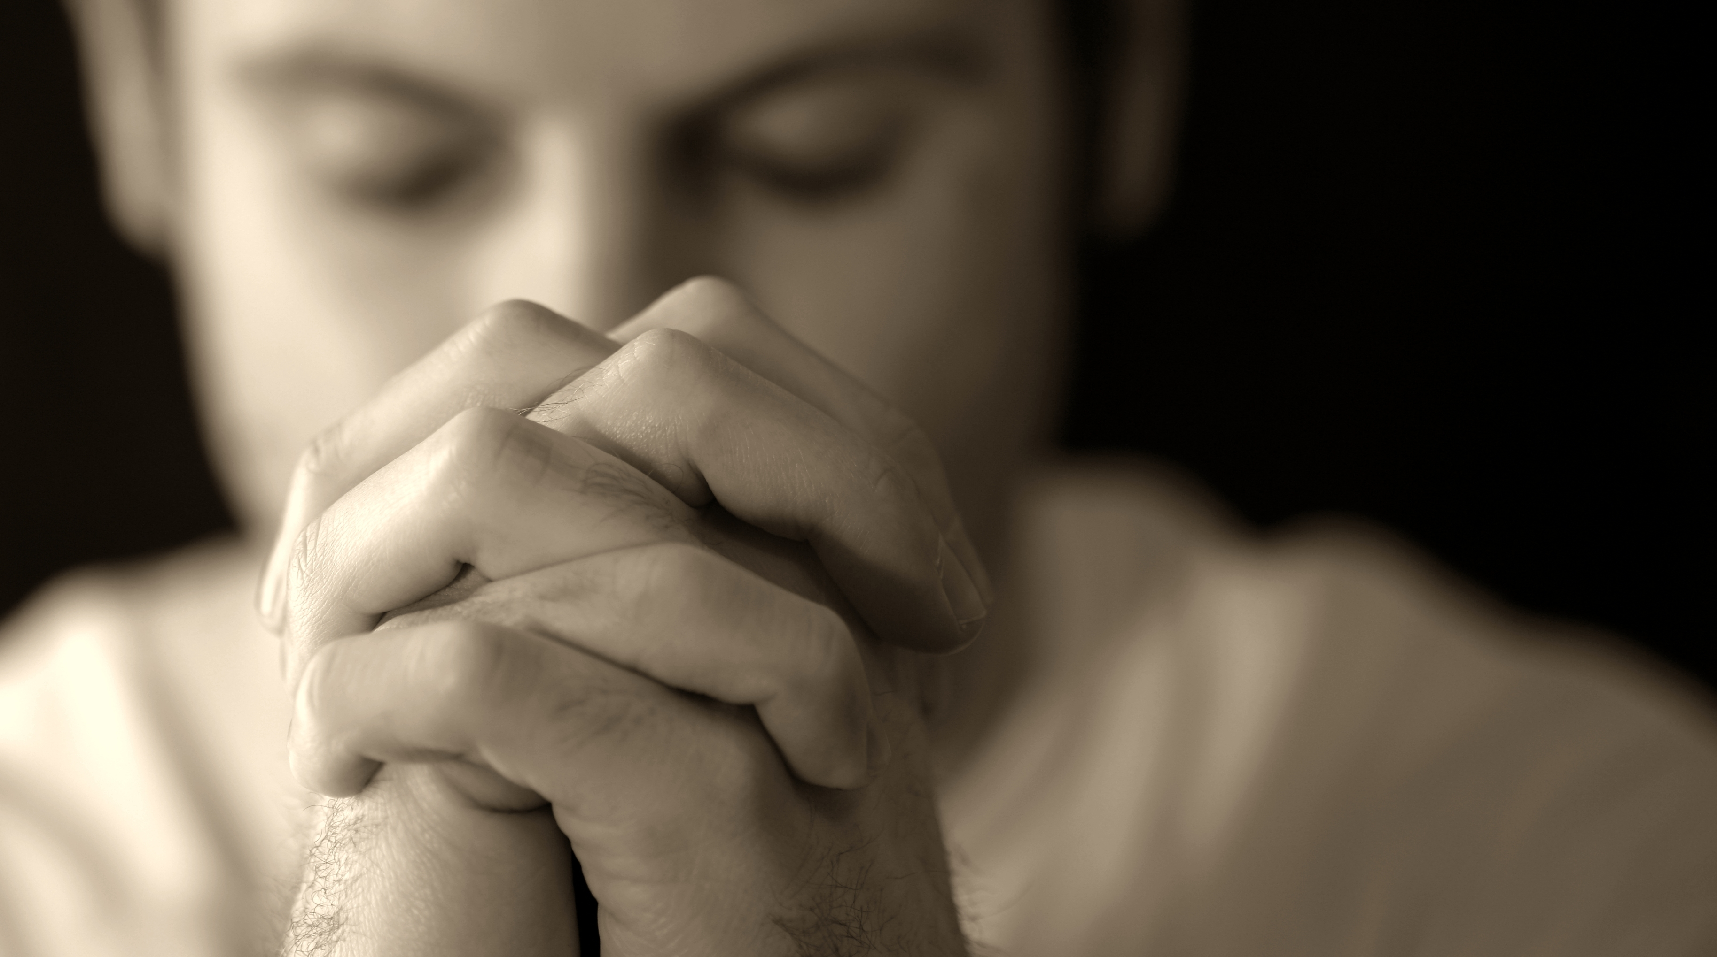
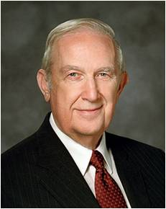
Prayer and Trust
Supplication = Humble, Ernest Request
Paul taught that the antidotes for anxiety were prayer and trust in the Lord. They bring “the peace of God, which passeth all understanding”
As faithful followers of Jesus Christ, if we pray with supplication and thanksgiving, then God will bless us with His peace
“Because He respects your agency, Father in Heaven will never force you to pray to Him. But as you exercise that agency and include Him in every aspect of your daily life, your heart will begin to fill with peace, buoyant peace. That peace will focus an eternal light on your struggles. It will help you to manage those challenges from an eternal perspective.” (4)
Philippians 4:6-7

Slide 5
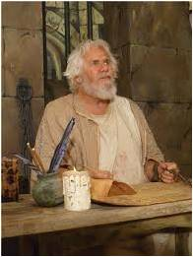
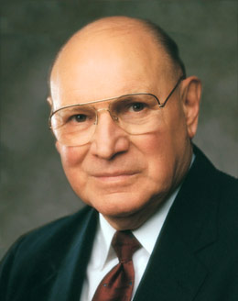
Admonition of Paul
“Finally, brethren, whatsoever things are true, whatsoever things are honest, whatsoever things are just, whatsoever things are pure, whatsoever things are lovely, whatsoever things are of good report; if there be any virtue, and if there be any praise, think on these things.”
Seek = to go in search of, try to discover, try to acquire. It requires an active, assertive approach to life. … It is the opposite of passively waiting for something good to come to us, with no effort on our part. (5)
Philippians 4:8

Slide 6
Peace In The Mists of Trials and Tribulations
“Our Savior declared to a modern prophet: ‘…he who doeth works of righteousness shall receive his reward, even peace in this world, and eternal life in the world to come.’”
—D&C 59:23
“Those things, which ye have both learned, and received, and heard, and seen in me, do: and the God of peace shall be with you.”
Philippians 4:9

Slide 7
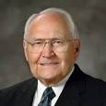
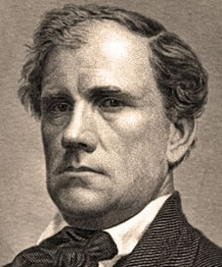
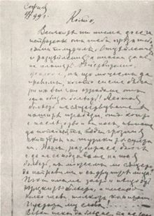
How the Articles of Faith Came to Be
“The Prophet was often asked to explain the teaching and practices of Mormonism.
“John Wentworth, editor of the Chicago Democrat, asked Joseph Smith to provide him with a sketch of ‘the rise, progress, persecution, and faith of the Latter-Day Saints.’”
(6)

Slide 8
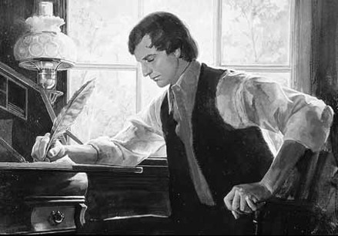
Joseph Compiles Documents
Accounts of many early events in the history of the Restoration…the First Vision, and the coming forth of the Book of Mormon
Thirteen statements outlining Latter-day Saints beliefs, which have come to be know as the Articles of Faith
The information was sent to Wentworth but not published. It was published in the Church newspaper, Times and Seasons, in March of 1842
(6)

Slide 9
Becoming Official Doctrine
1851 –Articles of Faith were included in the first edition of the Pearl of Great Price…published in the British Mission.
After the Pearl of Great Price was revised in 1878 and canonized in 1880, the Articles of Faith became official doctrine of the Church.
The 13th article provides a special insight into how we should conduct our lives and present ourselves before the peoples of the earth.
(6)

Slide 10
We Believe…
In being honest…
True…
Chaste…
Benevolent…
Virtuous…
free from fraud or deception
Steadfast, loyal
Innocent of unlawful sexual intercourse
Organized for the purpose of doing good
Conformity to a standard of right; morally excellent
13th Article of Faith

Slide 11
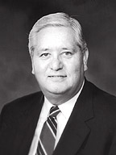
Integrity
Sincerity
Humility
Dependability
Christlike qualities:
Outward manifestation of the inner man
…ITY
Suffix=quality, state, or degree of being
Charity
Responsibility
Spirituality
Morality
Accountability
Generosity
Civility
Credibility
Fidelity
Confidentiality
(7)

Slide 12
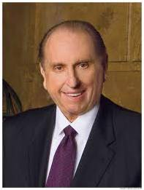
Personal Conduct
And in doing good to all men;
“Most people will not commit desperate acts if they have been taught that dignity, honesty, and integrity are more important than revenge or rage; if they understand that respect and kindness ultimately give one a better chance at success.”
(8)

Slide 13
Ethics of Behavior
Indeed, we may say that we follow the Admonition of Paul:
Admonition = an act or action of admonishing; authoritative counsel or warning.
Paul writes to the Philippians on how to conduct their lives in harmony with the Gospel of Christ

Slide 14
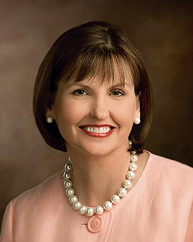
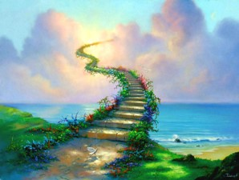
True to the Gospel of Christ
We Believe all things:
“Being true to our beliefs—even when doing so isn’t popular, easy, or fun—keeps us safely on the path that leads to eternal life with our Heavenly Father.”
(9)

Slide 15
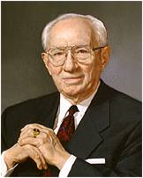
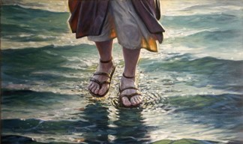
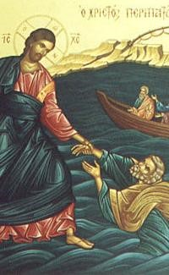
The Lord’s Side
We hope all things:
“…we have nothing to fear if we stay on the Lord’s side. If we will be prayerful, seeking wisdom from God…”
(10)

Slide 16
Endure
We have endured many things, and hope to be able to endure all things.
“Fear not, little flock; do good; let earth and hell combine against you, for if ye are built upon my rock, they cannot prevail….
“Look unto me in every thought; doubt not fear not.” D&C 6:33-34

Slide 17
Theology of Our Faith
If there is anything virtuous, lovely, or of good report or praiseworthy,
We seek after these things.
“For behold, the Spirit of Christ is given to every man, that he may know good from evil: wherefore, I show unto you the way to judge; for everything which inviteth to do good, and to persuade to believe in Christ, is sent forth by the power and gift of Christ; wherefore we may know with a perfect knowledge it is of God.”—Moroni 7:16

Slide 18
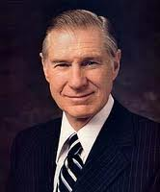
“The Spirit of Christ should permeate all we do, whether at work, at school or at home.”
(11)

Slide 19
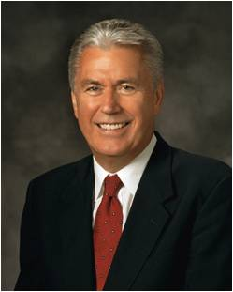
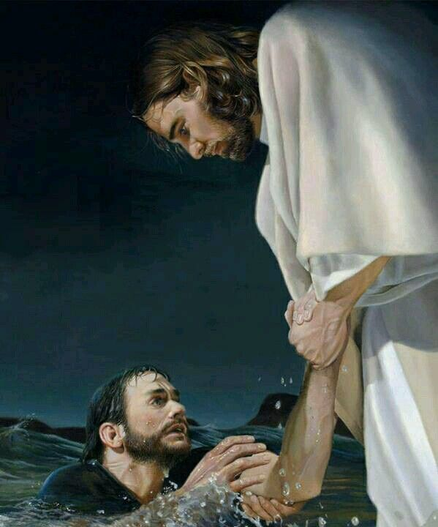
“God pours out blessings of power and strength, enabling us to achieve things that otherwise would be far beyond our reach.
It is by God’s amazing grace that His children can overcome the undercurrents and quicksands of the deceiver, rise above sin, and ‘be perfect[ed] in Christ.’”
Yea, come unto Christ, and be perfected in him, and deny yourselves of all ungodliness; and if ye shall deny yourselves of all ungodliness, and love God with all your might, mind and strength, then is his grace sufficient for you, that by his grace ye may be perfect in Christ; and if by the grace of God ye are perfect in Christ, ye can in nowise deny the power of God.
Moroni 10:32
(12)

Slide 20
Sources:
Suggested Hymn: #293 Each Life That Touches Us For Good
Video:
Strengthened in the Lord (4:23)
New Testament Institute Student Manual Chapter 45
Elder Bruce R. McConkie Doctrinal New Testament Commentary, 3:455
President Joseph Fielding Smith (in Conference Report, Oct. 1950, 10)
Elder Richard G. Scott (“Make the Exercise of Faith Your First Priority,” Ensign or Liahona, Nov. 2014, 93).
Elder Joseph B. Wirthlin (“Seeking the Good,” Ensign, May 1992, 86).
Elder L. Tom Perry “The Articles of Faith” May 1998 Ensign
Elder H. David Burton “Let Virtue Garnish Your Thoughts” Oct. GC 2009
President Thomas S. Monson “Family Values in a Violent Society” Jan. 16, 1994 or “Finding Peace” Ensign, Mar. 2004
Ann M. Dibb “I Believe in Being Honest and True” May 2011 Ensign
President Gordon B. Hinckley “Fear Not to Do Good” 1983 April Gen. Conf.
11. Elder James E. Faust “We Seek After These Things” 1998 April GC
12. President Dieter F. Uchtdorf (“The Gift of Grace,” Ensign or Liahona, May 2015, 108).
Presentation by ©http://fashionsbylynda.com/blog/

Slide 21
A LETTER FROM PAUL TO THE SAINTS IN PHILIPPI, MACEDONIA WRITTEN WHILE UNDER ARREST IN ROME, CA. A.D. 60-62 (PHILIPPIANS)
“Stand Fast in the Lord” | 4:1–9
Paul’s Thanks for Aid | 4:10–23
Strengthen Me Philippians 4:13:
“We don’t seek out tests, trials, and tribulations. Our personal journey through life will provide just the right amount for our needs. Many trials are just a natural part of our mortal existence, but they play such an important role in our progress. …
“Sometimes we want to have growth without challenges and to develop strength without any struggle. But growth cannot come by taking the easy way. We clearly understand that an athlete who resists rigorous training will never become a world-class athlete. We must be careful that we don’t resent the very things that help us put on the divine nature.
“Not one of the trials and tribulations we face is beyond our limits, because we have access to help from the Lord. We can do all things through Christ, who strengthens us [see Philippians 4:13]” Elder Paul V. Johnson (“More Than Conquerors through Him That Loved Us,” Ensign or Liahona, May 2011, 79–80).
Life and Teachings of Jesus and His Apostles Chapter 43
Philippians 4:8:
Of all the admonitions of Paul, of all his inspired advice, of all his exhortations, Joseph Smith included this one as the thirteenth article of our faith. It is an admonition for the saints to search out all good. While the world accuses us of being closed-minded, the opposite should really be the case. We reject evil in all of its manifestations but accept every form of goodness and righteousness throughout the earth-in whatever form it may be. As Mormon taught, "Wherefore, all things, which are good cometh of God...that which is of God inviteth and enticeth to do good continually; wherefore, every thing which inviteth and enticeth to do good, and to love God, and to serve him is inspired of God." (Moro. 7:12-13) How broad and all encompassing is this doctrine? It acknowledges the good in all men of all religions, from all sources, from all cultures. It spans the best of literature, philosophy, and government as well as the best of fashion, entertainment, and music.
On March 1, 1842, Joseph Smith, at the request of Mr. John Wentworth, editor of a Chicago newspaper, composed thirteen brief statements known as the Articles of Faith, which summarize some of the basic doctrines of the Church. As the concluding statement, the Prophet wrote this inspired code of conduct: (quotes A of F 1:13).
What an inspiring description of good people, God-fearing people, people committed to deal justly with mankind! These would be the type of people who could raise up a nation and help it survive, and the kind of people to comprehend the true gospel of Jesus Christ with the needed faith to proclaim it to the inhabitants of the earth. Daivid B. Haight ("Ethics and Honesty," Ensign, Nov. 1987, 13-14)
In this article of their faith, the Latter-day Saints declare their acceptance of a practical religion; a religion that shall consist, not alone of professions in spiritual matters... but also, and more particularly, of present and every-day duties, in which proper respect for self, love for fellow men, and devotion to God are the guiding principles. Religion without morality, professions of godliness without charity, church-membership without adequate responsibility as to individual conduct in daily life, are but as sounding brass and tinkling cymbals-noise without music, the words without the spirit of prayer...
The comprehensiveness of our faith must appeal to every earnest investigator of the principles taught by the Church... Within the pale of the Church there is a place for all truth-for everything that is praiseworthy, virtuous, lovely, or of good report. Elder James E. Talmage (Articles of Faith [Salt Lake City: Deseret Book Co., 1981], 390.)

