Slide 1
Lesson 126
Rooted in the Gospel
We can be reconciled to God through the Atonement of Jesus Christ if we continue to be grounded and settled in our faith
Colossians 1-3

Slide 2
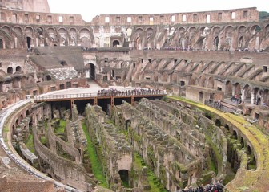
Colossians
This letter was written during his first Roman imprisonment to the saints in Colossae.
This letter was also to be read to the Saints in Laodicea
Macedonia
Black Sea
Rome
Italy
Adriatic Sea
Mysia
Colossae
Cilicia
Sicily
Laodicea
Antioch
Syria
Crete
Cyprus
Mediterranean Sea
Jerusalem
Colosse and larger neighboring cities of Hierapolis and Laodicea was a successful mercantile city in Asia Minor.

Slide 3
Epaphras
Known as “a faithful minister of Christ” was converted by Paul and spread the gospel throughout the region. However false religion was also accepted in Colosse.
Epaphras, unable to deal with the situation, went to Rome.
Paul wrote this letter sometime around A.D. 60-62.
The Epistles Include:
Correcting the false Greek and Jewish ideas by teaching that Christ is the very image of God.
* Christ is the Creator, the Head of the Church, and the first to be resurrected.
* Christ is a member of the Godhead, the Redeemer, and the “hope of the gospel, which ye have heard.”

Slide 4
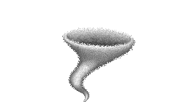
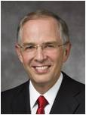
The Storm
If a storm came which of these trees might last the longest?
“More concerning than the prophesied earthquakes and wars [of the last days] are the spiritual whirlwinds that can uproot you from your spiritual foundations and land your spirit in places you never imagined possible, sometimes with your barely noticing that you have been moved.”
(2)

Slide 5
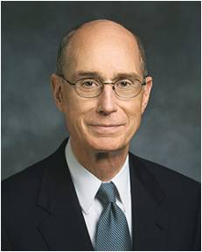
False Teachings Can Uproot
False beliefs and forms of worship in the area of Colossae minimized the eternal role and divinity of Jesus Christ.
It uprooted the Colossians from their faith.
“Because we need the Holy Ghost, we must be cautious and careful not to go beyond teaching true doctrine. The Holy Ghost is the Spirit of Truth. His confirmation is invited by our avoiding speculation or personal interpretation.
But we invite the Holy Ghost as our companion when we are careful to teach only true doctrine.
One of the surest ways to avoid even getting near false doctrine is to choose to be simple in our teaching. Safety is gained by that simplicity, and little is lost.”
Colossians 1:9
(3)

Slide 6
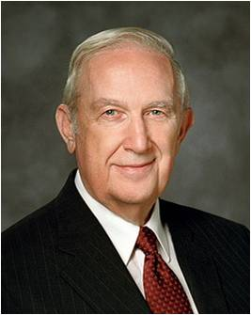
Blessings in Believing
Being fruitful in every good work
Paul acknowledged their faithfulness and explained that the gospel brings forth fruit, or blessings, in the lives of those who accept and live it.
“…true conversion is the fruit of faith, repentance, and consistent obedience. Faith comes by hearing the word of God and responding to it.
You will receive from the Holy Ghost a confirming witness of things you accept on faith by willingly doing them.
You will be led to repent of errors resulting from wrong things done or right things not done. As a consequence, your capacity to consistently obey will be strengthened.
…True conversion yields the fruit of enduring happiness that can be enjoyed even when the world is in turmoil and most are anything but happy.”
Colossians 1:1-11
(4)

Slide 7
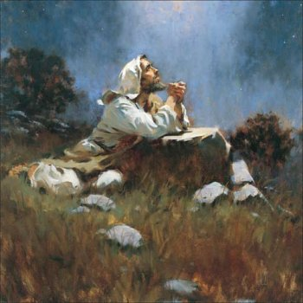
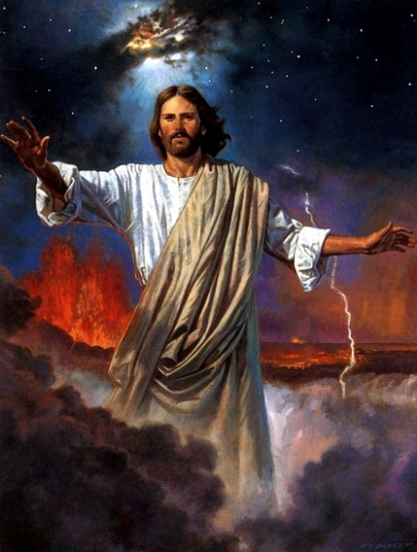
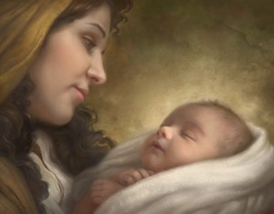
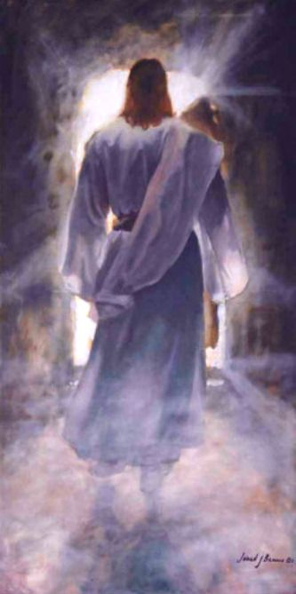
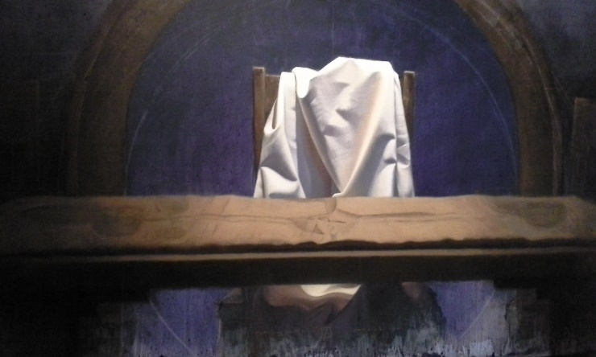
Who is Jesus Christ?
The Redeemer
The Firstborn of Heavenly Father’s sprit children
The Creator of all things
Brian Jekel
Howard Lyon
The head of the church
The first to be resurrected
Colossians 1:12-19
Jared Barnes

Slide 8
Mysteries of God
Spiritual truths known only by revelation.
God reveals his mysteries to those who are obedient to the gospel. Some of God’s mysteries are yet to be revealed.
Colossians 1:26-28; 2:2; 4:3; Bible Dictionary

Slide 9
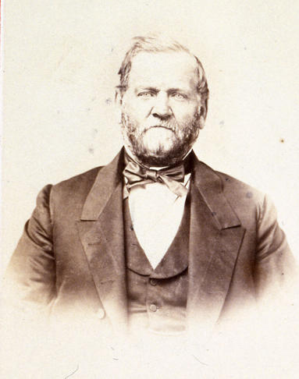
Treasures in Wisdom
“And inasmuch as our Heavenly Father is accessible to all, it is far better to store our minds with the treasures of wisdom and knowledge, by our own spiritual labours and toil, direct from the great Fountain of celestial light and love, than to trust wholly to the testimony and teachings of others.
Obtain the testimony of Jesus, which is the spirit of prophecy. Startle not at the idea of prophecy and prophets; for I would to God that all the Lord's people were prophets.”
Colossians 2:3
(7)

Slide 10
…so walk ye in him
“Rooted and built up in him, and stablished in the faith, as ye have been taught, abounding therein with thanksgiving.”
How often do we think of the Savior?
Are we grateful when we reflect on His life?
How central to our lives do we know him to be?
Colossians 2:6-7

Slide 11
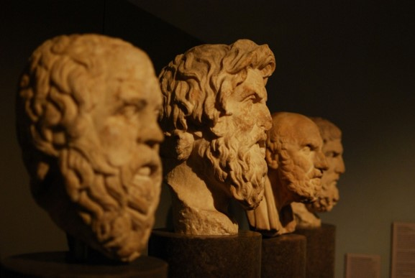
Complete in Him
“Beware lest any man spoil you through philosophy and vain deceit, after the tradition of men, after the rudiments of the world, and not after Christ.
As the church expanded to outlying areas and encompassed the
Gentile population, the influence of Greek philosophy became profound.
Colossians 2:8

Slide 12
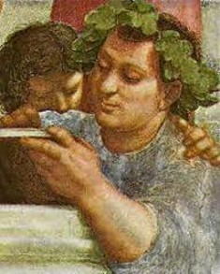
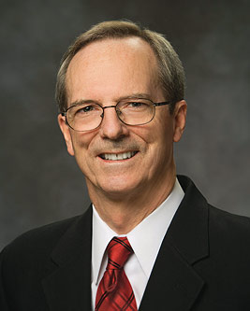
Making Christianity More Palatable
“From the time of Christ's heaven-heralded birth, heresies have crept into Christianity intended to dilute or undermine the pure doctrines of the gospel…
…These heresies are sponsored by the philosophies of men, in many instances, advocated by so-called Christian scholars.”
Colossians 2:8
(5)

Slide 13
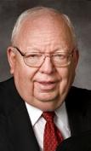
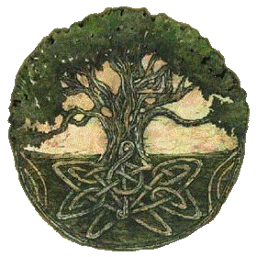
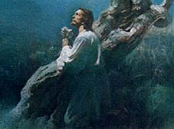
Substitutes
“The Saints in Colosse were warned against seeking any person, philosophy, or traditions of men, however clever or sophisticated, as a substitute for the real thing.”
By being rooted and built up in Jesus Christ, we can avoid being led astray by worldly philosophies and traditions
“Because of the atonement, Jesus Christ is sufficient for all men in all things.”
Read Col. 1:18
Colossians 2:8
(6)

Slide 14
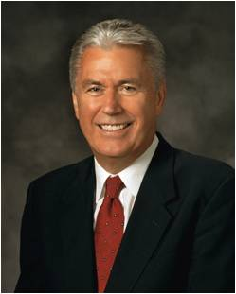
The world is not bashful in offering numerous new answers to every problem we face. People run from one new idea to the next, hoping to find something that will answer the burning questions of their souls. They attend seminars and buy books … and other products. They get caught up in the excitement of looking for something new.
But inevitably, the flame of each new theory fades, only to be replaced by another ‘new and improved’ solution that promises to do what the others before could not.
“It’s not that these worldly options don’t contain elements of truth—many of them do. Nevertheless, they all fall short of the lasting change we seek in our lives. After the excitement wears off, the hollowness remains as we look for the next new idea to unlock the secrets of happiness.
Colossians 2:6-8
(9)

Slide 15
“In contrast, the gospel of Jesus Christ has the answers to all of our problems.
The gospel is not a secret. It is not complicated or hidden.
“It can unlock the door to true happiness. It is not someone’s theory or proposition.
It does not come from man at all. It springs from the pure and everlasting waters of the Creator of the universe, who knows truths we cannot even begin to comprehend.”
Colossians 2:6-8
(9)

Slide 16
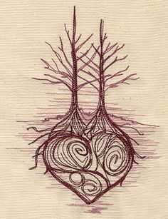
The Godhead
“Some have interpreted this passage to mean that the Godhead-Father, Son, and Holy Ghost-are the same person, or three persons in one.
Paul is anxious to combat the heretical notion that Christ was not a physical being and that his bodily suffering, death, and resurrection were only fictional.
In countering this false notion, and in order to emphasize the supremacy of the Savior above man and angels, Paul teaches that the fulness of the Godhead's glory, honor, and power is in Christ physically, or bodily-that is, nothing is lacking in the Savior that requires man to seek some other source or means of salvation."
(8)
Colossians 2:9

Slide 17
Let No Man Beguile You
“Let no man beguile you of your reward in a voluntary humility and worshipping of angel, intruding into those things which he hath not seen, vainly puffed up by his fleshly mind.”
Colossians 2:18

Slide 18
Paul’s warning
“Wherefore if ye be dead with Christ from the rudiments of the world, why, as though living in the world, are ye subject to ordinances…
“Touch not; taste not; handle not:
…Which all are to perish with the using; after the commandments and doctrines of men?”
Colossians 2:21-22, 23

Slide 19
Walk in Him
The saints were admonished to hold fast to Him, to set their affections on Him, and to “Walk…in Him
“Set your affection (mind) on things above, not on things on the earth.”
Colossians 3:2

Slide 20
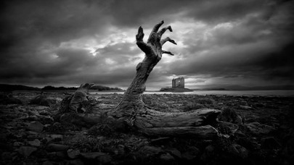
Do Not Punish the Body
Paul denounced the doctrine of body-abasement or asceticism.
He declared that the saints were not to punish the body, rather to mortify (put to death) the evils of the flesh.
“Asceticism (from the Grek: ἄσκησις, áskēsis, "exercise" or "training") describes a lifestyle characterized by abstinence from various worldly pleasures, often with the aim of pursuing religious and spiritual goals.
Many religious traditions (e.g. Buddhism, Jainism, the Christian Desert Fathers) include practices that involve restraint with respect to actions of body, speech, and mind.
The founders and earliest practitioners of these religions lived extremely austere lifestyles, refraining from sensual pleasures and the accumulation of material wealth.
They practiced asceticism not as a rejection of the enjoyment of life, or because the practices themselves are virtuous, but as an aid in the pursuit of salvation or liberation. (10)
Colossians 3:5

Slide 21
Out with the Old in with the New
Lie not one to another, seeing that ye have put off the old man with his deeds;
And have put on the new man, which is renewed in knowledge after the image of him that created him:”
Colossians 3:9-10

Slide 22
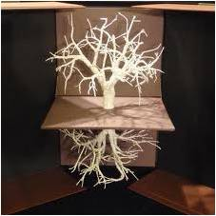
Charity Above All
They are to “put on charity”---the pure love of Christ--, which is the bond of perfectness.
“And above all these things put on charity, which is the bond of perfectness.”
Perfection and charity go hand in hand for one begets the other-they cannot be separated-they are bound together by spiritual law. As we gain charity, we gain perfection; as we gain perfection, we gain charity. (11)
Colossians 3:14

Slide 23
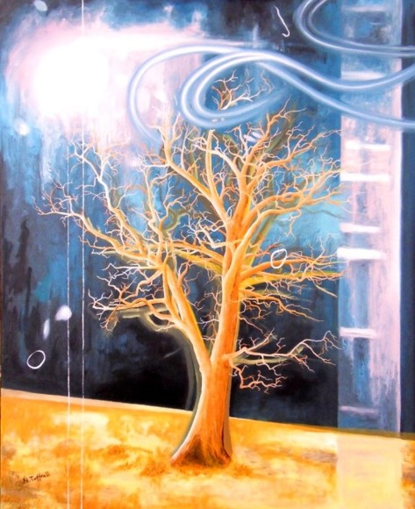
A Thanksgiving
“Let the word of Christ dwell in you richly in all wisdom; teaching and admonishing one another in psalm and hymns and spiritual songs, singing with grace in your hearts to the Lord.”
“and whatsoever ye do in word or deed, do all in the name of the Lord Jesus, giving thanks to God and the Father by him.”
Colossians 3:16-17

Slide 24
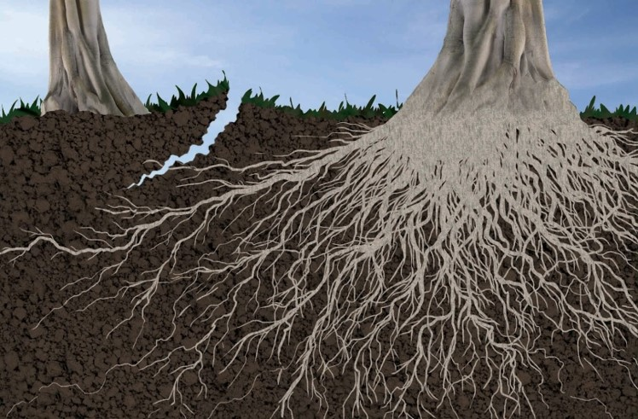
Rooted-Grounded-Established
“That Christ may dwell in your hearts by faith; that ye, being rooted and grounded in love,”
“ if ye continue in the faith grounded and settled, and be not moved away from the hope of the gospel, which ye have heard, and which was preached to every creature which is under heaven; whereof I Paul am made a minister;”
Colossians 1:23; Ephesians 3:17

Slide 25
Seasoned With Salt
In ancient times, salt was used in the offering of temple offerings and thus became a symbol of gospel covenants.
Salt was also used as a purifying agent.
Therefore, Paul’s teachings about speech being seasoned with salt reminded Church members that all their communication, even with non-Christians, should be pure and in harmony with the covenants they had made with the Lord. (1)
Colossians 4:5-6; Leviticus 2:13

Slide 26
Gaining a Testimony
To walk ye in Him
To be rooted and built up in Him
To be established in the faith
To be complete in Him
Colossians 2:6-10

Slide 27
Sources:
Suggested Hymn: #14 Sweet is the Peace the Gospel Brings
Video:
Deep Roots (1:47)
New Testament Institute Student Manual Chapter 45
Elder Neil A. Anderson (“Spiritual Whirlwinds,” Ensign or Liahona, May 2014, 18).
President Henry B. Eyring The Power of Teaching Doctrine April 1999 Gen. Conf.
Elder Richard G. Scott Full Conversion Brings Happiness April 2002 Gen. Cong.
Tad R. Callister “The Inevitable Apostasy” p. 32
Edward J. Brandt “New Testament Backgrounds” March 1976 Ensign
Orson Hyde (Journal of Discourses, 26 vols. [London: Latter-day Saints' Book Depot, 1854-1886], 5: 71.)
J. Lewis Taylor, "New Testament Backgrounds: Colossians," Ensign, Mar. 1976, 39
President Dieter F. Uchtdorf (“The Way of the Disciple,” Ensign or Liahona, May 2009, 75).
Wikipedia
Gospeldoctrine.com

Slide 28
Written from His Imprisonment in Rome, ca. A.D. 61–63 (Acts 25–28; Colossians)
Gospel Brings Hope, Blessings, Salvation | 1:1–12
Christ Created All Things | 1:13–19
The Colossians Share in Salvation | 1:20–29
Paul Warns Against False Doctrines | 2:1–23
Rules of Christian Behavior | 3:1–17
Saints Should Be Wise in All Things | 3:18–25; 4:1–18
Jesus the Creator of All Things Colossians 1:16-17:
“Under the direction and according to the plan of God the Father, Jesus Christ is the Creator, the source of the light and life of all things. Through modern revelation we have the testimony of John, who bore record that Jesus Christ is ‘the light and the Redeemer of the world, the Spirit of truth, who came into the world, because the world was made by him, and in him was the life of men and the light of men.
“‘The worlds were made by him; men were made by him; all things were made by him, and through him, and of him’ (D&C 93:9–10” Elder Dallin H. Oaks (“The Light and Life of the World,” Ensign, Nov. 1987, 63;
Beguile and Worshipping of Angels Colossians 2:18:
"...Paul explains by building on his earlier testimony of Christ as the 'head of the body, the church' (Col. 1:18). But false teachers added the 'worshipping of angels,' inventing things they had 'not seen,' which took away their true 'head,' Jesus Christ (Col. 2:18-19). Medieval Christianity added angels to intercede for mortals, whose lowly condition did not allow them to approach God... some first-century Christians taught the more radical doctrine that the physical creation was an inferior act of a lower divinity. And they added angels or divinities above the Old Testament creator. Paul fought such heresies at Colossae, for Christ's authority as the true creator was being challenged as well as his physical reality. Paul raised the standard of revealed Christianity-of believing in Christ as the only head and mediator under the Father-of believing in the physicalness of Christ, having the form of the Father." (Richard Lloyd Anderson, Understanding Paul [Salt Lake City: Deseret Book Co., 1983], 254.)
Life and Teachings of Jesus and His Apostles Chapter 42
Spoil and Deceit Colossians 2:8:
"One problem Christian gnostics faced was that Christians believed Jesus Christ to have been both God and man. Because Jesus had a body of matter, his position in the heavenly hierarchies was problematic for gnostics. Paul responded forcefully to this ambivalence regarding the role of Jesus when he emphasized in Colossians 1:16-17 and 2:9-10 His preeminence over all. Note the power of his words as he defined Jesus' position:
'For by him were all things created, that are in heaven, and that are in earth, visible and invisible, whether they be thrones, or dominions, or principalities, or powers: all things were created by him, and for him.' (Col: 1:16.)
"Paul proclaimed the Savior to be 'the head of all principality and power.' (Col. 2:10.) He warned the Colossians to 'beware lest any man spoil you through philosophy and vain deceit, after the tradition of men, after the rudiments of the world, and not after Christ.' (Col. 2:8.) Gnosticism and related heresies were a serious problem for the Church. Such beliefs were so antithetical to the doctrines of Jesus and the Apostles that attempts to merge and reconcile them contributed to the corruption of the original faith. Extra-biblical sources tell us that gnosticism played an important role in the first centuries of Christian history. Whereas the religion of the Apostles did not continue, its gnosticized counterpart did. (Kent P. Jackson, "Early Signs of the Apostasy," Ensign, Dec. 1984, 12)
Avoiding Things of the World Colossians 3:2:
“We can spend a lifetime whirling about at a feverish pace, checking off list after list of things that in the end really don’t matter.
“That we do a lot may not be so important. That we focus the energy of our minds, our hearts, and our souls on those things of eternal significance—that is essential.
“As the clatter and clamor of life bustle about us, we hear shouting to ‘come here’ and to ‘go there.’ In the midst of the noise and seductive voices that compete for our time and interest, a solitary figure stands on the shores of the Sea of Galilee, calling quietly to us, ‘Follow me’” Elder Joseph B. Wirthling (“Follow Me,” Ensign, May 2002, 16).

Slide 29
Colossians 4:7, 9, 11
Onesimus, a faithful and beloved brother
Jesus, which is called Justus
Tychicus... is a beloved brother, and a faithful minister
"The epistle to Philemon is a special letter of intercession on behalf of the runaway slave Onesimus, who had earlier fled his master Philemon, and possibly taken with him some of the latter's money or property. Ordinarily, under contemporary law, a runaway slave could be subject to frightful penalties. However, while in Rome Onesimus was converted to the gospel by Paul and had proved himself 'profitable' (Philem. 1:10-11); therefore, when Tychicus went to Colosse (bearing the epistle to the Colossians), Paul sent Onesimus along, with an appeal to Philemon to receive him in the spirit of forgiveness as 'a faithful and beloved brother.' (See Col. 4:7-9.)
"Aside from the fact that it is a remarkable example of a tactful appeal, [the epistle to Philemon] shows that the gospel of Jesus Christ is an equalizing force in the lives of men regardless of differences in social status. Because Onesimus had come repentant into the gospel brotherhood, Philemon was asked to receive him, not as a servant, but as "a brother beloved, ... both in the flesh, and in the Lord." (Philem. 1:15, 16.)
"Because Paul has, in effect, delivered a slave back into servitude, some have interpreted this epistle as an endorsement of slavery as a practice. On the other hand, others have understood the request to receive Onesimus 'not ... as a servant' (Philem. 1:16) to be a disavowal of slavery. But Paul seems to have intended neither of these. He simply acknowledges slavery indirectly as a social reality, at the same time reminding Philemon of the obligations of brotherhood in the kingdom. (Lane Johnson, "New Testament Backgrounds: Philemon," Ensign, Apr. 1976, 58)
The name Jesus is the Greek rendition of the Hebrew name Joshua, which means "God is help" or "God saves." Because Joshua of Moses' day was such a great Jewish leader, his name would have been very common at the time, especially among the Jews, whom Paul refers to as being "of the circumcision." Perhaps the Jesus mentioned in this verse was referred to as Justus because the saints were beginning to think of the name of Jesus as a holy name instead of a common one.
There is symbolism in the Lord of the Universe taking upon himself a common name. The plan was for the Master to be born into the most humble of circumstances, to be raised in a common city, to live a life with no wealth or material distinction, and to be given a common name. This is part of the great condescension of God. When we think of all the scriptural names for the Son of God, we understand that the name Jesus is perhaps the most humble of them all. Consider when the Lord comes again. Will he be called Jesus? John says that he will be called "Faithful and True...and his name is called The Word of God...And he hath on his vesture and on his thigh a name written, KING OF KINGS, AND LORD OF LORDS." (Rev. 19:11-16)
"Tychicus had shown his reliability in accompanying Paul to Jerusalem with the welfare collection, and he had... carried the letters to Ephesus and Colossae. Much like Titus in experience, Tychicus was the kind of man whom Paul would consider as the new regional supervisor in Crete...
"Paul... sent Tychicus to Ephesus, and others named after Demas were probably away from Rome on assignment. No less than nine men seem to be fellow-laborers sent by Paul to different areas as his life closed. Tychicus must be typical; he was from Asia and was sent there to replace Timothy, who was now coming to Rome to be with Paul. Both 'beloved' and 'faithful' (Col. 4:7), Tychicus is obviously another regional representative, directing bishops in a major area. Forces of rebellion probably consumed the main attention of these leaders, for the Pastoral Letters mainly guide regional leaders to direct members and to keep them from deception. To accomplish this, area supervisors had to appoint leaders and train them, the real meaning of Paul's reminder to teach 'faithful men' (the bishops) so they could 'teach others' (their flocks). (2 Tim. 2:2)" (Richard Lloyd Anderson, Understanding Paul [Salt Lake City: Deseret Book Co., 1983], 344-345, 372.)

Slide 30
Colossians 4:12-14
Luke, the beloved physician
Epaphras, who is one of you... saluteth you
…them that are in Laodicea, and them in Hierapolis
"The epithet 'beloved' is uncommon in Paul's writings, and indicates an especially close bond between the apostle and his doctor... [Later] Paul recounts how many of his associates either had forsaken him or had gone on errands, and concludes with: 'Only Luke is with me.' (2 Tim. 4:11.) Alone and facing death, Paul doubtless found Luke's presence of more than medical comfort." (C. Wilfred Griggs, "Paul: The Long Road from Damascus," Ensign, Sept. 1975, 60)
"Who was Luke, that he should be called to write so much of the life of Jesus and of the acts of the apostles? What do we know of the man whom Paul called 'the beloved physician' (Col. 4:14) in his letter to the saints at Colossae?
"Though Luke tells us nothing of himself in his letters, still his writings reveal much about his values, priorities, personal testimony, and his tender charity toward mankind. Any sincere student of the scriptures must be moved by the humane selectivity of Luke's characterizations, descriptions, and phrasing.
"Luke was thought to have been born in Antioch of Syria, the 'City of Greek Kings.' With its 200,000 people it was one of the greatest cities of the Roman Empire and more than 33 times its present size. During Luke's lifetime, Jews in Antioch had the same status and privileges as Greeks. It was here that the first gentile branch of the church in that dispensation was formed; here, disciples were first called Christians. (See Acts 11:20-21, 26.)
"It appears that Paul started three missions from Antioch. Perhaps it was in his home city that Luke became involved with Paul, the 'apostle of the Gentiles.' (Rom. 11:13.) Or, Luke may have become acquainted with Paul at Troas.
"Luke did not identify which areas or to what extent he traveled with Paul on his missions. The fact that he first recorded many of the highlights of Paul's life and travels in the third person ('he' and 'they') and then abruptly changes to the first person plural ('we' and 'us') indicates that they served together from Troas to Philippi, and perhaps also in Achaia and Alexandria. (See Acts 16:10-17; Acts 20:5 through Acts 21:18; Acts 27:1 through Acts 28:16.) Later they traveled together to Miletus, Tyre, Caesarea, and Jerusalem.
"After Paul's arrest, Luke joined him in Caesarea, where Paul boldly declared his testimony before Festus and King Agrippa. When Paul went to Rome, Luke went with him.
)
"Certainly this close association with Paul would have qualified Luke to write the book of Acts. Another important qualification was his matchless access to key facts about the life of Jesus Christ. Over 100 quotations or facts from 32 events of major consequence in the life of the Savior are recorded only in Luke. Similarly, most of the events and testimonies in Acts are uniquely recorded by Luke. He alone recorded 18 of the descriptive titles for Jesus; there are 258 such titles or characterizations of Jesus in the entire Bible.
"Luke sought out the 'eyewitnesses' to the Lord's life and ministry, even those 'which from the beginning were eyewitnesses.' (See Luke 1:2.) Some scholars think that, during the years Paul was in prison in Caesarea, Luke contacted persons who remembered the event of Christ's life. Perhaps Luke contacted the eyewitnesses earlier than this. Certainly, his narrative contains details dealing with 'the beginning' (annunciation to Elisabeth and Mary, the birth and blessing, etc.) that suggest he did seek to obtain all that was known from as many witnesses as possible." (Robert T. Stout, "I Have a Question," Ensign, Sept. 1975, 38)
"Philemon's letter closes with a greeting from 'Epaphras, my fellowprisoner in Christ Jesus' (Philem. 1:23). This is probably a way of honoring this man who was well known at Colossae; he was assisting Paul in prison, just as the returning Onesimus had done. Colossians also names Epaphras, 'who is one of you, a servant of Christ' (Col. 4:12). The Colossians had 'learned' the gospel from 'Epaphras our dear fellowservant, who is for you a faithful minister of Christ' (Col. 1:7). Since he had 'declared unto us your love in the Spirit' (Col. 1:8), Paul's knowledge of the current problems of that area came through this missionary with their interest at heart. And Paul apparently wanted them to know that negative information was relayed for their benefit, since Epaphras has a 'great zeal for you, and them that are in Laodicea, and them in Hierapolis' ("Col. 4:13Col. 4:13)." (Richard Lloyd Anderson, Understanding Paul [Salt Lake City: Deseret Book Co., 1983], 245 - 246.)
"Hierapolis and these two cities (Laodicea and Colossae) formed a triangle with sides about ten miles long. In writing to Colossae, Paul also named 'them that are in Laodicea, and them in Hierapolis' (Col. 4:13). Substantial ruins of the latter city are spread out around its well-preserved stone theater. It was built adjacent to massive hot springs that attracted religious and recreational pilgrims. But Laodicea was the major city of the area in Paul's day. Just before Paul, Strabo wrote that Laodicea 'grew large in our time and in that of our fathers.' That geographer paid tribute to its 'fertile territory' and the private wealth of some of its citizens. Its ruins, including its theater, are badly deteriorated, but Laodicea's stone-strewn area is massive. Although Hierapolis is merely mentioned in Paul's Colossian letter, Laodicea is prominent, probably reflecting the size of the Church in that large city. Laodicea was possibly the regional center of Church administration. Three decades later John sent his letter to Laodicea as the most important branch of the Church in that area." (Richard Lloyd Anderson, Understanding Paul [Salt Lake City: Deseret Book Co., 1983], 245.)

