Slide 1
Lesson 129
Wait For the Lord in Patience
2 Thessalonians 1-3
“And the Lord direct your hearts into the love of God, and into the patient waiting for Christ.”
2 Thessalonians 3:5

Slide 2
Many believe that the similarities between the 1st and the second may have been written within 6 months of each other.
Many Saints were eagerly preparing for the doctrine. They were so caught up in it that they discontinued their daily labors to wait for the Lord’s coming.

Slide 3
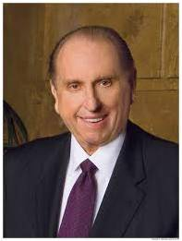
Defending Your Faith With Patience
Have you ever had to defend your faith?
…to stand as witnesses of God at all times and in all things, and in all places…
Mosiah 18:9
“I say to all and especially the youth of the Church that if you haven’t already, you will one day find yourself called upon to defend your faith or perhaps even endure some personal abuse simply because you are a member of The Church of Jesus Christ of Latter-day Saints.” (2)
We will all face fear, experience ridicule, and meet opposition. Let us—all of us—have the courage to defy the consensus, the courage to stand for principle. Courage, not compromise, brings the smile of God’s approval.” (3)
2 Thessalonians 1:1-4

Slide 4
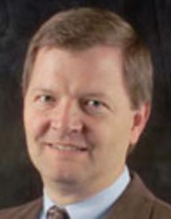
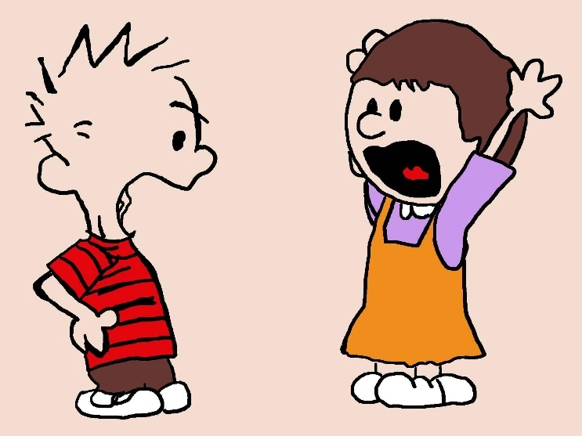
Reason and Logic
“Heavenly Father has given you the gift of the Holy Ghost, and you should take advantage of this gift.
This doesn’t mean reason and logic can’t be inspired or confirmed by the Spirit; it just means that you should rely on the Spirit to guide your defense of your faith.
Bear testimony by the Spirit.
That’s the Lord’s way.
“The point here is not that you should avoid any discussion in which people have differing points of view. Rather, it has to do with your intent as well as the emotions involved. We should seek understanding and try to persuade with meekness, not just score points and prove we’re right and someone else is wrong.
A discussion where people are getting really worked up and angry is one you should either try to soften or simply avoid.”
(4)

Slide 5
Wait
(4)

Slide 6
(4)

Slide 7
(4)

Slide 8
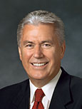
Faithfully Enduring
“Patience is not passive resignation, nor is it failing to act because of our fears.
Patience means active waiting and enduring. It means staying with something and doing all that we can—working, hoping, and exercising faith; bearing hardship with fortitude, even when the desires of our hearts are delayed.
Patience is not simply enduring; it is enduring well!”
Wait
If we faithfully endure opposition and tribulation with patience and faith, we may be counted worthy of the kingdom of God
2 Thessalonians 1:4
(5)

Slide 9
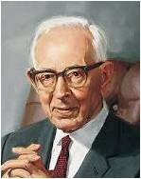
Recompense
Make amends to (someone) for loss or harm suffered; compensate.
“Those who have the blood of prophets and Saints upon their hands will receive their just reward."
Church’s persecutors
2 Thessalonians 1:6
(6)

Slide 10
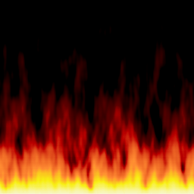
Flaming Fire
"...When the Lord comes in his glory, in flaming fire, that fire will both cleanse the vineyard and burn the earth. In that day, so intense shall be the heat and so universal the burning, the very elements of which this earth is composed shall melt.
The mountains, high and glorious and made of solid rock, shall melt like wax. They shall become molten and flow down into the valleys below.
The very earth itself, as now constituted, shall be dissolved.
All things shall burn with fervent heat. And out of it all shall come new heavens and a new earth whereon dwelleth righteousness.
It is of these things-and they, above all else, show the literal nature of the burning fires that shall attend that dreadful day." (7)
At the Second Coming of Jesus Christ, the righteous will rest and the wicked will be destroyed
2 Thessalonians 1:7-8

Slide 11
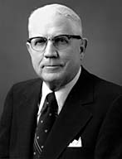
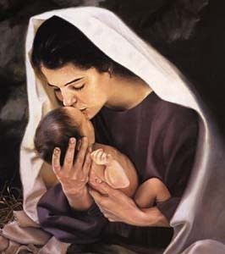
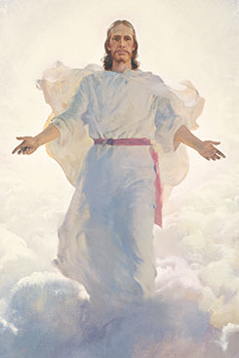
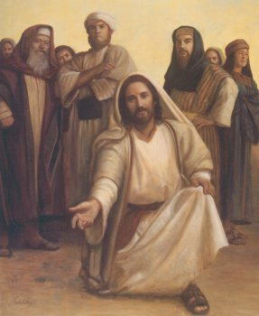
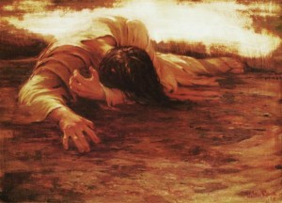
First and Second Coming
"[The Bible] foretells that he will come to the earth a second time, though in a different manner…
The first time he came as a man of sorrows who was acquainted with grief
(Isa. 53:3)
But the second time he will come as the mighty God (Isa. 9:6).
He will come the second time as King of kings and Lord of lords (Rev. 17:14).
He came the first time as the Prince of Peace (Isa. 9:6).
He came the first time to atone for our sins;
He will come the second time to judge those sinners who have not repented."
2 Thessalonians 1:6-10
Walter Rane
(8)

Slide 12
Doctrinal Mastery
2 Thessalonians 2:1-3
Now we beseech you, brethren, by the coming of our Lord Jesus Christ, and by our gathering together unto him,
That ye be not soon shaken in mind, or be troubled, neither by spirit, nor by word, nor by letter as from us, as that the day of Christ is at hand.
Let no man deceive you by any means: for that day shall not come, except there come a falling away first, and that man of sin be revealed, the son of perdition;
(4)

Slide 13
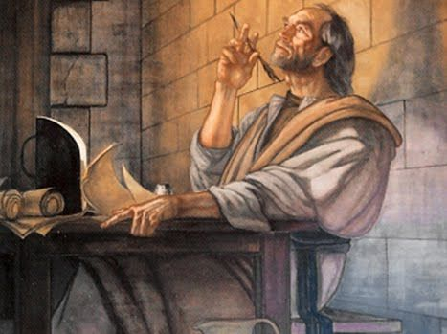
Be Not Soon Shaken
The believers in Paul’s day were alarmed or fearful that the Lord’s Second Coming had already taken place.
Their concerns may have resulted from doctrinal misunderstanding, or they may have been deceived by false teachings in a forged letter purportedly written by Paul.
Paul cautioned the Saints not to embrace information that Church leaders had not previously taught.
2 Thessalonians 2:1-3
(1)

Slide 14
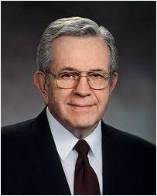
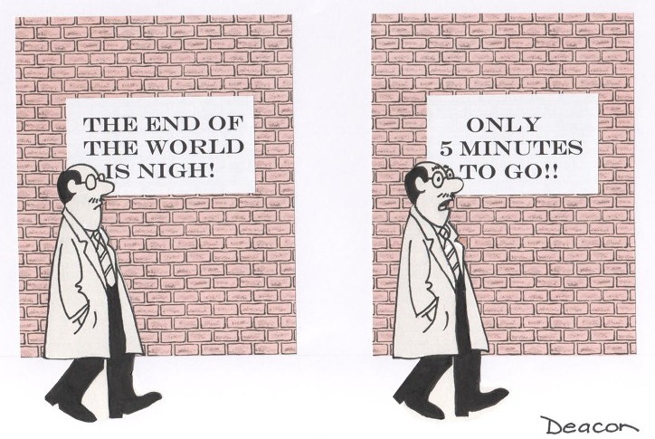
“There are some among us now who have not been regularly ordained by the heads of the Church [see D&C 42:11] who tell of impending political and economic chaos, the end of the world. … They are misleading members. …
“Those deceivers say that the Brethren do not know what is going on in the world or that the Brethren approve of their teaching but do not wish to speak of it over the pulpit.
Neither is true. The Brethren, by virtue of traveling constantly everywhere on earth, certainly know what is going on, and by virtue of prophetic insight are able to read the signs of the times. …
“… Follow your leaders who have been duly ordained and have been publicly sustained, and you will not be led astray”
2 Thessalonians 2:1-3
(9)

Slide 15
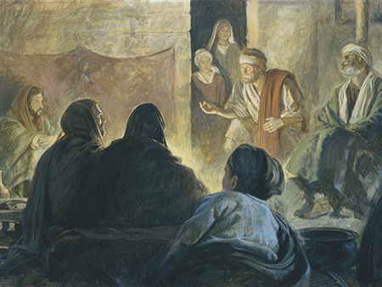
Apostasy—Falling Away First
“Falling away” is a translation of the Greek word apostasia, a word that is closer in meaning to “rebellion” or “mutiny.” Paul was therefore speaking of an intentional fight against the gospel of Jesus Christ rather than a gradual movement away from it.
Apostasy is often not simply a passive letting go of truth but an active rebellion that originates within the covenant community.
Robert T. Barrett
2 Thessalonians 2:3
(1)

Slide 16
Priesthood Authority Taken From Earth
“After the death of Jesus Christ, wicked people persecuted the Apostles and Church members and killed many of them.
With the death of the Apostles, priesthood keys and the presiding priesthood authority were taken from the earth.
The Apostles had kept the doctrines of the gospel pure and maintained the order and standard of worthiness for Church members.
Without the Apostles, over time the doctrines were corrupted, and unauthorized changes were made in Church organization and priesthood ordinances, such as baptism and conferring the gift of the Holy Ghost.”
2 Thessalonians 2:3
(10)

Slide 17
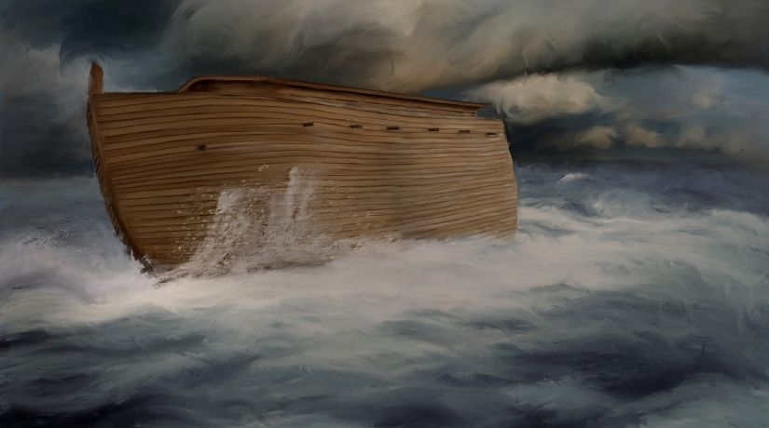
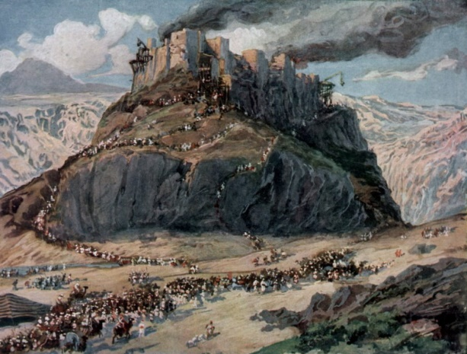
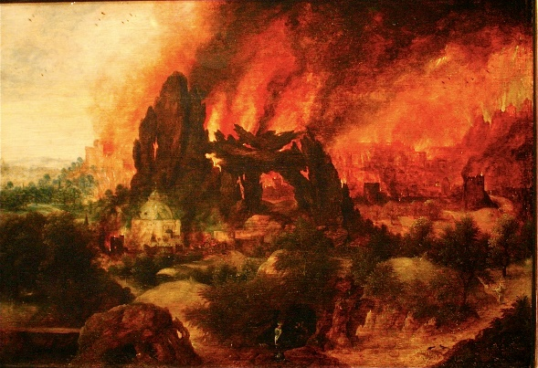
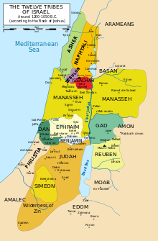
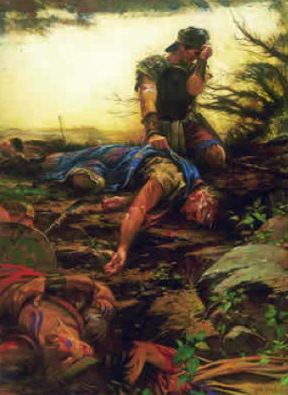
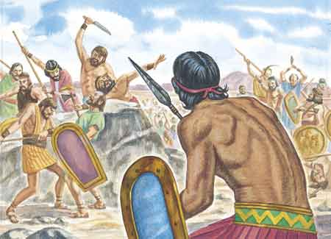
Apostasy Through the Ages
The Lord killed the inhabitants of Sodom and Gomorrah
The Lord destroyed the wicked in the Flood of Noah
The Lord commanded Israel to destroy the Amorites
The Jaradites are destroyed for rejecting Christ
The Lord destroys the Nephites and the Lamanites for iniquity
The gospel is lost after the Apostles die
Israel and Judah are cursed for iniquity
(11)

Slide 18
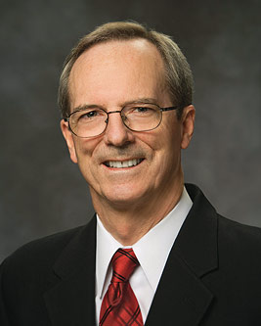
Evidence of Apostasy
Loss of Apostles and Revelation
The Bible ends
Loss of Miracles and gifts
The Dark Ages
Many teachings are perverted, others lost, and new ones invented
Many ordinances are perverted, lost, or new ones added
Mode of Prayer was changed
Scriptures removed from the lay members
Wickedness within the Church Hierarchy
Decline of Moral Standards and loss of Church Discipline
The Ongoing Church no longer bore Christ’s name
The Priesthood was lost
(12)

Slide 19
The Sin of Man – Son of Perdition
Paul explained that the “man of sin” or “son of perdition” would be revealed prior to the Lord’s Second Coming.
The word perdition is derived from the Latin perditionem, meaning “ruin” or “destruction,” and it is a title given to Lucifer when he was cast out of God’s presence during the premortal life.
All those who rebelled with Satan against God during the premortal existence became sons of perdition when they were cast out of God’s presence. Paul also described the “man of sin”—one who “opposeth and exalteth himself above all that is called God.”
The Joseph Smith Translation makes clear that in 2 Thessalonians 2:7–9 Paul was referring to Satan:
2 Thessalonians 2:7-9
(1)

Slide 20
Loss of the Truth
Paul taught that those who refuse to accept truth will eventually lose the opportunity to receive it.
Concerning those who “received not the love of the truth, that they might be saved,” Paul said that “God shall send them strong delusion, that they should believe a lie.”
God will permit unbelievers to accept false doctrines and thereby forfeit their salvation
And they that will harden their hearts, to them is given the lesser portion of the word until they know nothing concerning his mysteries; and then they are taken captive by the devil, and led by his will down to destruction. Now this is what is meant by the chains of hell.
Alma 12:11
2 Thessalonians 2:10-12
(1)

Slide 21
Walketh Disorderly
Paul taught that a Church member who “walketh disorderly” was not to enjoy full association with the Church.
Paul was specifically speaking about people who refused to work and support themselves.
In our day Church members are encouraged not to associate with “disorderly” people who oppose the truth.
“Enemies from within, traitors to the Cause, cultists who pervert the doctrines and practices which lead to salvation, often draw others away with them, and added souls lose their anticipated inheritance in the heavenly kingdom. When cultists and enemies become fixed in their opposition to the Church, and when they seek to convert others to their divisive positions, the course of wisdom is to avoid them, as Paul here directs, and to leave them in the Lord’s hands.”
2 Thessalonians 3:6-12
(1, 13)

Slide 22
Self Reliant and Help Others
“One of the blessings of work is developing self-reliance. When you are self-reliant, you use the blessings and abilities God has given you to care for yourself and your family and to find solutions for your own problems.
Self-reliance does not mean that you must be able to do all things on your own. To be truly self-reliant, you must learn how to work with others and turn to the Lord for His help and strength.
“Remember that God has a great work for you to do. He will bless you in your efforts to accomplish that work.”
2 Thessalonians 3:6-12
(14)

Slide 23
Paul’s Last Words to the Thessalonians
Paul concluded his epistle by counseling the Saints to discourage idleness and withdraw from idle and disruptive people.
However, the Saints were to not treat them as enemies but reprove them as brothers and sisters in the gospel.
2 Thessalonians 3:14-18

Slide 24
Sources:
Suggested Hymn: #3 Now Let Us Rejoice
Video:
The Cost—and Blessings—of Discipleship (2:06)
New Testament Institute Student Manual Chapter 46
Elder Jeffrey R. Holland (“The Cost—and Blessings—of Discipleship,” Ensign or Liahona, May 2014, 6).
President Thomas S. Monson (“Be Strong and of a Good Courage,” Ensign or Liahona, May 2014, 69).
David A. Edwards The Do’s and Don’ts of Defending Your Beliefs Youth Article
President Dieter F. Uchtdorf (“Continue in Patience,” Ensign or Liahona, May 2010, 57).
Joseph Fielding McConkie and Robert L. Millet, Doctrinal Commentary on the Book of Mormon, 4 vols. [Salt Lake City: Bookcraft, 1987-1992], 2: 268.
Elder Bruce R. McConkie (The Millennial Messiah: The Second Coming of the Son of Man [Salt Lake City: Deseret Book Co., 1982], 525-526.)
Sterling W. Sill (Conference Report, April 1966, First Day-Morning Meeting 20.)
President Boyd K. Packer (“To Be Learned Is Good If … ,” Ensign, Nov. 1992, 73).
Preach My Gospel: A Guide to Missionary Service[2004], 35).
Joseph Fielding Smith “Doctrines of Salvation’ vol. 3 pg. 34-35
Tad R. Callister “The Inevitable Apostasy” Contents
Elder Bruce R. McConkie (Doctrinal New Testament Commentary, 3:66; see also the commentary for Matthew 5:29–30).
For the Strength of Youth [booklet, 2011], 41).
Presentation by ©http://fashionsbylynda.com/blog/

Slide 25
WRITTEN FROM CORINTH DURING PAUL’S SECOND MISSIONARY JOURNEY 2 THESSALONIANS
Ungodly Damned at Second Coming | 1:1–12
Apostasy to Precede Second Coming | 2:1–12
Persevere for Eternal Glory | 2:13–17
Pray for Triumph of the Gospel | 3:1–5
Withdraw from Apostates | 3:6
Stand Against Idleness | 3:7–18
Something of Interest:
In a perfect world, people win arguments through the use of logic, facts, and better information. In reality, most people are pretty terrible at using logic, facts, and information. People make decisions from a place of emotion. We know this because if the emotional centers of a person's brain are damaged, they become incapable of making even the most basic decisions.
Arguments are inherently emotional interactions where the goal is winning, and if we have learned anything from sports it's that people will do anything to win. They will dope, cheat, break people’s legs, deflate footballs, and any number of other stupid, harmful, or ridiculous things to be declared the victor. This is why sports have refs, debates have moderators, and courtrooms have judges.
The desire to win will be so tempting to some people they will even engage in unethical behavior. These people will use almost anything they can get their hands on as a weapon against their opponent.
An argument culture creates an environment where winning is paramount...
Crossing boundaries and using aggression to win an argument includes making personal remarks, interrupting, speaking much more loudly than an opponent, or entering someone's personal space. Instead of staying on topic and trying to find the best solution, people might use personal attacks to undermine their opponent in order to win. Size and loudness are also ways to make another person back off in a disagreement, leaving the louder, larger person the winner regardless of the content of their argument. Kate Heddleston Blog
Life and Teachings of Jesus and His Apostles Chapter 33
The subscription note found immediately after 2 Thessalonians 3:18 in some versions of the Bible was added to the text by copyists long after Paul’s day, and it incorrectly states that the Second Epistle to the Thessalonians was written from Athens. (1)
Flaming Fire 2 Thessalonians 7-8:
"In flaming fire! What kind of fire? Flaming fire is flaming fire. It is actual, literal fire, fire that burns trees, melts ore, and consumes corruption. It is the same kind of fire that burned in the furnace of Nebuchadnezzar when Shadrach, Meshach, and Abednego were cast into its blazing flames...And so shall it be at the Second Coming when the same literal fire burns over all the earth. The wicked shall be consumed and the righteous shall be as though they walked in the furnace of Nebuchadnezzar.
"Graphic accounts of the fire and burning that will attend the Second Coming are found in the ancient word. 'Our God shall come, and shall not keep silence,' acclaims the Psalmist; 'a fire shall devour before him, and it shall be very tempestuous round about him.' (Ps. 50:3.) And also: 'The Lord reigneth. . . . A fire goeth before him, and burneth up his enemies round about. His lightnings enlightened the world: the earth saw, and trembled. The hills melted like wax at the presence of the Lord, at the presence of the Lord of the whole earth.' (Ps. 97:1-5.)
"None of the prophets excel Isaiah in literary craftsmanship and in the use of grand imagery to teach and testify about the God of Israel and his laws. 'The Lord cometh,' Isaiah says, 'burning with his anger, and . . . his lips are full of indignation, and his tongue as a devouring fire. . . . And the Lord shall cause his glorious voice to be heard, and shall shew the lighting down of his arm, with the indignation of his anger, and with the flame of a devouring fire, with scattering [i.e., with a blast], and tempest, and hailstones.' And 'the breath of the Lord, like a stream of brimstone,' shall kindle the fires that destroy false worship. (Isa. 30:27-33.) 'For, behold, the Lord will come with fire, and with his chariots like a whirlwind, to render his anger with fury, and his rebuke with flames of fire. For by fire and by his sword will the Lord plead with all flesh: and the slain of the Lord shall be many.' (Isa. 66:15-16.) (7)
Defending Your Faith:
Heavenly Father has given you the gift of the Holy Ghost, and you should take advantage of this gift. This doesn’t mean reason and logic can’t be inspired or confirmed by the Spirit; it just means that you should rely on the Spirit to guide your defense of your faith. Bear testimony by the Spirit. That’s the Lord’s way.
The point here is not that you should avoid any discussion in which people have differing points of view. Rather, it has to do with your intent as well as the emotions involved. We should seek understanding and try to persuade with meekness, not just score points and prove we’re right and someone else is wrong. A discussion where people are getting really worked up and angry is one you should either try to soften or simply avoid. David A. Edwards The Do’s and Don’ts of Defending Your Beliefs Youth Article

Slide 26
2 Thessalonians 2:3:
“Over the sweep of Christian history, some believers have, by focusing on a few prophecies while neglecting others, prematurely expected the Second Coming. Today, while we are obviously closer to that great moment, we are in the same danger… In the context of such cautions, I have no hesitancy in saying that there are some signs—but certainly not all—suggesting that ‘summer is nigh’ (Matthew 24:32)
“Members of the Church need not and should not be alarmists. They need not be deflected from quietly and righteously pursuing their daily lives” Neal A. Maxwell Conf Report April 1988 or Ensign May 1988
Walketh Disorderly 2 Thessalonians 3:6:
"Paul urged the saints in his day not to associate with those who were rude disbelievers. His conservative counsel sounds a little aloof until one remembers how much is at stake. C. S. Lewis in his 'Reflections on the Psalms' says, 'I am inclined to think a Christian would be wise to avoid, where he decently can, any meeting with people who are bullies, lascivious, cruel, dishonest, spiteful, and so forth. Not because we are `too good` for them. In a sense because we are not good enough. We are not good enough to cope with all the temptations, nor clever enough to cope with all the problems, which an evening spent in such society produces. . . .' (A Mind Awake, pp. 160-61.)
"Paul counseled the saints in Corinth 'not to company with fornicators.' (1 Corinthians 5:9.) He broadened the counsel to include not only fornicators but also 'the covetous, or extortioners, or with idolators.'
"As President Harold B. Lee said, in order to help someone else 'we must stand on higher ground' than he is standing on. We must be careful not to abandon that ground-for the sake of the sinner as well as for our own welfare. There is a difference between assisting the wounded Samaritan who needed help and companying with those who are evil.
"In similar counsel given to the saints in Thessalonica, Paul said, 'If any man obey not our word by this epistle, note that man, and have no company with him, that he may be ashamed. Yet count him not as an enemy, but admonish him as a brother.' (2 Thessalonians 3:14-15. Italics added.) In refusing to keep company with evil people, we do it not because they are our enemies, but because they are our friends. If we became just like them and did the things they do, we could not admonish them or help them 'as a brother.'" Elder Neal A. Maxwell (Things As They Really Are [Salt Lake City: Deseret Book Co., 1978], 86.)
Apostasy:
“Some of the early Apostles knew that an apostasy would occur before the Second Coming of the Lord Jesus Christ. To the Thessalonians, Paul wrote concerning this event, ‘Let no man deceive you by any means: for that day shall not come, except there come a falling away first’
“With this falling away, priesthood keys were lost, and some precious doctrines of the Church organized by the Savior were changed. Among these were baptism by immersion; receiving the Holy Ghost by the laying on of hands; the nature of the Godhead—that They are three distinct personages; all mankind will be resurrected through the Atonement of Christ, ‘both … the just and the unjust’ [Acts 24:15]; continuous revelation—that the heavens are not closed; and temple work for the living and the dead.
“The period that followed came to be known as the Dark Ages. This falling away was foreseen by the Apostle Peter, who declared that ‘heaven must receive [Jesus Christ] until the times of restitution of all things, which God hath spoken by the mouth of all his holy prophets since the world began’ [Acts 3:20–21]. Restitution would only be necessary if these precious things had been lost” President James E. Faust (“The Restoration of All Things,” Ensign or Liahona, May 2006, 61–62).
If Any Would Not Work 2 Thessalonians 3:10:
"The Lord's way builds individual self-esteem and develops and heals the dignity of the individual, whereas the world's way depresses the individual's view of himself and causes deep resentment.
"The Lord's way causes the individual to hasten his efforts to become economically independent again, even though he may have temporary need, because of special conditions, for help and assistance. The world's way deepens the individual's dependency on welfare programs and tends to make him demand more rather than encouraging him to return to economic independence.
"The Lord's way helps our members get a testimony for themselves about the gospel of work. For work is important to human happiness as well as productivity. The world's way, however, places greater and greater emphasis on leisure and upon the avoidance of work." President Spencer W. Kimball ("Family Preparedness," Ensign, May 1976, 125)

Slide 27
The Seven Church Dispensations
Seven Church Dispensations
Adam
Enoch
Noah
Abraham
Moses
Jesus Christ
Joseph Smith
Elder L. Tom Perry taught that a dispensation is "a period of time in which the Lord has at least one authorized servant on the earth who bears the keys of the holy priesthood. When the Lord organizes a dispensation, the gospel is revealed anew so that the people of that dispensation do not have to depend on past dispensations for knowledge of the plan of salvation." The seventh dispensation, in which we live, is the last dispensation which will not fall into an apostasy but will eventually be completed with the coming of Christ. After restoring His priesthood authority to the Prophet Joseph Smith, the Lord said:"Unto whom I have committed the keys of my kingdom, and a dispensation of the gospel for the last times; and for the fulness of times, in the which I will gather together in one all things, both which are in heaven, and which are on earth" (D&C 27:13).
Further information: 1989 Dec. “The Fulness of Times” Robert J. Matthews

