Slide 1
Lesson 13
Miracles of Jesus
Matthew 8-10
Looking unto Jesus the author and finisher of our faith; who for the joy that was set before him endured the cross, despising the shame, and is set down at the right hand of the throne of God.
Hebrews 12:2

Slide 2
Sidon and Tyre
Sidon = an ancient Phoenician port city.
Tyre and Sidon were a powerful city-state and first manufactured the purple dye…synonymous with royalty.
It was a Phoenician city port and later absorbed by Rome
Both Sidon and Tyre are mentioned 12 times in the New Testament and is where Jesus and Paul, the Apostle visited
Tyre = meaning ‘rock’
In myth, Tyre is known as the birthplace of Europa (who gave Europe its name)
The main trade was on an island about ½ mile from the mainland
The old city, known as Ushu, was founded in 2750 BC
The Tyrians were known as workers in dye from the shells of the Murex shellfish. This purple dye was highly valued and held royal connotations in the ancient world.
(1)

Slide 3
Chorazin
Chorazin = an ancient village in northern Galilee, two and a half miles from Capernaum on a hill above the northern shore of the Sea of Galilee.
Chorazin, along with Bethsaida and Capernaum, was named in the gospels of Matthew and Luke as "cities" (more likely just villages) in which Jesus performed "mighty works".
However, because these towns rejected his work ("they had not changed their ways"), they were subsequently cursed.
The Babylonian Talmud (Menahot, 85a) mentions that Chorazin was a town known for its grain.
Chorazin is mentioned 2 times in the New Testament
(2)

Slide 4
Gadara
Gadara/Geresa was called in the New Testament “the country of the Gadarenes.”
Gadara was a city of Decapolis, southeast of the Sea of Galilee, on the main road to Damascus.
The people were partly Greek and partly Syrian.
The district is mentioned in connection with the healing of a man with an unclean spirit; but the Gospels and the Greek manuscripts do not agree as to its name.
Compare the above passages with Matt. 8:28. The miracle was probably worked near Gergesa.
Gergesa
(4)

Slide 5
Bethsaida
Bethsaida is known as ‘House of fish, or house of fishers’. Probably there are two places of this name mentioned in the New Testament.
The older city was on the northeast end of the Sea of Galilee, near Capernaum, and was the home of Peter, Andrew, and Philip
Et-Tel, the mound identified as ancient Bethsaida, is located on a basaltic spur north of the Sea of Galilee, near the inflow of the Jordan River into the Sea of Galilee.
The name Bethsaida means "house of the hunt" in Hebrew.
Bethsaida is, as Mark 8:22-23 described, a town where Jesus met a blind man seeking healing.
Bethsaida is mentioned 7 times in the New Testament.
(2,3,4)

Slide 6
Capernaum
Capernaum is known as the Village of Nahum.
It is a town on the northern end of the Sea of Galilee, probably on the site now known as Tell-Hûm.
At the time of our Lord the district was one of the most prosperous and crowded in all Palestine. Here the Lord lived after the beginning of His ministry, so that Capernaum is called “his own city”.
It was the home of Peter and Andrew and of Matthew . Many of our Lord’s miracles were worked here (In the synagogue at Capernaum was spoken the wonderful discourse found in John 6:59.
Later the Lord upbraided the people of the place for their rejection of Him.
Capernaum is mentioned 16 times in the New Testament
(4)

Slide 7
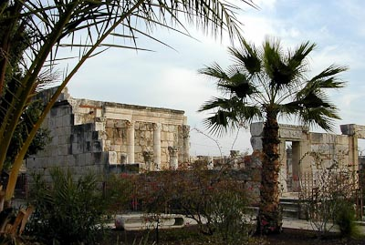
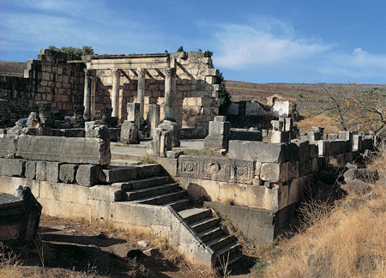
The Savior’s “Own City”
Matthew 9:1
It was a prosperous town, located on the famous Roman road, the Via Maris (the Way of the Sea), which linked ancient Egypt with Syria and Mesopotamia.
It was the home of Peter, the chief Apostle, and his brother Andrew, another of the Twelve Apostles.
Jesus delivered a powerful discourse at the synagogue located in Capernaum.
More recorded miracles occurred at Capernaum than at any other site. (5)
John 6:24-65—Ruins of Capernaum

Slide 8
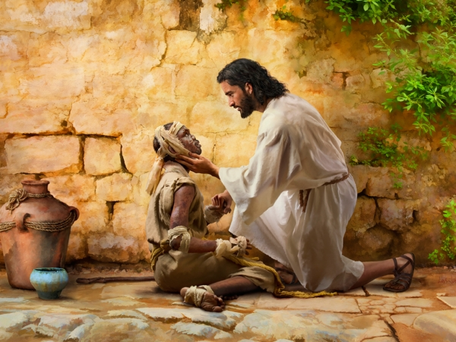
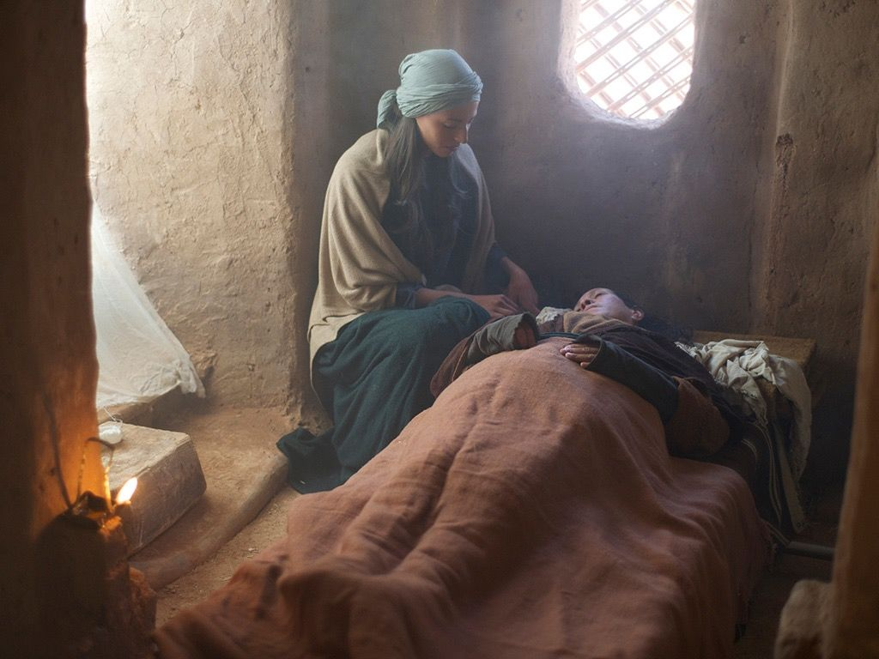
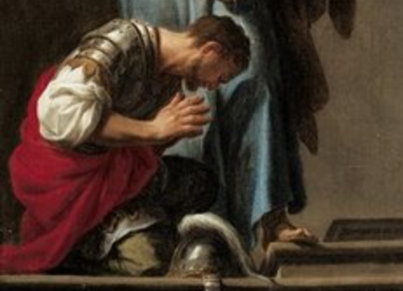
The Miracles
Matthew 8:1-4
Matthew 8:14-15
Matthew 8:5-13

Slide 9
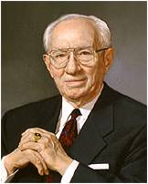
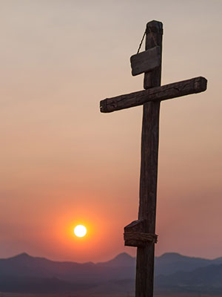
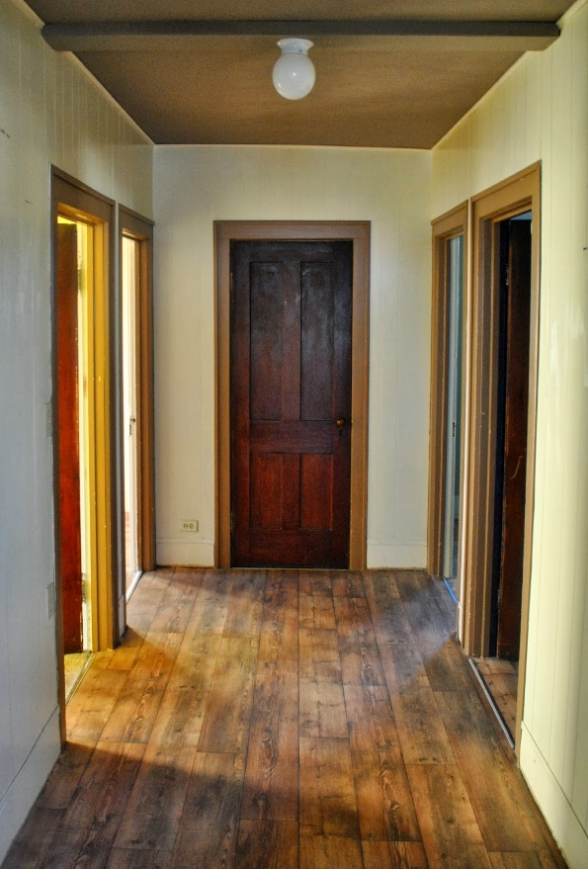
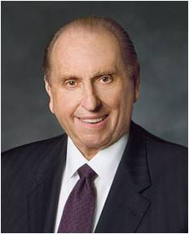
Foxes and Birds
"There is no lonelier picture in history than of the Savior upon the cross, alone, the Redeemer of mankind, the Savior of the world, bringing to pass the atonement, the Son of God suffering for the sins of mankind." (6)
"Seek the help of the Lord...Remember, we do not run alone in this great race of life-we can have the help of the Lord.
However, before we can take Jesus as our companion, before we can follow Him as our guide, we must find Him. You ask, 'How can we find
Jesus?' I would like to suggest that, first of
all, we need to make room for Him.” (7)
Matthew 8:20

Slide 10
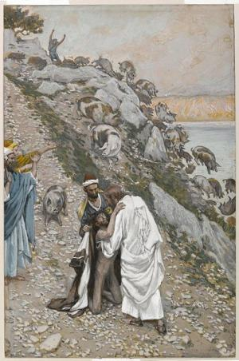
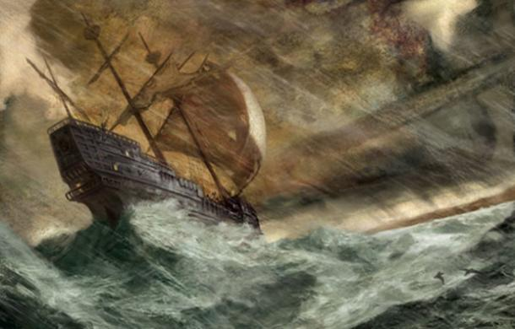
The Miracles
Matthew 8:28-32
Matthew 8:23-27

Slide 11
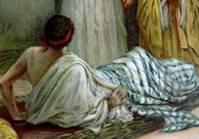
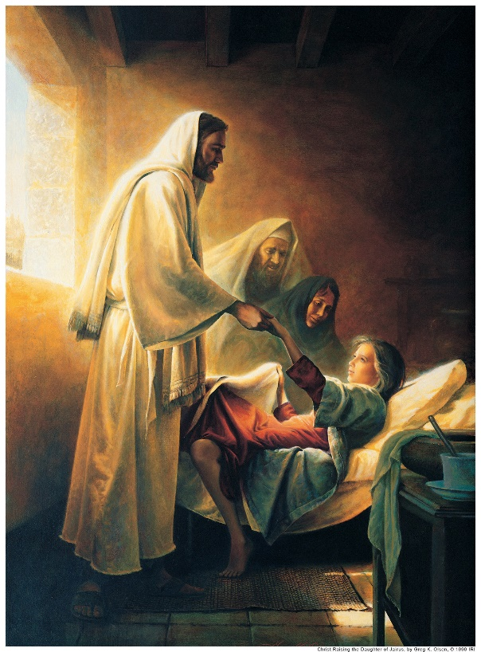
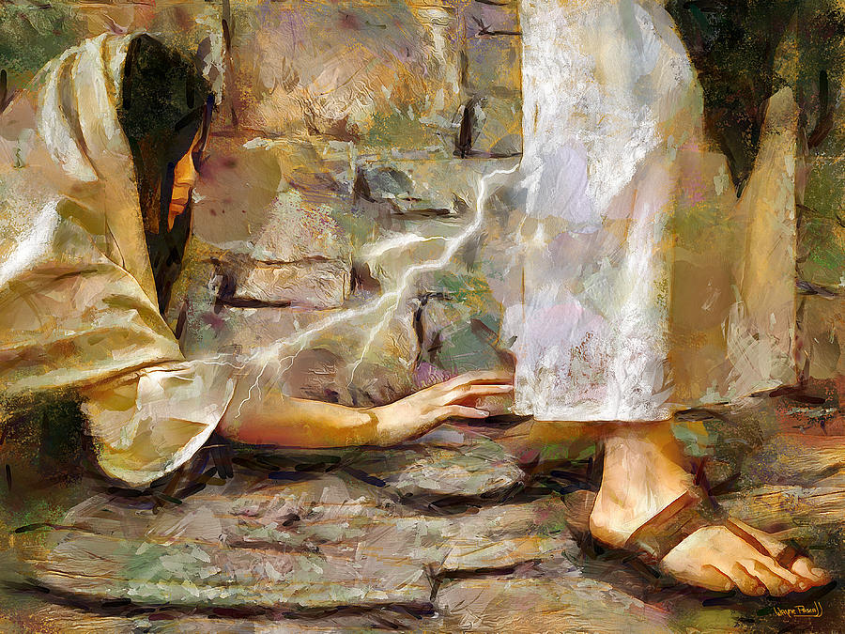
The Miracles
Matthew 9:1-8
Matthew 9:20-22
Matthew 9:18-19, 23-26
Wayne Pascall

Slide 12
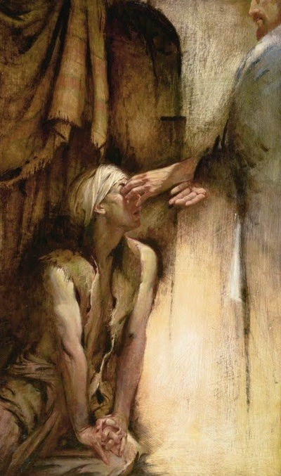
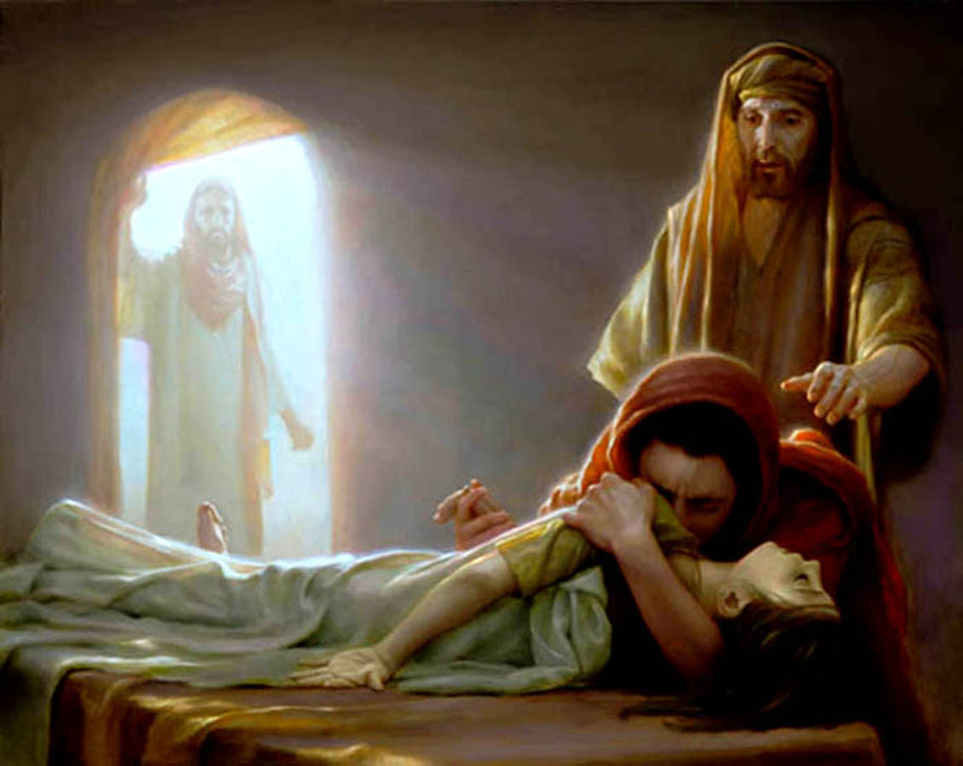
The Miracles
Matthew 9:27-31
Matthew 9:32-33
Matthew 9:23-26

Slide 13
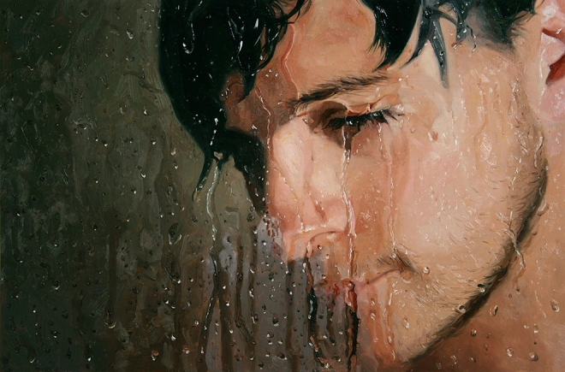
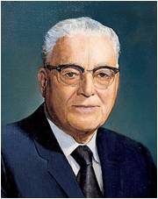
Jesus can heal us of our infirmities and sicknesses
"The greatest miracles I see today are not necessarily the healing of sick bodies, but the greatest miracles I see are the healing of sick souls, those who are sick in soul and spirit and are downhearted and distraught, on the verge of nervous breakdowns.
We are reaching out to all such, because they are precious in the sight of the Lord, and we want no one to feel that they are forgotten.“ (8)

Slide 14
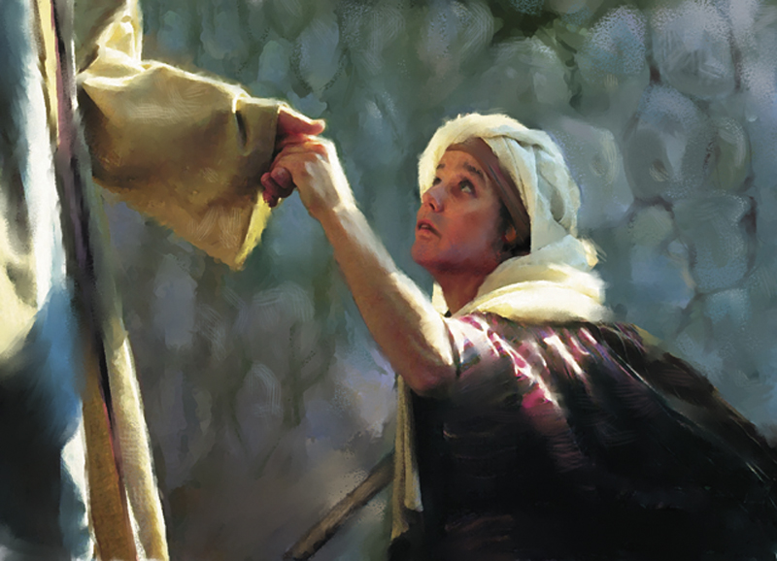
Miracles
An important part of Jesus’ earthly ministry
He used miracles to show compassion, to teach, to inspire, to motivate, and to testify that he was the true Messiah.
After his death and resurrection, his disciples continued to perform miracles and to testify that he was the Messiah, the Son of God who had come in power and authority.

Slide 15
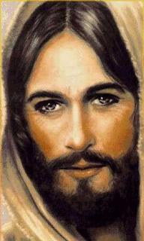
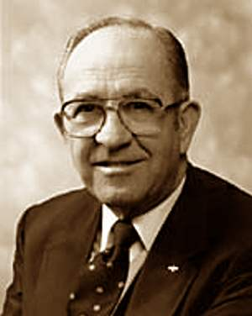
The Gospel Writers
Used Jesus’ miracles to testify that He had power over all enemies
“The healing of the leper, the centurion's servant, and Peter's mother-in-law testified that his power extends to persons of all nations, both Jew and Gentile.
The calming of the sea extended his power to include power over nature and the elements. Casting out the unclean spirits testified of his power over devils and all evil... 226.)
“For individuals in all generations, accounts of the miracles reveal the power of Jesus over all enemies and testify that he was the Son of God and that he had sufficient power to perform the Atonement and bring immortality and the possibility of eternal life to all men.“ (9)

Slide 16
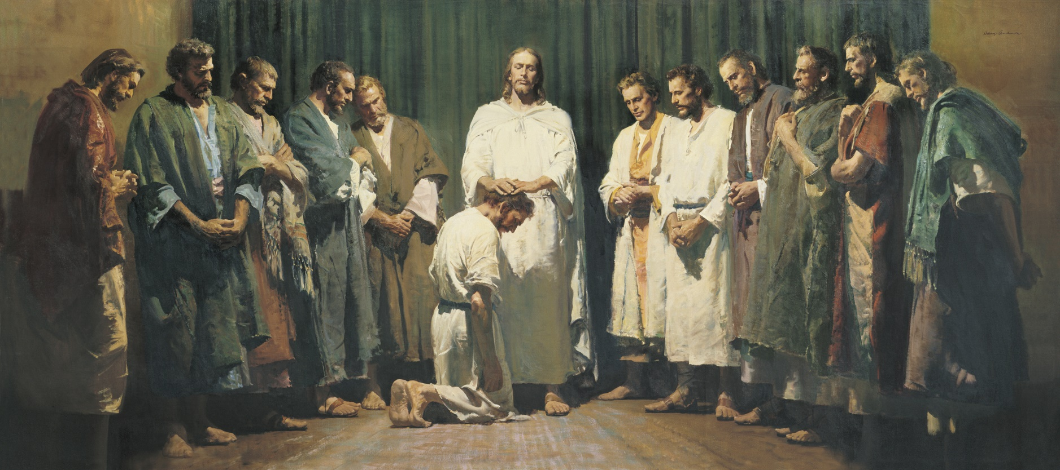
Jesus Calls the Apostles
And confers His authority upon them
The word apostle comes from a Greek word that means “one sent forth.”
At first the Apostles were sent only among the house of Israel. Later, the resurrected Savior commanded that the gospel also be preached among the Gentiles, or those who are not of the house of Israel.
Matthew 10:1-4

Slide 17
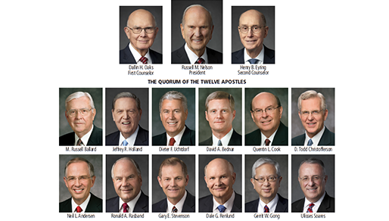
2019

Slide 18
Go Forth and Preach
The first, Simon, who is called Peter, and Andrew his brother; James the son of Zebedee, and John his brother;
Philip, and Bartholomew; Thomas, and Matthew the publican; James the son of Alphæus, and Lebbæus, whose surname was Thaddæus;
Simon the Canaanite, and Judas Iscariot, who also betrayed him.
And Judas the brother of James Luke 6:16
Matthew 10:2-4; Luke 6:16

Slide 19
Go Forth and Preach
The Kingdom of Heaven is at Hand
Heal the sick, raise the dead, and cast out
devils
Work for your meals
and clothes
Go to the lost sheep of Israel (the Jews)
Lodge with those who are worthy (trust)
Don’t take money,
nor script
And Bless them…
Matthew 10:6-13

Slide 20
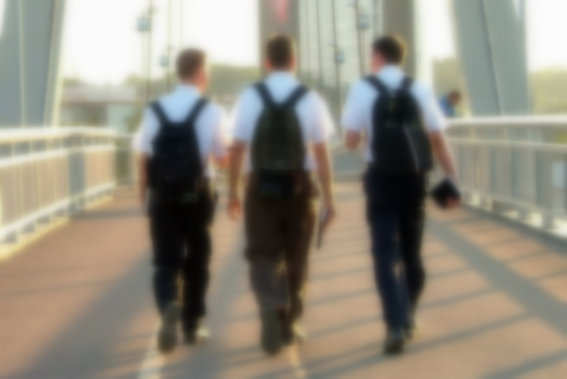
Shake off the Dust
"If the people refused to hear their message, the apostles were to leave that home or city and shake off the dust of their feet. This dusting of feet would be 'against them as a testimony.' (D&C 24:15.)
The servants of the Lord would have power 'to seal both on earth and in heaven, the unbelieving and rebellious; yea, verily to seal them up unto the day when the wrath of God shall be poured out upon the wicked without measure.' (D&C 1:8-9.)
They would know 'that in the day of judgment [they] shall be judges of that house, and condemn them.' (D&C 75:21}.
As Elder McConkie observed: 'It is as though those who reject the message are not worthy to receive even the dust that cleaves to an apostolic sandal.'" (10)
Matthew 10:14

Slide 21
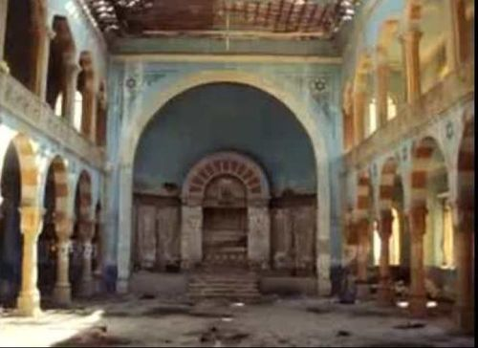
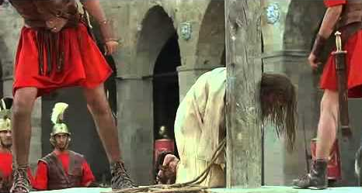
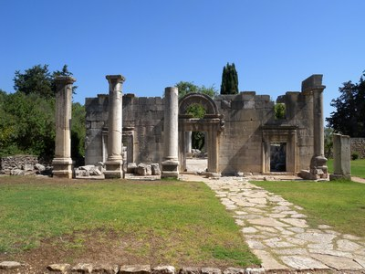
Synagogue of Satan
"In process of time the synagogues became houses of hate and persecution rather than houses of learning and true worship.
…In those sacred spots where sermons had attested to the saving power of the Promised Messiah, cries of anguish would now be heard from the lips of true believers as the scourgers' lash cut their flesh. …
…By rejecting Jesus and opposing the truth, the congregation of Israel became the congregation of unbelief, of hatred, of evil, of Lucifer. They became, as the scripture recites, 'the synagogue of Satan.' (Rev. 2:9)" (11)
Matthew 10:17-23

Slide 22
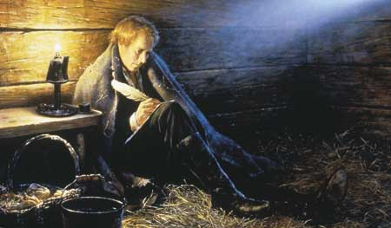
Fear Not
"I do not regard my own life. I am ready to be offered a sacrifice for this people; for what can our enemies do?
Only kill the body, and their power is then at an end.
Stand firm, my friends; never flinch.
Do not seek to save your lives, for he that is afraid to die for the truth, will lose eternal life." (12)
Some of the prophets and other church members were tortured and hung on the cross because of their beliefs.
Matthew 10:28

Slide 23
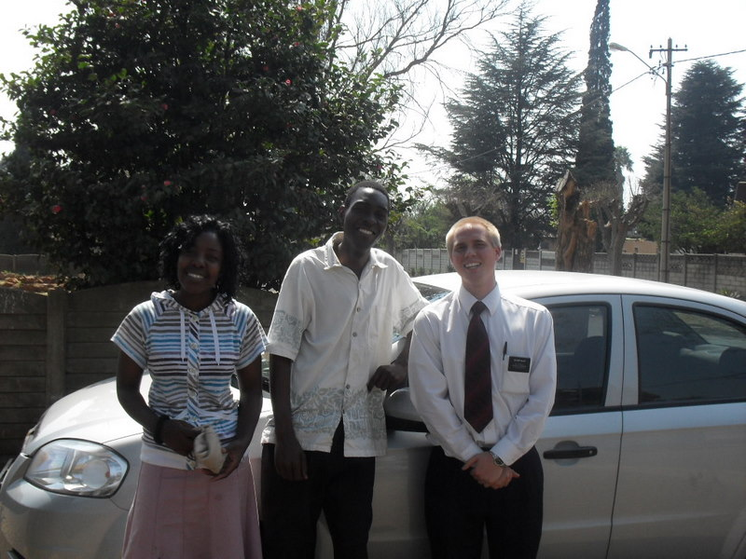
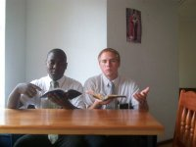
When we are in the service of the Lord, He will inspire us with what to say when needed
Matthew 10:19-20

Slide 24
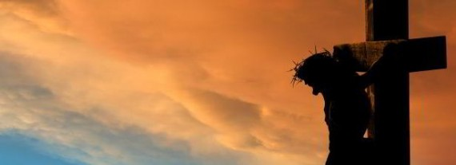
The Cross
One of the initial steps in becoming a disciple is to put away the natural man.
¶ Then said Jesus unto his disciples, If any man will come after me, let him deny himself, and take up his cross, and follow me. Matthew 16:24
We learn that to take up one's individual cross by putting off the natural man is a necessary prerequisite to true discipleship.
Then later, we will be worthy to bear the cross of Christ-which is to suffer the shame of the world
…they who have endured the crosses of the world, and despised the shame of it, they shall inherit the kingdom of God,
2 Nephi 9:18
Matthew 10:38

Slide 25
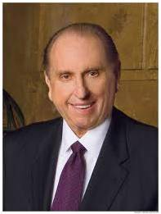
Lose and Find
To be willing to give of ourselves each day to serve Him and the people around us
He that findeth his life shall lose it: and he that losethhis life for my sake shall find it.
“I believe the Savior is telling us that unless we lose ourselves in service to others, there is little purpose to our own lives. Those who live only for themselves eventually shrivel up and figuratively lose their lives, while those who lose themselves in service to others grow and flourish—and in effect save their lives.” (7)
Matthew 10:39

Slide 26
Sources:
Suggested Hymn: #87 God is Love
Videos: Elder Bednar Speaks on Apostles' Role (2:19)
It’s True, Isn’t It? Then What Else Matters? (1:06)
Joshua J. Mark Ancient History Encyclopedia
Wikipedia
Jewish Virtual Library
Bible Dictionary
New Testament Student Manual Institute Chapter 4
Teachings of Gordon B. Hinckley, 304
Elder Thomas S. Monson (May 11, 1965, BYU Speeches of the Year, 1965, p. 9.)
What Have I Done for Someone Today? Ensign or Liahona, Nov. 2009, 85).
President Harold B. Lee (Ensign, July 1973, p. 123.)
Rex C. Reeve, Jr., Studies in Scripture, Vol. 5: The Gospels, ed by Kent P. Jackson and Robert L. Millet, 226.)
(Kent P. Jackson and Robert L. Millet, eds., Studies in Scripture, Vol. 5: The Gospels, 234.)
Elder Bruce R. McConkie (The Mortal Messiah: From Bethlehem to Calvary, 1: 199
Joseph Smith (History of The Church of Jesus Christ of Latter-day Saints, 6: 503.)
Presentation by ©http://fashionsbylynda.com/blog/

Slide 27
Ruins of a Capernaum synagogue dating to the fourth or fifth century A.D. Beneath the remains of the white limestone synagogue, the black basalt foundation of an earlier synagogue can be seen. It has been dated to the first century A.D. and is likely the synagogue built by the centurion, as described in Luke 7:5. In this synagogue, the Savior taught (see Mark 1:21; John 6:59), cast evil spirits out of a man (see Mark 1:21–26), and healed a man with a withered hand (see Mark 2:1; 3:1–5).
NT Student Institute Manual Chapter 4
Event | Matthew | Mark | Luke | John
Jesus Heals Peter’s Mother-in-Law and Others | 8:14-17 | 1:29-34 | 4:38-41
Jesus Cleanses a Leper | 8:2-4 | 1:40-45 | 5:12-16
Jesus Heals a Man with Palsy | 9:2-8 | 2:1-12 | 5:17-26
Matthew Follows Jesus | 9:9 | 2:13-14 | 5:27, 28
Jesus Came to Call Sinners to Repentance | 9:10-13 | 2:15-17 | 5:29-32
Jesus is the New law | 9:14-17 | 2:18-22 | 5:33-39
Call and Ordination of the Twelve Apostles | 10:2-4 | 3:13-19 | 6:12-16
Jesus Goes to Capernaum and Heals Centurion’s Servant | 8:1, 5-13 |  | 7:1-10
Jesus Calms the Storm at the Sea | 8:18, 23-27 | 4:35-41 | 8:22-25
Jesus Casts Legion of Devils into Swine | 8:28-34 | 5:1-20 | 8:26-39
Return to Capernaum | 9:1 | 5:21 | 8:40
Jairus Seeks Jesus to Heal His Dying Daughter | 9:18, 19 | 5:22-24 | 8:41, 42
Woman Touches Jesus and is Healed | 9:20-22 | 5:25-34 | 8:43-48
Jairus’ Daughter Raised from Death | 9:23-26 | 5:35-43 | 8:49-56
Two Blind Men are Healed | 9:27-31
Casting Devil Out of Dumb Man | 9:32-34
Miracles of Jesus:
"The miracles performed by Jesus were an important part of his earthly ministry. He used miracles to show compassion, to teach, to inspire, to motivate, and to testify that he was the true Messiah. After his death and resurrection, his disciples continued to perform miracles and to testify that he was the Messiah, the Son of God who had come in power and authority.
The Gospel writers used his miracles to testify that he had power over all enemies. The healing of the leper, the centurion's servant, and Peter's mother-in-law testified that his power extends to persons of all nations, both Jew and Gentile. The calming of the sea extended his power to include power over nature and the elements. Casting out the unclean spirits testified of his power over devils and all evil... For individuals in all generations, accounts of the miracles reveal the power of Jesus over all enemies and testify that he was the Son of God and that he had sufficient power to perform the Atonement and bring immortality and the possibility of eternal life to all men." (Rex C. Reeve, Jr., Studies in Scripture, Vol. 5: The Gospels, ed by Kent P. Jackson and Robert L. Millet, 226.)
Source: Horizontal Harmony of the Four Gospels by Thomas M. Mumford

Slide 28
Matthew 8:1-4 Healing a Leper:
A terrible form of skin disease spoken of in the Bible. Many notables were at some time afflicted with it, including Moses (Ex. 4:6–7), his sister Miriam (Num. 12:10), Naaman (2 Kgs. 5), and King Uzziah (2 Chr. 26:19–21).
In these cases leprosy was given as a sign, a warning, or a punishment. There were apparently several types of leprosy, and the word is used in the Bible to designate other sicknesses or diseases. For example, clothing and walls were said to be leprous when they had patches of mildew or some fungous growth, as in Lev. 13:47–59; 14:33–37. Instances of Jesus curing leprosy are recorded in Matt. 8:2–4; Mark 1:40–45; Luke 5:12–15; 17:11–15. Bible Dictionary
No Jew would dare approach a leper, let alone touch him. Yet, there was One whose perfect love knew no fear-the Holy One could not be contaminated by decaying flesh, and this leper was privileged to feel the touch of the Master's hand. Sister Chieko Okazaki said, "...he 'put forth his hand, and touched him.' Then he said, 'I will; be thou clean' (Matt. 8:1Matt. 8:2Matt. 8:3Matt. 8:1-3). I can't help thinking that the sheer physical fact of a loving touch was as healing to this person, whom no one had willingly touched for years, as the words of compassion and the act of healing must have been." (Disciples, 121 - 122.) gospeldoctrine.com
Tell No Man:
"My thoughts turned backward in time-back to the Holy Land; back to Him who on that special mountain taught His disciples the true spirit of giving when He counseled, 'Take heed that ye do not your alms before men, to be seen of them. . . . When thou doest alms, let not thy left hand know what thy right hand doeth.' (Matthew 6:1, 3.)
"Then, as though to indelibly impress on their souls the practical application of this sacred truth, He came down from the mountain with a great multitude following Him. 'And, behold, there came a leper and worshipped him, saying, Lord, if thou wilt, thou canst make me clean. And Jesus put forth his hand, and touched him, saying, I will; be thou clean. And immediately his leprosy was cleansed. And Jesus saith unto him, See thou tell no man.' (Matthew 8:2-4.)
"The word anonymous had a precious meaning then. It still has." President Thomas S. Monson (Live the Good Life, 28.)
Shew Thyself to a Priest:
In the rare circumstance that leprosy should go into remission, there was provision in the Law of Moses for the individual to be cleansed ceremonially and return to a normal life. The process involved an 8-day cleansing in which the individual offered two birds, the blood of one was taken and sprinkled on the leper. All body hair had to be shaved, the body and clothes cleaned. A week later, the individual could return to the priest. The priest would then offer a sin offering of two lambs or, if poor, one lamb and two birds. Once the atoning blood and ceremonial oil were anointed, the individual was clean (Lev 14). The cleansing process involved water, oil (symbolic of the Spirit) and blood, 'For by the water ye keep the commandment; by the Spirit ye are justified, and by the blood ye are sanctified' (Moses 6:60).
Matthew 8:5-13 Healing a Centurion’s Servant:
A centurion was an officer in the Roman army in command of a company of 50 to 100 men. The Jews generally viewed centurions with contempt, for they symbolized the Roman political and military authority. However, Luke highlighted several admirable qualities of this particular centurion. He was altruistic, centering his request on the needs of his servant, “who was dear unto him” (Luke 7:2). The centurion’s goodness was affirmed by elders of the Jews. He demonstrated genuine humility, deeming himself unworthy to visit Jesus in person or to have Jesus enter his house (see Luke 7:6–7). Another reason the centurion may not have sought a personal visit with Jesus is that observant Jews were forbidden to have close contact with Gentiles, such as eating with them or entering their homes.
The centurion, however, did not allow his feelings of unworthiness to prevent him from seeking the Savior’s help. He exercised tremendous faith in Jesus Christ, believing His word alone was sufficient to heal the servant. The centurion acknowledged Jesus’s divine authority and by using the word also likened it unto the military authority with which he was familiar (see Luke 7:8). The Savior’s response that He had “not found so great faith, no, not in Israel” (Luke 7:9) corresponds with His messianic declaration that He was anointed to bless all who would accept Him (see Luke 4:16–30) and supports Luke’s theme regarding the Lord’s concern for Gentiles.
Matthew 8:14-17 Healing of Peter’s Mother-in-law:
Elder Bruce R. McConkie (1915–85) of the Quorum of the Twelve Apostles used the account of Peter’s mother-in-law being healed by the Savior to teach that “Jesus’ specially selected disciples were married men with wives and children and families of their own, as his specially called servants should be in all ages” Elder Bruce R. McConkie (The Mortal Messiah: From Bethlehem to Calvary, 4 vols. [1979–81], 2:37).

Slide 29
Matthew 8:23-27 Jesus Calms the Seas
"Jesus found a resting place near the stern of the ship and soon fell asleep. A great storm arose; and still He slept. The circumstance is instructive as it evidences at once the reality of the physical attributes of Christ, and the healthy, normal condition of His body. He was subject to fatigue and bodily exhaustion from other causes, as are all men; without food He grew hungry; without drink He thirsted; by labor He became weary. The fact that after a day of strenuous effort He could calmly sleep, even amidst the turmoil of a tempest." James E. Talmage (Jesus the Christ, 285)
Matthew 9:2 Jesus Heals A man With palsy
The Master's spiritual perceptiveness is impressive. In this chapter alone, we see his ability to look into someone's eyes and perceive what was in their hearts. He perceives the faith of the palsied man and his entourage; he knows the thoughts of the scribes (v. 4), he anticipates the hypocrisy of the Pharisees (v. 14-18) he looks at a publican and sees an apostle (v. 9). One of the many characteristics of Christ which we should attempt to emulate is his incredible spiritual sensitivity. Gospel Doctrine.com
Matthew 8:29 Casting Out Unclean Spirits
"Our Lord's true identity is known to unclean spirits. Mortal men may profess not to know of his divinity, but there is no doubt in the minds of the devils in hell. They remember him from their pre-existent association. They know he was foreordained to be the Redeemer, that he was born into the world as the literal offspring of the Father, and that their course in opposing him is one in open rebellion against Deity." Bruce R. McConkie (Doctrinal New Testament Commentary, 1: 314.)
Joseph Smith
"The great principle of happiness consists in having a body. The Devil has no body, and herein is his punishment. He is pleased when he can obtain the tabernacle of [a] man, and when cast out by the Savior, he asked to go into the herd of swine, showing that he would prefer a swine's body to having none. All beings who have bodies have power over those who have not. The Devil has no power over us, only as we permit him; the moment we revolt at anything which comes from God, the Devil takes power.
"The Devil is without a tabernacle, and the Lord has set bounds to all spirits. Hence comes the saying: 'Thou son of David, why art thou come to torment us before the time?' Jesus commanded him to come out of the man, and the Devil besought him that he might enter in a herd of swine nearby. For the Devil knew they were a covetous people, and if he could kill their hogs, they would drive Jesus out of their coasts, and he then would have tabernacle[s] enough. Jesus permitted him to enter into the swine.
"Wicked spirits have their bounds, limits, and laws by which they are governed or controlled and know their future destiny. Hence those that were in the maniac said to our Savior, 'Art thou come to torment us before the time?'
"The greatness of his punishment is that he shall not have a tabernacle; this is his punishment. So the Devil thinks to thwart the decree of God by going up and down in the earth seeking whom he may destroy-any person that he can find that will yield to him. He will bind him and take possession of the body and reign there, glorying in it mightily, not thinking that he had got a stolen tabernacle. By and by, someone of authority will come along and cast him out and restore the tabernacle to his rightful owner. But the Devil steals a tabernacle because he has not one of his own, but if he steals one he is liable to be turned out of doors.
"When Lucifer was hurled from heaven, the decree was that he should not obtain a tabernacle, nor those that were with him, but go abroad upon the earth exposed to the anger of the elements, naked and bare. But oft times he lays hold upon men, binds up their spirits, enters their habitations, laughs at the decree of God, and rejoices in that he hath a house to dwell in. By and by, he is expelled by authority and goes abroad mourning, naked upon the earth like a man without a house, exposed to the tempest and the storm.
"The mortification of Satan consists in his not being permitted to take a body. He sometimes gets possession of a body, but when the proven authorities turn him out of doors, he finds it was not his but a stolen one." (Kent P. Jackson, comp. and ed., Joseph Smith's Commentary on the Bible, 85.)
Matthew 9:20-22 Jesus Heals the Woman
For a woman to have a constant issue of blood was a stigma of uncleanliness. According to the Law of Moses, when a woman had an issue of blood, she was considered ceremonially unclean for 14 days (Lev. 15:19-28). Should anyone even touch a portion of her clothing, they were considered unclean for that day. Therefore, this woman must have been unclean according to the Law of Moses for 12 consecutive years. In 12 long years, she would not have been able to perform the rites of purification necessary to be made clean before the Lord. Gospel Doctrine.com
Jesus Christ has the power to heal all manner of illness, whether spiritual or physical. A woman was healed by simply touching the border of his garment…we can feel the Savior’s touch, and we can help others feel that divine touch. We can bless each other by reaching out to the wayward youth, the inactive adult, the widowed, the aged, the sick, and to all of God’s children everywhere, member and nonmember of the Church alike.
The Savior’s Touch
M. Russell Ballard Oct. 1980 Gen. Conf.

Slide 30
Matthew 9:23-26 Jesus Heals the maid
"Oriental customs of public mourning and display at the time of death prevailed among the Jews of Jesus' day. Noise, tumult, weeping, screeching, screaming, flute playing, and the use of hired mourners-all were part of the orthodox mourning rituals." (Doctrinal New Testament Commentary, 1: 316.) Bruce R. McConkie
By this statement, Christ did not mean that the girl had not yet died, but that her condition was only temporary-like sleep. The statement seemed ridiculous and brought scorn, but it was intended as a foreshadowing of the miracle He intended to perform.
"That same power has been restored in this generation. It came through the laying on of hands by Peter, James, and John, who received it from the Lord himself. It was bestowed upon Joseph Smith, the prophet of this dispensation. Its presence is among us. Those who are acquainted with the history of the Church are familiar with the account related by Wilford Woodruff concerning the events of July 22, 1839. Nauvoo at that time was an unhealthy and swampy place. There was much sickness. Joseph was among those who were afflicted. But being filled with the Spirit, he rose from his bed and went out among the sick, healing them and raising them. He then crossed the river to the settlement in Montrose, Iowa.
I now refer to the account of Elder Woodruff:
'The first house he visited was that occupied by Elder Brigham Young, the president of the quorum of the twelve, who lay sick. Joseph healed him, then he arose and accompanied the Prophet on his visit to others who were in the same condition. They visited Elder W. Woodruff, also Elders Orson Pratt and John Taylor, all of whom were living in Montrose. They also accompanied him. The next place they visited was the home of Elijah Fordham, who was supposed to be about breathing his last. When the company entered the room the Prophet of God walked up to the dying man, and took hold of his right hand and spoke to him; but Brother Fordham was unable to speak, his eyes were set in his head like glass, and he seemed entirely unconscious of all around him. Joseph held his hand and looked into his eyes in silence for a length of time. A change in the countenance of Brother Fordham was soon perceptible to all present. His sight returned, and upon Joseph asking him if he knew him, he, in a low whisper, answered, 'Yes.' Joseph asked him if he had faith to be healed. He answered, 'I fear it is too late; if you had come sooner I think I would have been healed.' The Prophet said, 'Do you believe in Jesus Christ?' He answered in a feeble voice, 'I do.' Joseph then stood erect, still holding his hand in silence several moments; then he spoke in a very loud voice, saying: 'Brother Fordham, I command you in the name of Jesus Christ to arise from this bed and be made whole.' His voice was like the voice of God, and not of man. It seemed as though the house shook to its very foundations. Brother Fordham arose from his bed and was immediately made whole. His feet were bound in poultices, which he kicked off, then putting on his clothes, he ate a bowl of bread and milk, and followed the Prophet into the street. (As quoted in Joseph Fielding Smith, Essentials in Church History, rev. ed. [Salt Lake City: Deseret Book, 1979], pp. 223-24.)'" (Gordon B. Hinckley, Faith: The Essence of True Religion [Salt Lake City: Deseret Book Co., 1989], 31.)(As quoted in Joseph Fielding Smith, Essentials in Church History, rev. ed. [Salt Lake City: Deseret Book, 1979], pp. 223-24.)'" (Gordon B. Hinckley, Faith: The Essence of True Religion [Salt Lake City: Deseret Book Co., 1989], 31.)
Matthew 9:32-33 Jesus Heals the Dumb
Jesus healed many from physical diseases, but He did not withhold healing from those who sought to be “made whole” from other ailments. Matthew writes that He healed every sickness and every disease among the people (see Matthew 4:23 9:35 Great multitudes followed Him, and He “healed them all” Matthew 12:15 Surely these healings included those whose sicknesses were emotional, mental, or spiritual. He healed them all. Dallin H. Oaks 2006 Oct. Gen. Conf.
Matthew 10:14 Shake off the dust
"The elders were to seek out from among the people the honest in heart and leave their warning testimony with all others, thus they would become clean from their blood. The cleansing of their feet, either by washing or wiping off the dust, would be recorded in heaven as a testimony against the wicked. This act, however, was not to be performed in the presence of the offenders, 'lest thou provoke them, but in secret, and wash thy feet, as a testimony against them in the day of judgment.'" Joseph Fielding Smith (Doctrine and Covenants Encyclopedia, 514.)
Matthew 10:16 Wise As A Serpent
"The Lord foresaw the evils of our day and the designs of cunning and deceiving men who operate under the influence of Satan and his satanic hosts. Satan's power to deceive and to lead astray the children of men is unquestioned...We, the people of the Lord, cannot afford to be lulled into peaceful security and complacency. The dangers of our day are real and knocking constantly and unrelentingly at our doors. How ably will we meet the challenge of these evil influences and designs of wicked men? The test of true Church membership is here. Can we stand firm and true to the principles, ideals and standards of the gospel, or will we be so naive and unsuspecting as to fall into the traps of evil so cunningly planned and promoted by designing and conspiring men? Those of a religious nature are so often classified naive and innocently unsuspecting. The Savior knowing of this attribute counseled his disciples, 'Behold, I send you forth as sheep in the midst of wolves: be ye therefore wise as serpents and harmless as doves.' And he added: '. . . beware of men...' (Matt. 10:16-17.)
"Possessing, as we do, the endowment of the Holy Ghost, if worthy, we are entitled to the gift of discernment to guide and help us avoid the pitfalls of scheming and designing men to trap and ensnare us into the meshes of worldly lusts, influences, and pleasures.“ Elder Delbert L. Stapley (Conference Report, October 1961,

