Slide 1
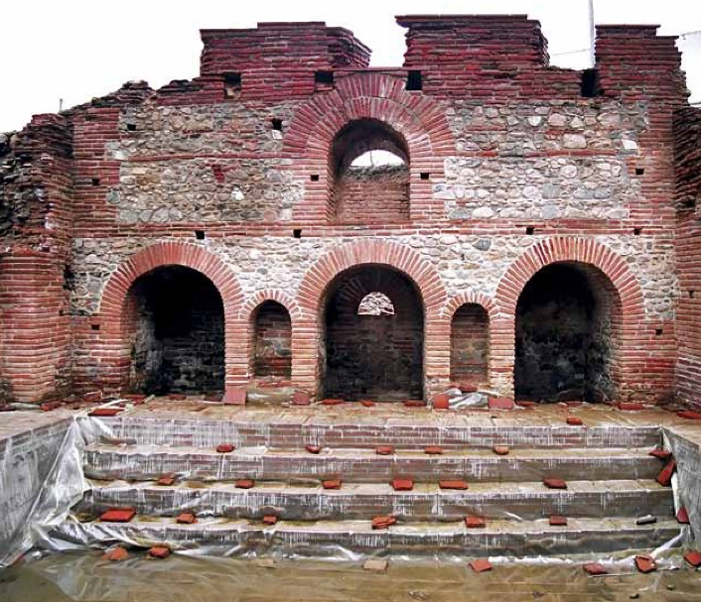
Lesson 130
Guidelines and Responsibilities
1 Timothy

Slide 2
Pastoral Epistles
Before writing this epistle, Paul had been released from his two-year imprisonment (house arrest) in Rome and was likely traveling widely, visiting regions where he had previously established branches of the Church
The books of 1 Timothy, 2 Timothy, and Titus are known as the pastoral Epistles because they contain instruction to help leaders regulate the Church.
Macedonia
Black Sea
Rome
Italy
Adriatic Sea
Mysia
Ephesus
Cilicia
Sicily
Antioch
Paul wrote this epistle to Timothy, who had served with Paul during his second missionary journey.
Syria
Crete
Cyprus
Mediterranean Sea
Jerusalem
(1)

Slide 3
Timothy
His name means Honored of God, and sometimes referred in the New Testament as Timotheus (Greek form)
He was a trusted young companion to Paul and mentioned 7 times in the New Testament and 17 more times as Timotheus
Paul’s names for him: “my workfellow”, “my own son in faith”, “my beloved son, and faithful in the Lord”, “our fellow labourer in the gospel of Christ”
Timothy served as Paul’s emissary or companion in multiple projects
He was, at one point, imprisoned, and then set free. (Hebrews 13:23)
He was considered an example of living the gospel of Christ and a faithful missionary and Church leader
Timothy received a letter from Paul while he was serving in Ephesus
(2)

Slide 4
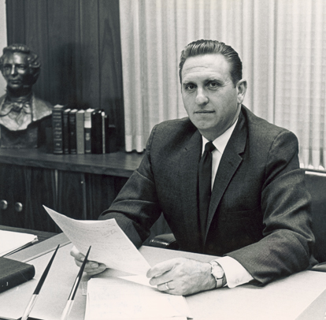
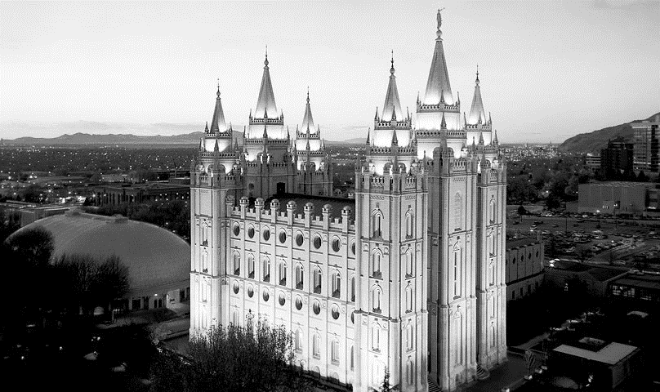
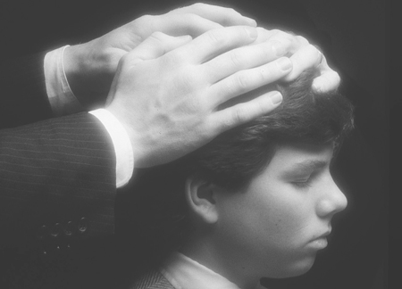
Unauthorized Practice
“I’m reminded of an experience I had many years ago when I served as a bishop. During the opening exercises of our priesthood meeting one Sunday morning, we were preparing to ordain a young man to the office of priest.
Visiting our ward that day was a high councilor who also served as a temple worker.
As I prepared to have the young man sit down to face the congregation so that we could proceed with the ordination, the high councilor stopped me and said, ‘Bishop, I always have those being ordained turned to face the temple.’
He repositioned the chair so that the young man would be facing in the direction of the temple. I immediately recognized an unauthorized practice.”
As bishop, President Monson, rather than the high councilor, was authorized to preside over the Lord’s work in his ward.
(3)

Slide 5
Apostolic Calling
“an apostle of Jesus Christ by the commandment of God”
The bishop is the presiding high priest and presides over all the members in his ward. In addition, he is the president of the priests quorum and, together with his counselors, is responsible to watch over and nurture the young men and young women in the ward.
A bishop/branch presidents are called by inspiration of the Lord and ordained by a stake president/stake mission president under the direction of the First Presidency of the Church and the Quorum of the Twelve.
Bishops and branch presidents are called to care for the spiritual well-being of the members of their Church units.
1 Timothy 1:3
(4)

Slide 6
Responsibilities
Paul instructed Timothy to stay in Ephesus and protect the Church from false teachings
Fables = false teachings; heeding
“endless genealogies” = the false tradition that salvation came only to those of the chosen seed of Abraham, who were often known by their lengthy or endless genealogies;
“vain jangling” = pointless discussion
Priesthood leaders have the responsibility to ensure that true doctrine and correct practices are taught
1 Timothy 1:3-7
(4)

Slide 7
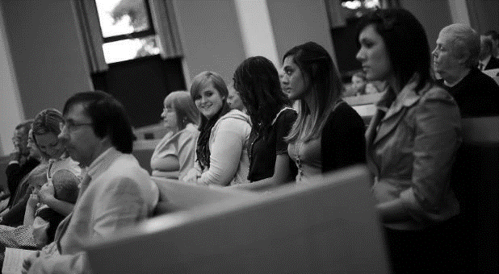
Authority
“I could see the potential for it to become more widespread in practice. Although much younger than the high councilor, I knew what needed to be done. I turned the chair back so that it was again facing the congregation and said to him, ‘In our ward, we face the congregation”.
“I have spoken before about the importance of keeping the doctrine of the Church pure, and seeing that it is taught in all of our meetings. … Small aberrations in doctrinal teaching can lead to large and evil falsehoods.”
(5)
(3)

Slide 8
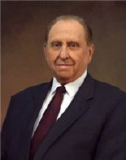
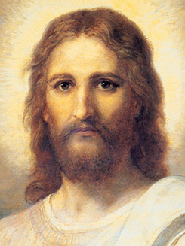
True or False Doctrine?
How Do You Know?
The Light of Christ. “The Light of Christ … prompts all rational individuals throughout the earth to distinguish truth from error, right from wrong. It activates your conscience.”
The Holy Ghost. “The Spirit of truth … will guide you into all truth”
(John 16:13).
Scriptures. “God uses scripture to unmask erroneous thinking, false traditions, and sin with its devastating effects.” The Book of Mormon is especially important in this regard, for it “exposes the enemies of Christ. It confounds false doctrines and lays down contention. (2 Ne. 3:12.)”
Modern prophets. “[A prophet’s] responsibility is to make known God’s will and true character to mankind. … A prophet denounces sin and foretells its consequences.”
Education. “A saint … seeks learning by study, and also by faith. Education … enables one to discern truth from error, particularly through studying the scriptures. ( D&C 88:118.)”
1 Timothy 1:3-7
(5)

Slide 9
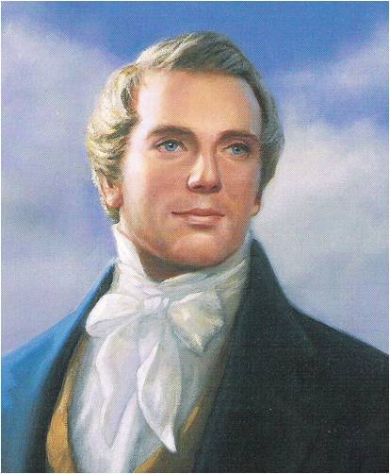
The Law
“The Church is not a debating society; it is not searching for a system of salvation; it is not a forum for social or political philosophies. It is, rather, the Lord’s kingdom with a commission to teach his truths for the salvation of men” (6)
Paul warned against those who desired to be teachers of God’s law but did not have a correct understanding of it.
?
Holy Bible
Without law all must certainly fall into chaos... [It is] for this reason, that law is beneficial to promote peace and happiness among men. And as before remarked, God is the source from whence proceeds all good; and if man is benefited by law, then certainly, law is good; and if law is good, then law, or the principle of it emanated from God; for God is
the source of all good; consequently, then,
he was the first Author of law, or the principle
of it, to mankind. (7)
The
Book
of
Mormon
Doctrine
And
Covenants
ANOTHER TESTAMENT
OF JESUS CHRIST
1 Timothy 1:3-7

Slide 10
Sinning In Ignorance
Paul taught that he had obtained mercy from Jesus Christ because he had acted in ignorance.
One of the gospel’s great eternal truths is that the Lord will not hold anyone accountable for sins committed in ignorance.
For behold, and also his blood atoneth for the sins of those who have fallen by the transgression of Adam, who have died not knowing the will of God concerning them, or who have ignorantly sinned. Mosiah 3:11
c
Mercy and grace are gifts the Lord gives to those who, in their weakness, are striving to be holy
And if men come unto me I will show unto them their weakness. I give unto men weakness that they may be humble; and my grace is sufficient for all men that humble themselves before me; for if they humble themselves before me, and have faith in me, then will I make weak things become strong unto them. Ether 12:27
1 Timothy 1:13-16
(1)

Slide 11
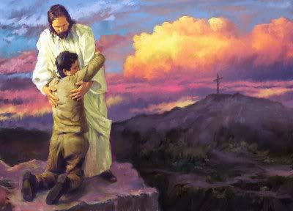
Our Mediator
A mediator is one who intervenes between two parties, usually to restore peace and friendship.
The Joseph Smith Translation provides the insight that Jesus Christ was “ordained to be a Mediator between God and man”
Because He took our sins upon Himself, Jesus Christ can redeem us and reconcile our relationship with the Father, allowing us to return to His presence.
Restored scripture attests that Jesus is the Mediator of the new covenant. He justifies men and women and then perfects them.
These are they who are just men made perfect through Jesus the mediator of the new covenant, who wrought out this perfect atonement through the shedding of his own blood.
D&C 76:69
1 Timothy 2:5-6; JST 1 Timothy 2:4
(1)

Slide 12
Warnings to Women and Men

Slide 13
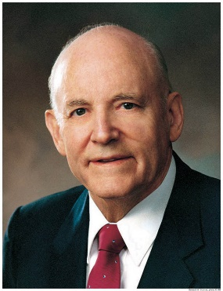
Women
“The girl who chooses to be modest chooses to be respected. A boy who is honest with himself will admit that he likes a girl who is modest in speech, conduct, and dress.
Modesty is one of the great virtues he looks for in the girl he hopes to marry. Most of us know what is modest, and most of us know when modesty ends and immodesty commences.
We know that nothing detracts from the loveliness of a young lady more than immodesty in speech or immodesty in conduct.
A girl fools only herself if she thinks she is impressing a boy by immodest conduct.
The young lady who dresses in an immodest manner ceases to be attractive and embarrasses the young man.
She has called his attention to the person rather than the personality. The girl who chooses to be modest, chooses to be respected.” (8)
Adorn themselves with modest apparel
1 Timothy 2:9-10

Slide 14
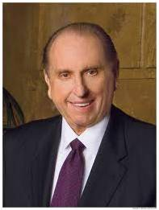
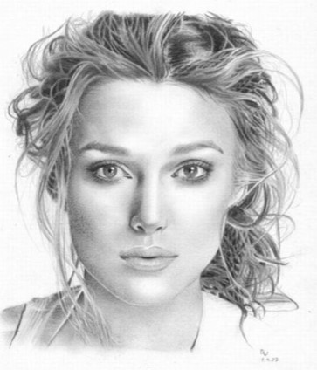
Three goals for Women
Study diligently
Pray earnestly.
Serve willingly
“God planted within women something divine that expresses itself in quiet strength, in refinement, in peace, in goodness, in virtue, in truth, in love.”
—President Gordon B. Hinckley (3)
(3)

Slide 15
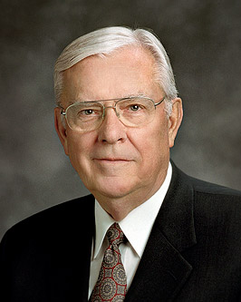
Women in the Church
Some people have taken these verses to mean that women were not allowed to speak in church in Paul’s day. However, his recommendation that women “learn in silence” may have been an effort to correct a specific problem where some women were usurping the authority of Church leaders. (1)
“Let your women keep silence in the churches: for it is not permitted unto them to speak; but they are commanded to be under obedience, as also saith the law.” 1 Corinthians 14:34
JST: rule
“Every sister in this Church who has made covenants with the Lord has a divine mandate to help save souls, to lead the women of the world, to strengthen the homes of Zion, and to build the kingdom of God.” (9)
1 Timothy 2:11-12

Slide 16
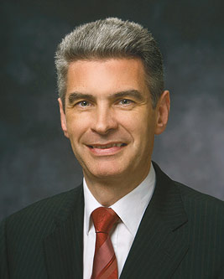
A Bishop
The title “bishop” is derived from the Greek word episcopos—epi, which means “over” (as in the epicenter of an earthquake, or the spot over which the quake centers), and scopos, meaning “look” or “watch.” Therefore, an episcopos, or bishop, is one who watches over the flock as an overseer or supervisor
“You must be men of integrity. You must stand as examples to the congregations over which you preside. You must stand on higher ground so that you can lift others. You must be absolutely honest, for you handle the funds of the Lord. …(5)
1 Timothy 3:1-3
Bishop Gérald Caussé

Slide 17
“Filthy Lucre”
Filthy lucre is blood money; that which is obtained through theft and robbery. It is that obtained through gambling or the operation of gambling establishments.
Filthy Lucre is that had through sin or sinful operations and that which comes from the handling of liquor, beer, narcotics
Filthy Lucre is also money that comes from bribery, and from exploitation.
1 Timothy 3:3

Slide 18
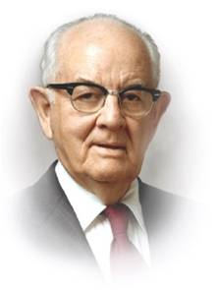
“Compromise money is filthy, graft money is unclean, profits and commissions derived from the sale of worthless stocks are contaminated as is money derived from other deceptions, excessive charges, oppression to the poor and compensation which is not fully earned.
I feel strongly that men who accept wages or salary and do not give commensurate time, energy, devotion, and service are receiving money that is not clean. Certainly those who deal in the forbidden are recipients of filthy lucre.” (10)

Slide 19
Men
“One that ruleth well his own house, having his children in subjection with all gravity;”
“(For if a man know not how to rule his own house, how shall he take care of the church of God?”
With a knowledge of the plan of salvation as a foundation, a man who holds the priesthood looks upon marriage as a sacred privilege and obligation…
A man who holds the priesthood has reverence for motherhood…
Honor your wife’s unique and divinely appointed role as a mother in Israel and her special capacity to bear and nurture children.
You share, as a loving partner, the care of the children. Help her to manage and keep up your home. Help teach, train, and discipline your children.
A man who holds the priesthood regards the family as ordained of God. Your leadership of the family is your most important and sacred responsibility. The family is the most important unit in time and in eternity and, as such, transcends every other interest in life. (11)
1 Timothy 3:3

Slide 20
Qualities of Today's Woman
Choosing righteousness
Taking responsibility for your choices
Having Gratitude in your hearts
Having a desire for Education
Building a strong relationship with your family
Choosing friends with high standards
Serving others
Physically fit
Willing to pay tithes and offerings
Dressing modestly, and unblemished by body piercings and tattoos
Choosing uplifting entertainment
Not using crude, profane or vulgar language or gestures.
Keeping sexually pure
Repentant
Honest
Sabbath observer
Upholding Priesthood Authority
Having a Faith in Jesus Christ

Slide 21
Qualities of Today's Man
Choosing righteousness
Taking responsibility for your choices
Having Gratitude in your hearts
Having a desire for Education
Building a strong relationship with your family
Choosing friends with high standards
Serving others
Physically fit
Willing to pay tithes and offerings
Dressing modestly, and unblemished by body piercings and tattoos
Choosing uplifting entertainment
Not using crude, profane or vulgar language or gestures.
Keeping sexually pure
Repentant
Honest
Sabbath observer
Upholding priesthood covenants
Having a Faith in Jesus Christ

Slide 22
If the paper clip represents a person, what might the magnet represent?
Influences
1 Timothy 4

Slide 23
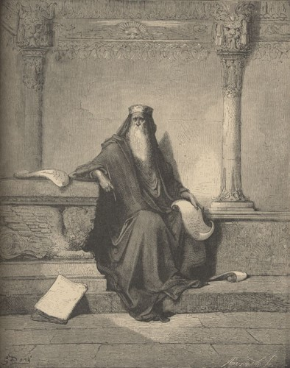
Forbidding to Marry
In Paul’s day, extreme asceticism—the practice of abstaining from physical pleasures in an effort to overcome desires of the flesh—was a threat to the Church.
Paul taught that bishops and deacons should be married and serve as good fathers, that capable adults should provide for the temporal needs of their family, that married women should love their husbands and children and care for their household, and that the last days would be characterized by disobedience to parents. (1)
1 Timothy 4:1-11; 5:8, 14 Titus 1:6-7; 2:4-5

Slide 24
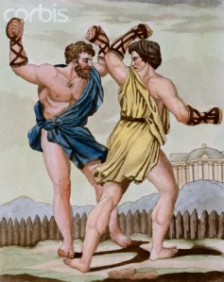
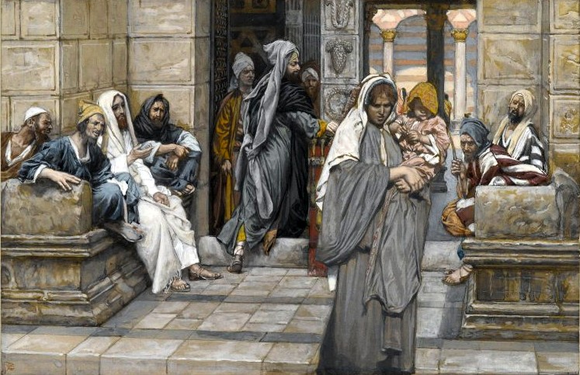
To Be An Example
Staying in Physical Shape
Paul rejected the overvaluation of physical fitness and taught that reading, exhortation, doctrine, and cultivating gifts of the Spirit should take higher priority…Remember this was Roman influences.
If we are examples of the believers of Jesus Christ, we can help bring salvation to ourselves and others
Caring for others
Paul taught true principles about welfare assistance.
If family members would assist widows, the Church could avoid becoming “burdened down”
1 Timothy 4:13-16; 5:4,10

Slide 25
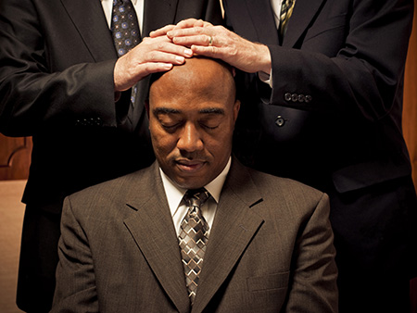
“Lay Hands Suddenly On No Man”
Men were not to be ordained without proper preparation. That preparation included ensuring that the one to be ordained was spiritually mature and worthy and seeking the Lord’s guidance.
1 Timothy 3:1-7; 5:22

Slide 26
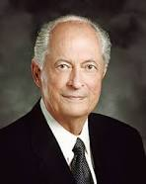
The Wealthy
Paul warned Timothy of the destructive influence that riches can have on those whose hearts are set on the things of the world. Paul’s warnings can be summarized by his statement that “the love of money is the root of all evil.”
Paul also spoke about people who had “coveted after” money and as a result had “erred from the faith, and pierced themselves through with many sorrows” (1)
The love of money leads to unrighteousness and apostasy
“Our world is fraught with feelings of entitlement. Some of us feel embarrassed, ashamed, less worthwhile if our family does not have everything the neighbors have. As a result, we go into debt to buy things we can’t afford—and things we do not really need….”
1 Timothy 6:10

Slide 27
“There is nothing inherently evil about money. The Good Samaritan used the same coinage to serve his fellowman that Judas used to betray the Master. It is ‘the love of money [which] is the root of all evil.’
The critical difference is the degree of spirituality we exercise in viewing, evaluating, and managing the things of this world.”
If we trust in the living God and are rich in good works, then we can lay hold on eternal life
1 Timothy 6:10

Slide 28
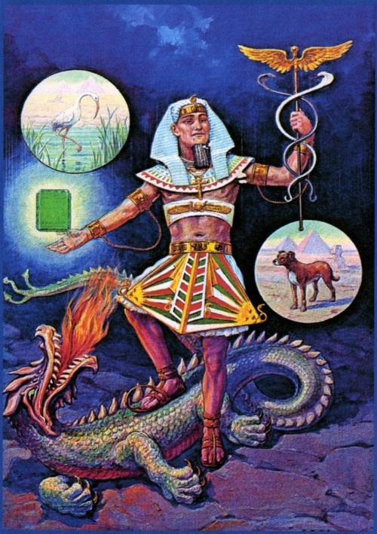
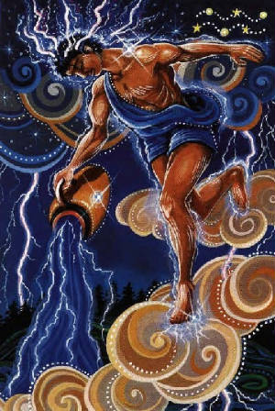
Avoid Vain Babblings
Paul told Timothy to avoid “profane and vain babblings, and oppositions of science”.
“Science” is a translation of the Greek term gnōseōs, = “knowledge,” and the term was probably referring specifically to the Gnostic movement that was then finding its way into early Christianity.
Gnostics believed that salvation was obtained by being instructed in secret knowledge (called gnosis). Gnosticism was a major source of controversy in second-century Christianity.
1 Timothy 6:20

Slide 29
Sources:
Suggested Hymn: #294 Love At Home
Video:
2010 Worldwide Leadership Training (1:08)
Charity: An Example of the Believers (4:50)
New Testament Institute Student Manual Chapter 47
Who’s Who in the New Testament by Richard J. Allen p 190
President Thomas S. Monson (“Opening Remarks” [worldwide leadership training meeting, Nov. 2010], lds.org/broadcasts). Nov. 2007 Ensign “Three Goals to Guide You”
Duties and Blessings of the Priesthood: Basic Manual for Priesthood Holders Lesson 8
Teachings of Gordon B. Hinckley [1997], 620. Bishops (“The Shepherds of Israel,” Ensign or Liahona, Nov. 2003, 60–61).
Elder Bruce R. McConkie (Doctrinal New Testament Commentary, 3 vols. [1965–73], 3:71).
Teachings of the Prophet Joseph Smith, selected and arranged by Joseph Fielding Smith [Salt Lake City: Deseret Book Co., 1976], 55.)
The Teachings of Howard W. Hunter, edited by Clyde J. Williams [Salt Lake City: Bookcraft, 1997], 123.) Husbands- Being a Righteous Husband and Father Oct. 1994 Gen. Conf.
Elder M. Russell Ballard ‘Great Indignation Meeting,’ Deseret Evening News, 15 Jan. 1870, 2)” (“Women of Righteousness,” Ensign, Apr. 2002, 70).
Spencer W. Kimball Conference Report Oct 1953
Elder Robert D. Hales (“Becoming Provident Providers Temporally and Spiritually,” Ensign or Liahona, May 2009, 8–10).
Elder Dallin H. Oaks (“Spirituality,” Ensign, Nov. 1985, 63).
Presentation by ©http://fashionsbylynda.com/blog/

Slide 30
Paul’s First Letter to Timothy Written from Macedonia to Ephesus sometime between A.D. 64 and 65 (1 Timothy)
Teach Only True Doctrine | 1:1–11
Christ Came to Save Repentant Sinners | 1:12–17
Timothy’s Responsibility | 1:18–20
Prayers of Thanks Are Pleasing to Our Mediator | 2:1–8
The Conduct of Women in Worship Services | 2:9–15
Requirements for a Bishop | 3:1–7
Description of a Worthy Deacon | 3:8–13
The Mystery of Godliness | 3:14–16
Signs of Latter-day Apostasy | 4:1–11
“Be Thou an Example of the Believers” | 4:12–16
Saints Commanded to Care for Their Worthy Poor | 5:1–16
The Responsibility of Elders | 5:17–25
Slaves Are to Respect Their Masters | 6:1, 2
Sound Teaching About Wealth | 6:3–10
Timothy—Fight the Good Fight | 6:11–21
Concerned for Reliable Bishops 1 Timothy 1:3:
"Paul's concern for reliable bishops suggests his purpose in writing. The earliest post-apostolic letters picture the bishop as the critical leader in the fight against apostasy. Paul said that he had excommunicated two who apparently spoke against the constituted authorities, 'whom I have delivered unto Satan, that they may learn not to blaspheme' (1 Tim. 1:20). Paul told Timothy to remain at Ephesus; the apostle was on his way to Macedonia, perhaps to visit the Philippian branch again (1 Tim. 1:3). He had assigned Timothy 'so you may command certain people not to teach different doctrines' (1 Tim. 1:3, literal trans.). Thus, true priesthood is linked with true doctrine. In these critical needs Paul not only instructed but planned to return 'shortly' to throw his strength into the battle (1 Tim. 3:14). There is an urgency in 1 Timothy from the opening warning about rebuking false teachers to the closing language of command. 'O Timothy, guard what has been entrusted to you' (1 Tim. 6:20, RSV) is spoken in sober warning against those reforming the revealed gospel." (Richard Lloyd Anderson, Understanding Paul [Salt Lake City: Deseret Book Co., 1983], 317.)
Fables and Endless Genealogies 1 Timothy 1:4; 4:7:
“‘The Jews had scrupulously preserved their genealogical tables, till the advent of Christ … but we are told that Herod destroyed the public registers: he, being an Idumean, was jealous of the noble origin of the Jews: and that none might be able to reproach him with his descent, he ordered the genealogical tables, which were kept among the archives in the temple, to be burned. …
From this time the Jews could refer to their genealogies only from memory, or from those imperfect tables which had been preserved in private hands; and to make out any regular line from these, must have been endless and uncertain. It is probably to this the apostle refers; I mean the endless and useless labor which the attempt to make out these genealogies, must produce; the authentic tables being destroyed.’
“So we may well conclude that Paul’s denunciation was towards doubtful and untruthful genealogies which had been tampered with for improper purposes.” (Smith, Answers to Gospel Questions, 1:214–15.)
Paul may also have had reference to the Jewish tendency to take great pride in their ancestry and in their belief that genealogical descent was a proof of God’s favor (John 8:37–45). This, Paul says, is a fable. God’s favor is given on the basis of righteousness, not ancestry. Life and Teachings of Jesus and His Apostles Chapter 44
"Paul was living in a time of conflict and confusion. False teachers abounded, preaching false doctrines and fables. Two specific problems existed relating to genealogies:
"(1) Some apostate teachers recited their genealogies to give credence to their claims as coming with authority. Many Jews had become arrogant because of their illustrious ancestors. Some even flaunted their lineage when opposing the Savior himself: "We be Abraham's seed" (John 8:33), they said, as if to indicate that they were thereby natural inheritors of the truth.
"(2) Some of the apostate Jewish teachers were guilty of manufacturing their own genealogies-creating them in hopes of giving the added weight of authority to their teachings. George H. Fudge, "I Have a Question," Ensign, Mar. 1986, 49
Life and Teachings of Jesus and His Apostles Chapter 44

Slide 31
Those Who Teach 1 Timothy 1:3-7, 18-20:
Those who teach must make sure the doctrine remains pure and that it is taught. Teach by the Spirit, using the scriptures and the approved curriculum. Do not introduce or dwell on speculative and questionable topics…In a word that is filled with sin, conflict, and confusion, we can find peace and safety in knowing and living the revealed truths of the gospel. Elder M. Russell Ballard Conf. Report Oct 1993, 104; or Ensign, Nov. 1993, 77
‘May women speak in church? Yes, in the sense of teaching, counseling, testifying, exhorting, and the like; no, in the sense of assuming rule over the Church as such, and in attempting to give direction as to how God’s affairs on earth shall be regulated: ‘A woman has no right to found or organize a church—God never sent them to do it.’
Paul is here telling the sisters they are subject to the priesthood, that it is not their province to rule and reign, that the bishop’s wife is not the bishop.”—Bruce R. McConkie “Doctrines of the New Testament Commentaries” pg 2:387-88
Women 1 Timothy 2:14:
“It was Eve who first transgressed the limits of Eden in order to initiate the conditions of mortality. Her act, whatever its nature, was formally a transgression but eternally a glorious necessity to open the doorway toward eternal life. Adam showed his wisdom by doing the same. And thus Eve and ‘Adam fell that men might be’ [2 Nephi 2:25].
“Some Christians condemn Eve for her act, concluding that she and her daughters are somehow flawed by it. Not the Latter-day Saints! Informed by revelation, we celebrate Eve’s act and honor her wisdom and courage in the great episode called the Fall. … Joseph Smith taught that it was not a ‘sin,’ because God had decreed it (see The Words of Joseph Smith, ed. Andrew F. Ehat and Lyndon W. Cook, [1980], p. 63). …
“Modern revelation shows that our first parents understood the necessity of the Fall. Adam declared, ‘Blessed be the name of God, for because of my transgression my eyes are opened, and in this life I shall have joy, and again in the flesh I shall see God’ (Moses 5:10).
“Note the different perspective and the special wisdom of Eve, who focused on the purpose and effect of the great plan of happiness: ‘Were it not for our transgression we never should have had seed, and never should have known good and evil, and the joy of our redemption, and the eternal life which God giveth unto all the obedient’ (v. 11). In his vision of the redemption of the dead, President Joseph F. Smith saw ‘the great and mighty ones’ assembled to meet the Son of God, and among them was ‘our glorious Mother Eve’ (D&C 138:38–9)” Elder Dallin H. Oaks (“The Great Plan of Happiness,” Ensign, Nov. 1993, 73).
Bishop Gérald Caussé, of France, was named the presiding bishop of The Church of Jesus Christ of Latter-day Saints on October 9, 2015. He filled the vacancy created by Gary E. Stevenson, who became a member of the Quorum of the Twelve Apostles on October 3, 2015.
Prior to this assignment, Bishop Caussé served as the first counselor in the Presiding Bishopric since March 2012. He previously served as as a General Authority Seventy and as a counselor in the Europe Area Presidency. He is the third presiding bishop born outside the United States and the first for whom English is a second language.
Bishop Caussé received a master’s degree in business from ESSEC in 1987. His career has been in the food industry, where he worked with several supermarket chains and food distribution companies. At the time of his call as a General Authority Seventy, he was the general manager of Pomona, a food distribution company in France.
Bishop Caussé has served in numerous Church callings, including elders quorum president, bishop’s counselor, stake president’s counselor, stake president, and Area Seventy.
Gérald Caussé was born in Bordeaux, France, on May 20, 1963. He married Valérie Lucienne Babin in August 1986. They are the parents of five children. Lds.org General Authorities and General Officers
Forbidding to Marry 1 Timothy 4:1-5:
“False prophets and false teachers … attempt to change the God-given and scripturally based doctrines that protect the sanctity of marriage, the divine nature of the family, and the essential doctrine of personal morality. They advocate a redefinition of morality to justify fornication, adultery, and homosexual relationships. Some openly champion the legalization of so-called same-gender marriages. To justify their rejection of God’s immutable laws that protect the family, these false prophets and false teachers even attack the inspired proclamation on the family issued to the world in 1995 by the First Presidency and the Twelve Apostles” (“Beware of False Prophets and False Teachers,” Elder M. Russell Ballard Ensign, Nov. 1999, 64; see also D&C 49:15).

Slide 32
Riches and Wealth 1 Timothy 6:10:
“Our world is fraught with feelings of entitlement. Some of us feel embarrassed, ashamed, less worthwhile if our family does not have everything the neighbors have. As a result, we go into debt to buy things we can’t afford—and things we do not really need. Whenever we do this, we become poor temporally and spiritually. We give away some of our precious, priceless agency and put ourselves in self-imposed servitude. Money we could have used to care for ourselves and others must now be used to pay our debts. What remains is often only enough to meet our most basic physical needs. Living at the subsistence level, we become depressed, our self-worth is affected, and our relationships with family, friends, neighbors, and the Lord are weakened. We do not have the time, energy, or interest to seek spiritual things. …
“… When faced with the choice to buy, consume, or engage in worldly things and activities, we all need to learn to say to one another, ‘We can’t afford it, even though we want it!’ or ‘We can afford it, but we don’t need it—and we really don’t even want it!’ …
“Whenever we want to experience or possess something that will impact us and our resources, we may want to ask ourselves, ‘Is the benefit temporary, or will it have eternal value and significance?’ Truthfully answering these questions may help us avoid excessive debt and other addictive behavior” Elder Robert D. Hales (“Becoming Provident Providers Temporally and Spiritually,” Ensign or Liahona, May 2009, 8–10).

