Slide 1
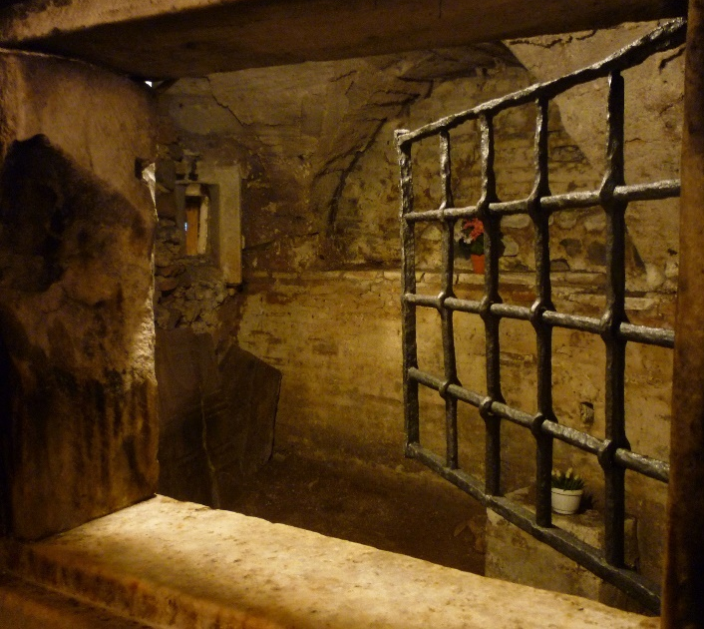
Lesson 131 and 132
Paul’s Last Words
2 Timothy
“I have fought a good fight, I have finished my course, I have kept the faith”
2 Timothy 4:7

Slide 2
2 Timothy
Paul wrote the epistle during his second imprisonment in Rome shortly before his martyrdom
At the end of his letter, Paul requested that Timothy and Mark visit him and bring him a few items that he had left behind. Although Paul’s letter was addressed specifically to Timothy, its counsel can be applied to those who live in “the last days” because Paul taught of challenges and solutions that are relevant to our day as well as his.
During his imprisonment Paul was in chains he was likely in a cell or dungeon and exposed to the elements, and his friends struggled to locate him.
Luke was apparently his only regular visitor, and Paul expected that his life was coming to an end.
2 Timothy 1:16-17; 2:9; 4:13,21; 4:6-8

Slide 3
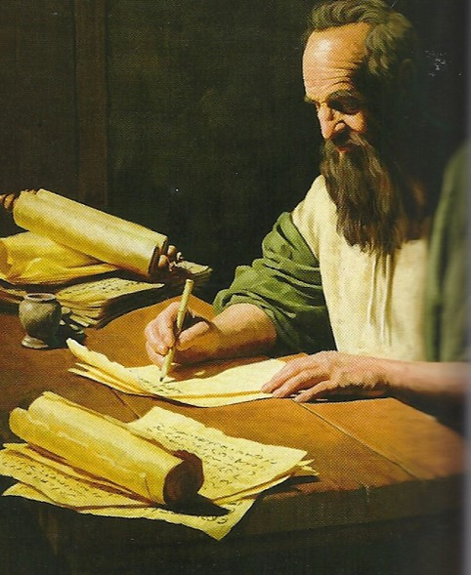
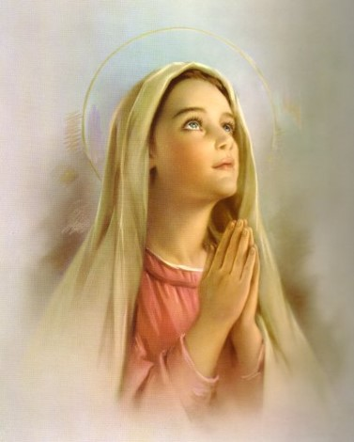
Promised Joy
Paul counsels on how to successfully complete your life’s journey and secure the deep joy promised by the Savior.
“Hitherto have ye asked nothing in my name: ask, and ye shall receive, that your joy may be full.”
—John 16:24
2 Timothy 1:4

Slide 4
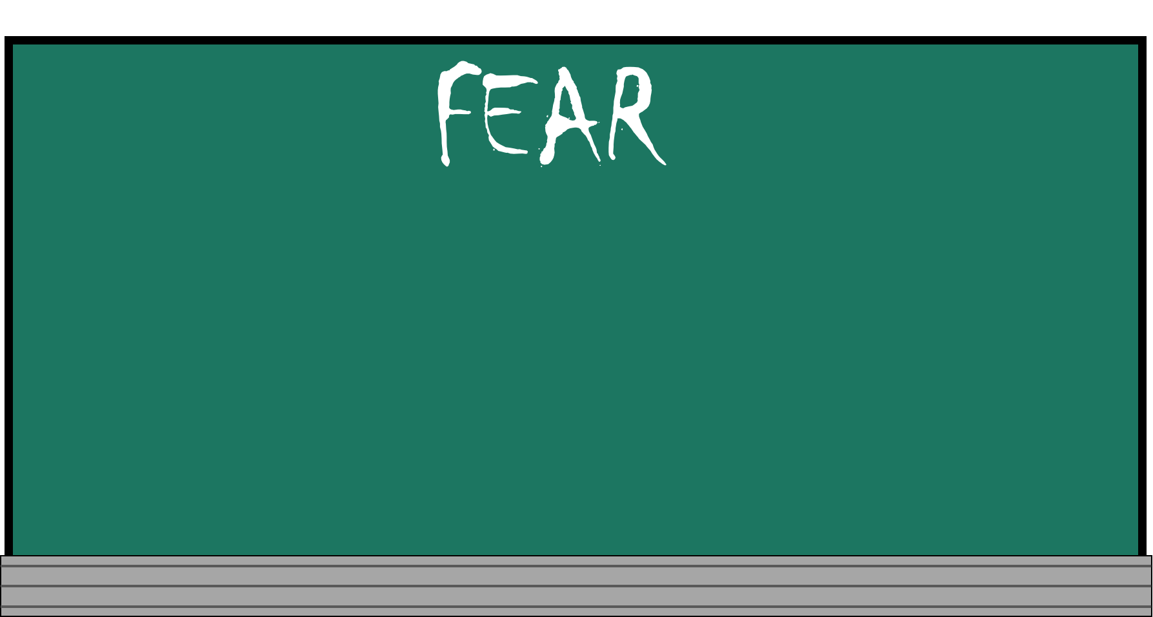
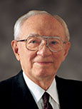
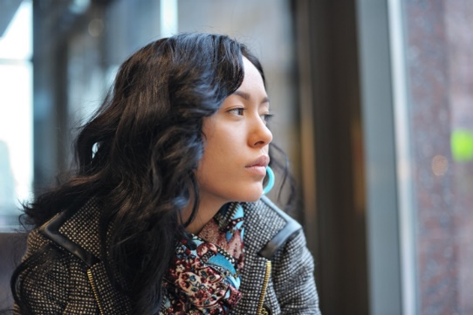
“Who among us can say that he or she has not felt fear?
I know of no one who has been entirely spared. Some, of course, experience fear to a greater degree than do others. Some are able to rise above it quickly, but others are trapped and pulled down by it and even driven to defeat.
We suffer from the fear of ridicule, the fear of failure, the fear of loneliness, the fear of ignorance. Some fear the present, some the future. Some carry the burden of sin and would give almost anything to unshackle themselves from those burdens but fear to change their lives” (2)
How could fear affect our ability to live the gospel?

Slide 5
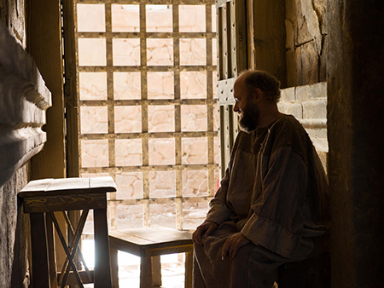
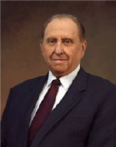
Stir Up-Rekindle
Paul admonished Timothy to rekindle the gift of the Holy Ghost, or to earnestly seek to have the Holy Ghost to be with him.
“The history of the Church in this, the dispensation of the fulness of times, is replete with the experiences of those who have struggled and yet who have remained steadfast and of good cheer as they have made the gospel of Jesus Christ the center of their lives. This attitude is what will pull us through whatever comes our way.
It will not remove our troubles from us but
rather will enable us to face our challenges,
to meet them head on, and to emerge victorious.”
(3)
2 Timothy 1:6-7

Slide 6
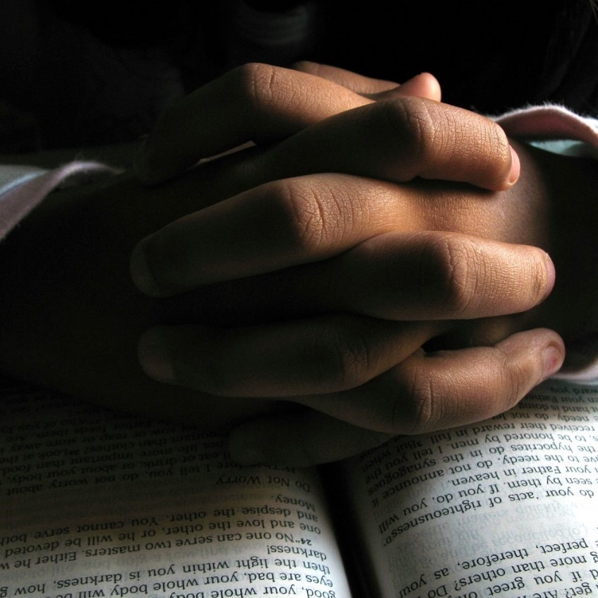
Worldly Fear VS Godly Fear
Wordily fear creates anxiety, uncertainty, and alarm and differs from what the scriptures refer to as “the fear of the Lord”
To fear the Lord is “to feel reverence and awe for Him and to obey His commandments”
As we earnestly seek to have the Spirit to be with us, we can overcome fear and be unashamed of our testimony of Jesus Christ.
2 Timothy 1:7-9

Slide 7
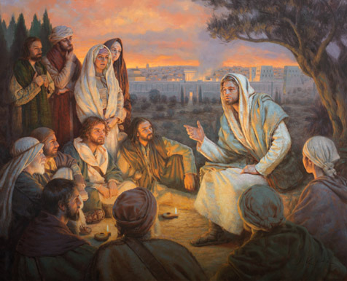
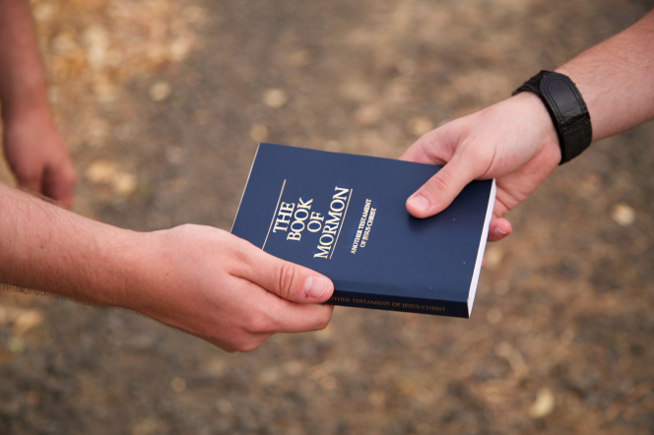
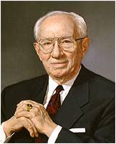
Be Not Ashamed and Hold Fast
Paul anticipated that he would soon be put to death by the Romans, yet he knew that Jesus Christ had “abolished death.” (1)
“If we were called upon to stand before God and give an accounting of ourselves, could we do it without embarrassment? This is Paul's great plea to his young friend. It is his plea to each of you.” (2)
2 Timothy 1:8-10

Slide 8
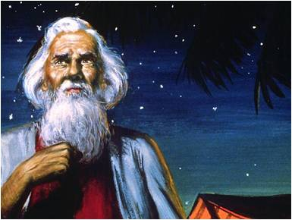
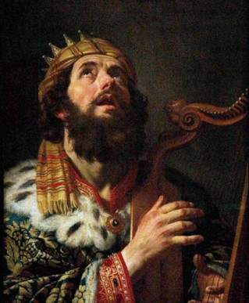
The Holy Calling
“Who hath saved us, and called us with an holy calling…
…before the world began”
To Abraham:
“…the intelligences that were organized before the world was; and among all these there were many of the noble and great ones;”
“…These I will make my rulers; for he stood in the midst of them, and he said: These I will make my rulers…”
Abraham was chosen before he was born.
Abraham 3:22-23
2 Timothy 1:9

Slide 9
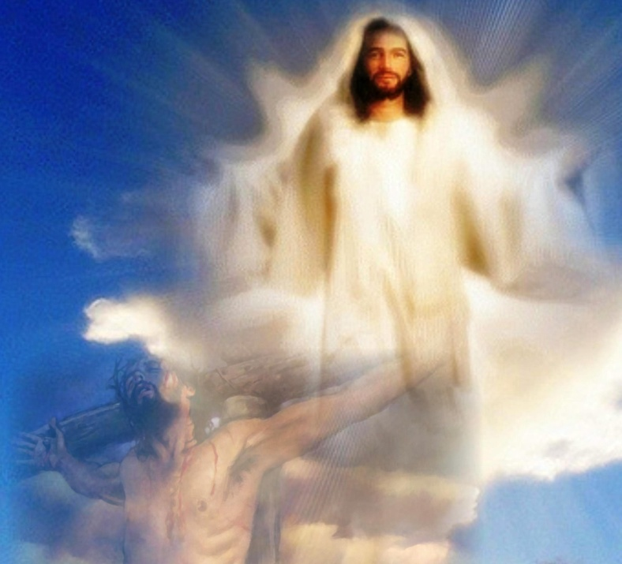
Bringing Life and Immortality to Light
“…our Saviour Jesus Christ, who hath abolished death…
…brought life and immortality to light through the gospel:”
2 Timothy 1:10

Slide 10
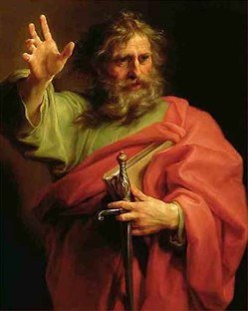
Paul Was Called an Apostle
“Whereunto I am appointed a preacher, and an apostle, and a teacher of the Gentiles.”
2 Timothy 1:11

Slide 11
Paul used the metaphors of a soldier, an athlete, and a husbandman (or farmer) to teach Timothy how to remain strong in the faith despite hardship.
A good soldier dutifully endures hardships and sets aside other affairs to please his or her superior
A farmer must work hard to enjoy the fruits of his or her labors
An athlete can be victorious only if he or she obeys the rules.
2 Timothy 2:3-6

Slide 12
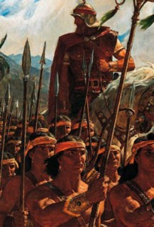
Nephi’s Testifies
“…Wherefore, if ye shall be obedient to the commandments, and endure to the end, ye shall be saved at the last day…”
“And, if you keep my commandments and endure to the end you shall have eternal life, which gift is the greatest of all the gifts of God.”
--D&C 14:7
1 Nephi 22:31

Slide 13
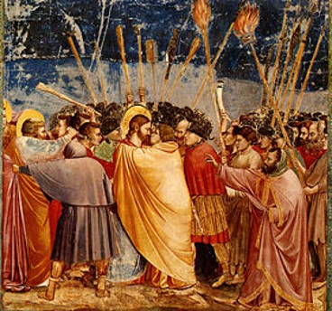
A General Apostasy
There is evidence that the Church in Paul’s day was falling away from the truth.
2 Timothy 3; Nephi 22:31

Slide 14
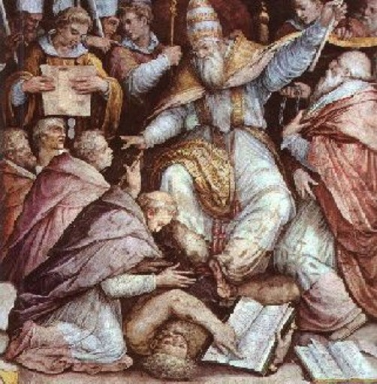
When would Apostasy take place?
Acts 20:31
“…Three years I ceased not to warn everyone night and day with tears.”

Slide 15
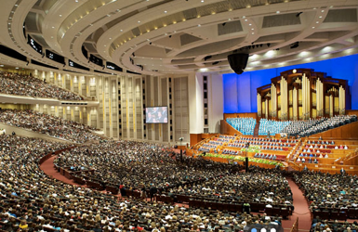
Church Continues
Although some may apostatize in our day, the church will not be withdrawn from the earth again.
“…and it shall stand for ever.”
Daniel 2:44-45
“Wherefore, may the kingdom of God go forth…”
D&C 65:2-6 Read all verses

Slide 16
“There are still those, not a few, who criticize and rebel, who apostatize and lift their voices against this work…
I suppose we always will have them as long as we are trying to do the work of the Lord. The honest in heart will detect that which is true and that which is false…
We are a body of Christian solders “marching as to war, with the cross of Jesus going on before.”
(2)

Slide 17
Having a form of godliness, but denying the power
Lovers of pleasure
Lovers of own self
Traitors, heady, high-minded
covetousness
Despisers of those that are good
Iniquities
boasters
fierce
prideful
incontinent
If we purge ourselves of iniquity, we can better serve the Lord
blasphemers
False accusers
Disobedient
to parents
trucebreakers
natural affection
unthankful
unholy
2 Timothy 3:1-5

Slide 18
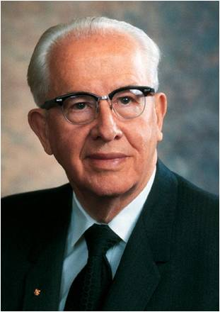
“…the word of God, as found in the scriptures, in the words of living prophets, and in personal revelation, has the power to fortify the Saints and arm them with the spirit so they can resist evil, hold fast to the good, and find joy in this life.”
(4)

Slide 19
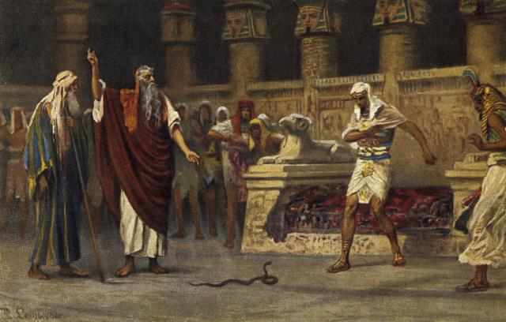
Jannes and Jambres
According to a Jewish tradition, Jannes and Jambres were the names of the two magicians in Pharaoh’s court who opposed Moses and Aaron
Then Pharaoh also called the wise men and the sorcerers: now the magicians of Egypt, they also did in like manner with their enchantments.
For they cast down every man his rod, and they became serpents: but Aaron’s rod swallowed up their rods.
Exodus 7:11-12
2 Timothy 3:8
(1)

Slide 20
Doctrinal Mastery
And that from a child thou hast known the holy scriptures, which are able to make thee wise unto salvation through faith which is in Christ Jesus.
All scripture is given by inspiration of God, and is profitable for doctrine, for reproof, for correction, for instruction in righteousness:
That the man of God may be perfect, throughly furnished unto all good works.
2 Timothy
3:15-17

Slide 21
Scriptures Provide
According to Paul, “the holy scriptures … are able to make thee wise unto salvation” and “all scripture is given by inspiration of God, and is profitable for doctrine, for reproof, for correction, for instruction in righteousness”
“In moments of fear or doubt or troubling times, hold the ground you have already won. … When those moments come and issues surface, the resolution of which is not immediately forthcoming, hold fast to what you already know and stand strong until additional knowledge comes.” (5)
2 Timothy 3:15-16

Slide 22
If we continue in the truths we have learned from trusted sources and in the scriptures, we can overcome the spiritual peril of the last days.
How can relying on the scriptures and on the truths we have learned help us overcome the perils of our day?

Slide 23
Holy Bible
As we study the scriptures, we can learn doctrine and receive correction and instruction that will help us grow toward perfection
The
Book
of
Mormon
Doctrine
And
Covenants
ANOTHER TESTAMENT
OF JESUS CHRIST
Doctrine, Correction, or Instruction
In what ways has the scriptures help you?
(1) to understand a doctrine of the gospel;
(2) by offering reproof or correction concerning something in their thinking, choices, or behavior that was not right; or
(3) by providing an answer to a prayer or giving instruction on how they might solve a problem.

Slide 24
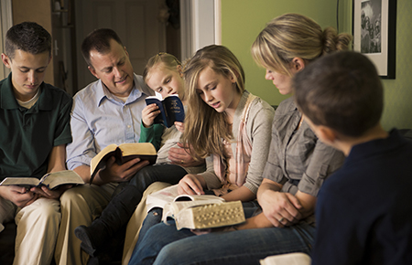
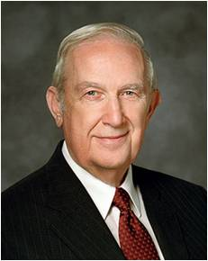
“Don’t yield to Satan’s lie that you don’t have time to study the scriptures. Choose to take time to study them. Feasting on the word of God each day is more important than sleep, school, work, television shows, video games, or social media. You may need to reorganize your priorities to provide time for the study of the word of God. If so, do it!
“… As you dedicate time every day, personally and with your family, to the study of God’s word, peace will prevail in your life.” (6)
2 Timothy 3:16-17

Slide 25
False Teachers
Paul’s words foreshadow the coming of the Great Apostasy, when people would “not endure sound doctrine” but instead would seek after false teachers who would say what their listeners’ “itching ears” wanted to hear.
“itching ears”
Those who choose to listen only to those things that they wish to hear.
2 Timothy 4:1-5

Slide 26
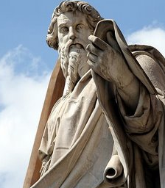
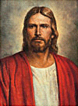
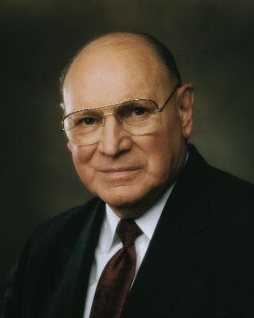
I Have Fought a Good Fight
Paul was ready to be offered
“Enduring to the end means that we have planted our lives firmly on gospel soil, staying in the mainstream of the Church, humbly serving our fellow men, living Christlike lives, and keeping our covenants.
Those who endure are balanced, consistent, humble, constantly improving, and without guile. Their testimony is not based on worldly reasons—it is based on truth, knowledge, experience, and the Spirit.” (7)
2 Timothy 4:7-8

Slide 27
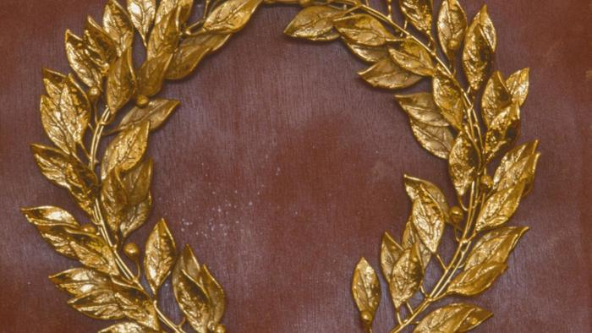
Crowned With Righteousness
A reference to the crowns of olive branches that were given to the victors in ancient Greek athletic contests. Paul then pointed out that an eternal crown will be given to all Saints who righteously endure to the end and prepare for the Second Coming of the Lord. Paul testified that throughout his persecution, “the Lord stood with [him], and strengthened” him as he preached the gospel. (1)
“Paul’s calling and election had been made sure. He was sealed up unto eternal life. He had kept the commandments, been tried at all hazards, and the Lord had given him the promise: ‘Son, Thou shalt be exalted.’ And since no man is or can be exalted alone, this is one of the crowning reasons why we know Paul was married.” (8)
If we remain faithful in all the Lord requires of us, we will receive a crown of righteousness
2 Timothy 4:8; 17

Slide 28
Sources:
Suggested Hymn: #152 God Be With You Till We Meet Again
Videos:
Stay within the Lines (5:10)
Defenders of the Family Proclamation (1:46)
New Testament Institute Student Manual Chapter 47
President Gordon B. Hinckley (“God Hath Not Given Us the Spirit of Fear,” Ensign, Oct. 1984, 2). ("Converts and Young Men," Ensign, May 1997, 49); Gordon B. Hinckley Apr. 1996 Conf. Report or Ensign May 1996
President Thomas S. Monson (“Be of Good Cheer,” Ensign or Liahona, May 2009, 89).
President Ezra Taft Benson “The Power of the Word” Ensign May 1986
Elder Jeffrey R. Holland (“Lord, I Believe,” Ensign or Liahona, May 2013, 93–94).
Elder Richard G. Scott (“Make the Exercise of Faith Your First Priority,” Ensign or Liahona, Nov. 2014, 93).
Elder Joseph B. Wirthlin (“Press On,” Ensign or Liahona, Nov. 2004, 101).
Elder Bruce R. McConkie DNTC, 3:116.)
Presentation by ©http://fashionsbylynda.com/blog/

Slide 29
The Second Letter of Paul to Timothy in Ephesus Written from Roman Imprisonment, sometime between A.D. 64 and 65
Timothy’s Gifts of the Spirit | 1:1–18
How Timothy Should Face Hardships | 2:1–7
Christ Gives Eternal Glory to the Elect | 2:8–13
Shun Contention, Seek Godliness | 2:14–26
Dangers of the Last Days | 3:1–13
Scriptures Guide Man to Salvation | 3:14–17
Timothy Exhorted to “Preach the Word” | 4:1–5
Paul and All Saints Assured of Exaltation | 4:6–22
Christ had Abolished Death 2 Timothy 1:10:
We bear record that he is the only mediator between man and God; that through his atoning sacrifice fallen man may be reconciled with God; and that he "hath abolished death, and hath brought life and immortality to light through the gospel" (2 Tim. 1:10).
...There is no salvation in worshiping false gods; there is no salvation in false religion; there is no salvation in error in any form.
Man alone cannot save himself. No man can call forth his own crumbling dust from the grave and cause it to live again in immortal glory. No man can create a celestial heaven whose inhabitants shall dwell in eternal splendor forever.
All the idols and icons and images combined, since the world began until the end of time, will never have power to cleanse and perfect a single human soul.
...But those who turn to Christ, who believe his gospel, and join his church, and live his laws, and who thereby worship the Father in his holy name-such shall find peace and safety and salvation. In the world men shall have tribulation; in Christ they shall find peace (see John 16:33). Elder Bruce R. McConkie ("The Lord God of the Restoration," Ensign, Nov. 1980, 51)
Life and Teachings of Jesus and His Apostles Chapter 45
Be Not Ashamed 2 Timothy 1:8:
It is not God who has given us the spirit of fear; this comes from the adversary. So many of us are fearful of what our peers will say, that we will be looked upon with disdain and criticized if we stand for what is right. But I remind you that "wickedness never was happiness" (Alma 41:10). Evil never was happiness. Sin never was happiness. Happiness lies in the power and the love and the sweet simplicity of the gospel of Jesus Christ.
We need not be prudish. We need not slink off in a corner, as it were. We need not be ashamed. We have the greatest thing in the world, the gospel of the risen Lord. Paul gives us a mandate: "Be not thou therefore ashamed of the testimony of our Lord" (2 Tim. 1:8). President Gordon B. Hinckley ("Converts and Young Men," Ensign, May 1997, 49)
Grandmother 2 Timothy 1:5:
"The word 'grandmother' appears in the Bible but once-in connection with Lois, the grandmother of Timothy. Paul addressed this same Timothy as 'my dearly beloved son.' (2 Tim. 1:2.) The one verse in the Bible that mentions Lois and her daughter Eunice, Timothy's mother, is surpassingly beautiful, illuminating not only the faith of Timothy but eloquently painting a picture of family fidelity for three generations. Paul writes, 'When I call to remembrance the unfeigned faith that is in thee, which dwelt first in thy grandmother Lois, and thy mother Eunice; and I am persuaded that in thee also. ...' (2 Tim. 1:5.)
"The hope of every mother and grandmother is underscored in these few words. As a woman seeks to increase in faith and good works she does so not to her own glory, but to fashion a legacy for her children and her children's children to inherit. Lois and Eunice lived in a generation when the gospel was a fresh, bright gift, newly restored from God in the person of his son Jesus Christ. How they must have rejoiced as they received its truth into their lives. Their home was Lystra, a city in the Roman province of Galatia. Eunice was a Jewess married to a Greek, whose name is not given. We may infer that she was a widow much of her life. Ties of kinship strengthened the family in that day where a grandmother and mother joined forces and faith to train their choice son. Ann N. Madsen, "Cameos: The Women of the New Testament," Ensign, Sept. 1975, 43)

Slide 30
The House of Onesiphorus 2 Timothy 1:16:
"Another Ephesian friend of the Apostle was the noble-minded and warm-hearted Onesiphorus, who was probably one of his numerous converts. How touchingly St. Paul speaks of him to Timothy when comparing his devotedness with the defection of the cowardly Asiatics, among whom he singles out the two men Phygellus and Hermogenes! Onesiphorus had come to Rome for some purpose of which we have no knowledge, but being aware that Paul was somewhere in that city as a prisoner, he diligently searched for him, and did not cease to do so till he had found him in his prison cell (II Tim. 1:15-17). During the Apostle's first Roman imprisonment it would have been always easy to trace him, for he dwelt then in his own hired house, or preached as publicly as a prisoner could do, and was doubtless known by name not only to all Christians but also to very many of the Pagan residents of the city. It was, however, quite another thing during his second and final imprisonment in A. D. 66. There he had no liberty whatever, and it is just possible that his actual whereabouts was not known even to many of the Roman Christians. He had comparatively few friends who visited him at that time while confined in the dreaded Mamertine dungeon, for, as Dr. Farrar puts it,-'in a city thronged with prisoners and under a government rife with suspicions, upon which it acted with the most cynical unscrupulousness, it was by no means a safe or pleasant task to find an obscure, aged, and deeply implicated victim.' Onesiphorus was, however, above such base timidity, and his search for his friend was eventually rewarded, and when he had found him, this staunch and bold fellow-Christian was not satisfied with a single visit, but readily faced the dangers which attended such interviews and went again and again. The Apostle told Timothy that Onesiphorus 'oft refreshed him' by his loving visits and companionship... This servant of the Lord proved himself to be in very truth to the aged Apostle in his time of calamity and desertion, what his Greek name (Onesiphorus) implies, namely a 'Profit Bringer.'" (St. Paul's Companions in Rome. by Col. R. M. Bryce-Thomas., Improvement Era, 1909, Vol. Xii. August, 1909. No. 10)
These last days 2 Timothy 3:1:
"In this last dispensation there will be great tribulation. (See Matt. 24:21.) We know that there will be wars and rumors of wars (see D&C 45:16) and that the whole earth will be in commotion (see D&C 45:26). All dispensations have had their perilous times, but our day will include genuine peril. (See 2 Tim. 3:1.) Evil men will flourish (see 2 Tim. 3:13), but then evil men have very often flourished. Calamities will come and iniquity will abound. (See D&C 45:27.)
"Inevitably the natural result of some of these kinds of prophecies is fear, and that is not fear limited to a younger generation. It is fear shared by those of any age who don't understand what we understand.
"But I want to stress that these feelings are not necessary for faithful Latter-day Saints, and they do not come from God. To ancient Israel, the great Jehovah said:
'Be strong and of a good courage, fear not, nor be afraid of them: for the Lord thy God, he it is that doth go with thee; he will not fail thee, nor forsake thee. ...
And the Lord, he it is that doth go before thee; he will be with thee, he will not fail thee, neither forsake thee: fear not, neither be dismayed.' (Deut. 31:6, 8.)" President Howard W. Hunter "An Anchor to the Souls of Men," Ensign, Oct. 1993, 71)
Jannes and Jambres: 2 Timothy 3:8-9:
"For assuredly Moses, being sent by God into Egypt, did many miracles, which the Lord commanded him to do before Pharaoh king of Egypt. And there were there Jannes and Jambres, servants of Pharaoh, and they also did not a few of the miracles which Moses did; and the Egyptians took them to be gods-this Jannes and this Jambres. But, since the miracles which they did were not of God, both they and those who believed in them were destroyed." (New Testament Pseudepigrapha, The Gospel of Nicodemus, The Acts of Pilate, chap. 5)
Scripture Knowledge 2 Timothy 3:15-17:
“The scriptures contain the words of Christ and are a reservoir of living water to which we have ready access and from which we can drink deeply and long. You and I must look to and come unto Christ, who is ‘the fountain of living waters’ (1 Nephi 11:25; compare Ether 8:26; 12:28), by reading (see Mosiah 1:5), studying (see D&C 26:1, searching (see John 5:39; Alma 17:2), and feasting (see 2 Nephi 32:3) upon the words of Christ as contained in the holy scriptures. By so doing, we can receive both spiritual direction and protection during our mortal journey” Elder David A. Bednar (“A Reservoir of Living Water” [Church Educational System fireside for young adults, Feb. 4, 2007], 1; si.lds.org).

Slide 31
All false doctrines are fables. 2 Timothy 4:4:
Stories which have been imagined, fabricated, and invented as opposed to the gospel which is real and true. (2 Pet. 1:16.) Apostasy consists in turning from true doctrine to fables.” (McConkie, Mormon Doctrine, p. 261.)
“I Have Fought a Good Fight” 2 Timothy 4:7-8:
“In life, we are not brought to earth just to be born into mortality. We came with a mission and a purpose, and that is to endure to the end. …
“If you have taken missteps in your youth, don’t let discouragement overcome you. The Lord’s judgments are not spiritual grade-point averages—with past sins and mistakes averaged into the final grade. He has promised that ‘he who has repented of his sins, the same is forgiven, and I, the Lord, remember them no more’ (D&C 58:42).
“So, if you are not where you want to be, decide today to get there.
“Our lifetime degree will be graded on how well we live up to the covenants made in our saving ordinances—baptism, receiving the Holy Ghost, washings, anointings, endowments, and sealings.
“You can cross the finish line with everyone else.
“‘Go forward and not backward. Courage, … and on, on to the victory!’ (D&C 128:22)”
Elder Robert D. Hales (“Ten Axioms to Guide Your Life,” Ensign, Feb. 2007, 29).
Was Paul to Be Martyred before His Time? 2 Timothy 4:6, 7.
“It will be recalled that Peter was released from prison by an angel and protected in many ways ’till his work was finished. And Paul likewise. No violence could take his life until he had borne his testimony to Rome and Greece and other lands. But finally he made the prophetic statement to Timothy: ‘For I am now ready to be offered, and the time of my departure is at hand. I have fought a good fight, I have finished my course, I have kept the faith.’ (2 Tim. 4:6, 7.) There was no fear in his approach to eternity—only assurance and calm resignation to the inevitable martyrdom which he faced. He did not want to die but was willing thus to seal his testimony of the Redeemer,” (Spencer W. Kimball in CR, Apr. 1946, p. 46.)
Paul’s Death:
The New Testament does not say when or how Paul died. There is an early tradition found in the writing of Ignatius, probably around 110 AD, that Paul was martyred. Dionysius of Corinth, in a letter to the Romans (166–174 AD), stated that Paul and Peter were martyred in Italy. Eusebius also cites the Dionysius passage.
The Acts of Paul, an apocryphal work written around 160, describes the martyrdom of Paul. According to the Acts of Paul, Nero condemned Paul to death by decapitation. The date of Paul's death is believed to have occurred after the Great Fire of Rome in July 64, but before the last year of Nero's reign, in 68. A legend later developed that his martyrdom occurred at the Acquae Salviae, on the Via Laurentina. According to this legend, after Paul was decapitated, his severed head rebounded three times, giving rise to a source of water each time that it touched the ground, which is how the place earned the name "San Paolo alle Tre Fontane" ("St Paul at the Three Fountains"). Also according to legend, Paul's body was buried outside the walls of Rome, at the second mile on the Via Ostiensis, on the estate owned by a Christian woman named Lucina. It was here, in the fourth century, that the Emperor Constantine built a first church. Then, between the fourth and fifth centuries it was considerably enlarged by the Emperors Valentinian I, Valentinian II, Theodosius I, and Arcadius. The present-day Basilica of Saint Paul Outside the Walls was built there in 1800.
Tertullian in his Prescription Against Heretics (200 AD) writes that Paul had a similar death to that of John the Baptist, who was beheaded.
Eusebius of Caesarea in his Church History (320 AD) testifies that Paul was beheaded in Rome and Peter crucified. He wrote that the tombs of these two apostles, with their inscriptions, were extant in his time; and quotes as his authority a holy man of the name of Caius.
Lactantius wrote that Nero "crucified Peter, and slew Paul." (318 AD)
Jerome in his De Viris Illustribus (On Illustrious Men) (392 AD) states that Paul was beheaded at Rome.
John Chrysostom (c. 349–407) wrote that Nero knew Paul personally and had him killed.
Sulpicius Severus says Nero killed Peter and Paul. (403 AD). Wikipedia
Crown of Righteousness Symbol 2 Timothy 4: 8:
A crown of laurels is a wreath or garland of laurel leaves worn in ancient Greek and Roman times as a symbol of victory or status. The laurel tree was sacred to the god Apollo, and a wreath of laurel leaves was given as the prize at the Pythian games, a forerunner of the modern Olympic games held in honor of Apollo.
The symbolic importance of the laurel tree has been passed down to modern times in a number of ways. The expression "resting on his laurels" is commonly used to describe a person who is so satisfied with his past achievements that he is no longer trying to accomplish anything new. It is also the source of the word "baccalaureate," indicating academic achievement. The terms "poet laureate" and "Nobel laureate" also derive directly from the practice of bestowing a laurel garland for a victory or a notable achievement. The laurel tree, also known a bay laurel, was very important to the ancient Greeks. It is the source of bay leaves, a popular herb commonly used for seasoning soups and sauces. Several traditional medicines are made from bay laurel extract, and the essential oil of bay laurel is reputed to relieve arthritis and rheumatism. World view reference.com

