Slide 1
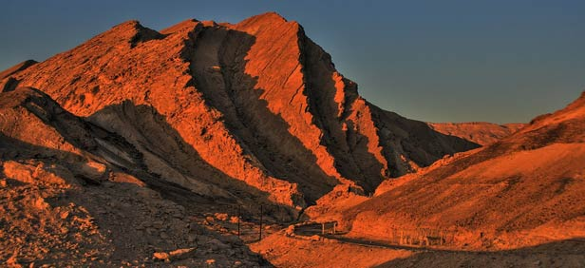
Lesson 133
Titus
An Epistle of Obedience

Slide 2
Titus
The book of Titus was written by Paul and addressed to Titus
Titus was a Greek convert and a faithful fellow laborer with Paul in spreading the gospel and organizing the Church
He helped gather donations for the poor in Jerusalem and accompanied Paul to the Jerusalem council
Paul entrusted Titus to take to Corinth Paul’s first epistle to the Saints living there
Paul wrote to Titus to strengthen him in his assignment to lead and care for the branch of the Church in Crete in spite of opposition
Titus is the Epistle of Obedience
Titus was ordained the first bishop of the Church of the Cretians, from Nicopolis of Macedonia.

Slide 3
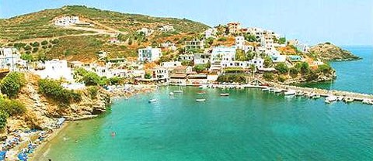
Background
*After Paul’s release from his 1st imprisonment Paul visited the Island of Crete with Titus.
*Paul left the island and Titus stayed to set the Church in order.
*This letter was written about A.D. 64.
Macedonia
Black Sea
Rome
Italy
Adriatic Sea
Mysia
Cilicia
Sicily
Antioch
Syria
Crete
Cyprus
Mediterranean Sea
Jerusalem

Slide 4
Titus—the Bishop
Titus presided over the branch of the Church on the Greek island of Crete and thus had authority to call bishops to oversee Church members.
Qualities of a Bishop
Blameless = Faithful and True
Selfwilled = Follows the Lord’s gospel and doctrine, not his own
Not soon angry = patient
Not given to wine = does not drink
No striker = Not a contentious person
Not given to Filthy lucre = Does not take money that doesn’t belong to him
Lover of hospitality, good men = Hospitable, and charitable
Convince the gainslayers = taking the responsibility to make sure correct doctrine is taught.
Titus 1:7-9

Slide 5
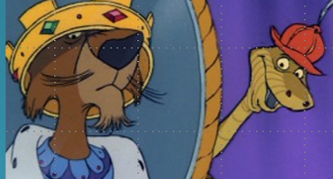
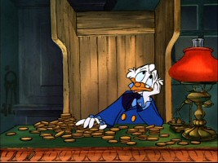
Self-Willed and Filthy Lucre
self-willed = obstinate or arrogant
“filthy lucre” = money that is obtained through dishonest or otherwise unrighteous means
Old Anglo-Saxon word “gegn” meaning contrary to or in opposition of.
Against
Gainslayer= those who speak against something in order to enrich oneself at the expense of others.
Titus 1:7-8

Slide 6
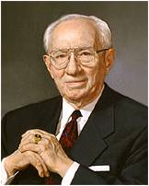
Your (bishops) personal behavior must be impeccable. You must be a man of integrity, above reproach of any kind. Your example will set the tone for the direction your people follow. You must be fearless in denouncing evil, willing to take a stand for the right, uncompromising in your defense of truth. While all of this requires firmness, it must be done with kindness and love. (2)
As we hold fast to the word of God, we will be able to use true doctrine to encourage others to live the gospel of Jesus Christ and to refute those who oppose it.
Titus 1:7-9

Slide 7
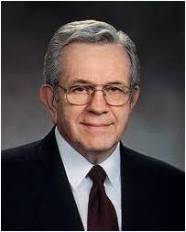
Beware of False Ministers and Doctrines
“True doctrine, understood, changes attitudes and behavior.
“The study of the doctrines of the gospel will improve behavior quicker than a study of behavior will improve behavior. … That is why we stress so forcefully the study of the doctrines of the gospel.” (3)
Titus 1:9

Slide 8
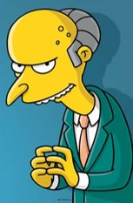
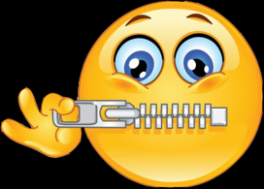
Liars, Evil Beasts, and Slow Bellies
Paul condemns the false teachers on Crete for perverting the gospel in order to make money.
False Teachers = Priestcraft:
He commandeth that there shall be no priestcrafts; for, behold, priestcrafts are that men preach and set themselves up for a light unto the world, that they may get gain and praise of the world; but they seek not the welfare of Zion.
2 Nephi 26:29
“For there are many unruly and vain talkers and deceivers, specially they of the circumcision:”
“Whose mouths must be stopped, who subvert whole houses, teaching things which they ought not, for filthy lucre’s sake.”
Titus 1:10-11

Slide 9
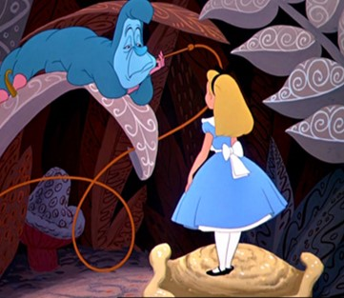
Cretans and Slow Bellies
Their reputation for lying became so commonly know that the name became both a verb (kretidzein=to speak like a “cretan” or to “lie”
“slow bellies”= idle bellies=lazy gluttony that leads to extreme obesity.
Titus 1:12

Slide 10
Fables
“Not giving heed to Jewish fables, and commandments of men, that turn from the truth.”
The Jewish kept genealogical records, but Herod destroyed the public register…He being an Idumean, was jealous of the noble origin of the Jews:
The Jews then had to refer to their genealogies from memory, or from imperfect tables which had been preserved in private hands.
Titus 1:14

Slide 11
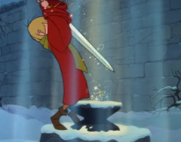
Pure in Heart
“Unto the pure all things are pure; but unto them that are defiled and unbelieving is nothing pure; but even their mind and conscience is defiled.”
Purity of body and mind. “The pure in heart are those who are free from moral defilement or guilt; who have bridled their passions, put off the natural man and become saints through the atonement…”
—Mosiah 3:19
c
Titus 1:15

Slide 12
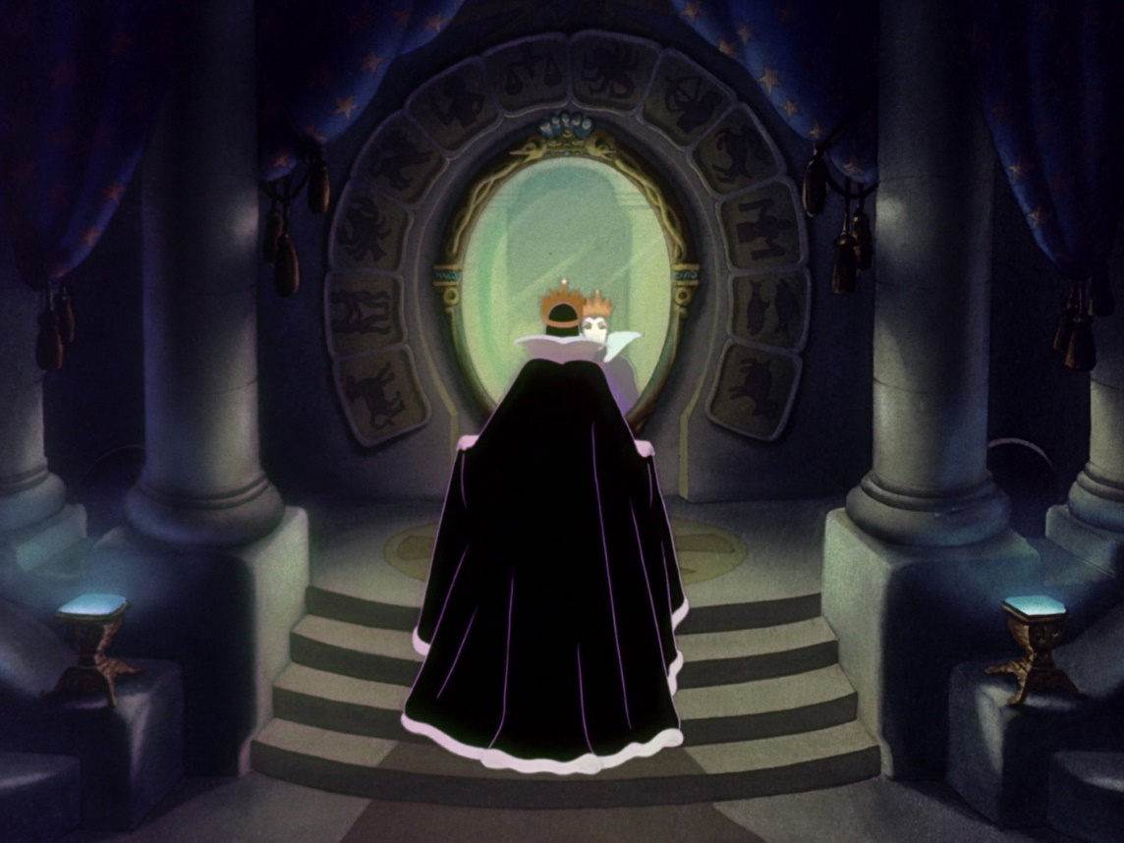
Perceiver VS Perceived
The apostle Paul recognized that faults may lie in the mind of the perceiver as much as in the person being perceived.
"The person who is bothered by evil thoughts may see others as being evil...
Some people... look so hard for faults and evil that they can see them in almost everything.
As with projection, the faults lie in the eye of the judge more than in the person being judged. (4)
Titus 1:15

Slide 13
Men, Women, Young Women, and Young Men
Men, Young and Old = Titus 2:2, 6-8
Women = Titus 2:3-5
Followers of Jesus Christ are to be good examples for others.
To be holy in all things
To not gossip or lie
To teach the young woman
To teach righteousness in the home and to be obedient to the Lord in all things
To have faith and charity and patience
To be sober minded
Be of service and sincere
Sound mind and speech
To be a good example
Righteous in all things
Titus 2:

Slide 14
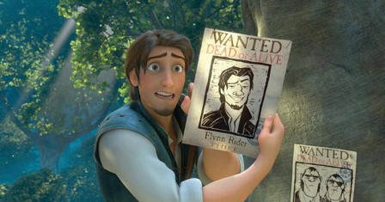
The Servant
Purloin = put far away from another = to appropriate something of another’s for one’s own use. (8)
It is more of a secret than an open theft.
Servants are exhorted by Paul not to take for their own use the things which belong to their masters…they are to be trustworthy.
Titus 2:10

Slide 15
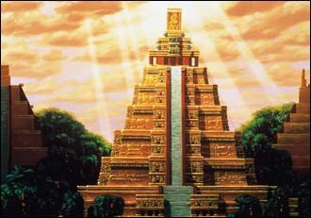
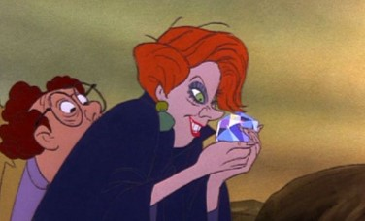
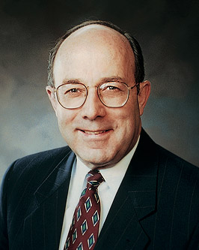
Worldly Lusts
“Teaching us that, denying ungodliness and worldly lusts, we should live soberly, righteously, and godly in this present world”
Beware of worldly lusts. They stimulate the senses but enslave the soul. Those caught in the web of sensuality find that it is not easliy broken. (5)
Titus 2:12

Slide 16
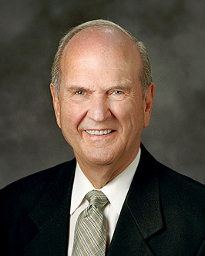
I looked [peculiar] up in a modern dictionary. It is currently defined as "unusual" or "eccentric"; "strange," "queer," "odd"; "standing apart from others"; "exclusive" or "unique."
But the term peculiar as used in the scriptures means something quite different.
In the Old Testament, the Hebrew term from which peculiar was translated is cgullah, which means "valued property," or "treasure."
In the New Testament, the Greek term from which peculiar was translated is peripoiesis, which means "possession," or "an obtaining."
With that understanding, we can see that the scriptural term peculiar does not mean "queer" or "odd" at all. It signifies "valued treasure," "made" or "selected by God."
Thus, for us to be identified by servants of the Lord as his peculiar people is a compliment of the highest order. (7)
Old Testament
New Testament
Jesus Christ gave Himself for us so that He could redeem us and purify us
Titus 2:14

Slide 17
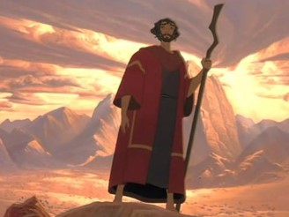
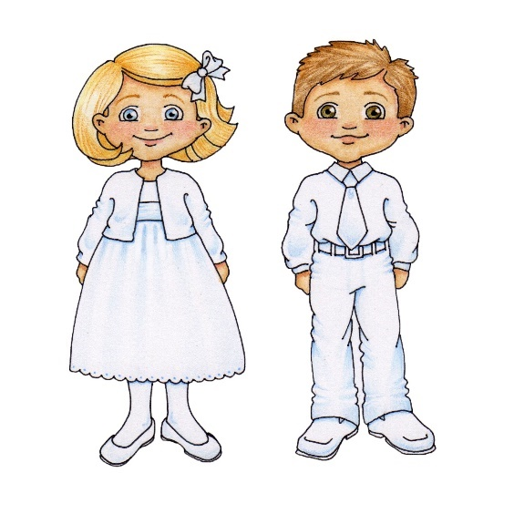
Righteous Living
Regeneration = Improvement= baptism in water
“Not by works of righteousness which we have done, but according to his mercy he saved us, by the washing of regeneration (baptizing in water) and renewing of the Holy ghost;”
“There are no good works which men may do which—standing alone—will cause them to be resurrected or to gain eternal life. Immortality and eternal life come through the atonement of Christ, the one being a free gift, the other being offered freely to all who will be baptized and who then keep the commandments.” (6)
Titus 3:5

Slide 18
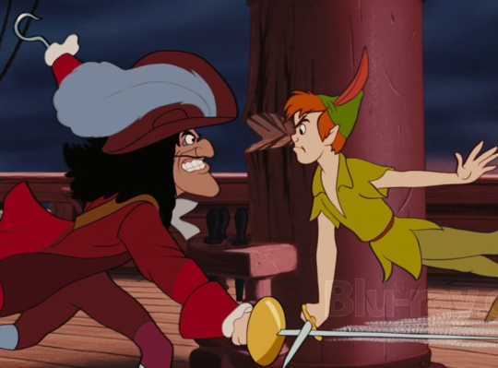
Avoid Foolish Talk
“But avoid foolish questions, and genealogies, and contentions and striving about the law; for they are unprofitable and vain.”
The missionaries are taught to teach the gospel, not argue the details of the gospel.
Read D&C 19:20-31
They are to teach and explain the basic doctrines of salvation and not engage in contentions and striving about the doctrines of sectarianism.
Titus 3:9

Slide 19
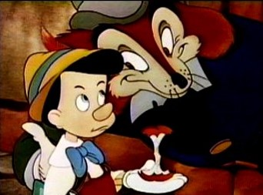
Heresy
“A man that is an heretick after the first and second admonition reject; Knowing that he that is such is subverted, and sinneth, being condemned of himself.”
Heretic=one who belongs to the church yet adheres to any religious opinion which is contrary to the official doctrine of the church.
Heresy=the belief and espousal of false doctrine.
Titus 3:10-11

Slide 20
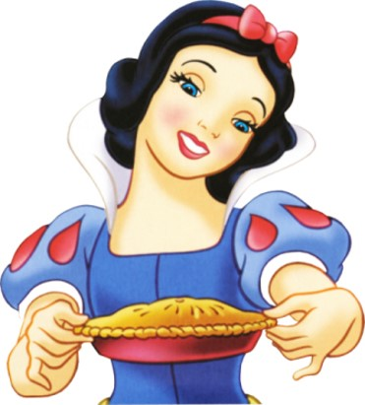
Maintain Good Works
“And let ours also learn to maintain good works for necessary uses, that they be not unfruitful.”
We recognize that we do not earn our salvation…all the good works in the world cannot save a single man, but as small as it might be in total equation, we must contribute the best we have to offer.
Titus 3:14

Slide 21
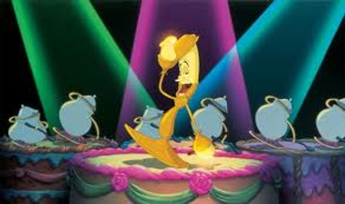
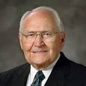
Let Your Light Shine
“Let your light so shine before men, that they may see your good works, and glorify your Father which is in heaven.”—Matthew 5:16
Our lives should be examples of goodness and virtue as we try to emulate His example to the world. (9)

Slide 22
Sources:
Suggested Hymn: #254 True to the Faith
New Testament Institute Student Manual Chapter 47
President Gordon B. Hinckley ("The Shepherds of the Flock," Ensign, May 1999, 52-53)
President Boyd K. Packer (“Little Children,” Ensign, Nov. 1986, 17).
Gospeldoctrine.com
Bishop Keith B. McMullin “An Invitation with Promise” May 2011 Ensign
Bruce R. McConkie DNTC 3:126-27
Elder Russell M. Nelson ("A More Excellent Hope," Ensign, Feb. 1997, 62-63)
Life and Teachings of Jesus and His Apostles Chapter 45
L. Tom Perry “Perfect Love Casteth Out Fear”(Oct. 2011 Gen. Conf.)
Presentation by ©http://fashionsbylynda.com/blog/

Slide 23
A LETTER FROM PAUL TO TITUS WRITTEN FROM MACEDONIA TO CRETE, CA. A.D. 67–68 (TITUS)
Paul Foreordained to Gain Eternal Life | 1:1–4
Appointment of Bishops | 1:5–9
Opposing False Teachers | 1:10–16
Instruction in Moral Living | 2:1–15
How to Live After Baptism | 3:1–8a
Personal Advice to Titus | 3:8b–15
Cretians Titus 1:12:
As Paul warned about false and greedy teachers among Titus’s own people, he pointed out that the people of Crete—“Cretians”—had a reputation for being “liars, evil beasts,” and “slow bellies” (Titus 1:12). Ancient writers such as Cicero, Livy, Plutarch, and Polybius similarly reported that the people of Crete were greedy. Historically, the word Cretan came to be synonymous with dishonesty. The term “slow bellies” in this verse is better translated as “idle bellies” and carries the idea of lazy gluttony. (1)
This Witness is True Titus 1:12-13:
Paul does not agree with the statement of this false prophet. His heart is full of charity; he does not have such a negative view of his fellowmen. When the epistle says "This witness is true," Paul is saying that he knows such false prophecies have been among them. With a tone if incredulity, Paul wants Titus to set things straight. The Christians of Crete could not spread the gospel to their neighbors if they really thought all the non-members were lazy liars. The tone of self-righteousness was alarming to Paul. Gospeldoctrine.com
Life and Teachings of Jesus and His Apostles Chapter 45
Be subject to principalities and powers Titus 3:1
As Church members, we live under the banner of many different flags. How important it is that we understand our place and our position in the lands in which we live! We should be familiar with the history, heritage, and laws of the lands that govern us. In those countries that allow us the right to participate in the affairs of government, we should use our free agency and be actively engaged in supporting and defending the principles of truth, right, and freedom. Elder L. Tom Perry ("A Meaningful Celebration," Ensign, Nov. 1987, 72)
against
late Old English agan, from earlier ongean (prep.) "toward; opposite, against, contrary to; in exchange for," as an adverb "in the opposite direction, back, to or toward a former place or position," from on "on" (see on (prep.) and compare a- (1)) + -gegn "against, toward," from Germanic root *gagina (source also of Old Norse gegn "straight, direct;" Danish igen "against;" Old Frisian jen, Old High German gegin, German gegen "against, toward," entgegen"against, in opposition to") In Old English, eft (see eftsoons) was the main word for "again," but this often was strengthened by ongean, which became the principal word by 13c. Norse influence is responsible for the hard -g-. Differentiated from against (q.v.) 16c. in southern writers, again becoming an adverb only, and against taking over as preposition and conjunction, but again clung to all senses in northern and Scottish dialect (where against was not adopted). Of action, "in return," early 13c.; of action or factr, "once more," late 14c.
Etomology Dictionary
Titus 2:2-8: Specific groups within the church need advice as much today as they did in Paul's time. That is why President Ezra Taft Benson specifically addressed different groups over a period of General Conference addresses in the late 1980's. These are landmark guidelines which are reminiscent of Paul's concern for specific counsel and direction.
Conference addresses from President Ezra Taft Benson:
To the "Youth of the Noble Birthright" Ensign, May 1986, 43-45
To the Young Women of the Church Ensign, Nov. 1986, 81-85
To the Home Teachers of the Church Ensign, May 1987, 48-51
To the Fathers in Israel Ensign, Nov. 1987, 48-51
To the Single Adult Brethren of the Church Ensign, May 1988, 51-53
To the Single Adult Sisters of the Church Ensign, Nov. 1988, 96-97
To the Children of the Church Ensign, May 1989, 81-83
To the Elderly in the Church Ensign, Nov. 1989, 4-7

Slide 24
Regeneration Titus 3:5:
What is the regeneration? I should call it an improvement, or an advancement in the things of God. By some it is said to be the change and renovation of the soul by the Spirit and grace of God. Then, again, it is called the new birth. Titus [is] somewhat more explicit upon the subject. [Paul] says, "But after that the kindness and love of God our Savior toward man appeared, not by works of righteousness which we have done, but according to his mercy he saved us, by the washing of regeneration, and the renewing of the Holy Ghost; which he shed on us abundantly, through Jesus Christ our Savior; that being justified by his grace, we should be made heirs according to the hope of eternal life." And our Savior speaking to Nicodemus, says, "Verily I say unto thee, except a man be born again, he cannot see the kingdom of God." In another place Jesus says:-"Verily I say unto you, that ye which followed me in the regeneration, when the Son of Man shall sit on the throne of his glory, ye also shall sit upon twelve thrones, judging the twelve tribes of Israel."-Matthew 19:28. Many other passages might be quoted to show how the doctrine of regeneration was taught by Christ and his Apostles, but these will be sufficient for my purpose at the present. I know that we, the Elders of Israel, are walking with Jesus in the regeneration, and we are becoming regenerated in Christ Jesus, and the blessings of the kingdom are being multiplied unto us day by day, and we shall continue to be enriched for ever and for ever. What! in property? Yes, and in every thing that is good. If it were not so, how could you possess all things, which are certainly promised through progression and faithfulness. (Journal of Discourses, 26 vols. [London: Latter-day Saints' Book Depot, 1854-1886], 10: 77.)Heber C. Kimball
Heretick Titus 3:10:
Every individual in the Church is free to think as he pleases, but when an individual speaks openly and actively and takes measures to enlist others in opposition to the Church and its programs and doctrines, then we feel there is cause for action. (Teachings of Gordon B. Hinckley [Salt Lake City: Deseret Book Co., 1997], 96.)
The Footnote at end of Titus:
"The King James footnote to Titus says that Paul wrote this letter from Nicopolis, but that is a late manuscript addition with no historical value, apparently added because of the mention of Nicopolis in the letter. However, the letter itself mentions the probable messengers carrying it: 'Zenas the lawyer,' a fascinating reference to one otherwise unknown, and Apollos, the talented and dynamic fellow laborer so prominent at the end of Acts 18 and throughout 1 Corinthians. He was still faithful and working under Paul's direction." (Richard Lloyd Anderson, Understanding Paul [Salt Lake City: Deseret Book Co., 1983], 345 - 346.)
Avoid Arguments Titus 3:9:
At some time or another, most Latter-day Saints have been involved in an argument over a gospel subject. But, as Professor Richard Lloyd Anderson has said, "Argument is a poor tool for discovering truth because it defends a narrow position but usually lacks breadth. Anyone can make a 'case' for or against anything."
Argument is never an appropriate way to resolve differences about the content or application of gospel principles. It is Satan who stirs up the hearts of people to contend over points of doctrine. (D&C 10:63.)
Elder Russell M. Nelson has taught, "Divine doctrine of the Church is the prime target of attack by the spiritually contentious. . . . Dissecting doctrine in a controversial way in order to draw attention to oneself is not pleasing to the Lord." (The Lord's Way [Salt Lake City: Deseret Book Co., 1991], 148.)

Slide 25
The Pauline epistles to Timothy and Titus have similar purposes and messages. Both were regional authorities, leading under Paul's direction. Both had been converted by him early in the Christian Era, and Paul loved to them as sons. Timothy was Paul's, "own son in the faith" and "my dearly beloved son," while Titus was called, "mine own son after the common faith." (1 Tim. 1:2; 2 Tim. 1:2; Titus 1:4) The timing and circumstances of each epistle are similar-local authority is being challenged, local congregations need to be set in order, the qualities and requirements of bishops are set forth, and practical advice is given for priesthood leaders. A review of the following similarities suggests that these two epistles may have been written about the same time. J. Lewis Taylor writes, "1 Timothy and Titus were written possibly between the time of Paul's first and second imprisonments in Rome, between A.D. 62 and 66; whereas 2 Timothy was written when his death was imminent, about A.D. 67 or 68." (J. Lewis Taylor, "New Testament Backgrounds: 1 Timothy, 2 Timothy, Titus," Ensign, Apr. 1976, 57)
Epistle | 1 Timothy | Epistle | Titus
1 Tim 1:2 | "my own son in the faith: Grace, mercy, and peace, from God our Father and Jesus Christ" | Titus 1:4 | "mine own son after the common faith: Grace, mercy, and peace, from God the Father and the Lord Jesus Christ"
1 Tim 1:3 | Protect against false doctrines | Titus 1:10-11 | Beware of false teachings and deceivers
1 Tim 1:4 | "Neither give heed to fables and endless genealogies, which minister questions" | Titus 3:9 | "Avoid foolish questions, and genealogies, and contentions, and strivings about the law"
1 Tim 3:1-7 | "A bishop then must be blameless..." | Titus 1:7-9 | Bishops virtues and qualities again listed
1 Tim 6:1-2 | Servants should be subject to their masters | Titus 2:9 | "Exhort servants to be obedient unto their own masters"
1 Tim 2:1-3 | Be thankful for and pray for kings and those that are in authority | Titus 3:1 | "Be subject to principalities and powers, to obey magistrates"
1 Tim 2:9-10; 5:14 | Counsel for women | Titus 2:3-5 | "teach the young women to be sober, to love their husbands"
1 Tim 4:11-12 | "These things command and teach. Let no man despise thy youth" | Titus 2:15 | "exhort, and rebuke with all authority. Let no man despise thee."

Slide 26
How Honest Are You?
Included in this quiz are some “small” things that really are not honest.
Take home paper, pencils, pens, or equipment or use the company photocopier for unauthorized personal items?
Take another person’s ideas and present them as your own?
Manipulate the facts when you fail to complete an assigned task or meet a specified goal?
Call in sick when you are not really sick?
Fail to give a day’s work for a day’s pay if you work?
Maybe you wouldn’t break into someone’s house and take his possessions, but would you—
Write a check for your purchases when you know you don’t have enough money in your account to pay for them?
Take others’ thoughts and ideas by copying their answers on a test?
Borrow from your neighbor and not return the items, or return them in worse shape than when you borrowed them?
Maybe you wouldn’t steal from the Church or the Lord, but would you—
Fail to pay a full tithe, a generous fast offering, and other Church assessments?
Fail to magnify your priesthood and/or Church responsibilities?
Maybe you wouldn’t physically assault or abuse someone, but would you—
Rob them of their virtue or any part of it?
Spread damaging rumors, lies, gossip, or half-truths to harm a person’s reputation?
Maybe you wouldn’t lie to your bishop or stake president, but would you—
Manipulate the feelings of others to make you feel good about yourself?
Sign a contract or make an oral promise and then fail to live up to it?
A Matter of Honesty
By Marshall B. Romney July 1984 Ensign
Modified for Seminary Students

