Slide 1
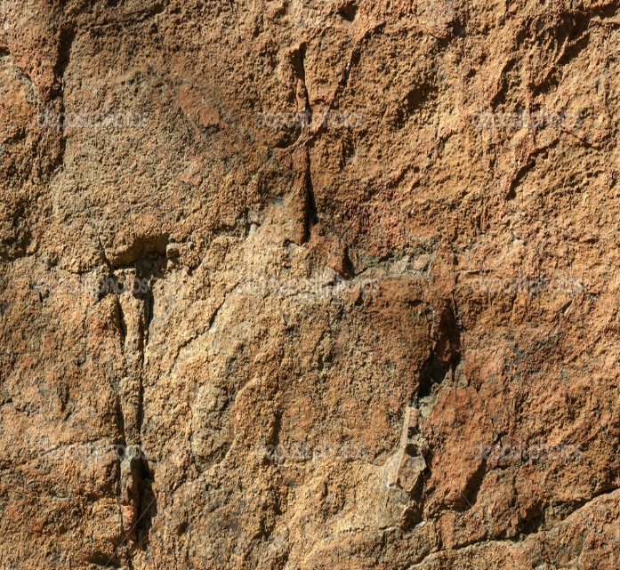
Lesson 134
Chains That Bind You—
Repentance and Forgiveness
Philemon 1

Slide 2
Philemon
He was one of the Colossian Saints (probably Greek) and a convert brought into the Church by Paul
He resided in Colosse
He was the owner of the slave Onesimus
His slave, Onesimus, had deserted his post and taken some valuables
Paul wrote a private letter to Philemon and asked him to receive Onesimus back as a brother in the gospel

Slide 3
Onesimus
His name means “useful” or “profitable”
He was a faithful messenger mention by Paul in his epistle to the Colossians (Colossians 4:6-9)
He had deserted his post with Philemon and gone to seek Paul
He was sent back to his master, Philemon with a message from Paul

Slide 4
Slavery in the Roman Empire
1st Century---human life was cheap---half of the total population of the empire were slaves.
Some wealthy Roman possessed as many as 20,000 slaves
Most of the slaves were those conquered in war. Some of those captured were more educated than their captors. Sometimes Greek slaves became schoolteachers for the family of their masters.

Slide 5
Roman Law
Slaves did not have the rights or protection such as he enjoyed under the Hebrew legislation.
“The attitude of the law toward the slave was expressed in the formula:
servile caput nullum jus habet; in other words: the slave has no right...

Slide 6
…The master’s power was unlimited. He might mutilate, torture, or kill the slave at his pleasure…
Augustus Caesar had 30,000 slaves crucified during his reign.

Slide 7
…Tracking fugitive slaves was a trade. Recovered runaway slaves were branded on the forehead with the letters:
C.F. representing “Cave furem” meaning:
Beware the thief
C.F.

Slide 8
The Law allowed that the slave could be reinstated with mercy, through the intercession of a special friend of the master.

Slide 9
Paul Writes to Philemon
10.I beseech thee for my son Onesimus, whom I have begotten in my bonds;”
11. Which in time past was to thee unprofitable, but now profitable to thee and to me:
12. Whom I have sent again: thou therefore receive him, that is, mine own bowels:
13. Whom I would have retained with me, that in thy stead he might have ministered unto me in the bonds of the gospel:

Slide 10
Paul Asks Philemon to Forgive
14. But without thy mind would I do nothing; that thy benefit should not be as it were of necessity, but willingly.
15. For perhaps he therefore departed for a season, that thou shouldest receive him for ever;
16. Not now as a servant, but above a servant, a brother beloved, specially to me, but how much more unto thee, both in the flesh, and in the Lord?
17. If thou count me therefore a partner, receive him as myself.

Slide 11
Paul Will ‘repay it’
18. If he hath wronged thee, or oweth thee ought, put that on mine account;
19. I Paul have written it with mine own hand, I will repay it: albeit I do not say to thee how thou owest unto me even thine own self besides.
20. Yea, brother, let me have joy of thee in the Lord: refresh my bowels in the Lord.

Slide 12
“Wherefore, I say unto you, that ye ought to forgive one another; for he that forgiveth not his brother his trespasses standeth condemned before the Lord; for there remaineth in him the greater sin.”—D&C 64:9
Read D&C 64:10-11

Slide 13
Equality
We are brothers and sisters in the gospel.
“…for the preacher was no better than the hearer, neither was the teacher any better than the learner; and thus they were all equal…”
Alma 1:26
Read D&C 88:107

Slide 14
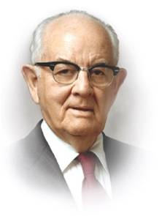
“I have always been uplifted by reading the short epistle of Paul to Philemon; it teaches us a principle and a spirit concerning gospel brotherhood. …
“It is an inspiration and joy to see this same spirit at work throughout the Church, to see the Saints embrace and help and assist and pray for those who daily enter the kingdom of our Lord. Continue to reach out to each other—and the many more who will enter the Church.
Welcome them and love and fellowship them.
“Sadly, there have been occasional incidents where some among us have not done so, accounts of some who have rejected those whom the Lord has accepted by baptism.
If the Lord was ‘not ashamed to call them brethren’ (Heb. 2:11), let us, therefore, … take our brothers and sisters by the hand and lift them up into our circles of concern and love.”
(4)

Slide 15
Is their someone you need to fellowship?

Slide 16
Is their someone you need to forgive?

Slide 17
Sources:
Suggested Song: Help Me, Dear Father (to Truly Forgive) Children’s Song Book #99
New Testament Institute Student Manual Chapter 47
Who’s Who in the New Testament by Richard J. Allen pp. 133, 141-142
3. Historical: Frank E. Gaebelein, Philemon the Gospel of Emancipation Page 17
A.T. Robertson, Epochs in the Life of Paul page 278
Gaebelien, op cit page 18,19
President Spencer W. Kimball (“Always a Convert Church: Some Lessons to Learn and Apply This Year,” Ensign, Sept. 1975, 4).
The Footnote: "The problem in the subscription at the end of Philemon is caused by the translation of the Greek word dia-rendered as 'by' in English-which suggests that Onesimus may have composed the letter. Actually, in the context of this Greek passage and in its genitive case, dia means 'through' or 'by means of' Onesimus. Hence, the subscription in Greek does not state that Onesimus composed the letter (which would contradict verse nineteen), but that the letter was written by means of or through Onesimus-as Paul's... messenger who delivered it." (Max H Parkin, "I Have a Question," Ensign, Sept. 1991, 61)
Presentation by ©http://fashionsbylynda.com/blog/

Slide 18
Paul writes to His Friend Philemon while his first Imprisonment in Rome about A.D. 60-62
Gospel Changes a Servant into a Brother | 1–25
Who Were Apphia and Archippus? Philemon 2
It is highly probable that these two persons were members of the church in Colossae and friends, perhaps converts, of Paul during his stay in Ephesus on his third mission. Some have even suggested that Apphia was Philemon’s wife and Archippus, his son. Nothing more is said of Apphia in Paul’s writings, but the letter to the Colossians, written about this same time, admonishes Archippus as follows: “Take heed to the ministry which thou hast received in the Lord, that thou fulfill it.” (Colossians 4:17.)
Precisely what this ministerial call was is unknown. There is an ancient tradition which holds that Philemon became bishop of Colossae and, during the persecution under Nero when Peter and Paul met their deaths, was martyred in Colossae with his wife, Apphia, his son Archippus, and his slave, OnesimusL
ife and Teachings of Jesus and His Apostles Chapter 43
Life and Teachings of Jesus and His Apostles Chapter 43
Philemon:
This epistle gives one of the finest pictures of the meaning of forgiveness and repentance that can be found in Paul’s writings. The apostle stands revealed as a model of Christ-like love and compassion. Encased in prison walls, Paul’s tender feelings reveal themselves as he pleads the cause of a poor runaway who has naught but Paul to recommend him. The letter is poignant in its beauty. “The epistle is tactfully and sweetly written and does more to reveal the personal feelings of its author than to contribute to the body of Christian doctrine.” (McConkie, DNTC, 3:129.)
Convenience Philemon 8
It may seem strange that Paul would appeal to Philemon to accept Onesimus back on the basis of “convenience.” The word chosen by the King James translators, however, has changed from its original meaning. The Greek word is formed from the verb which means “to come up to” and carries with it the idea of measuring up to a certain mark or standard. Paul’s choice of the word gives the delicate hint that Philemon’s forgiveness of his runaway slave would be the most fitting or becoming thing a true follower of Christ could do.
Life and Teachings of Jesus and His Apostles Chapter 43
Slavery was not viewed as evil within the New Testament Judeo-Christian culture and was supported by Roman law. Punishments for runaway slaves included being severely beaten, branded on the forehead, or even killed. After running away, Onesimus had encountered the Apostle Paul.
Roman Slavery Philemon 16:
In the days of Philemon and Onesimus, slaves were completely at the mercy of their owners. Even trivial offenses were often punished in the most cruel manner. Indicative of the unrestricted authority enjoyed by the masters is this statement by Vincent: “The attitude of the law toward the slave was expressed in the formula servile caput nullum jus gabet; the slave has no right. The master’s power was unlimited. He might mutilate, torture, or kill the slave at his pleasure.
Pollio, in the time of Augustus, ordered a slave to be thrown into a pond of voracious lampreys. Augustus interfered, but afterward ordered a slave of his own to be crucified on the mast of a ship for eating a favorite quail. Juvenal describes a profligate woman ordering a slave to be crucified. Some one remonstrates. She replies: ‘So then a slave is a man, is he! “He has done nothing,” you say. Granted. I command it. Let my pleasure stand for a reason’ (vi., 219). Martial records an instance of a master cutting out a slave’s tongue. The old Roman legislation imposed death for killing a plough-ox; but the murderer of a slave was not called to account.
Tracking fugitive slaves was a trade. Recovered slaves were branded on the forehead, condemned to double labor, and sometimes thrown to the beasts in the amphitheatre. The slave population was enormous. Some proprietors had as many as twenty thousand.” (Vincent, Word Studies in the New Testament, 2:921.)
Bowels Philemon 1:7, 12, 20:
The Greek word translated as bowels refers to one’s inner parts. It is a figurative reference to a person’s center of feelings, affections, and sympathy. The word heart is sometimes similarly used.
The Name Onesimus means useful or “profitable” (verse 11) (see Arthur A. Rupprecht, “Philemon,” in The Expositor’s Bible Commentary, ed. Frank E. Gaebelein, 12 vols. [1976–1992], 11:461). Onesimus may have been “unprofitable” (verse 11) to Philemon because Onesimus had run away and couldn’t perform his duties or because he may have stolen something from Philemon when he fled (see verse 18). However, Paul said that Onesimus had since become “profitable” to both Philemon and Paul (verse 11). In Paul’s case, Onesimus may have been profitable because he could assist Paul while Paul was in prison (see verse 13).

Slide 19
Options for Onesimus:
"What were Philemon's options when Onesimus returned? Merely probing them shows why Paul protected his new convert with letters to Philemon and to the Colossian branch of the Church... The fragments of preserved laws on the subject show Paul's legal duty to send Onesimus back: 'Anyone who has hidden a runaway slave is guilty of theft.' There were legal options to report to authorities or to return 'to the owners.'
The process of formal return hints at how masters might treat returning slaves: 'Carefully guarding them may even include chaining them up.' Second-century laws prevented owners from killing their slaves, but first-century masters seem to have been free to inflict almost anything to break a slave from deserting.
"'Do not torment him,' the senator Pliny wrote a friend, asking for leniency for an offending household servant. 'Make some concession to his youth, his tears, and to your own kind heart.' Such an appeal is admirable but superficial when comparing that request for human decency with Paul's bold testimony of equality: '[Onesimus] departed for a while for this purpose, that you might receive him forever, no longer as a slave but more than a slave, as a beloved brother' (Philem. 1:15-16, NKJB).
Such a request would not work unless Philemon really believed in eternal brotherhood. So Paul labors deftly but plainly for Philemon's conversion to that principle. He writes with the obvious goal of softening Philemon's heart." (Richard Lloyd Anderson, Understanding Paul [Salt Lake City: Deseret Book Co., 1983], 241 - 242.)
Repentance:
"Sincere repentance certainly involves righting the wrong, giving satisfaction to the person sinned against. And when that is done, the major duty shifts to the person wronged. Revelation warns the person sinned against to overcome his resentment through forgiveness: 'He that forgiveth not his brother his trespasses standeth condemned before the Lord; for there remaineth in him the greater sin' (D&C 64:9).
This is the principle dramatized by Jesus in the parable of the unforgiving servant (Matt. 18:21-35), and Paul's letter calls on Philemon to forgive. Paul and Onesimus did their duty to return Philemon's 'property.'
But Paul makes perfectly clear that the master legally owns only the slave's service, not his person. This tension between mortal law and God's higher morality makes this short letter a fascinating challenge to complacency.
For it highlights the duty of every believer in God to respect every child of God, of whatever age, sex, race, or social or economic level. The letter to Philemon admits the wrongdoing of the runaway slave but guards against the further sin of the master in how he takes him back. In short, the letter is really about potential offenses to others from those who have been in the right.
"Slavery was a reality in Paul's world. Cruel war had produced heartless enslavement of enemies, but Paul was on the high end of the social spectrum with the privilege of Roman citizenship. This meant that he was personally untouched by slavery and could have comfortably ignored it. But his Christian convictions did not allow that, for several of his letters command righteous treatment of slaves. Nevertheless, the legal system supported slavery as an institution. (Richard Lloyd Anderson, Understanding Paul [Salt Lake City: Deseret Book Co., 1983], 240 - 241.)

