Slide 1
Lesson 135
The True Nature of Christ
Hebrews 1-4
For we are made partakers of Christ, if we hold the beginning of our confidence steadfast unto the end;
Hebrews 3:14
Presentation by ©http://fashionsbylynda.com/blog/

Slide 2
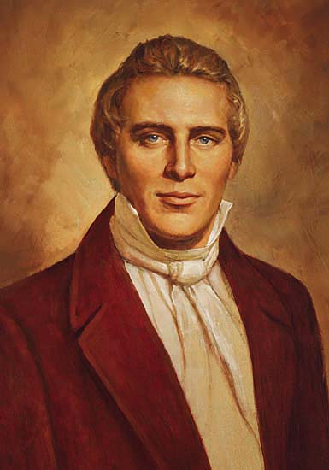
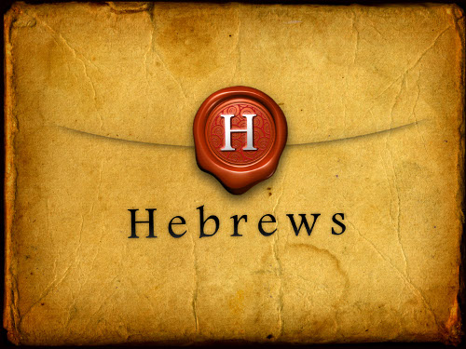
Hebrews
Most Latter-day Saints accept Paul as the author of Hebrews.
However, there are some who question whether Paul wrote this epistle because its style and language are different from Paul’s other letters. It is generally agreed that even if the pen was not Paul’s, the ideas were because the doctrines in Hebrews agree with those found in Paul’s other letters. (2)
The Prophet Joseph Smith attributed statements from Hebrews to the Apostle Paul
?
Just a thought:
Because Paul spoke a number of languages, and because his audience was Jewish and not Greek, his letters could be different in structure.

Slide 3
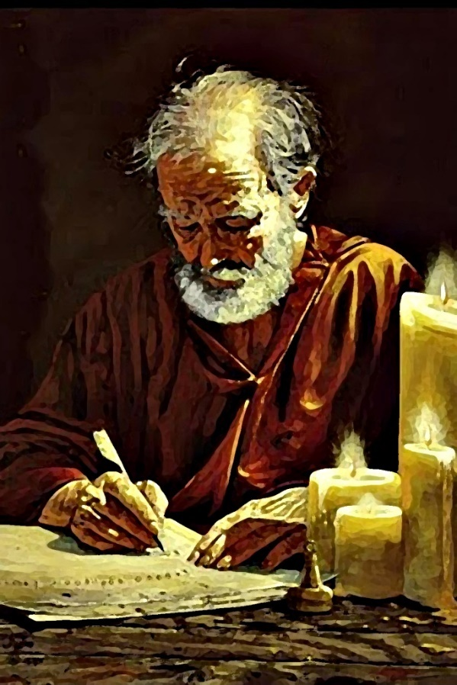
Jewish Christians
Paul wrote the Epistle to the Hebrews to encourage Jewish members of the Church to maintain their faith in Jesus Christ and not to return to their former ways
Under the pressure of various afflictions, many of these Jewish Christians were apparently withdrawing from the Church and returning to the relative safety of Jewish worship at the synagogue.
Paul desired to show these Jewish Christians that the law of Moses itself pointed to Jesus Christ and His Atonement as the true source of salvation.

Slide 4
“Hebrew…is to the New Testament what Leviticus is to the Old:”
Levitical Order
Leviticus announces the Mosaic system
Paul shows how the gospel grew out of the soil of the Levitical order
Intended to bridge those in the wilderness of carnality
The New Testament was in the process of preparation and nearly 3 centuries passed before it was accepted as standard, so the Old Testament was the only scripture available to the Christians.

Slide 5
“Hebrews is More Christ Centered”
Mosaic law no longer needed
Christ fulfills all requirements
Christ atones for all mankind
Crossing over into the “rest” of the Lord
Jesus is authorized to fulfill the old covenant of the law and administer the new covenant of the gospel
Hebrews shows how Christ is the fulfillment of the Mosaic system and the reality in Jesus of Nazareth and his atoning sacrifice

Slide 6
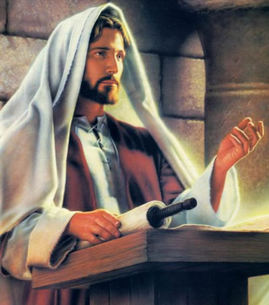
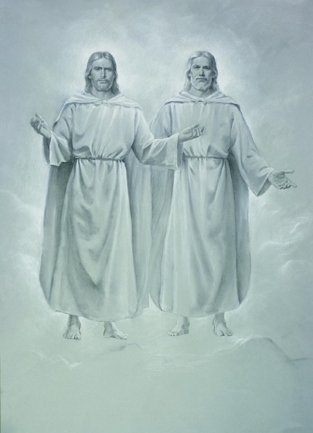
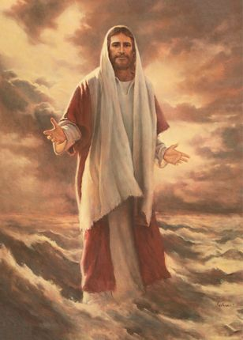
Created the heavens and the earth
Speaks for the Father
Reigns at the right hand of the Father
Jesus Christ:
Is in the express image of the Father
Purges our sins
Is the heir of the Father
Upholds all things by the word of His power
Hebrews 1:2-3

Slide 7
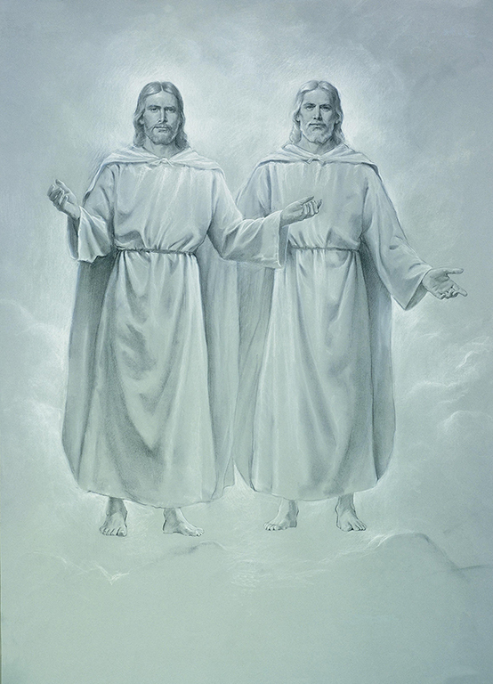
Physical Characters of Jesus Christ
“Who being the brightness of his glory, and the express image of his person…”
“If ye had known me, ye should have known my Father also: and from henceforth ye known him, and have seen him.”
—John 14:7
Hebrews 1:3

Slide 8
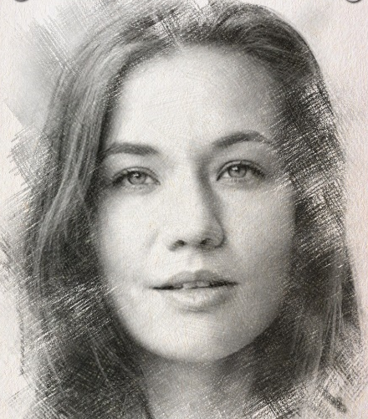
What do we receive from our parents when we are born?
Personality
Physical
Customs
Religious preference
Ethical and moral standards
Monetary status
Social environment
Hebrews 1:3

Slide 9
What have we inherited from Heavenly Father?
Personality
Physical
body
Choices
Free agency
A sense of right and wrong
Knowledge through scriptures
A place in His kingdom
Hebrews 1:3

Slide 10
Attributes and Characteristics of Christ
He will have a scepter of righteousness
Angels worship Him
He hates iniquity
He made Him lower than angels
He laid the foundation of the earth
Crowned him with glory and honor
Taste death for every man
Hebrews 1:6-12

Slide 11
“Condescension of God”
Read 1 Nephi 11:26-33
The Savior’s willingness to leave His throne on high, become mortal, suffer death on the cross, and pay for the sins of mankind
Hebrews 1:3

Slide 12
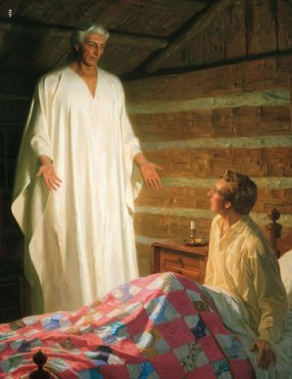
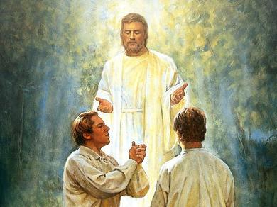
Angel =“Messenger”
Sent by God to do His work
Some may not have come to earth yet
With special callings to serve
Some are people who lived on earth:
Either in the Spirit World
Or
Translated beings
Or
Resurrected beings
Like John the Beloved
Like Moroni, or John the Baptist when they visited Joseph Smith

Slide 13
Angels without Physical Bodies
Angels with
Physical Bodies
A perfected resurrected being who has finished mortality
A translated being, like John the Revelator
Living in the premortal world, waiting to be born
Finished with mortality, living in the spirit world
J. Kirk Richards

Slide 14
“These angels are under the direction of Michael or Adam, who acts under the direction of the Lord.
From Hebrew 1:4 we learn that Paul perfectly understood the purposes of God in relation to His connection with man, and that glorious and perfect order which He established in Himself, whereby he sent forth power, revelations, and glory.”
(4)

Slide 15
Is the Savior Really Lower Than the Angels?
“The marginal reading of this quotation from Psalm 8:4-6 recites that man is made, not a little lower than the angels, but a little lower than Elohim, which means that all God’s offspring, Jesus included, as children in his family, are created subject to him, with the power to advance until all things are ‘in subjection’ to them.
Of those who gain eternal life, it is written: ‘Then shall they be above all, because all things are subject unto them, Then shall they be gods, because they have all power, and the angels are subject unto them.”
READ D&C 132:20
(5)

Slide 16
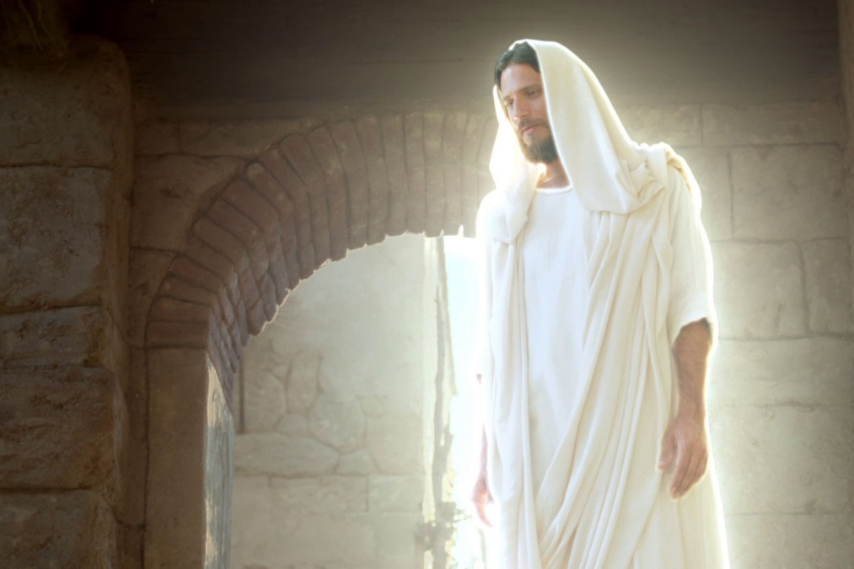
Angelic Status
“The only sense in which either men or Jesus are lower than the angels is in that mortal restrictions limit them for the moment; and for the that matter, angels themselves become mortals and then in the resurrection attain again their angelic status.”
(5)

Slide 17
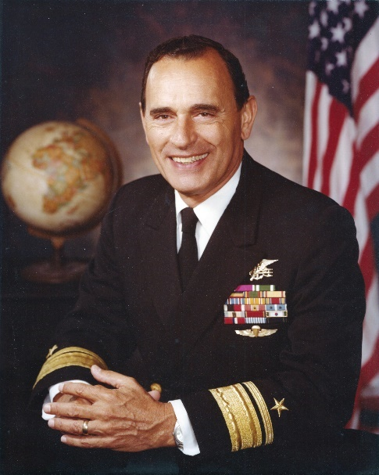
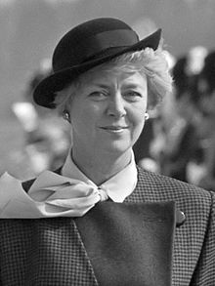
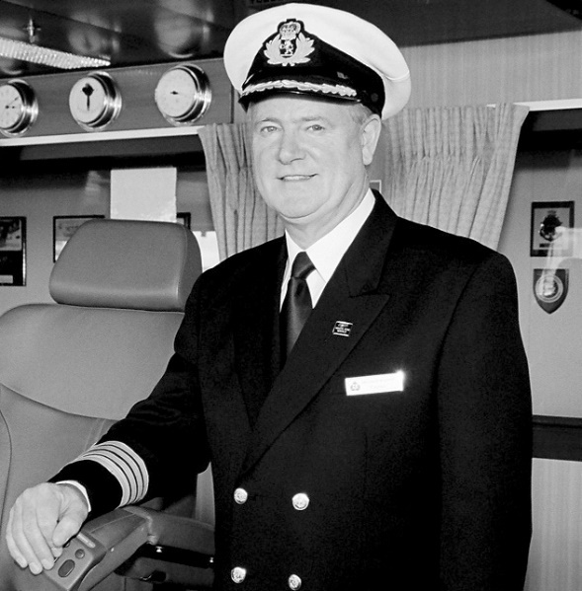
Captain of Salvation
What qualifications do you look for when selecting a captain or leader?
Richard Lyon (July 14, 1923 – February 3, 2017)
Vigdís Finnbogadóttir (First Iceland President)
Jesus Christ is the Captain of our salvation
Hebrews 2:10
Captain Bernard Warner (Queen Mary 2)

Slide 18
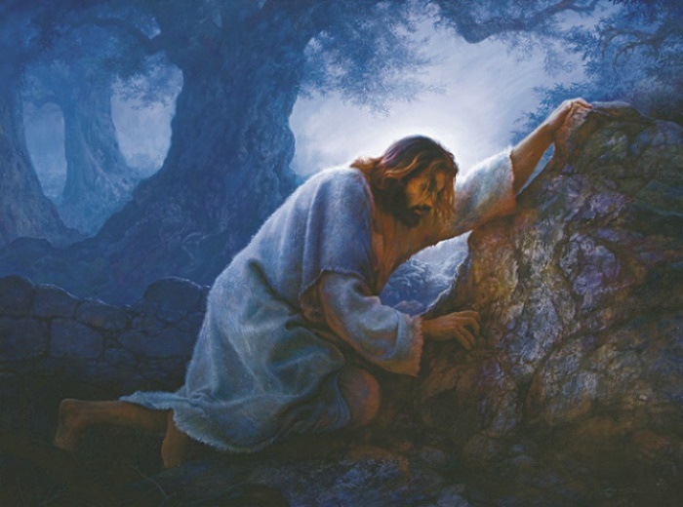
Reconciliation
Christ atoned for our sins, allowing us to be reconciled, or brought into a harmonious relationship, with Heavenly Father
Paul not only referred to the Savior as the Captain of our salvation, but he also called Him “a merciful and faithful high priest.”
Paul likened Jesus Christ to a Jewish high priest because the high priest was viewed as a mediator between the people and God.
Gregory K. Olsen
Because Jesus Christ suffered and was tempted in all things, He understands us perfectly and can help us in times of need
READ Alma 7:11-13
Hebrews 2:14-18

Slide 19
Goals
What goal would you like to accomplish?
What steps do you need to take to reach that goal?
Whose responsibility is it to obtain that goal?
“For we are made partakers of Christ, if we hold the beginning of our confidence steadfast unto the end;”
If you do not meet the requirements for that goal, do you think you should be given the reward anyway?
Hebrews 3:14

Slide 20
Enter into the Rest of the Lord
“So I sware in my wrath, They shall not enter into my rest.”
Rest
Presence of God
A privilege of seeing God
Manifestations of God
Hebrews 3:11

Slide 21
“True saints enter into the rest of the Lord while in this life, and by abiding in the truth, they continue in that blessed state until they rest with the Lord in heaven. …
The rest of the Lord, where mortals are concerned, is to gain a perfect knowledge of the divinity of the great latter-day work. …
The rest of the Lord, in eternity, is to inherit eternal life, to gain the fulness of the Lord’s glory.”
(5)

Slide 22
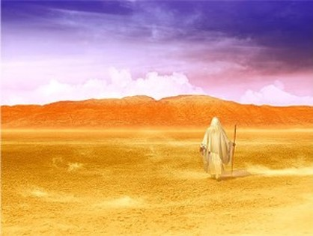
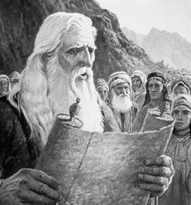
Forfeiting God’s Glory--Israelites
“But they hardened their hearts and could not endure his presence; therefore, the Lord in his wrath, for his anger was kindled against them, swore that they should not enter into his rest while in the wilderness…
…which rest is the fulness of his glory.”
--D&C 84:24

Slide 23
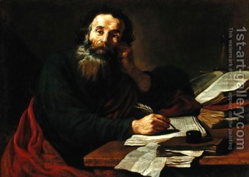
Paul Warns the Hebrews
“Take heed, brethren, lest there be in any of you an evil heart of unbelief, in departing from the living God.”
“But exhort one another daily, while it is called To day; lest any of you be hardened through the deceitfulness of sin.”
Hebrews 3:12-13

Slide 24
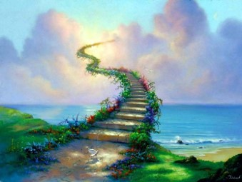
Paul Warns Us Today
“While it is said, To day if ye will hear his voice, harden not your hearts, as in the provocation.”
The righteous enter into a state of rest called paradise when they die…
…but we can also receive the Lord’s rest in this life.
Hebrews 3:15

Slide 25
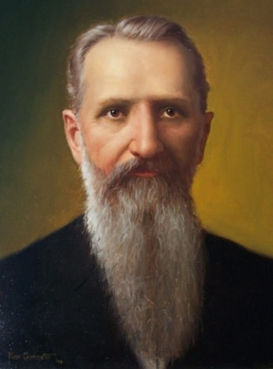
The Meaning of Entering Into God’s Rest
“To my mind, it means entering into the knowledge and love of God, having faith in his purpose and in his plan, to such an extent that we know we are right,
and that we are not hunting for something else,
we are not disturbed by every wind of doctrine,
or by the cunning and craftiness of men who
lie in wait to deceive.
(6)

Slide 26
Degree of Faith
“The man/woman who has reached that degree of faith in God that all doubt and fear have been cast from him, he has entered into ‘God’s rest’
Rest from doubt,
from fear,
from apprehension of danger,
from the religious turmoil of the world.
(6)

Slide 27
Falling Short of Your Goal
“For we which have believed do enter into rest, as he said,…if they shall enter into my rest: although the works were finished from the foundation of the world.”
“For if Jesus had given them rest, then would he not afterward have spoken of another day.”
Hebrews 2:3 and 8

Slide 28
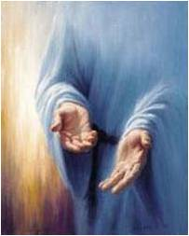
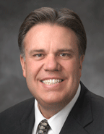
Jesus Has The Power
“Come unto me, all ye that labour and are heavy laden, and I will give you rest.”
Jesus Christ has the power to help each of us obtain His rest
Matthew 11:28
Jesus doesn’t take away the burdens we have but strengthens us to carry them and promises it will be for our good.
(7)

Slide 29
Obtaining Our Goal
Come unto Christ
Seek the rest
Seek the joy
If we remain faithful to the Savior and harden not our hearts, we will enter into the rest of the Lord
Seek the peace

Slide 30
Sources:
Suggested Hymn: #120 Lean on My Ample Arm
Video:
Meet McKay (3:59)
New Testament Institute Student Manual Chapter 47
Bible Dictionary
Teachings of Presidents of the Church: Joseph Smith [2007], 105).
Joseph Smith Teaching pg. 191
Elder Bruce R. McConkie DNTC 3:143; Elder Bruce R. McConkie (Mormon Doctrine, 2nd ed. [1966], 633).
Joseph F. Smith Gospel Doctrine pg 58
Brad Wilcox “Continuous Atonement”
Presentation by ©http://fashionsbylynda.com/blog/

Slide 31
LETTER TO THE HEBREWS—BELIEVED WRITTEN BY PAUL, about A.d. 60-62 (HEBREWS)
Christ the Creator, the Heir, the Son | 1:1–4
Angels Are Ministering Spirits | 1:5–14
Jesus: Made a Little Lower than Elohim | 2:1–9
Christ Became Mortal to Save Man | 2:10–18
Christ Is the Great High Priest and Apostle | 3:1–6
The Unfaithful Shall Not Earn the Rest of the Righteous | 3:7–19
The Gospel Was Offered to Ancient Israel | 4:1, 2
How to Enter into the Rest of the Lord | 4:3–11
The Sure Testimony of the Still, Small Voice | 4:12, 13
Christ, the Compassionate High Priest | 4:14–16; 5:1–3
The Difference Between an Angel and a Ministering Spirit Hebrews 1:4:
“He [Paul} explained the difference between an angel and a ministering spirit; the one a resurrected or translated body, with its spirit ministering to embodied spirits—the other a disembodied spirit, visiting and ministering to disembodied spirits. Jesus Christ became a ministering spirit (while His body was lying in the sepulchre) to the spirits in prison, to fulfill an important part of His mission, without which He could not have perfected His work, or entered into His rest. After His resurrection He appeared as an angel to His disciples.” (Smith, Teachings, p. 191.)
“These angels are under the direction of Michael or Adam, who acts under the direction of the Lord. From [Hebrews 1:4] we learn that Paul perfectly understood the purposes of God in relation to His connection with man, and that glorious and perfect order which He established in Himself, whereby he sent forth power, revelations, and glory.” (Smith, Teachings, p. 168.)
Angels Hebrews 1:6, 14:
“I believe we need to speak of and believe in and bear testimony to the ministry of angels more than we sometimes do. They constitute one of God’s great methods of witnessing through the veil” Elder Jeffrey R. Holland (“A Standard unto My People” [address delivered at the Church Educational System Symposium on the Book of Mormon, Aug. 9, 1994], 11; si.lds.org).
Angels Hebrews 1:6, 14:
“Some of these personal visits were dramatic and powerful. Think of the angels who ministered to the Nephite children in the account of 3 Nephi 17, or the angel who chastised Alma and Mosiah’s sons in answer to a father’s prayer. (See Mosiah 27.)
“Other personal manifestations have been so quiet that those who received them were unaware of the angelic presence. The ministry of these unseen angels is among the most sublime forms of interaction between heaven and earth, powerfully expressing God’s concern for us and bestowing tangible assurance and spiritual sustenance upon those in great need” Elder Bruce C. Hafen (“When Do the Angels Come?” Ensign, Apr. 1992, 12).
Life and Teachings of Jesus and His Apostles Chapter 46
Background for Hebrews:
Tension was often sharp between gentile and Jewish Christians, the former insisting that Mosaic ritual was done away in Christ’s atoning sacrifice and the latter often insisting that it was not. As the former point of view began to prevail, an interesting question arose: If we accept the truth that the law of Moses is no longer binding on Christians, what is the true value of the Old Testament and how should it be interpreted? The question was particularly pressing for Jewish Christians, since their personal upbringing included a reverent study of the ancient scriptures. (The only scriptures available to the Christians at this early date, whether Jew or gentile, were those known to us as the Old Testament. The New Testament was in the process of preparation, and nearly three centuries passed before it was accepted as a standard or rule of faith.) Paul’s letter to the Hebrews appears to have been written, at least in part, to answer this question.
Symbol of the Rest of the Lord Hebrews 4:4,10:
“The Sabbath Day is the sign and symbol of the rest of the Lord. Those who have entered into gospel rest keep the Sabbath Day holy as part of their righteous conduct and true worship. On that day they rest from their worldly labors, as God did from his creative enterprises, as a sign and testimony that they have entered into the rest of the Lord in this life, have testimonies of the gospel, and look forward to that rest of the Lord ‘which rest is the fulness of his glory’ hereafter. (D. & C. 84:24.)” Elder Bruce R. McConkie (Doctrinal New Testament Commentary, 3 vols. [1965–73], 3:151).

Slide 32
Richard Lyon, pioneering Navy SEAL who fought in two wars, dies at 93 (Feb. 3, 2017)
Born in the summer of 1923, Dick Lyon was destined to become an extraordinary waterman. Initially, while only a junior in high school, he became the #1 nationally ranked swimmer in the 50- and 100-yard freestyle. In 1940, Dick made the US national Olympic team. (Because of the 1940’s boycott he was never able to compete). Mentored by the formidable Yale coach Bob Kiphuth, it’s no surprise that Dick entered Yale in the fall of 1941.
He enlisted in the Navy on October 9, 1942 while an engineering major at Yale, and entered the accelerated program, graduating after only two years and nine months. While taking a tough course load, Dick never let up on his training in the pool. The whole time he competed at Yale the swim team never lost a meet. During Dick’s junior year he anchored the 400-yard freestyle relay team which set a new world’s record, stealing it from the Japanese national team who had held the record previously. Hearing the patriotic crowd roar with excitement at the prospect of Americans beating the Japanese, Dick got his best-ever split on his leg. When he touched the wall, his teammates jumped in with him and yelled, “We got it!” As soon as he could, Dick sent a telegraph to his delighted parents telling them his relay team in essence had “just broken the world’s record, ho hum.” They weren’t fooled for a second by his low key message. They were all over the moon. Finally, he capped off his swimming career by captaining Yale to the NCAA Division 1 National Championship in his senior year.
After graduating with honors in 1944, Dick went on to Columbia Midshipman School in New York City for three months. After the first month he was selected to take command of the entire regiment (2,400 midshipmen). Three weeks before he was to graduate as a 90-day-wonder he saw a notice “Wanted: Volunteers for Special Warfare Unit Involving Demolition of Explosives. Must be Strong Swimmer.” The assignment to the Scouts and Raiders (forefathers of today’s Navy Seals) was just his calling.
Sent to Ft. Pierce, Florida, Dick went through Class 8 of the Scouts and Raiders along with 56 other tough naval officers. Scouts and Raiders was the Navy’s first special warfare unit, developed to conduct reconnaissance on potential invasion beaches. They were soon followed in 1942 by NCDU’s (navy combat demolition units), and in 1943 by “frogmen”, the Underwater Demolition Teams (UDT’s), who were responsible for blowing up natural (reefs) and man-made obstacles on beaches to clear a path for invasion forces.
The Scouts and Raiders were the first to endure such trials as “hell week”, a week with almost no sleep or rations, which is today a standard part of training for Navy SEALS that prepares them to find ways to survive on their own behind enemy lines. Three months later, Class 8 were sent to Europe, the China-Burma-India (CBI) theater, and the Pacific. Dick landed on the Pacific side, where he joined the Administrative Command Amphibious Force Pacific Fleet.
Hopping from island to island primarily in the Philippines, Dick got to do his first reconnaissance mission of the war at a beach a little bit outside of Davao, one of the larger cities on Mindanao. Dick found and reported that it was clear of natural and man-made obstacles, a good place for a landing. Exactly five days after he did the recon, the first atomic bomb dropped on Japan.
The Amphibious Force picked up elements of the Army’s 33rd Infantry Division, then went on to Japan’s Honshu Island. There, inside Sagami Wan, a large curved bay west of Tokyo Bay, near the village of Wakayama, Dick did another recon of a beach. The town looked abandoned, but as Dick looked out of the water towards the small town center he saw three people walking down the main street to the beach. It soon became clear they were waiting to talk to him. So, Dick walked out of the water and up the beach towards the men. The leader of the little group said in clear English, “I want to let you know that I and the people of this city are so glad that this war is over.” Somewhat surprised to have met his first Japanese, and one who spoke English so well, Dick said he was glad the war was over too, “And I think you will find the occupation a peaceful one.” His new acquaintance replied, “I am sure you will find that the case in Wakayama.”
After several minutes, Dick asked how he spoke such good English. The Japanese man said, “I’m a graduate of Harvard.”
Not one to let that slip, Dick immediately expressed his regrets, “Well my heart goes out to you, because Yale always beats Harvard at football.”
They made an appointment to meet again on the beach in three days, and his now Japanese friend brought Dick to his house as a guest, where they had a delightful evening. Dick’s gift of two cartons of Lucky Strikes could not have been more enthusiastically received, and as he left he was presented with a portfolio of 23 antique prints with detailed hand appliqués of Samurai warriors…priceless!
Still not able to return home because he had so few points, Dick was somewhat at loose ends. Then he heard through the grapevine that the Commander of the 7th fleet based in Shanghai wanted a Scout intelligence officer on his staff. He spent the next year in northern China reporting on the activities of Mao Tse Tung’s armies on the Shantung Peninsula in an effort to hold off a Chinese civil war, an incredible experience for a very junior officer.
Leaving active duty after that assignment, Dick joined the Naval Reserves and had completed his first year of a Stanford MBA when he was recalled for Korea. Reporting in 1951 to Beach Jumper Unit 1, he again volunteered for NavSpecWar, UDTRA Class 2, and as a Navy Lieutenant became a Plank Owner (original commissioning member) of Underwater Demolition Team 5. That grueling training that UDT5 experienced was the beginning of what is now the 55-week SEAL training. Since then 281 additional classes have endured the training, and in early 2012 Class 287 will graduate.
After just a three-month training, UDT5 was sent immediately to Korea. For the first time they took mission responsibility beyond the mean high-water mark. In fact, UDT5 went in and blew up rail lines and tunnels. Dick worked in North Korea, above the 38th parallel, inside Won San harbor, recovering a new type of anti-amphibious assault mine. His job was to dive in 36-degree water in a dry suit (before SCUBA and wetsuits existed), under fire, swim under the mine, and cut its mooring line with a pair of 24” bolt cutters. After 20 minutes he had to be pulled out due to the cold. Working out of a little yellow raft with the explosive ordinance disposal expert, they would tow each mine to an island within the harbor and “render it safe” (defuse it). The mines were then sent back to Indian Head, Maryland, Navy Mine Warfare Headquarters, where all were determined to be Russian-made!
Dick eventually attained the rank of two-star Admiral in 1974, the first special warfare (SEAL) officer to do so. In this rank he was recalled for three more years of active duty as Deputy Chief of Naval Reserve, the senior reserve officer in the Navy. He has the distinction of holding the title “BullFrog 1”. “BullFrog” is that active-duty SEAL with the longest tenure in special warfare. When Admiral Eric Olson (BullFrog 14) retired, Admiral William H. McRaven, and Commander Brian Sebenaler (a Mustang) jointly inherited the title of BullFrog 15. Both graduated from BUD/S Class 87.
Retiring from the Navy after nearly 41 years of service, Dick became actively involved in community affairs. He was a founder and trustee president of Children’s Hospital, Orange County (CHOC). He also became mayor of Oceanside, California for eight years. and served as president of the city’s unified school district.
An avid outdoorsman, Lyon was a pilot, a skier and a yachtsman. He won body surfing contests well into his late 70s. He was a proud representative of the Scouts and Raiders. http://www.ww2historyproject.org/veterans/admiral-richard-lyon/

Slide 33
Captain Bernard Warner has been at sea for forty years and in command for the past twelve years. He was born near Leeds and grew up in the North Yorkshire town of Wetherby. A lifetime friendship with the sea was cultivated at Sandsend near Whitby on the north east coast of England, where he spent the summer holidays sailing and fishing with his father.
When just eight years old he went away to boarding school and was educated initially at Terrington Hall near York (1956 - 1961) and then at Denstone College in Staffordshire (1961 - 1964).
At sixteen he entered the Warsash School of Navigation at the University of Southampton. Queen Mary and Queen Elizabeth would frequently sail past the college as they made their way up Southampton Water into the port and it was these ships which gave him the inspiration to one day command a Cunard Trans Atlantic liner.
In 1965 Cunard Line would only consider employing navigating officers who had attained a Masters Certificate. Captain Warner would be twenty five years old by the time this had been achieved. The alternative was to join P&O, which was the other great passenger shipping company of the day. He signed indentures and commenced a four year cadetship with them on 1st January 1966. P&O had a large passenger fleet but an even larger fleet of cargo ships. His first voyage was from King George V dock in London to the Far East aboard Somali, a 7000 gross ton freighter.
Nearing the end of his cadetship in 1969, he joined his first passenger ship Oriana, and by the early seventies he was sailing as a Junior Deck Officer aboard the P&O ship Iberia. He was later to be appointed to the legendary P&O liner Canberra, where he also sailed as Deputy Captain in 1988.
Captain Warner met his wife, Tina, on board Royal Princess. They were married in 1988 and now live in Leek Wootton (about one mile from Warwick Castle). Their two sons, Tom (aged 16) and Charles (aged 11), enjoy sailing aboard with them during school holidays.
In 1994, he was appointed to his first command - the 20000 gross ton ship Island Princess - and since that time has commanded seven other passenger ships. He oversaw the building of Dawn Princess, Golden Princess and Diamond Princess and was designated the first Master of both Golden Princess and Diamond Princess, which at 116 000 gross tons, are slightly smaller than Queen Mary 2 (151,400 gross tons) On November 11th 1996 he was invited by the British & Commonwealth Office to lay a wreath at the Cenotaph on behalf of the British Merchant Navy. This is an annual event to honor all those who have given their lives in both World Wars.
In 1998 he was elected a Younger Brother of Trinity House whose Master is the Duke of Edinburgh, and who have recently asked Princess Anne to be its first female member. Bernard Warner is a descendant of Sir Thomas Warner who, in the 17th Century, was Captain of the schooner Marmaduke. Sir Thomas crossed the Atlantic in 1623, and founded the first English settlement in the West Indies at the island of St Christopher (now known as St Kitts). He claimed it on behalf of King James 1st of England and in 1625 became the islands first Governor General. His tomb is at St. Thomas church in Middle Island village on St Kitts.
Captain Warner has recently realized one of his career ambitions after being appointed to command the majestic Queen Mary 2.
http://www.qm2.org.uk/captain_bw.html

Slide 34
Vigdís Finnbogadóttir (born 15 April 1930) served as the fourth President of Iceland from 1 August 1980 to 1996. She was both Iceland's and Europe's first female president, and the world's first democratically directly elected female president. With a presidency of exactly sixteen years, she also remains the longest-serving elected female head of state of any country to date. Currently, she is a UNESCO Goodwil Ambassador, and a Member of the Club of Madrid. She is also to date Iceland's only female president.
Vigdís Finnbogadóttir was born in Reykjavík on 15 April 1930. Her father, Finnbogi Rútur Þorvaldsson, was a civil engineer, as well as a professor at the University of Iceland. Her mother, Sigríður Eiríksdóttir, was a nurse and the chairperson of the Icelandic Nurses Association. They had two children: Vigdís and then a son a year later. After passing her matriculation exam in 1949, Vigdís studied French and French literature at the University of Grenoble and the Sorbonne in Paris from 1949 to 1953, then studied the history of theater at the University of Copenhagen. She then acquired a BA in French and English, as well as PGCE, at the University of Iceland. She married a physician in 1954, but divorced in 1963, and at the age of 41 she adopted a daughter, being the first single woman who was allowed to adopt a child.
After graduation Vigdís taught French and French drama at the University and worked with experimental theatre. She worked with the Reykjavík Theatre Company from 1954 to 1957 and again from 1961 to 1964. During the summers, she also worked as a tour guide. Vigdís taught French at Menntaskólinn í Reykjavík 1962–67 and at Menntaskólinn við Hamrahlíð from 1967 to 1972. She also taught for a while at University of Iceland, as well as holding French courses on RÚV, the Icelandic state television.
She was the Artistic Director of the Reykjavík Theatre Company (Leikfélag Reykjavíkur), later the City Theatre from 1972 to 1980. From 1976 to 1980, she was a member of the Advisory Committee on Cultural Affairs in the Nordic countries.
In 1996 she became founding chair of the Council of Women World Leaders at the John F. Kennedy School of Government at Harvard University. Two years later she was appointed president of the United Nations Educational, Scientific and Cultural Organization World Commission on the Ethics of Scientific Knowledge and Technology.
The Icelandic women's movement has a long history. During the International Women's Year in 1975 Icelandic women attracted great attention when they organized a general strike to show how important women's undervalued work was. 90 per cent of the Icelandic women went on strike. And at the presidential election in 1980 the women's movement focused on electing a woman. After much persuasion Vigdís accepted to run against three male candidates. She was the first woman in the world to be elected as head of state in a democratic election, despite being a divorced single mother. She was narrowly elected, with 33.6 percent of the national vote, while her nearest rival got 32.1 percent. She became very popular and was subsequently reelected three times, unopposed in 1984, with 94.6 percent of the votes against another woman in 1988 and unopposed in 1992. In 1996 she decided not to run for reelection.
Although the Icelandic presidency is largely a ceremonial position, Vigdís took an active role as environmental activist and fought for Icelandic language and culture, acting as a cultural ambassador in promoting the country. She emphasized the role of small nations and hosted a crucial summit between US President Ronald Reagan and Soviet leader Mikhail Gorbachev in 1986. She had as her motto: 'Never let the women down' and worked specifically to promote girls' education. She was also aware of her role as a model for young women.
In 1993 the work Mitt Folk, commissioned by the British government, by the composer Oliver Kentish was dedicated to her as a gift from Britain to Iceland celebrating the 50th anniversary of the republic
Since 1998, Vigdís Finnbogadóttir has been UNESCO’s Goodwill Ambassador for languages.
She is also a member of the Fondation Chiracshonour committee, ever since the foundation was launched in 2008 by former French president Jacques Chirac in order to promote world peace.
She has received 16 honorary degrees in various countries and a a member of the Club of Madrid, an independent non-profit organization composed of 81 democratic former Presidents and Prime Ministers from 57 different countries.
Wikipedia

