Slide 1
Lesson 136
Called of God
Hebrews 5-6
For every high priest taken from among men is ordained for men in things pertaining to God, that he may offer both gifts and sacrifices for sins:
Hebrews 5:1

Slide 2
How Do You Know?
Do these students lack the authority and ability to perform either to operate on you or give you a ticket?
What must they have?
Qualifications, Degrees, Training, Authority to perform their duties
Law Enforcement
Doctor
Just as society has established necessary qualifications and ways to obtain authority to carry out certain responsibilities, God has established necessary qualifications (such as faithfulness and worthiness) and ways to obtain authority to carry out certain responsibilities in His Church.

Slide 3
The Pattern
God the Father
The Savior is the High Priest
Jesus received His authority from God the Father
Hebrews 4:14-16
Aaron was called of God by revelation to serve as the high priest, who represented the people before God in sacred matters and presided over other priesthood holders (the Levites). His calling came from God through a revelation to Moses:
Exodus 28:1
“We believe that a man must be called of God, by prophecy, and by the laying on of hands by those who are in authority, to preach the Gospel and administer in the ordinances thereof.”
Hebrews 5: 1-5; Article of Faith 1:5

Slide 4
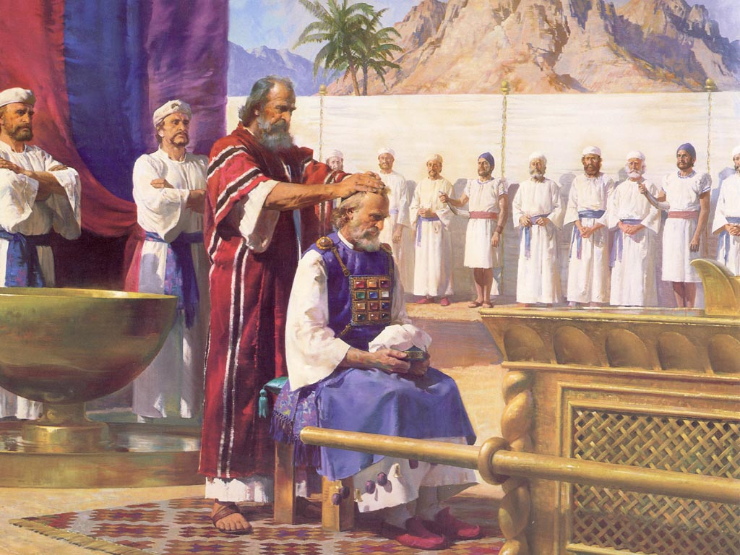
The Office of High Priest
The office of high priest referred to in these verses was, under the law of Moses, the presiding office in the Aaronic Priesthood. Aaron, Moses’s brother, was “the first high priest of the Aaronic order.”
The office was hereditary; after the time of Aaron, the high priest was selected from among the firstborn descendants of Aaron and his sons.
The high priest usually served for the remainder of his life, but this office was eventually seized by wicked men.
“High priests were inappropriately appointed and deposed at pleasure by Herod and the Romans alike.
The office was filled by 28 different men between 37 B.C. and A.D. 68”
Hebrews 5: 1-5; Article of Faith 1:5
(3)

Slide 5
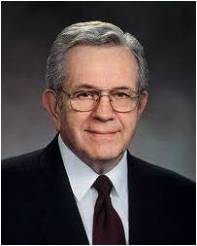
“The priesthood cannot be conferred like a diploma.
It cannot be handed to you as a certificate.
It cannot be delivered to you as a message or sent to you in a letter.
It comes only by proper ordination.
An authorized holder of the priesthood has to be there.
He must place his hands upon your head and ordain you.” (2)
Priesthood holder
Hebrews 5:4
(2)

Slide 6
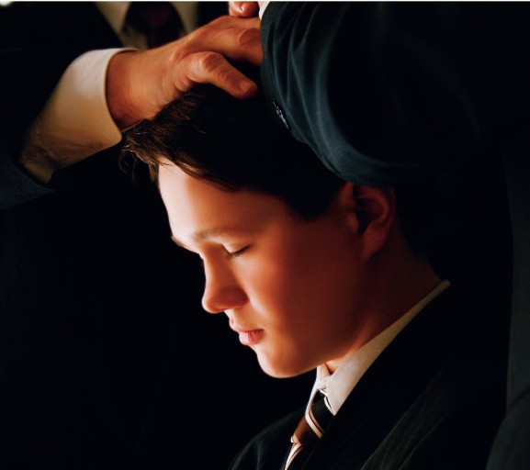
To Be Chosen
Those who are ordained to the priesthood must be called of God by revelation through His authorized servants
In the Church today, authorized priesthood leaders are to interview each candidate for ordination and seek the guidance of the Holy Ghost to determine a candidate’s readiness and worthiness to be ordained to the priesthood.
Ye have not chosen me, but I have chosen you, and ordained you, that ye should go and bring forth fruit, and that your fruit should remain: that whatsoever ye shall ask of the Father in my name, he may give it you.
John 15:16
Those who are ordained to the priesthood must be called of God by revelation through His authorized servants
Hebrews 5:4

Slide 7
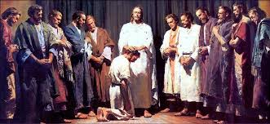
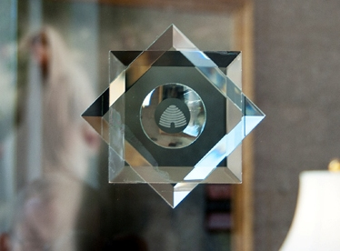
Authority
I will declare the decree: the Lord hath said unto me, Thou art my Son; this day have I begotten thee.
Psalm 2:7
The Lord hath sworn, and will not repent, Thou art a priest for ever after the order of Melchizedek.
Psalm 110:4
Who gave the Savior His authority?
What priesthood does Jesus Christ hold?
Symbols of Melchizedek Priesthood on San Diego Temple Windows
Hebrews 5: 5-6

Slide 8
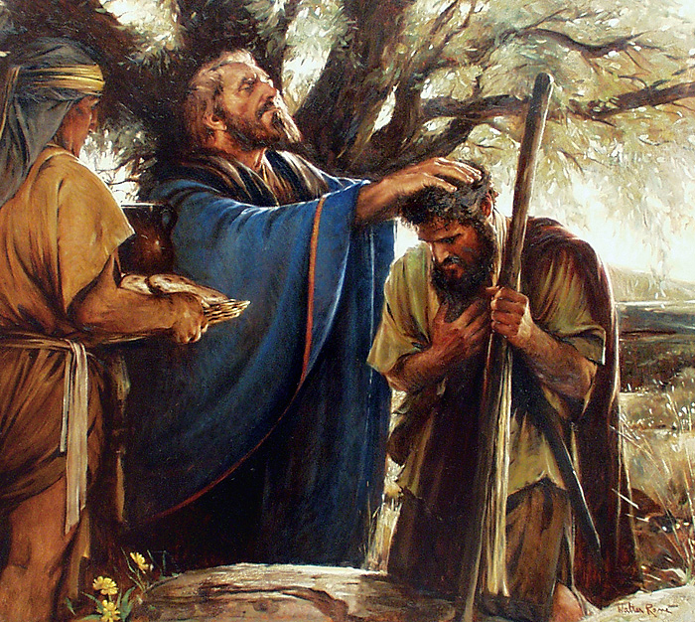
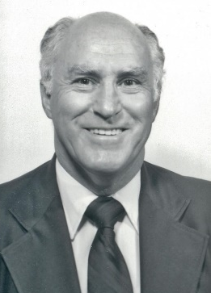
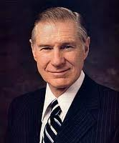
The Pattern--Obedience
Melchizedek was a prototype of Christ and that prophet’s ministry typified and foreshadowed that of our Lord in the same sense that the ministry of Moses did.
"The reference to Melchizedek was undoubtedly inserted because Melchizedek was a type or a foreshadowing of Christ...Hence, Hebrews 5:7-8, while referring specifically to Melchizedek, has equal, though indirect, application to Jesus Christ because Melchizedek typifies Christ." (4)
“As in all things, the Savior is our pattern. The Apostle Paul wrote, ‘Though he were a Son, yet learned he obedience’ In our own finite way, we too can learn obedience even as Christ did. … When obedience becomes our goal, it is no longer an irritation; instead of a stumbling block, it becomes a building block.” (5)
Hebrews 5:7-8

Slide 9
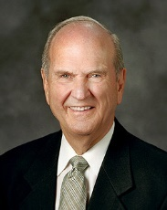
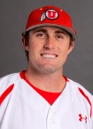
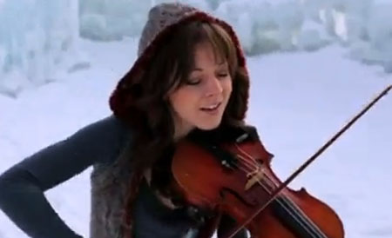
Mortal Perfection
Be ye therefore perfect, even as your Father which is in heaven is perfect. Matthew 5:48
In this life, certain actions can be perfected.
A baseball pitcher can throw a no-hit, no-run ball game.
A surgeon can perform an operation without an error.
A musician can render a selection without a mistake.
One can likewise achieve perfection in being punctual, paying tithing, keeping the Word of Wisdom, and so on.
The enormous effort required to attain such self-mastery is rewarded with a deep sense of satisfaction. More importantly, spiritual attainments in mortality accompany us into eternity.
Mortal perfection can be achieved as we try to perform every duty, keep every law, and strive to be as perfect in our sphere as our Heavenly Father is in his. If we do the best we can, the Lord will bless us according to our deeds and the desires of our hearts.
The process of perfection includes challenges to overcome and steps to repentance that may be very painful.
Hebrews 5:9
(6)

Slide 10
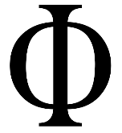
Eternal Perfection
Be ye therefore perfect, even as your Father which is in heaven is perfect. Matthew 5:48
perfect = Greek teleios, which means “complete.”
Teleios is an adjective derived from the noun telos, which means “end.”
The infinitive form of the verb is teleiono, which means “to reach a distant end, to be fully developed, to consummate, or to finish
Phi= perfect ratio between circle and line
“The word does not imply “freedom from error”; it implies “achieving a distant objective.”
The perfection that the Savior envisions for us is much more than errorless performance. It is the eternal expectation as expressed by the Lord in his great intercessory prayer to his Father—that we might be made perfect and be able to dwell with them in the eternities ahead.
Teleios is not a total stranger to us. From it comes the prefix tele- that we use every day.
Telephone literally means “distant talk.”
Television means “to see distantly.”
Telephoto means “distant light,” and so on.
Hebrews 5:9
(6)

Slide 11
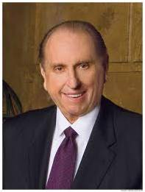
Blessings Are Conditional…
Peace
Answers to prayers
Happiness
Forgiveness
Blessing included in patriarchal blessings
Knowledge of resurrection
Knowledge of an eternal life
…upon our choices
“All of our choices have consequences, some of which have little or nothing to do with our eternal salvation and others of which have everything to do with it.”
Hebrews 6
(7)

Slide 12
“Leaving the Principles of the Doctrine of Christ”
Therefore leaving the principles of the doctrine of Christ, let us go on unto perfection; not laying again the foundation of repentance from dead works, and of faith toward God,
JST: Not leaving
And this will we do, if God permit.
JST: And we will go on unto perfection if God permit.
The Saints addressed in Hebrews had already received the first principles, ordinances, and doctrines of the gospel (including faith, repentance, baptism, and the laying on of hands for the gift of the Holy Ghost.
They were not to abandon those principles but were to continue growing toward spiritual maturity from that beginning point.
Hebrews 6:1-3
(6)

Slide 13
Who Are the Sons of Perdition?
Those who have a perfect knowledge of God and then turn away from this truth, rebel against the Savior, and refuse to repent.
And they that believe not unto eternal damnation; for they cannot be redeemed from their spiritual fall, because they repent not;
For they love darkness rather than light, and their deeds are evil, and they receive their wages of whom they list to obey.
Hebrews 6:4-8; D&C 29:44-45

Slide 14
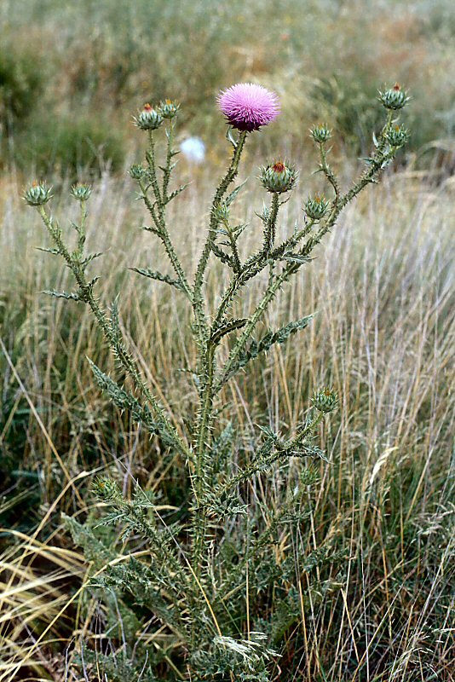
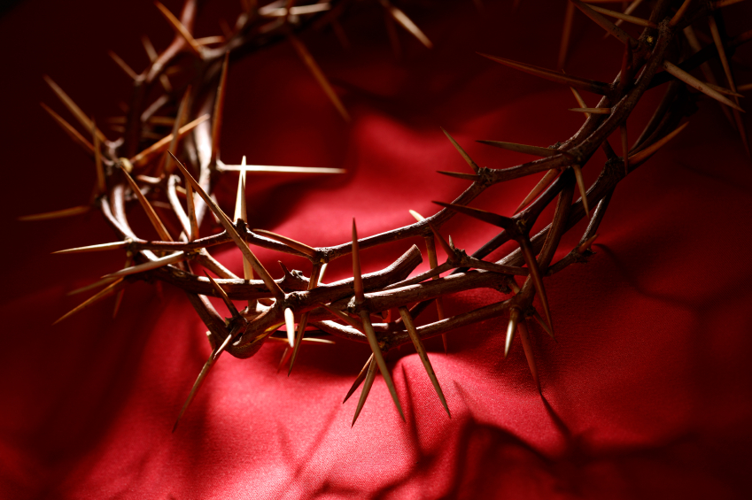
Thorns and Briers
An abundance of thistles and thorns grew in the Holy Land, and they did not escape the figurative eye of Jesus and His Apostles.
Thistles and thorns served only to afflict and annoy. The parable of the four kinds of soil has seeds falling among thorns, which sprang up and choked the seeds.
Those thorns represented the cares and pleasures of this world and the “deceitfulness of riches”
Thorns do not symbolize anything good or positive in the scriptures. Rather, “that which beareth thorns and briers is rejected, and is nigh unto cursing; whose end is to be burned.”
Hebrews 6:7-8
(1)

Slide 15
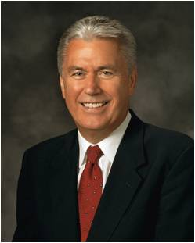
Hope As An Anchor
Hope
Hope in our Heavenly Father’s merciful plan of happiness leads to peace, mercy, rejoicing, and gladness. The hope of salvation is like a protective helmet; it is the foundation of our faith and an anchor to our souls.”
“Hope is a gift of the Spirit. It is a hope that through the Atonement of Jesus Christ and the power of His Resurrection, we shall be raised unto life eternal and this because of our faith in the Savior.
This kind of hope is both a principle of promise as well as a commandment, and, as with all commandments, we have the responsibility to make it an active part of our lives and overcome the temptation to lose hope.
Diligence
Faith
Patience
Peace
Mercy
Rejoicing
Gladness
Protection
Through diligence to the end, faith in Jesus Christ, and patience, we can inherit the blessings God has promised.
Our hope in God’s promises is a spiritual anchor for our souls.
Hebrews 6:11, 16-20
(8)

Slide 16
Sources:
Suggested Hymn: #249 Called to Serve
Video:
Good Things to Come (4:56)
New Testament Institute Student Manual Chapter 48
President Boyd K. Packer (“The Aaronic Priesthood,” Ensign, Nov. 1981, 32).
Bible Dictionary
Robert J. Matthews, "I Have a Question," Ensign, Aug. 1987, 21
President James E. Faust (“Obedience: The Path to Freedom,” Ensign, May 1999, 46–47).
Elder Russell M. Nelson Perfection Pending Oct. 1995 Gen. Conf.
President Thomas S. Monson The Three Rs of Choice Oct. 2010 Gen. Conf.
President Dieter F. Uchtdorf (“The Infinite Power of Hope,” Ensign or Liahona, Nov. 2008, 21–22).
Presentation by ©http://fashionsbylynda.com/blog/

Slide 17
LETTER TO THE HEBREWS—BELIEVED WRITTEN BY PAUL, (HEBREWS)
Christ Called to the Holy Priesthood | 5:4–14
“Let Us Go On unto Perfection” | 6:1–3
Sons of Perdition Crucify Christ Afresh | 6:4–9
God Swears That the Faithful Shall Be Saved | 6:10–20
Aaronic Priesthood:
“After mankind had been waiting for centuries for God’s authority to be restored, the power and glory of the holy Aaronic Priesthood returned to the earth. In section 107 of the Doctrine and Covenants, we learn why the lesser priesthood is called the Aaronic Priesthood:
“The second priesthood is called the Priesthood of Aaron, because it was conferred upon Aaron and his seed, throughout all their generations.
“Why it is called the lesser priesthood is because it is an appendage to the greater, or the Melchizedek Priesthood, and has power in administering outward ordinances. …
“The power and authority of the lesser, or Aaronic Priesthood, is to hold the keys of the ministering of angels, and to administer in outward ordinances, the letter of the gospel, the baptism of repentance for the remission of sins, agreeable to the covenants and commandments” (D&C 107:13–14, 20).
Not only do young men of the Aaronic Priesthood receive the power and authority to be agents of the Lord in carrying out their priesthood responsibilities, but they also receive the keys of the ministering of angels.”L. Tom Perry The Priesthood of Aaron 2010 Oct. Gen. Conf.
Life and Teachings of Jesus and His Apostles Chapter 46
Aaron and Priesthood Hebrews 5:1-4
After the time of Aaron, the high priest was selected from among the priestly families descended from Aaron and his sons. In ancient Israel, the office of high priest was an office in the Aaronic Priesthood and was comparable to the office of Presiding Bishop of the Church in our day. Aaron’s sons and other Levites performed many tasks, including serving in the tabernacle, conducting the morning and evening sacrifices in the tabernacle and later in the Jerusalem temple, keeping watch over the fire of the sacred altar, and teaching the people of Israel the commandments.
Both the Old and New Testaments show that priesthood holders received the priesthood through being ordained by an authorized holder of the priesthood. This practice continues in the Church today. (1)
"What kind of a man was this Melchizedek? ...The Joseph Smith Translation provides an additional 16 verses in Genesis 14 (Gen. 14:25-40) ...As a child Melchizedek had such faith as to stop the mouths of lions and quench the violence of fire (see also JST, Heb. 5:7). He was ordained a high priest after the order of the Son of God. He was a prophet like unto Enoch who had power through his faith over the elements, over the nations of the earth, and the power to stand in the presence of God 'by the will of the Son of God which was from before the foundation of the world' (JST, Gen. 14:31).
In addition to his biblical title 'King of peace' (Heb. 7:2), in the Joseph Smith Translation of Genesis 14:33 [Gen. 14:33] we learn Melchizedek was called by his people 'the Prince of peace,' another title identifying him as a type foreshadowing the ministry of Jesus Christ." (David Rolph Seely, "The Joseph Smith Translation: 'Plain and Precious Things' Restored," Ensign, Aug. 1997, 14)
Christ and Mechizedek Hebrews 5:8:
"Our discipleship is to be patterned after that of the Master (2 Nephi 31:16-17), who 'learned. . . obedience by the things which he suffered' (Hebrews 5:8). Can we expect it to be otherwise with us? We who are entreated to take his yoke upon us (Matthew 11:29) cannot expect immunity from tutoring and suffering at the hands of a loving Father." elder Neal A. Maxwell (Not My Will, But Thine [Salt Lake City: Bookcraft, 1998], 4.)
Learning Obedience Hebrews 5:8:
"So it is in our day. God grant that you and I may learn obedience to God's will, if necessary by the things which we suffer. One of the things that characterizes us as Saints, as King Benjamin told us, was to be 'submissive, meek, humble, patient, full of love, willing to submit to all things which the Lord seeth fit to inflict upon him, even as a child doth submit to his father.' (Mosiah 3:19.)" President Harold B. Lee (Conference Report, October 1965, Afternoon Meeting 130 - 131.)

Slide 18
Baptisms (Plural) Hebrews 6:2
"[Joseph Smith] said that the plural term 'baptisms' in this passage had reference to baptism for the living, baptism for the dead, and rebaptism. (Hebrews 6:1-2.)" (Hyrum L. Andrus and Helen Mae Andrus, comps., They Knew the Prophet, p. 87
Hope Hebrews 6:11-19:
"[Paul] was careful to press upon them the necessity of continuing on until they, as well as those who inherited the promises, might have the assurance of their salvation confirmed to them by an oath from the mouth of him who could not lie. For that seemed to be the example anciently, and Paul holds it out to his brethren as an object attainable in his day. And why not?...
"If the Saints in the days of the apostles were privileged to...[know] that their names were written in the Lamb's book of life and that they were sealed there as a perpetual memorial before the face of the Most High, will not the same faithfulness, the same purity of heart, and the same faith bring the same assurance of eternal life-and that in the same manner-to the children of men now in this age of the world?" (Kent P. Jackson, comp. and ed., Joseph Smith's Commentary on the Bible [Salt Lake City: Deseret Book Co., 1994], 190.)
Crucify To Themselves Hebrews 6:6:
Paul used the phrase “crucify to themselves the Son of God afresh” (Hebrews 6:6) to describe the actions of those who will not be forgiven because they turn from knowledge of the truth and will not repent. (1)
Crucify To Themselves Hebrews 6:6:
"Commission of the unpardonable sin consists in crucifying unto oneself the Son of God afresh and putting him to open shame. (Heb. 6:4–8; D. & C. 76:34–35.) To commit this unpardonable crime a man must receive the gospel, gain from the Holy Ghost by revelation the absolute knowledge of the divinity of Christ, and then deny ‘the new and everlasting covenant by which he was sanctified, calling it an unholy thing, and doing despite to the Spirit of grace.’ [History of the Church, 3:232.] He thereby commits murder by assenting unto the Lord’s death, that is, having a perfect knowledge of the truth he comes out in open rebellion and places himself in a position wherein he would have crucified Christ knowing perfectly the while that he was the Son of God. Christ is thus crucified afresh and put to open shame. (D. & C. 132:27.)” Elder Bruce R. McConkie (Doctrinal New Testament Commentary,3:161).
Sons of Perdition: "These who are to be so severely punished must first have the testimony of the gospel and by the power of the Holy Ghost know that Jesus is the Christ, the Only Begotten Son of God. Afterwards if they sin and openly and wilfully turn against the truth and deny Christ, they assent unto his death, and this is equivalent to crucifying him again and the shedding of innocent blood, and they put him to open shame." Joseph Fielding Smith (Answers to Gospel Questions, 5 vols. [Salt Lake City: Deseret Book Co., 1957-1966], 1: 63.)
Patience Hebrews 6:12:
"Is it any wonder, then, if, in His plan, our 'faith and patience' are regularly tried? (See Mosiah 23:21.) Paul confirms that those who 'inherit the promises' are those who have triumphed 'through faith and patience' (Hebrews 6:12). Abraham 'obtained the promise,' but only 'after he had patiently endured' (Hebrews 6:15). Long-suffering, endurance, and patience are designed to be constant companions, as are faith, hope, and charity.
"While a person is thinking his way through his particular hesitations or reservations about faith, he might ask, 'Does God really know what I am passing through?' The answer is 'Yes!' He knows!" (Lord, Increase Our Faith [Salt Lake City: Bookcraft, 1994], 39.)
Hope Hebrews 6:19:
"Hope is a steadying influence. To say it is an anchor is to say it can keep us from drifting aimlessly or getting caught in whirlpools or running into sandbars. Hope, the anchor, is essential in this world so full of tidal waves. Sometimes those waves slap us from behind, sometimes we see them coming but cannot stop them or get out of the way. In all cases hope ties us to safety. The waves come and go in their fury or playfulness, but hope is always there if we will but use this sure anchor." Sister Elaine L. Jack ("A Perfect Brightness of Hope," Ensign, Mar. 1992, 14)
God is Not Unrighteous Hebrews 6:10:
"...a follower of Christ is obligated to serve him. Many scriptural references to the name of the Lord seem to be references to the work of his kingdom. Thus, when Peter and the other Apostles were beaten, they rejoiced 'that they were counted worthy to suffer shame for his name.' (Acts 5:41.) Paul wrote certain members who had ministered to the Saints that the Lord would not forget the labor of love they had 'shewed toward his name.' (Heb. 6:10.) According to this meaning, by witnessing our willingness to take upon us the name of Jesus Christ, we signify our willingness to do the work of his kingdom." Elder Dalllin H. Oaks ("Taking upon Us the Name of Jesus Christ," Ensign, May 1985, 80)

Slide 19
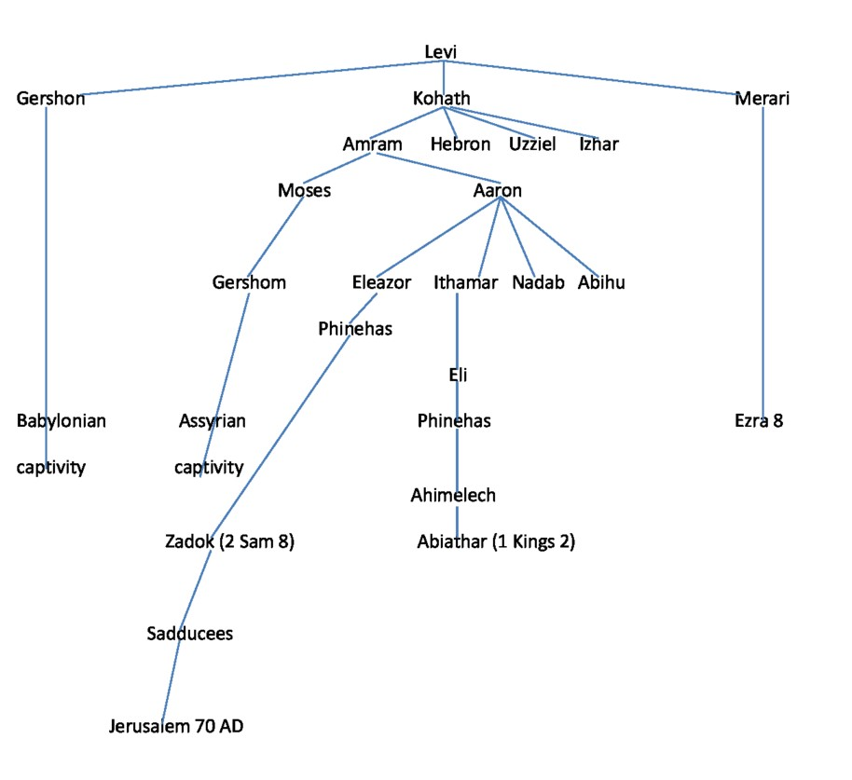
Priesthood Line
Moses and Aaron were sons of Kohath; and it was through Aaron’s line that the priesthood continued until the destruction of Jerusalem in 70 A.D., by way of his sons Eleazor, Ithamar, and Nadab and Abihu. The latter two met their end (and that of their lines) in Leviticus 10.
Ithamar’s line ended in 2 Kings 2:26-27 with Abiathar.
Eleazor’s line lived on until the destruction of Jerusalem in 70 A.D.
https://graceofourlord.com/2013/03/

