Slide 1
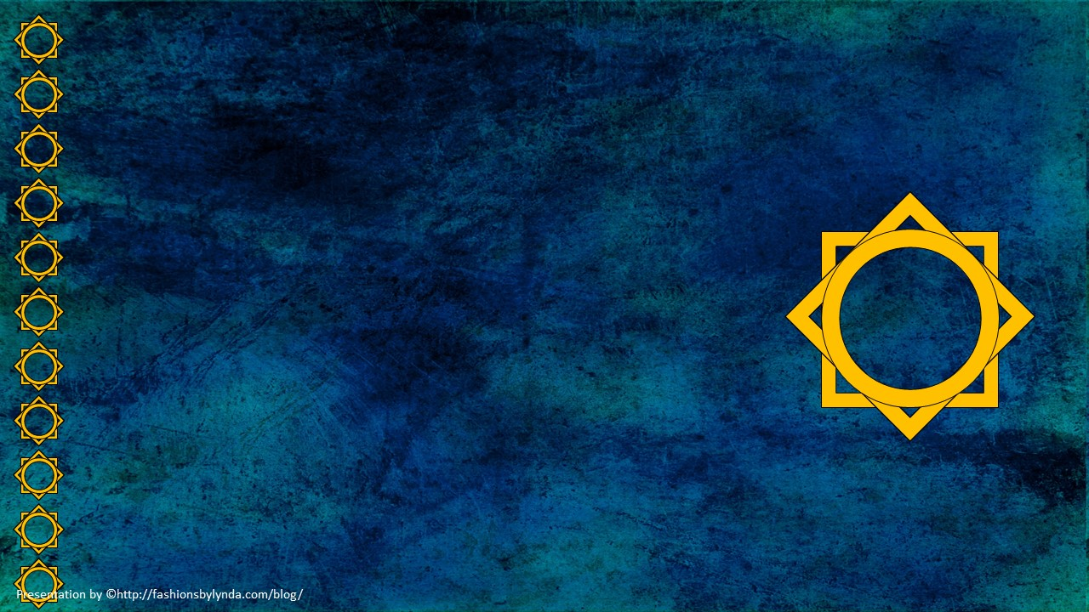
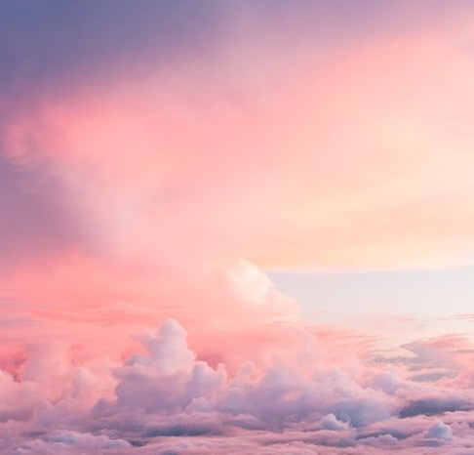
Lesson 137
New and Everlasting Covenant
Hebrews 7-10
For this is the covenant that I will make with the house of Israel after those days, saith the Lord; I will put my laws into their mind, and write them in their hearts: and I will be to them a God, and they shall be to me a people:
Hebrews 8:10

Slide 2
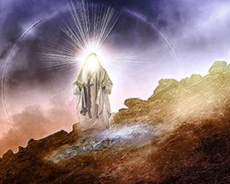
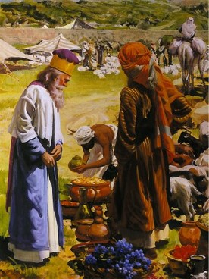
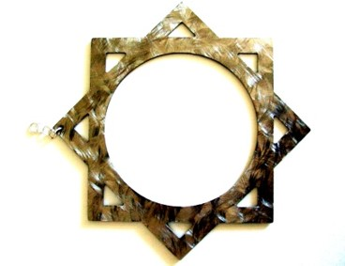
Melchisedec--Melchizedek
King of Salem
Priest of the most high God
Received tithes from Abraham
King of Peace
Hebrews 7:1-2

Slide 3
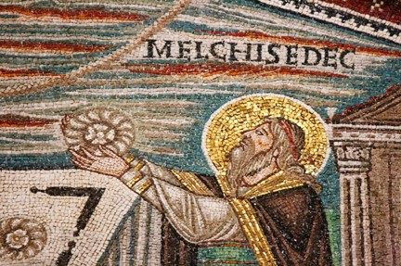
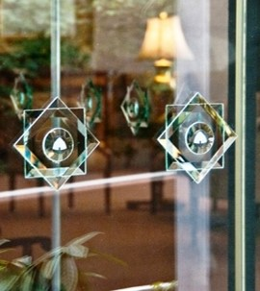
Priesthood by Authority
“Without father, without mother, without descent, having neither beginnings of day, nor end of life; but made like unto the Song of God; abideth a priest continually.”
Takes instruction from God
Hebrews 7:3

Slide 4
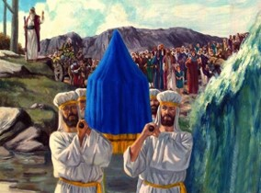
Sons of Levi—Tabernacle of Testimony
Levi was the third son of Jacob and Leah
His descendants ministered in the sanctuaries of Israel
Assisted the priests, (sons of Aaron)
Acted as musicians 1 Chronicles 15:16
They received no land inheritance in Cannaan
Numbers 1:47-54

Slide 5
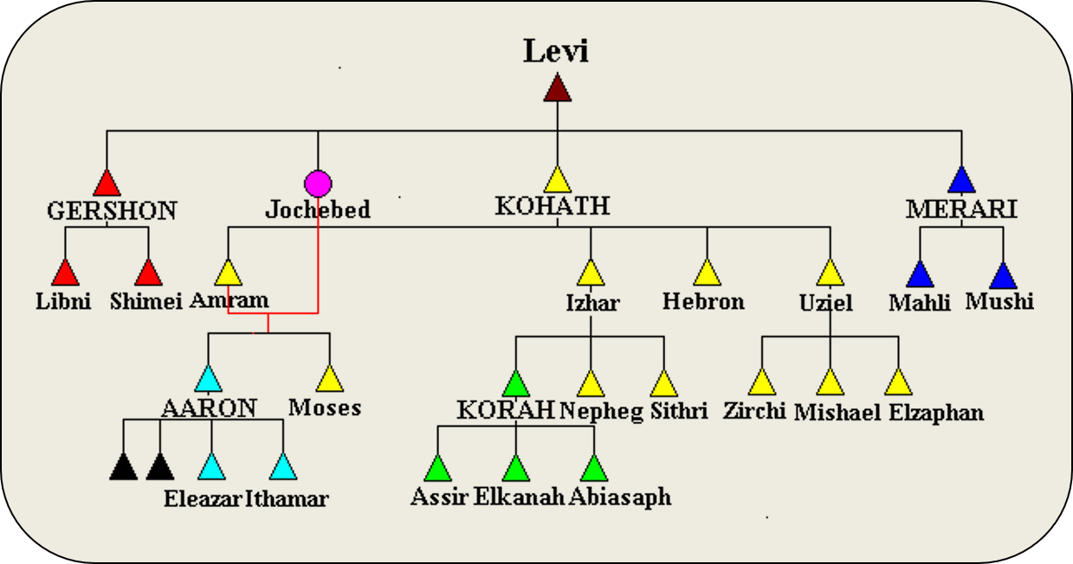

Slide 6
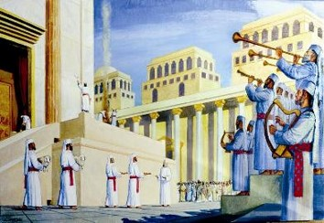
Levites Office of Priesthood
Jacob blessed Levi and his descendants. The Descendants of Levi ministered in the sanctuaries of Israel
“And verily they that are the sons of Levi, who receive the office of the priesthood, have a commandment to take tithes of the people according to the law…”
Hebrews 7:5

Slide 7
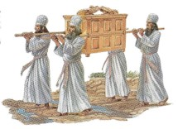
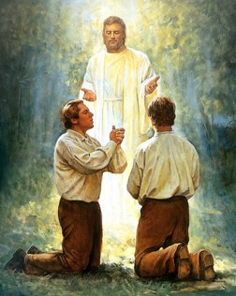
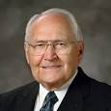
Priesthood of Aaron
Second priesthood
Conferred upon Aaron
An appendage to the greater, or Melchizedek Priesthood
Power to administer outward ordinances
(2)

Slide 8
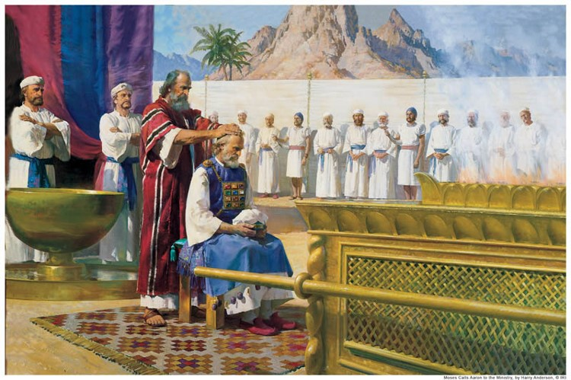
Priesthood of Aaron
The Aaronic Priesthood is a lesser authority, and it administers the preparatory gospel only.
Being the lesser order and thereby incapable of bringing men to perfection, was hereditary in nature, passing from father to son.
(2)

Slide 9
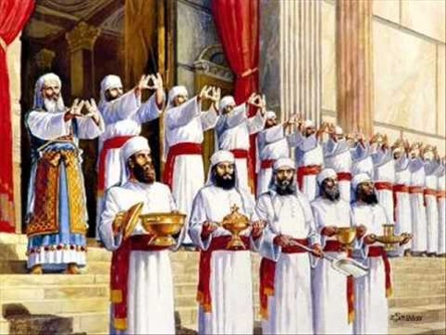
Not Without An Oath
“And inasmuch as not without an oath he was made priest:”
“(For those priests were made without an oath; but this with an oath by him that said unto him, The Lord sware and will not repent, Thou art a priest for ever after the order of Melchisedec)
Hebrews 7:20-21

Slide 10
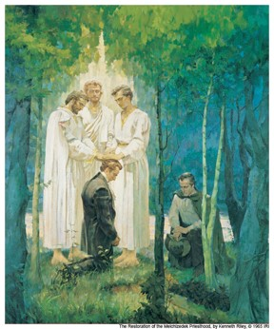
Receiving the Priesthood
“And this is according to the oath and covenant which belongeth to the priesthood.”
“Therefore, all those who receive the priesthood, receive this oath and covenant of my Father, which he cannot break, neither can it be moved.”
The Melchizedek Priesthood is received only by an oath and covenant.
D&C 84:39-40

Slide 11
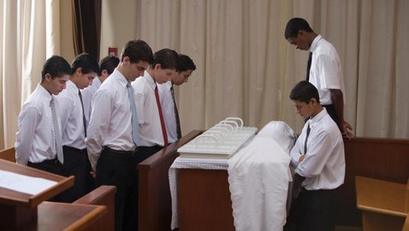
Covenant 1
Man on his part solemnly agrees to magnify his calling in the priesthood, to keep the commandments of God, to live by every word that proceedeth forth from the mouth of Deity, and to walk in paths of righteousness and virtue.
(3)

Slide 12
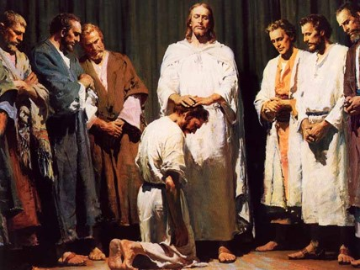
Covenant 2
God on his part agrees to give such persons an inheritance of exaltation and godhood in his everlasting presence. The oath is the solemn attestation of Deity, his sworn promise”
(3)

Slide 13
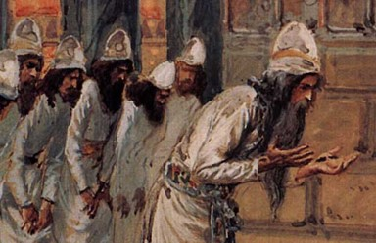
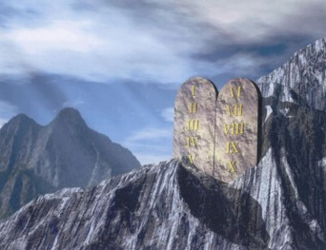
Change in Priesthood
“If therefore perfection were by the Levitical priesthood, (for under it the people received the law,) what further need was there that another priest should rise after the order of Melchisedec, and not be called after the order of Aaron?”
The mission and atonement of our Savior brought an end to the lesser law of Moses and instituted in its place the higher law of Jesus Christ.
Hebrews 7:11

Slide 14
I Am The Law
“For behold, the covenant which I have made with my people is not all fulfilled; but the law which was given unto Moses hath an end in me.
Behold, I am the law, and the light. Look unto me, and endure to the end…
3 Nephi 15:8-9

Slide 15
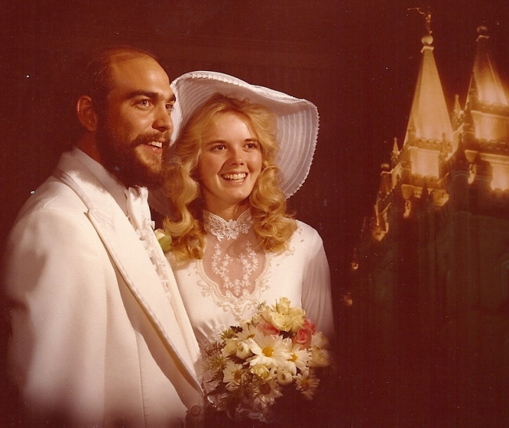
New and Everlasting Covenant
An order of the Priesthood
“Therefore, if a man marry him a wife in the world, and he marry her not by me nor by my word, and he covenant with her so long as he is in the world and she with him…
…their covenant and marriage are not of force when they are dead, and when they are out of the world…
D&C 132:15

Slide 16
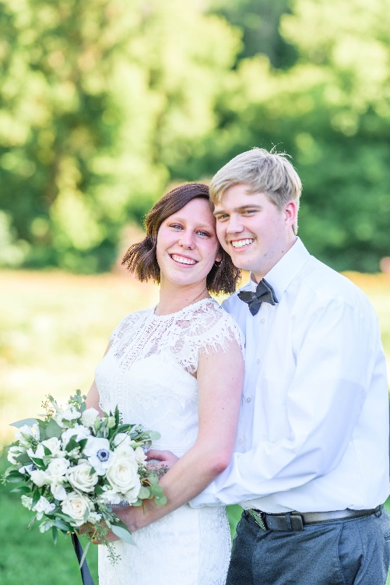
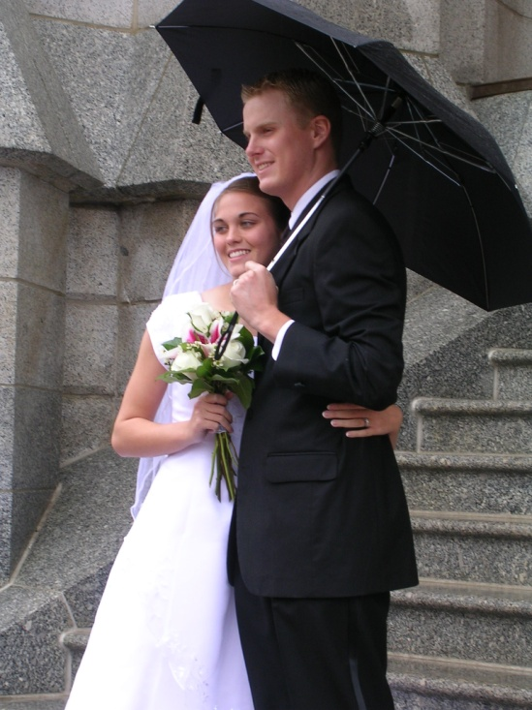
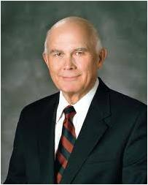
Marriage on Earth
…therefore, they are not bound by any law when they are out of the world.
Read D&C 132:16-18
“The blessings of the priesthood, such as baptism, receiving the Holy Ghost, the temple endowment, and eternal marriage, are available to men and women alike” (4)

Slide 17
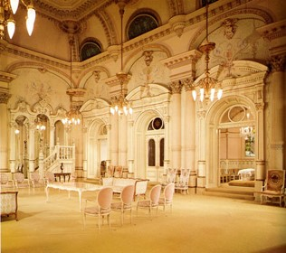
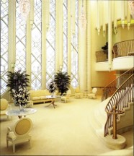
Celestial Glory
“And in order to obtain the highest, a man must enter into this order of the priesthood (meaning the new and everlasting covenant of marriage)
“He may enter into the other, but that is the end of his kingdom; he cannot have an increase.
D&C 131:1-2, 4

Slide 18
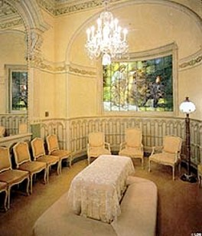
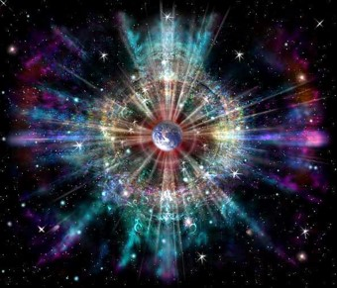
Sealed
A man who marries a wife in the new and everlasting covenant (sealed) will inherit thrones, kingdoms, etc.
…and a continuation of the seeds forever and ever.”
—D&C 132:19

Slide 19
“The Ten Blessings of the Priesthood” Hebrews 7-10

Slide 20
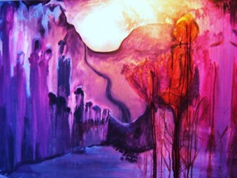
Blessing One
We are members of the only true and living Church upon the face of the whole earth, and we have received the fulness of the everlasting gospel.
(3)

Slide 21
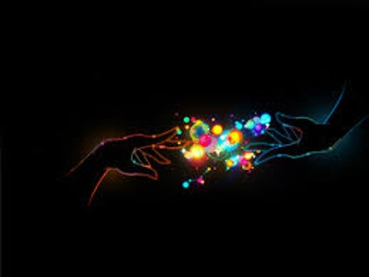
Blessing Two
We have received the gift of the Holy Ghost, and we are entitled to receive the gifts of the Spirit—those wondrous spiritual endowments which set us apart from the world and raise us above carnal things.
(3)

Slide 22
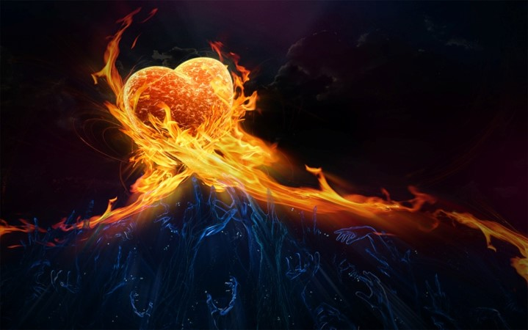
Blessing Three
We can be sanctified by the Spirit, have dross and evil burned out of us as though by fire, become clean and spotless, and be fit to dwell with gods and angels.
(3)

Slide 23
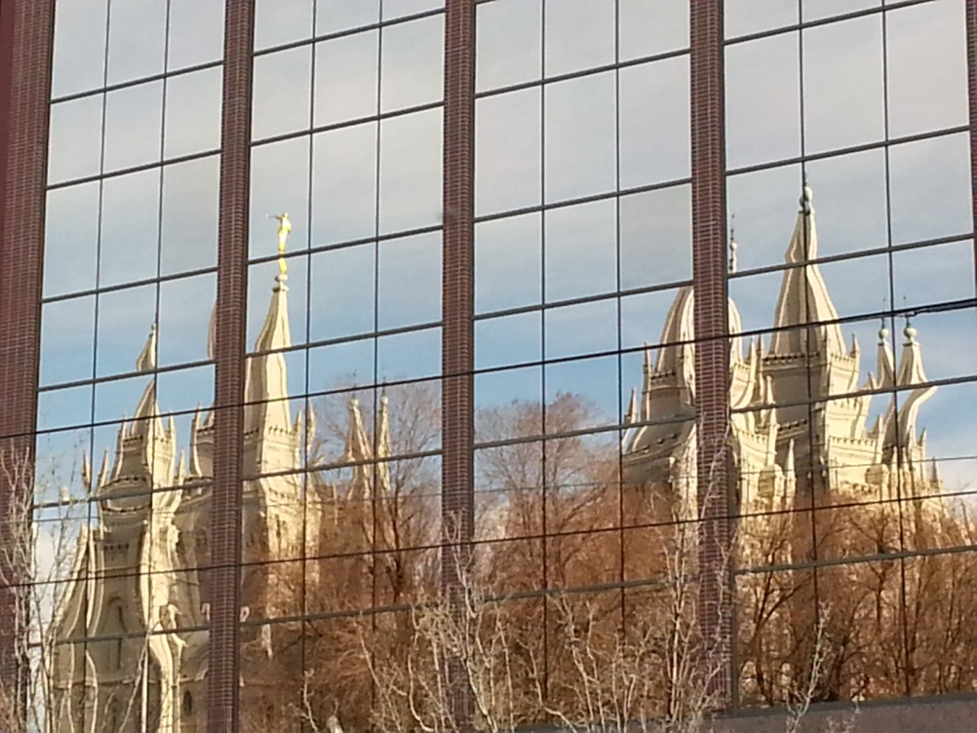
Blessing Four
We stand in the place and stead of the Lord Jesus Christ in administering salvation to the children of men.
(3)

Slide 24
Blessing Five
We have power to become the sons of God, to be adopted into the family of the Lord Jesus Christ, to have Him as our Father, to be one with Him as He is one with His Father.
(3)

Slide 25
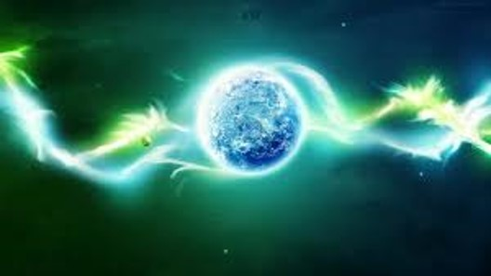
Blessing Six
We can enter into the patriarchal order, the order of eternal marriage, the order which enables the family unit to continue everlastingly in celestial glory.
(3)

Slide 26
Blessing Seven
We have power to govern all things, both temporal and spiritual kingdoms of the world, and the elements and storms and powers of the earth.
(3)

Slide 27
Blessing Eight
We have power, through the priesthood, to gain eternal life, the greatest of all the gifts of God.
(3)

Slide 28
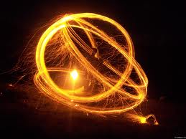
Blessing Nine
We have power to make our calling and election sure, so that while we yet dwell in mortality, having overcome the world and been true and faithful in all things, we shall be sealed up unto eternal life and have the unconditional promise of eternal life in the presence of Him whose we are.
(3)

Slide 29
Blessing Ten
We have the power—and it is our privilege—so to live, that becoming pure in heart, we shall see the face of God while we yet dwell as mortals in a world of sin and sorrow.
(3)

Slide 30
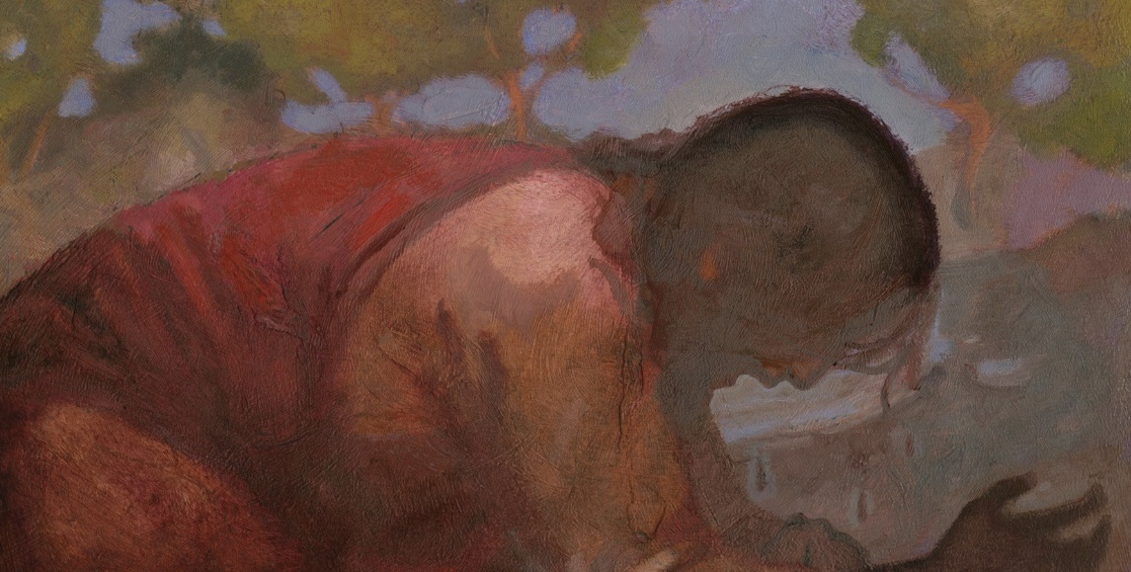
The Mediator of the Better Covenant
A third party who stands between two others to resolve their differences and to bring them together. (1)
Better Covenant = New Covenant
Read Jeremiah 31:31-34
“For every high priest is ordained to offer gifts and sacrifices: wherefore it is of necessity that this man have somewhat also to offer.”
Jesus Christ offered His own life as a sacrifice for our sins
Hebrews 8:1-13
J. Kirk Richards

Slide 31
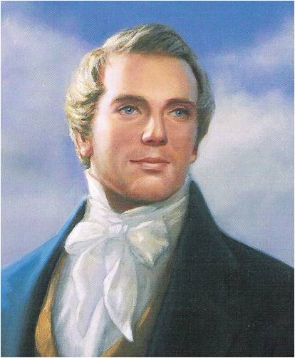
“Christ, in the days of His flesh, proposed to make a covenant with them, but they rejected Him and His proposals, and in consequence thereof, they were broken off, and no covenant was made with them at that time.
But their unbelief has not rendered the promise of God of none effect: no, for there was another day limited in David, which was the day of His power; and then His people, Israel, should be a willing people;—and He would write His law in their hearts, and print it in their thoughts; their sins and their iniquities He would remember no more.”
(5)

Slide 32
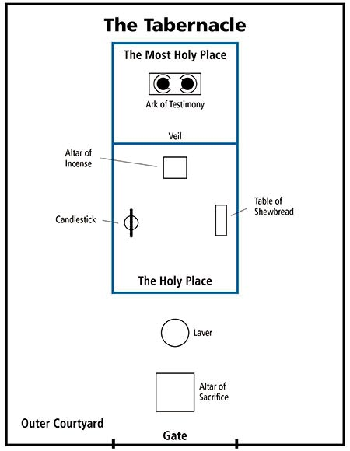
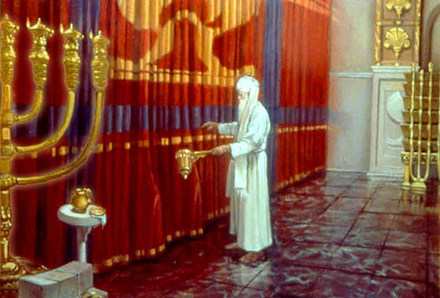
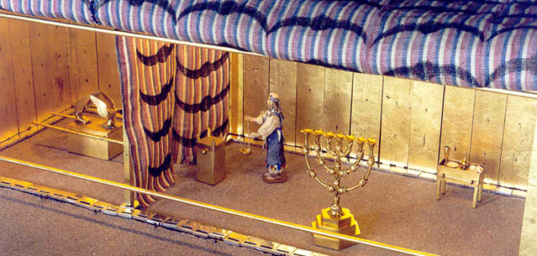
Blueprint
Ark of the testimony was the central feature of the tabernacle representing the presence of the Lord
Into this courtyard anyone of Israel could bring sacrifices, but only the priests could enter the tabernacle itself.
Most Holy Place is often called the Holy of Holies.
The Veil of the Tabernacle dividing two rooms
Basons underneath the Alter would catch the blood from the sacrifice
For the priests to clean and prepare to enter into Tabernacle
Hebrews 9-10; Exodus 26

Slide 33
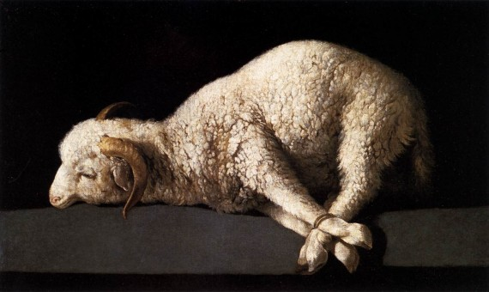
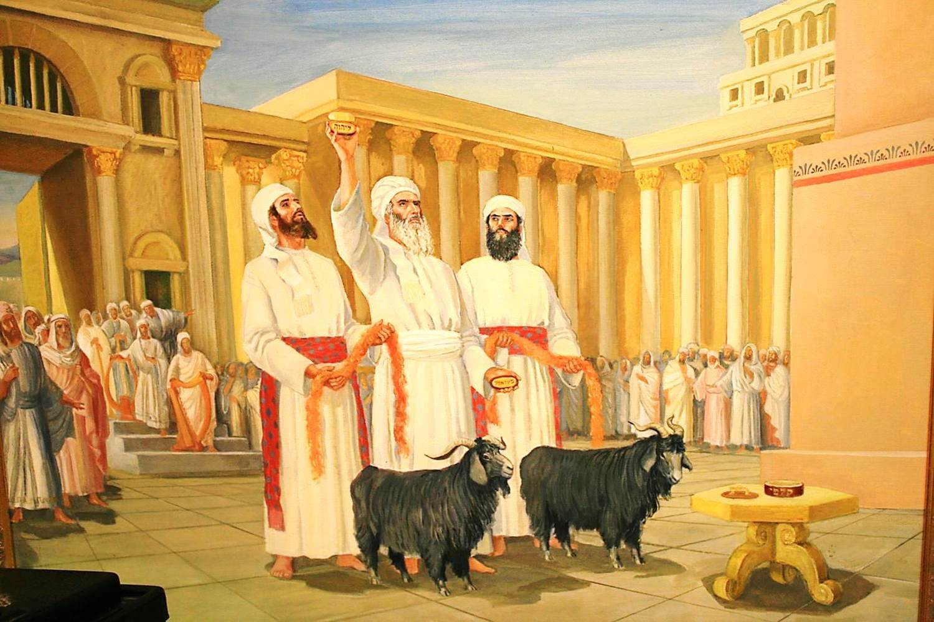
Day of Atonement
Once a year on the Jewish holy day called the Day of Atonement (also called Yom Kippur), the high priest was allowed to enter the Most Holy Place (also called the Holy of Holies) in the tabernacle or, later, the Jerusalem temple.
There, the high priest sacrificed a bullock and a he-goat. He sprinkled the animals’ blood in designated places in the Most Holy Place to symbolize Christ’s Atonement for the priest’s sins and for the people’s sins.
The high priest then symbolically transferred the people’s sins onto another he-goat (called the scapegoat), which was then driven into the wilderness, signifying the removal of the people’s sins.
He also sacrificed two rams as burnt offerings for himself and the people. (6)
Hebrews 9-10: Leviticus 16:22

Slide 34
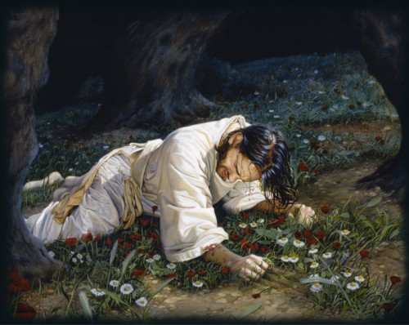
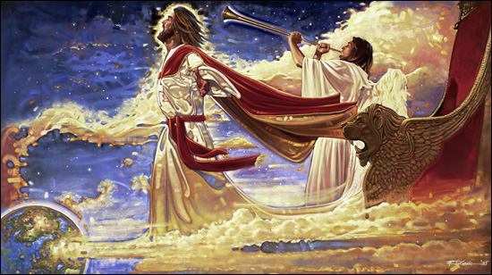
Day of Atonement
For then must he often have suffered since the foundation of the world: but now once in the end of the world hath he appeared to put away sin by the sacrifice of himself.
So Christ was once offered to bear the sins of many; and unto them that look for him shall he appear the second time without sin unto salvation.
Ron DiCianni
Hebrews 9:26, 28

Slide 35
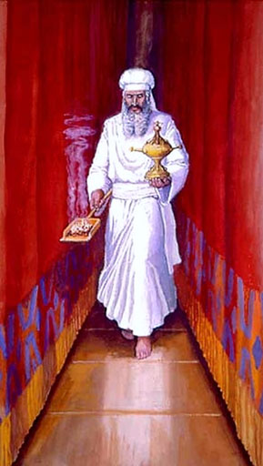
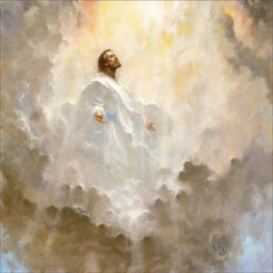
What is the importance of the Day of Atonement?
It was a rehearsal of things to come
Just as the high priests entered the Most Holy Place of the tabernacle on the Day of Atonement, what “holy place” could the Savior enter because of His Atonement?
Heavenly Father’s presence, or celestial glory.
Hebrews 9:12

Slide 36
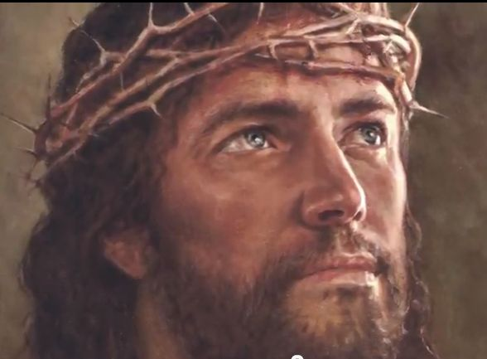
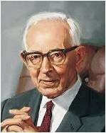
The Sacrifice
The Cleansing Power of Blood
What could Jesus Christ’s sacrifice do that the “blood of bulls and of goats” could not?
“The Latter-day Saints believe in the efficacy of the blood of Christ. They believe that through obedience to the laws and ordinances of the gospel they obtain a remission of sins; but this could not be if Christ had not died for them...” (6)
For it is expedient that there should be a great and last sacrifice; yea, not a sacrifice of man, neither of beast, neither of any manner of fowl; for it shall not be a human sacrifice; but it must be an infinite and eternal sacrifice.
Alma 34:10
Hebrews 10:4

Slide 37
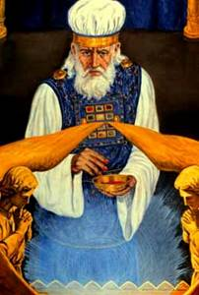
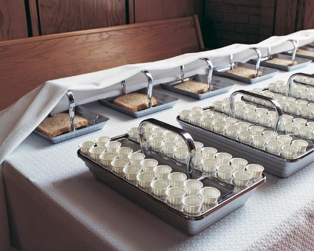
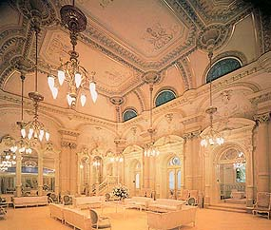
A Shadow of Good Things to Come
Why, then, did the high priests perform these sacrifices on the Day of Atonement?
To demonstrate “a shadow of the good things to come” or to point to the Savior’s Atonement.
We see the same shadowed symbolism in our day:
The sacrament is a shadow of the atoning sacrifice.
Baptism is a shadow of our entrance into the kingdom and our commitment to discipleship.
The celestial room is but a shadow of dwelling in the presence of God.
…someday, we will see the Light of the World-not through a glass darkly, not as a shadow cast by the gospel of Christ-but 'then face to face' (1 Cor. 13:12). (7)
Salt Lake Temple Celestial Room Liahona Nov. 1993
Hebrews 10:1

Slide 38
“[Jesus Christ’s] Atonement is infinite—without an end. It was also infinite in that all humankind would be saved from never-ending death. It was infinite in terms of His immense suffering. It was infinite in time, putting an end to the preceding prototype of animal sacrifice. It was infinite in scope—it was to be done once for all.”
Hebrews 10:10

Slide 39
The Holiest Place
The “new and living way” refers to the gospel of Jesus Christ, or the plan by which we can be forgiven and sanctified through His Atonement and thereby become worthy to return to God’s presence.
Because of Jesus Christ’s Atonement, we can enter the celestial kingdom if we hold fast to our faith in Him.
Hebrews 10:19-20

Slide 40
Caste Not Away Your Confidence
“In Latter-day Saint talk that is to say, Sure it is tough—before you join the Church, while you are trying to join, and after you have joined.
That is the way it has always been, Paul says, but don’t draw back. Don’t panic and retreat.
Don’t lose your confidence.
Don’t forget how you once felt.
Don’t distrust the experience you had.
That tenacity is what saved Moses and Joseph Smith when the adversary confronted them, and it is what will save you.” (9)
Hebrews 10:35
Poway Stake Trek for Youth 2013

Slide 41
Sources:
Suggested Hymn: #287 Rise, Ye Saints, and Temples Enter
Video:
“High Priest of Good Things to Come” (2:00)
“An High Priest of Good Things to Come” (2:38)
New Testament Institute Student Manual Chapter 48
Elder L. Tom Perry “The Priesthood of Aaron” 2010 Oct. General Conference
Bruce R. McConkie “Mormon Doctrine” page 480; “The Ten Blessings of the Priesthood” 1977 Oct. General Conference
Elder Dallin H. Oaks (“Priesthood Authority in the Family and the Church,” Ensign or Liahona, Nov. 2005, 26).
Joseph Smith in History of the Church, 1:313.
Joseph Fielding Smith Doctrines of Salvation, 3 vols., edited by Bruce R. McConkie [Salt Lake City: Bookcraft, 1954-1956], 1: 134-136
Gospeldoctrine.com
Elder Russell M. Nelson (“The Atonement,” Ensign, Nov. 1996, 35).
Elder Jeffrey R. Holland (“Cast Not Away Therefore Your Confidence,” Ensign, Mar. 2000, 8).
Presentation by ©http://fashionsbylynda.com/blog/

Slide 42
LETTER TO THE HEBREWS—BELIEVED WRITTEN BY PAUL, (HEBREWS)
Salvation Comes Through Christ’s Intercession | 7:23–28
Christ Offered Himself a Sacrifice for Sin | 8:1–5
A New Covenant with Israel | 8:6–13
Mosaic Ordinances Prefigure Christ’s Ministry | 9:1–14
Christ, the Mediator of the New Covenant | 9:15–28
“By the Blood Ye Are Sanctified” | 10:1–18
Those Who Fall From Grace Are Damned | 10:19–39
Salvation Comes Through Christ’s Intercession | 7:23–28
Day of Atonement Hebrews 9-10:
Once a year on the Jewish holy day called the Day of Atonement (also called Yom Kippur), the high priest was allowed to enter the Most Holy Place (also called the Holy of Holies) in the tabernacle or, later, the Jerusalem temple. There, the high priest sacrificed a bullock and a he-goat. He sprinkled the animals’ blood in designated places in the Most Holy Place to symbolize Christ’s Atonement for the priest’s sins and for the people’s sins. The high priest then symbolically transferred the people’s sins onto another he-goat (called the scapegoat), which was then driven into the wilderness, signifying the removal of the people’s sins. He also sacrificed two rams as burnt offerings for himself and the people. (See Bible Dictionary, “Fasts”; see also Leviticus 16:22.)
Good Things to Come Hebrews 9:11:
“Every one of us has times when we need to know things will get better. Moroni spoke of it in the Book of Mormon as ‘hope for a better world’ [Ether 12:4]. For emotional health and spiritual stamina, everyone needs to be able to look forward to some respite, to something pleasant and renewing and hopeful, whether that blessing be near at hand or still some distance ahead. It is enough just to know we can get there, that however measured or far away, there is the promise of ‘good things to come.’
“My declaration is that this is precisely what the gospel of Jesus Christ offers us, especially in times of need. There is help. There is happiness. There really is light at the end of the tunnel. It is the Light of the World, the Bright and Morning Star, the ‘light that is endless, that can never be darkened’ [Mosiah 16:9; see also John 8:12; Revelation 22:16]. … To any who may be struggling to see that light and find that hope, I say: Hold on. Keep trying. God loves you. Things will improve. Christ comes to you in His ‘more excellent ministry’ with a future of ‘better promises.’ He is your ‘high priest of good things to come’ [Hebrews 8:6; 9:11]” Elder Jeffrey R. Holland (“An High Priest of Good Things to Come,” Ensign, Nov. 1999, 36.
Life and Teachings of Jesus and His Apostles Chapter 47
‘Ordained into the Priesthood Hebrews 7:3; 11-19:
All those who are ordained unto this priesthood are made like unto the Son of God’ [Joseph Smith Translation, Hebrews 7:3; see also Moses 1:6]. This likeness is not only in ordination and ordinance but also in the perfecting of individual hearts, something that occurs ‘in process of time’ [Moses 7:21] as we ‘[yield] to the enticings of the Holy Spirit, and [put] off the natural man’ [Mosiah 3:19]. When a man is ordained to the Melchizedek Priesthood, he enters into an ‘order’ [Alma 13:2, 16 D&C 107:3] by which he may be refined through service to others” Elder Craig A. Cardon (“Moving Closer to Him,” Ensign or Liahona, Nov. 2006, 95).
Old and New Covenant Hebrews 9:22:
As Paul taught that both the old covenant and the new covenant required the blood of a sacrifice, he observed that “without shedding of blood is no remission” (Hebrews 9:22). Blood is symbolic of life. Sin offerings under the law of Moses required the shedding of an animal’s blood. In setting forth the laws respecting sacrificial ordinances in ancient Israel, the Lord explained: “For the life of the flesh is in the blood: and I have given it to you upon the altar to make an atonement for your souls: for it is the blood that maketh an atonement for the soul” (Leviticus 17:11). The blood of animals ratified the old covenant, foreshadowing the shedding of Jesus Christ’s blood that ratified the new covenant and made the remission of sins possible (see Hebrews 10:4; Mosiah 3:14–15). (1)

Slide 43
Hebrews 9:2-5 Holy artifacts of the Tabernacle
"Tabernacle: The tabernacle was a portable temple of the Lord, the place of the divine presence, and thus represents the kingdoms of heaven. The outer court represents the telestial order, the holy place the terrestrial order, and the Holy of Holies, the celestial world, the place where the throne of God is found.
"Candlestick: The seven-branched candelabrum of the tabernacle was part of the furniture of the holy place. It was not lighted by candles, but by pure olive oil in cup-shaped containers resting on the head of each of its branches. (Ex. 25:31-40.) Its light represents the light of the Holy Spirit. The seven branches or stems represent the fullness and perfection of the revelations of God and could be taken as affirmation that they would burn brightly in seven great gospel dispensations.
"Table: Paul's reference is to the table of shewbread that stood on the north or right side as one entered the holy place. It faced the candlestick and upon it were to be placed twelve loaves of bread made of fine (unleavened) flour. Paul does not identify its symbolism. Its equivalent in our day could be the sacrament table.
"Shewbread: Literally translated, the name shewbread means 'the bread of faces,' or 'the bread of the presence,' signifying that this bread was placed before the face of the Lord or in his presence. That there is a common symbolism between the Sabbath ritual in which the priests were to eat the shewbread and the ordinance of the sacrament, as introduced by Christ, seems apparent.
"Sanctuary: The sanctuary, in this text, refers to the holy place.
"Veil: Paul's reference is to the thick curtain separating the Holy of Holies from the holy place in the temple. The rending of the veil symbolizes the removal of the barrier between man and God, for man is thus enabled 'to enter into the holiest by the blood of Jesus.' ("Heb. 10:19Heb. 10:19.) Thus, the faithful and obedient can, in the fullest and most complete sense, enter into the rest of the Lord.
"Holiest of All: By holiest of all, Paul is referring to the Holy of Holies. This, the most sacred place in the temple, is the symbolic representation of the heavenly temple where the throne of God sits.
"Golden Censer: The vessel used for the burning of incense in the holy place was known as the golden censer. (Paul seems to indicate that this was housed in the Holy of Holies. There is nothing in the Old Testament that corroborates this.) The smoke rising from the vessel is a symbol of the prayers of Israel rising to God. (Ps. 141:2.)
"Ark of the Covenant: Housed within the Holy of Holies, the ark of the covenant signifies the divine presence and as such is the most sacred symbol in ancient Israel.
"Manna: Among the sacred relics found within the temple was a golden pot containing some of the manna sent down from heaven as food for Israel during their wilderness wanderings. This bread from heaven typifies the spiritual salvation that could be had only through Christ, who is the Bread of Life.
"Aaron's Rod: To affirm his call to Aaron and his tribe to labor in the priesthood in preference to the other tribes, the Lord instructed Moses to have each of the tribes bring a rod or branch with the name of their prince on it. These twelve rods were then placed before the Lord in the Holy of Holies. The following morning when Moses went to the sacred place, he found the rod of Aaron covered with buds, blossoms, and even mature almonds. The other rods remained as barren as before. (Num. 17.) As I have written elsewhere, 'The symbolism associated with this test was most deliberate: A rod, or branch, had been chosen to represent each of the twelve tribes or families of Israel; each had its name carefully placed upon it. By tradition, the rod, as a staff or sceptre, represented one's position and authority. Together, all were presented before the Lord. By making Aaron's rod bud, blossom, and put forth fruit, the Lord demonstrated once again that it was for him to choose those who will stand in his stead, be filled with his power, and bring forth his fruits.‘
"Tables of the Covenant: The tables of the covenant refers to the tablets upon which the Ten Commandments were written.
"Cherubim: The images of two cherubim were placed over the mercy seat of the ark in the Holy of Holies. Cherubim are angels, set to guard the way before the presence of the Lord. They are to see that no unclean thing enters the divine presence.
"Mercy Seat: The mercy seat is the golden lid to the ark of the covenant: This lid, which covers the ark, is a symbolic representation of the manner in which the Atonement overarches or covers all that is sacred. The name comes from the Hebrew kapporeth, which, in turn, comes from the root kaphar, meaning to cover or expiate. It implies the making of an atonement, a cleansing or forgiving.
"Though Paul did not detail the meaning of each of these items associated with the temple, his purpose was to emphasize that each was intended as a witness of Jesus as the Christ." (Joseph F. McConkie in Studies in Scripture, Vol. 6: Acts to Revelation, ed. By Robert L. Millet, [Salt Lake City: Deseret Book Co., 1987], 203.)

