Slide 1
Lesson 138
Faith
Hebrews 11
But without faith it is impossible to please him: for he that cometh to God must believe that he is, and that he is a rewarder of them that diligently seek him.
Hebrews 11:6

Slide 2
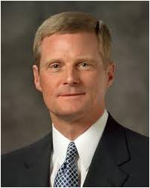
What is Faith?
(1) faith is the assurance of things hoped for that are true
(2) faith is the evidence of things not seen,
(3) faith is the principle of action in all intelligent beings.
These three elements of faith—assurance, evidence, and action—work together as we face the future, look to the past, and take action in the present.
(2)

Slide 3
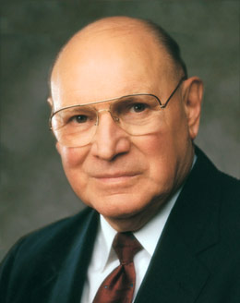
“Truly understood and properly practiced, faith is one of the grand and glorious powers of eternity. It is a force powerful beyond our comprehension.
‘Through faith … the worlds were framed by the word of God’.
Through faith, waters are parted, the sick healed, the wicked silenced, and salvation made possible.
F
A
I
T
H
“Our faith is the foundation upon which all our spiritual lives rest. It should be the most important resource of our lives.”
Hebrews 11:3
(3)

Slide 4
Cain and Abel
“By faith in this atonement or plan of redemption, Abel offered to God a sacrifice that was accepted, which was the firstlings of the flock.”
“Cain offered of the fruit of the ground, and was not accepted, because he could not do it in faith; he could have no faith, or could not exercise faith contrary to the plan of heaven.
Hebrews 11:4
(4)

Slide 5
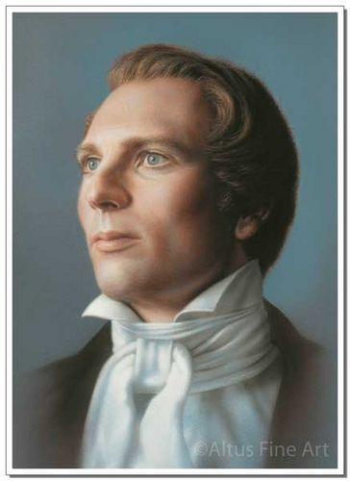
“It must be shedding the blood of the Only Begotten to atone for man, for this was the plan of redemption, and without the shedding of blood was no remission.
And as the sacrifice was instituted for a type by which man was to discern the great Sacrifice which God had prepared, to offer a sacrifice contrary to that, no faith could be exercised, because redemption was not purchased in that way, nor the power of atonement instituted after that order; consequently Cain could have no faith.”
Hebrews 11:4
(4)

Slide 6
Exercising Faith
To please God we must exercise our faith by coming unto Him, believing in Him, and believing that He rewards those who diligently seek Him.
Hebrews 11:6
(4)

Slide 7
By Faith and Through Faith
Enoch
“moved with fear” means that Noah acted with hope and assurance based on God’s guidance
Hebrews 11:5-6
Noah
Hebrews 11:7
Abraham
Sara
Hebrews 11:8-10
Hebrews 11:11
Hebrews 11:6

Slide 8
By Faith and Through Faith
Moses chose “rather to suffer affliction with the people of God, than to enjoy the pleasures of sin for a season; esteeming the reproach of Christ greater riches than the treasures in Egypt” (1)
Isaac
Hebrews 11:20
Jacob
Hebrews 11:21
Joseph
Moses
Hebrews 11:22
Hebrews 11:23-25

Slide 9
By Faith and Through Faith
Egypt
The traditional belief is that Isaiah was
“sawn asunder”
Hebrews 11:26-29
Jericho
Hebrews 11:30
Daniel
Shadrach
Meshach
Abednego
The widow of Zarephath
Isaiah
Rahab
Hebrews 11:31
Scriptural People
Hebrews 11:33-37

Slide 10
As we exercise faith in Jesus Christ, we can endure suffering, accomplish miracles, receive divine promises, strengthen our testimony of Him, and move toward perfection.
Hebrews 11:6
(4)

Slide 11
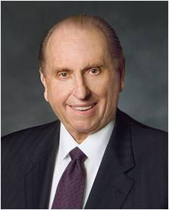
“Faith precedes the miracle. It has ever been so and shall ever be. It was not raining when Noah was commanded to build an ark. There was no visible ram in the thicket when Abraham prepared to sacrifice his son Isaac. Two heavenly personages were not yet seen when Joseph knelt and prayed. First came the test of faith—and then the miracle.”
(5)

Slide 12
Sources:
Suggested Hymn: #254 True to the Faith
Video:
Pure and Simple Faith (5:22)
New Testament Institute Student Manual Chapter 49
Elder David A. Bednar (“Seek Learning by Faith,” Ensign, Sept. 2007, 62).
Elder Joseph B. Wirthlin (“Shall He Find Faith on the Earth?” Ensign, Nov. 2002, 84).
Teachings of Presidents of the Church: Joseph Smith [2007], 48)
President Thomas S. Monson (“The Call to Serve,” Ensign, Nov. 2000, 48–49).

Slide 13
LETTER TO THE HEBREWS—BELIEVED WRITTEN BY PAUL, (HEBREWS)
By Faith the Worlds Were Made | 11:1–3
Why Abel’s Sacrifice Was Acceptable | 11:4
The Doctrine of Translation | 11:5, 6
Faith Saved Noah | 11:7
Abraham Sought a Heavenly City | 11:8–16
Why Abraham Was Commanded to Sacrifice Isaac | 11:17–19
By Faith the Worlds Were Made | 11:1–3
Patriarchal Blessings Came by Faith | 11:20–22
Faith of Ancients Centered in Christ | 11:23–31
Faith and Miracles Are Inseparable | 11:32–35
Faith Enables Men to Endure Sufferings | 11:35–40
Faith:
“Important components of faith are patience, long-suffering, and enduring to the end. The Apostle Paul recounts the faith of … Abraham, and Sara, concluding that ‘these all died in faith, not having received the promises, but having seen them afar off, and were persuaded of them, and embraced them, and confessed that they were strangers and pilgrims on the earth’ (see Hebrews 11:4–13). These faithful Saints knew that this earth life was a journey, not their final destination” Elder Spencer J. Condie (“Claim the Exceeding Great and Precious Promises,” Ensign or Liahona, Nov. 2007, 17).
Abraham’s Test:
“Who can conceive of a more severe test of faith than the heaven-sent order to sacrifice the heir of promise, the heir whom God must then raise from the dead that his promises concerning Isaac might be fulfilled. (Gen. 21:12.) Is it any wonder that in all succeeding generations the seed of Abraham have looked back with awe and reverence upon a scene which tested mortal man almost beyond mortal power to obey?
“Why did Deity devise such a test? Certainly it was for Abraham’s blessing and benefit. There can be no question that the harder the test, the higher the reward for passing it. And here Abraham laid his all on the altar, thus proving himself worthy of that exaltation which he has now received. (D. & C. 132:29) And immediately following his conformity to the divine will, he received a heavenly manifestation of the glory and honor reserved for him and his seed. (Gen. 22:15–18.}
“Certainly, also, Abraham’s willingness to sacrifice Isaac was intended to be an example forever of that perfect obedience which the Lord expects of all the heirs of promise” (Elder Bruce R. McConkie Doctrinal New Testament Commentary, 3 vols. [1965–73], 3:206–7).
True Peace and Happiness: Hebrews 11:25:
“Those who yield to the enticing of Satan may, as the scripture says, ‘enjoy the pleasures of sin for a season’ (Heb. 11:25), but that kind of pleasure can never lead to lasting happiness or eternal joy. …
“Brothers and sisters, old and young, I plead with each of you to remember that wickedness never was happiness and that sin leads to misery [see Alma 41:10. Young people, do not seek happiness in the glittering but shallow things of the world. We cannot achieve lasting happiness by pursuing the wrong things” Elder Dallin H. Oaks (“Joy and Mercy” Ensign, Nov. 1991, 75).
Life and Teachings of Jesus and His Apostles Chapter 48

