Slide 1
Lesson 139
Run the Race With Faith
Hebrews 12-13

Slide 2
What can motivate a runner to keep running even when he or she faces fatigue or other difficulties?
In what ways is life as a disciple of Jesus Christ like an endurance race?
What difficulties might we face as disciples of Jesus Christ?
(2)

Slide 3
How would wearing a backpack filled with rocks affect a runner?
In what ways are our sins like a backpack filled with rocks?
What does it mean to run the race of discipleship with patience?
(2)

Slide 4
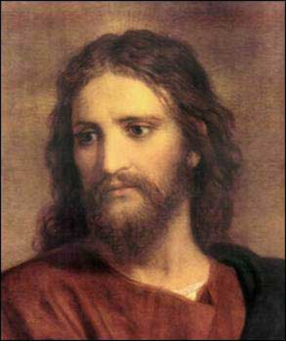
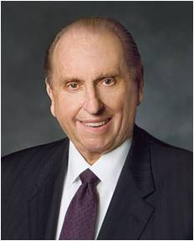
Lay Aside Sin
“author and finisher of our faith” = “the Leader and Perfecter of our faith”
Heinrich Hofmann
contradiction = opposition
“Remember that we do not run alone in this great race of life; we are entitled to the help of the Lord. (2)
As we look to the example of Jesus Christ, we can find strength to put aside our sins and patiently endure opposition.
Hebrews 12:2-4

Slide 5
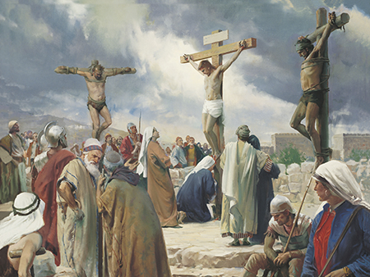
Willing to suffer
“For His Atonement to be infinite and eternal, He had to feel what it was like to die not only physically but spiritually, to sense what it was like to have the divine Spirit withdraw, leaving one feeling totally, abjectly, hopelessly alone.
“But Jesus held on. He pressed on. The goodness in Him allowed faith to triumph even in a state of complete anguish. The trust He lived by told Him in spite of His feelings that divine compassion is never absent, that God is always faithful, that He never flees nor fails us.” (3)
Hebrews 12:2-4

Slide 6
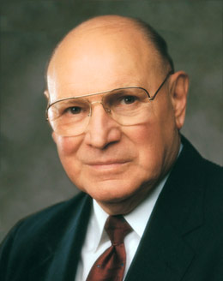
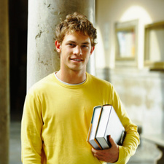
"God truly is our Father, the Father of the spirits of all mankind. We are his literal offspring and are formed in his image.
We have inherited divine characteristics from him. Knowing our relationship to our Heavenly Father helps us understand the divine nature that is in us and our potential.
The doctrine of the fatherhood of God lays a solid foundation for self-esteem.“
(4)

Slide 7
Doctrinal Mastery
Furthermore we have had fathers of our flesh which corrected us, and we gave them reverence: shall we not much rather be in subjection unto the Father of spirits, and live?
Hebrews 12:9

Slide 8
Be in Subjection
To be humble, teachable, and willing to make changes in our lives to align with His will.
If we submit to chastening from Heavenly Father, we will become more like Him and have the peace that comes from righteousness
Hebrews 12:9-10

Slide 9
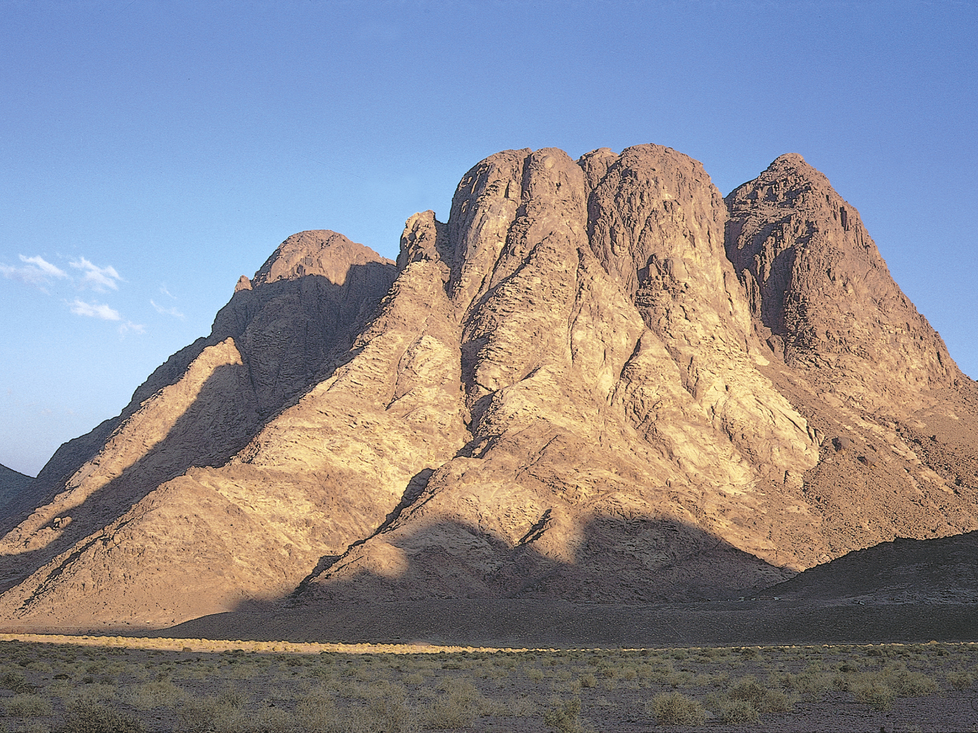
The Mount Might Be Touched
Paul compares the situation of the children of Israel in Moses’ day with the people of his own day.
In Moses’ time the children of Israel were forbidden by divine law to touch Mount Sinai on penalty of death; it was not so in Paul’s day, nor is it in our own.
“No longer is there a restraining barrier to keep the people from seeing and communing with their God. The mountain is no longer Sinai but Zion.” (5)
Hebrews 12:18; Ex. 19:9-25; 20:1-23.
(6)

Slide 10
Church of the Firstborn
Paul’s teaching that redeemed Saints join the “church of the firstborn” is the only biblical occurrence of this phrase.
In latter-day revelations, the Prophet Joseph Smith learned that the Church of the Firstborn refers to Christ’s heavenly Church, which comprises faithful, exalted Saints in the celestial kingdom .
That by keeping the commandments they might be washed and cleansed from all their sins, and receive the Holy Spirit by the laying on of the hands of him who is ordained and sealed unto this power;
And who overcome by faith, and are sealed by the Holy Spirit of promise, which the Father sheds forth upon all those who are just and true.
They are they who are the church of the Firstborn.
D&C 76:52-54
Hebrews 12:23
(7)

Slide 11
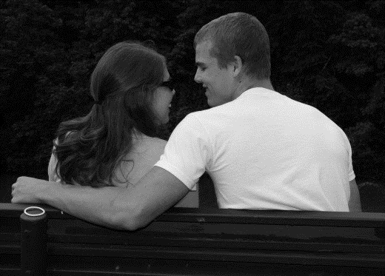
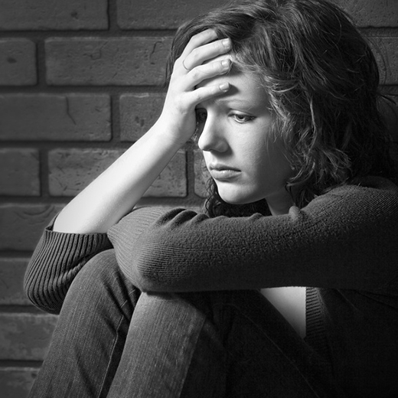
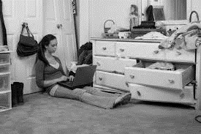
Paul’s Admonition
Brotherly Love = be mindful of those who suffer
Make marriage Honorable = Making sure your courtship is clean and virtuous
To not covet = to be content with all you have been given
Hebrews 13:1-9

Slide 12
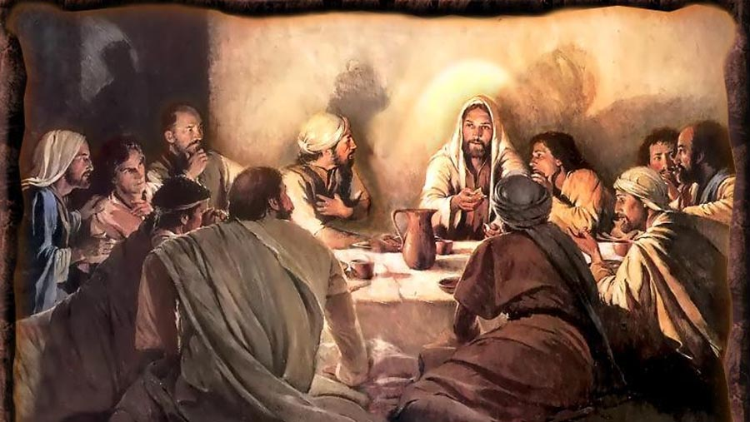
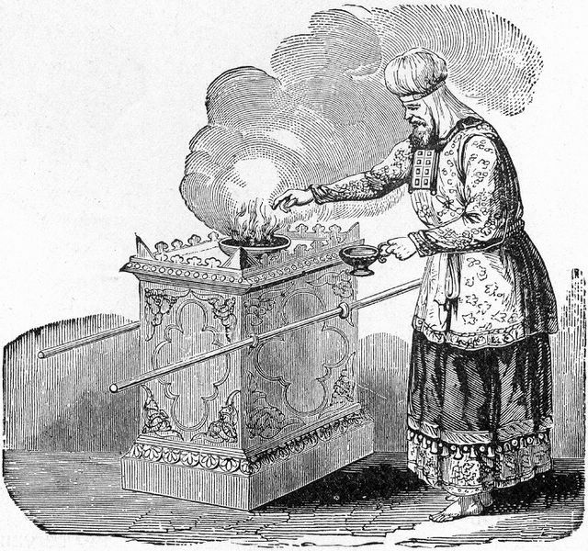
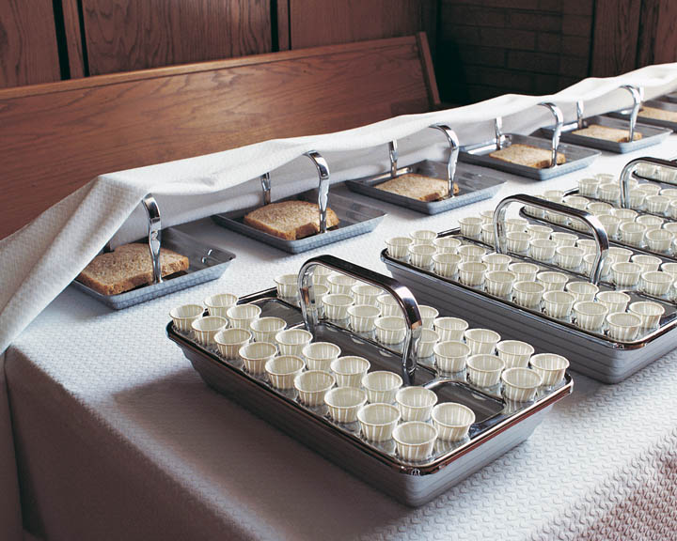
The Altar
The altar Paul refers to is the sacramental table spread by the atonement of Jesus Christ, which may be partaken of by all who covenant with Christ.
Today’s Altar
'Those who serve the tabernacle' has reference to the Levitical Priesthood holders who performed the ordinances in the ancient tabernacle and temple."
Hebrews 13:10-12
(6)

Slide 13
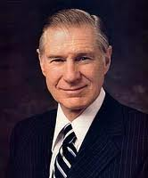
Obedience To Spiritual Leaders
"Submitting to the leadership, counsel, and direction of those placed over us may test us, particularly in view of the imperfections leaders have. (8)
"I humbly and prayerfully hope that what I have to say will be received in the spirit that I would like to convey. We have just heard the prophet of God. He is a watchman on the tower. He has raised a warning voice. I would urge all to listen and follow his counsel. It is tremendously important always to be in harmony with those who, according to Paul, have 'watch for your souls, as they that must give account, that they may do it with joy, and not with grief‘. (9)
Hebrews 13:17-25

Slide 14
Sources:
Suggested Hymn: #301 I Am A Child of God
Video:
Pure and Simple Faith (5:22)
The Will of God (3:02)
New Testament Institute Student Manual Chapter 49
President Thomas S. Monson (“Great Expectations” [Brigham Young University devotional, Jan. 11, 2009], 6; speeches.byu.edu).
Elder Jeffery R. Holland (“None Were with Him,” Ensign or Liahona, May 2009, 88).
Elder Joseph B. Wirthlin ("Fruits of the Restored Gospel of Jesus Christ," Ensign, Nov. 1991, 15)
Elder Bruce R. McConkie DNTC, 3:229.)
Life and Teachings of Jesus and His Apostles Chapter 48
Guide to the scriptures
Elder Neal A. Maxwell (Not My Will, But Thine [Salt Lake City: Bookcraft, 1998], 104.)
President James E. Faust " ("Unwanted Messages," Ensign, Nov. 1986, 8)
If we submit to chastening from Heavenly Father, we will become more like Him and have the peace that comes from righteousness.)
Presentation by ©http://fashionsbylynda.com/blog/

Slide 15
LETTER TO THE HEBREWS—BELIEVED WRITTEN BY PAUL, (HEBREWS)
“Whom the Lord Loveth He Chasteneth” | 12:1–8
Premortality and Exaltation | 12:9, 10
Peace and Holiness Lead One to See God | 12:11–17
Exalted Saints Belong to the Church of the Firstborn | 12:18–24
“Our God Is a Consuming Fire” | 12:25–29
“Some Have Entertained Angels Unawares” | 13:1–3
Marriage Is Honorable | 13:4–7
Christ is Everlastingly the Same | 13:8
How Christians Offer Sacrifices | 13:9–25
The Father of Spirits 12:9: ‘Who am I?’ I am a child of God with a spirit lineage to heavenly parents. That parentage defines our eternal potential. That powerful idea is a potent antidepressant. It can strengthen each of us to make righteous choices and to seek the best that is within us. Establish in the mind of a young person the powerful idea that he or she is a child of God and you have given self-respect and motivation to move against the problems of life” (“Powerful Ideas” ) Elder Dallin H. Oaks Ensign, Nov. 1995, 25).
Mount Sinai Hebrews 12:18:
“No longer is there a restraining barrier to keep the people from seeing and communing with their God. The mountain is no longer Sinai but Zion. And all those who have cleansed and perfected their souls, shall be welcomed on the heavenly mountain, and in the heavenly city, the new Jerusalem, the city of exalted beings. And there, in that heavenly realm, where the saints shall see and know, as Moses alone did in Israel, shall be found such might, display, splendor and omnipotence, that the doings of Jehovah on Sinai, incomprehensibly glorious as they were, shall be but a blurred image in comparison.” Elder Bruce R. McConkie (McConkie, DNTC, 3:229.)
Firstborn Hebrews 12:23, 24:
“Members of The Church of Jesus Christ of Latter-day Saints who so devote themselves to righteousness that they receive the higher ordinances of exaltation become members of the Church of the Firstborn. …
“The Church of the Firstborn is made up of the sons of God, those who have been adopted into the family of the Lord, those who are destined to be joint-heirs with Christ in receiving all that the Father hath.” (McConkie, Mormon Doctrine, p. 139.)
The phrase “the Church of the Firstborn” has no reference to the apostate group of the same name. (Life and Teachings of Jesus and His Apostles Chapter 48
Life and Teachings of Jesus and His Apostles Chapter 48
Endure Hebrews 12:5-13:
“No pain that we suffer, no trial that we experience is wasted. It ministers to our education, to the development of such qualities as patience, faith, fortitude and humility. All that we suffer and all that we endure, especially when we endure it patiently, builds up our characters, purifies our hearts, expands our souls, and makes us more tender and charitable, more worthy to be called the children of God … and it is through sorrow and suffering, toil and tribulation, that we gain the education that we come here to acquire and which will make us more like our Father and Mother in heaven. …” (Orson F. Whitney, as cited in Kimball, Faith Precedes the Miracle, p. 98.)
Can Make You Perfect Hebrews 13:21:
"...you can't make yourself perfect. You can't make yourself sinless and worthy of the presence of God the Father. You can't make yourself celestial, no matter how hard you try, because you have already sinned, and sinlessness requires not only perfect performance in the future, but also perfect performance in the past. Otherwise, you are not sinless, you are just a sinner who hasn't sinned recently. Many an obsessive student has learned the sad truth that once he or she gets just one B, no number of A's thereafter will restore a perfect record, a 4.0 grade-point average. Innocence requires forgiveness and cleansing. It requires that the record be expunged and rewritten, that all the sinful former deeds and actions cease to be counted-and all these things come only through the atonement of Christ...only Christ can make you perfect and celestial." (Stephen E. Robinson, Believing Christ: The Parable of the Bicycle and Other Good News [Salt Lake City: Deseret Book Co., 1992], 27.)

Slide 16
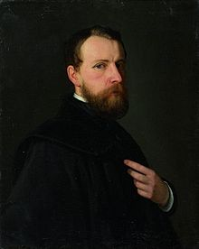
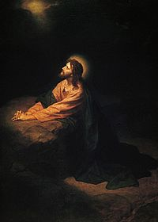
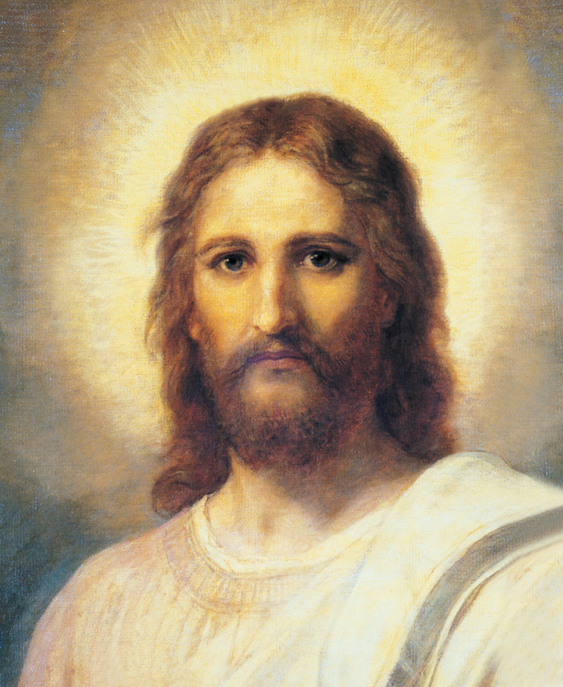
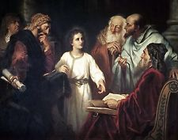
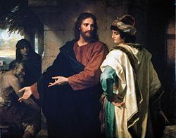
Johann Michael Ferdinand Heinrich Hofmann (March 19, 1824 - June 23, 1911) was a German painter of the late 19th to early 20th century. He was the uncle of the German painter Ludwig von Hofmann. He was born in Darmstadt and died in Dresden. He is best known for his many paintings depicting the life of Jesus Christ.
Heinrich Hofmann grew up in a family that harbored a deep interest in art. His father, advocate Heinrich Karl Hofmann (1795–1845) painted in watercolors, his mother Sophie Hofmann, née Volhard (1798–1854) gave lessons in art before she married, and his four brothers all showed artistic talent. Heinrich, however, was the only one for whom art was not only a profession but the center of his life.
In 1853, Hofmann returned to Darmstadt, and in the beginning of 1854, his beloved mother died. He was deeply moved by her death and it inspired him to paint his first large religious work: Burial of Christ.
he married Elisabeth Werner. The couple had no children. He died 23 June 1911 (aged 87) Dresden
Self portrait

