Slide 1
Lesson 14
John Sent To Prepare The Way
Matthew 11-12
Verily, verily, I say unto you, that as many as receive me, to them will I give power to become the sons of God, even to them that believe on my name”
D&C 11:30

Slide 2
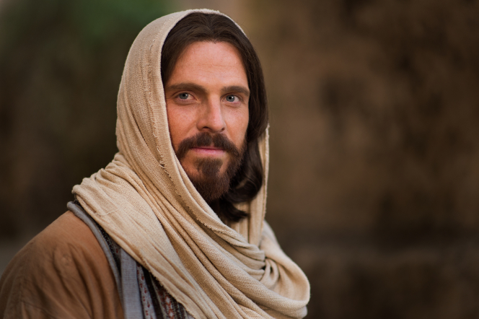
How Do You Know?
Why is it important to know that these people truly are who they appear to be?
How can you know that they are who they appear to be?

Slide 3
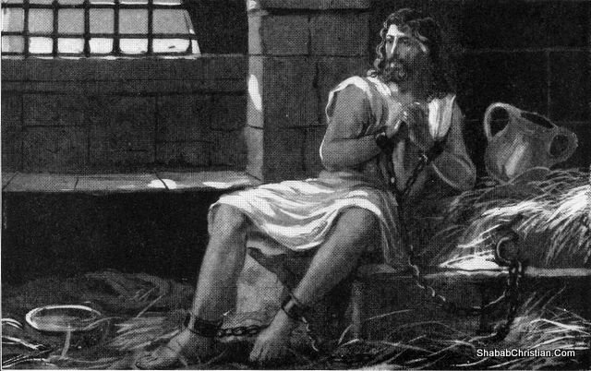
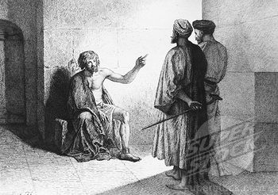
John, the Baptist
While Jesus was ministering throughout the cities of Galilee, John the Baptist, who had been put into prison by Herod, “sent two of his disciples to inquire of Jesus to reassure their faith.
Many have thought this event reflected a lack of confidence in John’s own mind. However, Jesus took the occasion to bear testimony of the great work John had done, emphasizing that he was unwavering and true” (1)
Matthew 11:2-3

Slide 4
John - Foreordained
Jesus began teaching the people about the greatness of John the Baptist. John the Baptist was foreordained to be a forerunner to Jesus Christ, a mission that fulfilled Old Testament prophecy.
The voice of him that crieth in the wilderness, Prepare ye the way of the Lord, make straight in the desert a highway for our God. Isaiah 40:3
See 1 Nephi 10:7-10
Behold, I will send my messenger, and he shall prepare the way before me: and the Lord, whom ye seek, shall suddenly come to his temple, even the messenger of the covenant, whom ye delight in: behold, he shall come, saith the Lord of hosts.
Malachi 3:1
See 1 D&C 84:20
Matthew 11:2-3

Slide 5
Who is the Messiah?
John’s disciples were asking Jesus if He was the Messiah.
John the Baptist already knew that Jesus was the Messiah
And I saw, and bare record that this is the Son of God.
John 1:34
As we seek to learn of Jesus Christ and as we testify of Him, our own testimony of Him can be strengthened
Matthew 11:2-3

Slide 6
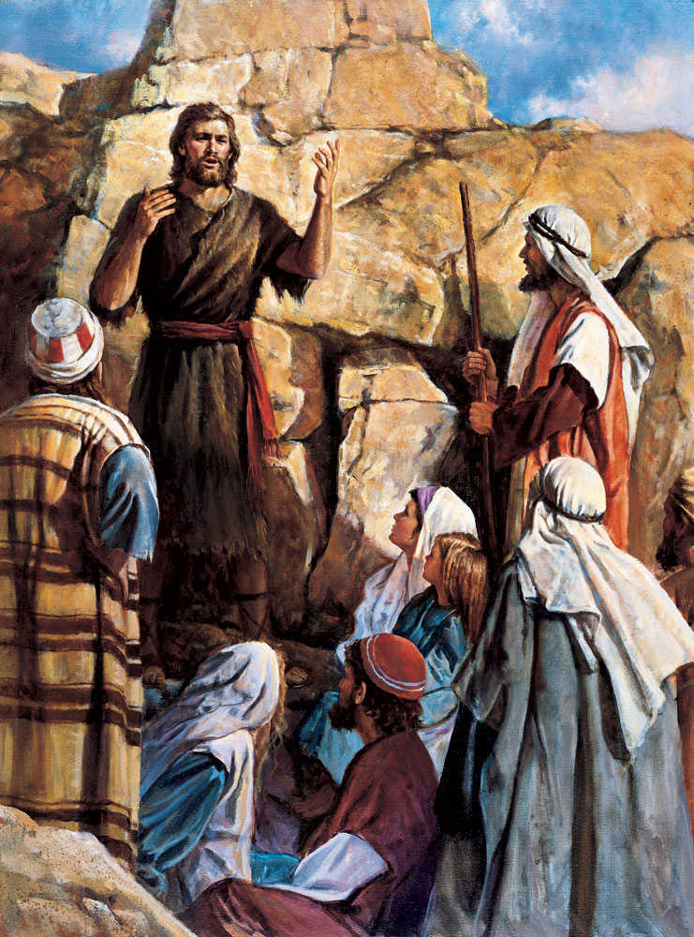
John was the Chosen Prophet
To prepare the way of the Messiah
Jesus condemned those who rejected John the Baptist as well as those who had witnessed clear evidence of the Lord’s divinity yet rejected Him.
But the days will come, when the violent shall have no power; for all the prophets and the law prophesied that it should be thus until John.
Yea, as many as have prophesied have foretold of these days.
And if ye will receive it, verily, he was the Elias, who was for to come and prepare all things.
JST Matthew 11:13-15

Slide 7
Children in the Market
The Savior illustrated the inconsistency and unbelief of those who rejected Him and John the Baptist
Bruce R. McConkie Commentary
“What illustration can I choose to show how petty, peevish, and insincere are you unbelieving Jews? You are like fickle children playing games; when you hold a mock wedding, your playmates refuse to dance; when you change the game to a funeral procession, your playmates refuse to mourn. In like manner you are only playing at religion. As cross and capricious children you reject John because he came with the strictness of the Nazarites, and ye reject me because I display the warm human demeanor that makes for pleasant social intercourse” (2)
Matthew 11:16-19

Slide 8
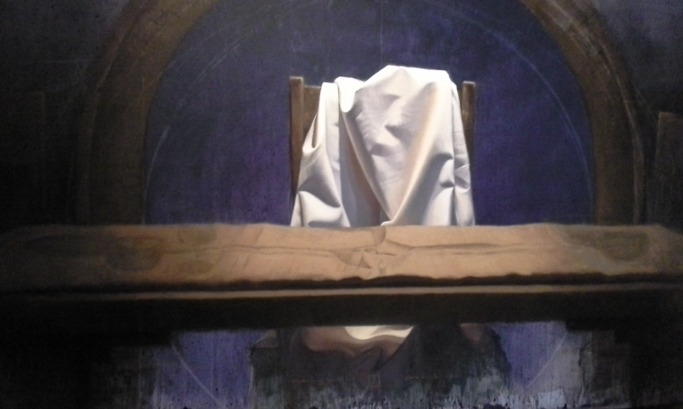
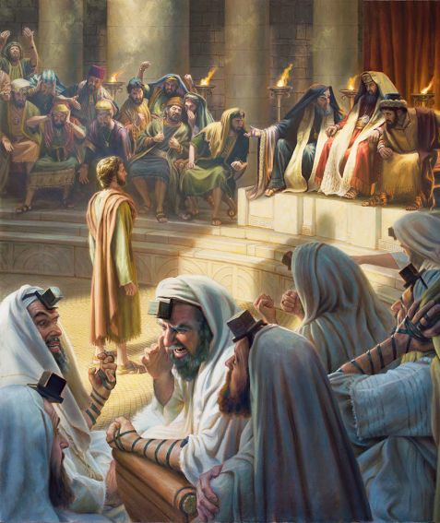
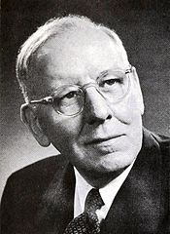
Jesus Christ is Not On Trial
The Jews were insolent and self-righteous. When the Jews piped, Jesus didn't dance. They judged Him harshly because He didn't do what they wanted. They rejected him because he didn't behave the way they expected the Messiah to behave. They had the cart before the horse, for Christ was not to be judged by the world-the world is to be judged by Christ. (4)
"The Lord Jesus Christ is not on trial before the world. Men should understand that. The world is on trial before the Lord Jesus Christ, and we will have to account for the attitude taken toward him and his
message, and we cannot accept him without accepting his
principles and his doctrines. If we reject his principles and
his doctrines, we reject him." (3)
Matthew 11:17

Slide 9
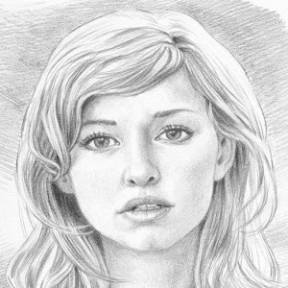
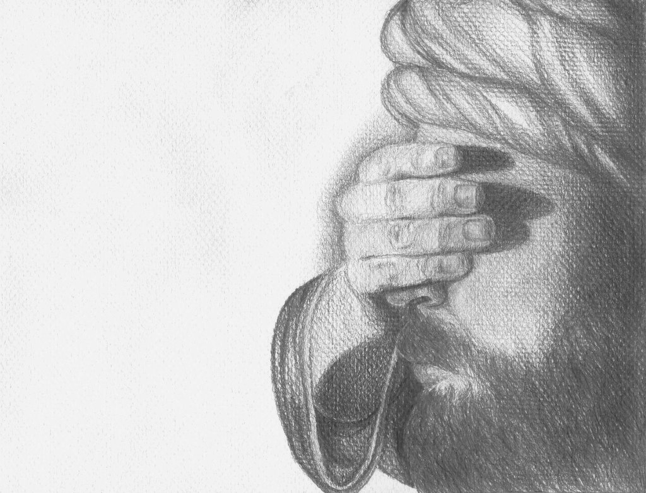
Revealed Unto Babes
"Compared with the learned men of the time, such as the rabbis and scribes, whose knowledge served but to harden their hearts against the truth, these devoted servants were as babes in humility, trust, and faith.
Such children were and are among the nobles of the kingdom." (5)
We are like children when we are prepared to receive the gospel.
Matthew 11:25

Slide 10
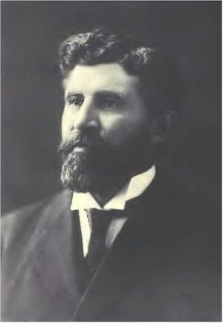
University of God
“…people are not wise in this world's learning, or experienced; they are youthful, inexperienced, frequently uneducated, and crude, but enjoying an experience and receiving an education superior to that obtained anywhere else. We value the privilege of educating our children in the great universities of the world, preparing them for life's duties; but is it not far more important that they should be prepared both for this life's duties and those of the life to come, the eternities?
“It is the greatest university training, to be thus divinely inspired, guided and educated.
It is more than what people call religious training.
There is in it also a most practical training for life's secular duties as well.
It develops more than any college work will, initiative, self reliance, leadership, moral character, virtue, love of fellowmen, and above all the love of God, and a knowledge of him." (6)
Matthew 11:25

Slide 11
A Repeated Invitation
The Savior promised rest to all who come unto Him, no matter how difficult life’s trials
“Just believing, just having a ‘molecule’ of faith— … that simple step, when focused on the Lord Jesus Christ, has ever been and always will be the first principle of His eternal gospel,
…the first step out of despair.
“Second, we must change anything we can change that may be part of the problem. In short we must repent,
Anything we can change we should change, and we must forgive the rest.
He will take it from there.
“Third, in as many ways as possible we try to take upon us His identity, and we begin by taking upon us His name. That name is formally bestowed by covenant in the saving ordinances of the gospel. These start with baptism and conclude with temple covenants, with many others, such as partaking of the sacrament, laced throughout our lives as additional blessings and reminders. …(7)
Matthew 11:28-30

Slide 12
Doctrinal Mastery
Come unto me, all ye that labour and are heavy laden, and I will give you rest.
Take my yoke upon you, and learn of me; for I am meek and lowly in heart: and ye shall find rest unto your souls.
For my yoke is easy, and my burden is light.
Matthew 11:28-30

Slide 13
If we come unto Jesus Christ, He will ease our burdens and give us rest

Slide 14
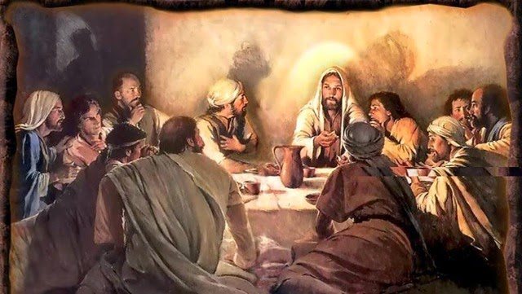
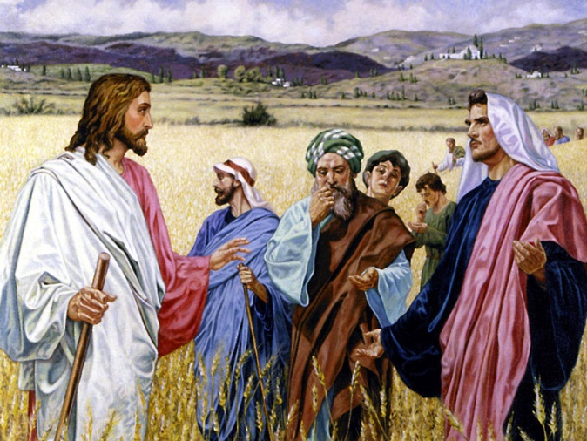
Sabbath laws
Christ's message regarding Sabbath worship was that the spirit of the law was to do good, regardless of the restrictions of the letter-the letter calls for sacrifice, but the spirit calls for mercy.
"There is a higher law. Mercy is greater than sacrifice. The 'letter,' as it were, of sacrificial performances, or of Sabbath observance, or of tithe paying, or of keeping the Word of Wisdom, or of any act or performance, 'killeth'; only the spirit giveth 'life.' Sabbath restrictions are not to be compared with Sabbath acts involving mercy and goodness and grace.
The lesser law is superseded by the higher. 'The Sabbath was expressly designed for mercy, and therefore not only might all acts of mercy be blamelessly performed thereon, but such acts would be more pleasing to God than all the insensate and self-satisfied scrupulosities which had turned a rich blessing into a burden and a snare.‘ (3)
Matthew 12:1

Slide 15
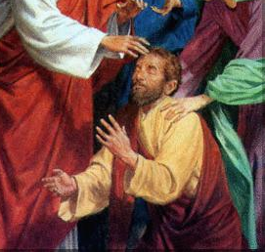
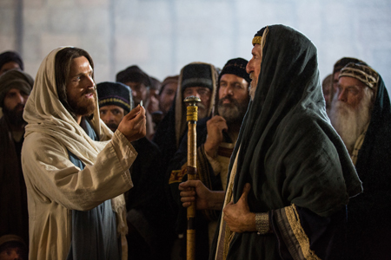
He is the Messiah
After Jesus healed a man on the Sabbath day, some of the Pharisees began seeking to destroy Him.
When He healed someone possessed of a devil, they attempted to discredit Him in front of the people by accusing Him of performing those works by the power of the devil.
Jesus knew their thoughts and asserted that, on the contrary, by casting out devils He was demonstrating that He was the Messiah and was establishing God’s kingdom.
Matthew 12:1-30

Slide 16
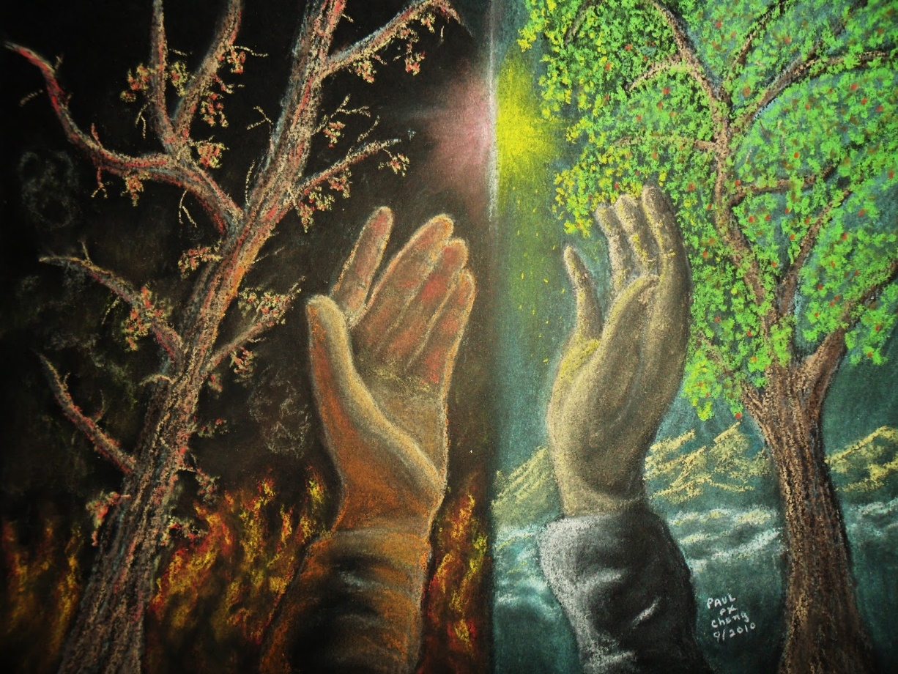
Good Tree VS Corrupt Tree
The Savior taught that “a good tree cannot bring forth evil fruit, neither can a corrupt tree bring forth good fruit”
Jesus was telling them they needed to make a choice about Him.
Because of His good works they could not consistently call Him evil, and they could not take a neutral position.
Confronted with His testimony and good works, the Pharisees had to choose whether or not they would accept Him as the Christ and follow Him. (8)
The Pharisees took an untenable position when they accused Jesus of using the power of the devil to do something good by healing a man possessed with a devil.
Matthew 12:22-30, 33

Slide 17
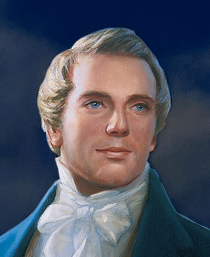
Blasphemy against the Holy Ghost
“Blasphemy against the Holy Ghost” is sometimes used interchangeably with the terms “denying the Holy Ghost” or “the unpardonable sin.”
“What must a man do to commit the unpardonable sin?
He must receive the Holy Ghost, have the heavens opened unto him, and know God, and then sin against him.
After a man has sinned against the Holy Ghost, there is no repentance for him.
He has got to say that the sun does not shine while he sees it; he has got to deny Jesus Christ when the heavens have been opened unto him, and to deny the plan of salvation with his eyes open to the truth of it; and from that time he begins to be an enemy.” (9)
Matthew 12:31-32, 43-45

Slide 18
Parable of the Empty House
Finding No Rest
37 Then came some of the scribes and said unto him, Master, it is written that, Every sin shall be forgiven; but ye say, Whosoever speaketh against the Holy Ghost shall not be forgiven. And they asked him, saying, How can these things be?
38 And he said unto them, When the unclean spirit is gone out of a man, he walketh through dry places, seeking rest and findeth none; but when a man speaketh against the Holy Ghost, then he saith, I will return into my house from whence I came out; and when he is come, he findeth him empty, swept and garnished; for the good spirit leaveth him unto himself.
JST Matthew 12:43-45

Slide 19
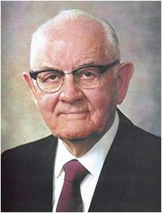
“In abandoning sin one cannot merely wish for better conditions.
He must make them. …
“… The things which engaged him and caught his fancy and occupied his thoughts are gone, and better substitutions have not yet filled the void. This is Satan’s opportunity” (10)
We can repel evil influences after removing them from our lives by replacing them with righteousness
Matthew 12:45

Slide 20
“It is not enough to simply try to resist evil or empty your life of sin.
You must fill your life with righteousness and engage in activities that bring spiritual power. …
“Full obedience brings the complete power of the gospel into your life, including increased strength to overcome your weaknesses. This obedience includes actions you might not initially consider part of repentance, such as attending meetings, paying tithing, giving service, and forgiving others.” (11)
Matthew 12:31-32, 43-45

Slide 21
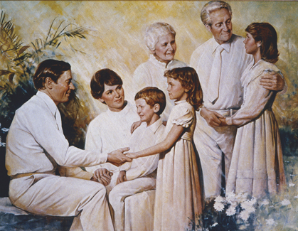
Belonging to An Eternal Family
“The blessings of heaven are available—freely, without money and without price—to all men.
All men cannot be born into this world as the sons of God, after the manner of the flesh, but all, through righteousness, can be adopted into the family of the Eternal God and become joint-heirs with Christ of the fullness of the glory and power of the Father” (2)
Matthew 12:48-50

Slide 22
Sources:
Suggested Hymn:#89 The Lord is My Light
Video:
Look to the Light (4:29)
Bible Dictionary, “John the Baptist”
Bruce R. McConkie Doctrinal New Testament Commentary, 3 vols. [1965–73], 1:263
Bruce R. McConkie noted (Farrar, p. 337.)" (The Mortal Messiah: From Bethlehem to Calvary, 2: 87; Mortal Messiah, 2:227
George Q. Morris (Conference Report, April 1955, Fourth Day-Morning Meeting 101)
Gospel Doctrine.com
James E. Talmage Jesus the Christ, 397
Elder James H. Moyle (Conference Report, October 1929, Afternoon Meeting 125.)
Elder Jeffrey R. Holland (“Broken Things to Mend,” Ensign or Liahona, May 2006, 69–70).
New Testament Institute Student Manual Chapter 4
President Joseph Smith (in History of the Church, 6:314).
President Spencer W. Kimball (The Miracle of Forgiveness [1969], 171–72; emphasis added).
(True to the Faith: A Gospel Reference [2004], 135).
Presentation by ©http://fashionsbylynda.com/blog/

Slide 23
Event | Matthew | Mark | Luke | John
Jesus is Lord of the Sabbath | 12:1-8 | 2:23-28 | 6:1-5
Jesus Heals Man With Withered Hand on the Sabbath | 12:9-14 | 3:1-6 | 6:6-11
Multitudes Throng Jesus | 12:15-21 | 3:7-12
John the Baptist Sends Messenger to Jesus | 11:2-6 |  | 7:18-23
Jesus Testifies of John’s Greatness | 11:7-19 |  | 7:24-35
Jesus Accused of Working with Beelzebub | 12:22-30 | 3:19-27
No Forgiveness for Blasphemy Against Holy Ghost | 12:31-37 | 3:28-20
Discourse on Signs | 12:38-45
Jesus’ Mother and Brother Seek Him | 12:46-50 | 3:31-35 | 8:19-21
Jesus Sends Forth the Seventy | 11:20-24 | 10:1:1-16
Matthew 11:17 Piped into you and you have not danced:
Jesus is using a parable to show the people that they can't have it both ways. John the Baptist comes to them from the wilderness as an isolated, austere prophet dressed in camel's hair, and he is rejected. Jesus comes to them as a common man; he associates with poor people eating and drinking with sinners, and he is rejected. God gave this generation two totally different kinds of prophets, one that was a loner who rejected all common pleasures and One that was social and ate and drank like the common man. Would the Jews reject both kinds? Which kind of prophet did they want?
To paraphrase the parable, "when we played happy music, you didn't rejoice and sing and dance; when we played sad music, you didn't cry and mourn and lament." The kind of music played was completely opposite just like God's presentation of these two prophets. In both instances, the hearers (John the Baptist and Jesus) didn't behave the way the musicians (the Jews) wanted.
When people think of prophets, they have widely different expectations. Joseph Smith often received the same response. People rejected him as a prophet because he didn't meet their expectations of how a prophet should behave. Joseph Wakefield must have expected a true prophet to be serious all the time. He once witnessed the Prophet Joseph stop translating the Bible so he could play with the children. He was completely astonished at this. "This convinced him that the Prophet was not a man of God, and that the work was false." (Susan Easton Black, Who's Who in the Doctrine and Covenants [Salt Lake City: Bookcraft, 1997], 324 - 325)
The Jews were insolent and self-righteous. When the Jews piped, Jesus didn't dance. They judged Him harshly because He didn't do what they wanted. They rejected him because he didn't behave the way they expected the Messiah to behave. They had the cart before the horse, for Christ was not to be judged by the world-the world is to be judged by Christ. Gospel Doctrine.com
Source: Horizontal Harmony of the Four Gospels by Thomas M. Mumford
Matthew 11:2-3 John the Baptist sends two:
“The question they were to put to Jesus was for their edification, not for his own. John knew, as no one else knew, who Jesus was, and he had known it for a long time. He had had revelation from heaven to this effect: he had seen with his eyes, he had heard with his ears, and he had the testimony of the Holy Ghost. … The most satisfactory answer seems to be that John sent his disciples to question Jesus about his identity so that they themselves would at long last realize the truth of what John had been testifying” Robert L. Millet (A Burning Light: The Life and Ministry of John the Baptist [1972], 92).

Slide 24
Matthew 11:38-40 The Lord’s Yoke
In biblical times the yoke was a device of great assistance to those who tilled the field. It allowed the strength of a second animal to be linked and coupled with the effort of a single animal, sharing and reducing the heavy labor of the plow or wagon. A burden that was overwhelming or perhaps impossible for one to bear could be equitably and comfortably borne by two bound together with a common yoke. …
“Why face life’s burdens alone, Christ asks, or why face them with temporal support that will quickly falter? To the heavy laden it is Christ’s yoke, it is the power and peace of standing side by side with a God that will provide the support, balance, and strength to meet our challenges and endure our tasks here in the hardpan field of mortality.
“Obviously, the personal burdens of life vary from person to person, but every one of us has them. Furthermore, each trial in life is tailored to the individual’s capacities and needs as known by a loving Father in Heaven. Of course, some sorrows are brought on by the sins of a world not following the counsel of that Father in Heaven. Whatever the reason, none of us seems to be completely free from life’s challenges. To one and all, Christ said, in effect: As long as we all must bear some burden and shoulder some yoke, why not let it be mine? My promise to you is that my yoke is easy, and my burden is light. (See Matt. 11:28–30.)” President Howard W. Hunter (“Come unto Me,”Ensign, Nov. 1990, 18).
Matthew 12:31-32, 43-46 Sin against the Holy Ghost
President Spencer W. Kimball (1895–1985) noted that few will commit this sin: “The sin against the Holy Ghost requires such knowledge that it is manifestly impossible for the rank and file [members of the Church] to commit such a sin” (The Miracle of Forgiveness [1969], 123).
President Boyd K. Packer of the Quorum of the Twelve Apostles similarly reassured Church members: “Save for those few who defect to perdition after having known a fulness, there is no habit, no addiction, no rebellion, no transgression, no offense exempted from the promise of complete forgiveness” (“The Brilliant Morning of Forgiveness,” Ensign, Nov. 1995, 19).
Matthew 12:41-42 “The Men of Nineveh” and “the Queen of the South”
Ancient Assyria, whose capital was Nineveh, was notorious for its brutal treatment of war captives, who were often tortured, beheaded, dismembered before family members, flayed alive, roasted over a slow fire, or sent back to Assyria for forced relocation or public execution. Nonetheless, the ancient inhabitants of Nineveh, who were not of Israelite descent, responded to Jonah’s cry of repentance (see Jonah 3:1–9).
Similarly, the queen of the south (queen of Sheba), also not of Israel, had great respect for Solomon, the Israelite king (see 1 Kings 10:1–13).
The Savior referred to the men of Nineveh and the queen of Sheba while rebuking the Pharisees for failing to believe in Him. He was “greater than Jonas” (Matthew 12:41) and “greater than Solomon” (Matthew 12:42)—yet to the shame of the Jewish leaders, who were of Israel and ought to have known better, they were refusing to honor and hearken to Jesus Christ, the greatest of all. (See similar rebukes in Matthew 8:10;11:20–24; Luke 4:25–27.)
Matthew 12:2 Unlawful on the Sabbath?
"On a certain Sabbath, He and the disciples walked through a field of grain, and, being hungry, the disciples began to pluck some of the ripening ears; rubbing out the kernels between their hands, they ate. There was no element of theft in what they did, for the Mosaic law provided that in passing through another's vineyard or corn field one might pluck grapes or corn to relieve hunger; but it was forbidden to use a sickle in the field, or to carry away any of the grapes in a vessel. (Deut. 23:24,25)
The permission extended only to the relief of present need. When the disciples of Jesus availed themselves of this lawful privilege, there were Pharisees on the watch, and these came at once to the Master, saying: 'Behold, thy disciples do that which is not lawful to do upon the sabbath day.' The accusers doubtless had in mind the rabbinical dictum that rubbing out an ear of grain in the hands was a species of threshing; that blowing away the chaff was winnowing; and that it was unlawful to thresh or winnow on the Sabbath. Indeed, some learned rabbis had held it to be a sin to walk on grass during the Sabbath, inasmuch as the grass might be in seed, and the treading out of the seed would be as the threshing of grain.“ James E. Talmage (Jesus the Christ, 198-99)
Matthew 12:3-5 In the Service of the Lord
The disciples, when following the Lord, were similarly on the service of the Lord; ministering to Him was more than ministering in the Temple, for He was greater than the Temple.
If the Pharisees had believed this, they would not have questioned their conduct, nor in so doing have themselves infringed that higher law which enjoined mercy, not sacrifice.' (Edersheim 2:58.)" (Bruce R. McConkie, The Mortal Messiah: From Bethlehem to Calvary, 2: 87.)
Matthew 12:22-30 Making a Choice—the Messiah or Not
Christian writer C. S. Lewis taught that we too must make an all-or-nothing choice in response to Jesus Christ: “You must make your choice. Either this man [Jesus Christ] was, and is, the Son of God: or else a madman or something worse. You can shut Him up for a fool, you can spit at Him and kill Him as a demon; or you can fall at His feet and call Him Lord and God. But let us not come with any patronising nonsense about His being a great human teacher. He has not left that open to us. He did not intend to” (Mere Christianity[1952], 41).

Slide 25
James H. Moyle, one of Utah's most representative attorneys, is a native of Salt Lake City, having been born there September 17, 1858. His father, James Moyle, was a successful builder and contractor, and his mother was Elizabeth Wood Moyle. J. H. Moyle was educated in the district schools of Salt Lake City, and later took a course at the University of Utah, graduating in 1881. He subsequently took the course at the University of Michigan Law School, from which he graduated in 1885, and was a student for three years also at the University of Michigan in its School of Political Science. Mr. Moyle was admitted to the bar of Utah and of Michigan in 1885, and later to the Supreme Court of the United States. He was Assistant City Attorney and Deputy County Attorney for one year, and was elected County Attorney in 1886, and re-elected in 1888. The same year he was elected a member of the State legislature. He was chairman of the committee in 1889 which visited the principal Reform Schools of the United States, and upon whose report our Territorial Reform School was established. He was chairman of the Democratic State Committee in the campaigns of 1898 and 1899, and his party was victorious in both. During the last day of the legislature in 1899, Mr. Moyle was the caucus nominee of the Democratic Party for United States Senator; but no Senator was elected because of so many members being held by obligations to A. W. McCune, from which he would not release them. Hence the deadlock. Mr. Moyle was the choice of the Democrats as their candidate for governor in 1900 and 1904, and in the latter campaign led his ticket in number of votes received by him. He also has taken a keen interest in livestock, its conventions and organizations, and was for many years a director of the Utah Fair Association. He was also for many years a trustee of the Reform School, and for two years was president of the Board of Trustees of that institution. While Mr. Moyle is active in business, farming, livestock, and mining, he has been more attentive to his large legal practice. The law firm was originally Richards & Moyle; later on, Moyle, Zane & Costigan and at the present time, Moyle & Van Cott, and their clientage and law business is one of the largest in the State. Mr. Moyle is a director in the Consolidated Wagon and Machine Company, the Deseret Live Stock Company, the Utah Commercial and Savings Bank, the Silver Brothers' Iron Works Company, the Inter-Mountain Packing Company, the Utah Independent Telephone Company, the Utah Consolidated Plaster Company, the Blackfoot Stock Company, and many other important enterprises, especially mining companies, too numerous to mention. Mr. Moyle was married to Alice E. Dinwoodey, November 17, 1887, and they are the parents of eight children, of whom six are living, namely: Henry D., Alice E., Walter G., Gilbert D., James D., and Sarah Virginia Moyle. Mr. Moyle is a member of the Commercial Club and president of the Utah Democratic Club. He resides at 405 East First South Street, Salt Lake City. Intermountain Utah Biographies
Something of interest
The following sides will also be in Lesson 48 Luke:7:18-35

Slide 26
Who was John the Baptist?

Slide 27
John’s forthcoming birth and ministry were announced to John’s father by the angel Gabriel
Luke 1:5-25

Slide 28
John was the son of Zacharias and Elisabeth being a priestly descent through both parents.

Slide 29
John was a child of promise, with prophecies of his mission having been given by:
1 Nephi 10:7-10
Isaiah (40:3)
Malachi (3:1)

Slide 30
John was baptized at a
very early age
John was ordained to the priesthood at the time he was eight days old
D&C 84:27-28

Slide 31
John was a cousin of Jesus and born 6 months before Jesus

Slide 32
John grew up in the desert until the time arrived for his ministry to prepare the way for the Savior

Slide 33
John had preached and baptized for several months before he baptized the Savior, and continued to do so afterwards for several months.
John 3:23-24

Slide 34
John, the beloved, and Andrew, later members of the Twelve were baptized and disciples of John the Baptist. Others were probably tutored by John
Acts 1:21-22

Slide 35
At the time of Jesus’ baptism, John saw the sign and heard the voice of the Father bearing record that Jesus was the Beloved Son, in whom the Father was well pleased
(Matthew 3:13-17)

Slide 36
The sign of the dove, as an emblem for the Holy Ghost, was a pre-appointed signal by which John knew he was to recognize that he had baptized the Son of God.
John 1:29-34

Slide 37
John was shut up in prison by order of Herod, for criticizing Herod’s unlawful marriage of Herod
Mark 6:16-29

Slide 38
While in prison, John sent two of his disciples to inquire of Jesus to reassure their faith. Jesus took the occasion to bear testimony of the great work John had done, emphasizing that he was unwavering and true.
Luke 7:24-28

Slide 39
After nearly a year in prison, John was beheaded at the instigation of Herodias
John
the Baptist
Matthew 14:3
Mark 6:17

Slide 40
On May 15, 1829 John came to Joseph Smith and Oliver Cowdery on the banks of the Susquehanna River near Harmony, Pennsylvania, and ordained them to the Priesthood of Aaron
(D&C 13, 27: 7-8)
(JS-H 1:68-72)

Slide 41
John’s ministry has operated in three dispensations; He was the last of the prophets under the law of Moses, he was the first of the New Testament prophets, and he brought the Aaronic Priesthood to the dispensation of the fulness of times.

Slide 42
John the Baptist source: (1)

