Slide 1
Lesson 140
Messages of Salvation
James 1
For all those who will not endure chastening, but deny me, cannot be sanctified.
D&C 101:5

Slide 2
James
He was the author of James and identifies himself as “James, a servant of God and of the Lord Jesus Christ”
James is probably the half brother of Jesus, not James, the brother of John
He was initially one of Jesus’ disciples but after Jesus’ resurrection James was one who was a special witness to whom Jesus appeared
He later became an Apostle and first Bishop in the Church in Jerusalem
(1)

Slide 3
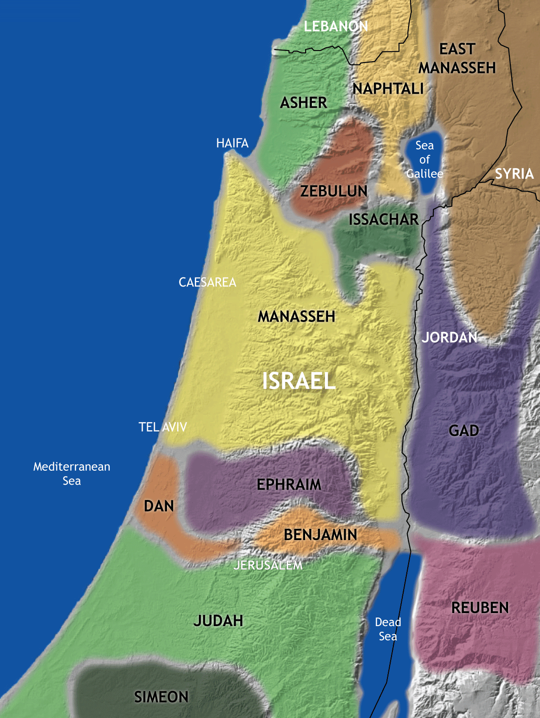
The Epistle of James
*James is the first of the seven “general Epistles” included in the New Testament—the others being 1 and 2 Peter; 1, 2, and 3 John; and Jude.
*James’ audience was to the scattered 12 Tribes and we assume it was written in Jerusalem.
*Written probably before A.D 62. But maybe before A.D. 50. Which would mean that this letter was one of the earliest in the New Testament.
* In Josephus it is recorded that James and some others were taken before the Sanhedrin, sentenced to death, and delivered to be stoned.
(1)

Slide 4
Seeking Eternal Life
Faith Tested or Tried
Patience Produced
Sanctification and spiritual development
Patience
And again, be patient in tribulation until I come; and, behold, I come quickly, and my reward is with me, and they who have sought me early shall find rest to their souls. Even so. Amen.
D&C 54:10
James 1:2-4

Slide 5
Seeking Wisdom
My mind at times was greatly excited, the cry and tumult were so great and incessant. The Presbyterians were most decided against the Baptists and Methodists, and used all the powers of both reason and sophistry to prove their errors, or, at least, to make the people think they were in error. On the other hand, the Baptists and Methodists in their turn were equally zealous in endeavoring to establish their own tenets and disprove all others.
In the midst of this war of words and tumult of opinions, I often said to myself: What is to be done? Who of all these parties are right; or, are they all wrong together? If any one of them be right, which is it, and how shall I know it?
Joseph Smith—History 1:9-10

Slide 6
Doctrinal Mastery
If any of you lack wisdom, let him ask of God, that giveth to all men liberally, and upbraideth not; and it shall be given him.
But let him ask in faith, nothing wavering. For he that wavereth is like a wave of the sea driven with the wind and tossed.
James 1:5-6

Slide 7
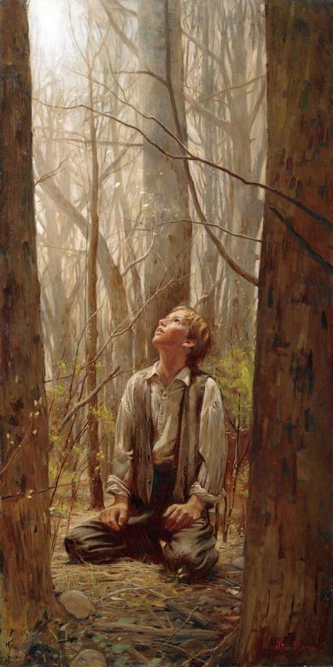
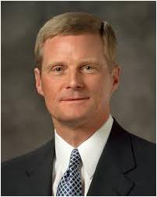
“Joseph’s questions focused not just on what he needed to know but also on what was to be done!
His prayer was not simply, ‘Which church is right?’ His question was, ‘Which church should I join?’ Joseph went to the grove to ask in faith, and he was determined to act.
“True faith is focused in and on the Lord Jesus Christ and always leads to righteous action. …
“… We press forward and persevere in the consecrated work of prayer, after we say ‘amen,’ by acting upon the things we have expressed to Heavenly Father.
“Asking in faith requires honesty, effort, commitment, and persistence.” (2)

Slide 8
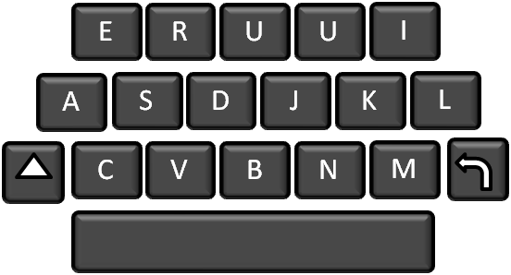
Four Steps to Obtain Personal Divine Communication
Study the scriptures daily, with an emphasis upon the Book of Mormon and the modern scriptures.
Be obedient to it
Pray Daily
Listen for the divine answer.
God generously gives wisdom to those who ask of Him in faith
(3)

Slide 9
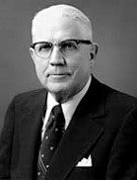
Double Minded
Wavering in loyalty and commitment to the Lord
"James pointed out that 'a double minded man is unstable in all his ways‘.
There are also some triple-minded and quadruple-minded individuals-people who have not tuned out enough of their distractions.
The secret of success is to limit the scope, narrow the vision, and concentrate the effort with a finer focus on a single objective.”
James 1:8
(4)

Slide 10
Resisting Temptations
While God is known to test the faith of His children He is not the source of temptation.
James taught that temptations do not come from God but from the devil, who attempts to draw us away from righteousness by enticing us to do evil.
The Greek verbs from which “drawn away” and “enticed” are translated refer to the traps and bait used when hunting and fishing
James 1:12-21
(1)

Slide 11
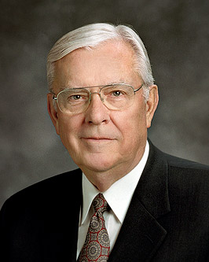
“The use of artificial lures to fool and catch a fish is an example of the way Lucifer often tempts, deceives, and tries to ensnare us.
“Like the fly fisherman who knows that trout are driven by hunger, Lucifer knows our ‘hunger,’ or weaknesses, and tempts us with counterfeit lures which, if taken, can cause us to be yanked from the stream of life into his unmerciful influence.”
James 1:12-21
(5)

Slide 12
Temptations Today
Inappropriate viewings on the internet
Illegal drug use
Immorality
Indecent Entertainment
We show our love for the Lord by resisting temptation, which is one of the requirements for receiving the crown of eternal life
James 1:12-21

Slide 13
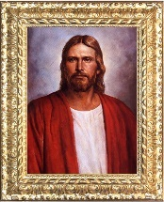
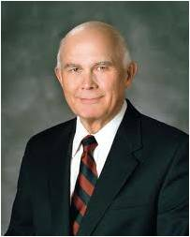
Hearers But Not Doers
James taught readers that it is not sufficient to hear the word of God; the Lord expects us to act upon gospel truths.
As we hear and act on the word of God, He will bless us in our deeds
“It is not enough to know that God lives, that Jesus Christ is our Savior, and that the gospel is true. We must take the high road by acting upon that knowledge.”
(6)
James 1:23-24
(1)

Slide 14
How fully do I believe the truths I am learning in the scriptures, at home, at church, and at seminary?
How often do I set spiritual goals to act on the truths I am learning?
How often do I achieve them?
How often do I forget them?
What can I do better to be a doer of the word and not just a hearer?

Slide 15
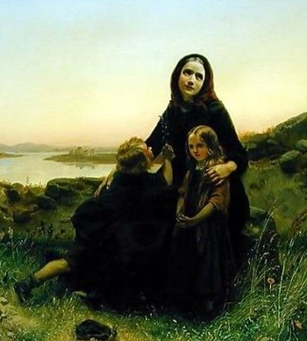
Pure Religion
James observed that caring for others, particularly widows and the fatherless, is a manifestation of “pure religion”
Carl Wilhelm Huebner
Anciently, widows and orphans were among the most underprivileged members of society and had few rights or opportunities; thus, the Lord repeatedly commanded His people to care for them and for others in great need.
James 1:26-27
(1)

Slide 16
Sources:
Suggested Hymn: #223 Have I Done Any Good?
Video:
Doers of the Word (3:01)
Michelle’s Story (5:49)
New Testament Institute Student Manual Chapter 50
Elder David A. Bednar (“Ask in Faith,” Ensign or Liahona, May 2008, 94–95).
President James E. Faust "He Restoreth My Soul," Ensign, Oct. 1997, 4
Elder Sterling W. Sill ("The Strait Gate," Ensign, July 1980, 6)
Elder M. Russell Ballard (“O That Cunning Plan of the Evil One,” Ensign or Liahona, Nov. 2010, 108).
Elder Dallin H. Oaks (“Be Not Deceived,” Ensign or Liahona, Nov. 2004, 46).
Presentation by ©http://fashionsbylynda.com/blog/

Slide 17
LETTER TO THE HEBREWS—BELIEVED WRITTEN BY PAUL, (HEBREWS)
Trials Are a Privilege—Ask God for Wisdom | 1:1–7
God Tempts No One to Do Wrong | 1:8–18
“Be Ye Doers of the Word” | 1:19–27
We Commit Sin If We Show Favoritism | 2:1–9
The Entire Law Must Be Kept | 2:10–13
“Faith Without Works Is Dead” | 2:14–26
Controlled Language Aids Perfection | 3:1–12
Envy and Strife Are of Evil | 3:13–18
The Source of War and Strife | 4:1–3
Identifying the Enemies of God | 4:4–6
Becoming a Friend of God | 4:7–12
What Is Sin? | 4:13–17
A Warning for the Wealthy | 5:1–6
Await the Lord’s Coming with Patience | 5:7–11
Elders Anoint and Heal the Sick | 5:12–20
Ask in Faith James 1:5-6:
“This single verse of scripture has had a greater impact and a more far reaching effect upon mankind than any other single sentence ever recorded by any prophet in any age. It might well be said that the crowning act of the ministry of James was not his martyrdom for the testimony of Jesus, but his recitation, as guided by the Holy Ghost, of these simple words which led to the opening of the heavens in modern times.
“And it might well be added that every investigator of revealed truth stands, at some time in the course of his search, in the place where Joseph Smith stood. He must turn to the Almighty and gain wisdom from God by revelation if he is to gain a place on that strait and narrow path which leads to eternal life” Elder Bruce R. McConkie (Doctrinal New Testament Commentary, 3:246–47).
Temptation James 1:13:
"'God made me that way,' some say, as they rationalize and excuse themselves for their perversions. 'I can't help it,' they add. This is blasphemy. Is man not made in the image of God, and does he think God to be 'that way'? Man is responsible for his own sins. It is possible that he may rationalize and excuse himself until the groove is so deep that he cannot get out without great difficulty, but he can resist, he can change. Temptations come to all people. The difference between the reprobate and the worthy person is generally that one yielded and the other resisted. It is true that one's background may make the decision and accomplishment easier or more difficult, but if one is mentally alert, he can still control his future. That is the gospel message-personal responsibility." (President Kimball Speaks Out [Salt Lake City: Deseret Book Co., 1981], 12.)
Drawn out James 1:14:
"As James describes man being influenced by his own lusts, he chooses two words that are vivid and descriptive of how Satan works upon men. The first word, translated as drawn out, was used in hunting and was the word which described what the hunter did when he lured wild game out of the safety of the thick brush into an area set with snares. And the word entice came from fishing and meant 'to bait, or to catch with bait.' How apt is the description, for the lusts of the flesh are designed to lure us out from the true safety of protective righteousness to become the victim of the evil hunter or fisherman." (Institute Manual, The Life and Teachings of Jesus & his Apostles, 2nd ed., p. 408)
Life and Teachings of Jesus and His Apostles Chapter 49

Slide 18
Doers and Not Hearers Only James 1:23-24:
"Some tend to think that just because a few ordinances have been performed, or just because they have repented, they can relax and think they 'have it made.' This life is not one of arrival; rather it is a journey, where we are continually being given the opportunity to prove ourselves worthy of the rewards promised to those whose efforts have been characterized with steadfastness, hope, faith, and love throughout life to the very last moment of this existence." Robert E. Wells (The Mount and the Master [Salt Lake City: Deseret Book Co., 1991], 204.)
Caring for Others James 1:26-27:
This may be interpreted as meaning that a person who is religious is thoughtful to the unfortunate, and has an inner spirit that prompts to deeds of kindness and to the leading of a blameless life; who is just, truthful; who does not, as Paul says, think more highly of himself than he ought to think; who is affectionate, patient in tribulation, diligent, cheerful, fervent in spirit, hospitable, merciful; and who abhors evil and cleaves to that which is good. The possession of such a spirit and feeling is a true sign that a person is naturally religious.
The Church's outward ordinances and requirements are but necessary-yet they are necessary-aids to the inner spiritual life. The Church itself, the organization, meetings, ordinances, requirements, are only helps, but very necessary helps, to the practice of true religion." (Gospel Doctrine: Selections from the Sermons and Writings of Joseph F. Smith, compiled by John A. Widtsoe [Salt Lake City: Deseret Book Co., 1939], 121.)
“The term widows is used 34 times in the scriptures. In 23 of these passages, the term refers to widows and the fatherless. I believe the Lord has a tender feeling toward widows and the fatherless, or orphans. He knows that they may have to rely more completely on Him than on others. …
“To the family and friends of widows, God knows of your service and He may judge your works by how well you assist the widow. …
“… I know that the leaders of the Church are concerned about the welfare of widows. We members should care for and assist the widows within our family, home, ward, and neighborhood” Elder Earl C. Tingey (“The Widows of Zion,” Ensign, May 2000, 62–63).

