Slide 1
Lesson 142
Be careful with your words.
Once they are said, they can be only forgiven, not forgotten.
Watch Your Tongue
James 3

Slide 2
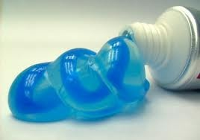
Words
How hard would it be to get the toothpaste back in the tube?
Wa Wa Wa Wa Wa
Imagine the toothpaste represents the words we say…
James 2:1-4

Slide 3
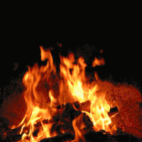
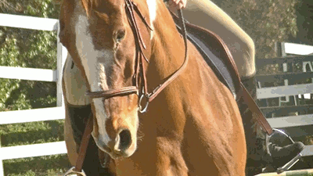
Symbolism
James 3:2
James 3:3
James 3:5-6
James 3:7-8
As we learn to control our speech, we can learn to control the rest of our actions
James 2:1-4

Slide 4
“Obviously James doesn’t mean our tongues are always iniquitous, nor that everything we say is ‘full of deadly poison.’ But he clearly means that at least some things we say can be destructive, even venomous—and that is a chilling indictment for a Latter-day Saint!
The voice that bears profound testimony, utters fervent prayer, and sings the hymns of Zion can be the same voice that berates and criticizes, embarrasses and demeans, inflicts pain and destroys the spirit of oneself and of others in the process. …
James 3:2-10
(2)
James 2:1-4

Slide 5
Husbands…
“Husbands, you have been entrusted with the most sacred gift God can give you—a wife, a daughter of God, the mother of your children who has voluntarily given herself to you for love and joyful companionship.
Think of the kind things you said when you were courting, think of the blessings you have given with hands placed lovingly upon her head, … and then reflect on other moments characterized by cold, caustic, unbridled words.
… A husband who would never dream of striking his wife physically can break, if not her bones, then certainly her heart by the brutality of thoughtless or unkind speech. …
James 3:2-10
(2)
James 2:1-4

Slide 6
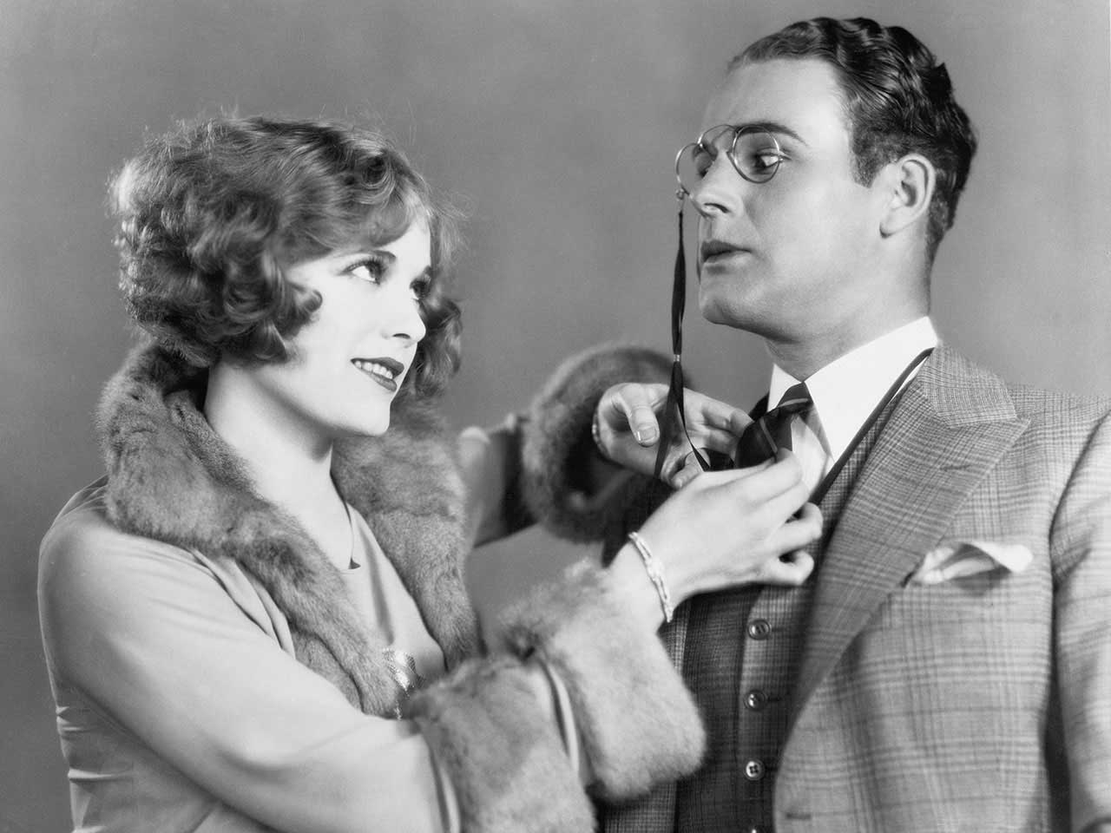
Wives…
“… Wives, what of the unbridled tongue in your mouth, of the power for good or ill in your words?
How is it that such a lovely voice … could ever in a turn be so shrill, so biting, so acrid and untamed?
A woman’s words can be more piercing than any dagger ever forged, and they can drive the people they love to retreat beyond a barrier more distant than anyone in the beginning of that exchange could ever have imagined.”
James 3:2-10
(2)
James 2:1-4

Slide 7
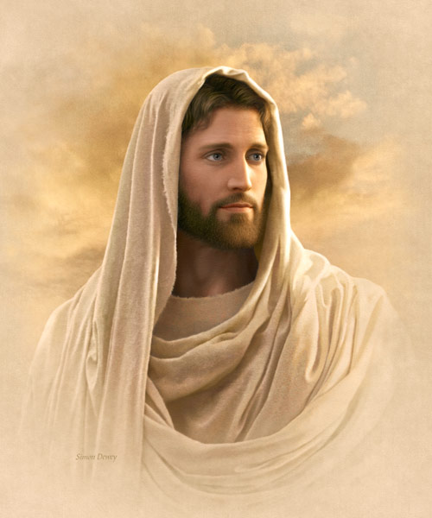
Communicating With Others
“How you communicate should reflect who you are as a son or daughter of God. Clean and intelligent language is evidence of a bright and wholesome mind. …
“Always use the names of God and Jesus Christ with reverence and respect. Misusing the names of Deity is a sin. …
James 3:2-10
Simon Dewey
(3)
James 2:1-4

Slide 8
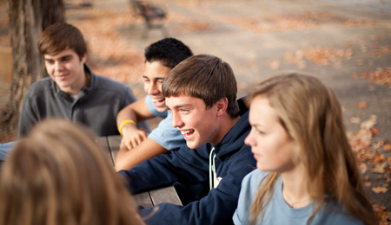
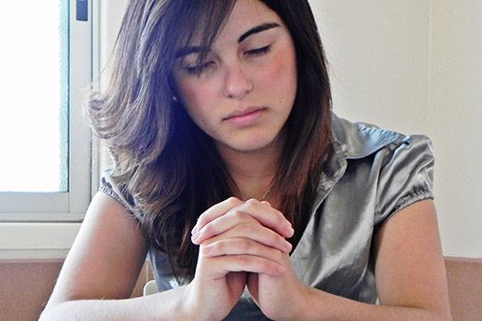
Communicating With Others
“If you have developed the habit of using language that is not in keeping with these standards—such as swearing, mocking, gossiping, or speaking in anger to others—you can change.
Pray for help. Ask your family and friends to support you in your desire to use good language.”
Followers of God strive to use their language for righteous purposes, not to spread evil
James 3:2-10
(3)
James 2:1-4

Slide 9
Sources:
Suggested Hymn: #232 Let Us Oft Speak Kind Words
Video:
The Tongue Is a Fire (2:29)
New Testament Institute Student Manual Chapter 50
Elder Jeffrey R. Holland (“The Tongue of Angels,” Ensign or Liahona, May 2007, 16–17)
For the Strength of Youth [booklet, 2011], 20–21).

Slide 10
LETTER TO THE HEBREWS—BELIEVED WRITTEN BY PAUL, (HEBREWS)
Trials Are a Privilege—Ask God for Wisdom | 1:1–7
God Tempts No One to Do Wrong | 1:8–18
“Be Ye Doers of the Word” | 1:19–27
We Commit Sin If We Show Favoritism | 2:1–9
The Entire Law Must Be Kept | 2:10–13
“Faith Without Works Is Dead” | 2:14–26
Controlled Language Aids Perfection | 3:1–12
Envy and Strife Are of Evil | 3:13–18
The Source of War and Strife | 4:1–3
Identifying the Enemies of God | 4:4–6
Becoming a Friend of God | 4:7–12
What Is Sin? | 4:13–17
A Warning for the Wealthy | 5:1–6
Await the Lord’s Coming with Patience | 5:7–11
Elders Anoint and Heal the Sick | 5:12–20
Positive Speech James 3:2:
“I suppose it goes without saying that negative speaking so often flows from negative thinking, including negative thinking about ourselves. We see our own faults, we speak—or at least think—critically of ourselves, and before long that is how we see everyone and everything. No sunshine, no roses, no promise of hope or happiness. Before long we and everybody around us are miserable.
“… We should honor the Savior’s declaration to ‘be of good cheer’ [Matthew 14:27; Mark 6:50 John 16:33. (Indeed, it seems to me we may be more guilty of breaking that commandment than almost any other!) Speak hopefully. Speak encouragingly, including about yourself. Try not to complain and moan incessantly” (Elder Jeffrey R. Holland “The Tongue of Angels,” Ensign or Liahona, May 2007, 17–18).
“Our words and external expressions are not neutral, for they reflect both who we are and shape who we are becoming. …
“What we say and how we present ourselves not only betray our inner person but also mold that person, those around us, and finally our whole society. Every day each of us is implicated in obscuring the light or in chasing away the darkness. We have been called to invite the light and to be a light, to sanctify ourselves and edify others. …
“When we speak and act, we should ask whether our words and expressions are calculated to invite the powers of heaven into our lives and to invite all to come unto Christ. We must treat sacred things with reverence. We need to eliminate from our conversations the immodest and the lewd, the violent and the threatening, the demeaning and the false. As the Apostle Peter wrote, ‘But as he which hath called you is holy, so be ye holy in all manner of conversation’ (1 Pet. 1:15). The expression conversation refers here not only to speech but also to our entire comportment.” Elder Robert S. Woods (“The Tongue of Angels,” Ensign, Nov. 1999, 83, 84).
Life and Teachings of Jesus and His Apostles Chapter 49

