Slide 1
Lesson 143
Anointing
James 4 and 5
…Fill thine horn with oil, and go…” 1 Samuel 16:1

Slide 2
Enmity
Hostility or hatred
To be a friend of the world
This does not mean we should avoid associating with individuals who are not members of the Church.
Rather, we should avoid embracing the false teachings and unrighteous desires, standards, and practices of the world.
James 4:4
(1)

Slide 3
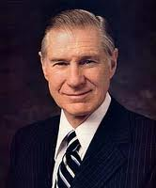
Someone once said, "If you come to a fork in the road, take it."
But it doesn't work that way.
The Savior said, "No man can serve two masters: for either he will hate the one, and love the other; or else he will hold to the one, and despise the other. Ye cannot serve God and mammon."
Today many of us are trying to serve two masters-the Lord and our own selfish interests-without offending the devil. The influence of God, our Eternal Father, urges us, pleads us, and inspires us to follow him. In contrast the power of Satan urges us to disbelieve and disregard God's commandments.”
James 4:4
(2)

Slide 4
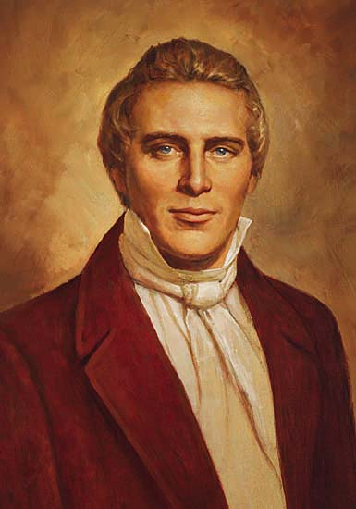
Resisting
He (the devil) can have no power over us unless we permit it. He is really a coward, and if we stand firm, he will retreat.
And because of the righteousness of his people, Satan has no power; wherefore, he cannot be loosed for the space of many years; for he hath no power over the hearts of the people, for they dwell in righteousness, and the Holy One of Israel reigneth. 1 Nephi 22:26
“All beings who have bodies have power over those who have not. The devil has no power over us only as we permit him. The moment we revolt at anything which comes from God, the devil takes power." He also stated, "Wicked spirits have their bounds, limits, and laws by which they are governed." So Satan and his angels are not all-powerful. ”
James 4:6-8
(2)

Slide 5
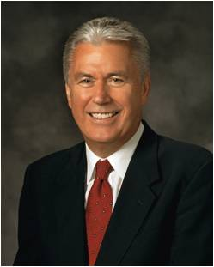
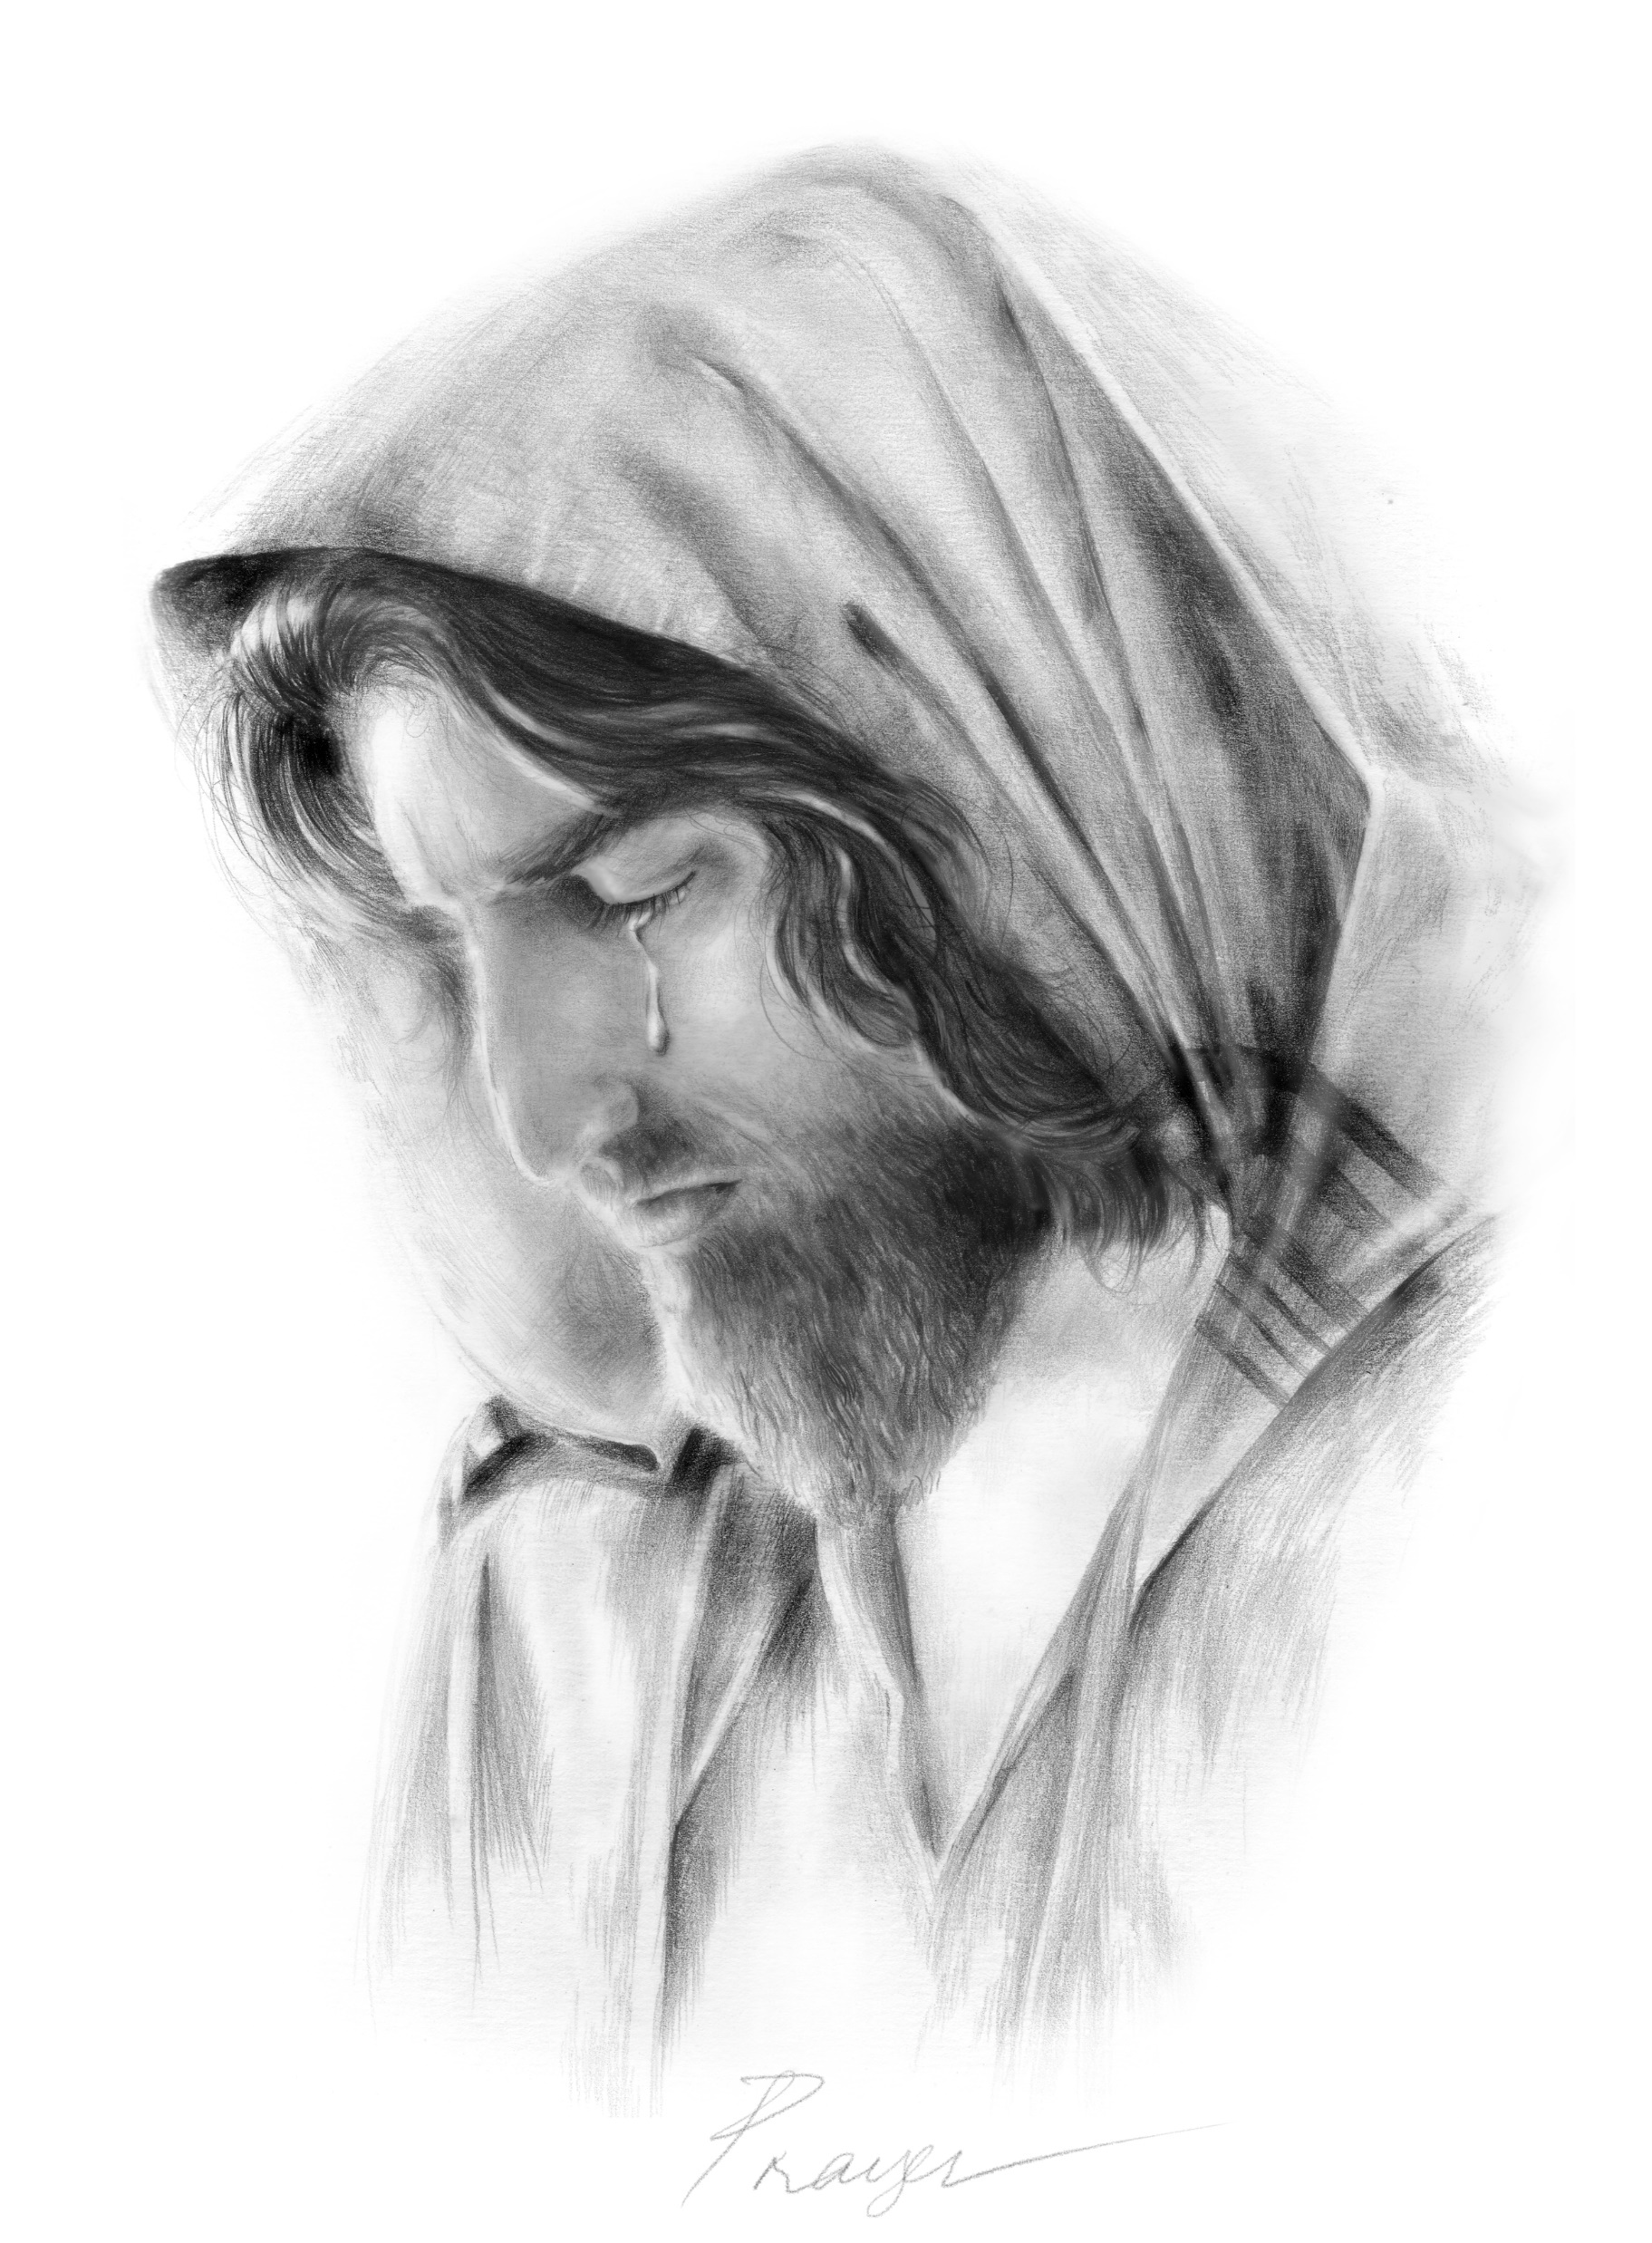
Draw Near to God
Cleanse your hands and purify your hearts
“Lift up your soul in prayer and explain to your Heavenly Father what you are feeling.
Acknowledge your shortcomings.
Pour out your heart and express your gratitude. Let Him know of the trials you are facing.
Plead with Him in Christ’s name for strength and support.
Ask that your ears may be opened, that you may hear His voice.
Ask that your eyes may be opened, that you may see His light.
Kathy Berry
James 4:8
(3)

Slide 6
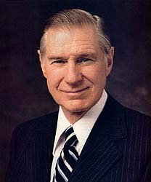
Laughter Turned To Morning
Having Godly Sorrow for Sins
If we know to do good but choose not to do it, we commit sin
“I fear that some of our greatest sins are sins of omission. These are some of the weightier matters of the law the Savior said we should not leave undone. These are the thoughtful, caring deeds we fail to do and feel so guilty for having neglected them. (2)
James 4:9,17; Matthew 23:23

Slide 7
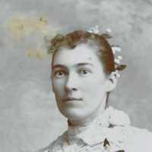
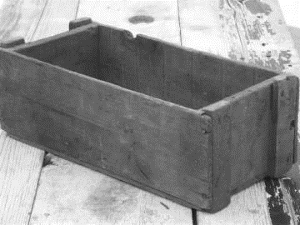
“As a small boy on the farm during the searing heat of the summer, I remember my grandmother Mary Finlinson cooking our delicious meals on a hot woodstove.
When the wood box next to the stove became empty, Grandmother would silently pick up the box, go out to refill it from the pile of cedar wood outside, and bring the heavily laden box back into the house.
I was so insensitive and interested in the conversation in the kitchen, I sat there and let my beloved grandmother refill the kitchen wood box.
I feel ashamed of myself and have regretted my omission for all of my life. I hope someday to ask for her forgiveness.”
Mary Caroline Roper Finlinson
(2)

Slide 8
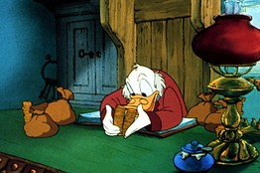
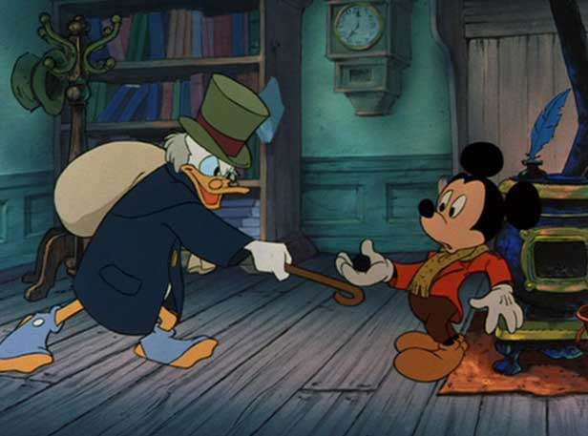
Pride Accompanies Wealth
A warning to the Rich
3 areas of concern
Failing to pay wages to employees
Hoarding Wealth = Accumulating so much material wealth that it sets unused and decaying
Living a luxurious and self-indulgent lifestyle
James 5:2-4
(1)

Slide 9
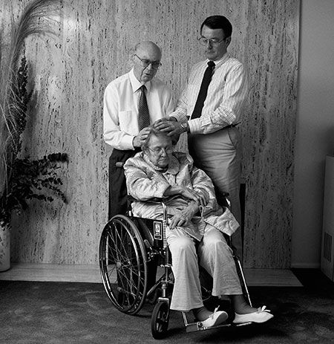
The Sick and Afflicted
“When someone has been anointed by the authority of the Melchizedek Priesthood, the anointing is sealed by that same authority.
To seal something means to affirm it, to make it binding for its intended purpose.
When elders anoint a sick person and seal the anointing, they open the windows of heaven for the Lord to pour forth the blessing He wills for the person afflicted.
James 5:13-16
(1)

Slide 10
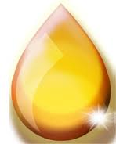
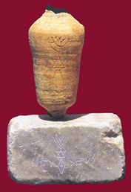
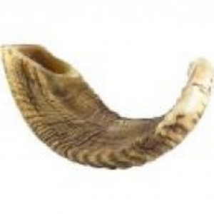
Anciently Anointing was done for both secular and sacred reasons
(4)

Slide 11
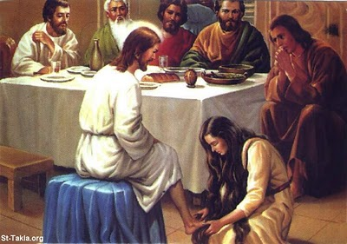
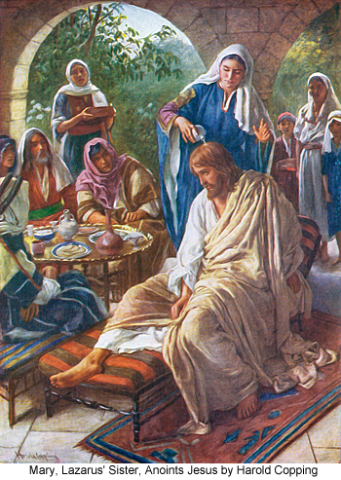
A sign of Hospitality (Luke 7:46)
When one entered a home the custom was to wash the feet, and pour oil on them.
Also to pour oil on the head because of the harshness of the weather.
(Matthew 26:7)
(4)

Slide 12
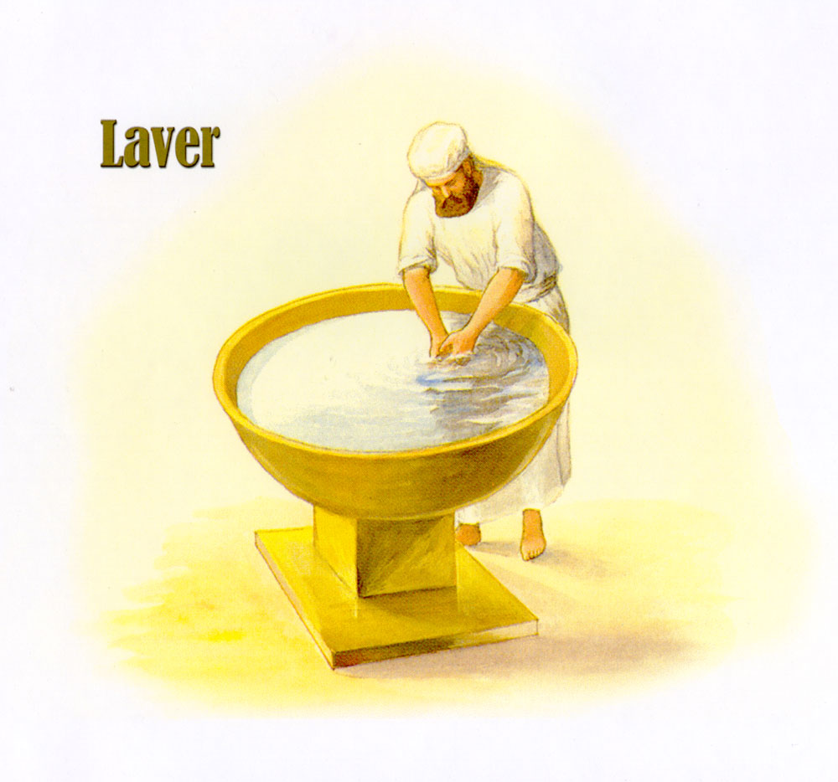
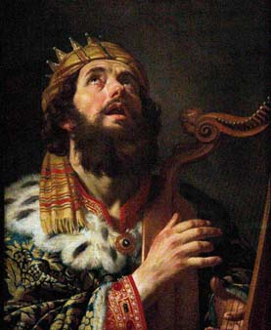
Anointing was also used in personal grooming
(2 Samuel 12:20)
(4)

Slide 13
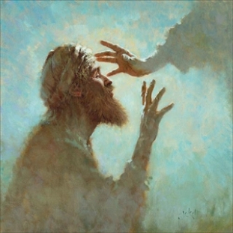
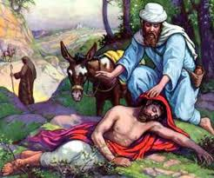
The maimed or sick were anointed with wine, oil, and/or ointment as medicine
Isaiah 1:6
Luke 10:34
Rev 3:18
(4)

Slide 14
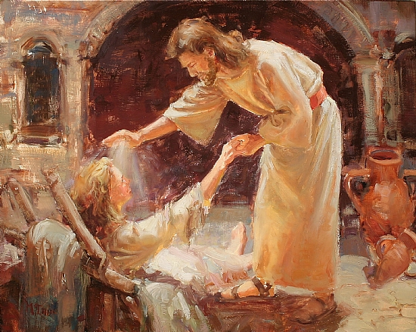
The sick were also anointed with oil as part of the sacred procedure in healing of the sick by faith and the laying on of hands
Mark 6:13
James 5:14-15
(4)

Slide 15
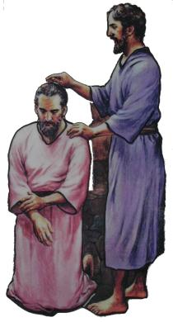
Kings were anointed to their office by the prophets.
1 Samuel 10:1
2 Samuel 5:3
(4)

Slide 16
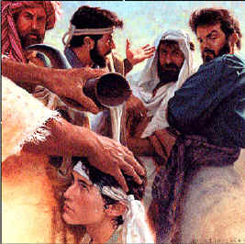
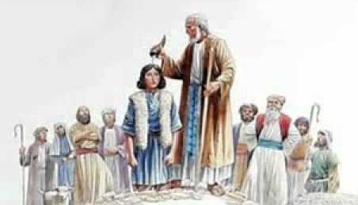
The Lord told Samuel to go to Jesse, who was the father of David, and anoint one of his sons to be king…
”fill thine horn with oil, and go”
1 Samuel 16: 1, 3 , 13
(4)

Slide 17
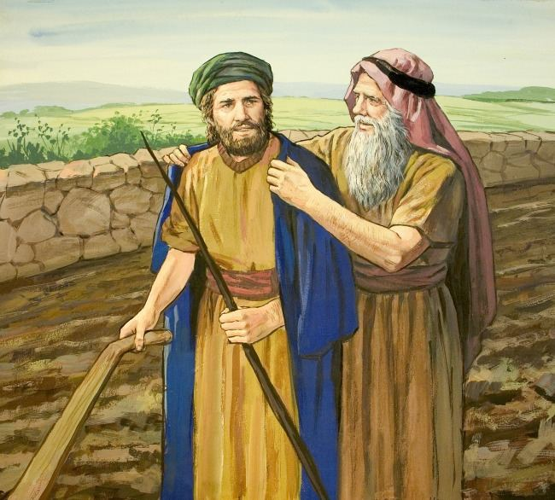
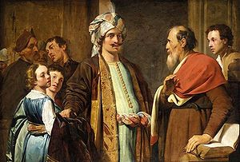
Elisha was to be anointed by the prophet Elijah
1 Kings 19:16
(4)

Slide 18
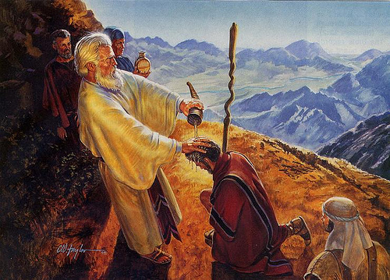
Moses anoints Aaron and his sons and consecrated before all Israel (Leviticus 8)
(4)

Slide 19
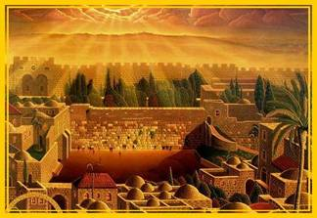
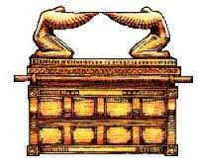
“And Moses took the anointing oil, and anointed the tabernacle and all that was therein, and sanctified them.”
“And he sprinkled thereof upon the altar seven times, and anointed the altar and all his vessels, both the laver and his foot, to sanctify them.”
(4)

Slide 20
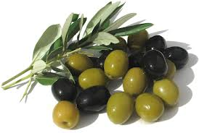
The Holy anointing oil used in the law of Moses was composed of olive oil mixed with spices and was to be restricted in use to certain specified ceremonies
(Ex. 30:22-33)
Myrrh
Cinnamon
Calamus
Cassia
Olive oil
(4)

Slide 21
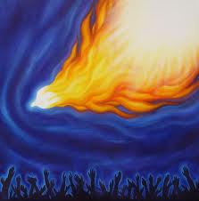
Paul and John Speak of Anointing of the Spirit
(4)

Slide 22
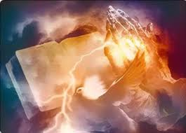
1 John 2:27
“…the anointing which ye have received of him abideth in you, and ye need not that any man teach you…
…but as the same anointing teacheth you of all things, and is truth, and is no lie, and even as it hath taught you, ye shall abide in him.”
(4)

Slide 23
2 Corinthians 1:21-22
“Now he which stablisheth us with you in Christ, and hath anointed us, is God;
Who hath also sealed us, and given the earnest of the Spirit in our hearts.
(4)

Slide 24
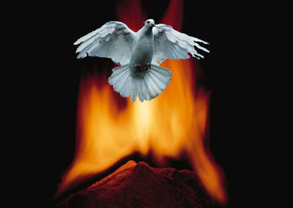
And Peter says that “God anointed Jesus of Nazareth with the Holy Ghost and with power” (Acts 10:38)
(4)

Slide 25
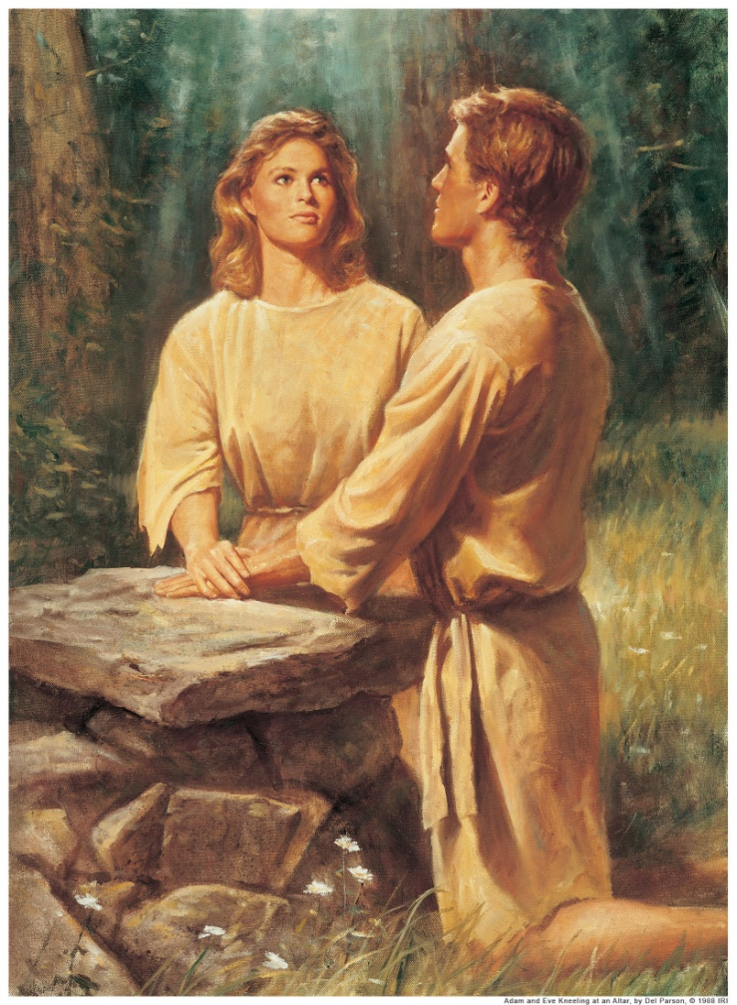
Although the scriptures do not specifically so state, we may confidently assume that anointing with oil has been part of true, revealed religion ever since the gospel was first introduced on this earth to Adam
(4)

Slide 26
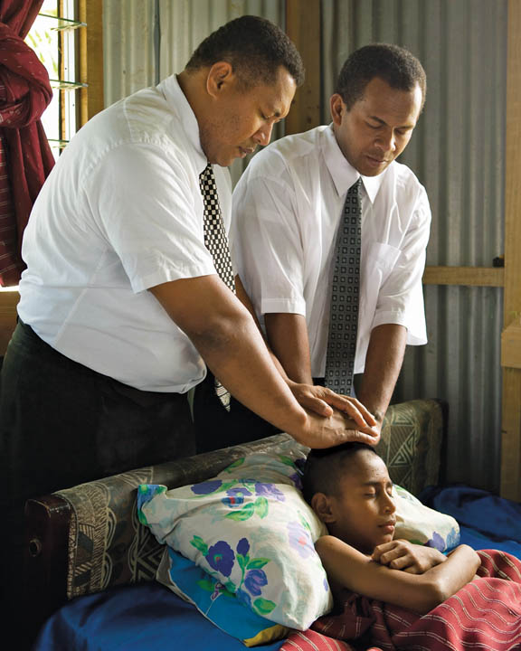
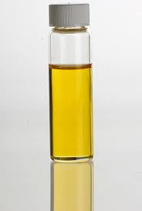
In the Church today holy consecrated olive oil is used in anointing a person in various sacred ceremonies, including administration to the sick…
(4)

Slide 27
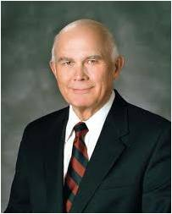
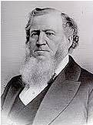
“When elders anoint a sick person and seal the anointing, they open the windows of heaven for the Lord to pour forth the blessing He wills for the person afflicted.” (5)
Through the prayer of faith and the power of the priesthood, the sick can be healed
“Faith is essential for healing by the powers of heaven.” (5)
‘When I lay hands on the sick, I expect the healing power and influence of God to pass through me to the patient, and the disease to give way. … When we are prepared, when we are holy vessels before the Lord, a stream of power from the Almighty can pass through the tabernacle of the administrator to the system of the patient, and the sick are made whole.’” (6)

Slide 28
“The kind of humility and faith required for us to be healed physically is the same kind of humility and faith required for us to receive forgiveness.”
(7)

Slide 29
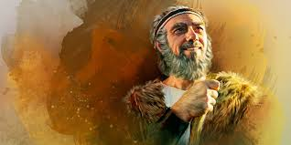
Elijah—An Example
James referred to the prophet Elijah as an example of someone who used the power of fervent prayer.
He also counseled
the Saints to help
sinners repent.
James 5:17-20

Slide 30
Sources:
Suggested Hymn: #101 Guide Me to Thee
Video:
The Weightier Matters of the Law: Judgment, Mercy, and Faith (1:51)
Sanctify Yourselves (4:38)
New Testament Institute Student Manual Chapter 50
President James E. Faust ("Serving the Lord and Resisting the Devil," Ensign, Sept. 1995, 2); (“The Weightier Matters of the Law: Judgment, Mercy, and Faith” Ensign, Nov. 1997, 59).
President Dieter F. Uchtdor The Hope of God’s Light April 2013 Gen. Conf.
Anointing slides Bible Dictionary—Anointing of priests is outlined in Exodus 40:15 and high priest (Aaronic order) in Lev. 21:10
Elder Dallin H. Oaks (“Healing the Sick,” Ensign or Liahona, May 2010, 48).
President Brigham Young [Teachings of Presidents of the Church: Brigham Young (1997), 252].
Elder Bruce R. McConkie, Mormon Doctrine, 2nd ed. [1966], 297–98)
Presentation by ©http://fashionsbylynda.com/blog/

Slide 31
LETTER TO THE HEBREWS—BELIEVED WRITTEN BY PAUL, (HEBREWS)
Trials Are a Privilege—Ask God for Wisdom | 1:1–7
God Tempts No One to Do Wrong | 1:8–18
“Be Ye Doers of the Word” | 1:19–27
We Commit Sin If We Show Favoritism | 2:1–9
The Entire Law Must Be Kept | 2:10–13
“Faith Without Works Is Dead” | 2:14–26
Controlled Language Aids Perfection | 3:1–12
Envy and Strife Are of Evil | 3:13–18
The Source of War and Strife | 4:1–3
Identifying the Enemies of God | 4:4–6
Becoming a Friend of God | 4:7–12
What Is Sin? | 4:13–17
A Warning for the Wealthy | 5:1–6
Await the Lord’s Coming with Patience | 5:7–11
Elders Anoint and Heal the Sick | 5:12–20
Sins of Omission James 4:9:
“I fear that some of our greatest sins are sins of omission. These are some of the weightier matters of the law the Savior said we should not leave undone [see Matthew 23:23]. These are the thoughtful, caring deeds we fail to do and feel so guilty for having neglected them.
“As a small boy on the farm during the searing heat of the summer, I remember my grandmother Mary Finlinson cooking our delicious meals on a hot woodstove. When the wood box next to the stove became empty, Grandmother would silently pick up the box, go out to refill it from the pile of cedar wood outside, and bring the heavily laden box back into the house. I was so insensitive and interested in the conversation in the kitchen, I sat there and let my beloved grandmother refill the kitchen wood box. I feel ashamed of myself and have regretted my omission for all of my life. I hope someday to ask for her forgiveness.” President James E. Faust (“The Weightier Matters of the Law: Judgment, Mercy, and Faith,” Ensign, Nov. 1997, 59).
Sick and Afflicted James 5:15:
“As we exercise the undoubted power of the priesthood of God and as we treasure His promise that He will hear and answer the prayer of faith, we must always remember that faith and the healing power of the priesthood cannot produce a result contrary to the will of Him whose priesthood it is. …
“… Even the servants of the Lord, exercising His divine power in a circumstance where there is sufficient faith to be healed, cannot give a priesthood blessing that will cause a person to be healed if that healing is not the will of the Lord.
“As children of God, knowing of His great love and His ultimate knowledge of what is best for our eternal welfare, we trust in Him. The first principle of the gospel is faith in the Lord Jesus Christ, and faith means trust. … I felt that same trust in the words of the father of [a] choice girl whose life was taken by cancer in her teen years. He declared, ‘Our family’s faith is in Jesus Christ and is not dependent on outcomes.’ Those teachings ring true to me. We do all that we can for the healing of a loved one, and then we trust in the Lord for the outcome” Elder Dallin H. Oaks (“Healing the Sick,” 50).
Elder Bruce R. McConkie stated that “the person who by faith, devotion, righteousness, and personal worthiness, is in a position to be healed, is also in a position to have the justifying approval of the Spirit for his course of life, and his sins are forgiven him, as witnessed by the fact that he receives the companionship of the Spirit, which he could not have if he were unworthy” (Mormon Doctrine, 2nd ed. [1966], 297–98).
Life and Teachings of Jesus and His Apostles Chapter 49

