Slide 1
Lesson 144
Faithfully Endure
1 Peter 1-2
Behold, I am the law, and the light. Look unto me, and endure to the end, and ye shall live; for unto him that endureth to the end will I give eternal life.
3 Nephi 15:9

Slide 2
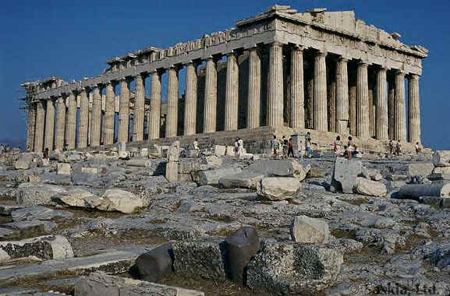
Roman Government
The Roman Government displayed a general tolerance for all religions, including Christianity.
The Church was under a divine commission to preach the gospel unto “all the world” and began circulating in the Roman Empire.
The messages was not a favorite message to the Roman monarchs.

Slide 3
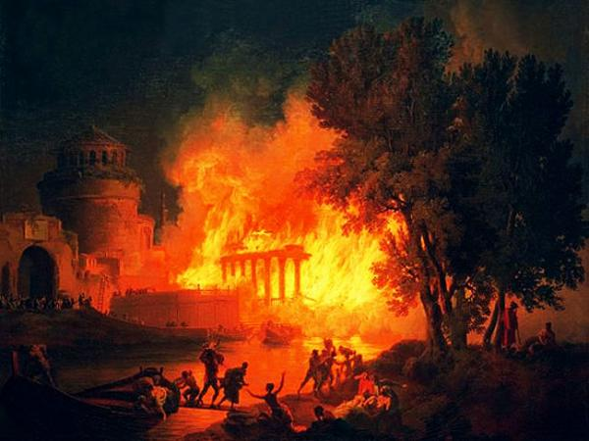
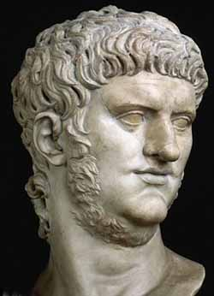
Fire in Rome
In A.D 64 a fire destroyed much of Rome.
An accusing (Nero) finger was pointed at the Christians and the Saints were persecuted.
Peter wrote from “Babylon” which probably means Rome.

Slide 4
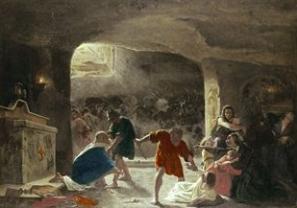
Heightened Persecution
It was rumored that Emperor Nero himself ordered the fire to be started in order to put the blame on the Christians living in Rome.
Intense persecution began to take place in the Provinces of Rome.
Peter exhorted the Saints to turn to one another in love and tenderness and that the Church leaders needed to strengthen their congregations.

Slide 5
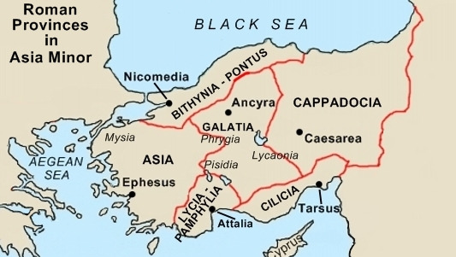
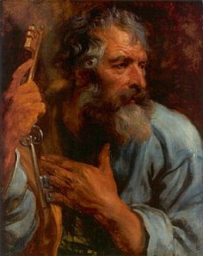
1 Peter
Peter writes this epistle to the Church members living in the 5 roman provinces of Asia Minor located in modern-day Turkey.
Peter considers his readers to be the “Elect” of God.
1 Peter 1:1-2

Slide 6
Peter
He was the brother of Andrew and son of Jonah. He is also known as Simon or Simeon.
He was the chief apostle of the Church
He held the priesthood keys of the kingdom on the earth
He held a position similar to that of the President of The Church of Jesus Christ of Latter-day Saints in our day.
Peter mentioned that Silvanus had served as a scribe.
Silvanus, also known as Silas, had previously served as both a scribe and a mission companion to Paul
Peter addressed this epistle to Church members “scattered throughout Pontus, Galatia, Cappadocia, Asia, and Bithynia”—the five Roman provinces in Asia Minor
In the latter days Peter, with James and John, came from heaven and literally conferred the Melchizedek Priesthood and the keys thereof upon Joseph Smith and Oliver Cowdery. This took place in May or June 1829, near Harmony, Pennsylvania.

Slide 7
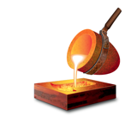
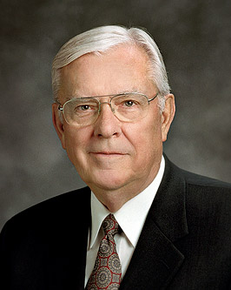
Crucible
A crucible is a container in which metals or other substances are refined, which means they are heated and melted in order to remove impurities and strengthen the final product.
“As I travel throughout the Church, I see members being tried in the crucible of affliction.” (2)
What does he mean?
The challenging trials or adversities of life.

Slide 8
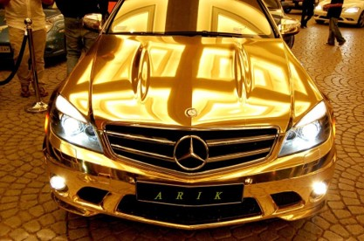
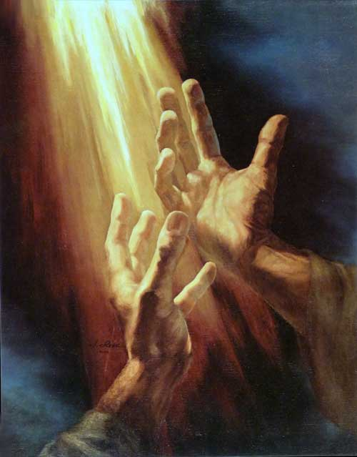
More Precious Than Gold
“That the trial of your faith, being much more precious than gold that perisheth, though it be tried with fire, might be found unto praise and honour and glory at the appearing of Jesus Christ”
“Yet if any man suffer as a Christian, let him not be ashamed; but let him glorify God on this behalf.”
1 Peter 1:7 1 Peter 4:16
1 Peter 1:7

Slide 9
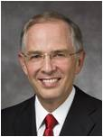
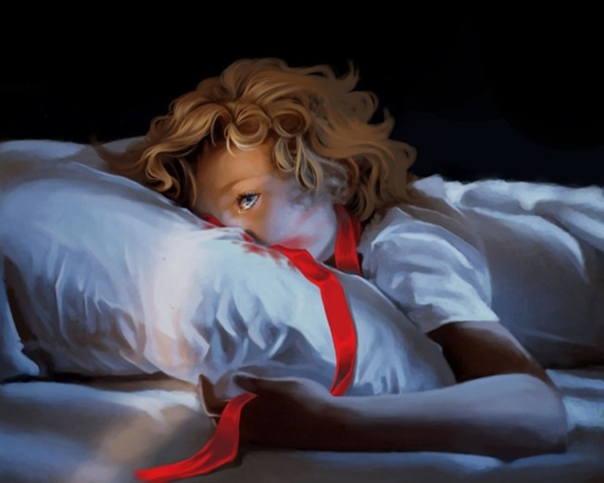
“These fiery trials are designed to make you stronger, but they have the potential to diminish or even destroy your trust in the Son of God and to weaken your resolve to keep your promises to Him.
“How do you remain ‘steadfast and immovable’ during a trial of faith? You immerse yourself in the very things that helped build your core of faith: you exercise faith in Christ, you pray, you ponder the scriptures, you repent, you keep the commandments, and you serve others.
1 Peter 1:7 1 Peter 4:16
1 Peter 1:7

Slide 10
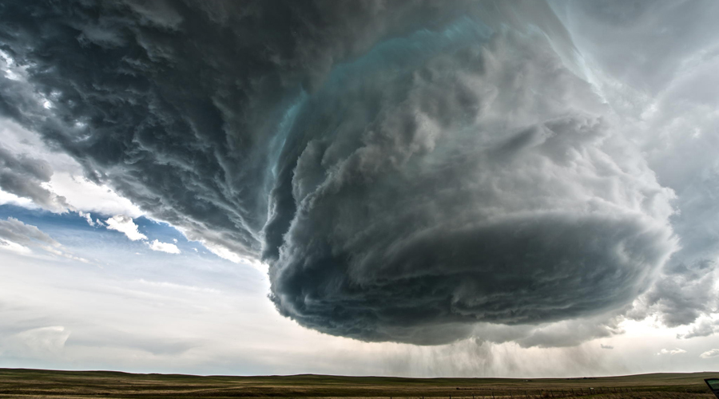
“When faced with a trial of faith—whatever you do, you don’t step away from the Church!
Distancing yourself from the kingdom of God during a trial of faith is like leaving the safety of a secure storm cellar just as the tornado comes into view.”
1 Peter 1:7 1 Peter 4:16
1 Peter 1:7

Slide 11
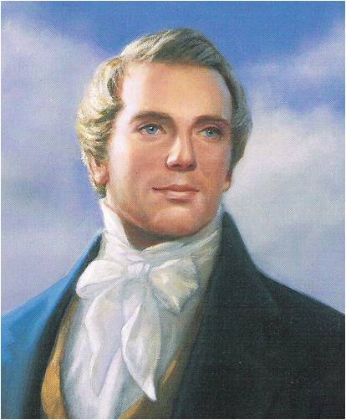
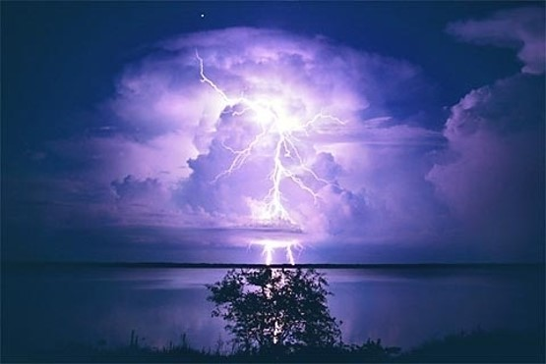
Support
“Though the thunders might roll and lightnings flash, and earthquakes bellow, and war gather thick around, yet this hope and knowledge would support the soul in every hour of trial, trouble and tribulation.”
(4)

Slide 12
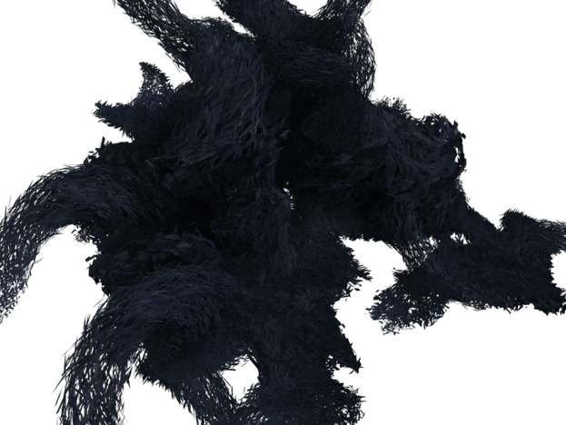
Vulnerable
These trials can take root in our weaknesses, our vulnerabilities, our sensitivities, or in those things that matter most to us.”
(3)
Although we experience trials, we can rejoice in Jesus Christ’s Atonement and in the future blessings God has promised to give us.

Slide 13
Enduring to the End—The Goal
…Hope having seen not…
…yet believing.
Receiving the end of your faith…
…salvation
Ether 12:4
1 Peter 1:8-9

Slide 14
Above all, taking the shield of faith, wherewith ye shall be able to quench all the fiery darts of the wicked.
Ephesians 6:16
Failing a test
Chastity issues
Someone tells false lies about you
Unexpected death of a loved one
Problems at home
Testing Our Faith
v
v
v
v

Slide 15
Increasing our faith will provide us with a hope that anchors us to God as we endure the trials of Life.
Except and deal with it
Go through steps to fix it
Talk to a person
Understanding the eternal Plan of Salvation
Prayer and follow counsel of the Prophets
Enduring
Enduring With Faith

Slide 16
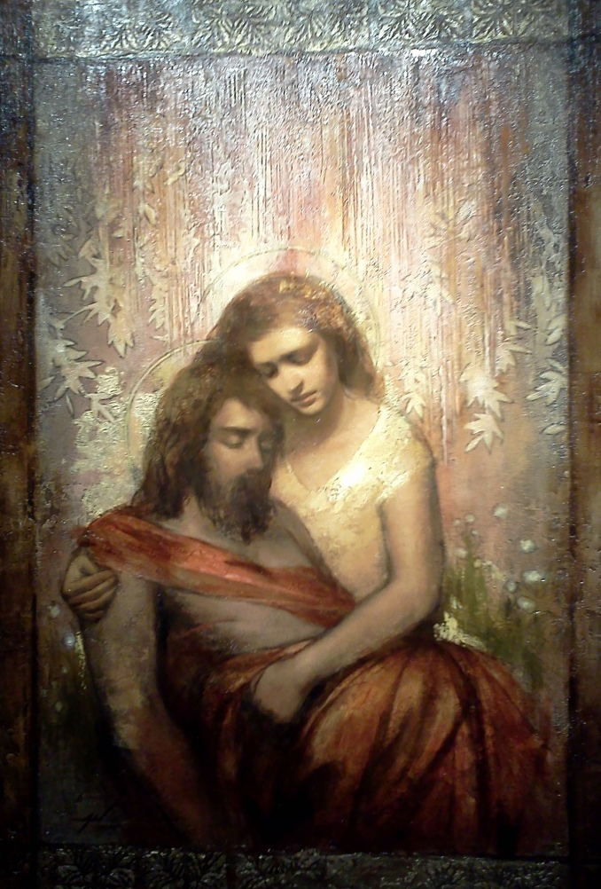
Redeemed Through Jesus Christ
“For it is better, if the will of God be so, that ye suffer for well doing, than for evil doing.”
1 Peter 3:17
We are redeemed through the precious blood of Jesus Christ. Because Jesus Christ lived a sinless life, He could offer Himself as a perfect sacrifice for us.
Jesus Christ was foreordained to be our Redeemer.
Annie Henrie Nadar
1 Peter 13-14

Slide 17
Love One Another
Peter encouraged the Saints to love one another and to remember that they had been born again by embracing the word of God, which endures forever.
1 Peter 1:22-25

Slide 18
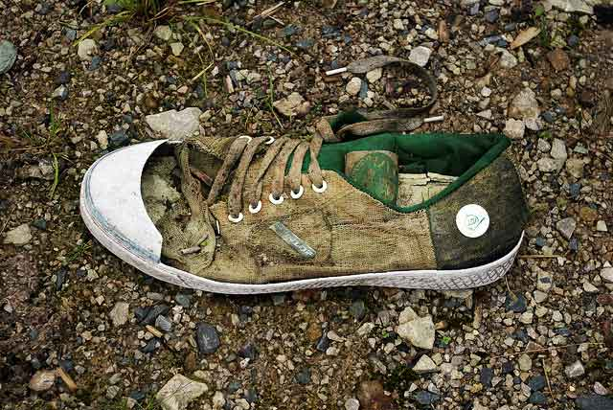
All Flesh is as Grass
The voice said, Cry. And he said, What shall I cry? All flesh is grass, and all the goodliness thereof is as the flower of the field:
The grass withereth, the flower fadeth: because the spirit of the Lord bloweth upon it: surely the people is grass.
The grass withereth, the flower fadeth: but the word of our God shall stand for ever.
Isaiah 40:6-8
A man’s frailties to the withering of vegetation in the hot desert wind.
Unlike the withering grass, the word of the Lord “abideth for ever”; it gives life and strength to all who embrace it and are born again.
1 Peter 1:23-25

Slide 19
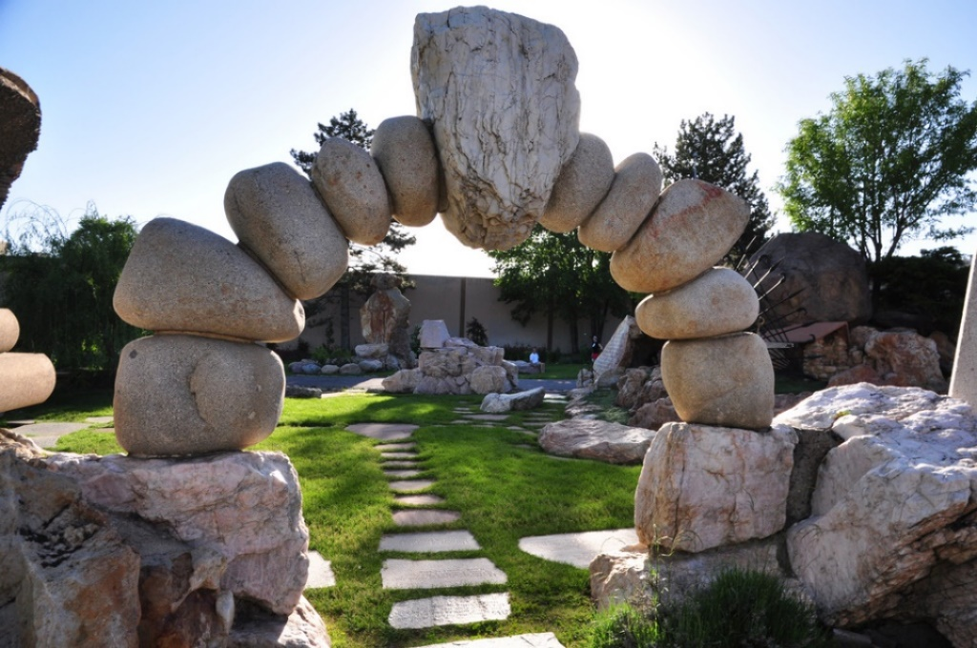
Living Stones
Lay Aside Past Sins
Peter taught that when the Saints come unto Jesus Christ, who is the “living stone,” they become a “lively stone” that is added to the building of God’s spiritual house.
Peter also called Christ the “chief corner stone,” emphasizing that the house is built upon the resurrected Jesus Christ.
Gilgal Sculpture Garden in Salt Lake City, Utah
1 Peter 2:1-5

Slide 20
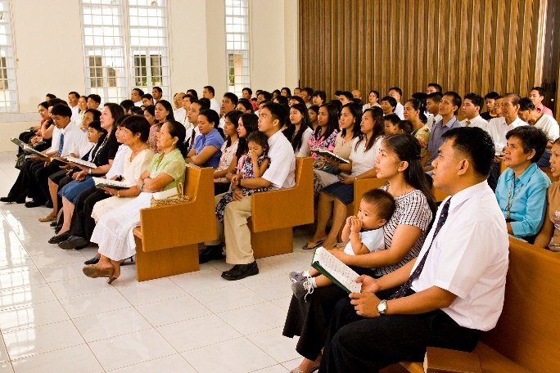
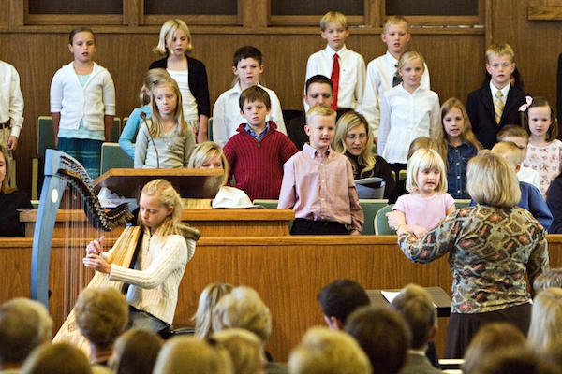
A Peculiar People
A Chosen Generation
A Royal Priesthood
A Holy Nation
Peter’s message was that by embracing the gospel, gentile converts had become part of God’s chosen people, the new Israel.
1 Peter 2:9-10

Slide 21
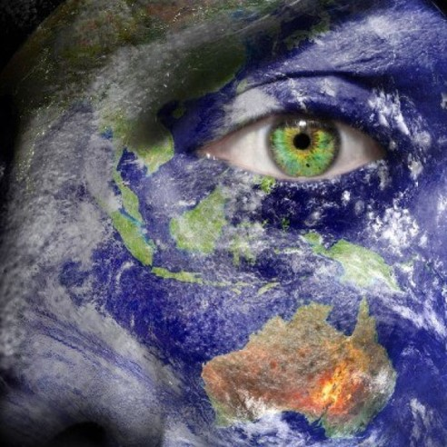
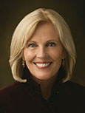
God calls His Saints to be separate and distinct from the world so that others can see their example and glorify Him
“If you desire to make a difference in the world, you must be different from the world.”
1 Peter 2:11-12
(5)

Slide 22
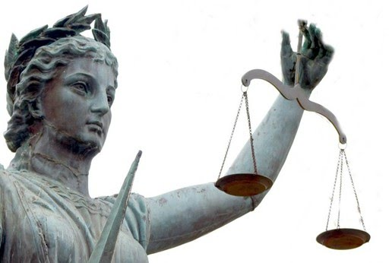
Submit to Civil Laws
Peter taught the Saints to submit themselves to the laws and civil authorities that governed them (including the Roman emperor who promoted persecution against them.)
Let no man break the laws of the land, for he that keepeth the laws of God hath no need to break the laws of the land.
Wherefore, be subject to the powers that be, until he reigns whose right it is to reign, and subdues all enemies under his feet. D&C 58:21-22
He encouraged those who suffered hardship as servants to bear their suffering with patience and to remember that God was aware of them.
1 Peter 2:13-25

Slide 23
Sources:
Suggested Hymn: #128 When Faith Endures
Videos:
The Refiner's Fire (5:02)
Unto All the World: Despoina's Story (3:12)
New Testament Institute Student Manual Chapter 51
Elder M. Russell Ballard (“Hyrum Smith: ‘Firm As the Pillars of Heaven,’” Ensign, Nov. 1995, 9).
Elder Neil L. Anderson (“Trial of Your Faith,” Ensign or Liahona, Nov. 2012, 39–40).
Joseph Smith “Teachings of the Prophet Joseph Smith Pg. 298
Sister Elaine S. Dalton,(“Now Is the Time to Arise and Shine!” Ensign or Liahona, May 2012, 124).
Presentation by ©http://fashionsbylynda.com/blog/

Slide 24
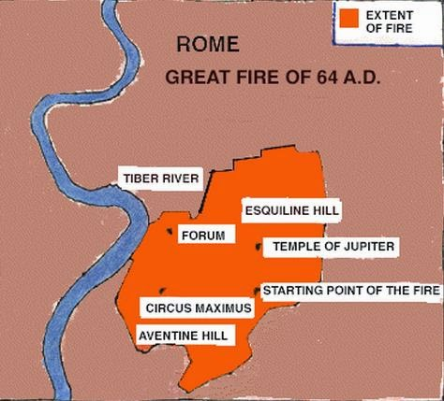
THE FIRST LETTER OF PETER TO SAINTS IN FIVE PROVINCES APPARENTLY WRITTEN FROM ROME, CA. A.D. 62–64 (1 PETER)
Salvation Comes by Faith in Christ | 1:1–16
Christ Was Foreordained to Be the Redeemer | 1:17–21
Converts Experience a New Birth in Christ | 1:22–25; 2:1–3
Christ, the Cornerstone for a Holy Nation | 2:4–10
The Obligation of Christians Towards Gentiles | 2:11, 12
Saints to Accept Civil Authority | 2:13–25
Husbands and Wives Should Honor Each Other | 3:1–7
“Be Followers of That Which Is Good” | 3:8–17
Christ Preached the Gospel to Spirits in Prison | 3:18–22; 4:1–6
“Speak as an Oracle of God” | 4:7–11
Saints to Be Tried in All Things | 4:12–19
Elders to Feed the Flock of God | 5:1–4
God Refuses the Proud and Favors the Humble | 5:5–14
Roman Fire:
During the night of July 18, 64 AD, fire broke out in the merchant area of the city of Rome. Fanned by summer winds, the flames quickly spread through the dry, wooden structures of the Imperial City. Soon the fire took on a life of its own consuming all in its path for six days and seven nights. When the conflagration finally ran its course it left seventy percent of the city in smoldering ruins. From the ashes of the fire rose a more spectacular Rome. A city made of marble and stone with wide streets, pedestrian arcades and ample supplies of water to quell any future blaze. The debris from the fire was used to fill the malaria-ridden marshes that had plagued the city for generations.
J.P. Ronan
Trial of Your Faith 1 Peter 1:7:
"Imagine yourself as a living house. God comes in to rebuild that house. At first, perhaps, you can understand what He is doing. He is getting the drains right and stopping the leaks in the roof and so on: you knew that those jobs needed doing and so you are not surprised. But presently he starts knocking the house about in a way that hurts abominably and does not seem to make sense. What on earth is He up to? The explanation is that He is building quite a different house from the one you thought of-throwing out a new wing here, putting on an extra floor there, running up towers, making courtyards. You thought you were going to be made into a decent little cottage: but He is building a palace. ..." (C. S. Lewis, New York: The Macmillan Company, 1952, p. 160.)
Life and Teachings of Jesus and His Apostles Chapter
Gird Up Your Loins of Your Mind 1 Peter 1:13:
Think clean thoughts. Those who think clean thoughts do not do filthy deeds. You are responsible before God not only for your acts but also for controlling your thoughts. So live that you would not blush with shame if your thoughts and acts should be flashed on a screen in your chapel. The old adage is still true that you sow thoughts and you reap acts, you sow acts and you reap habits, you sow habits and you reap a character, and your character determines your eternal destiny. "As [a man] thinketh in his heart, so is he" (Proverbs 23:7). (The Teachings of Ezra Taft Benson [Salt Lake City: Bookcraft, 1988], 445 - 446.)

Slide 25
A Peculiar People 1 Peter 2:9-10:
“In the Old Testament, the Hebrew term from which peculiar was translated is segullah, which means ‘valued property,’ or ‘treasure.’ In the New Testament, the Greek term from which peculiar was translated is peripoiesis, which means ‘possession,’ or ‘an obtaining.’
“Thus, we see that the scriptural term peculiar signifies ‘valued treasure,’ ‘made’ or ‘selected by God.’ For us to be identified by servants of the Lord as his peculiar people is a compliment of the highest order.” Elder Russell M. Nelson (“Children of the Covenant,” Ensign, May 1995, 34).
Submit to Civil Law 1 Peter 2: 20-23:
Peter specifically addressed household servants, who in the Roman Empire were almost always slaves and were often mistreated by their masters. He taught about the difference between suffering for one’s faults and enduring undeserved punishment (see 1 Peter 2:20). Peter encouraged servants to learn from the example of Jesus Christ, who was falsely accused before Jewish and Roman leaders and yet did not retaliate (see 1 Peter 2:23). The Greek word Peter used that was translated as buffeted (1 Peter 2:20) literally means “to be struck with fists” and is the term used by both Matthew and Mark to describe the treatment of the Master.
Peter hinted at the contemptuous scorn of the Jewish leaders and Christ’s silent acceptance of it (see 1 Peter 2:23). Peter mentioned the stripes the Lord received, using the word which means “bruise” or the “bloody welt which results from lashing with a whip,” which is exactly the result of a Roman scourging (see Isaiah 53:5–12). (1)
Elder Alexander B. Morrison taught: “Peter, the great apostle, who himself suffered a martyr’s death (see John 21:18–19), recognized that divine merit is associated with patient suffering for Christ’s sake but that little glory accrues to us if we suffer for our own sins. [1 Peter 2:19–20.] As we endure undeserved suffering, we develop Christlike attributes that perfect our souls and bring us closer to Him” (Feed My Sheep: Leadership Ideas for Latter-day Shepherds [1992], 166).
A Royal Priesthood 1 Peter 2:9:
"As bearers of the priesthood, we have been placed on earth in troubled times. We live in a complex world with currents of conflict everywhere to be found. Political machinations ruin the stability of nations, despots grasp for power, and segments of society seem forever downtrodden, deprived of opportunity and left with a feeling of failure.
"We who have been ordained to the priesthood of God can make a difference. When we qualify for the help of the Lord, we can build boys, we can mend men, we can accomplish miracles in His holy service. Our opportunities are without limit.
"Though the task looms large, we are strengthened by the truth: 'The greatest force in this world today is the power of God as it works through man.' If we are on the Lord's errand, we are entitled to the Lord's help. That divine help, however, is predicated upon our worthiness. To sail safely the seas of mortality, to perform a human rescue mission, we need the guidance of that eternal mariner-even the great Jehovah. We reach out, we reach up, to obtain heavenly help." President Thomas S. Monson ("You Make a Difference," Ensign, May 1988, 41)

Slide 26
1 Peter and Isaiah
1 Peter 2:21-26 | Isaiah 53
v. 21 'Christ also suffered for us' | v. 4 'Surely he hath borne our griefs, and carried our sorrows'
v. 22 'Who did no sin, neither was guile found in his mouth' | v. 9 'he had done no violence, neither was any deceit in his mouth'
v. 23 'Who, when he was reviled, reviled not again' | v. 7 'He was oppressed, and he was afflicted, yet he opened not his mouth'
v. 24 'who his own self bare our sins' | v. 12 'and he bare the sin of many'
v. 24 'by whose stripes ye were healed' | v. 5 'and with his stripes we are healed'
v. 25 'For ye were as sheep going astray' | v. 6 'All we like sheep have gone astray'

