Slide 1
Lesson 145
Be Ready To Testify
1 Peter 3-5
Our father Lehi was driven out of Jerusalem because he testified of these things. Nephi also testified of these things, and also almost all of our fathers, even down to this time; yea, they have testified of the coming of Christ, and have looked forward, and have rejoiced in his day which is to come.
Helaman 8:22

Slide 2
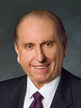
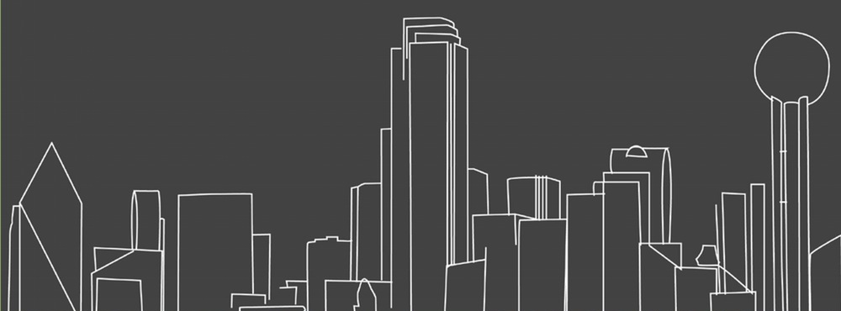
An Opportunity
“We will have opportunities throughout our lives to share our beliefs, although we don’t always know when we will be called upon to do so.
“Such an opportunity came to me in 1957, when I worked in the publishing business and was asked to go to Dallas, Texas, [USA,] sometimes called ‘the city of churches,’ to address a business convention.”
(2)

Slide 3
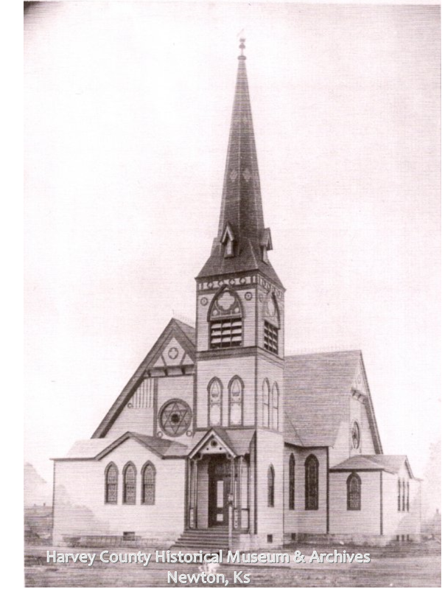
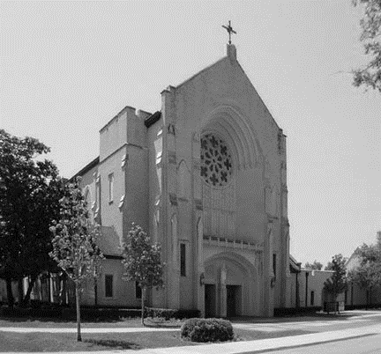
“Following the conclusion of the convention, I took a sightseeing bus ride through the city’s suburbs.
As we passed the various churches, our driver would comment, ‘On the left you see the Methodist church’ or ‘There on the right is the Catholic cathedral.’
(2)

Slide 4
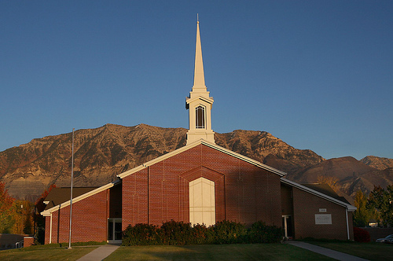
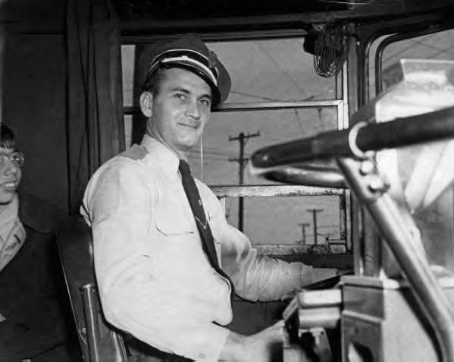
“As we passed a beautiful red brick building situated upon a hill, the driver exclaimed, ‘That building is where the Mormons meet.’ A lady in the rear of the bus called out, ‘Driver, can you tell us something more about the Mormons?’
“The driver pulled the bus over to the side of the road, turned around in his seat, and replied, ‘Lady, all I know about the Mormons is that they meet in that red brick building. Is there anyone on this bus who knows anything more about the Mormons?’”
(2)

Slide 5
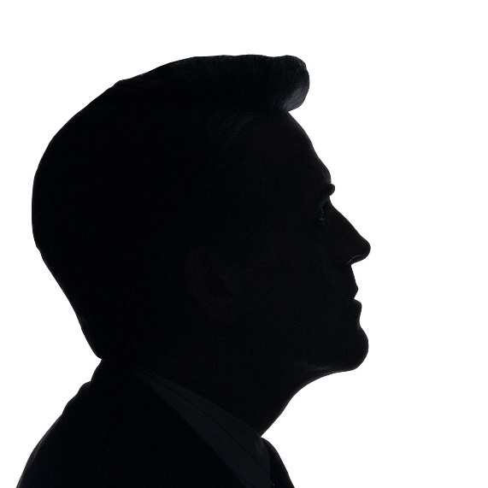
Household Codes
He counseled husbands to honor their wives.
He also counseled members to live according to gospel standards.
Wives are to help bring unbelieving husbands to Christ through their righteous conduct.
1 Peter 3:1-11

Slide 6
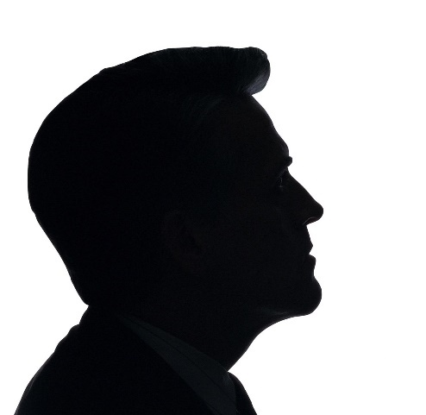
Heirs Together
In the true Patriarchal Order man holds the priesthood and is the head of the household of faith, but he cannot attain a fulness of joy here or of eternal reward hereafter alone. Woman stands at his side a joint-inheritor with him in the fulness of all things.
Exaltation and eternal increase is her lot as well as his.
Godhood is not for men only; it is for men and women together.
1 Peter 3:7; D&C 131:1-4; 132:19-20
(3)

Slide 7
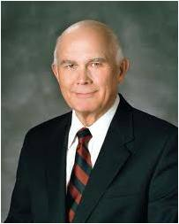
Be Ready To Give An Answer
The Savior taught us to love all as our brothers and sisters, and we honor that teaching by sharing the witness and message of the restored gospel “among all nations, kindreds, tongues, and people.”
As followers of Jesus Christ, we should strive to always be ready to share and defend our beliefs with meekness and reverence
1 Peter 3:15; D&C 112:1
(3)

Slide 8
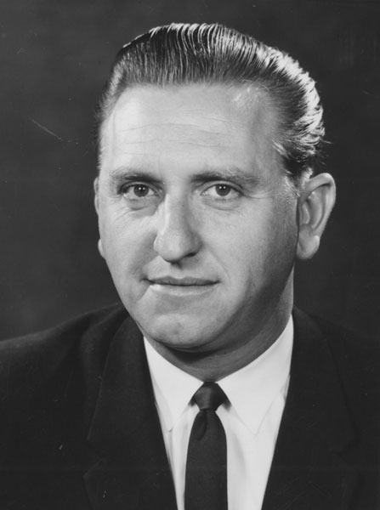
An Opportunity (Continues)
“I waited for someone to respond. I gazed at the expression on each person’s face for some sign of recognition, some desire to comment. Nothing. I realized it was up to me to do as the Apostle Peter suggested, to ‘be ready always to give an answer to every man that asketh you a reason of the hope that is in you.’ I also realized the truth of the adage ‘When the time for decision arrives, the time for preparation is past.’
“For the next 15 or so minutes, I had the privilege of sharing with those on the bus my testimony concerning the Church and our beliefs. I was grateful for my testimony and grateful that I was prepared to share it”
(2)

Slide 9
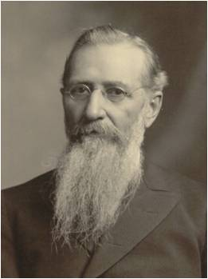
The Spirit World
Jesus went to preach in the Spirit World between his death and Resurrection
President Joseph F. Smith was wondering how the Savior could perform such a work in such a short time.
The answer was that the Lord didn't go in person to preach to all those spirits but "organized his forces and appointed messengers".
The spirits in prison were not worthy of a direct visitation of the Lord.
The resurrected Lord never appeared to the wicked.
He only appeared to the righteous Jewish saints as a resurrected being. Similarly, the wicked Nephites were destroyed before he could openly minister on that continent.
Read D&C 138:28-30
1 Peter 3:18-20; 4:6

Slide 10
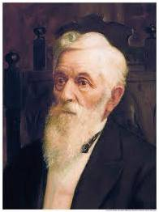
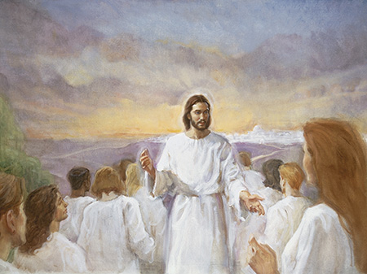
Teaching in Spirit Prison
Those in the spirit world who did not accept the gospel or have the opportunity to hear it while in mortality.
“When the Gospel is preached to the spirits in prison, the success attending that preaching will be far greater than that attending the preaching of our Elders in this life.
I believe there will be very few indeed of those spirits who will not gladly receive the Gospel when it is carried to them.
The circumstances there will be a thousand times more favorable.”
D. Keith Larson
1 Peter 3:19
(5)

Slide 11
Doctrinal Mastery
1 Peter 4:6
For for this cause was the gospel preached also to them that are dead, that they might be judged according to men in the flesh, but live according to God in the spirit.
(5)

Slide 12
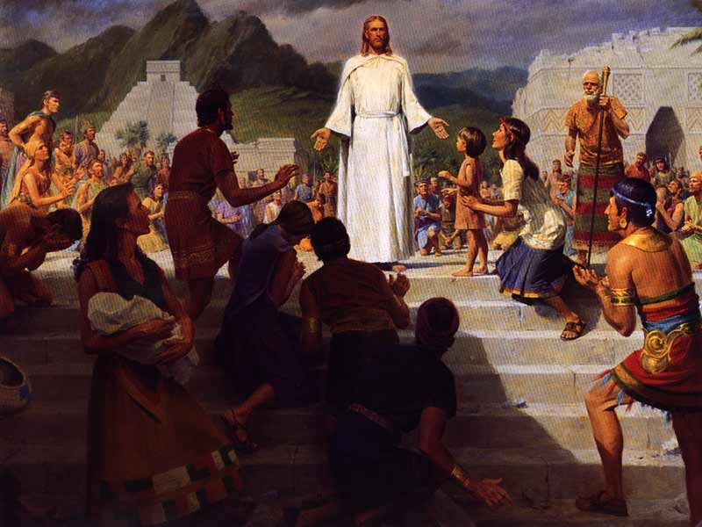
Doctrine of Salvation
The Savior’s preaching to the spirits in prison is an example of God’s fairness and justice. This doctrine of salvation for the dead makes it possible for all mankind to accept the gospel even though they may never have heard it in mortality. The doctrine of salvation for the dead is unique to Latter-day Saints. (1)
“Not only did Jesus Christ organize his Church and choose missionaries to teach the gospel on earth, but he also spent three days in the spirit world, where the spirits of those who have died await the resurrection. There he organized his work so that all the dead will be able to hear the gospel fully." (6)
1 Peter 4:6
Papeete Tahiti Temple: baptismal font

Slide 13
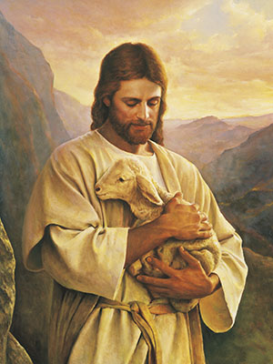
Watching Over God’s Flocks
“feed the flock of God” = to take care of and watch over the members of the Church.
Church leaders were to serve willingly and with love rather than grudgingly or out of a desire for reward.
They were to be examples to the members instead of “lords” over them.
Church leaders have the responsibility to care for and watch over God’s flock in love and by example
1 Peter 5:1-3

Slide 14
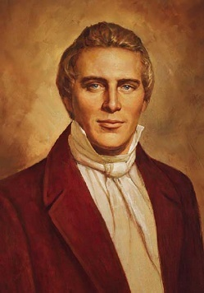
Casting Your Care Upon Him
Our only confidence can be in God; our only wisdom obtained from Him: and He alone must be our protector and safeguard, spiritually and temporally, or we fall. (7)
“We depend upon God; and in all our works and labors, and in all the success that attends us in our labors, we feel that it has been God who has wrought it.” (5)
1 Peter 5:5-19

Slide 15
Sources:
Suggested Hymn: #221 Dear to the Heart of the Shepherd
Video:
Dare to Stand Alone (1:44)
New Testament Institute Student Manual Chapter 51
President Thomas S. Monson (“Dare to Stand Alone,” Ensign or Liahona, Nov. 2011, 67).
Elder Bruce R. McConkie (Mormon Doctrine, 2d ed. [Salt Lake City: Bookcraft, 1966], 844.)
Elder Dallin H. Oaks Sharing the Restored Gospel Oct. 2016 Gen. Conf.
Lorenzo Snow(“Discourse by President Lorenzo Snow,” Millennial Star, Jan. 22, 1894, 50). (The Teachings of Lorenzo Snow, edited by Clyde J. Williams [Salt Lake City: Bookcraft, 1984], 14.)
George Lyman, "I Have a Question," Ensign, June 1988, 58)
President Joseph Smith (History of The Church of Jesus Christ of Latter-day Saints, 7 vols. 5:65)
Presentation by ©http://fashionsbylynda.com/blog/

Slide 16
THE FIRST LETTER OF PETER TO SAINTS IN FIVE PROVINCES APPARENTLY WRITTEN FROM ROME, CA. A.D. 62–64 (1 PETER))
Salvation Comes by Faith in Christ | 1:1–16
Christ Was Foreordained to Be the Redeemer | 1:17–21
Converts Experience a New Birth in Christ | 1:22–25; 2:1–3
Christ, the Cornerstone for a Holy Nation | 2:4–10
The Obligation of Christians Towards Gentiles | 2:11, 12
Saints to Accept Civil Authority | 2:13–25
Husbands and Wives Should Honor Each Other | 3:1–7
“Be Followers of That Which Is Good” | 3:8–17
Christ Preached the Gospel to Spirits in Prison | 3:18–22; 4:1–6
“Speak as an Oracle of God” | 4:7–11
Saints to Be Tried in All Things | 4:12–19
Elders to Feed the Flock of God | 5:1–4
God Refuses the Proud and Favors the Humble | 5:5–14
Household codes 1 Peter 1-11:
"The wife is to obey her husband in righteousness, which I believe includes her righteousness, for she is not to be his judge. If she attempts to be his judge and to obey whatever suits her fancy, withdrawing her support or obedience when she disagrees, or if she competes with him for leadership and direction, the patriarchal concept will be distorted. If she 'punishes him' in one way or another when he's 'off base' in her eyes, her husband could likely feel that he has atoned and no longer has to change or repent. The wife is called to love and to sustain the husband, and I believe nothing will do more to encourage and chasten him in his own stewardship than consistent acceptance, unconditional love, and steadfast sustaining. If he is absolutely unworthy, or consistently makes unrighteous demands, then she might counsel with the steward over him, the bishop, but she is not to be his judge and punisher. (quotes Ephesians 5:22-24 and 1 Peter 3:1-6)
"Children are to obey and honor their parents. Children first need examples or models to follow. They need understanding and respect; they need clear limits, well-established rules, and consistently applied discipline. They need explicit teaching and testifying; they need order, system, and regularity; they need work and responsibility and opportunities to give an accounting; they need time for fun, free expression, and good humor.
"I have come to believe from my own experience, as well as my observations of others, that children tend not to obey their parents when the father does not in truth or in deed obey the Lord, or when the wife does not in truth or in deed obey her husband, or when the parents do not have this vision of the patriarchal family concept and at least a deep commitment to their parenthood responsibility." (Stephen R. Covey, Spiritual Roots of Human Relations [Salt Lake City: Deseret Book Co., 1970], 189.)
Equal Valued Roles For Husbands and Wives 1 Peter 3: 1-11:
“In our Heavenly Father’s great priesthood-endowed plan, men have the unique responsibility to administer the priesthood, but they are not the priesthood. Men and women have different but equally valued roles. Just as a woman cannot conceive a child without a man, so a man cannot fully exercise the power of the priesthood to establish an eternal family without a woman. In other words, in the eternal perspective, both the procreative power and the priesthood power are shared by husband and wife” Elder M. Russell Ballard (“This Is My Work and Glory,” Ensign or Liahona, May 2013, 19).
Life and Teachings of Jesus and His Apostles Chapter 51

Slide 17
Preparing to teach to the wicked 1 Peter 3:18-20
“In the justice of the Father, he is going to give to every man the privilege of hearing the gospel. Not one soul shall be overlooked or forgotten. This being true, what about the countless thousands who have died and never heard of Christ, never had an opportunity of repentance and remission of their sins, never met an elder of the Church holding the authority? …
“The Lord has so arranged his plan of redemption that all who have died without this opportunity shall be given it in the spirit world. … All those who did not have an opportunity here to receive it, who there repent and receive the gospel, shall be heirs of the celestial kingdom of God. The Savior inaugurated this great work when he went and preached to the spirits held in prison, that they might be judged according to men in the flesh (or in other words, according to the principles of the gospel) and then live according to God in the spirit, through their repentance and acceptance of the mission of Jesus Christ who died for them” (Doctrines of Salvation, comp. Bruce R. McConkie, 3 vols. [1954–56], 2:132–33).
Doctrine of Salvation 1 Peter 4:6:
[The Savior] provided the opportunity whereby they might repent of their sins, change their attitudes and their lives, and live according to God in the spirit. We do not know how many millions of spirits are involved. We know that many have passed away in wars, pestilence, and in various accidents. We know that the spirit world is filled with the spirits of men who are waiting for you and me to get busy-waiting as the signers of the Declaration of Independence waited. "Why," they asked President Wilford Woodruff, "why do you keep us waiting?" That question continues to be asked of us also, by our own people.
We wonder about our progenitors-grandparents, great-grandparents, great-great-grandparents, etc. What do they think of you and me? We are their offspring. We have the responsibility to do their temple work, and the beautiful temples of the Lord stand day after day, yet we do not fill them always. We have a grave responsibility that we cannot avoid, and may stand in jeopardy if we fail to do this important work.
I hope our Saints will understand the glorious reality of it all: that as the work in our temples is done in this world, it helps to prepare us for another and better world. President Spencer W. Kimball ("The Things of Eternity-Stand We in Jeopardy?" Ensign, Jan. 1977, 5)

