Slide 1
Lesson 146
Calling Election Made Sure
2 Peter 1
(May 17th, 1843.) The more sure word of prophecy means a man’s knowing that he is sealed up unto eternal life, by revelation and the spirit of prophecy, through the power of the Holy Priesthood.
D&C 131:5

Slide 2
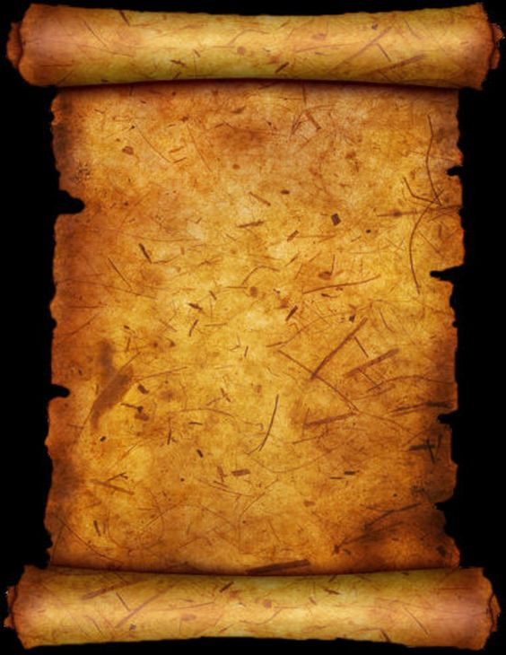
Who Wrote 2 Peter?
Church members and leaders have traditionally accepted Peter as the author.
Some modern scholars, however, have questioned whether the epistle was truly written by Peter because the style and language differ from 1 Peter, which was written with the scribal aid of Silvanus (Silas).
It may be that 2 Peter was written with the help of a different scribe, or that the epistle was put into its current form by others but contains authentic material from Peter himself.
The Second Epistle of Peter states that it was written by “Simon Peter, a servant and an apostle of Jesus Christ
Peter may have written his second epistle shortly before his death in Rome; if so, this Second Epistle of Peter is one of his last testimonies.

Slide 3
The Will Within
Our Best Selves
Obtain Faith in Jesus Christ
Stay True to Your
Testimony
2 Peter 1:1-4

Slide 4
"Those members of the Church who devote themselves wholly to righteousness, living by every word that proceedeth forth from the mouth of God, make their calling and election sure.
That is, they receive the more sure word of prophecy, which means that the Lord seals their exaltation upon them while they are yet in this life.
Peter summarized the course of righteousness which the saints must pursue to make their calling and election sure and then (referring to his experience on the Mount of Transfiguration with James and John) said that those three had received this more sure word of prophecy.”
(2)

Slide 5
Attributes
To
Develop
charity
kindness
As we develop divine attributes within ourselves, we can come to know Jesus Christ
godliness
patience
temperance
knowledge
virtue
diligence
faith
2 Peter 1:5-7

Slide 6
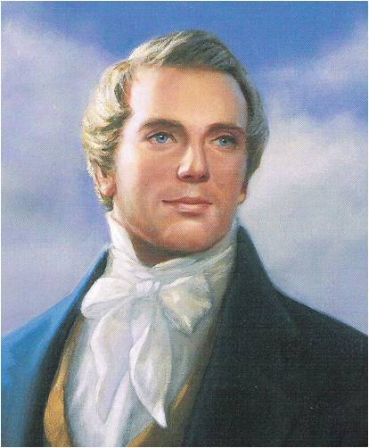
“The principle of knowledge is the principle of salvation.
This principle can be comprehended by the faithful and diligent; and every one that does not obtain knowledge sufficient to be saved will be condemned.
The principle of salvation is given us through the knowledge of Jesus Christ.”
(3)

Slide 7
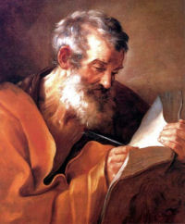
Assurance
“to make your calling and election sure” = to receive in this life God’s assurance that you will obtain eternal life.
Peter also referred to this as “a more sure word of prophecy.”
If we are diligent in developing our divine potential while in this life, we can receive God’s assurance of eternal life.
2 Peter 1:10-11

Slide 8
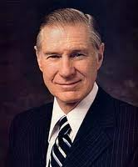
Witnesses of Jesus Christ
Prophets receive scripture through the Holy Ghost.
"Those of us who hold the holy apostleship always wish to fulfill our responsibility by testifying of the divinity of the Savior. I feel compelled to do so. I have had a testimony all of my life.
Recently, however, there has come into my soul an overpowering witness of the divinity of this holy work.
This sure witness is more certain than ever before in my life." (1997)
2 Peter 1:12-21
(3)

Slide 9
A Sure Witness
A sure witness is the Second Comforter.
Two Comforters are spoken of. The first is the Holy Ghost.
The Second Comforter is the Lord Jesus Christ Himself. “When any man obtains this last Comforter, he will have the personage of Jesus Christ to attend him, or appear unto him from time to time, and even He will manifest the Father unto him”
“I am a witness of the Resurrection of the Lord as surely as if I had been there in the evening with the two disciples in the house on Emmaus road. I know that He lives as surely as did Joseph Smith when he saw the Father and the Son in the light of a brilliant morning in a grove of trees in Palmyra.” (6)
2 Peter 1:12-21; John 14:16-27; Moroni 8:26; D&C 21:9; 42;:17; 90:11
(5)

Slide 10
Scriptures
Holy Bible
And whatsoever they shall speak when moved upon by the Holy Ghost shall be scripture, shall be the will of the Lord, shall be the mind of the Lord, shall be the word of the Lord, shall be the voice of the Lord, and the power of God unto salvation.
D&C 68:4
The
Book
of
Mormon
Doctrine
And
Covenants
ANOTHER TESTAMENT
OF JESUS CHRIST
“[Scriptures are] words, both written and spoken, by holy men of God when moved upon by the Holy Ghost.”
Some scripture has been canonized. A canon is “a recognized, authoritative collection of sacred books.
In The Church of Jesus Christ of Latter-day Saints, the canonical books are called the standard works and include the Old and New Testaments, the Book of Mormon, the Doctrine and Covenants, and the Pearl of Great Price.”
Prophets receive scripture through the Holy Ghost
(7)
2 Peter 1:20

Slide 11
Sources:
Suggested Hymn: #21 Come Listen to a Prophet’s Vioce
Video:
Christlike Attributes (2:54)
New Testament Institute Student Manual Chapter 51
Elder Bruce R. McConkie (Teachings, pp. 149-151.)" (Mormon Doctrine, 2d ed. [Salt Lake City: Bookcraft, 1966], 109.)
Prophet Joseph Smith (Teachings of Presidents of the Church: Joseph Smith [2007], 212).
President James E. Faust ("The Weightier Matters of the Law: Judgment, Mercy, and Faith," Ensign, Nov. 1997)
Bible Dictionary (Comforter)
President Henry B. Eyirng Come Unto Me April 2013 Gen. Conf.
Guide to the Scriptures (Scriptures; Canon)
Presentation by ©http://fashionsbylynda.com/blog/

Slide 12
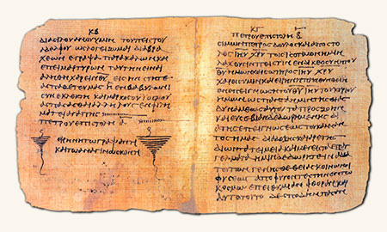
WRITTEN FROM ROME PRIOR TO A.D. 68 (2 PETER)
“Make Your Calling and Election Sure” | 1:1–19
Prophecy Comes by the Holy Ghost | 1:20, 21
False Teachers Are Damned | 2:1–9
The Fallen State of Lustful Saints | 2:10–22
Latter-day Scoffers Shall Deny the Second Coming | 3:1–10
Holy and Saintly Lives Are Prepared for the Lord | 3:11–18
To Know God 2 Peter 1:1-3:
“It is one thing to know about God and another to know him. We know about him when we learn that he is a personal being in whose image man is created; when we learn that the Son is in the express image of his Father’s person; when we learn that both the Father and the Son possess certain specified attributes and powers. But we know them, in the sense of gaining eternal life, when we enjoy and experience the same things they do. To know God is to think what he thinks, to feel what he feels, to have the power he possesses, to comprehend the truths he understands, and to do what he does. Those who know God become like him, and have his kind of life, which is eternal life” Elder Bruce R. McConkie (Doctrinal New Testament Commentary, 3 vols. [1965–73], 1:762).
What is a Sure Witness? Interview with Elder Richard G. Scott
“There are 15 men on earth who hold all of the keys of the kingdom,” Elder Richard G. Scott of the Quorum of the Twelve Apostles said in an interview recently. “And [that apostolic calling] is a constant, 24-hour-a-day … burden and privilege … each of us feels. For me, the best way [to fulfill my calling] is to bear testimony of truth, to express gratitude for that sacred privilege and honor, and to respond to what is in section 46 of the Doctrine and Covenants, where it says: ‘To some it is given by the Holy Ghost to know that Jesus Christ is the Son of God, and that he was crucified for the sins of the world.
“‘To others it is given to believe on their words, that they also might have eternal life if they continue faithful’ [verses 13–14].
“That word know is a very important word for those 15 men who are Apostles. [It expresses] the sacred experiences and the confirmation that there is a certainty that our Father in Heaven lives and that His Son, Jesus Christ, is our Savior—not a hope, not a belief, not a wish, but an absolute, confirmed certainty. . . . Our Father in Heaven is real. His Son, Jesus Christ, is real. I know that personally and bear certain witness because I know the Savior.”
A Sure Witness of Jesus Christ: Elder Richard G. Scott
Prophets and Apostles LDS.org
Life and Teachings of Jesus and His Apostles Chapter 51
Text written on papyrus. The oldest known source of Peter’s Second Epistle
Scripture Today 2 Peter 1:20:
“[Prophets are] the channel by which God has spoken to His children through the scriptures in times past. And it is this line through which He currently speaks through the teachings and counsel of living prophets and apostles and other inspired leaders” (“Two Lines of Communication,” Elder Dallin H. Oaks Ensign or Liahona, Nov. 2010, 84).

Slide 13
Who are some who have had their calling and election made sure?
Abraham D&C132:29
Moroni Ether12:37
Peter 2 Peter 1:1-19
Zion’s camp D&C 105:35-36
John Rev. 1:6
Alma Mosiah 26:20
Hyrum Smith D&C 124:124
Bro. of Jared Ether 3:19-30
Joseph Smith D&C 132:49
William Clayton HC, Vol 5, 391
“They Knew the Prophet” by Hyrum Andrus Page 23-24

