Slide 1
Lesson 147
Deceivers
2 Peter 2-3
With him is strength and wisdom: the deceived and the deceiver are his.
Job 12:16

Slide 2
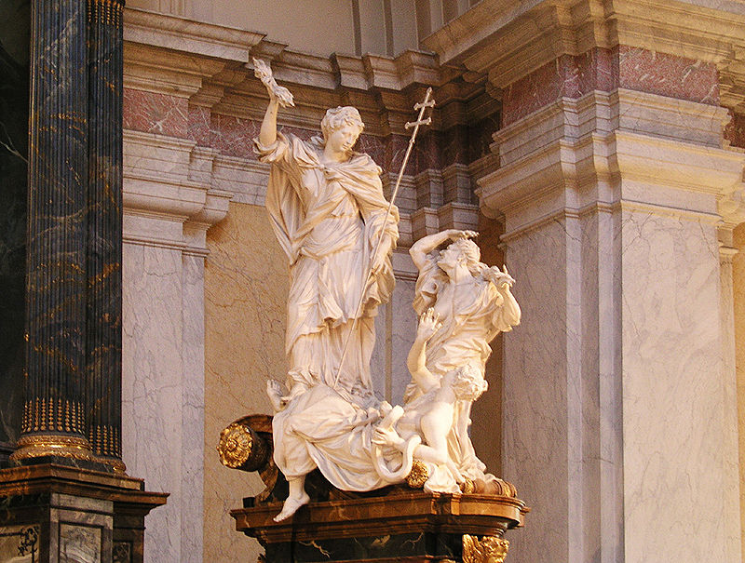
False Prophets Plague Ancient Israel
Heresies = any belief or theory that is strongly at variance with established beliefs or customs.
A heretic is a proponent of such claims or beliefs.
Distinct from both apostasy, which is the explicit renunciation of one's religion, principles or cause,[and blasphemy, which is an impious utterance or action concerning God or sacred things.
Burchard Precht
(2)

Slide 3
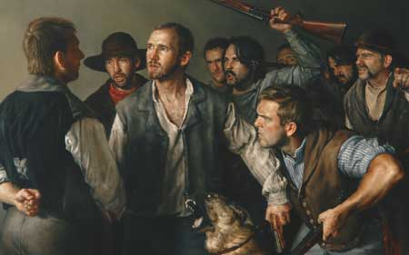
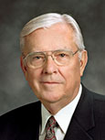
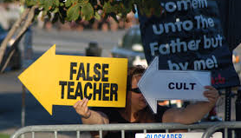
“False prophets and false teachers are those who declare that the Prophet Joseph Smith was a duplicitous deceiver; they challenge the First Vision as an authentic experience.
They declare that the Book of Mormon and other canonical works are not ancient records of scripture.
They also attempt to redefine the nature of the Godhead, and they deny that God has given and continues to give revelation today to His ordained and sustained prophets. …
2 Peter 2:1-7
(3)

Slide 4
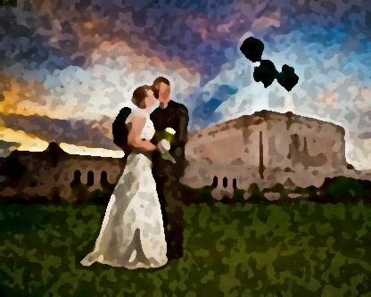
“False prophets and false teachers are also those who attempt to change the God-given and scripturally based doctrines that protect the sanctity of marriage, the divine nature of the family, and the essential doctrine of personal morality.
They advocate a redefinition of morality to justify fornication, adultery, and homosexual relationships.”
2 Peter 2:1-7
(3)

Slide 5
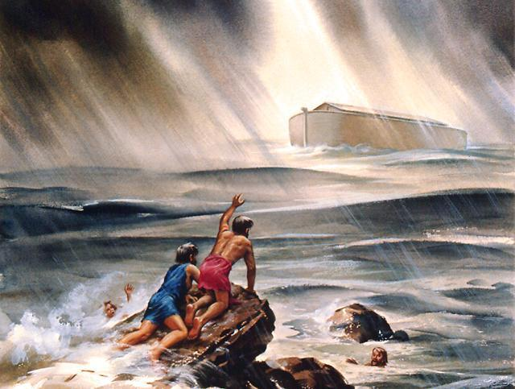
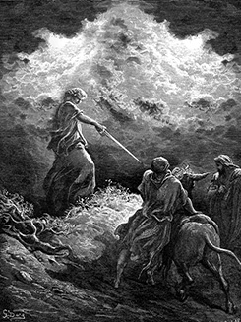
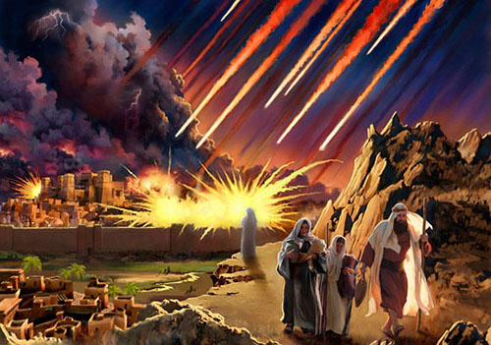
Consequences of False Preaching
The Past
The Flood
Baalam
All but 8 are destroyed
Sodom and Gomorrah
Paul Gustave
People are destroyed spiritually
Everyone left in the cities are destroyed by fire
2 Peter 2:5-6, 15
(2)

Slide 6
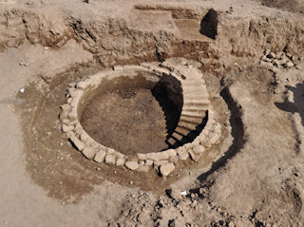
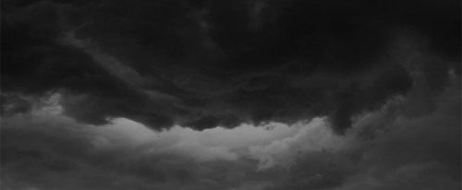
Description of Deceivers
Wells Without Water
Clouds that are carried with a tempest
False teachers would meet the same destruction that came upon the wicked in ancient times.
Why might people choose to sin even when they know that what they are doing is wrong
2 Peter 2:17
(2)

Slide 7
Lures and Bates
How do false teachers entice and deceive Church members?
Examples of Today’s Lures and Bates
False teachers seek to deceive us into believing that sin leads to greater liberty
Inappropriate internet use and texting
2 Peter 2:18-19

Slide 8
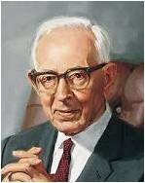
Better To Have Never Known
"...when a person once enlightened by the Spirit so that he receives knowledge that Jesus Christ is the Only Begotten Son of God in the flesh, then turns away and fights the Lord and his work, he does so against the light and testimony he has received by the power of God.
Therefore, he has resigned himself to evil knowingly. Therefore Jesus said there is no forgiveness for such a person.
"The testimony of the Holy Ghost is the strongest testimony that a man can receive.“
For of him unto whom much is given much is required; and he who sins against the greater light shall receive the greater condemnation.
D&C 81:3
2 Peter 2:20-22
(4)

Slide 9
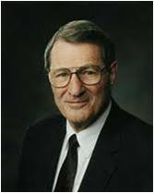
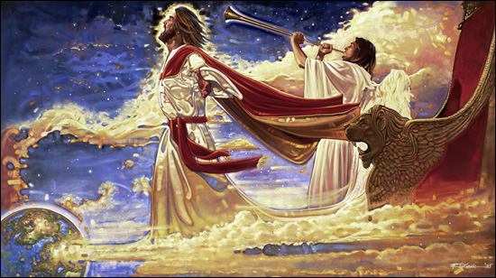
The Promise of His Coming
“one day is with the Lord as a thousand years, and a thousand years as one day”
“God lives in an eternal now where the past, present, and future are constantly before Him.
His divine determinations are guaranteed, since whatever He takes in His heart to do, He will surely do it.
He knows the end from the beginning!”
Ron DiCianni
2 Peter 3:1-8; D&C 130:7; Abraham 3:17
(5)

Slide 10
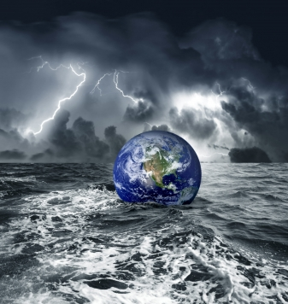
To Prepare For the Second Coming
Looking forward to a new heaven and earth
The earth is to be purified and become the abode of the righteous.
The new heaven and new earth will be the same heaven and the same earth on which we now sojourn, for this earth is to receive the resurrection after this day of mortality and be the abode of the righteous in eternity.
Without the revelations of the Lord given to men, this truth would not be made known. Neither would we have knowledge of the final glory to which this earth will be assigned."
2 Peter 3:10-14
(4)

Slide 11
Sources:
Suggested Hymn: #254 True To The Faith
Video:
True to the Faith (3:04)
New Testament Institute Student Manual Chapter 51
Wikipedia
Elder M. Russell Ballard (“Beware of False Prophets and False Teachers,” Ensign, Nov. 1999, 63, 64).
Joseph Fielding Smith (Answers to Gospel Questions, 5 vols. [Salt Lake City: Deseret Book Co., 1957-1966], 4: 92.); Conference Report, October 1964, First Day-Morning Meeting 7.
Elder Neal A. Maxwell (“Care for the Life of the Soul,” Ensign or Liahona, May 2003, 70).
Presentation by ©http://fashionsbylynda.com/blog/

Slide 12
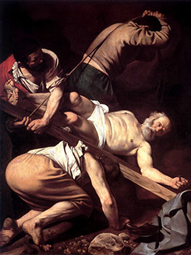
WRITTEN FROM ROME PRIOR TO A.D. 68 (2 PETER)
“Make Your Calling and Election Sure” | 1:1–19
Prophecy Comes by the Holy Ghost | 1:20, 21
False Teachers Are Damned | 2:1–9
The Fallen State of Lustful Saints | 2:10–22
Latter-day Scoffers Shall Deny the Second Coming | 3:1–10
Holy and Saintly Lives Are Prepared for the Lord | 3:11–18
Baalam 2 Peter 2:15:
Balaam was an Old Testament prophet, whose actions are recorded in Numbers 22–24; 31:16. He appeared at first to be true to the Lord and His people, repeatedly refusing Balak’s request to curse Israel. Nevertheless, Balaam eventually succumbed to Balak’s offer of riches and taught Balak how to cause the army of Israel to weaken themselves through sexual sin and idolatry (see Numbers 25:1–5; 31:13–16). The plan included having Moabite women seduce the men of Israel and persuade them to offer sacrifices to heathen gods, thus destroying them spiritually. (1)
“[At the Second Coming] 2 Peter 3:12:
a seemingly impossible experience [will occur]: ‘All flesh,’ the Lord says, ‘shall see me together’ [D&C 101:23]. How will it happen? We do not know. But I testify it will happen—exactly as prophesied. We will kneel in reverence, ‘and the Lord shall utter his voice, and all the ends of the earth shall hear it’ [D&C 45:49]. ‘It shall be … as the voice of many waters, and as the voice of a great thunder’ [D&C 133:22]. ‘[Then] the Lord, … the Savior, shall stand in the midst of his people’ [D&C 133:25]. …
“In that day the skeptics will be silent, ‘for every ear shall hear … , and every knee shall bow, and every tongue shall confess’ [D&C 88:104] that Jesus is the Christ, the Son of God, the Savior and Redeemer of the world.” Elder Neal A. Maxwell (“Thy Kingdom Come,” Ensign or Liahona, May 2015, 122).
Life and Teachings of Jesus and His Apostles Chapter 51
Crucifixion of St. Peter, by Caravaggio. When writing his Second Epistle, Peter knew that he would soon be put to death. This painting depicts the manner in which Peter is traditionally believed to have been killed—by being crucified upside down (see 2 Peter 1:14–15; see also John 21:18–19). (1)
Those who are not afraid to speak evil of dignities 2 Peter 2:10-12
“They ‘speak evil of dignities’ and ‘of the things that they understand not,’ says Peter. (2 Pet. 2:10, 1.) They complain of the programs, belittle the constituted authorities, and generally set themselves up as judges. After a while they absent themselves from Church meetings for imagined offenses, and fail to pay their tithes and meet their other Church obligations. In a word, they have the spirit of apostasy, which is almost always the harvest of the seeds of criticism. … As Peter puts it, they ‘perish in their own corruption’ [2 Peter 2:12]” President Spencer W. Kimball (The Miracle of Forgiveness [1969], 42–43).

