Slide 1
Lesson 148
God is Love
1 John
But ye will teach them to walk in the ways of truth and soberness; ye will teach them to love one another, and to serve one another.
Mosiah 4:15

Slide 2
Traditionally John is identified as the author of 1, 2, and 3 John.
Clues point to him as the author although his name is never mentioned.
John was one of the original 12 Apostles.
The contents of this letter suggests that he wrote to believers, and were addressed to several locations.
John resided in Ephesus for a long period of time.
The First Epistle General of John
The author of the Epistles of John was an eyewitness of the resurrected Savior, which was certainly true of John the Apostle

Slide 3
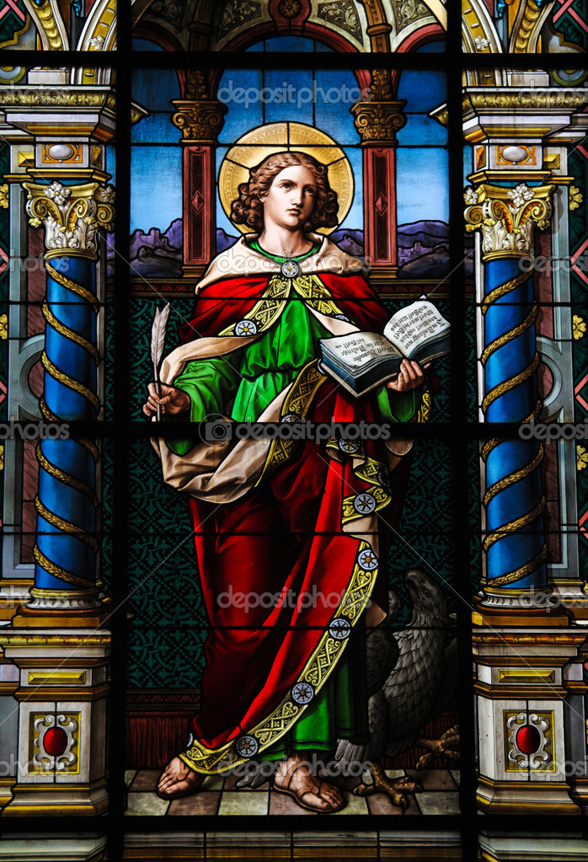
History
At this time, false teachers had created a schism, or division, among the Saints in the region, and apostasy was spreading in the Church.
A particular philosophy that was gaining popularity was Docetism.
Docetism was part of a larger movement known as Gnosticism.
A core teaching in many forms of Gnosticism was that the spirit was wholly good and that matter, including the physical body, was wholly evil.
1 John 2:18-19; 22; 26; 4:1

Slide 4
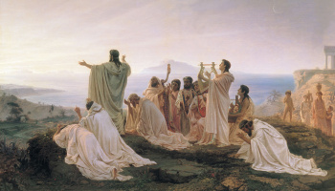
Followers of Gnosticism
Followers of Gnosticism believed that salvation was not achieved by being freed from sin but rather by freeing the spirit from matter, meaning the physical body.
They also believed that salvation was achieved through special knowledge (gnosis) rather than through faith in Jesus Christ.
1 John 2:18-19; 22; 26; 4:1

Slide 5
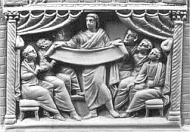
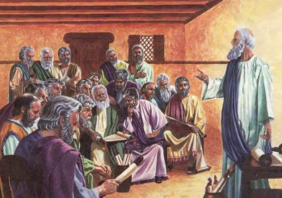
Followers of Docetism
Docetism comes from the Greek word dokeō, meaning “to seem” or “to appear.”
Followers of Docetism overemphasized Jesus’s spiritual nature to the point that they rejected the idea that He came to earth in actual bodily form.
They believed that God was invisible, immortal, all-knowing, and immaterial, and they considered the physical world and the physical body to be base and evil.
Therefore, they believed that since Jesus was the divine Son of God, He could not have experienced the limitations of being human.
In their view, Jesus Christ was not literally born in the flesh, and He did not inhabit a tangible body, bleed, suffer, die, or rise with a physical resurrected body—He only seemed to do these things.
1 John 2:18-19; 22; 26; 4:1

Slide 6
Apostasy
Turning away from the truth
Antichrist
Anyone or anything that counterfeits the true gospel plan of salvation and that openly or secretly opposes Christ” and the authority and teachings of His chosen servants
Some antichrists in John’s day were teaching that Jesus Christ did not have a physical body while on earth but only appeared to be a physical being.
(2)

Slide 7
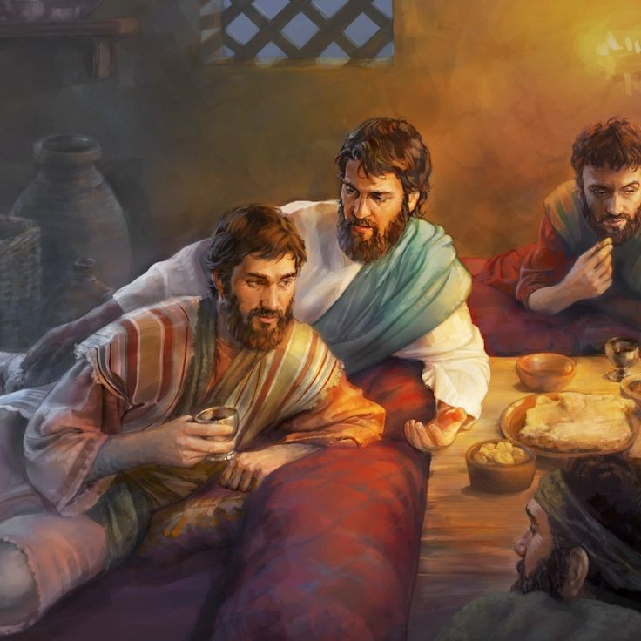
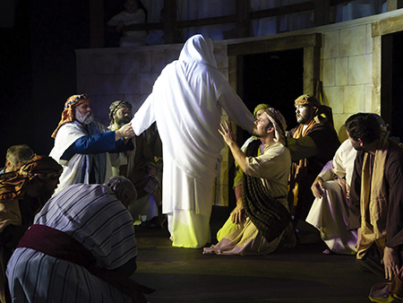
The Word of Life
Christ
John and the Apostles had personally seen, been with, and heard Jesus Christ as a teacher, leader, and the Son of God.
They were witnesses of miracles and healings, and of His resurrection.
1 John:1-4
(2)

Slide 8
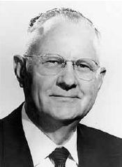
Light From God
Light leads to salvation; it edifies and uplifts.
“The gospel of Christ is a lamp in our hands to guide us in righteous paths. Light can always dissipate darkness, but darkness can never replace light.
It is only when the light of the Spirit within us is dimmed or goes out that the darkness of temptation and sin enters in, and Satan takes over.”
1 John:5-7
(3)

Slide 9
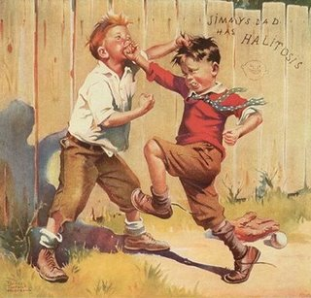
Struggling to Obey
A young man reads the scriptures each day and faithfully performs many of his priesthood duties,
but he is often unkind to his younger brother.
A young woman regularly attends her Church meetings and has earned her Young Womanhood Recognition. However, she often posts rude comments about some of her classmates and teachers on social media.
1 John:2:4
(3)

Slide 10
God is Love
He that loveth his brother abideth in the light, and there is none occasion of stumbling in him.
“Our feelings toward one another must be those of brotherly love. Religion should cement and strengthen and never weaken this feeling. It is most important that we respect and honor the religious beliefs and feelings of our neighbors.”
1 John:2:10-21
(4)

Slide 11
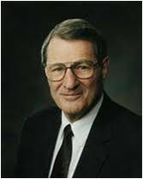
Love Not the World
“Since you don't let people come in and walk around in your house with muddy feet, do not let them walk through your minds with muddy feet...
Because our behavioral standards are different... we must come to despise the shame of the world.
We must not hold the people of the world in contempt; we must love them. But we must come to have contempt for the shame of the world, because it matters so little in the end...
“Remember, those who are in error must not call the cadence for your life, for those who boast of their sexual conquests are only boasting of that which has conquered them-in the same way that people who make nervous jokes about drunkenness are only mocking that which has come to mock them. We may pity behavioral clones, but we do not envy them.
1 John:2:10-21
(5)

Slide 12
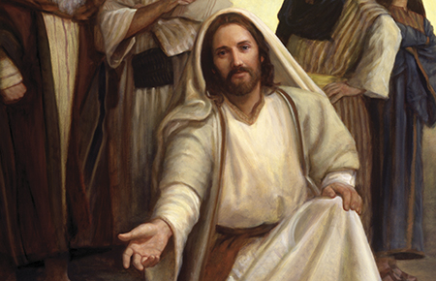
Love Through Our Actions
Why do you think it is important that we demonstrate our love through our actions and not through our words alone?
My little children, let us not love in word, neither in tongue; but in deed and in truth.
1 John 3:17-18

Slide 13
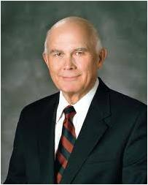
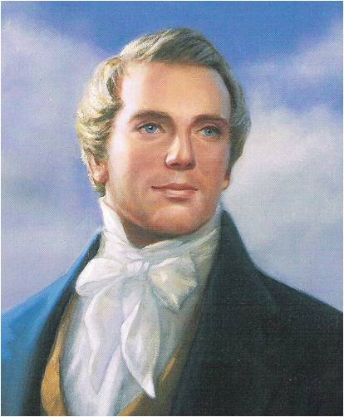
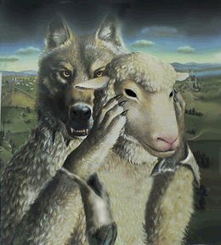
The False Spirit
“[The] power of discernment is essential if we are to distinguish between genuine spiritual gifts and the counterfeits Satan seeks to use to deceive men and women and thwart the work of God.” (6)
"Nothing is a greater injury to the children of men than to be under the influence of a false spirit when they think they have the spirit of God."
“No man nor sect of men without the regular constituted authorities, the Priesthood and discerning of spirits, can tell true from false spirits." (7)
1 John 4:1

Slide 14
34 Love Words in 1 John 4:7-5:5

Slide 15
1 John 4:7
1, 2, 3, 4
Beloved, let us love one another: for love is of God; and every one that loveth is born of God, and knoweth God
1 John 4: 8
5, 6
He that loveth not knoweth not God; for God is love.
1 John 4:9
7
In this was manifested the love of God toward us, because that God sent his only begotten Son into the world, that we might live through him.
1 John 4:10
8, 9, 10
Herein is love, not that we loved God, but that he loved us, and sent his Son to be the propitiation for our sins.
1 John 4:11
11, 12, 13
Beloved, if God so loved us, we ought also to love one another.
1 John 4:12
14, 15
No man hath seen God at any time. If we love one another, God dwelleth in us, and his love is perfected in us.
1 John 4:16
16, 17, 18
And we have known and believed the love that God hath to us. God is love; and he that dwelleth in love dwelleth in God, and God in him.
1 John 4:17
19
Herein is our love made perfect, that we may have boldness in the day of judgment: because as he is, so are we in this world.

Slide 16
1 John 4:18
20, 21, 22
There is no fear in love; but perfect love casteth out fear: because fear hath torment. He that feareth is not made perfect in love.
1 John 4:19
23, 24
We love him, because he first loved us.
1 John 4:20
25, 26, 27
If a man say, I love God, and hateth his brother, he is a liar: for he that loveth not his brother whom he hath seen, how can he love God whom he hath not seen?
1 John 4:21
28, 29
And this commandment have we from him, That he who loveth God love his brother also.
1 John 5:1
30, 31
Whosoever believeth that Jesus is the Christ is born of God: and every one that loveth him that begat loveth him also that is begotten of him.
1 John 5:2
32, 33
By this we know that we love the children of God, when we love God, and keep his commandments.
1 John 5:3
34
For this is the love of God, that we keep his commandments: and his commandments are not grievous.

Slide 17
Sources:
Suggested Hymn: #308 Love One Another
Video:
Two Brothers Apart (6:12)
New Testament Institute Student Manual Chapter 52
Guide to the Scriptures
Elder Delbert L. Stapely (Conference Report, April 1968, Afternoon Meeting 28.)
N. Eldon Tanner ("The Great Commandments," Ensign, July 1980, 3-4)
Elder Neal A. Maxwell ("The Stern but Sweet Seventh Commandment," New Era, June 1979, 41-42)
Elder Dallin H. Oaks "Spiritual Gifts," Ensign, Sept. 1986, 71-72)
Prophet Joseph Smith (Teachings, p. 213.)
As we come unto Jesus Christ with our burdens, He will give us rest
Presentation by ©http://fashionsbylynda.com/blog/

Slide 18
A LETTER TO THE CHRISTIAN COMMUNITIES, CA. A.D. 96 John
Walk in the Light of Christ | 1:1–7
We Must Break from Our Sins | 1:8–10; 2:1, 2
The Saints May Know God and Christ | 2:3–6
Abide in the Light Through the Law of Love | 2:7–14
“Love Not the World” | 2:15–17
Anti-Christs to Come in Latter Days | 2:18–26
The Holy Ghost Leads Saints to Truth | 2:27–29
The Sons of God Shall Be Like Christ | 3:1–3
Saints Must Not Continue in Sin | 3:4–9
Love the Brethren and Gain Eternal Life | 3:10–18
Gaining Answers to Prayers | 3:19–24
“Try the Spirits” | 4:1–6
“God Is Love” | 4:7–21
“Who Is Born of God?” | 5:1–4
Many Witnesses Testify of Eternal Life in Christ | 5:5–21
The Theme of 1 John:
“Written by the Disciple whom Jesus loved, and who in turn had such great love for his Lord and his fellowmen that he gained permission to remain on earth and seek to save souls until the Second Coming—this Epistle has as its essential Theme:
“That God is love;
“That love is the foundation upon which all personal righteousness rests;
“That all the purposes and plans of Deity are based on his infinite and eternal love; and
“That if men will personify that love in their lives, they will become like the Lord himself and have eternal life with him.
“The doctrines expounded include how to gain fellowship with God; how to know God and Christ; how to become the sons of God; how to abide in the light and love the brethren; how to dwell in God and have him dwell in us; how to be born again and gain eternal life.” Elder Bruce R. McConkie, DNTC, 3:371.)
The Light of Christ 1 john 1:7:
Where the true gospel of Christ is, there is light; and where that gospel is not found, darkness reigns. "The whole world lieth in sin, and groaneth under darkness and under the bondage of sin, . . . because they come not unto me," the Lord said. (D. & C. 84:49-54.) "Darkness covereth the earth, and gross darkness the minds of the people," (D. & C. 112:23.) The kingdom of the devil is "full of darkness," (Rev. 16: 10.) And men "love darkness rather than light, because their deeds are evil." (D. & C. 10:21; John 3:19.) But when men repent and heed the call of Christ, they thereby come "out of darkness into his marvelous light." (1 Pet. 2:9; 1 Thess. 5:4; 1 John 2:9.) Elder Bruce R. McConkie (Mormon Doctrine, 2d ed. [Salt Lake City: Bookcraft, 1966], 179.)
Spirit of antichrist 1 John 4:3
Today there are many men who proclaim the doctrine that man has the power in himself to rise through his native intelligence, and if there is any salvation to be obtained such a man will receive it irrespective of any act or virtue coming from Jesus Christ. This is the spirit of anti-Christ which the Lord said would be in the world. Joseph Fielding Smith (Church History and Modern Revelation, 4 vols. [Salt Lake City: The Church of Jesus Christ of Latter-day Saints, 1946-1949], 1: 88, footnote 6)
Life and Teachings of Jesus and His Apostles Chapter 52
“…Only the pure love of Christ will see us through. It is Christ’s love which suffereth long, and is kind. It is Christ’s love which is not puffed up nor easily provoked. Only his pure love enables him- and us- to bear all things, believe all things, hope all things, and endure all things.” Elder Jeffrey R. Holland

Slide 19
Do You Really Know Him? 1 John 2:4-5:
"The scriptures make crystal clear that proper behavior (works) must be part of our life in Christ. The Savior himself taught, 'Not every one that saith unto me, Lord, Lord, shall enter into the kingdom of heaven; but he that doeth the will of my Father which is in heaven. . . . Depart from me, ye that work iniquity' (Matthew 7:21, 23; emphasis added). In other words, merely acknowledging Jesus' lordship, merely saying the words or making the confession, while refusing to make him our lord by serving him and conforming our behavior to his will-this will not get us into the kingdom. The confession or the acknowledgment must be accompanied by doing the will of the Father in heaven and by not doing iniquity. Jesus explicitly established the undeniable link between salvation and good works: 'If thou wilt enter into life, keep the commandments' (Matthew 19:17). In John's Gospel (3:20-21) he is quoted as saying: 'Every one that doeth evil hateth the light, neither cometh to the light, lest his deeds should be reproved. But he that doeth truth cometh to the light, that his deeds may be made manifest, that they are wrought in God' (emphasis added). You can't do evil and be in the light-our deeds and our spiritual condition and destiny are interconnected. Moreover, Jesus also makes keeping his commandments-that is, behavior-a part of abiding in his love: 'If ye keep my commandments, ye shall abide in my love; even as I have kept my Father's commandments, and abide in his love' (John 15:10; see also 14:15, 21). The necessary link between proper behavior and being 'in Christ' is further taught by John: 'He that saith, I know him, and keepeth not his commandments, is a liar, and the truth is not in him. But whoso keepeth his word, in him verily is the love of God perfected: hereby know we that we are in him' (1 John 2:4). Who is truly 'in Christ'? Those who keep the commandments! There are those who profess him but will not work for him, those who claim to be sons and daughters but refuse to do their chores. But these, according to the scripture, are 'liars.'" (Stephen E. Robinson, Following Christ: The Parable of the Divers and More Good News [Salt Lake City: Deseret Book Co., 1995], 77.)
"God is love (1 John 4:7-5:5)... The word love is used thirty-four times in these twenty verses, which highlight at least five characteristics of love: God, through his Son, is the source of love (1 John 4:7-12); love is a gift of faith received through the Spirit (1 John 4:13-16); love brings confidence and dispels fear (1 John 4:17-18); love of God is manifest in our love for others (1 John 4:19-21); and the ultimate reward of keeping God's commandment to love is to share in his Son's victory (1 John 5:1-5). For John, these are the cardinal principles of Christian discipleship." (Victor L. Ludlow, "John: The Once and Future Witness," Ensign, Dec. 1991, 54)

