Slide 1
Lesson 15 and 16
Teaching in Parables
Matthew 13
But without a parable spake he not unto them: and when they were alone, he expounded all things to his disciples.
Mark 4:34

Slide 2
Parables
The Lord uses Parables to veil the meaning
Greek in origin and means a setting side by side, a comparison—with material things
The Hebrew—Mashal used to translate
A simple story used to illustrate and teach a spiritual truth or principle. A parable is based on comparing an ordinary object or event to a truth”
Thus it is that the parable exhibits the condition of all true knowledge. Only he who seeks finds. (1)

Slide 3
Interpretation of Parables
It is important to distinguish between the interpretation of a parable and the application of a parable.
The only true interpretation is the meaning the parable conveyed, or was meant to convey, when first spoken.
The application of a parable may vary in every age and circumstance. But if the original meaning is to be grasped, it is important to consider its context and setting. (1)

Slide 4
The Parable of the Sower
Matthew 13:3-9, 19-23
Matthew 13:4, 19; Luke 8:5-8
“A sower went out to sow his seed; and as he sowed, some fell by the way side…some fell upon a rock…some fell among thorns…and other fell on good ground…”

Slide 5
The Sower represents one who preaches the gospel
The Field represents the world

Slide 6
The Fowl represents Satan
The soil represents your Testimony
The Seeds represent the Word of God

Slide 7
The Stones represent the strength needed to survive

Slide 8
The Thorns
represent Satan’s temptations and the cares of the world

Slide 9
The Fruit
represent our knowledge of the gospel

Slide 10
The path is trodden and hard, the seed can not grow and is devoured by the fowl
Satan has a hold on them whose hearts are hardened and don’t or won’t try to understand
Mosiah 26:3
“And now because of their unbelief they could not understand the word of God and their hearts were hardened”

Slide 11
When we are trying to grow the word of the kingdom in our hearts, Satan will be watching, eager to take it all away.
Matthew 13:4, 19; Luke 8:12
“Those by the way side are they that hear; then cometh the devil, and taketh away the word out of their hearts, lest they should believe and be saved

Slide 12
Some roots take place, but many are destroyed by weather because the roots are not deep enough
These are the people who start out with the word of God and then lose their way
Matthew 13:5-6, 20-21; Luke 8:13
“They on the rock are they, which, when they hear, receive the word with joy; and these have no root, which for a while believe, and in time of temptation fall away.”

Slide 13
The gospel may be planted in our hearts but if not nourished it will be forgotten with the cares of the world
Weeds may grow and take all the nourishment the plants need to survive
Matthew 13:7, 22; Luke 8:14
“And that which fell among thorns are they, which, when they have heard, go forth, and are choked with the cares and riches and pleasures of this life, and bring no fruit to perfection”

Slide 14
These are they that are deeply rooted in the Gospel and the knowledge of Jesus Christ for the blessings will come
The Plants that are deeply rooted and can endure the weather and other destructive forces will bear fruit
Matthew 13:8, 23; Luke 8:15
“But that on the good ground are they, which in an honest and good heart, having heard the word, keep it, and bring forth fruit with patience.”

Slide 15
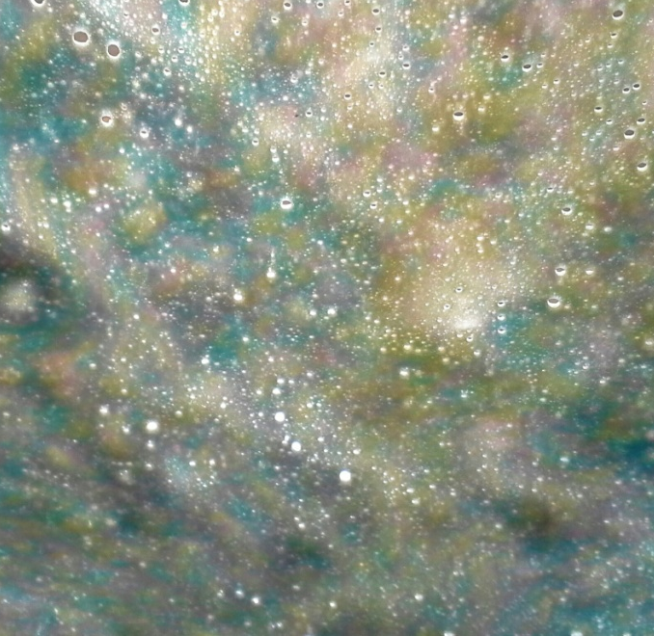
Why Parables?
Parables revealed the mysteries or truths of the kingdom of heaven to those who were ready to receive them, while hiding the meaning from those who were spiritually unprepared.
Matthew 13:10-13

Slide 16
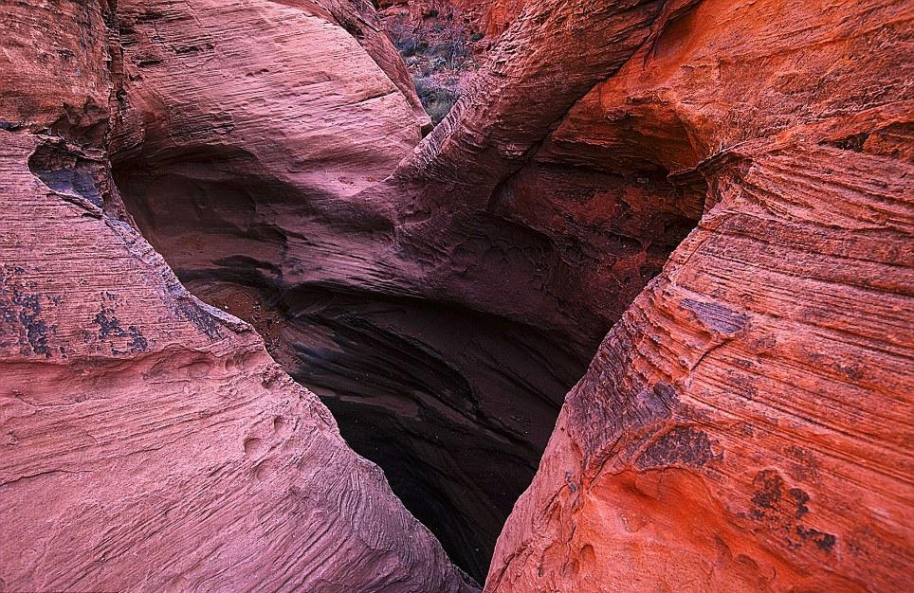
Hearts Are Waxed Gross
The people’s hearts had become hard and insensitive
If we harden our hearts, then we will not understand the word of God, be converted to the Savior, and be healed by Him.
Matthew 13:14-15

Slide 17
Eyes to See Ears to Hear
The people’s hearts had become hard and insensitive
"Each of us knows those who do not have sight. We also know many others who walk in darkness at noonday. Those in this latter group may never carry the usual white cane and carefully make their way to the sound of its familiar tap, tap, tap. They may not have a faithful seeing-eye dog by their side nor carry a sign about their neck which reads, 'I am blind.' But blind they surely are. Some have been blinded by anger, others by indifference, by revenge, by hate, by prejudice, by ignorance, by neglect of precious opportunities. (2)
Matthew 13:16-17

Slide 18
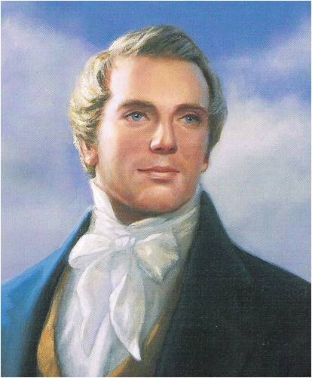
Parables of Gathering
“I have a key by which I understand the scriptures. I enquire, what was the question which drew out the answer, or caused Jesus to utter the parable? … To ascertain its meaning, we must dig up the root and ascertain what it was that drew the saying out of Jesus.” (3)

Slide 19
The Kingdom of Heaven is like unto….Matthew 13:24

Slide 20
The Sowers…
the seeds grow differently depending on the ground they fall on.

Slide 21
The Wheat and Tares
An enemy plants tares in a wheat field. The householder tell his servants to let the wheat and tares grow together until the harvest
If reapers tried to pull out the tares before the wheat and tares matured, they would likely destroy much of the wheat as well.
The tares were gathered first, bundled then burned. The wheat was gathered to the barn
Matthew 13:24-30

Slide 22
“We learn by this parable [of wheat and tares], not only the setting up of the Kingdom in the days of the Savior, which is represented by the good seed, which produced fruit, but also the corruptions of the Church, which are represented by the tares, which were sown by the enemy, which His disciples would fain have plucked up, or cleansed the Church of, if their views had been favored by the Savior.
But He, knowing all things, says, Not so. As much as to say, your views are not correct, the Church is in its infancy, and if you take this rash step, you will destroy the wheat, or the Church, with the tares; therefore it is better to let them grow together until the harvest, or the end of the world, which means the destruction of the wicked, which is not yet fulfilled” (3)

Slide 23
The Mustard Seed-
The smallest seed grows into the largest of herbs
Matthew 13:31-32

Slide 24
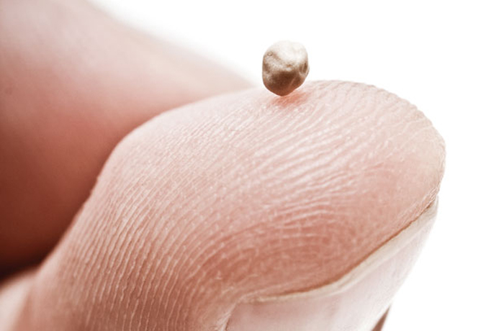
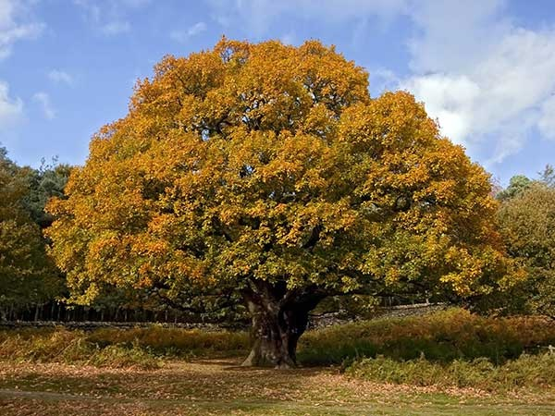
This figure is given to represent the Church as it shall come forth in the last days. … Let us take the Book of Mormon, which a man took and hid in his field, securing it by his faith, to spring up in the last days, or in due time; let us behold it coming forth out of the ground, which is indeed accounted the least of all seeds, but behold it branching forth, yea, even towering with lofty branches and Godlike majesty, until it, like the mustard seed, becomes the greatest of all herbs. …
God is sending down His powers, gifts, and angels to lodge in the branches thereof” (3)

Slide 25
The Leaven
a small amount of yeast in 3 measures of flour grows until it leavens all the dough
Leaven
Leaven
Leaven
Matthew 13:33

Slide 26
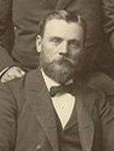
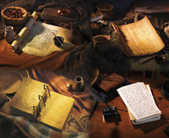
The latter-day Church will spread throughout the earth, aided by the leaven of the testimonies of the Three Witnesses and the latter-day scriptures.
These were, according to the Book of Mormon, the Jews in Palestine [who produced the Bible], the seed of Joseph on the Western hemisphere [who produced the Book of Mormon], and the ten tribes in the North country [whose leavening record is yet to come]. These all were visited by the Savior. They heard His voice and were taught of Him 'one Lord, one faith, one baptism,' that there might be 'one fold and one shepherd.'“ (4)

Slide 27
Hidden Treasure…a man sells all he has to buy a field with a hidden treasure
Matthew 13:44-46

Slide 28
Pearl of Great Price-
a merchant sells all he has to buy the most valuable pearl.
Matthew 13:44-46

Slide 29
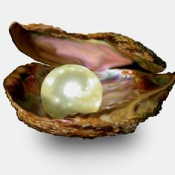
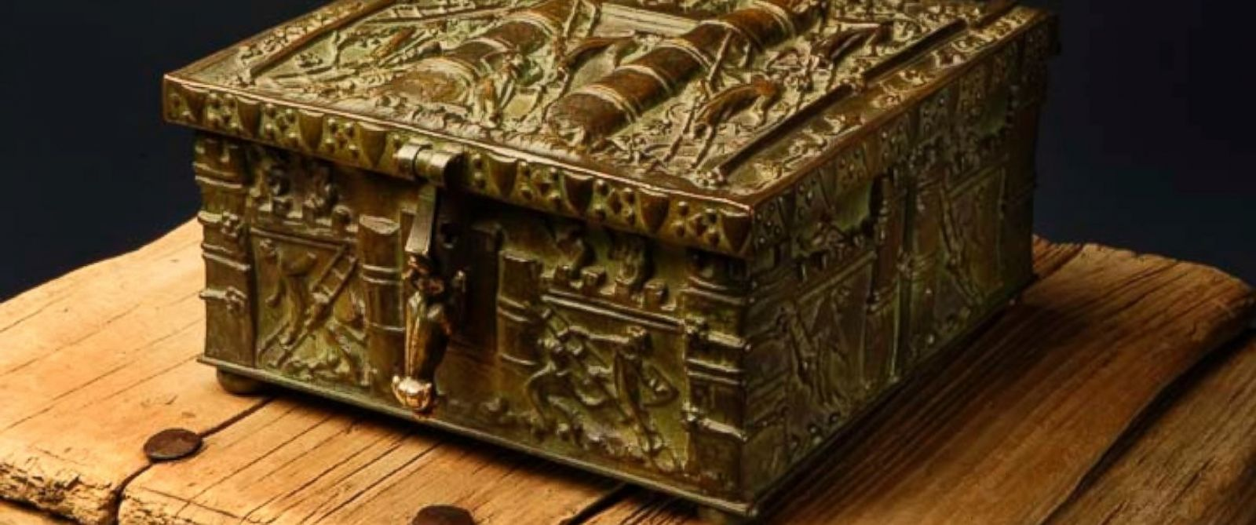
“While the treasure in the field was accidentally discovered, the pearl of great price was deliberately sought.
Similarly, some stumble upon the gospel as if by accident; others find it by searching.
Earthly treasure is no match for treasure in heaven.
What am I will to give for the kingdom of God?

Slide 30
The Fish Net- fishers catch all kinds of fish in their net, and they separate them later.
Matthew 13:47-50

Slide 31
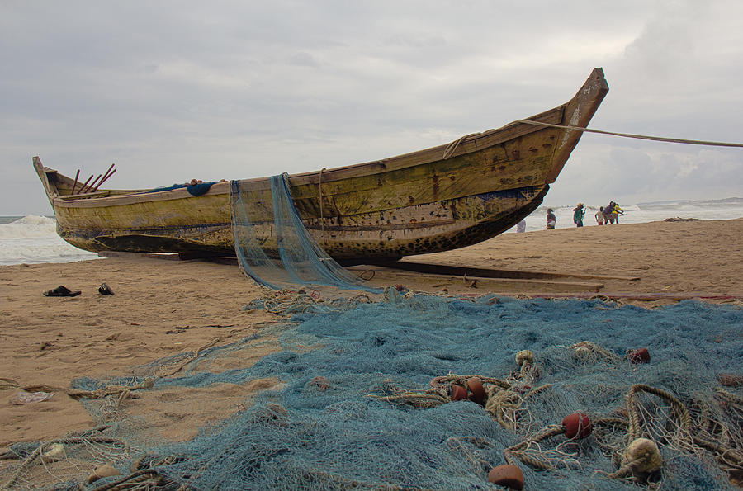
“The net here meant is draw net or a seine, which may be as much as half a mile in length; it is leaded below so it will sweep the bottom of the sea, while corks keep the top floating near the surface. As it is swept along the beach it gathers in fish of every sort without reference to their ultimate use or worth. (5)
For the work of this pattern, behold the seed of Joseph, spreading forth the Gospel net upon the face of the earth, gathering of every kind, that the good may be saved in vessels
prepared for that purpose, and the
angels will take
care of the bad”
(2)

Slide 32
New and Old Treasures-
a righteous scribe brings out both old and new treasures
The Old Testament
The New Testament
Matthew 13:51-52

Slide 33
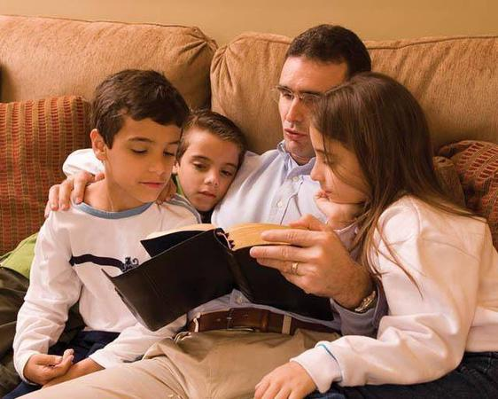
“For the works of this example, see the Book of Mormon coming forth out of the treasure of the heart. Also the covenants given to the latter-day Saints, also the translation of the bible—thus bringing forth out of the heart things new and old.” (2)
A householder is the head of the household whose duty is to clothe, feed, and govern the inhabitants.
Also one who loves, cares for, and reveals the gospel to his children in all dispensations.
(7)
“scribes”—not in the sense that they were doctors of the law, but that “their aim was to reproduce and reach others to reproduce accurately the words of the wise.” (6)
Scribes should try to teach accurately what Jesus taught.

Slide 34
Gathering
Leaven
The latter-day Church will spread throughout the earth, aided by the leaven of the testimonies of the Three Witnesses and the latter-day scriptures.
The righteous and wicked grew together in New Testament times, eventually leading to the Great Apostasy. In the latter days, the righteous will be gathered into the Church and the wicked will be destroyed.
Jesus Christ and His Apostles sowed the seeds of the gospel in their day.
The Church of Jesus Christ will be restored. From small beginnings it will grow, spread, and become a majestic worldwide Church.
All types of people will be gathered into the Church. At the end of the world, the wicked will be cast out and destroyed.
The righteous will gather to the kingdom of God. Latter-day Saints will sacrifice and work to build Zion.

Slide 35
Sources:
Suggested Hymn: #216 We Are Sowing
Video: The Gospel Shall Roll Forth (2:45)
Parable of the Sower (4:37)
Guide to the Scriptures
Elder Thomas S. Monson Conference Report, April 1965, Second Day-Morning Meeting 48
Joseph Smith (in History of the Church,5:261). Teachings of Joseph Smith p. 102, 299-303
Matthias F. Cowley Talks on Doctrine p. 179
Elder Bruce R. McConkie Mortal Messiah 2:266
Bible dictionary
John Bythway Of Pigs, Pearls & Prodigals p. 46
Presentation by ©http://fashionsbylynda.com/blog/

Slide 36
Parables: Other rules of interpretation are:
(a) Do not force a meaning on subordinate incidents.
(b) Do not regard as parallel parables that are connected by superficial likeness of imagery.
(c) Bear in mind that the same illustration does not always have the same significance—for example, leaven signifies a principle of good as well as a principle of evil.
(d) Remember that the comparison in a parable is not complete, does not touch at every point. Thus, the characters of the unjust judge or the unjust steward or the nobleman who went into a far country—possibly referring to the infamous Archelaus—do not concern the interpretation of the parable.
The parable draws a picture of life as it is, not as it ought to be, and compares certain points in this picture with heavenly doctrine.
(e) Observe the proper proportions of a parable, and do not make the episode more prominent than the main line of teaching.
Bible Dictionary
Parable Comparison to Lehi’s dream
Matthew 13:4-23 | Lehi’s Dream
Some seeds fell by the way side Matthew 13:4, 19 | Some went directly to the great and spacious building 1 Nephi 8:31-32
Some seeds grew, then withered in the sun Matthew 13:5-6; 20-21 | Some partook of the fruit, then fell away 1 Nephi 8;25
Some grew among thorns and choked Matthew 13:7, 22 | Some started on the path, then wandered off 1 Nephi 8:23
Some grew in good soil and brought forth fruit Matthew 13:8, 23 | Some partook of the fruit and stayed by the tree 1 Nephi 8:30

Slide 37
Matthew | Mark | Luke
The House Built Upon a Rock (7:24-27) | The seed growing secretly (4:26-29) | The Two Debtors (7:36-50)
The Sower (4 kinds of soil) (13:3-9, 18-23) |  | The Sower (8:4-15)
The Wheat and Tares (13:24-30; 36-43) |  | The Good Samaritan (10:25-37)
The Mustard Seed (13:31-32) |  | The Foolish Rich Man (12:16-21)
The Leaven (13:33) |  | The Barren Fig Tree (13:6-9)
The Hidden Treasure and the Pearl of Great Price (13:44-46) |  | The Chief Seats (14:7-11)
The draw-net (13:47-50) |  | The Great Supper (14:16-24)
The Householder (13:51-52) |  | The Uncompleted Tower and the King’s Warfare (14:28-33)
The Unmerciful Servant (18:23-35) |  | The Lost Sheep (15:3-7)
The Laborers in the Vineyard (20:1-16) |  | The Lost Coin (15:8-10)
The Two Sons (21:28-31) |  | The Lost Prodigal Son (15:11-32)
The Wicked Husbandmen (21:33-46) |  | The Unjust Steward (16:19-31)
The Royal Marriage(22:1-14) |  | The Rich Man and Lazarus (18:1-8)
The 10 Virgins (25:1-13) |  | The Pharisee and the Publican (18:9-14)
The Talents 25:14-30) |  | The Pounds (19:12-27)
The Sheep and the Goats (25:31-46)
Parables in the
New Testament
John has no true parables but presents two allegories: the good shepherd (John 10:1–16) and the vine and the branches (15:17). (1)
Listed in of Pigs, Pearls, and Prodigals by John Bytheway

Slide 38
Wheat and Tares Matthew 13:36-43
Tares occurs in the New Testament only in this one parable. The Greek word zizanion, translated as ‘tares,’ is said to come from a Semitic root and refers to weeds in grain . Most assume it is the somewhat poisonous bearded darnel, or weed grass (Ogden and Skinner, Verse by Verse, 219-92)
If there are dandelions among the wheat, it’s easy to tell the good and bad pants apart. But tares look like wheat in their early stages of growth. The roots of the two plants often grow together and intertwine, making it difficult to remove the tares without damaging the wheat. [planted in spring, grown in summer and harvested in fall] Of Pigs, Pearls & Prodigals by John Bytheway p. 20-21
Parallels: Son of Man = The sower; Field= the world; Good seed= children of the kingdom; the enemy = the devil; harvest = end of world; Reapers = angels
Treasures and Pearl of Great Price Matthew 13:44-46
Through its entire history, Palestine has been a land where its inhabitants have often buried treasure in its ground. Foreign foes have many times swept through the land to plunder.
Many times have valuable possessions been buried in secret places. This was often done by men before leaving for battle, or before going on a long journey. If they returned safely they would be able to reclaim their buried treasure. But if they died in battle, or for any other reason failed to return, the place where the valuables were hidden would remain a lost secret. Because of this situation, there always has been a looking for hidden treasure by certain people all over the Holy Land Fred H. Wight(Manners and Customs, 249) found in Of Pigs, Pearls & Prodigals by John Bytheway
Rabbinic law of the time: If one finds a treasure on another’s property, he cannot take it on the spot but must purchase the land in order to obtain the treasure. This man, then, purchased the field and obtained title to the land. In other words, he did not receive the gospel outside the covenant; instead, be became a legal member of the Church (Understanding the Parable, 43 by Jay A. and Donald W. Parry
Pearls were the costliest of gems, and wealthy people purchased them as investments. The Talmud speks of pearls as being beyond price. The Egyptians actually worshiped them. John refers them in Rev. 21:21 as in the vision of the heavenly city revealed gates that are giant pearls.
Mustard Seed Matthew 13:31-32
Jesus compares it to a tiny mustard seed that grows into a plant large enough for a bird to build its nest. Jesus’ audiences also knew that mustard plants would appear as a splotch of yellow on a hillside one day, and quickly spread across the entire hill, cloaking it with a brilliant yellow. In this annual act of nature, listeners could envision the spread of god’s kingdom.
Leaven Matthew 13:33
“For the works of this example, see the Book of Mormon coming forth out of the treasure of the heart. Also the covenants given to the Latter-day Saints [the Doctrine and Covenants], also the translation of the Bible—thus bringing forth out of the heart things new and old, thus answering to three measures of meal undergoing the purifying touch by a revelation of Jesus Christ, … which will answer to the leaven which leavened the whole lump” (Teachings: Joseph Smith, 302–3).
Bread, along with water, was considered an essential of life. Except for the Sabbath, all mornings began with the women grinding wheat. Each family ad a courtyard oven for baking bread. Bread was often dipped in olive oil or pureed legumes, or used as a spoon to scoop up and eat other food. Joel Kauffman (Nazareth Jesus Knew, 28)
Draw-nets Matthew 13:47-50
This way of fishing illustrates the value of co-operative effort. A number of men will work together. Some of them will row the boats, some will pull the rope with great strength, and some will throw stones or in other ways seek to keep the fish from getting away by frightening them. As they get close to the shore, the edges of the net are held, and it is dragged to land and the fish must be seized. Afterward the fish caught are sorted. Fred h. Wight (Manners and Customs, 216)

