Slide 1
Lesson 150
Earnestly Contend For The Gospel
Jude
They stand fast for ever and ever, and are done in truth and uprightness.
Psalms 111:8

Slide 2
Jude
He was one of the brethren of the Lord and probable author of the epistle of Jude
Although the question of authorship has been much debated, no solid evidence has been produced to show that anyone other than Jude, brother of Jesus and James, wrote the letter
We have no indication that Jude held any office of importance in the early church, but the epistle seems to suggest that he eventually attained to a position wherein a letter from him would carry some weight
Jude was evidently a Church member of high esteem in Jerusalem, and he may have traveled as a missionary
Jude is the shortest letter in the New Testament. Like the other general epistles, little is known concerning the group or groups to which the epistle was directed. Jude merely addresses his writing “to them that are sanctified by God the Father, and preserved in Jesus Christ, and called.” (Jude 1:1)
The Epistle of Jude contains information that is not found anywhere else in the Bible
(2,3)

Slide 3
Pre-existence
“In the whole Bible, it is Jude only who preserves for us the concept that pre-existence was our first estate and that certain angels failed to pass its tests.
“It is to him that we turn for our meager knowledge of the disputation between Michael and Lucifer about the body of Moses.
“He alone records Enoch’s glorious prophecy about the Second Coming of the Son of Man.
“And he is the only inspired writer to express the counsel that the saints should hate even the garments spotted with the flesh.”
The General Epistle
Of
Jude
(2,3)

Slide 4
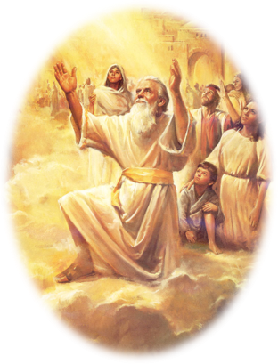
“And Enoch also, the seventh from Adam, prophesied of these, saying, Behold, the Lord cometh with ten thousands of his saints,”
Jude 1:14

Slide 5
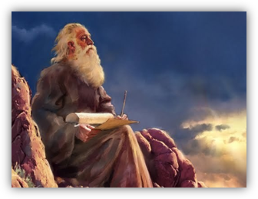
“To execute judgment upon all, and to convince all that are ungodly among them of all their ungodly deeds which they have ungodly committed, and of all their hard speeches which ungodly sinners have spoken against him.”
Jude 1:15

Slide 6
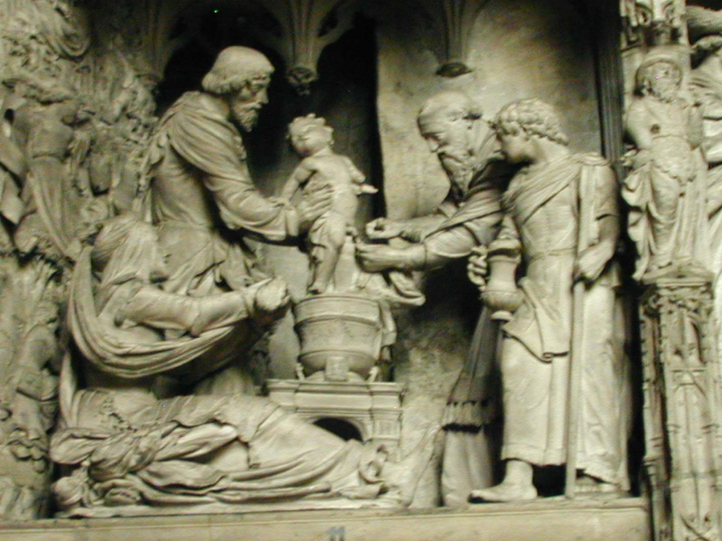
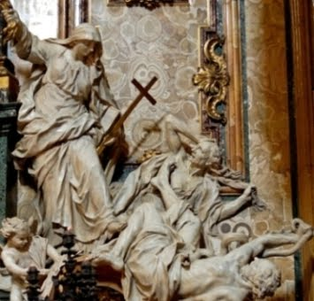
Ungodly Men With False Teachings
These Church members promoted corrupt, immoral practices by teaching that the doctrine of grace allowed for a complete license to sin because God would mercifully forgive.
They also rejected certain truths about Heavenly Father and Jesus Christ.
The phrase “who were before of old ordained to this condemnation” = the condemnation of such people had been written about long ago.
Jude 1:4

Slide 7
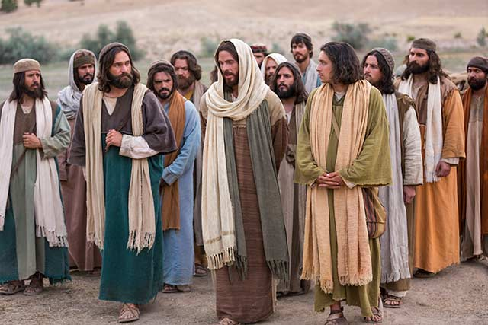
Earnestly Contend For Their Faith
Jude was referring to the faith that was taught originally by Christ Himself and then by His Apostles.
The same faith that we read about in the New Testament has been restored in our day and is found in The Church of Jesus Christ of Latter-day Saints.
Disciples of Jesus Christ should earnestly contend for the gospel of Jesus Christ against false teachings and corrupt practices
Jude 1:3
(1)

Slide 8
Characteristics of False Teachers
Defile their bodies with immorality
Despise authority and speak evil of dignities
Speak evil of things they do not understand
Corrupt themselves by living by the carnal knowledge they possess
Act in ungodly ways
Speak harsh words against God
Murmur and complain
Follow and act upon their lusts
Boast
Express admiration for others for the sake of personal advantage
Mock the Lord’s Church and its standards
Separate themselves from the believers
Think and act in sensual ways
Do not have the Spirit
Jude 1:8-19
(1)

Slide 9
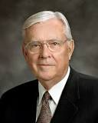
Apostles and prophets warn us of and help us recognize those who seek to weaken our faith and obedience
“Today we warn you that there are false prophets and false teachers arising; and if we are not careful, even those who are among the faithful members of The Church of Jesus Christ of Latter-day Saints will fall victim to their deception.”
(6)

Slide 10
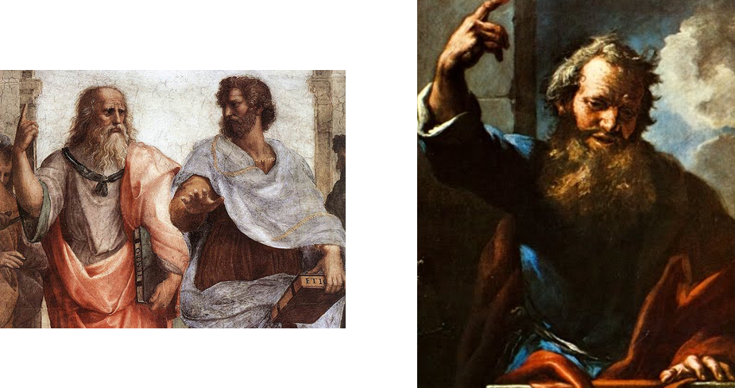
“These are murmurers, complainers, walking after their own lusts; and their mouth speaketh great swelling words, having men’s persons in admiration because of advantage.”
Jude 1:15

Slide 11
“But ye, beloved, building up yourselves on your most holy faith, praying in the Holy Ghost,”
Jude 1:20

Slide 12
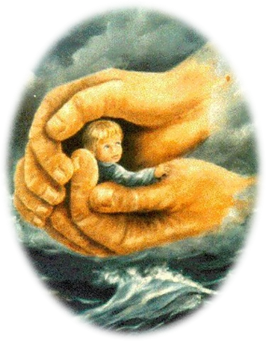
“Keep yourselves in the love of God, looking for the mercy of our Lord Jesus Christ unto eternal life.”
Jude 1:21

Slide 13
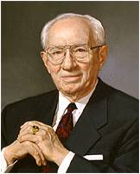
“The example of our living will carry a greater influence than will all the preaching in which we might indulge. We cannot expect to lift others unless we stand on higher ground ourselves.”
Jude 1:20-21
(5)

Slide 14
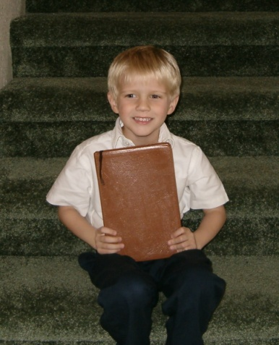
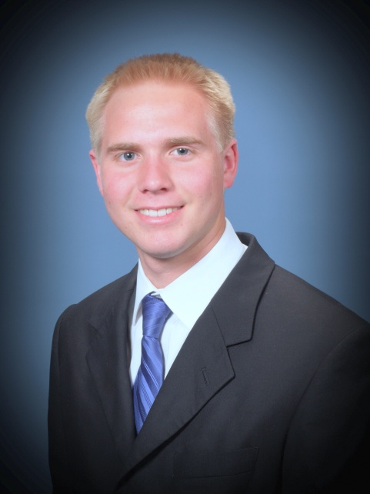
“It is your friendliness, your concern for others, and the good examples of your lives that result in the opinions held by others concerning the Latter-day Saints.”
Jude 1:20-21
(5)

Slide 15
Sources:
Suggested Hymn: #239 Choose the Right
Video:
Spiritual Whirlwinds (1:48)
Dangerous Tides (3:28)
New Testament Institute Student Manual Chapter 51
Bible Dictionary
Life and Teachings of Jesus and His Apostles Chapter 53
Elder Bruce R. McConkie (McConkie, DNTC, 3:415.)
President Gordon B. Hinckley Oct. 1975 Conference Report
Elder M. Russell Ballard (“Beware of False Prophets and False Teachers,” Ensign, Nov. 1999, 62).
Presentation by ©http://fashionsbylynda.com/blog/

Slide 16
THE LETTER OF JUDE, A BROTHER OF THE LORD, TO JEWISH CHRISTIANS FROM JERUSALEM, CA. A.D. 70–90 (JUDE)
Jude’s words are sharp and incisive against the particular form of apostasy with which he was concerned. In graphic style, he cites three scriptural precedents to show how God has dealt in times past with disbelievers: the destruction of those who came out of Egypt and were not permitted to enter the Promised Land, the angels “who kept not their first estate,” and the inhabitants of Sodom and Gomorrah. These Jude likens to apostates of his own day, and he predicts that the same fateful calamity which befell those in other eras will come to modern apostates as well. They err, he contends, in the same way that Cain, Balaam, and Korah of old erred—they trust in themselves rather than God. The only solution for those who would avoid such calamities is to call to mind the source of their blessings and to continue in prayer and good works. (See vss. 20, 21.) Having preserved themselves from apostasy, faithful members should be active in helping to avoid a similar fate (vss. 22, 23).
Jude
“Contend for the Faith” | 1:1–5
Certain Angels Kept Not their First Estate | 1:7–13
The Disputation of Michael the Archangel | 1:7–13
Enoch Prophesied of Christ’s Second Coming | 1:14–16
Earnestly Contend for the Gospel Jude 1:6:
“When evil wants to strike out and disrupt the essence of God’s work, it attacks the family. It does so by attempting to disregard the law of chastity, to confuse gender, to desensitize violence, to make crude and blasphemous language the norm, and to make immoral and deviant behavior seem like the rule rather than the exception.
“We need to remember Edmund Burke’s statement: ‘The only thing necessary for the triumph of evil is for good men to do nothing’ [attributed in John Bartlett, comp., Familiar Quotations,15th ed. (1980), ix]. We need to raise our voices with other concerned citizens throughout the world in opposition to current trends” Elder M. Russel Ballard (“Let Our Voice Be Heard” Ensign or Liahona,Nov. 2003, 18).
Modern Apostles have instructed Church members on how to contend for the gospel without being contentious. For example, see Elder Robert D. Hales, “Christian Courage: The Price of Discipleship,” Ensign or Liahona, Nov. 2008, 72–75; Elder Jeffrey R. Holland, “The Cost—and Blessings—of Discipleship,” Ensign or Liahona, May 2014, 6–9; and Elder Dallin H. Oaks, “Loving Others and Living with Differences,” Ensign or Liahona, Nov. 2014, 25–28.
Life and Teachings of Jesus and His Apostles Chapter 53
The Angels Who Did Not Keep Their First Estate Jude 1:6:
Both Abraham and Jude speak of the premortal world as our “first estate” (Abraham 3:26). Those spirits who were faithful in that initial stage of eternal progression qualified for the privilege of coming into mortality, our second estate, while those who rebelled against God and followed Lucifer are they of whom Jude speaks, “angels which kept not their first estate.’’ The Prophet Joseph Smith explains their condition:
“The spirits in the eternal world are like the spirits in this world. When those have come into this world and received tabernacles, then died and again have risen and received glorified bodies, they will have an ascendancy over the spirits who have received no bodies, or kept not their first estate, like the devil. The punishment of the devil was that he should not have a habitation like men.” (Smith, Teachings, pp. 305–6.)

