Slide 1
Lesson 151
Apostle of the Lamb
Revelation 1
I am the light of the world: he that followeth me shall not walk in darkness, but shall have the light of life.
John 8:12

Slide 2
Prophecies fulfilled:
Christ would be born of a virgin
He would be born in Bethlehem
He would flee to Egypt with His family

Slide 3
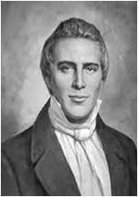
Apocalypse in Greek means revelation, uncovering, or unveiling.
In Revelation John records the events Jesus Christ showed him in a vision “which must shortly come to pass”.
Purpose of Revelation: to bless those who hear the words of this prophecy, and keep those things which are written therein.
Prophet Joseph Smith said, “the Book of Revelation is one of the plainest books God ever caused to be written.”

Slide 4
The Book of Revelation
John the Beloved is the ancient author of Revelation.
Revelation is a book of holy scripture. It came by revelation from the Lord.
Revelation deals with those things that interest people who have received the gift of the Holy Ghost, and those who have hope of eternal life.
Before John was born Nephi saw John in a vision and angels identified him as “One of the 12 apostles of the Lamb.”
That John was appointed and foreordained to write the very visions now found in the book.
(1)

Slide 5
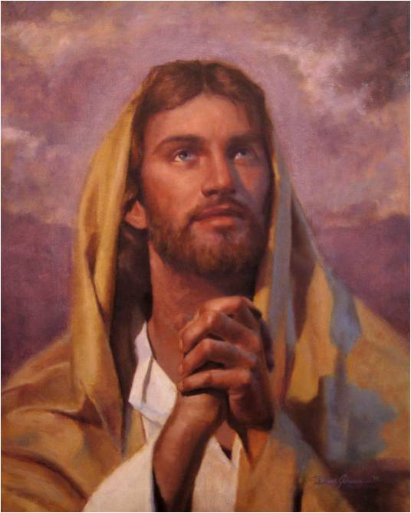
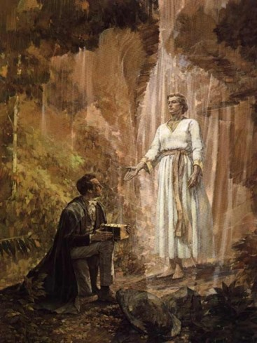
Divine Investiture
The Savior speaks for the Father (D&C 29:1, 42, 46)
The Holy Ghost speaks for the Savior(Moses 5:9)
An angel speaks for the Savior (Rev. 1:1)
And so forth….

Slide 6
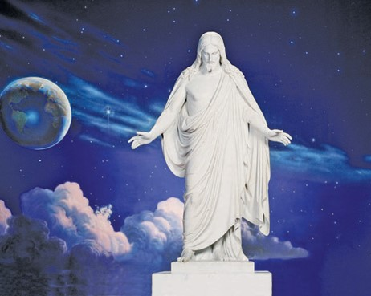
Jesus In Speaking For The Father
“In giving revelations our Savior speaks at times for Himself; at other times for the Father, and in the Father’s name, as though He were the Father, and yet it is Jesus Christ, our Redeemer who gives the message.”
Read D&C 29:1
(2)

Slide 7
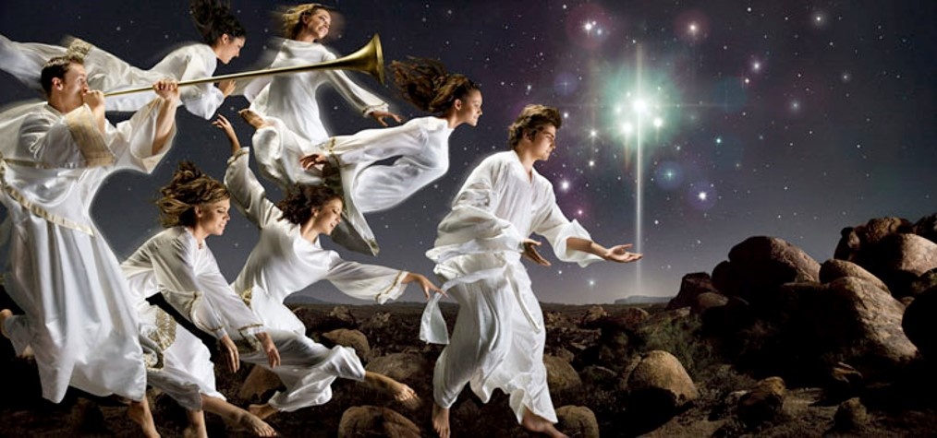
John Address Us In Our Day
JST
Blessed are they who hear and understand the words of the prophecy.
The Lord draweth nigh
Revelation 1:2-3

Slide 8
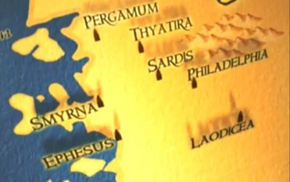
John’s Testimony Over the Churches
To the 7 leaders of the 7 branches of the Church in Asia
Now western Turkey
Sends blessings and peace from Jesus Christ
Being cleansed by Atonement
---washed us---blood cells constantly cleans out toxins and give us newness of life to each cell.
Revelation 1:4-5

Slide 9
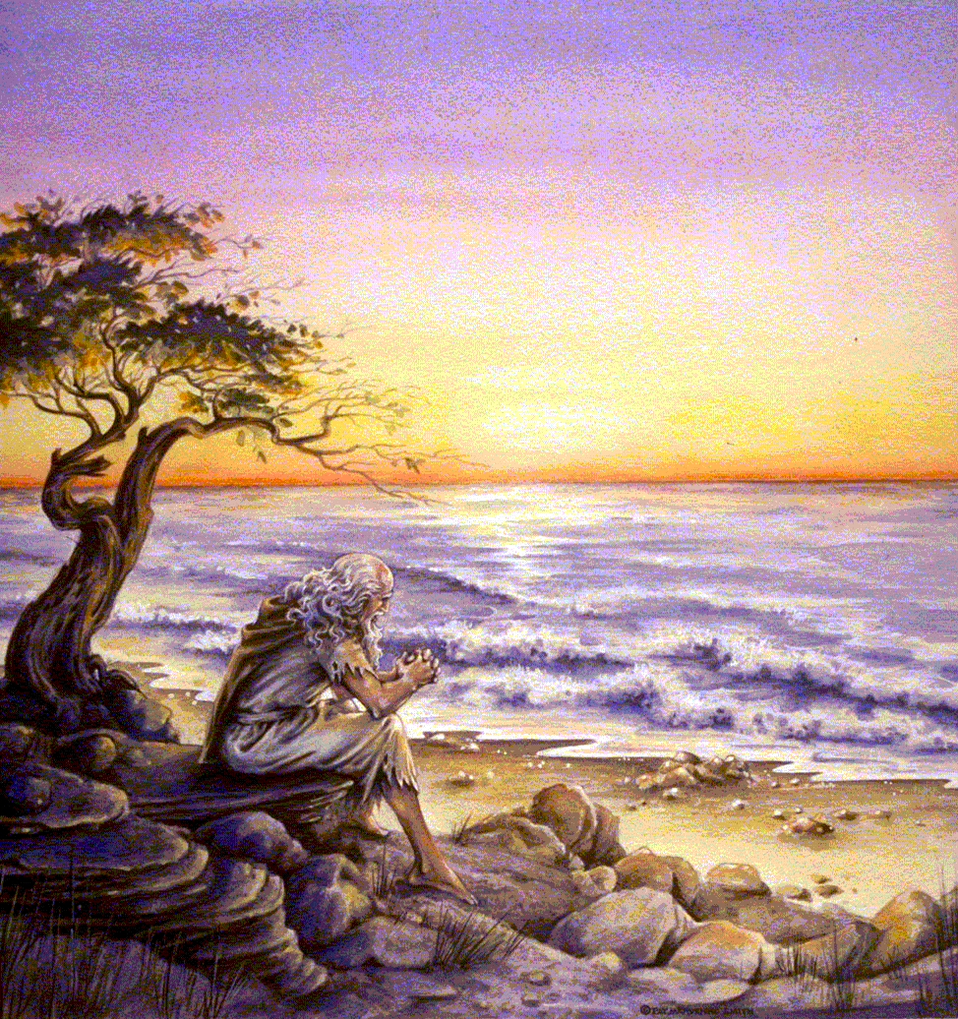
Addressed to the seven branches of the Church in Asia Minor. But is not exclusively for them
Background: Severe persecution against the Saints. Most likely administered by Rome either during the reign of Nero ad 54-68 or Domitian ad 81-96. Domitian persecuted those who did not worship gods approved by the state and many refused and were executed or exiled.
John wrote from a penal colony on the Island of Patmos, where he had been exiled because of his word of God and testimony of Jesus Christ.
The early Church suffered from internal apostasy , a warning from Paul the apostle.

Slide 10
About Revelation:
Same as all scriptures, there will be an eventual triumph on this earth of God over the devil. A permanent victory of good over evil, of the saints over their persecutors, of the kingdom of God over the kingdoms of men and of Satan.
2 sections: a vision of John’s day chapters 1-3, and a vision of the future Chapters 4-22.
Lord reveals to the seven churches their strengths and weaknesses and invites them to prepare for the future by repenting and learning to overcome the world.

Slide 11
Heaven’s Open
John was on the Island of Patmos. It was Sunday. The heavens opened, angelic ministrants attended, voices were heard, and visions were seen.
John was overshadowed by the power of the Holy Ghost.
Prophecy, visions, and revelations come by the power of the Holy Ghost and can only be understood in their fullness and perfection by the power of that same Spirit

Slide 12
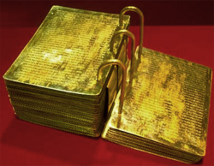
Searching Through Revelation
The Lord expects us to seek wisdom, to ponder his reveled truths, and to gain a knowledge of them by the power of his Spirit.
He has sealed a portion of the Book of Mormon from us because it is beyond our present ability to comprehend.
He has not withheld Revelations because it is not beyond our capacity to comprehend.

Slide 13
Beasts and Plagues
“ I make this broad declaration, that whenever God gives a vision of an image, or beast, or figure of any kind, He always holds Himself responsible to give a revelation or interpretation of the meaning thereof, otherwise we are not responsible or accountable for our belief in it.
Don’t be afraid of being damned for not knowing the meaning of a vision or figure, if God has not given a revelation or interpretation of the subject.”
As we read, seek to understand, and obey the Lord’s words, we will be blessed
(3)

Slide 14
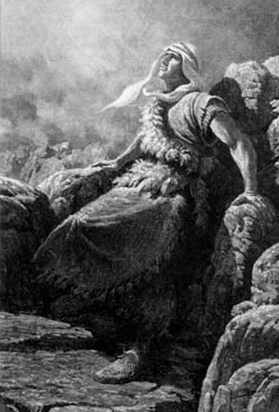
Nephi’s Vision
“And I looked and beheld a man, and he was dressed in a white robe…
…and the angel said unto me: Behold one of the twelve apostles of the Lamb.”
1 Nephi 14:19-20

Slide 15
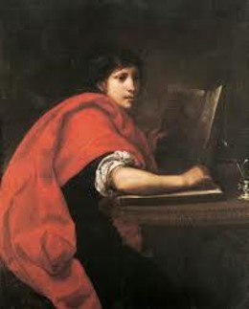
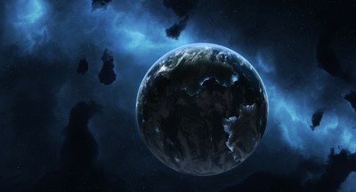
The Prophecy
“Behold, he shall see and write the remainder of these things; yea, and also many things which have been.”
…and he shall also write concerning the end of the world.”
1 Nephi 14:21-22

Slide 16
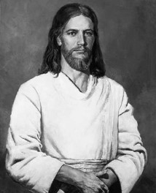
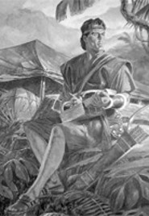
Bearing Record—writing record
“And I, Nephi, heard and bear record, that the name of the apostle of the lamb was John, according to the word of the angel.”
John is commanded by Jesus to “write in a book, and send it unto the seven churches…”
1 Nephi 14:27; Revelation 1:11

Slide 17
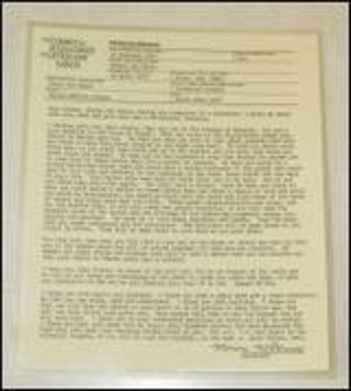
Your Record--Future
Patriarchal blessings are given to worthy members of the Church by ordained patriarchs.
Patriarchal blessings include a declaration of a person's lineage in the house of Israel and contain personal counsel from the Lord.
As a person studies his or her patriarchal blessing and follow the counsel it contains, it will provide guidance, comfort, and protection.

Slide 18
Angel to John
“The Revelation of Jesus Christ, which God gave unto him, to shew unto his servants things which must shortly come to pass; and he sent and signified it by his angel unto his servant John:”
Signified = representing by a sign, mark, or token.
“Blessed is he that readeth, and they that hear the words of this prophecy…
hear the words = study and understand and keep
Revelation 1:1-3

Slide 19
Jesus Christ
“…Grace be unto you, and peace, from him which is, and which was, and which is to come;”
Which is, which was, and which is to come = “I Am”
Read D&C 93
“I am Alpha and Omega, the beginning and the ending…”
“…what thou seest, write in a book, and send it unto the seven churches…”
Revelation 1:4-8, 11

Slide 20
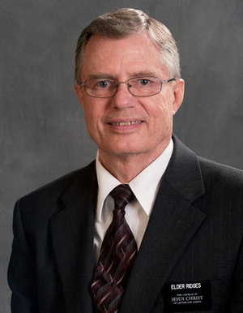
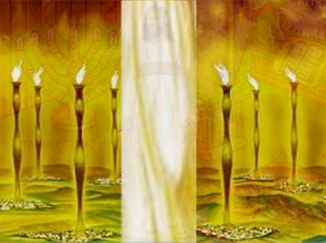
Vision of John
“And I turned to see the voice that spake with me, and being turned, I saw seven gold candlesticks.”
Gold = the best, or true gospel
Candlesticks do not give light, rather, they carry the source of light, which is Christ and His gospel, to the world.
(4)
Revelation 1:12

Slide 21
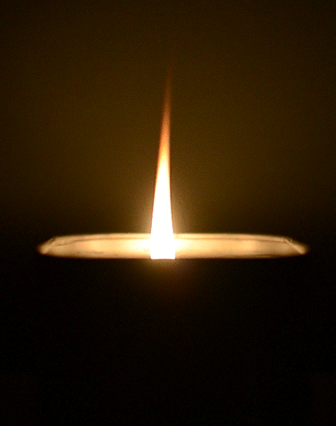
Christ is the Light of the World
“Candlesticks carry light; they do not create it. Their function is to make it available, not to bring it into being.
So by using seven candlesticks to portray the seven churches to whom John is now to give counsel, the Lord is showing that his congregations on earth are to carry his light to the world…
‘Hold up your light that it may shine unto the world. Behold I am the light which ye shall hold up—that which ye have seen me do.’
Revelation 1:12; John 8:12; 3 Nephi 18:24; Matthew 5:14-16
(5)

Slide 22
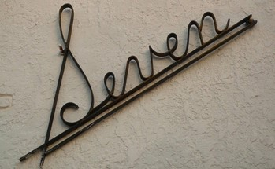
Seven = Completeness, Perfection
Seven Churches
The Seven Seals
The Seven Judgments on Harlots
The Seven Persons
The Seven Vials
The Seven Trumpets

Slide 23
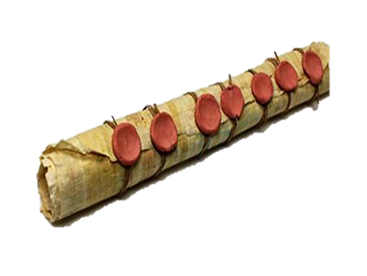
“The message of Revelation is the same as that of all scripture: there will be an eventual triumph on this earth of God over the devil; a permanent victory of good over evil, of the Saints over their persecutors, of the kingdom of God over the kingdoms of men and of Satan” (1)

Slide 24
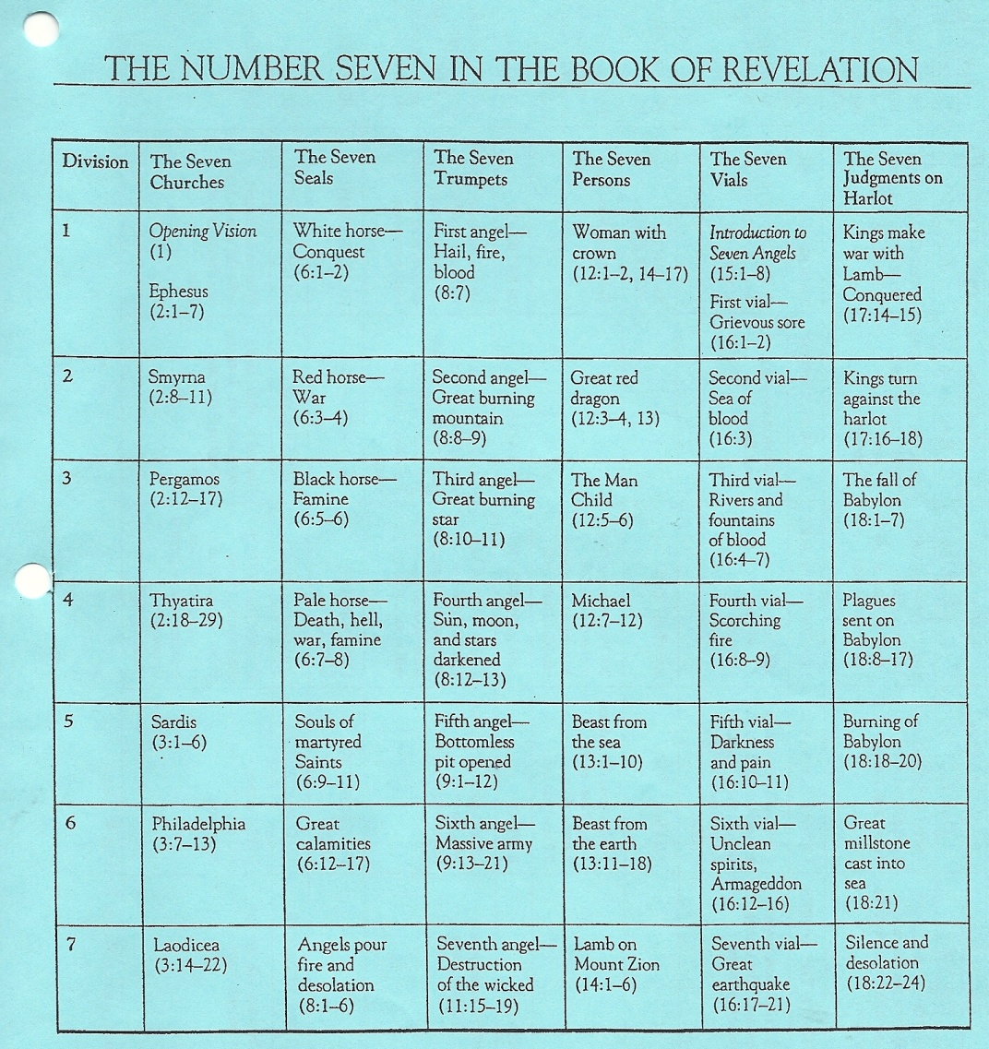
David J. Ridges “The Book of Revelation Made Easier” pg. 12

Slide 25
Sources:
Suggested Hymn: #89 The Lord is My Light
Bible Dictionary
Joseph Fielding Smith---Doc. Of Salvation 1:27
Teachings of the Prophet Joseph Smith p 291
David J. Ridges “The Book of Revelation Made Easier” pg. 12
Elder Bruce R. McConkie Doctrinal New Testament Commentary, 3 vols. [1965–73], 3:442.
Presentation by ©http://fashionsbylynda.com/blog/

Slide 26
Understanding Revelation:
Book of Revelation deals with things that are to occur after New Testament times, particularly in the last days.
Knowledge of the plan of salvation and of the nature of God’s dealing with men on earth.
Use various latter-day revelations which expand upon the same subjects in similar language. Example: D&C 45 Latter-day plagues and the Second Coming. D&C 76 expands upon the doctrines relative to salvation and exaltation.
Study the sermons of Joseph Smith relative to the book of Revelation.
Use the Inspired Version of the Bible.
Reserve judgment on those things for which no interpretation is given. Avoid being entangled in the specious speculation of an uninspired world.
Seek the Spirit.
Chief Message: That Jesus is Lord of all, that He descended from his Father’s throne to dwell among men, that He worked out the infinite and eternal atonement and has now returned in glory to that throne from whence he came, and that He will raise all men to a kindred glory and a like dominion if they will overcome the world and walk as He walked.
Elder Bruce R. McConkie Sept. 1975 Ensign

Slide 27
Symbols in Revelation 1
SYMBOL | POSSIBLE MEANING
Revelation 1:12—Seven golden candlesticks | Revelation 1:20; 3 Nephi 18:24—
Revelation 1:16–17—The right hand | Mark 16:19—
Revelation 1:16—Seven stars | Joseph Smith Translation, Revelation 1:20 (in Revelation 1:20, footnote b)—
Revelation 1:16—A sharp two-edged sword | Hebrews 4:12—
Revelation 1:18—The keys of hell and death | 2 Nephi 9:10–13—

