Slide 1
Lesson 152
The Seven Churches
Revelation 2-3

Slide 2
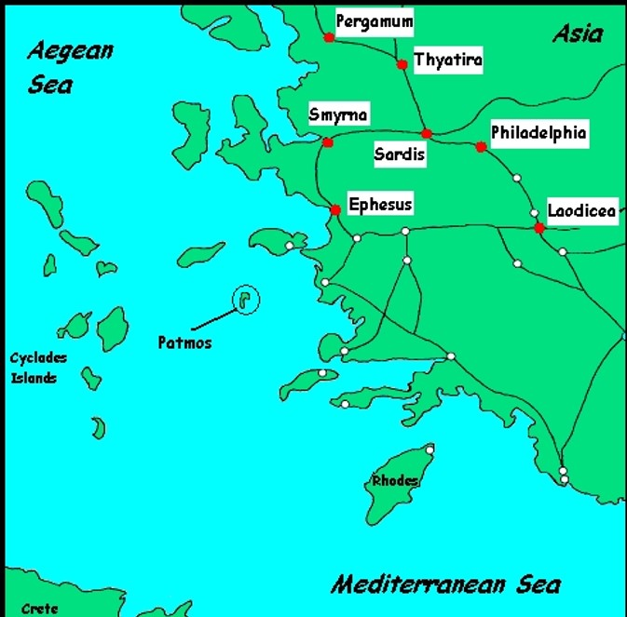

Slide 4
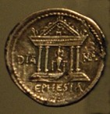
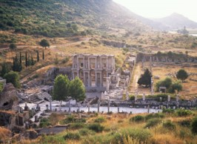
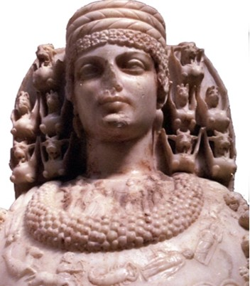
Ephesus: Revelation 2:1-7
The largest city in Asia Minor. It was an import and harbor
and junction for important highways and trade routes. It
was famous throughout the world for its magnificent temple
of Diana, one of the seven wonders of the ancient world.
The temple was the center of the riot in Ephesus involving the apostle Paul. His preaching threatened to destroy the business of the local artisans who made silver models of the temple to sell to tourists and worshippers (Acts 19:23). At the time of Paul, the port was filling with silt from the river Cayster, and, while still a major city, Ephesus was in a state of gradual decline. Ephesus was the center of the Christian church for many years until the center gradually shifted to Rome.

Slide 5
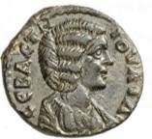
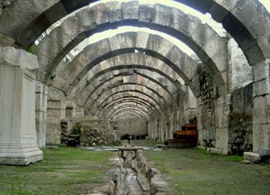
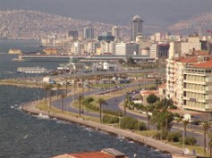
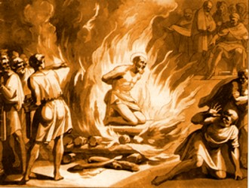
Smyrna Revelation 2:8-10
Called the “Jewel of Asia.” Situated on an excellent harbor
that is still one of the major ports of Turkey (present day
Izmir). Smyrna was an important trade center. It was
destroyed by an earthquake in 627 BC and was rebuilt,
one of the few “planned” cities of the ancient world. Smyrna built a temple to the goddess of Rome and was one of the first and foremost cities to heartily embrace the Imperial Cult or emperor worship. The Saints of Smyrna faced intense persecution and struggled under the burden of poverty. Special encouragement to the servants in Smyrna. It is interesting to note that Polycarp, the Bishop of Smyrna, was martyred when he refused to deny Christ. He was burned at the stake and smitten with a sword as the flames encircled him.

Slide 6
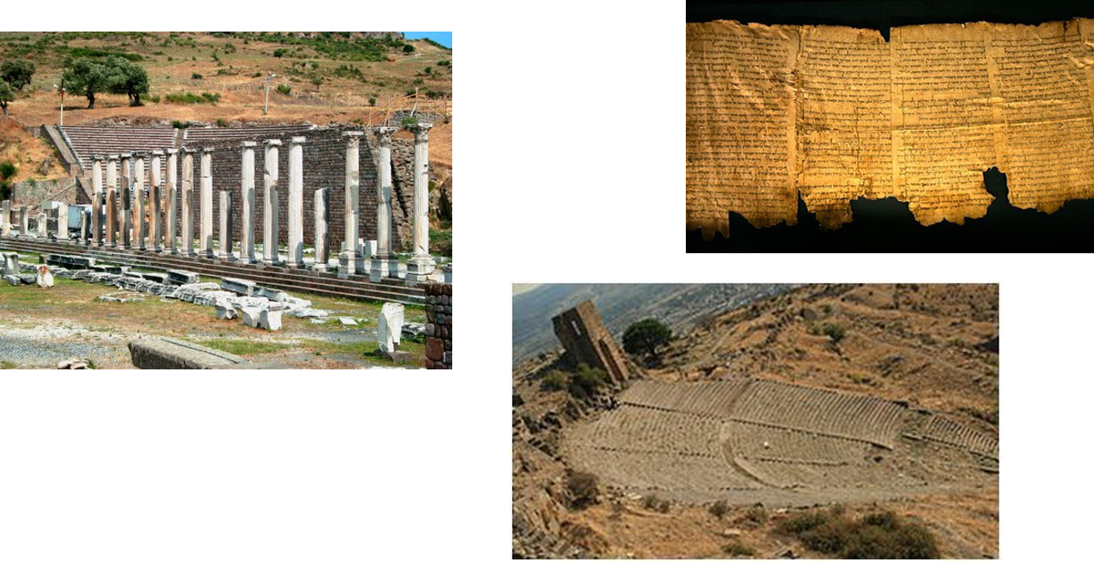
Pergamos Revelation 2:12-17
This city was the provincial capital of Asia, the seat of the proconsul of Rome. Pergamos became a major center for emperor worship and was most famous for its library which housed over 200,000 scrolls. It was also a major center for the worship of the serpent god, whose 3 temples stood in the city. The city was a place of much wickedness.

Slide 7
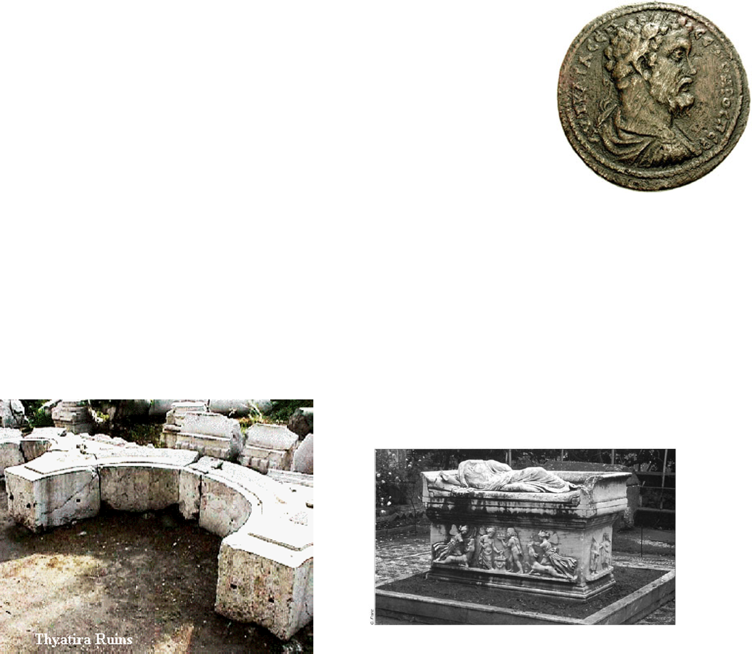
Thyatira Revelation 2:18-29
Even though Thyatira was the smallest of the seven cities,
they received the longest letter. The city was best known as
a center for many craft guilds, including dyeing of wool.
To be a member of one of the many trade guilds, you were
required to participate in the guild banquets. In these banquets, all meat and wine were sacrificed to the particular god associated with that guild. All those in attendance had to eat and drink—honoring their patron---and they were also expected to participate in the other “festivities”, which were often public and sexual in nature. The city was a garrison city. The military spirit was stressed highly and its chief deity, a son-god, was portrayed in attitudes of military prowess.

Slide 8
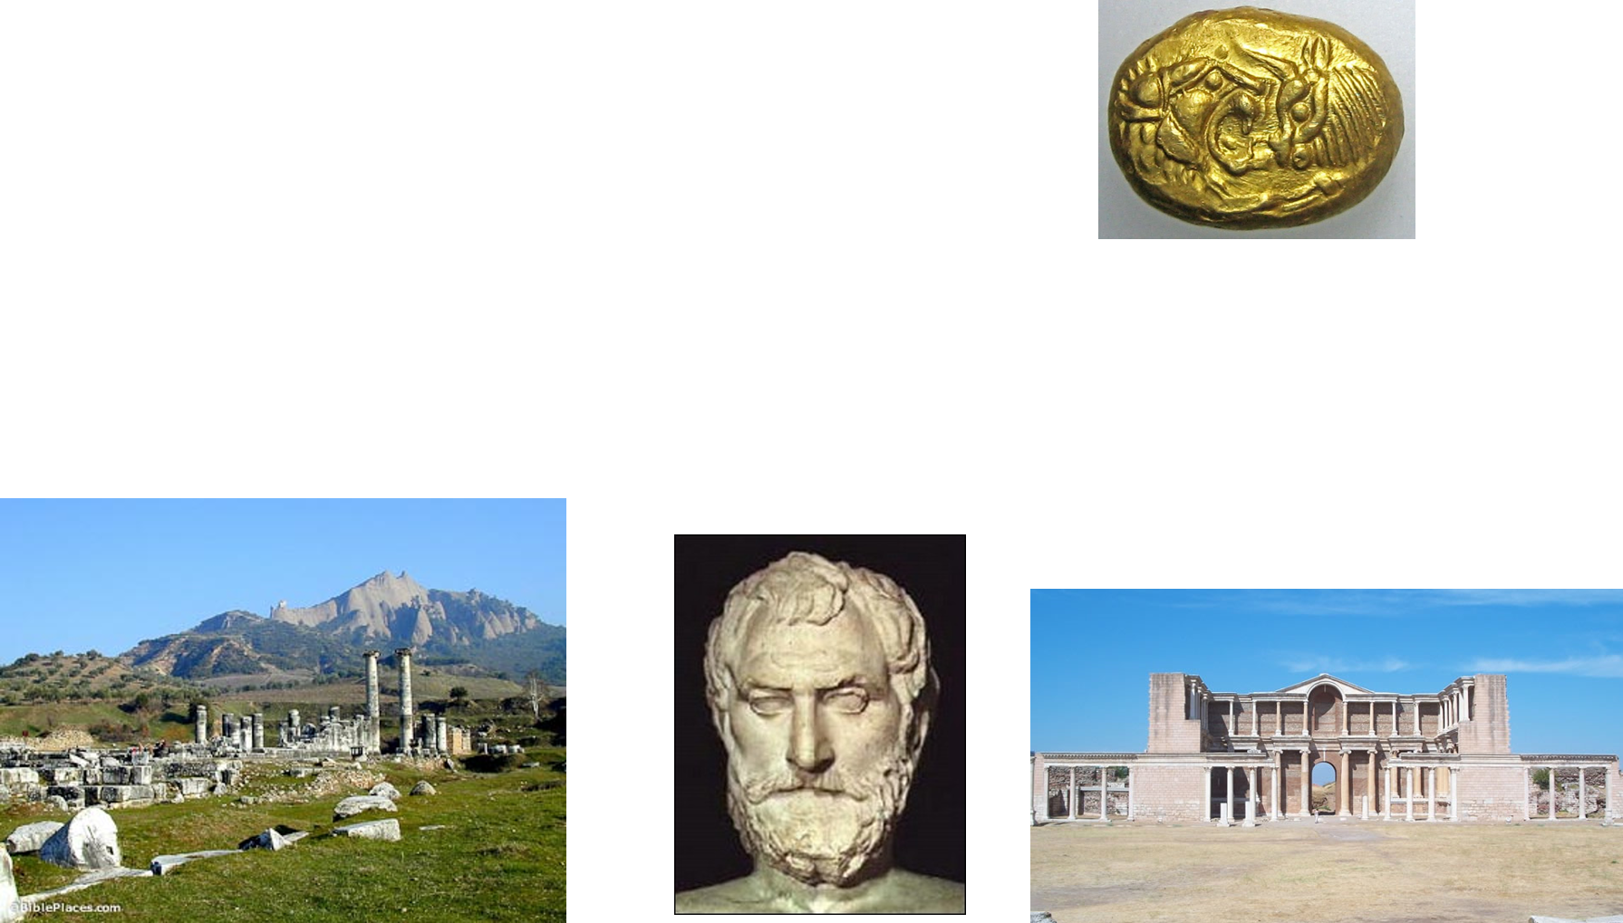
Sardis Revelation 3:1-6
Sardis was located at the crossroads of five major land
routes and was an important inland trade center.
Thales, the first Greek philosopher, was from there.
Built on an impregnable cliff, made Sardis virtually impenetrable to attack.
The river which flowed through the town carried gold dust. It was renowned for its great wealth, and resulting inner softness and corruption. “I know thy works, that thou has a name (a reputation) that thou livest and art (spiritually) dead”

Slide 9
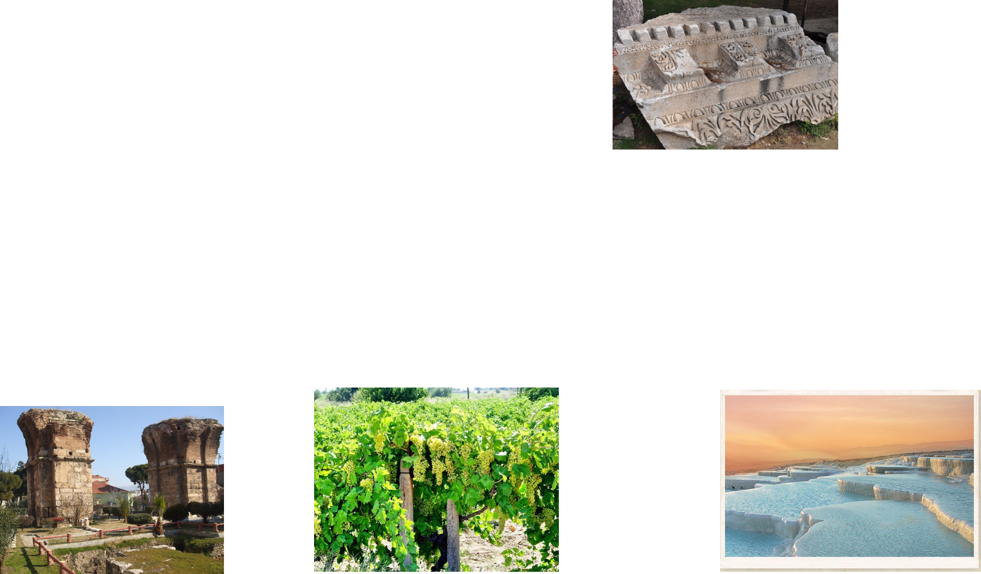
Philadelphia Revelation 3:7-13
Philadelphia was called the “Gateway to the East”
because of its location. Its name means city of brotherly
love. It was in the midst of an active volcanic region and
had several hot springs in the area. It was a city of great
idolatry Bacchus, the god of wine, was the primary god worshiped there, since Philadelphia lay in a rich area of vineyards. The city of Philadelphia was subject to frequent and sever earthquakes. Because of this situation, the people often fled to the open country living in tents or booths. The city was often shattered and the migrations from its ruins were frequent. The citizens lived in constant terror. Christ encouraged His people with the promise that if they were faithful they would one day enter the New Jerusalem---the city of god, where they could dwell safely and “go no more out.”

Slide 10
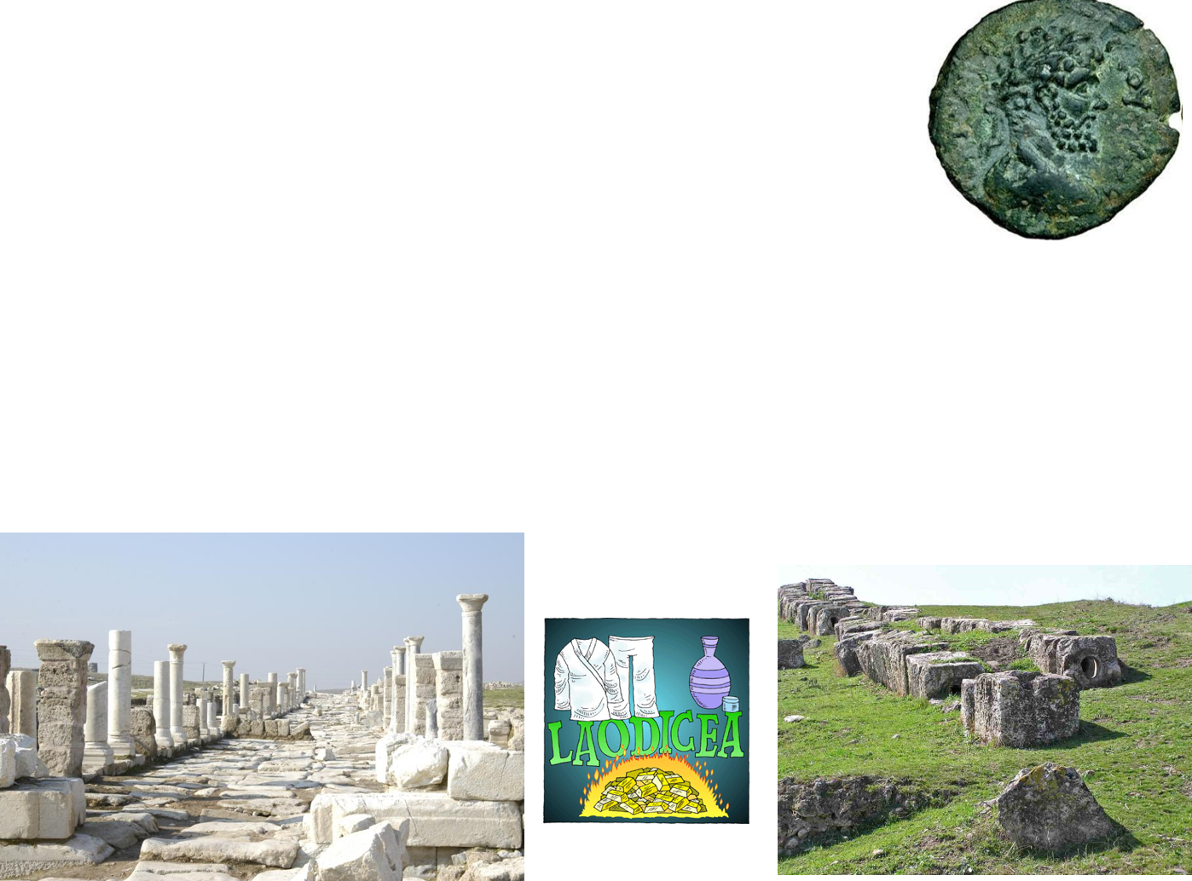
Laodicea Revelation 3:14-21
Laodicea was located at the junction of two important valleys
and three major roads. Is was one of the richest commercial
centers in the ancient world. Laodicea was a center of learning,
art and culture. It was especially noted for its banking, its
manufacture of a unique black wool, and for a medical school that was famous for an eye salve made from Phyrgian stone (3:18). Hot springs, a short distance to the north, and a place of healing, sent steaming waters into the ice cold streams from nearby mountains. By the time the water mixed and reached the city it was luke warm. It had a reputation for accommodating itself to all peoples---a melting pot of diversity---a City of Compromise.

Slide 11
Promises to the Seven Branches of the Church
Eternal life and exaltation in the Celestial Kingdom
Revelation 2-3

Slide 12
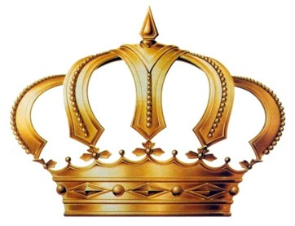
Tree of Life
Revelation 2:7
Crown of Life and promise of ruling
Revelation 2:10
Revelation 2:27
White Stone with a new name
Revelation 2:17
Eternal Life
Revelation 22:2
Blessings in the celestial kingdom of ruling as kings and priests forever
D&C 76:56
Only given to those who obtain the celestial kingdom
D&C 130:10-11

Slide 13
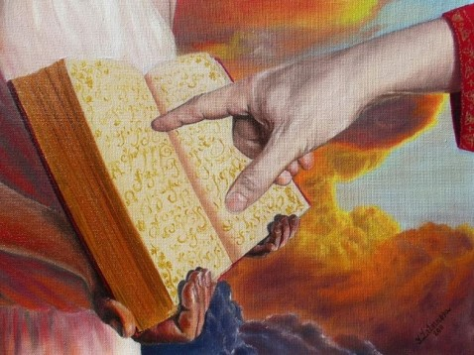
Clothed in white and whose names are written in book of life
Revelation 3:4-5
Name of God written on them are gods themselves
Revelation 3:12
Those who are sanctified and inherit the celestial kingdom
D&C 88:2
The promised blessing of those who are exalted
D&C 76:58

Slide 14
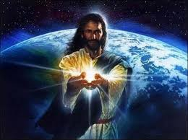
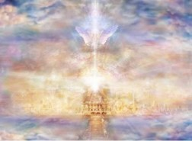
The Morning Star
Revelation 3:14
Sit with Christ on His throne is to be as He is
Revelation 3:21
A Symbol of Jesus Christ
Only given to those who inherit exaltation in the highest degree of the celestial kingdom
D&C 132:20

Slide 15
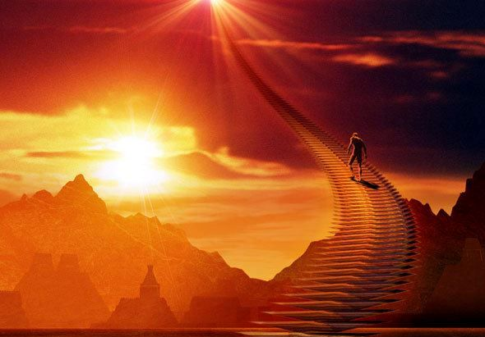
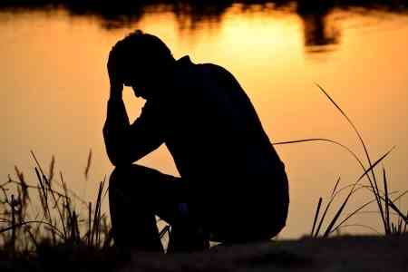
If we overcome, then we can receive the blessings of exaltation
Because the Lord loves us, He corrects us so we will repent
The Lord is merciful, and those who have sinned can obtain eternal life if they will repent

Slide 16
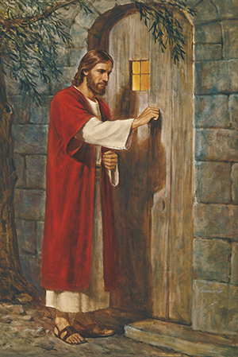
“One day [an artist named Holman Hunt] was showing his picture of ‘Christ Knocking at the Door’ to a friend when the friend suddenly exclaimed: ‘There is one thing wrong about your picture.’
“‘What is it?’ inquired the artist.
“‘The door on which Jesus knocks has no handle,’ replied his friend.
“‘Ah,’ responded Mr. Hunt, ‘that is not a mistake. You see, this is the door to the human heart. It can only be opened from the inside.’
“And thus it is. Jesus may stand and knock, but each of us decides whether to open.”
As we open the door to the Savior, He will come in to us and sup with us
(2)

Slide 17
Sources:
Suggested Hymn: #65 Come, All Ye Saints Who Dwell on Earth
Video:
The Will of God (3:02)
Taken from Poway Institute Handouts by Lesly Meachum and Becky Davies
President Spencer W. Kimball (The Miracle of Forgiveness [1969], 212).
See Article Jay M. Todd, "The Seven Cities of Revelation ," Ensign, August 1976
Presentation by ©http://fashionsbylynda.com/blog/

Slide 18
“Revelation 2:11 teaches that the faithful ‘shall not be hurt of the second death.’ The wicked, however, ‘shall have their part in the lake which burneth with fire and brimstone: which is the second death’ (Revelation 21:8). While serving in the Presidency of the Seventy, Elder Earl C. Tingey explained that ‘the second death is spiritual. It is separation from God’s presence’” (‘The Great Plan of Happiness,’ Ensign or Liahona, May 2006, 73).
“In one sense, we all experienced a spiritual death when we left God’s presence to come to earth. This initial separation, however, is not the ‘second death’ mentioned in Revelation 2:11. Through the Atonement of Jesus Christ, all of God’s children will overcome this initial spiritual death and be brought back to God’s presence to be judged (see Helaman 14:16–17), after which most people will inherit a kingdom of glory. A second spiritual death will be pronounced at the Day of Judgment upon those who refuse to repent of their sins and who willfully rebel against the light and truth of the gospel, as Satan did [see D&C 29:44–45; Guide to the Scriptures, ‘Death, Spiritual,’ scriptures.lds.org]. They will be forever separated from God and will be sons of perdition (see D&C 76:30–37, 44)” (New Testament Student Manual [Church Educational System manual, 2014], 534)
Hidden Manna and White Stone Revelation 2:17:
“The Lord provided life-sustaining manna for the children of Israel to eat during their 40-year sojourn in the wilderness (see Exodus 16:15, 35). Just as the manna sustained physical life, Jesus Christ is the ‘bread of life’ that sustains spiritual life (John 6:35, 48). The ‘hidden manna’ mentioned in Revelation 2:17 refers to Jesus Christ. Jesus is ‘hidden’ from the wicked. But, as He taught in John 6, those who symbolically partake of His flesh will receive everlasting life (see John 6:47–58). …
“… For revealed insight into the meaning of the white stone, see Doctrine and Covenants 130:8–11” (New Testament Student Manual [Church Educational System manual, 2014], 535).
The Morning Star Revelation 2:28:
“‘The morning star’ is a symbol of Jesus Christ (Revelation 2:28; 22:16). The promise of ‘the morning star’ is given to him ‘that overcometh, and keepeth my works unto the end’ (Revelation 2:26)” (New Testament Student Manual [Church Educational System manual, 2014], 535).
Balaam Revelation 2:14:
“Balaam was an Old Testament prophet, whose actions are recorded in Numbers 22–24; 31:16. He appeared at first to be true to the Lord and His people, repeatedly refusing Balak’s request to curse Israel. Nevertheless, Balaam eventually succumbed to Balak’s offer of riches and taught Balak how to cause the army of Israel to weaken themselves through sexual sin and idolatry (see Numbers 25:1–5; 31:13–16). The plan included having Moabite women seduce the men of Israel and persuade them to offer sacrifices to heathen gods, thus destroying them spiritually” (New Testament Student Manual[Church Educational System manual, 2014], 534).
Amen Revelation 3:14:
“In Hebrew and Greek the word ‘amen’ means truly, certainly, or faithfully. In Revelation 3:14, Christ’s faithfulness and truthfulness as the great ‘Amen’ are presented as a contrast to the lukewarm attitudes of the Laodiceans. When uttered at the conclusion of a prayer or a discourse, ‘amen’ is a way of solemnly affirming what has been said or expressing agreement with it. Elder Bruce R. McConkie taught that the Savior’s title ‘Amen’ also shows ‘that it is in and through him that the seal of divine affirmation is placed on all the promises of the Father’ (Mormon Doctrine, 2nd ed. [1966], 32)” (New Testament Student Manual [Church Educational System manual, 2014], 536).

