Slide 1
Lesson 153
A Vision of the Future
Revelation 4-5

Slide 2
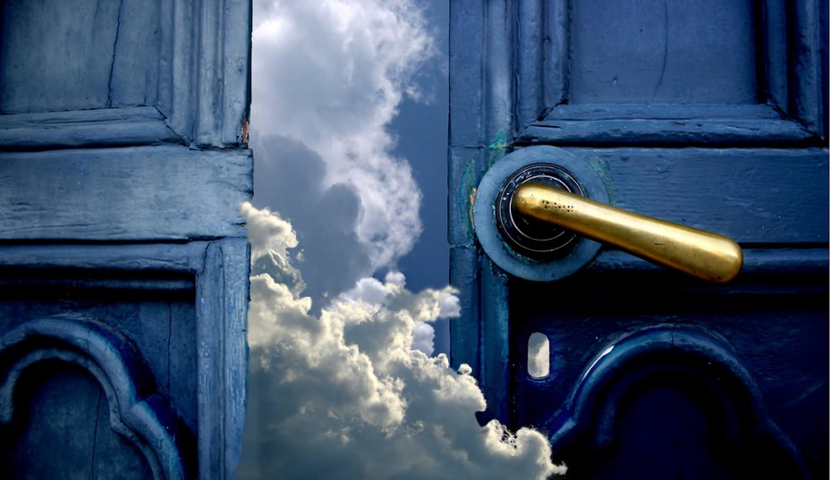
Come Up Hither
John sees a door open in heaven and is invited to “Come up Hither”
(JST: open into Heaven)
Revelation 4:1

Slide 3
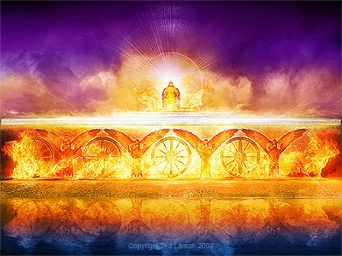
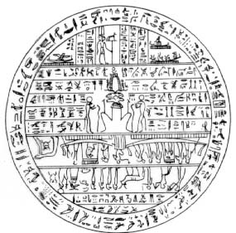
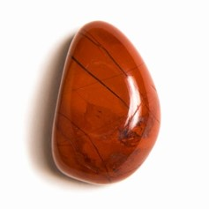
The Throne of God
Jasper and sardine stone=hard, deep orange-red—look on with awe
Rainbow=glory and beauty, mercy and Covenant
See Book of Abraham Facsimile 2, fig. 3
Revelation 4:3

Slide 4
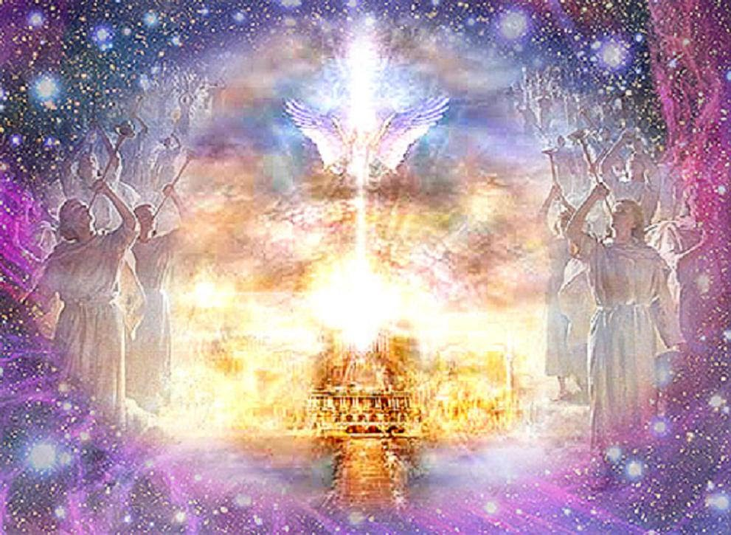
Heavenly Images Described by Ezekiel
A throne, as the appearance of a sapphire stone: and upon the likeness of the throne was the likeness as the appearance of a man above upon it.
And I saw as the colour of amber, as the appearance of fire round about within it, from the appearance of his loins even upward, and from the appearance of his loins even downward, I saw as it were the appearance of fire, and it had brightness round about.
As the appearance of the bow that is in the cloud in the day of rain, so was the appearance of the brightness round about. This was the appearance of the likeness of the glory of the Lord. And when I saw it, I fell upon my face, and I heard a voice of one that spake.
Revelation 4:3; Ezekiel 1:26-28

Slide 5
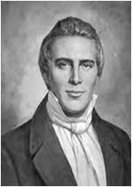
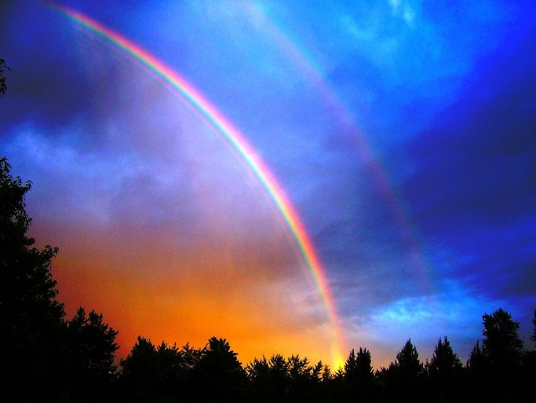
A Rainbow
A Rainbow is a result of sunlight passing through raindrops. Each raindrop acts as a prism to bend the light which produces the colors. They always appear in this order: red, orange, yellow, green, blue, purple and violet.
Light and water are scriptural symbols of revelation.
God’s mercy and covenants come through revelation to man, not to be taken from the earth until Christ comes.
(2)

Slide 6
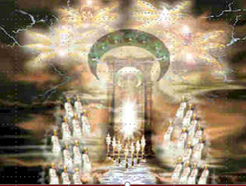
Four and twenty Seats = thrones, symbolic of royalty—twenty four elders
Multiple of 12 suggests fullness
12 Patriarchs of the 12 tribes of Israel and 12 Apostles
Rev. 4:4; D&C 77

Slide 7
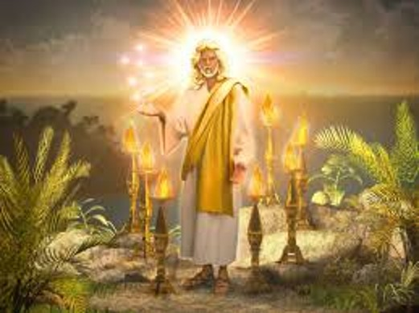
Lightnings and Thunderings and Voices
7 lamps of burning fire=
7 Spirits of God=
7 leaders of
7 wards
Rev. 4:5

Slide 8
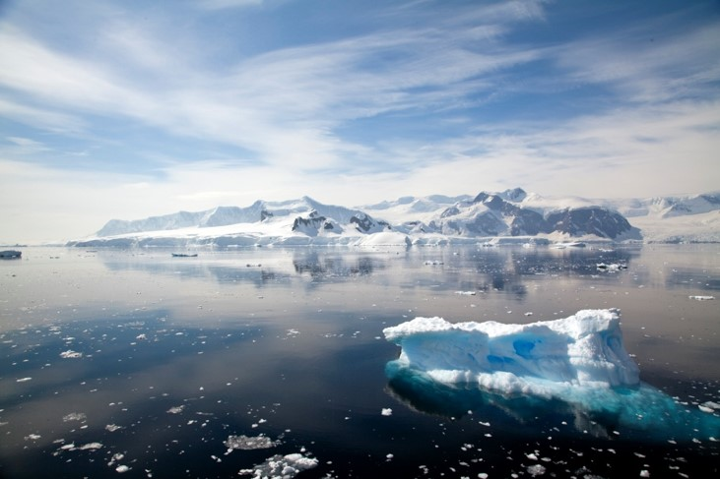
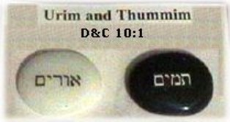
Sea of Glass
Crystal=beauty, purity, clarity=transparent, nothing hidden
(Urim and Thummin)
The earth in its celestial glory
Rev. 4:6 and D&C 77:1

Slide 9
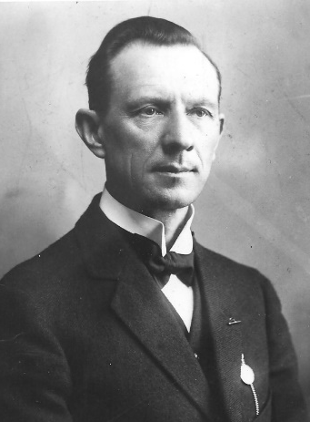
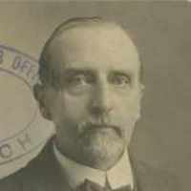
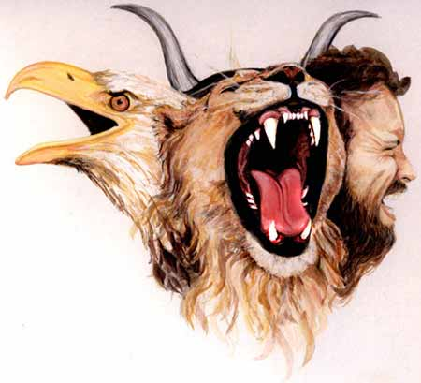
4 beasts—all the energy emulating from God
Lion—King, predator, wild, strength=Mark
Eagle---dignified, birds, might=John
Calf—docile, friendly, domestic, heart=Luke
Man—Thought, highest order, mind=Matthew
D&C 77:2
(3)

Slide 10
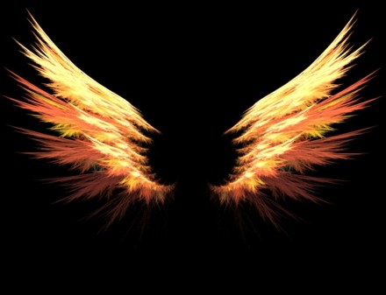
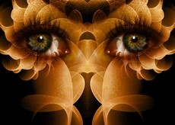
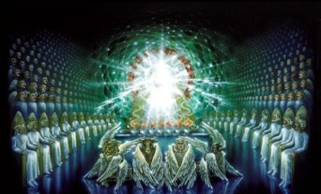
Beasts have Spirits and will dwell in eternal felicity
Power to Move and Act
6 wings—movement and power
Full of eyes within---full of light and knowledge
Rev. 4:8 and D&C 77:4

Slide 11
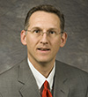
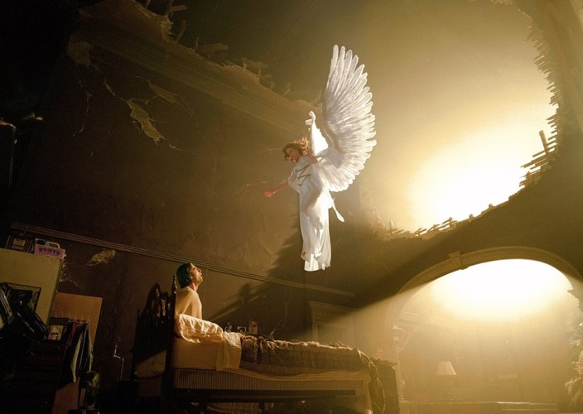
Wings
The Prophet Jeremiah uses wings as an image of power swooping down upon Moab and Bozrah (Jeremiah 48:40)
In Isaiah there is a similar image regarding Judah (Isaiah 8:8)
“More often than not, ancient and modern iconography depicts heavenly beings as possessing wings. This image is purely symbolic, however, for “an angel of God never has wings.”
(Joseph Smith)
Rev. 4:8
(4)

Slide 12
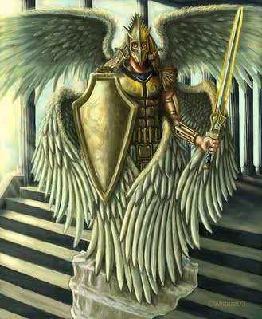
Six
Heavenly creatures have 6 wings:
Six = symbol of incomplete
“It may be a representation of their (the beasts) interim state as celestial heirs awaiting resurrection, which may explain the sense in which they are “incomplete”
Rev. 4:8
(4)

Slide 13
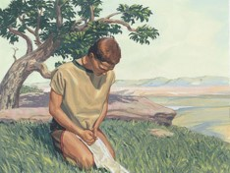
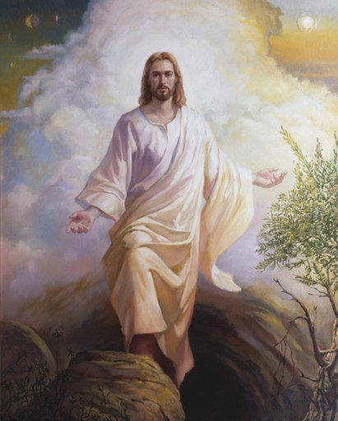
The Power of Wings
“Upon the wings of his Spirit hath my body been carried away upon exceedingly high mountains.”
(2 Nephi 4:25)
The power of the Holy Ghost
“…healing in his wings…” Malachi 4:2
2 Nephi 25:13
3 Nephi 25:2
An image of His power over death and the blessing that awaits all people because of that power.
Rev. 4:8
(4)

Slide 14
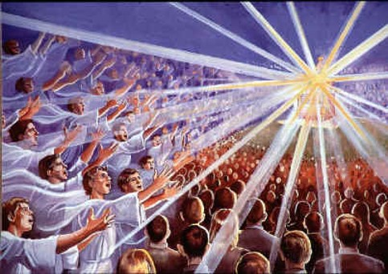
Praises To God and The Lamb
“Thou art worthy, O Lord, to receive glory and honour and power: for thou hast created all things, and for thy pleasure according to thy will they are and were created.”
God’s Work
Begets children
Creates worlds
Exalts them
As we recognize Heavenly Father’s greatness, we desire to worship and praise Him
Rev. 4:9

Slide 15
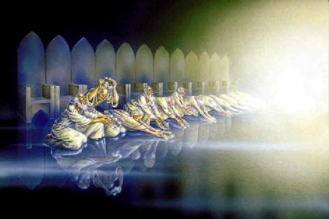
Casting Their Crowns
24 elders show their humility, submission, and respect to the Father and His authority
Before the throne—
Consecrating their stewardship
Rev. 4:10
(5)

Slide 16
Temporal existence of earth
Revelation 5

Slide 17
Revelation 5
What was contained in the book described in Rev. 5:1?
How long is the earth’s temporal existence?
Who was the only one who could open and read the book in Rev. 5:5?
What number did Joseph Smith change in Rev. 5:6?
Who did the spirits of God in Rev. 5:6 represent?
Were the 4 beasts in Rev. 5:8 actual animals? See also Rev. 4:8
The “will, mysteries, and the works of God” concerning the earth during its temporal existence (D&C 77:6)
7,000 years (D&C 77:6)
Jesus Christ (Rev. 22:16)
The number 7 to 12 (JST Rev. 5:6)
The Twelve Apostles (JST Rev. 5:6)
Yes, though John describes them figuratively (D&C 77:2-4)

Slide 18
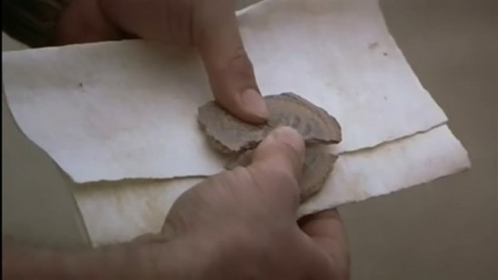
Why was Jesus Christ able to open the sealed book?
How many angels did John see shouting praises to the Lamb? See Rev. 5:11
Who else praised Him?
Because of His atoning sacrifice (Rev. 5:9)
“Ten thousand times ten thousand, and thousands of thousands” (Rev. 5:11)

Slide 19
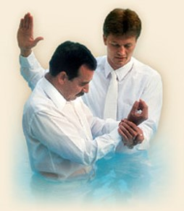
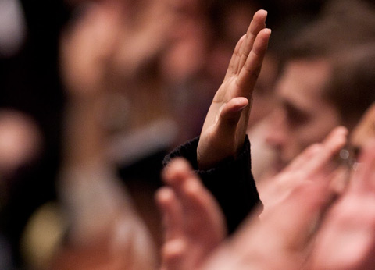
The Right Hand = Covenant hand
Rev. 5:1

Slide 20
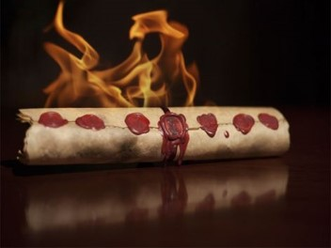
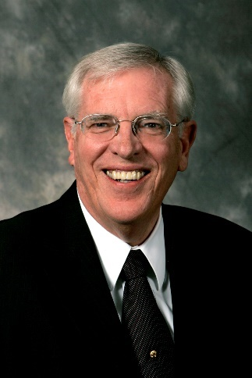
Seven Seals
In ancient times, important documents were sealed with clay or wax seals. Only the owner of the document and those whom the owner authorized were allowed to break the seals and read the text
“And when I looked, behold, an hand was sent unto me; and , lo, a roll of a book was therein;
And he spread it before me; and it was written within and without…”
"The document is sealed with seven seals. The use of seals was common during ancient times to prevent adulteration of important papers and, more importantly, to prove their authenticity.
The verb sphragiz, to provide with a seal, carried the idea of assured content and authenticity. But the idea of ownership was important because the owner protected the document. In John's day, seals carried the mark of the owner who guaranteed the contents and was responsible for carrying out the agreements, if any, contained therein." (6)
Rev. 5:1-4; Ezekiel 2:9-10

Slide 21
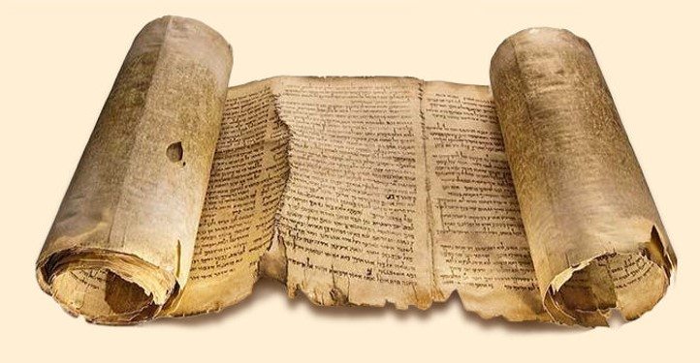
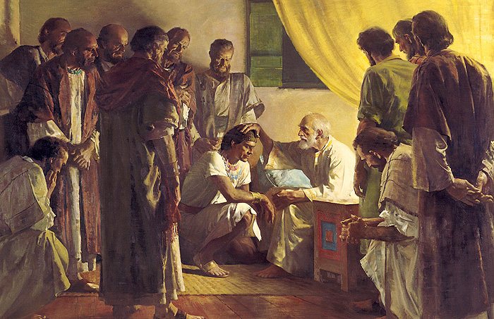
Weep Not
Christ is the Lion of the tribe of Juda
The root of David
A Lamb---Christ
Who is worthy to open the book?—no man
When Father Jacob gave Judah his patriarchal blessing, Judah was likened both to a lion's whelp and to an old lion and was promised that the sceptre should not depart from his descendants until the coming of Christ.
Accordingly, to denominate our Lord as the Lion of the Tribe of Judah is to point to his position as a descendant of Judah, to his membership in that tribe from which kings were chosen to reign, and also to show his status as the most pre-eminent of all that house. (7)
Revelation 5:5-6; Genesis 49:8-12

Slide 22
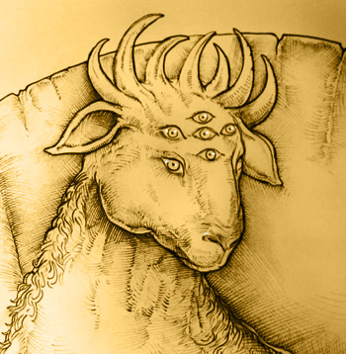
12 Horns and Eyes
The twelve servants are the apostles of the Lamb. Their eyes are a representation of light and knowledge.
Their horns are likely a representation of their strength in fighting the dragon as they are "sent forth into all the earth."
The Number 12 symbolizes complete
Revelation 5:6; D&C 77:4

Slide 23
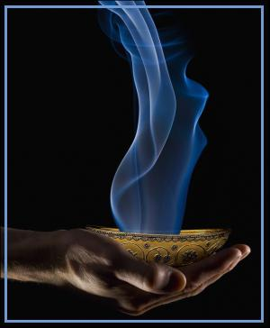
“vials full of odours” = wide cups or bowls full of incense.
In the tabernacle of Moses and the temple of Solomon, there was an altar of incense made of gold. Upon it sat the candlestick (candelabra) and an altar for offering incense.
Every morning, when the candlestick was dressed and every evening when the lamps were lit, sweet incense was burned to the Lord.
The smoke of the incense rising up to heaven was symbolic of the prayers of his people ascending to God. King David's petition was, "Let my prayer be set forth before thee as incense."
Similarly, the golden vials full of sweet odors are a similitude of the prayers of the saints of God. It would seem that the prayers of the righteous are the perfume of heaven.
Jesus Christ is the only one who is worthy and able to redeem us
Revelation 5:8; Exodus 30:7-8; 40:4-6; Psalms 141:2

Slide 24
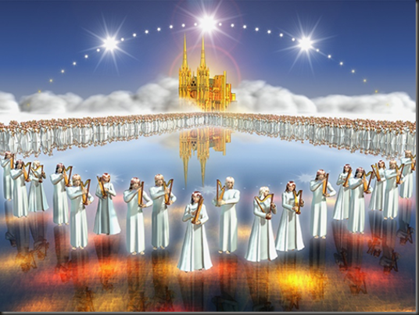
Praising in Song
“And they sung a new song, saying, Thou art worth to take the book, and open the seals thereof: for thou wast slain, and hast redeemed us to God by the blood out of every Kindred, and tongue, and people, and nation;”
Revelation 5:9

Slide 25
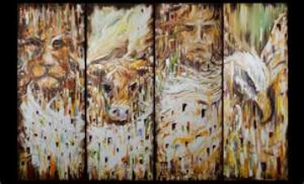
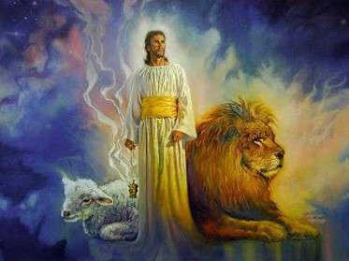
Gratitude Unto the Lamb
“And every creature which is in heaven, and on the earth, and under the earth, and such as are in the sea, and all that are in them, heard I saying, Blessing, and honour, and glory, and power, be unto him that sitteth upon the throne, and unto the lamb for ever and ever.
As we recognize and feel gratitude for what Heavenly Father and Jesus Christ have done for us, we desire to worship and praise Them
Revelation 5:13

Slide 26
“True and perfect worship consists in following in the steps of the Son of God; it consists in keeping the commandments and obeying the will of the Father to that degree that we advance from grace to grace until we are glorified in Christ as he is in his Father.
It is far more than prayer and sermon and song. It is living and doing and obeying. It is emulating the life of the great Exemplar.”
(7)

Slide 27
Sources:
Suggested Hymn: #67 Glory to God On High
Video:
The Will of God (3:02)
Earthly Father, Heavenly Father (4:00)
Taken from Poway Institute Handouts by Lesly Meacham and Becky Davies
Words of Joseph Smith page 211---rainbow
Smith, Hyrum M. Smith and Janne M. Sjodahl D&C Commentary pg. 473
“The Lost Language of Symbolism” Alonzo L. Gaskill
“The Book of Revelation Made Easier” David J. Ridges
Richard D. Draper, Opening the Seven Seals: The Visions of John the Revelator [Salt Lake City: Deseret Book Co., 1991], 53.
Elder Bruce R. McConkie (Mormon Doctrine, 2d ed. [Salt Lake City: Bookcraft, 1966], 449.); How to Worship,” Ensign, Dec. 1971, 130
Presentation by ©http://fashionsbylynda.com/blog/

Slide 28
Vision of Heaven Revelation 4:1:
Now, I make this declaration, that those things which John saw in heaven had no allusion to anything that had been on the earth previous to that time, because they were the representation of "things which must shortly come to pass," and not of what has already transpired. John saw beasts that had to do with things on the earth, but not in past ages... The revelations do not give us to understand anything of the past in relation to the kingdom of God. What John saw and speaks of were things which he saw in heaven; those which Daniel saw were on and pertaining to the earth. (Discourses of the Prophet Joseph Smith, compiled by Alma P. Burton [Salt Lake City: Deseret Book Co., 1977], 248.)
Beast of Beast Rev. 4:6-8: The prophets do not declare that they saw a beast or beasts, but that they saw the image or figure of a beast. Daniel did not see an actual bear or a lion, but the images or figures of those beasts. The translation should have been rendered "image" instead of "beast," in every instance where beasts are mentioned by the prophets. But John saw the actual beast in heaven, showing to John that beasts did actually exist there, and not to represent figures of things on the earth. When the prophets speak of seeing beasts in their visions, they mean that they saw the images, they being types to represent certain things. At the same time they received the interpretation as to what those images or types were designed to represent.
I make this broad declaration, that whenever God gives a vision of an image, or beast, or figure of any kind, He always holds Himself responsible to give a revelation or interpretation of the meaning thereof, otherwise we are not responsible or accountable for our belief in it. Don't be afraid of being damned for not knowing the meaning of a vision or figure, if God has not given a revelation or interpretation of the subject.
John saw curious looking beasts in heaven; he saw every creature that was in heaven,-all the beasts, fowls and fish in heaven,-actually there, giving glory to God. How do you prove it? (See Rev. 5:13.) "And every creature which is in heaven, and on the earth, and under the earth, and such as are in the sea, and all that are in them, heard I saying, Blessing, and honor, and glory, and power, be unto Him that sitteth upon the throne, and unto the Lamb for ever and ever.“
I suppose John saw beings there of a thousand forms, that had been saved from ten thousand times ten thousand earths like this,-strange beasts of which we have no conception: all might be seen in heaven. The grand secret was to show John what there was in heaven. John learned that God glorified Himself by saving all that His hands had made, whether beasts, fowls, fishes or men; and He will glorify Himself with them.
Says one, "I cannot believe in the salvation of beasts." Any man who would tell you that this could not be, would tell you that the revelations are not true. John heard the words of the beasts giving glory to God, and understood them. God who made the beasts could understand every language spoken by them. The four beasts were four of the most noble animals that had filled the measure of their creation, and had been saved from other worlds, because they were perfect: they were like angels in their sphere. We are not told where they came from, and I do not know; but they were seen and heard by John praising and glorifying God...
Again, there is no revelation to prove that things do not exist in heaven as I have set forth, nor yet to show that the beasts meant anything but beasts; and we never can comprehend the things of God and of heaven, but by revelation. We may spiritualize and express opinions to all eternity; but that is no authority. (Teachings of the Prophet Joseph Smith, selected and arranged by Joseph Fielding Smith [Salt Lake City: Deseret Book Co., 1976], 291-292)
The Gems Revelation 4:3:
John described glory of the Lord as jasper green and the deep orange-red color of sardine stone. Ezekiel saw the glory of the Lord as the "colour of amber" and the "appearance of fire" sitting upon a sapphire blue throne. Ezekiel said the glory emanating from the throne was in the shape of a rainbow; John tells us the rainbow was emerald green in color. "John does not give us a prismatic bow; it shimmers of but one hue, green, suggesting that life overarches all God is and all He does." (Richard D. Draper, Opening the Seven Seals: The Visions of John the Revelator [Salt Lake City: Deseret Book Co., 1991], 45.)
All four precious gems mentioned by these prophets were contained in the breastplate which the High Priest wore in ancient days. Sardius, emerald, sapphire, and jasper were four of the twelve precious gems inset into the breastplate (Ex. 28:17-20). Anciently, the breastplate was to be used with the Urim and Thummim. The heavenly representation of the Urim and Thummim is the "sea of glass like unto crystal" which was before the throne (Rev. 4:6, D&C 130:7-9). Thus, anciently, when a seer wore the breastplate and used the Urim and Thummim, the colors of God's throne sat upon his breast as he looked into the Urim and Thummim, like the sea of glass before the throne, "where all things...are manifest, past, present, and future." (D&C 130:7)
24 Elders Revelation 4:4
It is worthy of note that these [righteous] persons who are sitting with God on his throne are elders: not seventies, not high priests, not patriarchs, not apostles, but elders-than which there is no more important priesthood in God's earthly kingdom. Indeed, every elder who magnifies his calling as an elder has the immutable promise of the Father, guaranteed by his personal oath, that he shall gain all that the Father hath, which is eternal life, which is godhood, which is to sit with him on his throne. Elder Bruce R. McConkie (Doctrinal New Testament Commentary, 3 vols. [Salt Lake City: Bookcraft, 1965-1973], 3: 466.)

Slide 29
Joseph Smith – D&C 77:2-3
Paul understood that in the resurrection, there would be different classes of creatures to be resurrected. He said, "All flesh is not the same flesh: but there is one kind of flesh of men, another flesh of beasts, another of fishes, and another of birds." (1 Cor. 15:39) The same principle is here taught by John. He sees four individual beasts each representing their class of beings. The lion, the eagle, etc. are the most noble and glorious of their class of beings and are therefore representative.
Description of Beast (Rev. 4:7) | Representative class (D&C 77:3)
The first beast was like a lion | Beasts, primarily mammals
The second beast [was] like a calf | Creeping things
The third beast had a face as a man | Man
The fourth beast was like a flying eagle | Fowls of the air
Immediately, we see the incongruity of a calf being used to represent creeping things. The lion rules among the beasts of the forest, the eagle soars above the fowls of the air, man is given dominion over all the animals, and the calf is out of place among the creeping things. The term calf usually refers to a young cow. Occasionally, it may refer to the young of other animals but not to any class of animals which creep upon the ground. Probably, it is a mistranslation. More consistent would be the most powerful and noble of all reptiles and snakes. However, the student should be aware that Ezekiel also described four beasts. Each had faces of different creatures: man, lion, ox, and eagle (Ezek. 1:10). Neither Ezekiel's ox nor John's calf make sense as representing a class of creatures which creep upon the ground, but the principle is still instructive.
John saw curious looking beasts in heaven; he saw every creature that was in heaven,-all the beasts, fowls and fish in heaven,-actually there, giving glory to God. How do you prove it? (See Rev. 5:13.) "And every creature which is in heaven, and on the earth, and under the earth, and such as are in the sea, and all that are in them, heard I saying, Blessing, and honor, and glory, and power, be unto Him that sitteth upon the throne, and unto the Lamb for ever and ever."
John learned that God glorified Himself by saving all that His hands had made, whether beasts, fowls, fishes or men; and He will glorify Himself with them.
...John heard the words of the beasts giving glory to God, and understood them. God who made the beasts could understand every language spoken by them. The four beasts were four of the most noble animals that had filled the measure of their creation, and had been saved from other worlds, because they were perfect: they were like angels in their sphere. We are not told where they came from, and I do not know; but they were seen and heard by John praising and glorifying God. (Teachings of the Prophet Joseph Smith, selected and arranged by Joseph Fielding Smith [Salt Lake City: Deseret Book Co., 1976], 291-292)

Slide 30
Revelation 4
WHAT JOHN SAW | CROSS-REFERENCE | ADDITIONAL INFORMATION
Throne (Revelation 4:2–3) | Doctrine and Covenants 137:1–4
Twenty-four elders with crowns (Revelation 4:4) | Doctrine and Covenants 77:5
Seven Spirits of God (Revelation 4:5) | Joseph Smith Translation, Revelation 4:5 (in Revelation 4:5, footnote a)
Sea of glass (Revelation 4:6) | Doctrine and Covenants 77:1; 130:6–9
Four beasts (Revelation 4:6–7) | Doctrine and Covenants 77:2–3
Beasts’ many eyes and six wings (Revelation 4:8) | Doctrine and Covenants 77:4
Revelation 4
WHAT JOHN SAW | CROSS-REFERENCE | ADDITIONAL INFORMATION
Throne (Revelation 4:2–3) | Doctrine and Covenants 137:1–4
Twenty-four elders with crowns (Revelation 4:4) | Doctrine and Covenants 77:5
Seven Spirits of God (Revelation 4:5) | Joseph Smith Translation, Revelation 4:5 (in Revelation 4:5, footnote a)
Sea of glass (Revelation 4:6) | Doctrine and Covenants 77:1; 130:6–9
Four beasts (Revelation 4:6–7) | Doctrine and Covenants 77:2–3
Beasts’ many eyes and six wings (Revelation 4:8) | Doctrine and Covenants 77:4

