Slide 1
Lesson 154 and 155
7 Seals and 7 Angels
Revelation 6-11
…but if ye are prepared ye shall not fear.
D&C 38:30

Slide 2
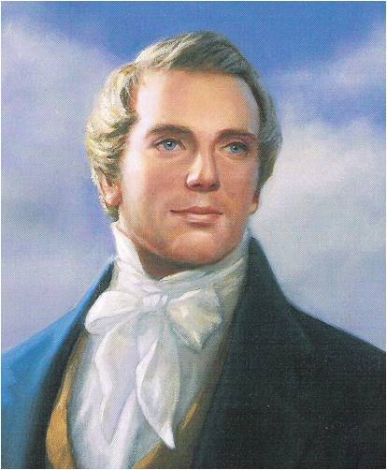
“Prophets, priests and kings … have looked forward with joyful anticipation to the day in which we live; and fired with heavenly and joyful anticipations they have sung and written and prophesied of this our day.”
(6)

Slide 3
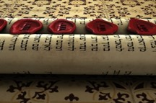
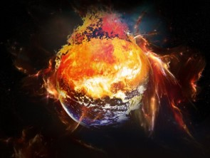
1,000 Years Each Seal
Each of the seals represents one thousand years of the earth’s temporal or mortal existence.
--D&C 77:7
“We understand this to mean that the earth has a total of 7,000 years from the time of the Fall of Adam and Eve to the end of the “little season”
--D&C 88:111 …
…at the end of the Millennium when the earth’s temporal existence comes to an end.
--D&C 77:6
(2)

Slide 4
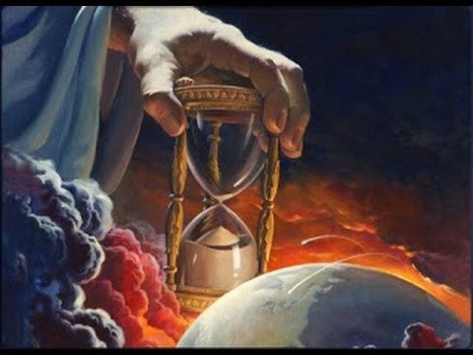
7,000 Years
“It is important to remember that we do not know the exact date of Adam’s Fall…Thus, we cannot tell exactly where we are in relation to the 7,000 years.”
(2)

Slide 5
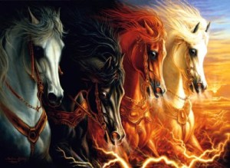
Revelation 6: The First Four thousand years
White horse—victory
Bow—Warfare
Crown—conquer
Red horse—bloodshed
Sword—war and destruction
Black Horse—famine
Balances—high price for food
Pale Horse—color of dead bodies
Death and hell—wicked killing the wicked
This describes Enoch’s day, and that the riders are possibly Enoch and Adam.
Describes Noah’s day, when wickedness covered the earth.
This is the Age of Abraham when many died of starvation.
This is the Millennium of those great kingdoms and nations whose wars and treacheries tormented and overran Israel, again and again.
First Seal
Second Seal
Third Seal
Fourth Seal
Revelation 6:1-6
(3)

Slide 6
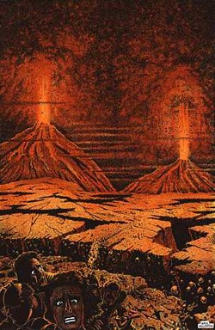
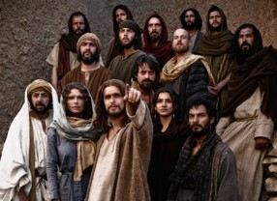
Revelation 6: The fifth and sixth thousand years
This refers to the persecution in which so many early Christians in John’s day lost their lives
This describes our own time and events leading up to the Millennium, when Jesus will reign personally on the earth
Fifth Seal
Sixth Seal
Alter—symbol of sacrifice
Souls—martyrs -Church members killed for their belief
Catastrophic events given as signs of the last days
Revelation 6:7-17
(3)

Slide 7
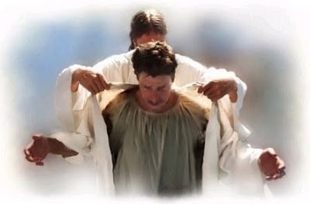
White Robes—Fifth Seal
Symbol of Purity
Given unto every one, the righteous martyrs and they will rest a little season…
Many early Christians, including nearly all of the original Apostles, gave their lives as martyrs. John saw the Christian martyrs “under the altar,” suggesting that their lives were given in sacrifice to God’s service, much like the sacrificial animals offered upon the altar of the temple. Because they gave up their lives “for the word of God, and for the testimony which they held,” they were given “white robes,” symbolic of purity.
Revelation 6:11

Slide 8
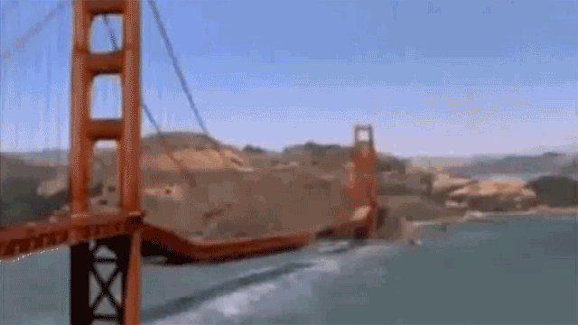
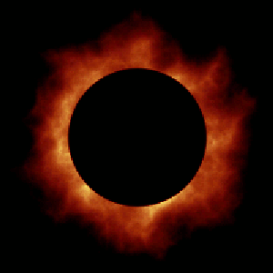
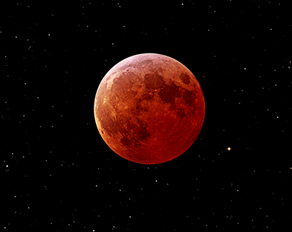
Sixth Seal—signs of the times
Earthquakes, Sun Black, Moon as blood, and Stars fall
Revelation 6:12-14

Slide 9
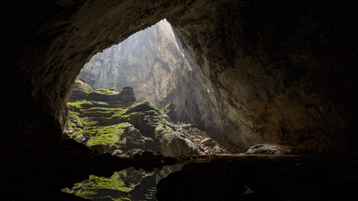
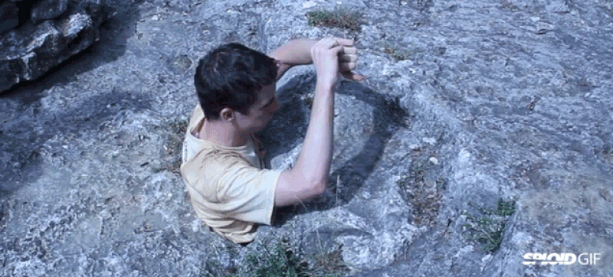
Sixth Seal— Kings=Leaders
Wicked and influential
All wicked hide in caves
--Isaiah 2:19 and 2 Nephi 12:10,19,21
Revelation 6:14

Slide 10
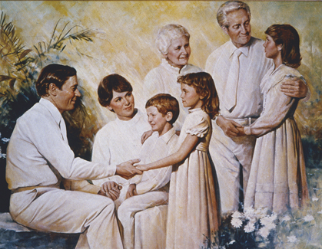
Terrestrial or Celestial lifestyle
“Because of the destruction of the wicked at the Savior’s Second Coming, only righteous people will live on the earth at the beginning of the Millennium. They will be those who have lived virtuous and honest lives. These people will inherit either the terrestrial or celestial kingdom.”
Revelation 6:16-17
(4)

Slide 11
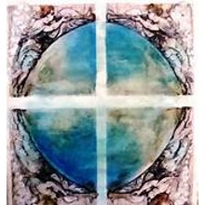
Revelation 7: The Sixth Seal
Standing over 4 corners of the earth
Four Angels
Holding the four winds…power in all directions
Ormonde Jayne
“Say, Hurt not the earth, neither the sea, nor the trees till we have sealed the servants of our God in their foreheads.”
Revelation 7:1-9

Slide 12
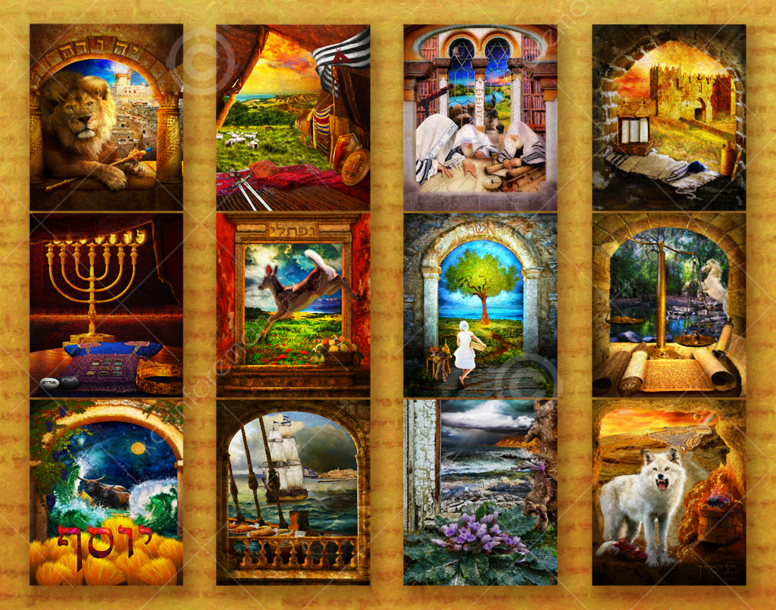
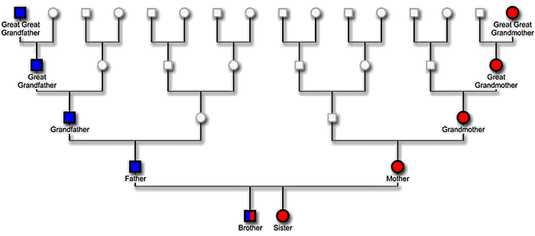
Who are the 144,000?
High Priests
12,000 out of each of the tribes of Israel, who will “bring as many as will come to the Church of the Firstborn”
D&C 77:11
144= these are not the only ones saved…
—palms in their hands
The Church of the Firstborn—the Church of Jesus Christ of Latter-day Saints and often includes the connotation of being exalted.
D&C 76:54-56
Juda—12,000
Reuben—12,000
Gad—12,000
Aser—12,000
Nephthalim—12,000
Manasses—12,000
Simeon—12,000
Levi—12,000
Issachar—12,000
Zabulon—12,000
Joseph—12,000
Benjamin—12,000
Dan and Ephraim l(not mentioned)
Read Abraham 2:9-11
All lineage will have blessings
Revelation 7:4-8

Slide 13
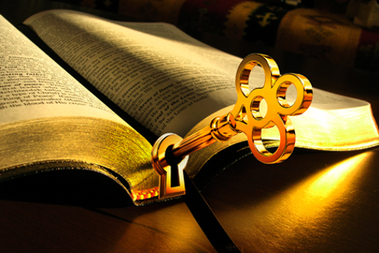
Elias – The Other Angel
A “title for those whose mission [is] to commit keys and powers to men in the final dispensation”
“…signifies sealing the blessing upon their heads, the everlasting covenant, making their calling and election sure.”
(5)
Elias—with keys—given to “hurt the earth and sea” (Angels are not just to destroy but to save lives too)
Forerunner or Restorer
Revelation 7:4-8

Slide 14
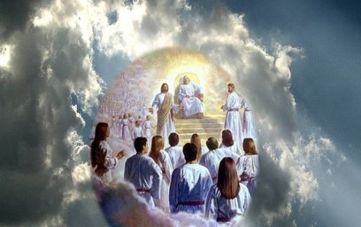
Standing Before the Throne
Multitudes-too many to count
D&C 7:9
Saying “Amen”—we agree
Zion
White Robes—
They which came out of great tribulation—tough times ahead
Washed their robes in blood of the lamb--repentance
Serve God day and night in Temple
God dwells among them
No more hunger, thirst, or trials
God will feed them and give them water and wipe their tears
They not only serve but are served in return
Revelation 7:13-17

Slide 15
The Seventh Seal
Revelation 8-11

Slide 16
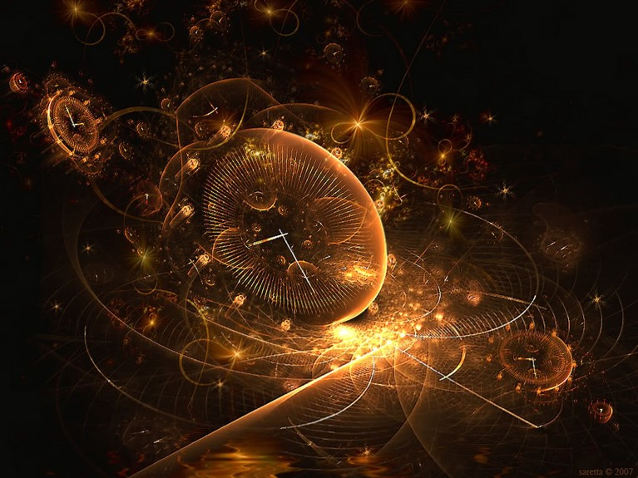
Silence in Heaven
D&C 88:95
There will be a great sign in heaven all shall see but say it is a natural phenomenon…this may be a repetition of the sign of Christ’s first coming (Zech 14:67)
Silence—in Americas after the destruction and Christ’s voice (3 Nephi 1-2)
½ Hour—Period of time—fractions denote partial of time. Possibilities:
21 years= ½ hour in God’s day of 1000 years
30 minutes in our time
Dramatic—to get out attention
Long-suffering and mercy—2 Peter 3:9
Final word—Lord has nothing else to say
Revelation 8:1

Slide 17
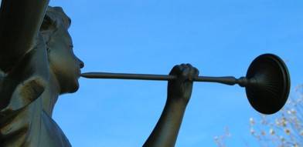
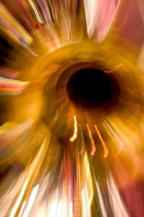
Seven Angels
Ready Finished Full
Trumpets—Call to attention or announce something important (D&C 77:12)
A call to the earth’s Sabbath=Millennium
Angels and trumpets—preparing the way before the time of His coming.
Revelation 8:2

Slide 18
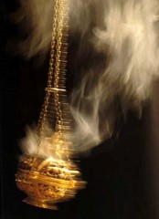
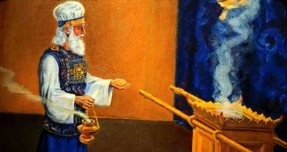
Another Angel—Adam?
One who holds the keys over this earth.
(D&C 88:112)
Golden Censer of incense—ancient temple had a golden altar of incense denoting the prayers of the righteous that would pass through the veil to God—a pleading with the Lord to come
Smoke of incense ascends up—prayers
Fire on the altar—punishments from God
Voices—Earth must go through a cleansing first
Revelation 8:3-5

Slide 19
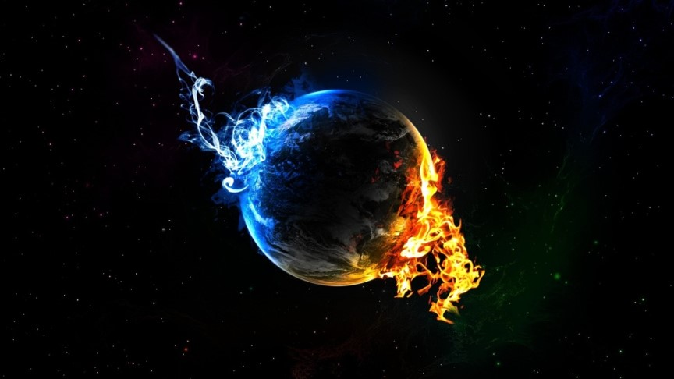
3 Major Cleansing Agents
Water--Baptism
Blood--Atonement
Fire—
Holy Ghost
Or you can be cleansed by water, fire and blood of War Fire—becomes the chief cleansing medium—war of burning in which
“The people shall be as the fuel of the fire” (2 Nephi 19:19)

Slide 20
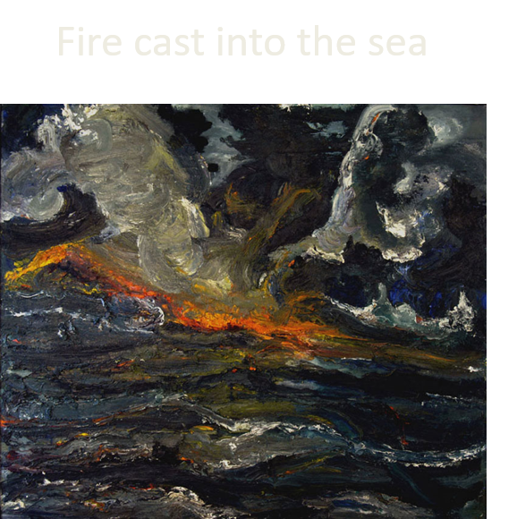
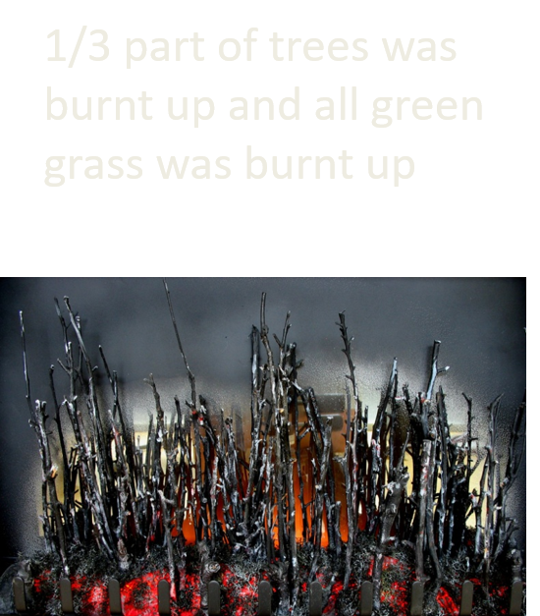
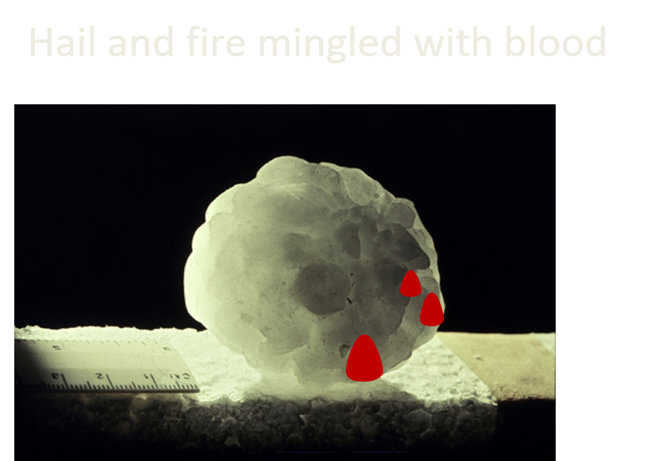
1st Angel Sounds
For, behold, the day cometh, that shall burn as an oven; and all the proud, yea, and all that do wickedly, shall be stubble: and the day that cometh shall burn them up." (Malachi 4:1)
Revelation 8:7

Slide 21
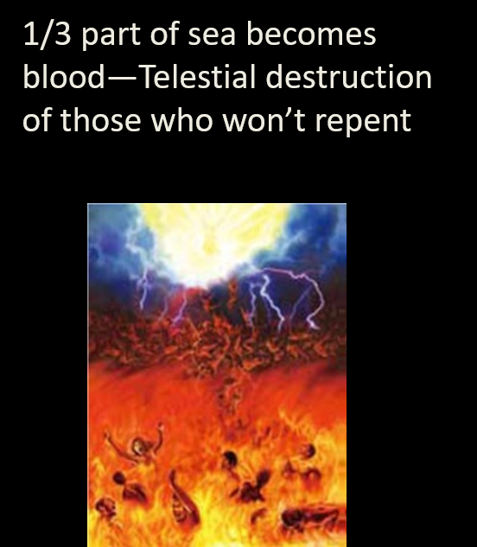
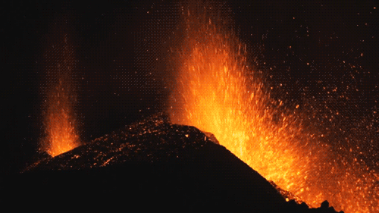
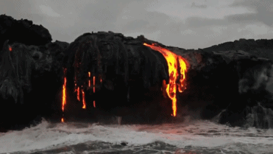
2nd Angel Sounds
Great mountain burning with fire--mankind
Sea “creatures” die and ships destroyed
“We have no way of conceiving what kind of a natural calamity would destroy a third part of the sea life and of all ships. Will it be a volcanic eruption of such magnitude as to involve whole continents?” (3)
Revelation 8:8-9

Slide 22
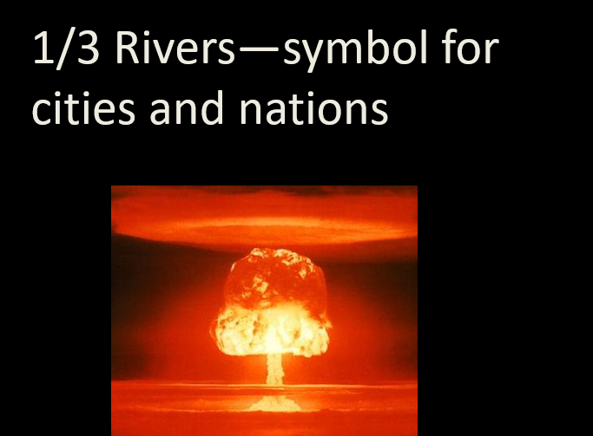
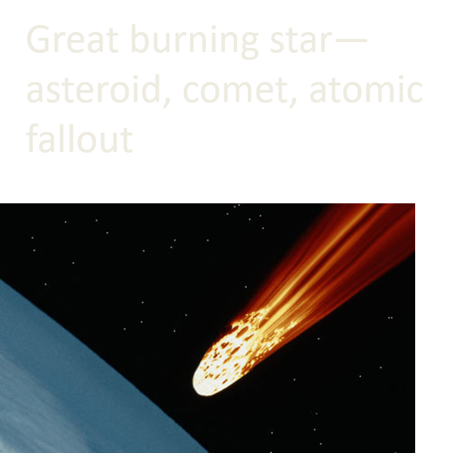
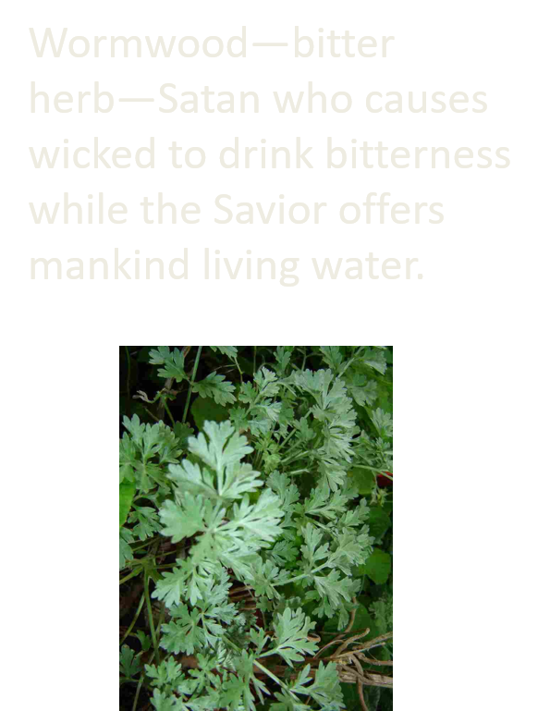
3rd Angel Sounds
In Moses' day, the lakes, ponds, storage water, and the Nile itself were turned to blood so that the fish died, the river stank, and the Egyptians couldn't drink of the water. They dug for wells away from the Nile to obtain uncontaminated water. This curse lasted 7 days (Ex. 7:14-25).
Revelation 8:10-11

Slide 23
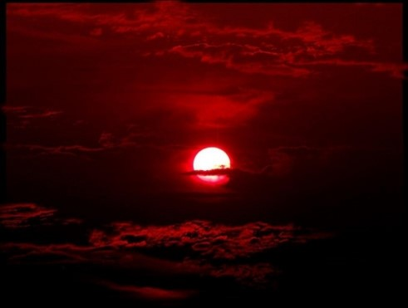
4th Angel Sounds
1/3 Part
Sun
Moon
Stars darkened
Great spiritual darkness upon the earth in the last days before the Second Coming of the Savior.
Revelation 8:12

Slide 24
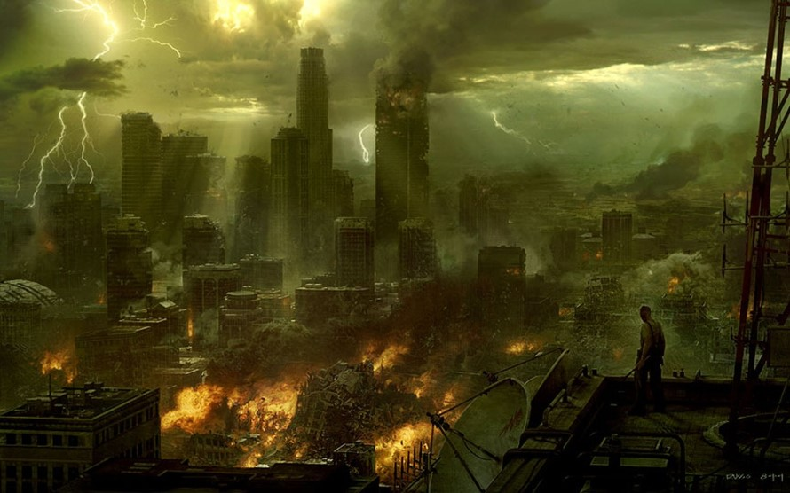
Woe, Woe, Woe
Dramatic Warning
1st Woe will be the gathering of the armies of destruction.
It will be frightening as we see destruction gathering.
Revelation 8:13

Slide 25
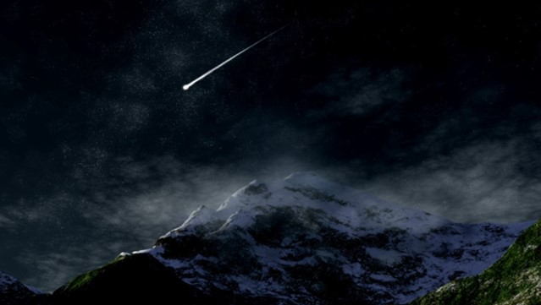
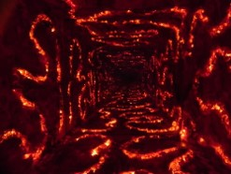
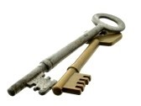
Fifth Angel Sounds
Star falls from heaven—Satan
“I beheld Satan as lightning fall from heaven.” Luke 10:18
How art thou fallen from heaven, O Lucifer, son of the morning! how art thou cut down to the ground, which didst weaken the nations!
Isaiah 14:12
Key to bottomless pit—Power to his (Satan’s) own kingdom
Bottomless Pit—pit of the abyss
Note: Both Christ and Satan hold keys to the pit
Revelation 9:1

Slide 26
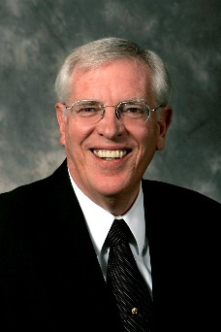
The Key Unleashed
Note: Both Christ and Satan hold keys to the pit
"John witnesses Satan turn the key to unleash the very powers of hell upon an unsuspecting world.
The predator's intent is to destroy the earth. From the onset of this millennial battle, John shows that Satan leads the hosts forth upon the earth.
Before this, God overmastered the plagues through the destroying angels.
From this point on, Satan personally directs the operations bringing the misery that fuels hell to the surface of the earth.
The Seer reveals the Adversary at his worst-venting anger, frustration, and rage. The world will feel the full thrust of his fury.
Revelation 9:1
(7)

Slide 27
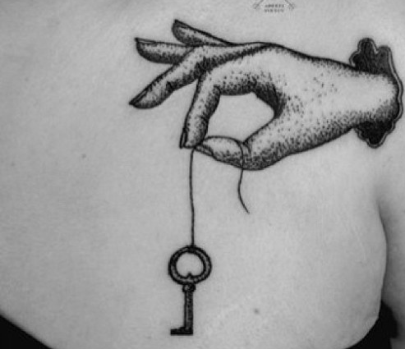
Satan Does Not Own The Key
"John sees the evil pour out of the pit in the abyss. Ancient writings show this place to be the abode of Jehovah's enemy and a kind of holding tank for fallen angels or even Satan himself.
The key Satan uses to open the pit symbolizes power, authority, and ownership.
But note, Satan does not own the key. He receives it.
Once again, John reveals that someone acts behind the scenes, controlling and directing even the machinations of the Evil One.
Ironically this potent one, for all his flaunted authority, cannot free the might of hell until God gives him the key. In this way John shows that Perdition's dominion starts and ends where the Lord dictates. Satan's limits are firm-he cannot go beyond them (Job 1:12; 2:6)."
Revelation 9:1
(7)

Slide 28
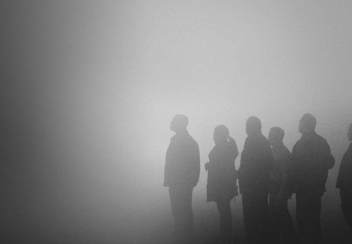
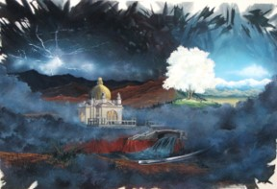
Satan Opens Pit
Smoke—obscured vision—blind eyes and hardened hearts
Lehi’s Dream—mists—three symbols:
Tree or love of God
Rod of Iron—Words and Truth of God
River—consequences of sin
If there is no love, no truth, no consequences—hardened hearts which result in contention, hatred and war
Revelation 9:2

Slide 29
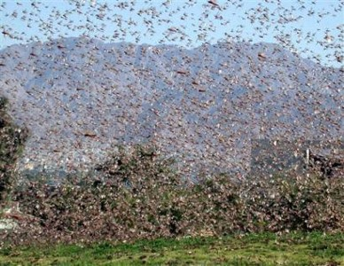
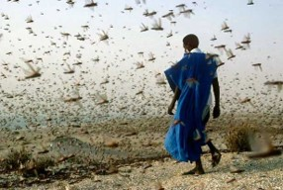
Locust
Out of the smoke of hatred—they are born and devour all. Their season lasts about 5 months—late spring to early fall
Ancient armies fought mostly during this season
Swarms cause darkness—men are blinded by sin/corruption
Frenzy of evil not unlike the feeding frenzy of the locusts—their objective is to torture men
Revelation 9:3

Slide 30
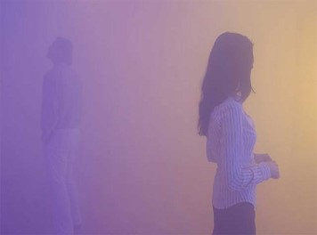
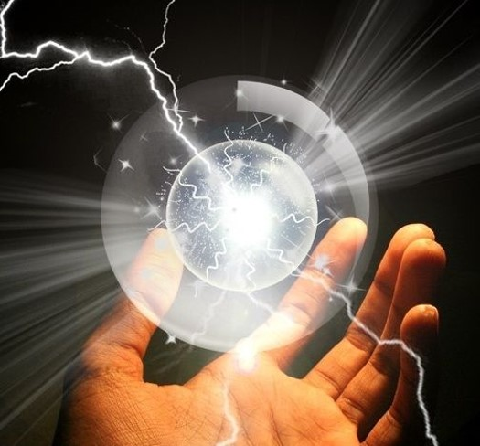
The Seal of God
Torture (internal conflict) to evil except those “sealed in forehead”
God sets the limits to the horror—it is never out of control
The Atonement—our protection
Revelation 9:4-5

Slide 31
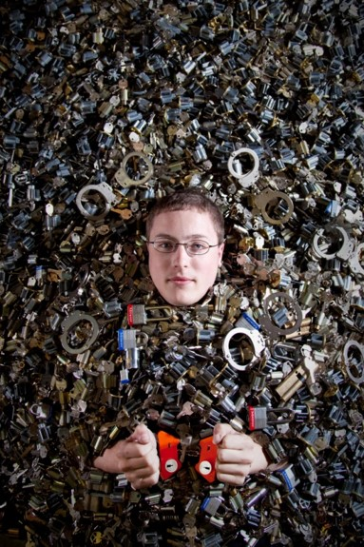
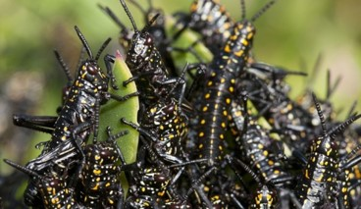
Men Seek Death
There could be relief but righteousness is the price and for these men it is too high—death appears easier and cheaper
Some would rather die than face the plagues
Revelation 9:6

Slide 32
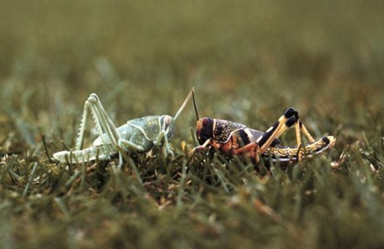
Description
Locust = military horses
Horses—war Crowns—victory but temporary
Faces of men—intelligent, cunning enemy
Hair as women—strength, brute power,
prowess
Lion’s teeth—ferocity, savageness,
aggression
Breastplate—invulnerable and invincible
(protection)
Sound—to create fear before they are
even seen, rapid, unstoppable
Revelation 9:7-10

Slide 33
Angel of Bottomless Pit
Hebrew: Abaddon—he who causes to perish. Ruin, destruction
Greek: Apollyon—The destroyer
Satan has gone from one who bears the light to one whose sole intent is to destroy
Revelation 9:11

Slide 34
6th Angel--Loose the 4 Angels
Angels of destruction
Now to destroy man—Euphrates—
JST—bottomless pit
Hour—Day—Month—Year:
The angels are prepared for that moment in time. They are not late for their appointment with mankind.
Revelation 9:14-15

Slide 35
200 thousand thousand
200,000,000
Horsemen—similar to locusts
Breastplate of fire—destructive armor
Horse heads of lions—embodiment of cruelty and destruction
Fire, smoke, brimstone—torment of hell
Killing of a staggering number of people
These deaths are not quick but agonizing misery
Revelation 9:17-19

Slide 36
Battle of Armageddon
A terrible destruction will be unleashed by God’s messengers during the last days before the Savior’s Second Coming.
We do not know whether that number is symbolic or literal. John also recorded that “the third part of men” will be slain
“The slain will be a third of the inhabitants of the earth itself, however many billions of people that may turn out to be.” (3)
Revelation 9:17-19

Slide 37
The Destroyer
“The Destroyer seems to be taking full advantage of the time remaining to him in this, the great day of his power.
Evil seems about to engulf us like a great wave, and we feel that truly we are living in conditions similar to those in the days of Noah before the flood.”
(8)

Slide 38
Idolatry
“Sadly, however, we find that to be shown the way is not necessarily to walk in it, and many have not been able to continue in faith. These have submitted themselves in one degree or another to the enticings of Satan and his servants and joined with those of “the world” in lives of ever-deepening idolatry…
…Whatever thing a man sets his heart and his trust in most is his god; and if his god doesn’t also happen to be the true and living God of Israel, that man is laboring in idolatry.
(8)

Slide 39
Angel Clothed With a Cloud
Cloud—in power, glory, beauty (Celestial)
There are two kinds of beings in heaven, namely: Angels, who are resurrected personages... Secondly: the spirits of just men made perfect." (D&C 129:1)
When we read of this angel with a face as the sun and feet as pillars of fire, we should immediately recognize that this angel is a glorified and resurrected being. "These are they whose bodies are celestial, whose glory is that of the sun, even the glory of God." (5)
Rainbow—sign of God’s covenant with mankind (Revelation 4)
Read D&C 76:70
Revelation 10:1

Slide 40
7th Angel
Possible 7th Angel—Adam?
And again, another angel shall sound his trump, which is the seventh angel, saying: It is finished; it is finished! The Lamb of God hath overcome and trodden the wine-press alone, even the wine-press of the fierceness of the wrath of Almighty God. D&C 88:106
And so on, until the seventh angel shall sound his trump; and he shall stand forth upon the land and upon the sea, and swear in the name of him who sitteth upon the throne, that there shall be time no longer; and Satan shall be bound, that old serpent, who is called the devil, and shall not be loosed for the space of a thousand years. D&C 88:110
And Michael, the seventh angel, even the archangel, shall gather together his armies, even the hosts of heaven. D&C 88:112
Revelation 10:1

Slide 41
Little Book—John’s Mission
D&C 77:14—Elias must come and restore all things—to gather Israel
That the book was “sweet as honey” in John’s mouth but “bitter” in his belly may suggest that his mission would involve many sweet and joyous experiences but also rejection and painful experiences.
Eating the Book = John accepts his mission
Revelation 10:2, 10

Slide 42
John Eats Little Book
He made it a part of him…
It is his responsibility to gather Israel in the last days.
Revelation 10:9-11 and D&C 77:14

Slide 43
Right Foot—Left Foot
Right Foot—Sea Left Foot—earth
Total dominion, power and possession..indicates all the earth is subject to Him.
Placing one’s foot on something—conquest (Joshua 10:24)
Revelation 10:2

Slide 44
A Lion Roareth—God’s Voice
Seal up—write them not
(D&C 88:87-95)
5th trumpet—Every knee will bow
(D&C 88:103-104)
7 thunders and voices—7 angels with seven seals
(D&C 88:108-110)
6th trumpet—declares that the apostasy’s grip on mankind is broken (D&C 88:105)
First 4 trumpets—announce the resurrection of the Celestial, Terrestrial, Telestial, and Sons of Perdition—they will stay bound until the Millennium
7th trumpet—it is finished and we are made equal with him (D&C 88:106-107)
After it is sounded the heavenly chorus proclaims “The kingdoms of this world are become the kingdoms of our Lord…”
Revelation 10:3-6

Slide 45
No More Time
The day of repentance is past, that there should be no more delay
The Beginning of the Millennium
Revelation 10:6

Slide 46
Reed
A rod—a measuring device
Temple:
Placing of a protective line around an area—God’s protection
Those outside the limits will not have God’s shelter—they are outside of the spirit and not committed to God
Sanctuary is a symbol of the Lord’s people
Judgment—how do we measure up?
Revelation 11:1
Roberta Boice

Slide 47
Outer Court
Gentiles: Not their time to be judged
Holy city—Jerusalem
42 months:
3 ½ years—time of persecution, dissent and apostasy
6X7—perfection missing the mark
Limited period in which evil is allowed to reign
Revelation 11:2

Slide 48
Two Witnesses
Two—necessary to sustain a charge in court—law of witnesses
D&C 77:15 Three things must happen:
1. Restoration
2. Jews must gather to the land of their inheritance
3. Jews must rebuild Jerusalem
Sackcloth—those with extreme humility
The Lord's answer to Joseph Smith, reveals that these two prophets were "raised up to the Jewish nation." Isaiah says they were sons of Jerusalem (Isa. 51:20), implying that they were Jewish natives and perhaps separate from the organizational structure of the church.
However, Elder Bruce McConkie has commented that they will likely be apostles. For sure, they are prophets.
Revelation 11:3’ Isaiah 51:20

Slide 49
2 Olive Trees/2 Candlesticks
The witnesses not only uphold the light (Christ) but the substance of the light, the Holy Ghost, flows through them
They will have divine protection
Fire issuing—their testimonies
Power to shut the heavens—no rain, Elijah sealed the heaven
Power over waters and earth and plagues (like Moses)
Revelation 11:4-6

Slide 50
Beasts Make War
Overcome them—kill them once the message is completed—they will be martyrs
Bodies shall lie in streets
People will see bodies for 3 ½ days
People will rejoice of their death
After 3 ½ days the Spirit of life from God will enter into them and they will stand on their feet. The people will be afraid.
They will ascend up to heaven in a cloud—God takes center stage and has full authority over life and death
Revelation 11:7-12

Slide 51
The Dead Lie in the Street
Under the Law of Moses, dead bodies were unclean. They were not to be touched.
For these prophets' bodies to lie in the streets is a great pollution according to the Law.
"Whosoever toucheth the dead body of any man that is dead, and purifieth not himself, defileth the tabernacle of the Lord; and that soul shall be cut off from Israel." (Num 19:13)
As Christ was considered cursed under the law by being hung on a tree (Gal. 3:13), so these prophets are considered cursed under the law by being left in the streets without burial.
Revelation 11:8-12

Slide 52
Lord’s Tithe of the Wicked
The damage is selective—tenth part
7,000—fullness, completeness of the wicked (D&C 133)
Remnant=gave glory to God of heaven
“Wherefore, prepare ye for the coming of the Bridegroom; go ye, go ye out to meet him.”
D&C 133:19
See also Matthew 24
“Parables of the 10 Virgins”
2nd woe has past
Revelation 11:13-14

Slide 53
Seventh Angel Sounded
Adam
Kingdom of earth is turned over to Christ
(Daniel 7:9-14)
D&C 133:48
“And the Lord shall be red in his apparel, and his garments like him that treadeth in the wine-vat”
24 elders—it is finally time!
Revelation 11:15-17

Slide 54
Nations Angry
They are still not repentant
All will receive a Reward:
Prophet and Saints—great and small (humble righteous)
OR
Destroyers and corruptors get what they deserve—self destruction
Revelation 11:18

Slide 55
Temple of the Ark
A symbol of God’s Covenant
The ark was behind the veil and when the
High Priest passed through the veil it
symbolized going into the presence of God.
The Earthly ark was destroyed but the
heavenly exists. The Covenant is not broken.
At this point the heavenly host enters the Holy of Holies and receives their eternal rest.
The temple is open in preparation for Christ
to leave its sanctity and descend to the earth
The wicked must now stand Judgment
Revelation 11:19

Slide 56
Our Desires
“Our desire to be in the Temple expresses our desire to be with God”

Slide 57
Sources:
Suggested Hymn: #266 The Time is Far Spent Verses 1, 3, 4
Video:
We Can Live With God Again (4:10)
Helps With Understanding The Book of Revelation Segments 1-3
Taken from Poway Institute Handouts by Lesly Meacham and Becky Davies
David J. Ridges “The Book of Revelation made Easier” Page 41-42
Bruce R. McConkie “New Testament Teacher Resource Manual” pages 253-254 and “The Life and Teachings of Jesus Christ and Apostles” pages 458-460; volcano-- The Millennial Messiah: The Second Coming of the Son of Man [Salt Lake City: Deseret Book Co., 1982], 383; Millennial Messiah, 453
Gospel Principles page 263
Joseph Smith TPJS p 321
Teachings of Presidents of the Church: Joseph Smith [2007], 186
(Richard D. Draper, Opening the Seven Seals: The Visions of John the Revelator [Salt Lake City: Deseret Book Co., 1991],
President Spencer W. Kimball June 1976 Ensign “The False Gods We Worship”
Presentation by ©http://fashionsbylynda.com/blog/

Slide 59
The 6 Time Periods – Revelation 6
Seal 1 Enoch and Zion | Seal 2 Wickedness/flood/Noah | Seal 3 Famine/ Abraham/ Israel | Seal 4 Age of Empires | Seal 5 Age of martyrs | Seal 6 Latter Days
4000-3000 BC Adam and Enoch White horse-Victory Enoch Conqueror Moses 7:13-17 Bow = Warfare Crown = Conqueror | 3000-2000 BC Enoch translated Red hors=-bloodshed Sword= War and Destruction Tower of Babel-Jaredites Flood-2348 BC The rider of the red horse could be the devil himself or perhaps “a person representing many murdering warriors. | 2000-1000 BC Abraham to Moses Black horse= famine/death Balances = high prices for food Jacob/Joseph- famine/ bondage Law of Moses Abraham’s day: A person could purchase only enough food to live on with a whole day’s wages, indicating extreme famine prices. | 1000-0 BC Saul David Israel Judah scattered Pale horse-war, pestilence Divided Kingdom Lost 10 tribes Apostasy Nations include Babylon, Persia, Egypt, Greece, and Rome | 0-1000 John the Baptist Christ’s birth Kingdom set up Alter = (Sacrifice) Atonement Resurrection Gospel to Gentiles Great Apostasy Christians killed for their beliefs Dark Ages | 1000-2000 Renaissance Reformation Joseph Smith’s ministry Restoration World-wide Church Zion Established World-wide calamities
(2, 3)

Slide 60
Revelation 6:12-13:
There may be more than one occasion when the light of the sun and the moon shall be withheld from men, and when it will seem as though the very stars in the firmament are being hurled from their places. What is here recited could mean that the light of the sun is blotted out by smoke and weather conditions, which would also make the moon appear "as blood." This falling of the stars "unto the earth" could be meteoric showers, as distinguished from the stars, on another occasion, appearing to fall because the earth itself reels to and fro. Perhaps the passage has reference to both types of falling stars. The latter-day revelation that seems to parallel John's words has come to us in this language: "Not many days hence and the earth shall tremble and reel to and fro as a drunken man; and the sun shall hide his face, and shall refuse to give light; and the moon shall be bathed in blood; and the stars shall become exceedingly angry, and shall cast themselves down as a fig that falleth from off a fig-tree." ("D&C 88:87D&C 88:87.) Bruce R. McConkie (The Millennial Messiah: The Second Coming of the Son of Man [Salt Lake City: Deseret Book Co., 1982], 380.)
The Angels Revelation 7:1
“God has held the angels of destruction for many years, lest they should reap down the wheat with the tares. But I want to tell you now, that those angels have left the portals of heaven … and are hovering over the earth waiting to pour out the judgments. And from this very day they shall be poured out. Calamities and troubles are increasing in the earth, and there is a meaning to these things. Remember this, and reflect upon these matters. If you do your duty, and I do my duty, we’ll have protection, and shall pass through the afflictions in peace and in safety” (The Discourses of Wilford Woodruff, sel. G. Homer Durham [1946], 230).
Sealing on Their Foreheads Revelation 7:3
“The Prophet Joseph Smith taught that the sealing of the faithful in their foreheads ‘signifies sealing the blessing upon their heads, meaning the everlasting covenant, thereby making their calling and election sure’ (in History of the Church, 5:530)” (New Testament Student Manual [Church Educational System manual, 2014], 544..
Kings of the Earth Revelation 6:14:
"The Seer notes seven consequences to the wickedness of mankind: (1) the earthquake, (2) the darkened sun, (3) the reddening of the moon, (4) the stars falling, (5) the heavens rolling up, (6) the mountains and islands moving out of their places, and (7) the universal consternation of mankind. Further, he notes seven classes of men who will be affected: (1) kings, (2) great men, (3) rich men, (4) chief captains, (5) mighty men, (6) bondmen, and (7) free men. Such numbering seems deliberate on his part. It emphasizes the idea of completeness: no enemy of God, no matter how high or low born, will escape the wrath of the Lamb. He will move in his fury when patience ceases to be a virtue: 'It shall come to pass, because of the wickedness of the world, that I will take vengeance upon the wicked, for they will not repent; for the cup of mine indignation is full; for behold, my blood shall not cleanse them if they hear me not' (D&C 29:17). (Richard D. Draper, Opening the Seven Seals: The Visions of John the Revelator [Salt Lake City: Deseret Book Co., 1991], 72.)
Palms in Their Hands/ White Robes Revelation 7:9; 13-14
The image of the righteous with palm branches in their hands recalls the Savior’s triumphal entry into Jerusalem (see Matthew 21:1–9; John 12:12–15).
Palm branches can symbolize victory and joy (see D&C 109:76). The image of robes washed and made “white in the blood of the Lamb” (Revelation 7:14) refers to our being purified through the Atonement of Jesus Christ. New Testament Institute Student Manual
Palms in Their Hands/ White Robes Revelation 7:9; 13-14
The image of the righteous with palm branches in their hands recalls the Savior’s triumphal entry into Jerusalem (see Matthew 21:1–9; John 12:12–15).
Palm branches can symbolize victory and joy (see D&C 109:76). The image of robes washed and made “white in the blood of the Lamb” (Revelation 7:14) refers to our being purified through the Atonement of Jesus Christ. New Testament Institute Student Manual

Slide 61
Silence in Heaven Revelation 8:1:
‘…the curtain of heaven be unrolled so that the people may gaze upon those celestial beings who will make their appearance in the clouds. The face of the Lord will be unveiled, and those who are alive will be quickened, and they will be caught up; and the Saints who are in their graves, will come forth and be caught up, together with those who are quickened, and they will be taken into the heavens into the midst of those celestial beings who will make their appearance at that time. These are the ones who are the first fruits, that is, the first fruits at the time of his coming..” Orson Pratt (Journal of Discourses, 26 vols. [London: Latter-day Saints' Book Depot, 1854-1886], 16: 328.)
Abaddon and Apollyon Revelation 9:4-10:
John stated that “Abaddon” and “Apollyon” are names (in Hebrew and Greek, respectively) for the angel of the bottomless pit, or leader of the evil forces described in Revelation 9:3–10. Both names come from terms meaning “destruction.” New Testament Institute Student Manual
Four Angel Released Revelation 9:14:
One of the thematic elements of Revelation is the destruction of Babylon. The Euphrates River is the area of ancient Babylon. The reference to the river would seem to indicate a destruction on those who were faithful to spiritual Babylon. They were idolatrous worshippers of devils, gold, silver, and brass (v. 20), "and great Babylon came in remembrance before God, to give unto her the cup of the wine of the fierceness of his wrath." (Rev. 16:19)
Seven Angels Revelation 8:2:
The earliest reference to a system of seven archangels as a group appears to be in Enoch 1 (the Book of Enoch) which is not part of the Jewish Cannon but is prevalent in the Judaic tradition, where they are named as Gabriel (Noah), Michael (Adam), Raphael (Elijah), Ureil, Raguel, Remeil, and Saragael. While this book today is non-canonical in most Christian Churches, it was explicitly quoted in the New Testament (letter of Jude 1:14-15) and by many of the early Church Fathers. The Ethiopian Orthodox Church to this day regards it to be canonical.
Modern Day Idolatry Revelation 9:20-21:
“Our culture tends to determine what foods we like, how we dress, what constitutes polite behavior, what sports we should follow, what our taste in music should be, the importance of education, and our attitudes toward honesty. It also influences men as to the importance of recreation or religion, influences women about the priority of career or childbearing, and has a powerful effect on how we approach procreation and moral issues. All too often, we are like puppets on a string, as our culture determines what is ‘cool.’ …
“Seduced by our culture, we often hardly recognize our idolatry, as our strings are pulled by that which is popular in the Babylonian world” Elder David R. Stone (“Zion in the Midst of Babylon,” Ensign or Liahona, May 2006, 91–92).
Woe, Woe, Woe Revelation 8:13:
"Woe denotes great trouble and anguish; three woes magnify the trouble and anguish. The first woe occurs when the fifth angel sounds his trumpet (9:1-12), and the second woe accompanies the sixth angel's trumpet blast (9:13-21) and is fulfilled in Rev. 11:14, although there is an interlude in chapter 10. John does not identify the fulfillment of the third woe." (Donald W. Parry and Jay A. Parry, Understanding the Book of Revelation [Salt Lake City: Deseret Book Co., 1998], 113.)
Sorcery Revelation 9:21:
“It is not good practice to become intrigued by Satan and his mysteries. No good can come from getting close to evil. Like playing with fire, it is too easy to get burned: ‘The knowledge of sin tempteth to its commission’ [Joseph F. Smith, Gospel Doctrine, 5th ed. (1939), 373]. The only safe course is to keep well distanced from him and any of his wicked activities or nefarious practices. The mischief of devil worship, sorcery, witchcraft, voodooism, casting spells, black magic, and all other forms of demonism should always be avoided.” Elder James E. Faust (“The Forces That Will Save Us,” Ensign, Jan. 2007, 5).
The Pit is Opened Revelation 9:2:
As the pit is opened, smoke billows forth and obscures the light of the sun. Darkness reigns. Through this powerful symbol, John reveals the nature of the first thrust against mankind: a blow against the light.' The smoke, like the 'mists of darkness' in Lehi's dream, represents evil, darkness, and 'the temptations of the devil, which blindeth the eyes, and hardeneth the hearts of the children of men, and leadeth them away into broad roads, that they perish and are lost' (1 Ne. 12:17). Richard Draper (Donald W. Parry and Jay A. Parry, Understanding the Signs of the Times [Salt Lake City: Deseret Book Co., 1999], 254.)

Slide 62
The Rainbow and The Cloud Revelation 10:1:
The rainbow is reminiscent of the writings of Ezekiel who described the throne of God, "As the appearance of the bow that is in the cloud in the day of rain, so was the appearance of the brightness round about." (Ezek. 1:28) Similarly, John described God's throne with "a rainbow round about... in sight like unto an emerald." (Rev. 4:3) From these passages we conclude that the angel is not only resurrected but exalted. The rainbow represents his exalted status as a god with a throne of his own. The identity of this angel is Michael, the archangel (compare Rev. 10 with D&C 88:110-112). We should not be surprised to find out John saw him as an exalted being. The Lord declared that Abraham had "entered into his exaltation and sitteth upon his throne;" that he with Isaac and Jacob "have entered into their exaltation, according to the promises, and sit upon thrones, and are not angels but gods." (D&C 132:29, 37) If Abraham had been resurrected at the time of Christ to inherit his exaltation, then wouldn't Adam have received the same glory? Joseph Smith and Gospeldoctrine.com
Measure the Temple Revelation 11:1
"A yeshiva (school) in Jerusalem called Ateret Cohanim concentrates on studies pertaining to Temple service and ritual to 'enable their students to step in the moment a Temple is erected.' The dean of the yeshiva, Matityahu Hacohen, maintained that 'we are ready to begin building the Temple the minute we get the go-ahead from the Chief Rabbinate and the Israeli government.' His enthusiasm was tempered by the former Chief Rabbi Shlomo Goren, one of the country's foremost experts on the Temple and its religious meaning to the Jews. Goren warned that 'one of the greatest Jews who ever lived, King David, lost the privilege of building the First Temple simply because he did not enjoy the proper guidance by a prophet.'
"...An organization called the Temple Institute has reconstructed thirty-eight ritual implements required for temple service. The Institute hopes to finish the remaining sixty-five items as funds become available. Small shops, such as Beged Ivri, create clothing; Harrari Harps make musical instruments. The Institute spokesman, Zev Golan, said, 'If we do not prepare and show God that we want a temple, then God won't give it to us.' Accordingly, the Institute is using a computer to draw up blueprints for rebuilding the Temple.
"The objective of those physically preparing for a future Temple is to be ready when the time comes. Without exception, those preoccupied with studying or actually preparing for the Temple concede that they do not know when it will come about, but they all share a common goal: to be ready when the time does come." (David B. Galbraith, D. Kelly Ogden, Andrew C. Skinner, Jerusalem: The Eternal City [Salt Lake City: Deseret Book Co., 1996], 478-479)
The Gathering Revelation 11:
Suffice it to say, the Jews gather home, and rebuild Jerusalem. The nations gather against them in battle. Their armies encompass the city, and have more or less power over it for three years and a half. A couple of Jewish Prophets... are slain, and the city is left in a great measure to the mercy of their enemies for three days and a half, the two Prophets rise from the dead and ascend into heaven. The Messiah comes, convulses the earth, overthrows the army of the Gentiles, delivers the Jews, cleanses Jerusalem, cuts off all wickedness from the earth, raises the Saints from the dead, brings them with Him and commences His reign of a thousand years. Parley P. Pratt (David B. Galbraith, D. Kelly Ogden, and Andrew C. Skinner, Jerusalem: The Eternal City [Salt Lake City: Deseret Book Co., 1996], 536)
Two Witnesses Revelation 11:3
These two shall be followers of that humble man, Joseph Smith, through whom the Lord of Heaven restored the fulness of his everlasting gospel in this final dispensation of grace. No doubt they will be members of the Council of the Twelve or of the First Presidency of the Church. Elder Bruce R. McConkie (Doctrinal New Testament Commentary, 3 vols. [Salt Lake City: Bookcraft, 1965-1973], 3: 510.)
Tread Under for 42 Months Revelation 11:2:
For 3.5 years (42 months) prior to the Second Coming, Jerusalem will be under siege by her enemies. The siege is a case of history repeating itself. The same thing happened in AD 70 by the Roman armies. In that terrible siege, the inhabitants of Jerusalem suffered from famine and hunger. Those bold enough to venture outside the walls of the city for food were caught by Roman ambushes. "They were first whipped, and then tormented with all sorts of tortures before they died, and were then crucified before the wall of the city." (Josephus, Wars of the Jews, Book V Chap. XI, verse 1)

Slide 63
 | Seven Trumpets | Seven Vials | Moses
1 | Hail and fire mingled with blood destroys 1/3 of trees and green grass | A noisome and grievous sore upon the men which had the mark of the beast | Plague 7: The Lord sent thunder and hail, and the fire ran along upon the ground. Plague 6: Boils upon man and beast
2 | Third part of sea became blood, killing 1/3 of sealife, destroying 1/3 of ships | The sea became as the blood of a dead man: and every living soul died in the sea | Plague 1: All the waters in the river were turned to blood, And the fish died; and the river stank
3 | Third part of rivers and fountains of waters became bitter (wormwood). Many men die. | The rivers and fountains of waters became blood | Plague 1: All the waters in the river were turned to blood, And the fish died; and the river stank
4 | Night and day darkened by 1/3 of sun, 1/3 of moon, and 1/3 of stars being darkened | The sun scorched men with fire. And men blasphemed the name of God | Plague 9: There was a thick darkness in all the land for three days
5 | Smoke from bottomless pit releases locusts which torment men for 5 months with the sting of their tails | The beast and his followers gnawed their tongues for pain, And blasphemed because of their pains and their sores | Plague 8: east wind brings locusts which destroy fruit and herbs Plague 6: Boils upon man and beast
6 | Euphrates River: Four destroying angels released to slay 1/3 of men. Army of 200 million horsemen kill 1/3 of men. | Euphrates River: Unclean spirits from the dragon, beast, and false prophet come like a plague of frogs to the battle of Armageddon | Plague 2: Frogs came up, and covered the land of Egypt
7 | Lightnings, voices, thunderings, an earthquake, and great hail destroy them which destroy the earth | Voices, thunders, lightnings, and a mighty earthquake destroys cities. Islands and mountains flee. Great hail from heaven. | Plague 7: The Lord sent thunder and hail, and the fire ran along upon the ground. Plague 10: Firstborn of man and beast die
Gospeldoctrine.com

Slide 64
Destroying Angels
ANGEL | WHAT IS DESTROYED OR HARMED | DESTROYING AGENT AND POSSIBLE INTERPRETATION
First angel (Revelation 8:7) | Third part of trees and all green grass are burnt up. | “Hail and fire mingled with blood … were cast upon the earth” (Revelation 8:7). “Speculatively, most of the plagues and destructions here announced could be brought to pass by men themselves as they use the weapons and armaments they have created”
Second angel (Revelation 8:8–9) | Third part of the sea becomes blood; third part of living creatures of the sea die; third part of ships are destroyed. | “A great mountain burning with fire was cast into the sea” (Revelation 8:8). “Perhaps the turning of the waters of Egypt to blood was in similitude of this great latter-day plague. (Ex. 7:19–25.)”
Third angel (Revelation 8:10–11) | Third part of rivers and waters are made bitter; many men die. | “There fell a great star from heaven, burning as it were a lamp” (Revelation 8:10). “Could this result from atomic fallout or pollutions from the factories of the world? Or will it be brought to pass by some law of nature beyond our control?”
Fourth angel (Revelation 8:12) | Third part of the sun, moon, and stars are smitten and darkened. | No destroying agent mentioned. “Perhaps a merciful God withholds from us the ways and the means whereby the very luminaries of heaven will cease to serve their ordained purposes” (
Fifth angel (Revelation 9:1–12) | The sun and air are darkened; those without the seal of God are tormented for five months. | “There arose a smoke out of the pit. … And there came out of the smoke locusts upon the earth” (Revelation 9:2–3). “Lucifer opens the doors of hell, and every vile influence ascends from its evil depths as does smoke from a great furnace. So dark is the smoke and so widespread is the evil that the sun and the air are darkened”
Sixth angel (Revelation 9:13–21) | Third part of men are killed. | Four angels who are prepared to slay one-third of men. “Four angels of the devil, demons from the depths of hell, are given free reign to lead the armies of men in destroying a third of the population of the earth”
Seventh angel (Revelation 11:15–19) | Those who destroy (corrupt, waste, pervert) the earth are destroyed. | The Lord Himself. “Lo, the Great Millennium cometh! And Christ reigneth! ‘And the Lord shall be king over all the earth: in that day shall there be one Lord, and his name one.’ (Zech. 14:9.) In that day he shall make ‘a full end of all nations’ (D. & C. 87:6), as he said: ‘I will be your ruler when I come’ (D. & C. 41:4); and, ‘Ye shall have no laws but my laws when I come, for I am your lawgiver.’ (D. & C. 38:22)”
Bruce R. McConkie, Millennial Messiah, 382-326; Doctrinal New Testament Commentary, 3:499; 3:512

