Slide 1
Lesson 156
The War In Heaven
Revelation 12-14

Slide 2
Symbolism
Symbol | Cross-references | Meanings
Woman | JST, Revelation 12:7, D&C 5:14 | Christ’s Church
Twelve Stars | JST, Revelation 5:6 | The Twelve Apostles
A child “who is to rule all nations” | JST, Revelation 12:3; D&C 65:5-6 | Christ reigning personally on the earth
Dragon | D&C 88:110 | Satan or Lucifer
Third part of stars being drawn away by the dragon | D&C 29:36-38 | Satan drawing away a third of the spirits
Rod of iron | 1 Nephi 11:25 | The Word of God
Woman fleeing into the wilderness | Amos 8:11 D&C 86:1-3 | The Church being withdrawn at the time of the Great Apostasy

Slide 3
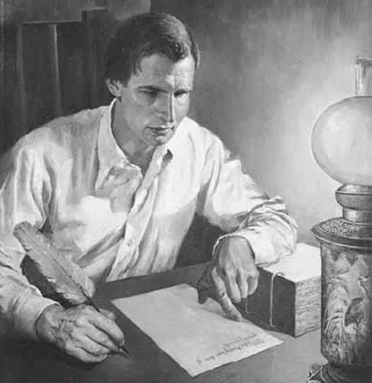
Interesting side note
Joseph Smith made more changes in Chapter 12 than any other portion of Revelation

Slide 4
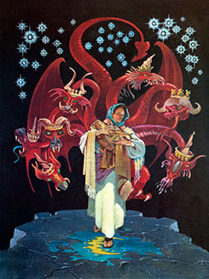
Woman – Christ’s Church
What happened to the woman?
She gave birth to a son “who was to rule all nations”
Revelation 12:1

Slide 5
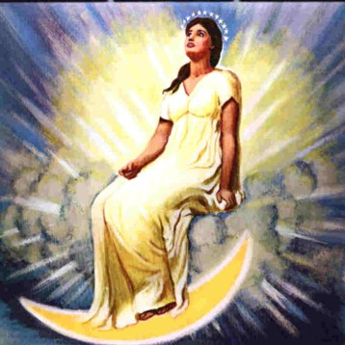
The Beginning of the church
A Wonder—a great sign in Heaven to the world. Celestial Glory (Church of Christ) with Terrestrial world under her dominion, and governed by a ruling power of Priesthood Authority.
Crown of 12 stars—power and Apostles
Woman—The Church of Jesus Christ
Sun and Moon—beauty and glory
Clothed with the sun— “having been clothed” a protection from God
Revelation 12:1

Slide 6
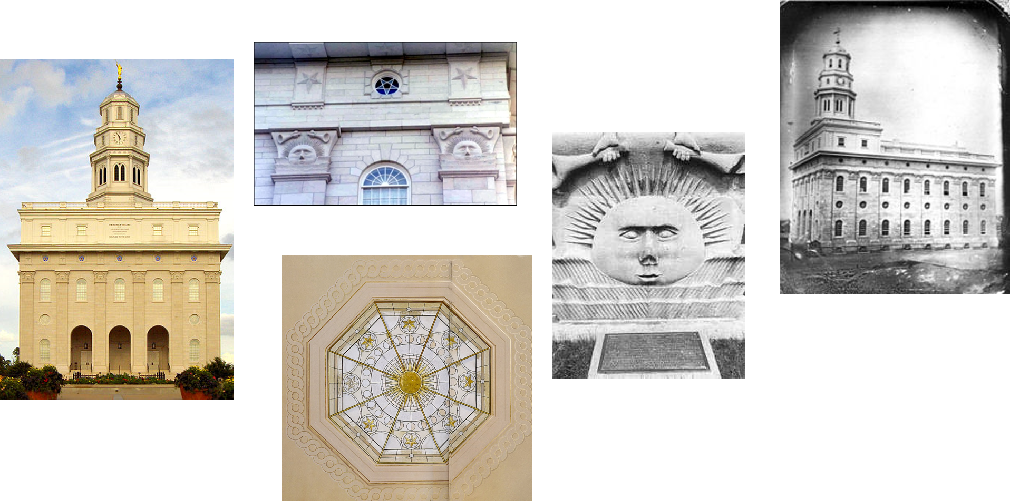
Symbols in Nauvoo
Moon at the bottom, sun, then 12 stars at the top

Slide 7
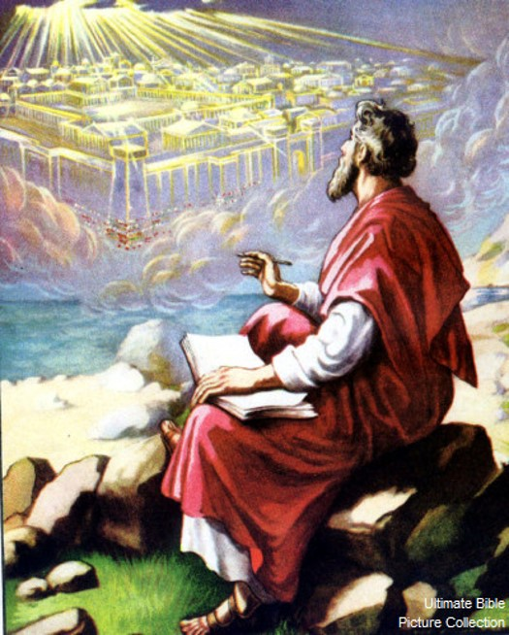
Child – Kingdom of God and his Christ
Zion or political kingdom of God
Travailing—labor pains—There was labor and pain involved in bringing forth the kingdom of God. (Isaiah 54:1)
JST 12:3
Zion which has the power to lift man to a higher plane. (Isaiah 66:7-9)
Child caught up to God/throne—the early church tried to establish Zion but were unsuccessful.
God removed its authority
Revelation 12:2

Slide 8
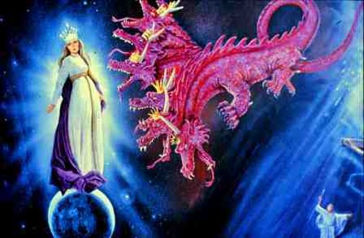
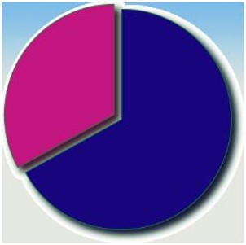
Dragon--Satan
Red—violent—accomplishing his (Satan’s) work
7 heads and 10 horns--Satan has great power
Tail drew away 1/3 part—End result in the War in Heaven (significant number of children chose to follow Satan).
Devour--Satan is waiting to destroy Zion
Revelation 12:3-4

Slide 9
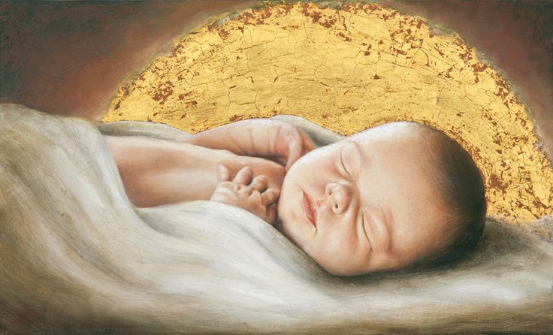
Rule All Nations
The child would use the rod of iron, which may symbolize the gospel, the priesthood, and the word and power of God, to righteously govern the nations of the world (2)
Revelation 12:5
Jordan Jones

Slide 10
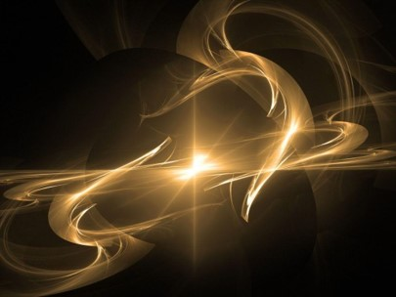
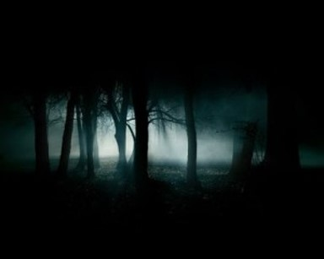
Iron Rod and Apostasy
Man Child—The Kingdom of God and His Christ rules with the Iron Rod--With the Word of God
Woman flee into wilderness—The Church authority was taken from the earth
1,260 years—Time of Apostasy
JST 12:5 changes days to years
“Michael and his angels” = Adam and other righteous spirit children of God
Read D&C 86:3
Revelation 12:5-6

Slide 11
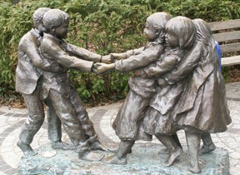
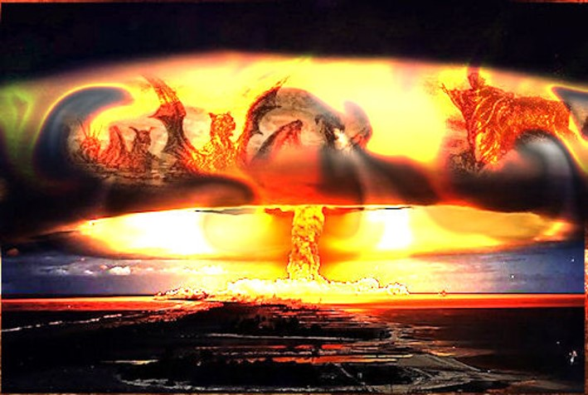
War in Heaven
Between Satan and the Saints of God
War of Words, opinions, truth, error, light, darkness and so forth.
Michael and angels fight against dragon—Satan and his followers—Cast out
Revelation 12:7-9

Slide 12
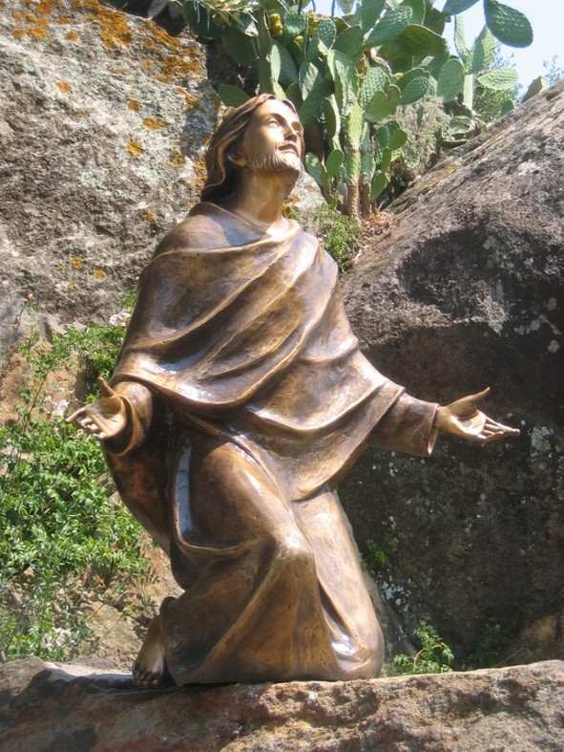
Overcoming Satan
By the Blood of the Lamb—the Atonement of the Savior
Righteous overcame by:
Faith in the Atonement
Their testimony and willing to proclaim it to all who would hear
Undo death—willing martyrs
We can overcome Satan’s influences through the Savior’s Atonement and by remaining true to our testimonies of the gospel
Revelation 12:9-11

Slide 13
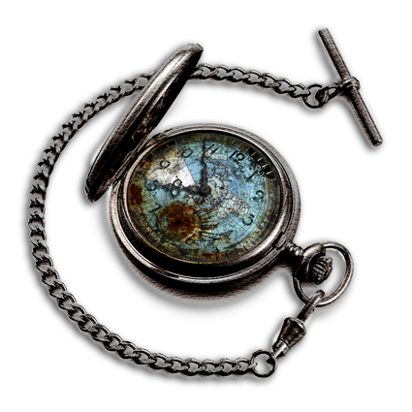
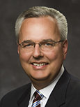
“Reserved to come forth in these last days and labor for our Father and His Son are some of the most valiant and noble of our Father’s sons and daughters. Their valiance and nobility were demonstrated in the pre-earth struggle with Satan. …
“With God’s kingdom restored to the earth and your entry into the world, Satan knows that ‘he hath but a short time’.
Therefore, Satan is marshalling every resource at his disposal to entice you into transgression. He knows that if he can draw you into transgression, he may prevent you from serving a full-time mission, marrying in the temple, and securing your future children in the faith, all of which weakens not only you but the Church.
He knows that if he can draw you into transgression, he may prevent you from serving a full-time mission, marrying in the temple, and securing your future children in the faith, all of which weakens not only you but the Church.
He knows that nothing can overthrow God’s kingdom ‘save it [be] the transgression of [his] people’ [Mosiah 27:13]. Make no mistake about it—the focus of his war is now on you.” (3)
Revelation 12:12

Slide 14
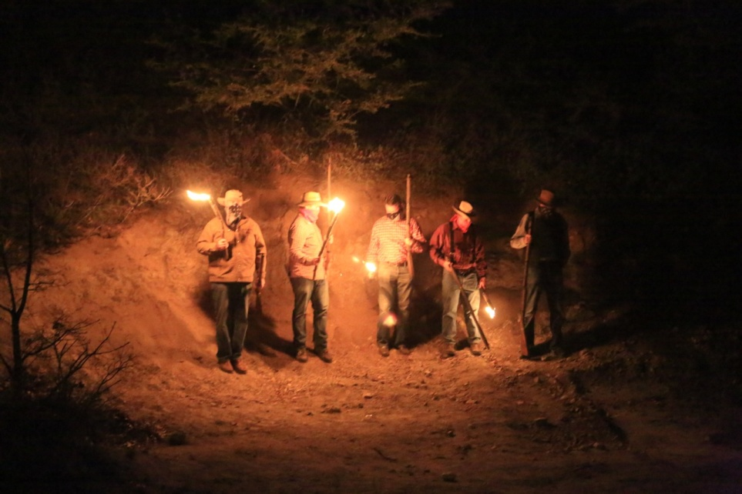
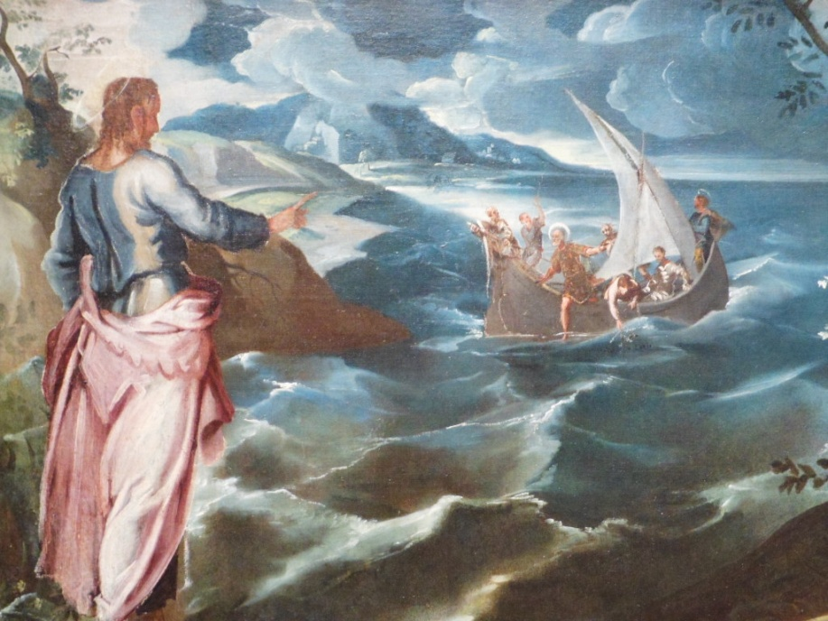
Persecution
Satan persecutes the Church of Jesus Christ.
But the woman or truths were found in small ways in the monasteries and kingdoms through the art works, cathedrals and writings of Europe.
Revelation 12:12

Slide 15
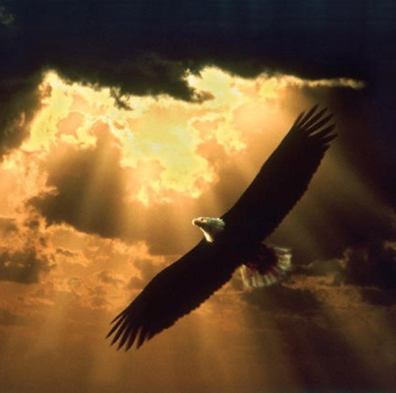
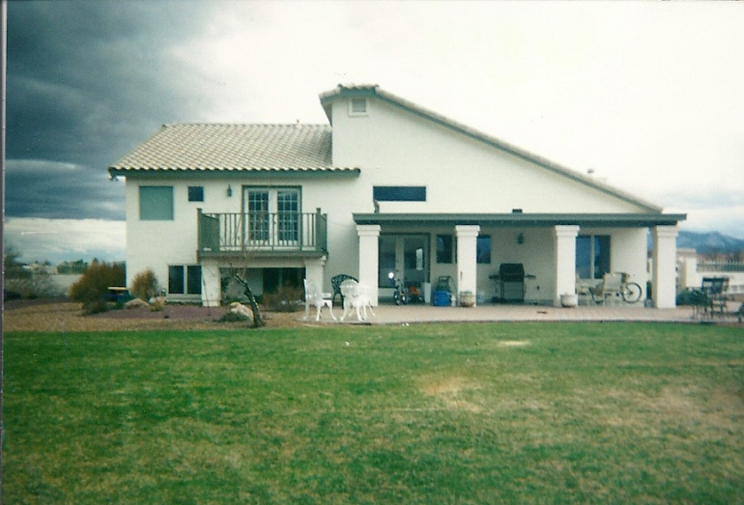
Wings of an eagle
Ability to move—(Deut. 32:10-11) and (Isaiah 40:31)
Wilderness—spiritual refuge—a place of safety, a place to wait on God.
Where is your spiritual refuge?
Revelation 12:14

Slide 16
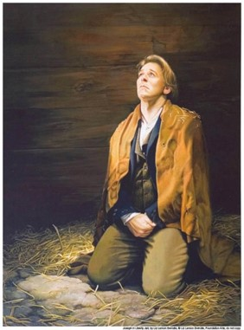
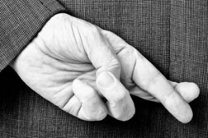
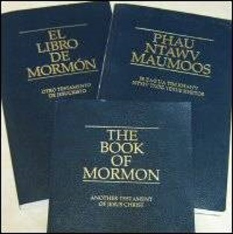
Casts Water out
Satan, the father of lies, tries to drown Christianity with a deluge of lies and deceptions.
Could also be a flood of tribulation and persecution. Satan attempts to seduce and threaten, or wear out the true Saints.
The earth is to be flooded with the Book of Mormon to counter Satan’s flood.
Revelation 12:15

Slide 17
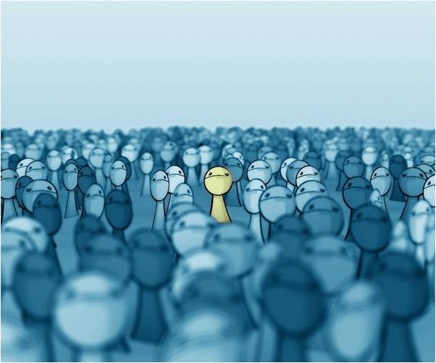
Dragon makes war
Satan makes war on those who are the spiritually begotten of Jesus Christ. (D&C 76:50-53)
The Dragon may seem fierce yet he is not real.
Satan has no power over you unless you give him permission
Revelation 12:19

Slide 18
Satan Has the Power to Deceive
Revelation 13

Slide 19
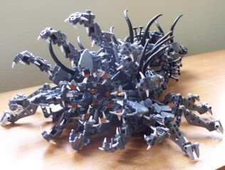
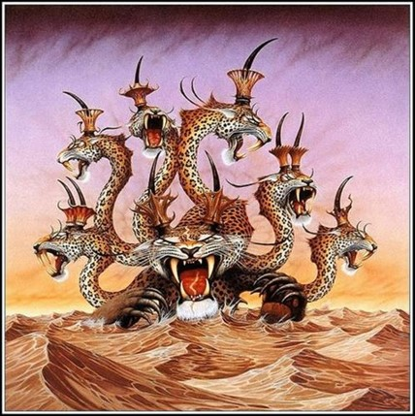
The Image of the Beast
Sea of Humanity
Dragon--Satan
Crown= power
over the Kingdom
Beast coming up from the sea
See also: (Daniel 7:3-5)
Characteristics of
a Beast:
Murderers,
corrupt,
carnivorous,
and brutal in their dispositions
7= complete, fullness of evil
10= Power, but incomplete, just short of 12 (Authority)
Note: At first glance the image is that of the dragon, but there is a difference. This beast has 10 crowns placed upon its horns not his heads. The beast’s crowns suggest that its power rests upon brute force. The beast actually has less power than the dragon.
Revelation 13:1

Slide 20
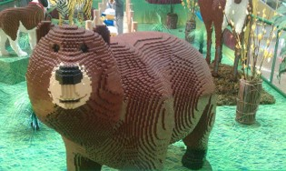
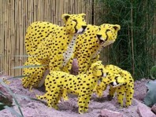
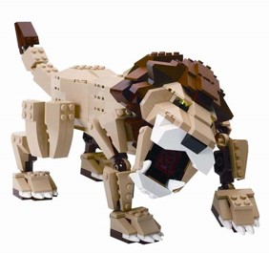
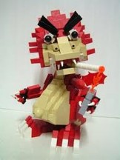
Leopards…bears…lions
“Oh my”
Beasts of Prey
The Beast receives his power and authority from the Dragon
However
The Beast gets approved power from us
Revelation 13:2

Slide 21
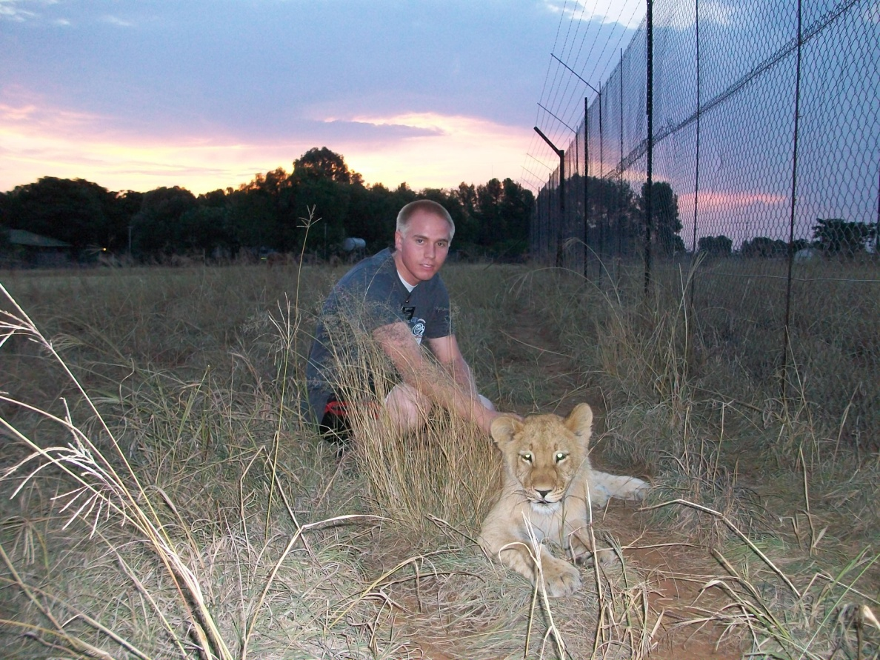
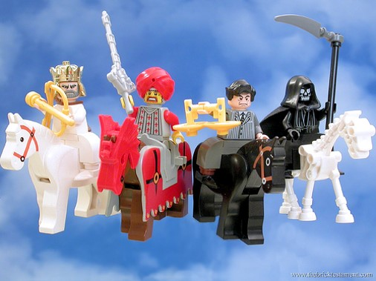
Changing our Hearts
How do you kill the Beast?
Alma 5:7
By changing our hearts so the beast
has no more power over us.
The Majority of the world will admire and desire wickedness in the last days.
Revelation 13:3

Slide 22
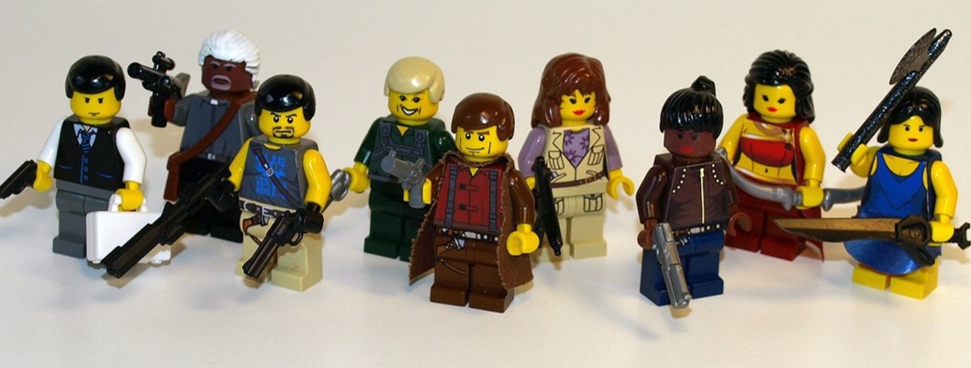
Admiration and Worship
This gives power to the Beast
Satan gives the beast his power and authority just as the Father does the Son.
Not only does the beast wear the name of blasphemy upon its heads, but it pretends to be God for the unseeing world.
Admiration of:
Crudeness
Filth
Cruelty
Violence
Sexual immorality
Disloyalty to commitments
Unfaithfulness
Political corruption
Revelation 13:4

Slide 23
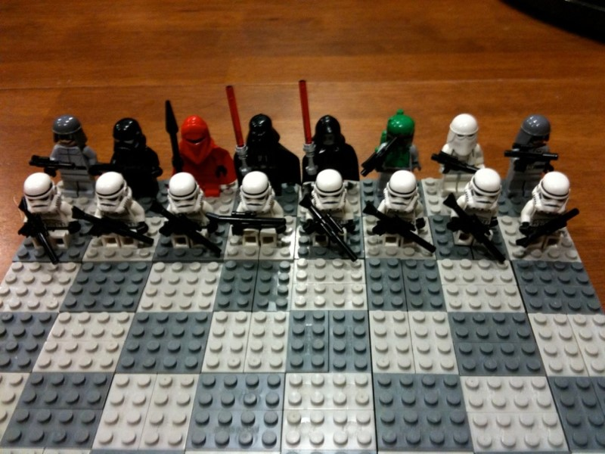
Temporary Victory
Since the beast receives power from Satan and Satan is restricted by God, the beast is actually allowed to do his work within bounds God has set.
God uses the beast in his own grand strategy.
Revelation 13:5

Slide 24
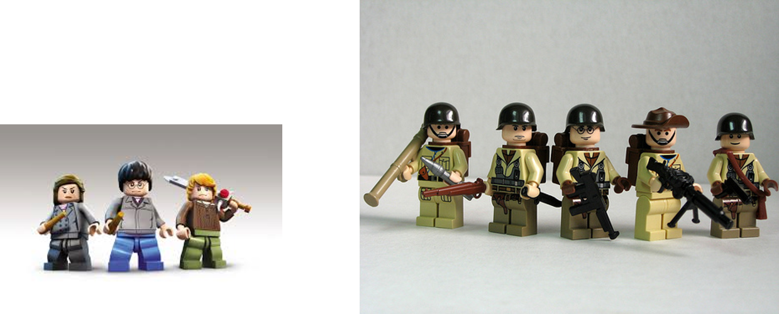
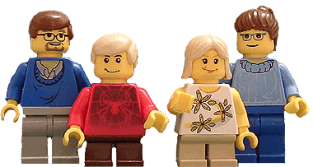
Worship
Satan and followers will mock God and all that is sacred.
Worship God of War and force
Or
Inviting a God of Peace and gentleness?
Revelation 13:6-7

Slide 25
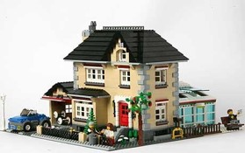
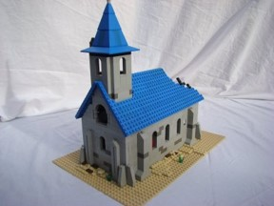
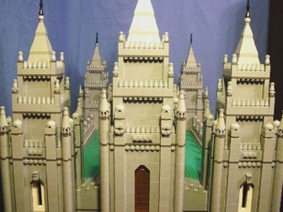
Defending in Holy Places
All that take the sword—All that endure and not fight against Satan
Home
Temple
Church
Stay away from Satan’s turf
Revelation 13:8-10

Slide 26
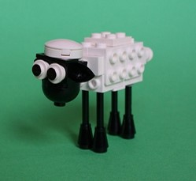
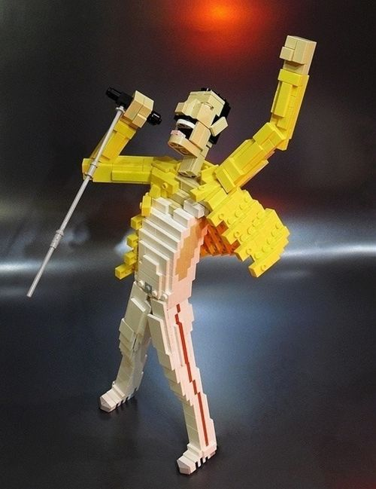
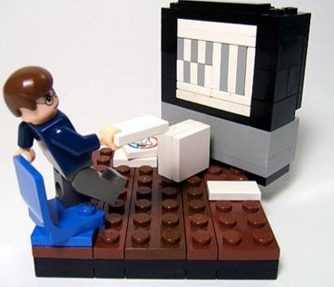
1st Presidency of Satan
Another beast—appears harmless
Testifies of 1st beast
False Lamb
False Prophets
False Doctrine
Antichrists
Propagandist—media influences
Revelation 13:11-12

Slide 27
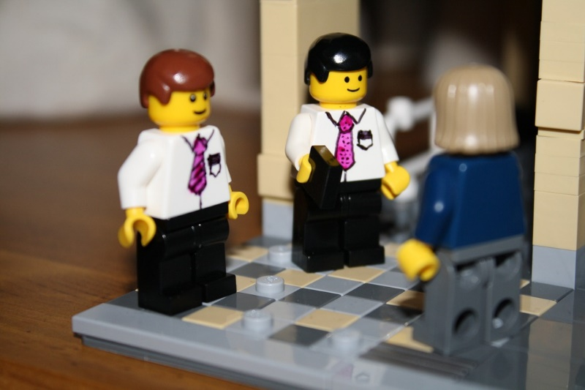
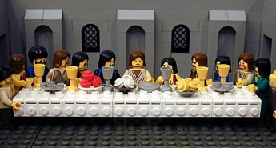
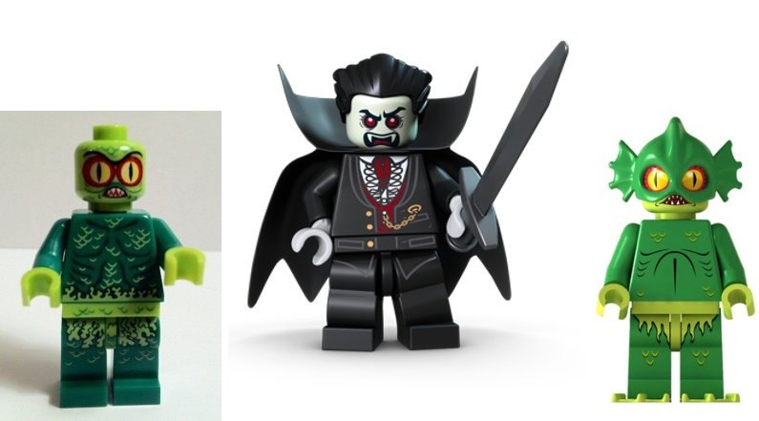
2 witnesses
Jesus has his two witnesses—to Testify of Christ
The Dragon also has his two monsters—to testify of the first beast
Revelation 13:11-12

Slide 28
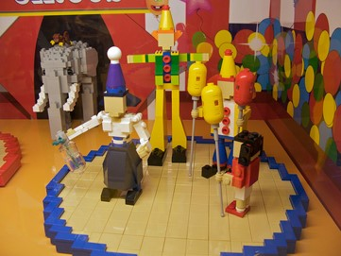
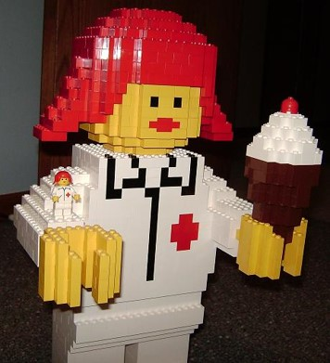
Great Wonders
2nd Beast performs miracles
Satan will do all he can to get all people to follow him, to “worship” him by living wickedly in the last days.
Revelation 13:13-14

Slide 29
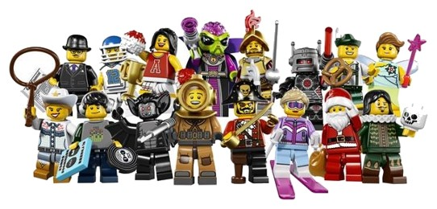
Power to Give Life
To make it real or to endow it with influence and power.
Idols—can take over lives and cause them to die spiritually as well as physically in wars, plagues, etc. Also the wicked can cause great trouble, temporarily for the righteous.
Revelation 13:15

Slide 30
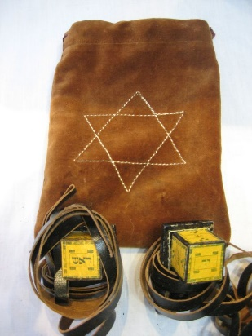
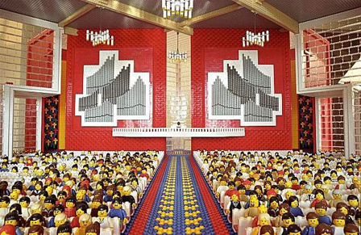
Mark in the Forehead
Forehead—symbolic of “loyalty”
“phylacteries” worn on foreheads
Rev. 14:1
144,000 righteous who have the “Father’s name written in their foreheads”
Revelation 13:16-17

Slide 31
Number of a Man
“Here is wisdom. Let him that hath understanding count the number of the beast: for it is the number of a man; and his number is Six Hundred threescore and six.”
666—We don’t know what the number means.
“Yea, verily I say unto you, in that day when the Lord shall come, he shall reveal all things
—D&C 101:32
Revelation 13:18

Slide 32
Sources:
Suggested Hymn: #60 Battle Hymn of the Republic
Taken from Poway Institute Handouts by Lesley Meacham and Becky Davies
Bruce R. McConkie, Doctrinal New Testament Commentary, 3 vols. (1965–73), 3:517].)
3. Elder James J. Hamula (“Winning the War against Evil,” Ensign or Liahona, Nov. 2008, 50, 51).
4. Sections taken from “The Book of Revelation Made Easier” David J. Ridges
Presentation by ©http://fashionsbylynda.com/blog/

Slide 33
Fierce Looking Beasts Revelation 13:
Apart from the knowledge that the beasts represent worldly kingdoms, we do not have any interpretation from the Lord concerning the beasts. While speaking about the mysteries of the book of Revelation, the Prophet Joseph Smith said the following:
“Whenever God gives a vision of an image, or beast, or figure of any kind, He always holds Himself responsible to give a revelation or interpretation of the meaning thereof, otherwise we are not responsible or accountable for our belief in it. …
“… Never meddle with the visions of beasts and subjects you do not understand” (in History of the Church, 5:343, 344).
The War With the Saints Revelation 13:7:
“Satan is waging war against the members of the Church who have testimonies and are trying to keep the commandments. And while many of our members are remaining faithful and strong, some are wavering. Some are falling. Some are fulfilling John’s prophecy that in the war with Satan, some Saints would be overcome.” President Ezra Taft Benson (“The Power of the Word,” Ensign, May 1986, 79).
The Book of Life Revelation 13:8:
“the book of life, or Lamb’s book of Life, is the record kept in heaven which contains the names of the faithful and an account of their righteous covenants and deeds. Elder Bruce R. McConkie Doctrinal New Testament Commentary,
“We are not going to be saved in the kingdom of God just because our names are on the records of the Church. It will require more than that. We will have to have our names written in the Lamb’s Book of Life, and if they are written in the Lamb’s Book of Life then it is an evidence we have kept the commandments. Every soul who will not keep those commandments shall have his name blotted out of that book” President Joseph Fielding Smith (in Conference Report, Oct. 1950, 10; see also Alma 5:57–58).
Lamb Slain Revelation 13:8:
The phrase “the Lamb slain from the foundation of the world” refers to Jesus Christ and His Atonement. “From the foundation of the world” refers to the premortal life, before the world was created. Therefore, we can understand from this verse that the effects of the Savior’s Atonement were in place before Jesus was even born. For example, people who lived before the time of Christ could exercise faith in Christ, repent, and have their sins forgiven through the power of His Atonement, even though the Savior had yet to be born (see D&C 20:25–26).
Attempting to identify the Beast Revelation 1-12:
Rather than attempting to specify an exact identity of the beast, it may be more profitable to note the following general characteristics about the beast: It had power over many nations (see Revelation 13:1, 7); it opposed God and blasphemed against Him (see verses 5–6); the power it wielded was like the power that predatory animals have over their prey (see verse 2); Satan gave it power (see verses 2, 4); people of the world worshipped or followed the beast (see verse 4); and it was able to overpower many, including the Saints (see verse 7). It could be said that any kingdom or government that exhibits these characteristics manifests the spirit of the beast. Revelation 17:8–12 contains additional information about the beast, including its ultimate destruction. New Testament Institute Manual Chapter 55

