Slide 1
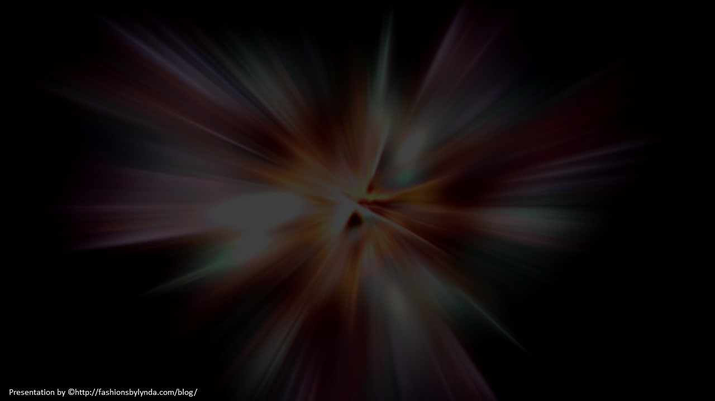
Lesson 157
Preparing for the Last Days
Revelation 14-16

Slide 2
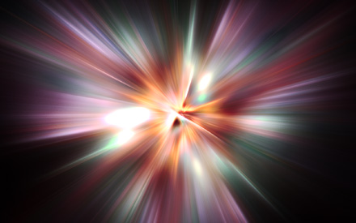
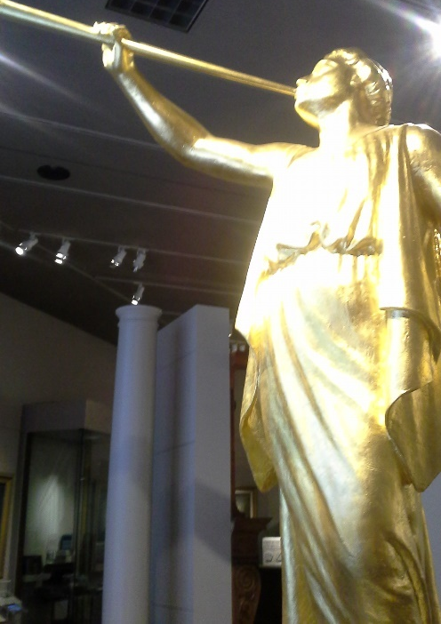
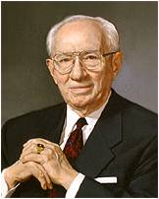
“John the Revelator, saw another angel fly in the midst of heaven, having the everlasting gospel to preach unto them that dwell on the earth, and to every nation, and kindred , and tongue, and people.”
“That Angel has come. His name is Moroni. His is a voice speaking from the dust, bringing another witness of the living reality of the Lord Jesus Christ.”
(2)

Slide 3
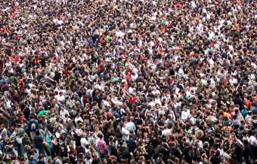
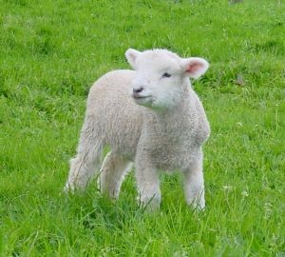
The Lamb
Christ is the symbol of peace and gentleness
144,000
Innumerable host of those called the elected, who think the thoughts and do the will of god.
Both men and women
Revelation 14:1

Slide 4
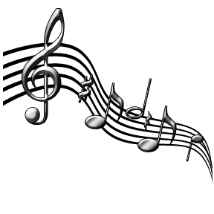
New Song
A victory sung by the above host before God’s throne
99 The Lord hath brought again Zion; The Lord hath redeemed his people, Israel, According to the election of grace, Which was brought to pass by the faith And covenant of their fathers.
100 The Lord hath redeemed his people; And Satan is bound and time is no longer. The Lord hath gathered all things in one. The Lord hath brought down Zion from above. The Lord hath brought up Zion from beneath.
101 The earth hath travailed and brought forth her strength; And truth is established in her bowels; And the heavens have smiled upon her; And she is clothed with the glory of her God; For he stands in the midst of his people.
102 Glory, and honor, and power, and might, Be ascribed to our God; for he is full of mercy, Justice, grace and truth, and peace, Forever and ever, Amen.
Revelation 14:2-3; D&C 84:99-102

Slide 5
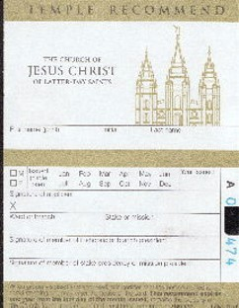
Those Singing Before the Throne
Christ’s Bride:
They have lived the law of chastity, keeping all their desires within the boundaries established by God.
They have live the law of obedience—their willingness to follow the Lamb in all things. Places and circumstances
They were not without sin—but have applied the cleansing and redeeming power of the Atonement.
They have been honest—no deceit in their dealings with their fellow men—maintained an active stance as a witness of truth.
These are elements of a Temple Recommend interview
Revelation 14:4-5

Slide 6
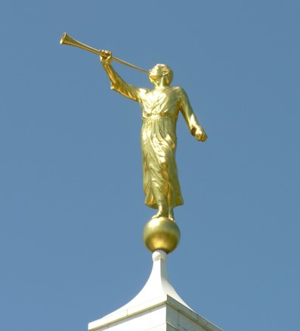
First Angel
Invites all to worship God=
Moroni and the coming forth of the Book of Mormon
Missionaries who take the message to the world (D&C 133:36-39 and 90:9-11 and 88:103-4)
This Church is the only church upon the face of the earth who has claimed that angels from heaven have restored the everlasting gospel to the earth.
The Hour of Judgment—the moment of Life with Heavenly Father or Death with Satan
Revelation 14:6-7

Slide 7
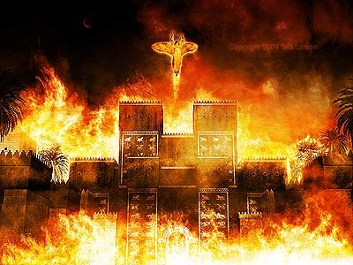
Second Angel
Joyfully proclaims: ‘Babylon is fallen”
A form of Apostasy
Babylon is a result of wickedness for Satan and his followers –it is a state of mind—everything that uses deceit, blasphemy and lying.
God is not the destroyer of the world—man is.
God allows men to receive the results of their own lawlessness. Those no longer with hope of repentance..
Revelation 14:8

Slide 8
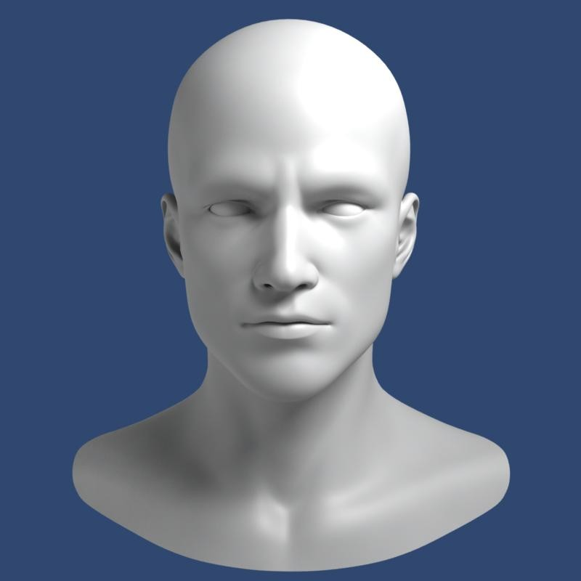
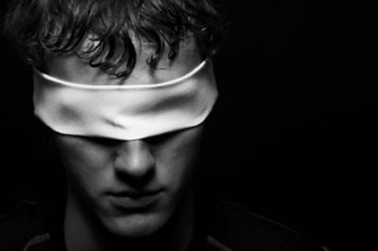
Third Angel
Judgment—Mark on the forehead
Moses 7:37
Results of punishment—
Torment of fire and brimstone—they will not be able to withstand the presence of God
D&C 88:22
If we live righteously, then we will be blessed for our works and rest from our labors after we die
Revelation 14:9-11

Slide 9
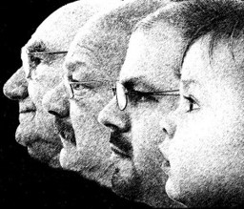
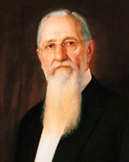
Patience of the Saints
The righteous will leave a legacy
Those who endure, remain faithful, stay obedient and die in the Lord will rest and their works will testify of them.
“Entering into God’s rest”—enter into the knowledge of the love of God; having faith in his purpose and in his plan, to such and extent that we know we are right, and that we are not hunting for anything else.
The man who has reached the degree of faith in God that all doubt and fear have been cast from him, he has entered into “God’s rest” (3)
Revelation 14:12-13

Slide 10
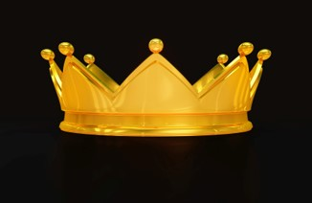
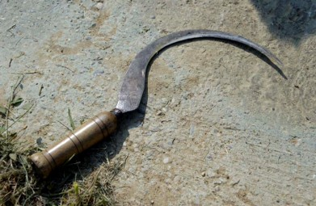
Jesus Leads the Harvest
The Resurrected Lord in his fullness and Power
Golden crown—untarnished, Eternal Victory
Sharp Sickle—This is the first harvest of the righteous and all people will have a chance to hear the gospel proclaimed in their own tongue. D&C 86:4-7
Revelation 14:14

Slide 11
The Harvest
This harvest has been going on since the Restoration of the Gospel—D&C 4:4
Great Honor for those who participate
1st the righteous are gathered out of all the earth
Revelation 14:15-16

Slide 12
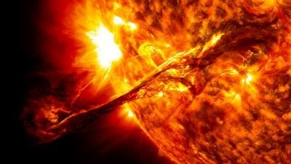
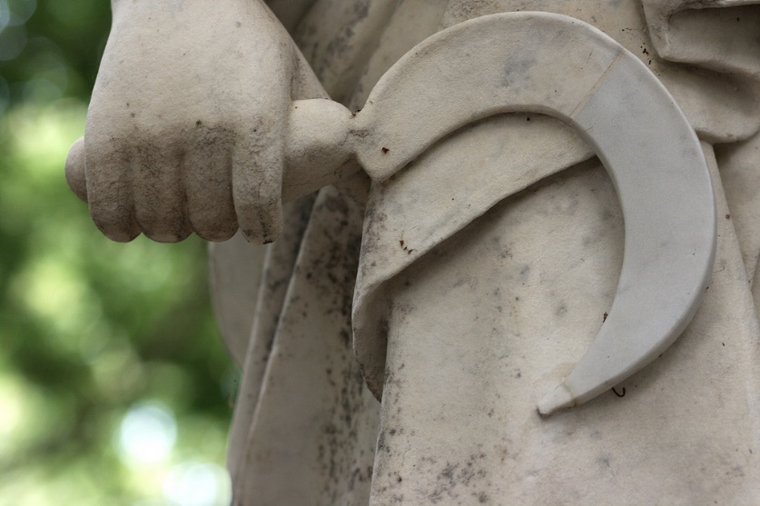
Judgment
One from the Temple—sharp sickle (the destroying angel)
One from the Altar (suggesting faithful martyrs may play a role in the harvesting of the wicked.
—from the presence of God—
Power over fire—grim reaper who has power over fire which will be used to burn, not the fields, but the vineyards.
This marks the beginning of the 2nd Harvest
“gather the clusters of the vine (the Lord’s vineyard) of the earth: for her grapes are fully ripe.
It is time to burn the “unproductive” vineyards
Revelation 14:17-18

Slide 13
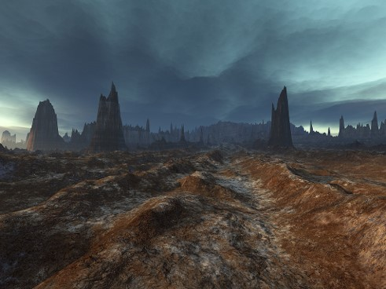
Wicked VS Wicked
A battlefield where the people of the earth will gather for war in their attempts to dominate each other.
D&C 63:33
The Spirit of the Lord is withdrawn
Revelation 14:19

Slide 14
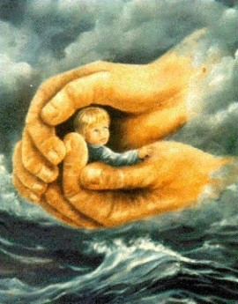
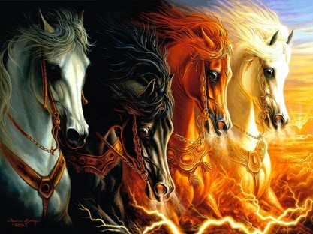
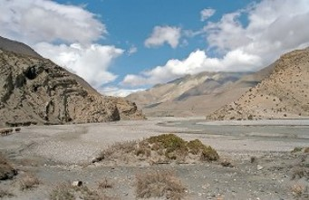
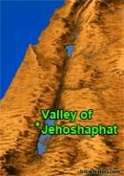
Those Who Remain
Those who remain are protected by God.
Horse bridles—a reminder of the 4 horses of war
Without the city—Valley of Decision
2 Chronicles 20:3-5,9,12,17,22-23
Joel reads that judgment will take place in the valley of Jehoshaphat which is synonymous with the Kidron Valley between Jerusalem and the Mt. of Olives.
Joel 3:14
This is near the area Christ suffered so that all who would come to Him would not need to suffer.
Revelation 14:20

Slide 15
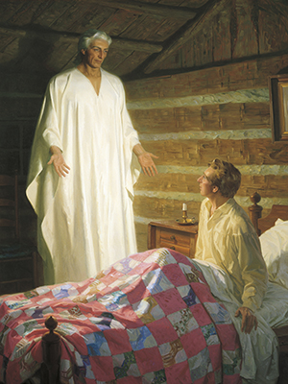
Gospel Restored
The time will come when Jesus Christ will judge all the people of the earth. His judgments will occur both at the Second Coming
Behold, I will send my messenger, and he shall prepare the way before me: and the Lord, whom ye seek, shall suddenly come to his temple, even the messenger of the covenant, whom ye delight in: behold, he shall come, saith the Lord of hosts.
Malachi 3:1
God restored the gospel of Jesus Christ to prepare the earth’s inhabitants for the Second Coming of Jesus Christ
Revelation 14:7-8

Slide 16
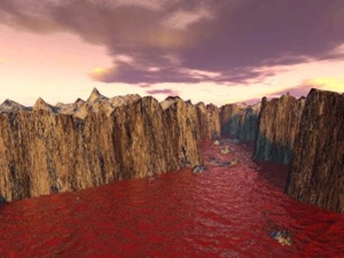
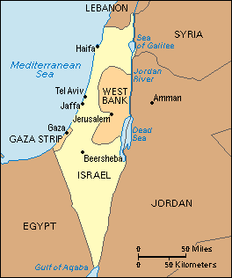
1600 Furlongs
184 miles—the blood flows as a river from this winepress of humanity.
Geographically about the maximum length of Palestine.
Symbolically 184 is the square root of 4 which means geographic completeness multiplied by the square of 10,
(4 x 4 x 100) meaning the judgment involves not only John’s world but an increasing magnitude of worldwide destruction.
Revelation 14:20

Slide 17
“7 Angels with 7 Plagues”
Revelation 15-16

Slide 18
The Wrath of God
John gives another view of God’s wrath to be released before the kingdom of the devil comes to an end.
7= perfection, complete
Plagues= the last dregs of God’s wrath
Revelation 15:1

Slide 19
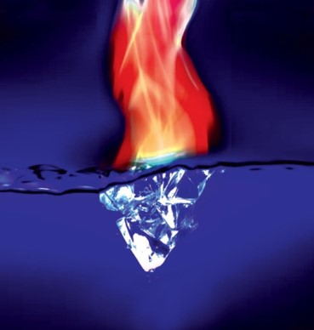
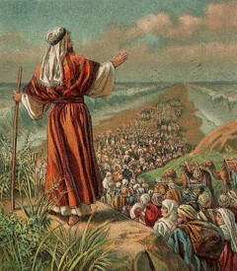
Sea of Glass
The Celestial earth mingled with fire—the saints will have come through great trials
Victory over the beast, image mark, and name—All done through the Atonement
Song of Moses—Israel sang when the Egyptian host was destroyed in the Red Sea and they were free
Song of the Lamb—All Saints sing the song of victory
Revelation 15:2-4

Slide 20
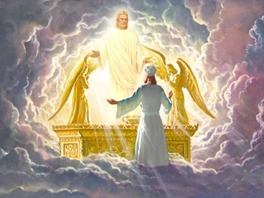
Temple of the Tabernacle
Covenant—Revelation 11:19
We saw the ark in the heavenly tabernacle.
Covenant VS Contract
Now the covenant and the law stand in the center. Mercy had its day. The time for execution of the law has come
Revelation 15:5

Slide 21
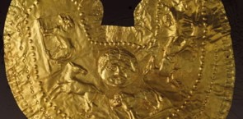
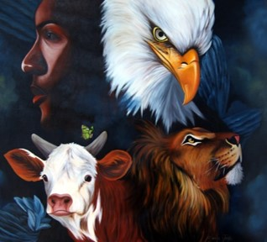
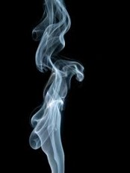
7 Angels and 7 Plagues
Pure and white linen—personal righteousness
(Rev 19:8)
4 beasts: (Rev. 4:7)
Lion
Calf
Man
Eagle
Breasts girded with golden girdles—angels of high rank. Pure—lasts forever
Smoke—signal of acceptance. God approves the mission of the 7 angels
Revelation 15:6-8

Slide 22
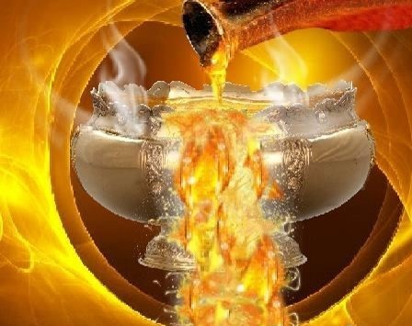
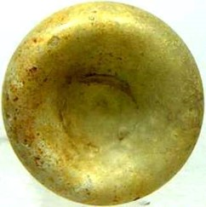
A Great Voice
Probably the voice of God
Vials—bowls for catching blood of the sacrificial animal.
The contents of the bowls is not blood but that which will shed blood.
Revelation 16:1

Slide 23
1st Angel
Pours vial on upon the earth—those with the mark of the beast
Noisome—evil and destructive nature of sores that plague the mind as well as the body.
Grievous sore—open abscesses or ulcers—representing the embodiment of all spiritual and physical suffering the wicked must endure themselves because they refused the Atonement (D&C 19:15-18)
Revelation 16:2

Slide 24
2nd Angel
Pours vial on the sea
Became as the blood of a dead man—the sea is a symbol of mankind. The first monster rose from the “Sea of mankind” (Rev. 13).
A spiritually dead society.
Dangers on the water: A curse.
D&C 61:4-5, 14-16
They have rejected the “Living Water”
Revelation 16:3

Slide 25
3rd Angel
Pours vial on the rivers and fountains—
The blood that was shed for the wicked
Joseph Smith—Carthage
D&C 87 and 88
Revelation and prophecy on war
Revelation 16:4

Slide 26
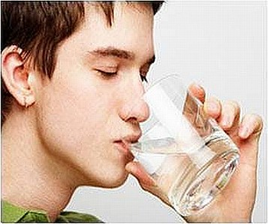
Angels of the waters
Which art, and wast, and shalt be—describes Truth and Christ
The angel is praising Christ for his wisdom in judgment
The Lord is making the wicked drink the cup they forced others to drink.
Revelation 16:5-7

Slide 27
4th Angel
Pours vial on the sun
Great heat is often associated with deserts and barren, unproductive land
This fire is cleansing, purifying the earth of all dross
This justice is a cosmic force that acts as a heavenly flame. When this consuming fire contacts something that is not itself just, it bursts into flame.
Revelation 16:8-9; D&C 64:23-24

Slide 28
5th Angel
Pours vial on the seat of the beast
Darkness—like plague of Egypt—thick, smothering
This darkness is of evil deeds and desires (Deut. 28:28-29)
The darkness is swallowing the kingdom of the first beast who is excluded from God’s light
(Isaiah 9:19-20)
Revelation 16:10-11

Slide 29
6th Angel
Prepares the world for war
Euphrates dries up—everything that held back the war is dried up and the war may go forth. (Red Sea and Jordan)
Frogs—unclean animals (Lev. 11:10)
3 frogs—Lies come out of the mouths of the unholy trinity in 3 forms:
1. Dragon—river of lies
2. Beast—blasphemies
3. False prophet—seductive propaganda
lie
lie
lie
Revelation 16:12-14

Slide 30
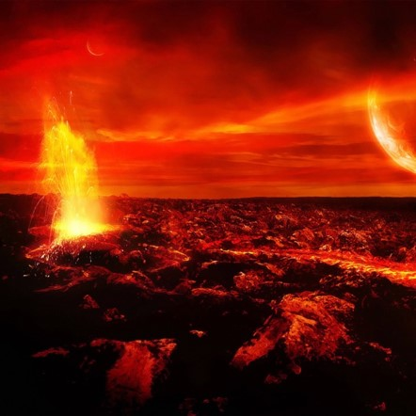
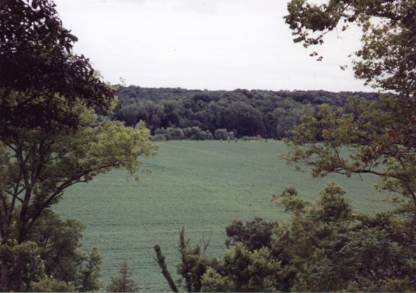
Armageddon
Place of rendezvous—all the forces of evil are gathering to battle.
Just as there is a gathering to the Gospel and Zion.
One ideology and theology against another
Revelation 16:15-16

Slide 31
7th Angel
Pours vial into air
“It is done”
Voices, Earthquakes, thunders, lightnings, hail
Babylon is divided into 3 parts
Cities of nations fell
Every island fled away, and mountains not found.
Chaotic Changes—beginning of earth for its paradisiacal state.
Hail—talent—
60-80 lbs
Revelation 16:17-19 and D&C 133:21-25

Slide 32
“It is a false idea that the Saints will escape all the judgments, whilst the wicked suffer; for all flesh is subject to suffer, and ‘the righteous shall hardly escape’ still many of the Saints will escape, for the just shall live by faith; yet many of the righteous shall fall a prey to disease, to pestilence, etc., by reason of the weakness of the flesh, and yet be save in the Kingdom of God. (2)
If we are watchful and spiritually ready, then we will be prepared for the Second Coming of Jesus Christ

Slide 33
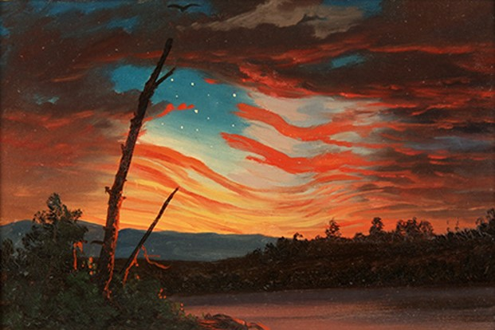
How do I Survive?
“Abide ye in the liberty wherewith ye are made free; entangle not yourselves in sin, but let your hands be clean, until the Lord come.”
D&C 88:86

Slide 34
Sources:
Suggested Hymn: #15 I Saw a Mighty Angel Fly
Video:
Spiritually Prepared (2:19)
Notes from Lesley Meacham and Becky Davies Poway Institute
History of the Church 4:11
Presentation by ©http://fashionsbylynda.com/blog/

Slide 35
Angel Revelation 14:6:
““That angel has come. His name is Moroni” President Gordon B. Hinckley (“Stay the Course—Keep the Faith” Ensign, Nov. 1995, 70). The angel may also represent a composite of the many heavenly messengers, including Moroni, who have assisted in the latter-day Restoration of the gospel of Jesus Christ (see Bruce R. McConkie, Doctrinal New Testament Commentary, 3 vols. [1965–73], 3:529–31;
Armageddon Revelation 16: 14-21:
“The name Armageddon is derived from the Hebrew Har Megiddon, meaning the ‘mountain of Megiddo.’ The valley of Megiddo is in the western portion of the plain of Esdraelon, fifty miles (eighty kilometers) north of Jerusalem, and is the site of several crucial battles in Old Testament times. A great and final conflict that will take place near the time of the Second Coming of the Lord is called the battle of Armageddon because it will begin in the same locale. (See Ezek. 39:11; Zech. 12–14, especially 12:11; Rev. 16:14–21.)” (Guide to the Scriptures, “Armageddon,” scriptures.lds.org).
The battle that will begin at Har Megiddon will spread to Jerusalem.
Departed Spirits Revelation 14:11
The great misery of departed spirits in the world of spirits, where they go after death, is to know that they come short of the glory that others enjoy and that they might have enjoyed themselves, and they are their own accusers” (Teachings of Presidents of the Church: Joseph Smith[2007], 224).
“A man is his own tormentor and his own condemner. Hence the saying, They shall go into the lake that burns with fire and brimstone [see Revelation 21:8]. The torment of disappointment in the mind of man is as exquisite as a lake burning with fire and brimstone” (Teachings of Presidents of the Church: Joseph Smith, 224).
Babel Revelation 14:8:
“Babel was founded by Nimrod and was one of the oldest cities in the land of Mesopotamia, or Shinar (Gen. 10:8–10). The Lord confounded the languages at the time the people were building the Tower of Babel (Gen. 11:1–9 Ether 1:3–5, 33–35). Babylon later became Nebuchadnezzar’s capital. He built an enormous city of which the ruins still remain. Babylon became a very wicked city and has since come to symbolize the wickedness of the world” (Guide to the Scriptures, “Babel, Baby” scriptures.lds.org).
“The song of Moses” Revelation 15:1-19:
was sung by the children of Israel following their deliverance from Egyptian bondage (see Exodus 15:1–19). Revelation 15:3 tells us that the song of Moses will be sung again by those who inherit the celestial kingdom in celebration of the Lamb of God delivering them from the bondage of sin. New Testament Institute Manual Chapter 55
Mark on the Forehead / Mark on His name Revelation 14:11:
The practice common among Oriental nations of colouring the forehead or impressing on it some distinctive mark as a sign of devotion to some deity is alluded to in Revelation 13:16
Bible Study Tools

Slide 36
REVELATION 16 | DESCRIPTION OF THE PLAGUE
Verse 2 | First, “a noisome and grievous sore” comes upon the wicked. (Similar plagues are described in Exodus 9:8–12 and Zechariah 14:12.)
Verse 3 | Second, the waters of the sea turn to blood, and all creatures in the waters die (see also Exodus 7:19–21).
Verse 4 | Third, the rivers and fountains of water turn to blood (see also Exodus 7:19–21).
Verses 8–9 | Fourth, the sun scorches the wicked with fire and great heat.
Verses 10–11 | Fifth, darkness spreads across the kingdom of the devil, and the wicked suffer pains and sores.
Verses 12–16 | Sixth, the waters of the Euphrates River dry up to prepare for the gathering of the kings of the world at Armageddon (see also Zechariah 12:11).
Verses 17–21 | Seventh, there are voices, thunders, lightnings, and a great earthquake; the cities of the nations fall; Babylon receives the cup of God’s wrath; and great hail falls upon men.
New Testament Institute Manual Chapter 55

Slide 37
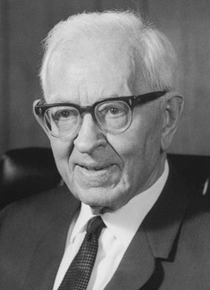
“We are informed that the Lord ‘shall command the great deep, and it shall be driven back into the north country, and the islands shall become one land; and the land of Jerusalem and the land of Zion shall be turned back into their own place, and the earth shall be like as it was in the days before it was divided.’ (Gen. 10:25.) The notion prevails quite generally that the dividing of the earth in the days of Peleg was a division politically among the people, but from this word of the Lord we gain the idea that the earth itself was divided and that when Christ comes it will again be brought back to the same conditions physically as prevailed before this division took place. The sea is to be driven back into the north. The land is to be brought back as it was originally and the lands of Zion (America) and Jerusalem (Palestine and all the land pertaining unto it) will be restored to their own place as they were in the beginning. The Savior will stand in the midst of his people, and shall reign over all flesh. We have discovered in our study that the wicked, or all things that are corruptible [D&C 101:23–35], will be consumed and therefore will not be permitted to be on the earth when this time comes.”
Joseph Fielding Smith (Church History and Modern Revelation, 2 vols. [1953], 1:264; see Isaiah 40:4; 64:1; D&C 133:22–24, 40, 44).

