Slide 1
Lesson 158
Babylon, a Symbol of Satan’s Power
Revelation 17-19
It is easier to avoid temptation than it is to resist temptation” --Elder Lynn G. Robbins
Presentation by ©http://fashionsbylynda.com/blog/

Slide 2
“The titles church of the devil and great and abominable church are used to identify all churches or organizations of whatever name or nature—whether political, philosophical, educational, economic, social, fraternal, civic, or religious—which are designed to take men on a course that leads away from God and his laws and thus from salvation in the kingdom of god.” (2)

Slide 3
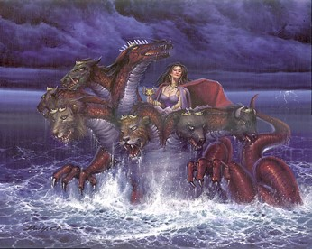
Great Whore
Those who left the Church
Those who broke the covenant
Those who committed fornication
Whenever people prove unfaithful to their covenants, they can be likened to a faithless woman who has sold herself to immorality and sin. (1)
Revelation 17:1-2

Slide 4
Sitteth Upon Waters
Jeremiah 51:13
“O thou that dwellest upon many waters, abundant in treasures, thine end is come, and the measure of thy covetousness.”
Waters: Representing peoples, and multitudes, and nations, and ‘tongues whom the harlot rules’
She has power and influence over the nations.
Wherefore, he that fighteth against Zion, both Jew and Gentile, both bond and free, both male and female, shall perish; for they are they who are the whore of all the earth; for they who are not for me are against me, saith our God.
2 Nephi 10:16
Revelation 17:1-2, 15; 1 Nephi 14:11

Slide 5
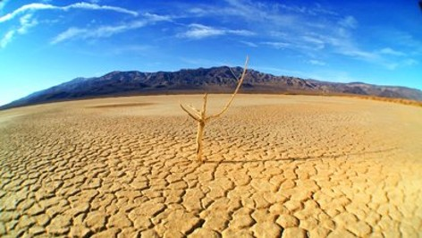
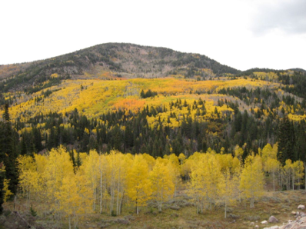
Wilderness
Apostasy—all the descriptions:
The whore of all the earth
The great and abominable church
The church of the devil
D&C 86:3 and 1 Nephi 13:5
Dualism
Those who are not His people will find themselves in the wilderness, full of wild beasts, desolation, etc.
(Zephaniah 2:13)
Denotes a place of discipline and protection, like the place the church with Zion was sent for safety. Psalms: 78:52
Revelation 17:3

Slide 6
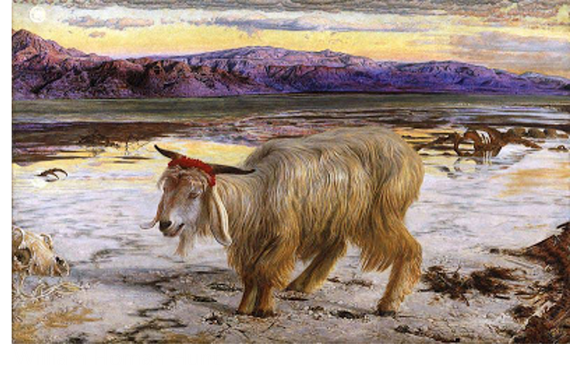
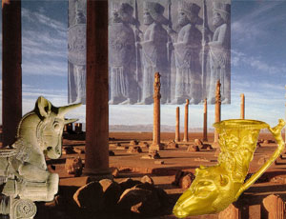
Scarlet Beast
A ribbon of this color was tied around the neck of the scapegoat on the Day of Atonement before it was driven into the wilderness to its death.
The Sins of Israel—associated with harlotry and the deep sins of ungodly conduct.
Beast—monster supporting the woman—associated with blasphemy—defiling name of God.
The beast may represent Rome in John’s day as well as corrupt kingdoms and nations in the last days.
Revelation 17:4

Slide 7
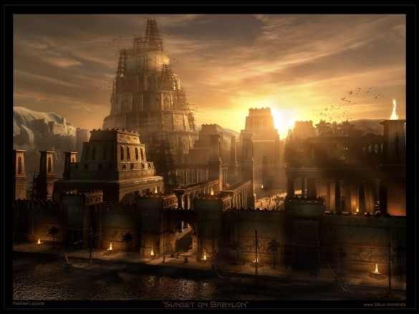
The Woman is Babylon
The ancient city had the reputation of being the first where men combined against god with the deliberate goal of frustration and wresting control from him.
Spiritual Babylon
All leagues which would be anti-Christ, one who perverts the right way of the Lord, and that promotes antichristian principle and life-styles.
Revelation 17:5

Slide 8
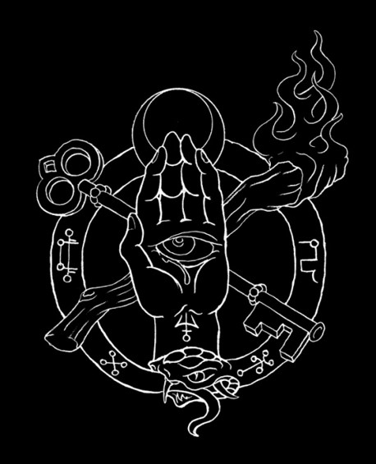
Mystery
Refers to the most holy teachings and doctrines of God kept from the profane world.
The apostles are stewards of the mysteries of God. Only the Holy Ghost reveals these mysteries.
The whore represents counterfeit ordinances with their secret oaths and biding covenant—secret works of darkness
Revelation 17:5

Slide 9
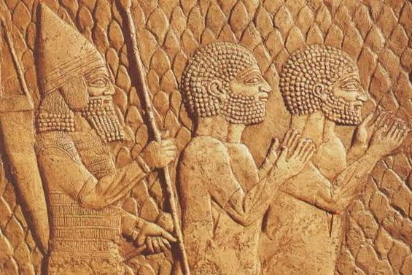
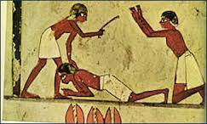
Being Drunk
Throughout the ages, many righteous people have been slain by the wicked, and the scriptural language suggests that slaying the righteous had an intoxicating effect on those who carried out the slaughter.
Throughout the ages, many righteous people have been slain by the wicked, and the scriptural language suggests that slaying the righteous had an intoxicating effect on those who carried out the slaughter.
Revelation 17:6

Slide 10
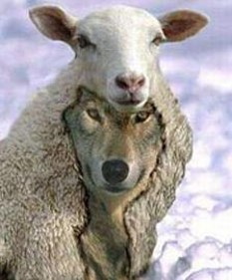
Admiration and Perdition
A negative connotation
Beast is the counterfeit of the Lamb of God.
The Lord is eternal
The beast is momentary
Revelation 17:6-8

Slide 11
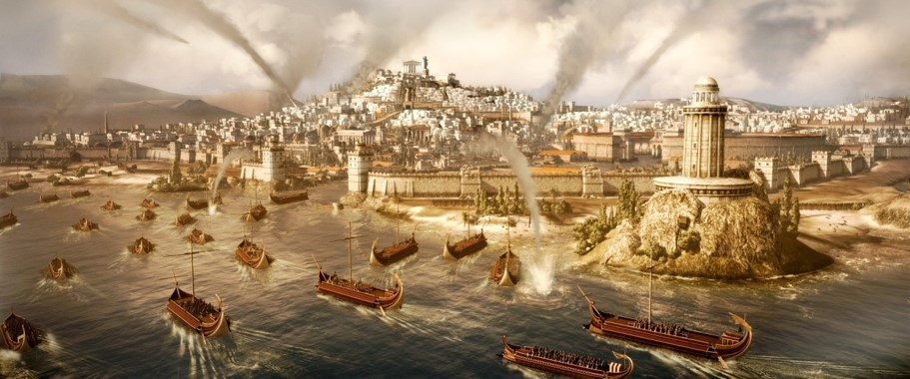
7 Heads are 7 Mountains
This fits Rome, which is called the city of 7 hills.
Rome itself stand as a symbol of the archetypal Babylon
This is a “type” of all wicked cities.
And there are seven kings: five are fallen, and one is, and the other is not yet come; and when he cometh, he must continue a short space.
Revelation 17:10

Slide 12
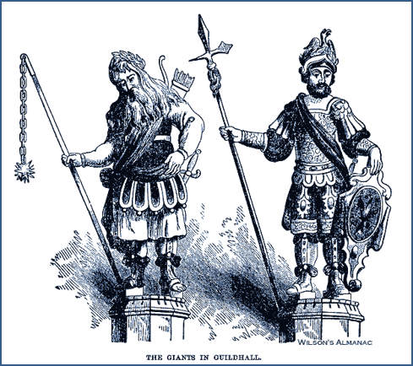
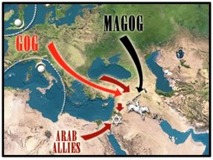
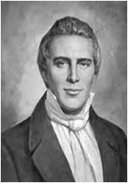
The Beast
Goeth into Perdition
Make war with the Lamb (with the faithful)
Shall be made desolate
Shall be burned by fire
Ezekiel 38:8-12, 39
Gog and Magog:
Before the coming of Christ, the great war, sometimes called Armageddon, will take place as spoken by Ezekiel
Another war of Gog and Magog will be after the millennium. (3)
Revelation 17:13-18

Slide 13
Things That Give Us the Greatest Problems:
Possessions
Do any possessions have a hold of me?
Power
Do I want to have all control?
Passion
Do I desire a physical need beyond the laws of God?
Popularity
Do I have a need for attention?
Pride
Do I have a high opinion of myself and regard myself superior to others?

Slide 14
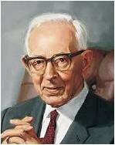
“Satan has control now. No matter where you look, he is in control, even in our own land. He is guiding the governments as far as the Lord will permit him.
That is why there is so much strife, turmoil, and confusion all over the earth. One master mind is governing the nations.
It is not the president of the United States; it is not Hitler; It is not Mussolini; it is not the king or government of England or any other land; it is Satan himself.”
(4)

Slide 15
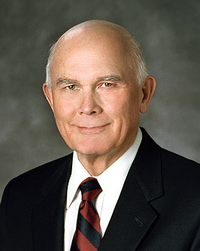
“The good, the true, and the beautiful are being replaced by the no-good, the “whatever,” and the valueless fodder of personal whim.
Not surprisingly, many of our youth and adults are caught up in pornography, pagan piercing of body parts, self-serving pleasure pursuits, dishonest behavior, revealing attire, foul language, and degrading sexual indulgence.” (5)

Slide 16
The Fall of Babylon
Revelation 18

Slide 17
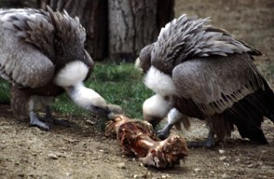
Angel Lightened in Glory
The Glory of the Lord returns to His temple and people.
A restoration
“Babylon has fallen”
Satan’s kingdom has come to an end via the Second Coming
Unclean birds—
1 Mosaic law=fowls (predators) that eat carrion (dead animals) were considered unclean.
2 Old Testament= associates fowls with the judgment of God upon the rebellious—something that feeds upon the souls of men
Revelation 18:1-2

Slide 18
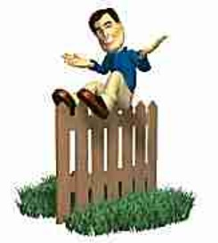
Fornication
Merchants—rich=Economic based on the finer things in life. Profit is the essential motive that drives Babylon.
“Come out of her”
“Lehk lekah” Get thee out (Gen 12:1) of the world. (D&C 133:7)
The price is the souls of men
There are no fence sitters. If we are not for the Lord and the truth we are fighting for the adversary.
Partakers of her sins—The righteous are warned not to participate in the evils of the last days
Revelation 18:3-4

Slide 19
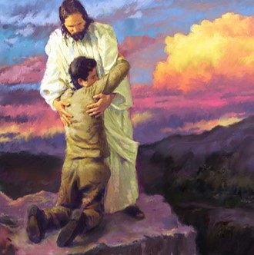
However:
“…Know the LORD: for they shall all know me, from the least of them unto the greatest of them, saith the LORD: for I will forgive their iniquity, and I will remember their sin no more.”
Jeremiah 31:34

Slide 20
Separating ourselves from the wickedness of the world can help us avoid sin and the judgments that will come upon the wicked in the last days

Slide 21
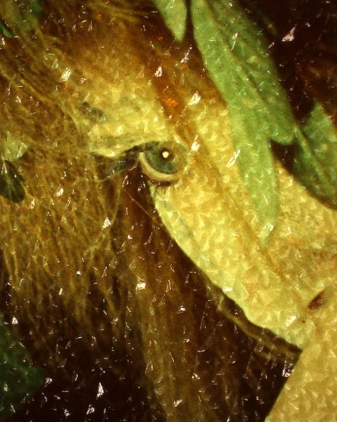
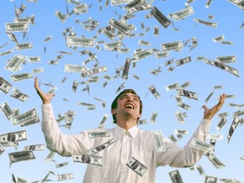
Payment
What does Babylon want?
The Souls of Men
She (Babylon) will give you what you want, only temporarily and at a price
Double=
Her payment to us is not 1 for 1, but 2 for 1
Revelation 18:5-6

Slide 22
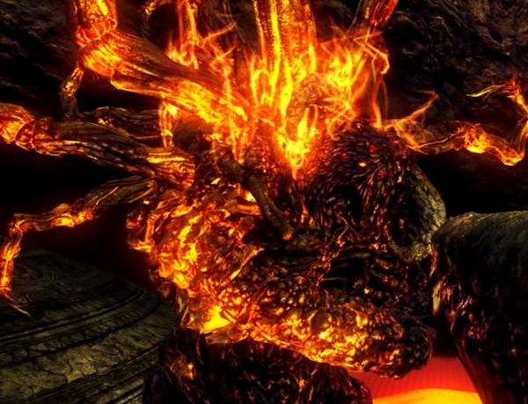
Plagues
Burned—
1. A purifying agent used in the last days. Only those things already pure and incorruptible will remain.
2. Fire of the Holy Ghost will purge those willing to have his companionship. They will cast Satan out.
Death and Mourning and Famine
And burned with fire
Representing the priestly class: Babylon, the whore.
Under the law, a woman found in adultery or harlotry, was stoned, but the daughter of a Levitical High Priest, was burned
Revelation 18:8

Slide 23
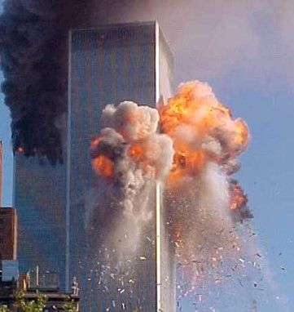
Kings Bewail
Powerful wicked Leaders
They will lament not because of guilt, but instead, they can’t continue living deliciously. They have lost their mistress (power) who provided great satisfaction.
People tend to put up with sin as long as the economy is good.
Standing afar off—fear of Babylon’s torment. Those who are in disbelief of the swiftness of the fall of their world. (9/11) Example
Merchants weep—their stores are full but no one is buying
No one buys because the whole economic structure has collapsed.
The spirit of consecration has humbled the power of possession.
Revelation 18:9-11

Slide 24
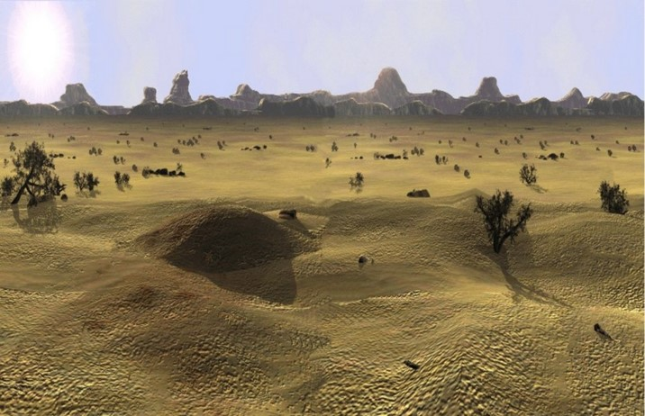
Departed From Thee
All is taken away
Mourning—of those who sold themselves to Babylon. It is suddenly gone. Not a cry of repentance but a grief that it can’t go on forever.
Is the Lord opposed to prosperity?
Read D&C 49:19-20
Revelation 18:12-19

Slide 25
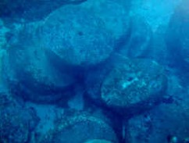
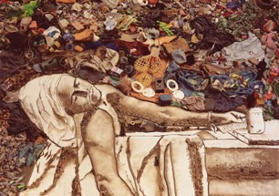
God’s Law
Law of bloodshed=Life of a man is required if he slays a fellow man
Law of a spiteful witness=if a witness is found guilty of perjury he receives the punishment he desired for his fellow man.
As this millstone is thrown violently and sinks down into the abyss, Babylon is gone, never to rise again from the depths.
All the degrading music that was part of this city will cease
Revelation 18:20-24

Slide 26
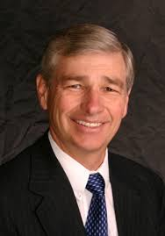
Don’t Look Back
“When we leave her (Babylon) we are not to depart, as did Israel out of Egypt, constantly looking back, longing for the “flesh pots” of their former bondage.
We must not itch and pine for the “good old days’ of worldliness. When we leave Babylon we are to go rejoicing, singing, and eager to tell the whole world the wonders of the Savior’s atonement that gave us a way out. “(6)

Slide 27
Preparing the Way for the Millennium Revelation 19

Slide 28
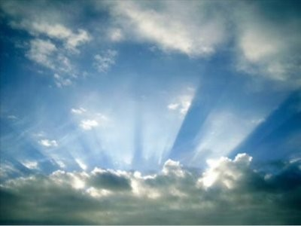
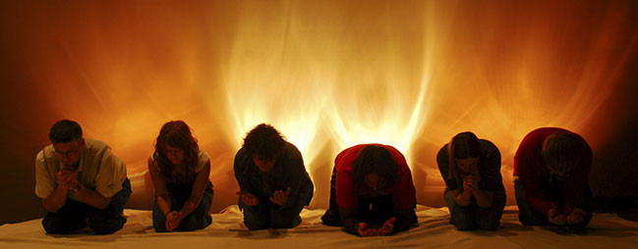
Alleluia—Praise ye the Lord
After all these things--After the destruction of Satan and the kingdom of Babylon
(D&C 29:21)
Hallehu-Jah=Praise ye Jehovah
The Righteous Rejoice—judgment has been made
Smoke rose up for ever and ever—Those who participated in the idolatries of Babylon shall go away into eternal burnings.
The prayers of the wicked are not heard anymore.
Revelation 19:1-3

Slide 29
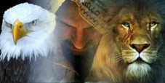
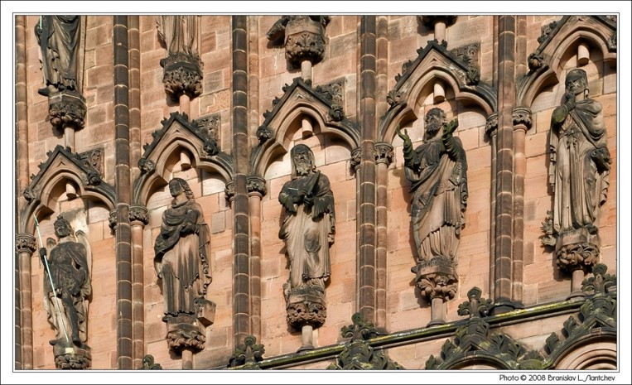
24 Elders and 4 Beasts
The Faithful elders during John’s day who belonged to the seven churches.
D&C 77:5
Beasts—the Highest of all God’s Creatures
Rev. 4:6-7 and D&C 77:2-3
Amen= Closure—Signifying agreement
Revelation 19:4

Slide 30
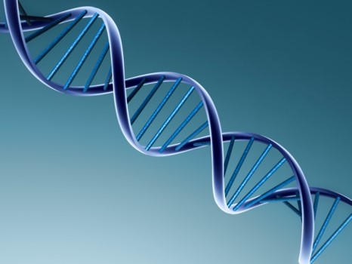
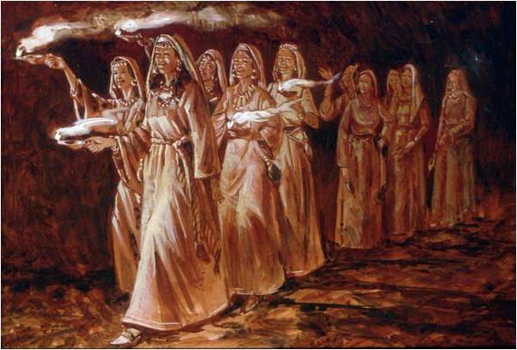
Made Themselves Ready
Voice of many waters—
All nature and all the righteous praise Christ
“Marriage of the Lamb”
See: Parable of the 10 virgins Matthew 25:4
Revelation 19:6-7

Slide 31
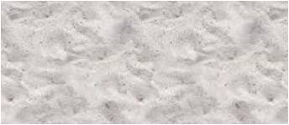
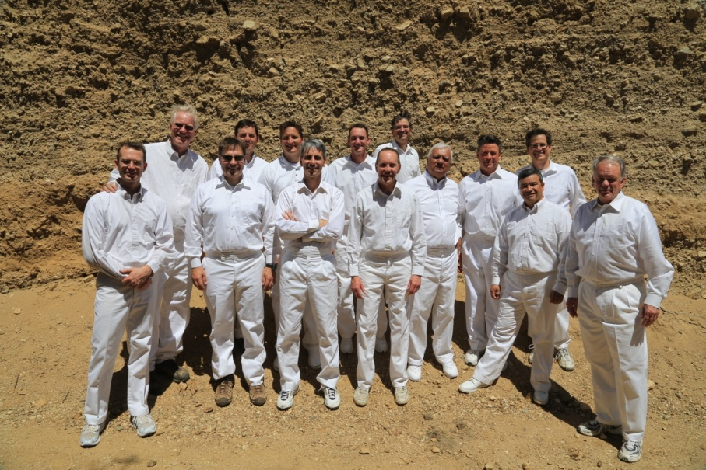
Fine Linen
Description of the clothing of the bride
Contrast to the whores clothing in Rev. 17:4
Clean and White=they are clothed with personal righteousness.
The Savior’s Atonement can do this for us, after all we can do.
Read 2 Nephi 9:14; 25:23
Revelation 19:8

Slide 32
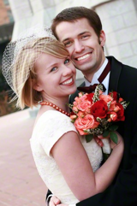
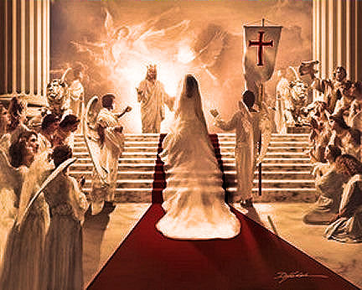
Marriage Analogy
“marriage of the Lamb”
“On your wedding day the very best gift you can give your eternal companion is your very best self—clean and pure and worthy of such purity in return.” (7)
“In this dispensation the Bridegroom, who is the Lamb of God, shall come to claim his bride, which is the Church composed of the faithful saints who have watched for his return.” (2)
Revelation 19:1-6

Slide 33
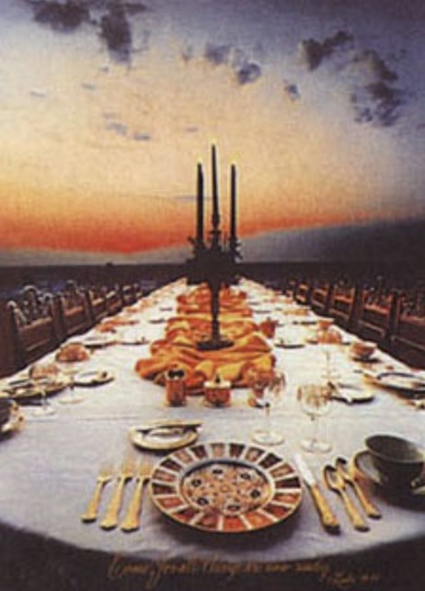
Marriage Supper
The Angel in Rev. 1-- bearing a testimony -- asks John to Write
Those that are called (an invitation into God’s Kingdom)
If the Bride is the Church, Who are the guests?
Individual Saints
Read D&C 88:96
If we are clean and righteous, then we will be ready for the coming of the Lord Jesus Christ
Revelation 19:9

Slide 34
Two Feasts
The condemned
Satan is the host
He entices us to sit at his feast
His is the meal of lies, betrayal, deception, and worldliness
Sanctified and justified
Savior is the Bridegroom and an honored patron of the ceremony, but he is also the server
He invites us to sit and brings the feast
A meal of truth
Which Feast would you desire to attend?

Slide 35
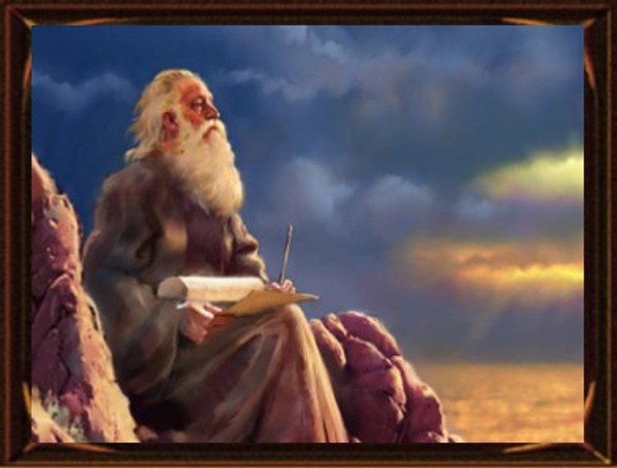
John Fell at His Feet
“I am your fellow servant”
Spirit of Prophecy—Spirit of Revelation
When we have a firm testimony of Jesus Christ we will see things more clearly and can, in a sense, foretell future consequences.
Revelation 19:10

Slide 36
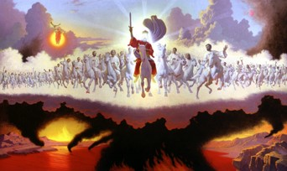
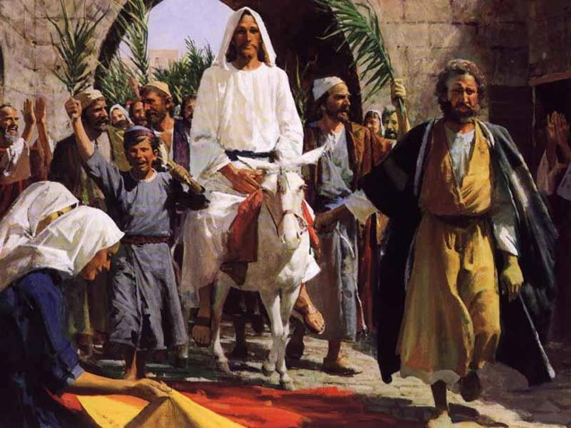
White Horse
Symbol of Victory—Christ’s return as King of Kings and a conqueror of evil
The Father turns all judgment over to Jesus
Jesus’ first ride was a donkey—symbol of peace
Revelation 19:11

Slide 37
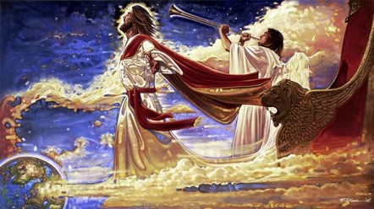
Description of Jesus
Eye’s were as a flame of fire and many crowns—Christ rules over many kingdoms
Read D&C 88:50-61
New name—symbolic of Celestial glory—the key word
Read D&C 130:11
Revelation 19:12

Slide 38
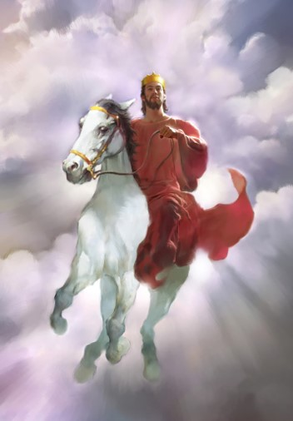
Clothing
Dyed garments—
He will wear Red at His coming
Symbolic of the blood of the wicked as judgment falls upon them.
Read:
D&C 133:46-48
Isaiah 63:1-6
His Name = The Word of God
Revelation 19:12-13

Slide 39
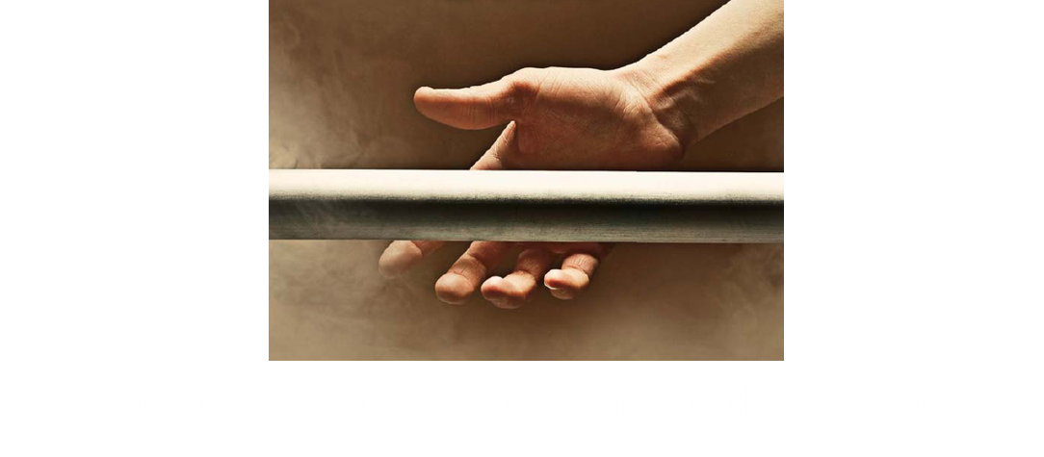
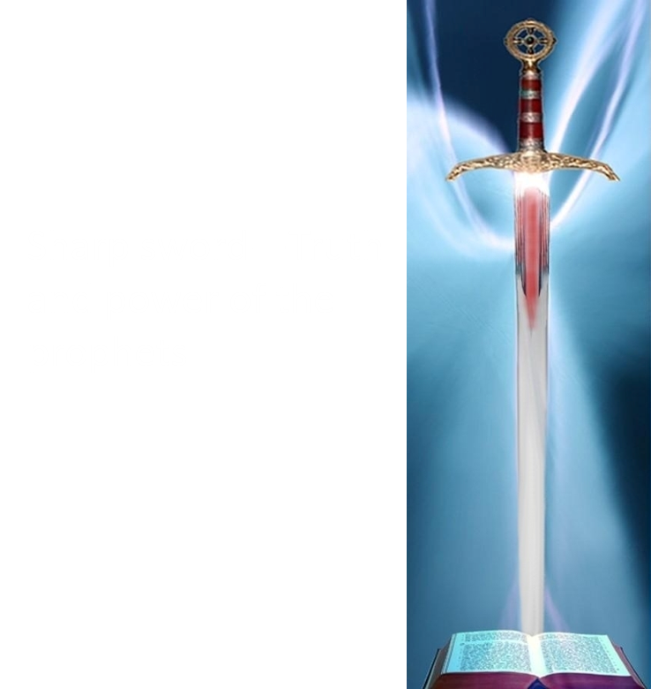
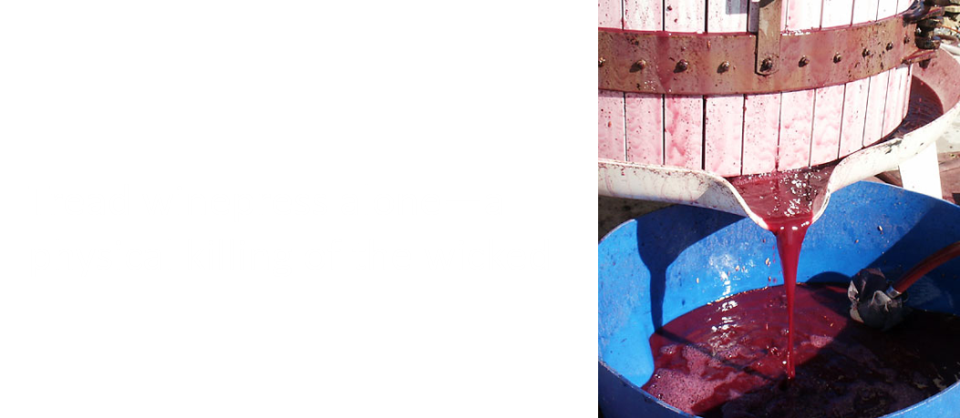
Armies
An Army of Righteousness—
Those who fought in the war in Heaven
Revelation 19:14-15

Slide 40
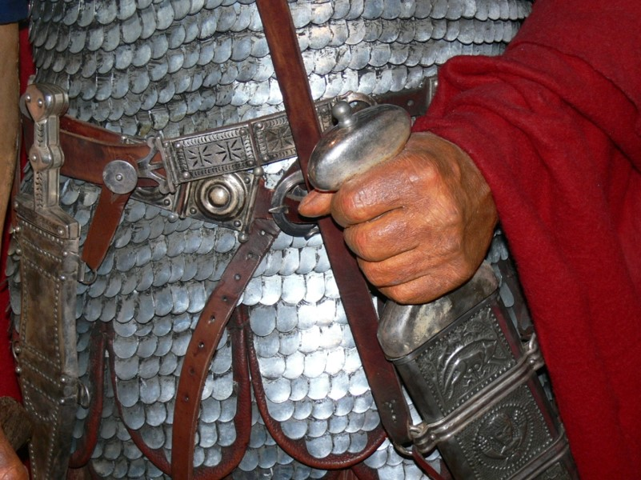
Name Written
King of Kings and Lord of Lords—by birthright and son ship
Thigh—it is where the sword is kept.
Revelation 19:16

Slide 41
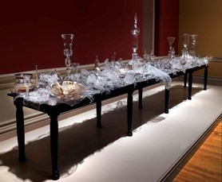
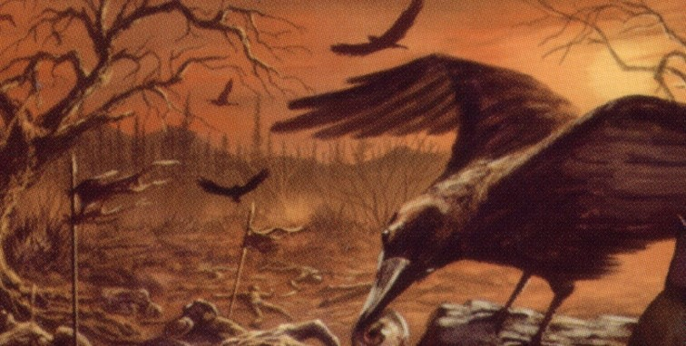
Angel in the Sun
Angel--Celestial Glory—power and authority
Fowls—Scavenge the souls of the wicked
Satan’s Banquet--Anarchy
Bodies of the rebellious supply the entrée.
D&C 29:14-21
Revelation 19:17-19

Slide 42
First to Fall
The Beast and the false prophets are the first to fall, under the power of Christ. False political entities and faithless institutions and philosophies will fail.
No longer supported by these philosophies, the armies of the world will succumb to
anarchy.
The only weapon the prophets need to
defeat the enemy and to establish peace
on the earth is the proclamation of the
gospel.
Revelation 19:20-21

Slide 43
Becoming Worthy
“Have ye walked, keeping yourselves blameless before God” Could ye say, if ye were called to die at this time, within yourselves, that ye have been sufficiently humble? That your garments have been cleansed and made white through the blood of Christ, who will come to redeem his people from their sins?
Behold, are ye stripped of pride? I say unto you, if ye are not ye are not prepared to meet God. Behold ye must prepare quickly; for the kingdom of heaven is soon at hand, and such an one hath not eternal life.”
Alma 5: 27-28

Slide 44
Sources:
Suggested Hymn: #7 Israel, Israel, God is Calling verse 1 and 4
Video:
Leave the Party (6:26)
“Life and Teachings of Jesus Christ and His Apostles” Page 464
Bruce R. McConkie “Mormon Doctrine” Pages 137-138; (Mormon Doctrine, 2nd ed. [1966], 469).
Joseph Smith (HC 5:298).
Joseph Fielding Smith “Doctrines of Salvation” 3:45; 3:315
Dallin H. Oaks Ensign, May 2004
6. Michael Wilcox “Who Shall Be Able to Stand” page 266
7. Elder Jeffrey R. Holland (“Personal Purity,” Ensign, Nov. 1998, 77).
David J. Ridges “The Book of Revelation Made Easier”
Notes from Lesley Meacham and Becky Davies from the Poway Institute Class
Presentation by ©http://fashionsbylynda.com/blog/

Slide 45
Babylon Revelation 17:1-6:
Because of the worldliness and corruption of ancient Babylon, and because it was a place where the children of Israel were captive, Babylon is often used figuratively in the scriptures to represent sin, worldliness, the influence of the devil on the earth, and spiritual captivity
Clothed with a Vesture Dipped in Blood Revelation 19:13:
“Having bled at every pore, how red His raiment must have been in Gethsemane, how crimson that cloak!
“No wonder, when Christ comes in power and glory, that He will come in reminding red attire (see D&C 133:48), signifying not only the winepress of wrath, but also to bring to our remembrance how He suffered for each of us in Gethsemane and on Calvary!” Elder Neal A. Maxwell (“Overcome … Even As I Also Overcame,” Ensign, May 1987, 72).
Come Out of Babylon Revelation 18:4
“Much of the world is being engulfed in a rising river of degenerate filth, with the abandonment of virtue, righteousness, personal integrity, traditional marriage, and family life. …
“… Despite pockets of evil, the world overall is majestically beautiful, filled with many good and sincere people. God has provided a way to live in this world and not be contaminated by the degrading pressures evil agents spread throughout it. You can live a virtuous, productive, righteous life by following the plan of protection created by your Father in Heaven: His plan of happiness” Elder Richard G. Scott (“How to Live Well amid Increasing Evil,” Ensign or Liahona, May 2004, 100).
The “marriage supper of the Lamb” (Revelation 19:9) is a symbolic reference to the Second Coming of Jesus Christ. The Prophet Joseph Smith taught:
“Those who keep the commandments of the Lord and walk in His statutes to the end, are the only individuals permitted to sit at this glorious feast. …
“Reflect for a moment, brethren [and sisters], and enquire, whether you would consider yourselves worthy [of] a seat at the marriage feast” (Teachings of Presidents of the Church: Joseph Smith [2007], 165–66).
Receive Not Her Plagues Revelation 18:4:
“It is a false idea that the Saints will escape all the judgments, whilst the wicked suffer; for all flesh is subject to suffer, and ‘the righteous shall hardly escape;’ … many of the righteous shall fall a prey to disease, to pestilence, etc., by reason of the weakness of the flesh, and yet be saved in the Kingdom of God” Joseph Smith (in History of the Church, 4:11).

