Slide 1
Lesson 159
Binding of Satan
Revelation 20

Slide 2
During Millennium
Satan is bound for a thousand years and no longer deceives the nations
Revelation 20:1-3
1 Nephi 22:26-28
The righteous rise in the First Resurrection
Revelation 20:4-6
Mosiah 15:21-23
D&C 88:96-98
“During that thousand years of peace the great work of the Lord shall be in the temples, and into those temples the people shall go to labor for those who have (died) and who are waiting to have these ordinances…preformed for them by those who still (live) upon the earth”
Joseph Fielding Smith
Doctrines of Salvation 3:58
Isaiah 2:2-5
D&C 128:15
If we are faithful to Jesus Christ, we will have part in the First Resurrection and reign with Christ during the Millennium

Slide 3
End of Millennium
Satan is loosed from his prison and once again deceives the nations. He gathers them to battle against God
Revelation 20:7-8
D&C 88:110-111
Satan’s armies surround the camp of the Saints. God sends fire that destroys Satan’s armies, Satan and others are cast into the lake of fire and brimstone.
Revelation 20:9-10
D&C 88:112-114
Those not in the First Resurrection are resurrected and judged. The wicked are sent away to suffer the second death.
Revelation 20:11-15
Helaman 14:17-19
D&C 63:17
At the end of the Millennium, the forces of God will defeat Satan and his followers.

Slide 4
After Millennium
The earth receives its celestial glory. God’s holy city is established upon the earth
Revelation 21:1-3; 22:1-2
The righteous Saints live with God in celestial splendor
Isaiah 60:19-21
Revelation 21:4-7; 22:3-5
Those who are exalted shall reign as gods
D&C 132:20
“Every man who reigns in celestial glory is a God to his dominions”
Joseph Smith “Teachings of the Prophet Joseph Smith” pg 374

Slide 5
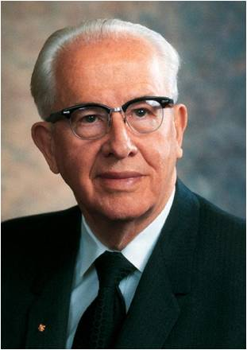
The End—Or is it?
John is one of the few prophets to see the end of the earth whose writing the Lord has allowed to go forth to the world.
1 Nephi 14:24-27
“I testify that not many years hence the earth will be cleansed…Jesus the Christ will come again, this time in power and great glory to vanquish His foes (destroy His enemies) and to rule and reign on the Earth.”
Ezra T. Benson
1988 Conference Report or Ensign Nov. 1988

Slide 6
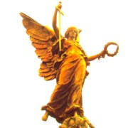
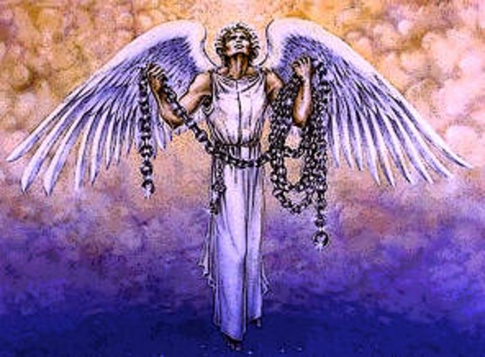
Key to Bottomless Pit
Michael will gather and lead the armies as he did in the War in Heaven
D&C 88:112
Dan 7:22
Key—Christ is the holder of the key
Chain—Satan’s Chain on us
The Key and the chain denote God’s supremacy over both Satan and his realm
Revelation 20:1

Slide 7
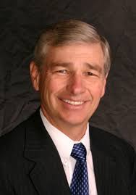
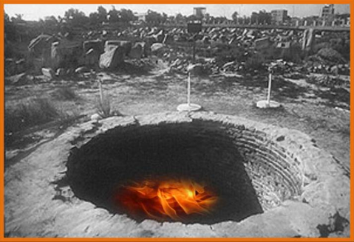
God is Magistrate of Pit, Not Satan
He who chained others is now chained.
He who loved to spread darkness over the earth is shut up in darkness
He who dragged others into the pit descends himself into it
He descends into the pit that he himself has dug
Isaiah 14:12-16, 19
(1)
D&C 88:32
Hell is described as your “own Place.”
Revelation 20:1

Slide 8
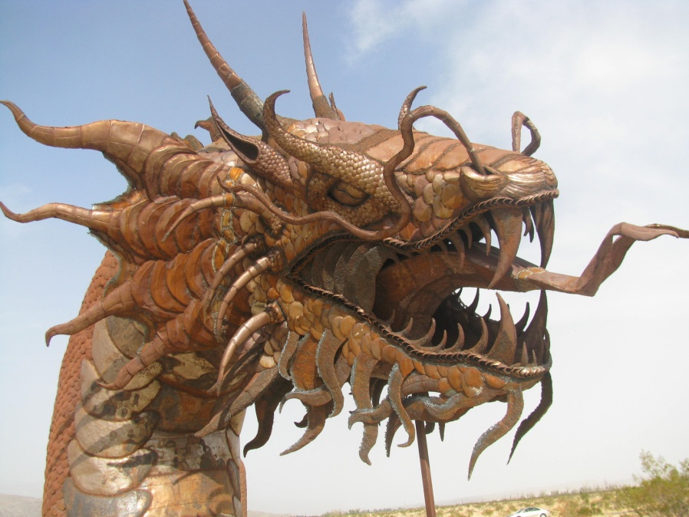
Binding for 1,000 Years
Dragon--Satan
“And in that day Satan shall not have power to tempt any man.”
D&C 101:28
Some suggest that it will only be “because of the righteousness of his people” that “Satan has no power” during the Millennium.
Revelation 20:2

Slide 9
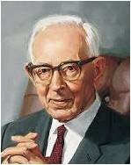
“There are many among us who teach that the binding of Satan will be merely the binding which those dwelling on the earth will place upon him by their refusal to hear his enticings. This is not so. He will not have the privilege during that period of time to tempt any man.”
(3)
The Lord’s power binds Satan initially and the righteousness of the Saints Keeps him bound.
1 Nephi 22:26

Slide 10
Setting a Seal Upon Him
The purpose of Satan’s binding is precautionary.
The Savior and his people must have time to prepare the earth for the celestial glory.
Bottomless pit=Outer Darkness
The angel does the binding, not mankind.
People do not bring about the millennial condition through some kind of supreme righteous act.
Revelation 20:3

Slide 11
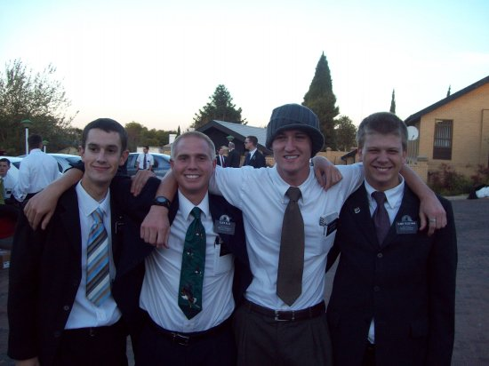
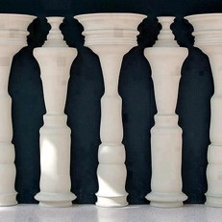
Loosed a Little Season
“There will be many within the nations who shall not know of the gospel law yet who shall live terrestrial live.
These will be spared destruction and enjoy the millennial period with the Saints of God through missionary work.”
(3)
After 1,000 years, Satan will be released to gather his army for the final battle where he will be cast into perdition forever.
Since only the power of God can loose him then his freedom must play an important part of God’s purposes.
Men will begin to
deny God.
Revelation 20:3 and 7

Slide 12
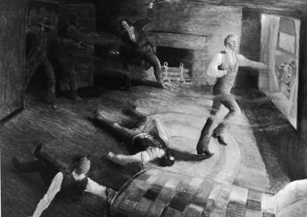
Paradisiacal Era
People who share in the Millennial reign
They worship God not Satan
They did not fall for Satan’s ideology
They actively fought for truth
All the martyrs who gave their lives in the service of the Lamb.
Christ had promised his apostles that they would be the judges of Israel.
D&C 29:12
Revelation 20:4

Slide 13
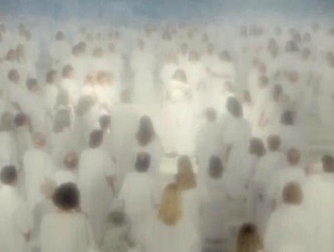
First Resurrection
D&C 88:96-101
“And the saints that are upon the earth, who are alive, shall be quickened and be caught up to meet him.”
Alma 13:11-12
“Therefore they were called after this holy order, and were sanctified, and their garments were washed white through the blood of the Lamb.”
“…they shall be priests (the priesthood) of God and of Christ, and shall reign with him a thousand years.”
Revelation 20:5-6

Slide 14
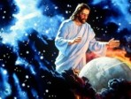
Second Resurrection
At the End of the Millennium
Hath no power (Alma 12:16-18)
Spiritual death
They are cast out of the presence of the Lord for 1,000 years
They are dead as pertaining to the things of righteousness (the things of the Spirit)
“These are the ones who have earned a telestial body, who were wicked and carnal in mortality, and who have suffered the wrath of God in hell “until the last resurrection” until Christ has finished His work...their final destiny is to inherit a telestial glory
(D&C 76:81-112)
(7)
Revelation 20:5-6

Slide 15
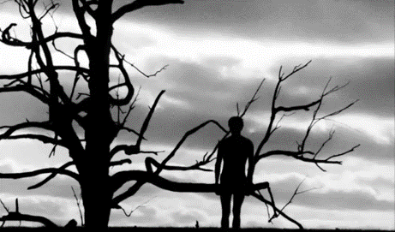
Sons of Perdition
Those who remain filthy still
Shall come forth out of their graves.
2 Nephi 9:14-16
“Then is the time when their torments shall be as a lake of fire and brimstone, whose flame ascendeth up forever and ever; and then is the time that they shall be chained down to an everlasting destruction, according to the power and captivity of Satan”
(Alma 12:17-18)
All except sons of perdition are save at least to some degree, by Christ, into the telestial, terrestrial, or celestial kingdoms
D&C 76:37-38, 81-87
Revelation 20:5-6

Slide 16
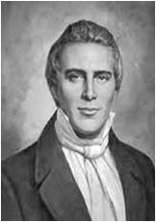
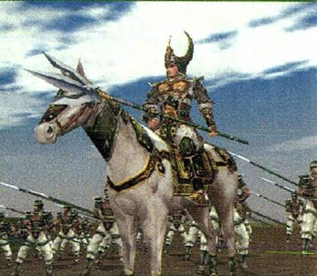
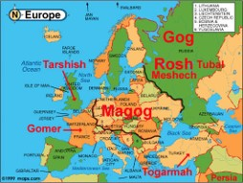
Gog and Magog
Symbolic of wicked nations and their leaders
“The battle of Gog and Magog will be after the millennium." (6)
King of Magog, a county or people near the Black Sea, and equivalent to Scythian, whose invasion of Israel was prophesied by Ezekiel (Ezek. 38-39)
The prophecy points to a time when the gentile nations of the north would set themselves against the people of God and would be defeated and led to recognize Jehovah as King. (5)
There will be a battle before the 2nd Coming and again after the Millennium, this time led by Michael—Those who will not answer Michael’s call will be those who rejected the doctrine of Christ. (1)
Revelation 20:8

Slide 17
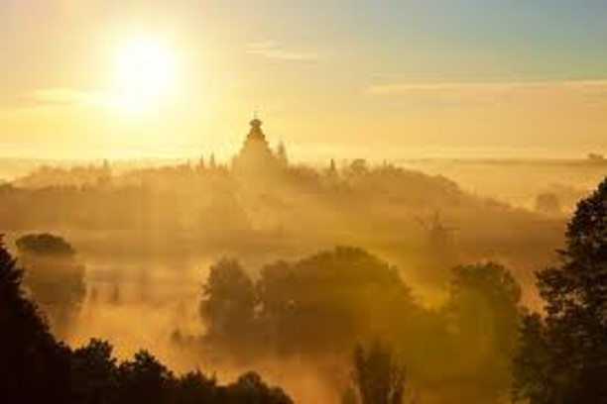
Beloved City
The Lord’s Kingdom
“compassed” the Saints and the city—protected
And cast the wicked out forever
Revelation 20:9-10

Slide 18
Fire and Brimston
“A man is his own tormentor and his own condemner.
Hence the saying, They shall go into the lake that burns with fire and brimstone.
“The torment of disappointment in the mind of man is as exquisite as a lake burning with fire and brimstone.” (6)
Revelation 20:8

Slide 19
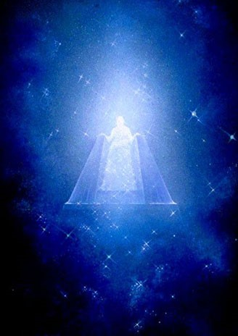
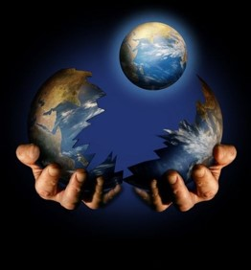
White Throne
Christ’s throne of purity and justice
Earth and Heaven fled away—
The end of the earth and of the atmospheric heaven which surround it.
—a new earth
D&C 29:24-25
Revelation 20:11

Slide 20
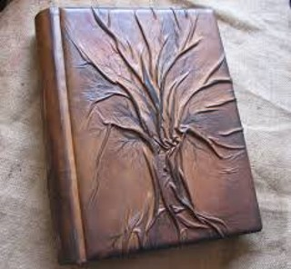
Book of Life
“and I saw the dead, small and great, stand before god; and the books were opened: and another book was opened, which is the book of life; and the dead were judged out of those things which were written in the books, according to their works…
The records of our acts are transcribed in our souls. The account of our obedience or disobedience is written in our bodies.
(7)
…And the sea gave up the dead which were in it; and death and hell delivered up the dead which were in them: and they were judged every man according to their works.”
Revelation 20:12-13; D&C 128:6-7

Slide 21
Doctrinal Mastery
And I saw the dead, small and great, stand before God; and the books were opened: and another book was opened, which is the book of life: and the dead were judged out of those things which were written in the books, according to their works.
Revelation 20:12

Slide 22
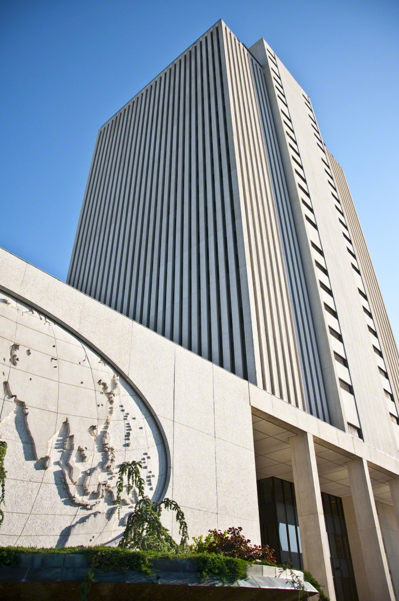
What Books?
The Standard Works of the Church, the holy scriptures wherein the law of the Lord is recorded and the instruction given as to how men should walk in this mortal probation;
also, the records of the Church wherein are recorded the faith and good works of the saints-the records of their baptism, celestial marriage, tithe paying, missionary service, and their acts of devotion and worship." (7)
God will judge us out of the books that have been written according to our works
Revelation 20:12

Slide 23
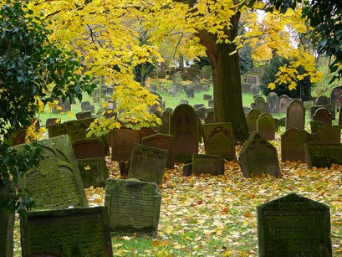
What about those who haven’t heard the Word of the Lord?
“…All who have died without a knowledge of this gospel, who thou have received it if they had been permitted to tarry, shall be heirs of the celestial kingdom of God.”
D&C 137:7

Slide 24
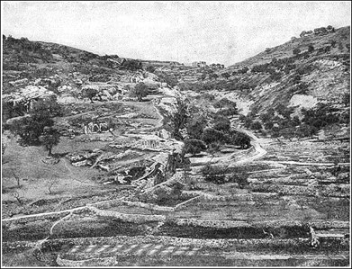
Note of Warning from John
Those who deny grace and reject Christ go to the eternal fire prepared for the devil and his angels, or Gehenna.
Gehenna, Valley of Hinnom, was an area in Israel used as a dump for trash and became synonymous with hell. (7)
Hell was not prepared for men, only for demons.
This is the Second Death.
It is visited only upon the most hardened, those who cannot find humility and acceptance and who remain “filthy still”
D&C 88:35
When they are resurrected, and all will be
resurrected, death—spiritual death—
immediately reclaims them.

Slide 25
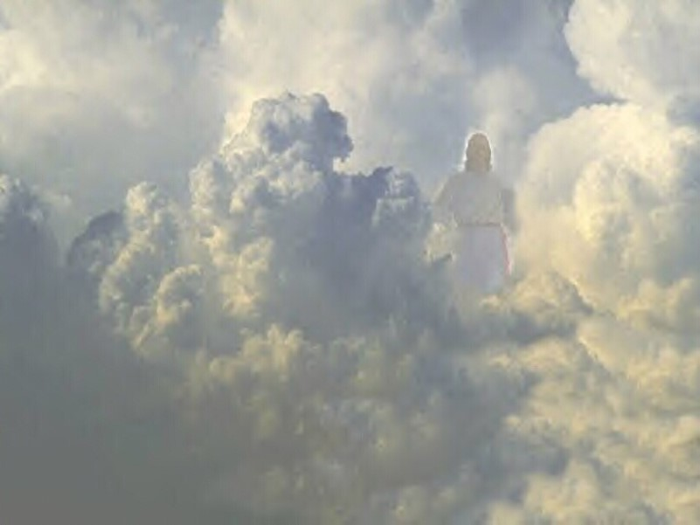
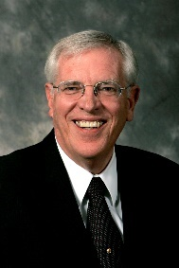
2 Principles from John 20
The power of the first resurrection reaches only those of the past and present ages who are Christ’s at the time of His coming. That moment is critical.
Those who must seek a little time while they get their lives in order will find that the word, “I come quickly” indeed mean “I come suddenly, even before you are ready.”
The binding of Satan does more than merely give hope for the future.
The Power of evil, though deadly real now, has no place in the future.
It exists and operates at any time only by permission of God. When he
determines that
it will end, it will
end. (4)

Slide 26
Sources:
Suggested Hymn: #52 The Day Dawn Is Breaking
Michael Wilcox “Who Shall Be Able to Stand” page 284-285, 297
David J. Ridges “The Book of Revelation Made Easier”
Joseph Fielding Smith “Church History and Modern Revelation, 1:192 “Doctrine of Salvation” page 640, page 97
Richard D. Draper “Opening the Seven Seals” page 225-226
Bible Dictionary
Joseph Smith History of The Church of Jesus Christ of Latter-day Saints, 5: 298. Teachings of Joseph Smith, 224
Elder Bruce R. McConkie Doctrinal New Testament Commentary, 3 vols. [Salt Lake City: Bookcraft, 1965-1973], 3: 521, 579.)
Notes from Lesley Meacham and Becky Davis Poway Institute
Dragon artwork (iron) found in Borrego Springs California
Presentation by ©http://fashionsbylynda.com/blog/

Slide 27
Bottomless Pit Revelation 20:1
"The bottomless pit is the depths of hell. It is not a literal pit without a bottom, for such is a contradiction in terms. But it is a pit or prison where the inhabitants suffer, as mortals view suffering, to an infinite, unlimited, or bottomless extent. Referring to finite inability to comprehend the vastness of the suffering of those reaping the full measure of this status, the revelation says: 'The end, the width, the height, the depth, and the misery thereof, they understand not, neither any man except those who are ordained unto this condemnation.' (D. & C. 76:48.)" Elder Bruce R. McConkie (Mormon Doctrine, 2d ed. [Salt Lake City: Bookcraft, 1966], 101.)
After the Thousand Years Revelation 20:7
"Satan will be sealed up in the bottomless pit for a thousand years-but not forever. 'When the thousand years are expired, Satan shall be loosed' to once again do his work of deception and destruction on the earth. He will gather followers from all nations to a battle in which the warriors are as many 'as the sand of the sea.' Satan's mortal hosts will surround the Saints and their 'beloved city,' but the Lord will act in great glory and power to devour his enemy. Then the devil will be cast away forever, to be punished for his great sins for all eternity.
"The account in 4 Ne. 1 gives us a sobering preview of how the bright millennial era can be brought to a close. After the Savior's visit to the descendants of Lehi in the Americas, the people entered into a condition that was millennial in some important respects: 'There was no contention in the land, because of the love of God which did dwell in the hearts of the people...'
"The breakdown in this near-perfect society had tiny beginnings: 'a small part of the people . . . revolted from the church and [had] taken upon them the name of Lamanites' (vv. 20)...From that point, the society disintegrated rapidly. Within the next decade, 'there were many churches in the land; yea, there were many churches which professed to know the Christ, and yet they did deny the more parts of his gospel, insomuch that they did receive all manner of wickedness, and did administer that which was sacred unto him to whom it had been forbidden because of unworthiness. And this church did multiply exceedingly because of iniquity, and because of the power of Satan who did get hold upon their hearts' (vv. 27-28).
"Thus it was that in only a few years, Satan, who had essentially been bound, was loosed again in the land...The decline and fall of this blessed society makes for troubling reading, and the lessons for our day are clear. Satan ever lies in wait to deceive and destroy, and if he fails with one generation, he will try with redoubled efforts to harm the next." (Donald W. Parry and Jay A. Parry, Understanding the Book of Revelation [Salt Lake City: Deseret Book Co., 1998], 273-274.)
Judgment Revelation 20:3
"Under Christ, selected agents and representatives shall sit in judgment upon specified peoples and nations. Scriptural intimations indicate that there will be a great judicial hierarchy, each judge acting in his own sphere of appointment and in conformity with the eternal principles of judgment which are in Christ." Elder Bruce R. McConkie (Mormon Doctrine, 2d ed. [Salt Lake City: Bookcraft, 1966], 399.)
All those who have died in Christ Revelation 20:4:
"All those who have died in Christ shall come forth from the dead at his coming and shall dwell upon the earth as Christ shall be upon the earth during this millennium. They shall not remain here all the time during the thousand years, but they will mingle with those who are still here in mortal life. These resurrected saints and the Savior himself, shall come to give instruction and guidance; to reveal unto us [mortals] the things we ought to know; to give us information concerning the work in the temples of the Lord so we may do the work which is essential to the salvation of worthy men. Smith, Joseph Fielding" (Doctrines of Salvation, 3 vols., edited by Bruce R. McConkie [Salt Lake City: Bookcraft, 1954-1956], 3: 59.)
Book of Life Revelation 20:12:
“In one sense the book of life is the sum total of one’s thoughts and actions—the record of his life. However, the scriptures indicate that a heavenly record is kept of the faithful, whose names are recorded, as well as an account of their righteous deeds (D&C 88:2; 128:7)” (Bible Dictionary, “Book of life”).

Slide 28
“God judges men according to the use they make of the light which He gives them” (Teachings: Joseph Smith, 405). He also explained, “[The Lord] will award judgment or mercy to all nations according to their several deserts, their means of obtaining intelligence, the laws by which they are governed, the facilities afforded them of obtaining correct information, and His inscrutable designs” (Teachings: Joseph Smith, 404).
Revelation 20:14:
The second death, or spiritual death, is defined as being cut off from the presence of God. This means that you cannot see the face of God, you cannot withstand the presence of God, you will not enjoy the visitation of the Son, and you are not worthy of the smallest portion of the spirit of the Holy Ghost. It is a total and complete separation from God. As described in scripture, this state happens to those who suffer in hell. It also describes the state of the Sons of Perdition who are cast out after the last soul is resurrected. Therefore, the second death has power upon all those who suffer in hell until the resurrection of the wicked. At that point the second death applies only to the Sons of Perdition, 'These are they who shall go away into the lake of fire and brimstone, with the devil and his angels-And the only ones on whom the second death shall have any power' (DC 76:36-7).
One might be inclined to think that the "first death" must be the death of the mortal body. This is not the case. The Lord explains that the first death is also spiritual and occurs when we leave his presence and come to earth. This is symbolized by the fall of Adam, 'I, the Lord God, caused that he should be cast out from the Garden of Eden, from my presence, because of his transgression, wherein he became spiritually dead, which is the first death, even that same death which is the last death (or second death), which is spiritual, which shall be pronounced upon the wicked when I shall say: Depart, ye cursed' (DC 29:41).gospeldoctrine.com

