Slide 1
Lesson 160
Those Who Overcome
Revelation 21-22
John’s Last Words

Slide 2
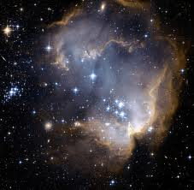
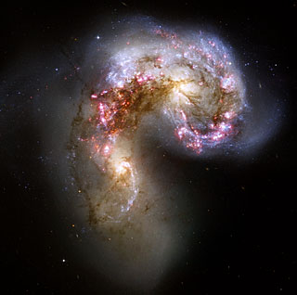
New Heaven and New Earth
The earth passing through various stages:
It was created and pronounced good.
It partook of the decree of mortality coming through the fall.
It is now in the telestial condition, in which telestial beings predominate and rule.
It will then pass into the “renewed” or restored state, for a thousand years as a terrestrial earth and the abode of terrestrial inhabitants.
Then it comes to the end. The earth must die. It will then receive its resurrection and be celestialized in accordance to the Laws of Obedience
Revelation 21:1

Slide 3
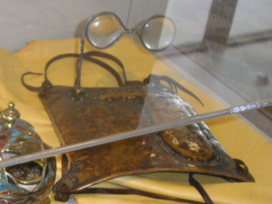
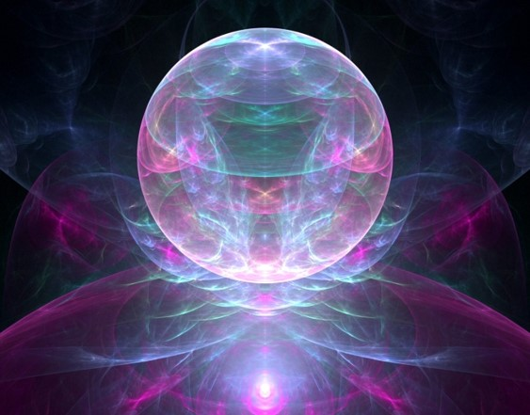
Celestial
“The place where God resides is a great Urim and Thummin.”
…This earth, in its sanctified and immortal state, will be made like unto crystal and will be a Urim and Thummim to the inhabitants who dwell thereon…and this earth will be Christ’s”
D&C 130:8-9

Slide 4
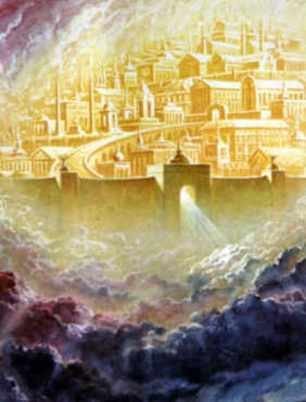
New Jerusalem
A city of the Celestial order
“…the same sociality (families, love within, marriage, eternal) which exists among us here will exist among us there, only it will be coupled with eternal glory we do not now enjoy.”
D&C 130:2
Revelation 21:2

Slide 5
The Lord is Here
1. Ancient Jerusalem, the city of much of our Lord’s personal ministry among men, shall be rebuilt in the last days and become one of the two great world capitals, a millennial city from which the word of the Lord shall go forth.
When this earth becomes a celestial sphere ‘that great city, the holy Jerusalem,’ shall again descend ‘out of heaven from God,’ as this earth becomes the abode of celestial beings forever—(2)
2. A new Jerusalem, a new Zion, a city of God shall be built on the American continent.
3. Enoch’s city, the original Zion, ‘the City of Holiness’ with its translated inhabitants now in their resurrected state, shall return, as a New Jerusalem, to join with the city of the same name which has been built upon the American continent.
Ezekiel 48:35—(1)
Revelation 21:2

Slide 6
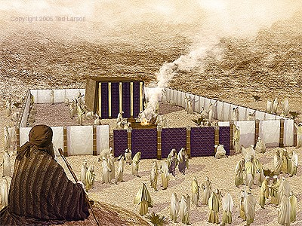
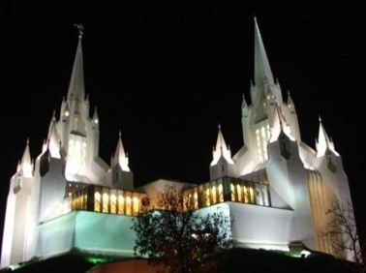
The Tabernacle of God
Tent—God’s personal presence—
a covering—an atonement
Covenant Symbol=new and everlasting covenant
While on earth the Saints felt themselves as strangers seek a
“Better country, that is, an heavenly; Wherefore God is not ashamed to be called their God; for he hath prepared for them a city.” Hebrews 11:16
Revelation 21:3

Slide 7
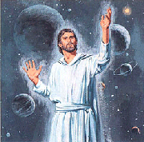
All Things New
God begins to reveal himself
Christ bears testimony to John of the truthfulness of the things he is seeing and hearing.
God will dwell with and comfort His people, and they will no longer experience death, sorrow, or pain.
Revelation 21:5

Slide 8
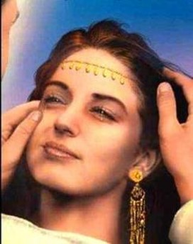
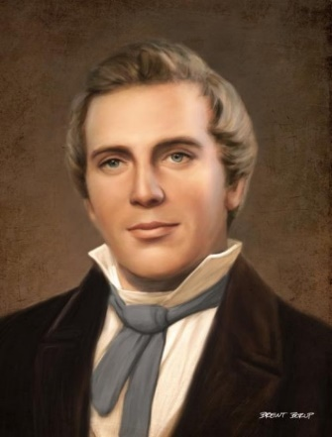
Wipe Away all Tears
Sometimes our pains are so great we don’t believe any future joy can compensate for them
The wiping of tears is a gesture of deepest intimacy.
Only family or the closest of friends would do such a thing for another.
“All your losses will be made up to you in the resurrection provided you continue faithful.”
(9)
Isaiah 65:17-21
Revelation 21:4
Brent Borup

Slide 9
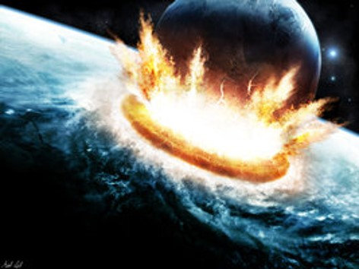
It is Done
Everything is fulfilled
His work is complete
Alpha and Omega
The beginning and end of the Greek alphabet.
What is Christ the end of?
The end of tears, of death, of sorrow, of crying, of pain.
What is Christ the beginning of?
The beginning of life, of peace, of happiness, of pleasure, of forgiveness.
Revelation 21:6

Slide 10
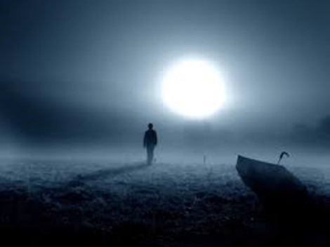
2nd death
…a spiritual death, meaning they are cast out of the presence of the Lord and are dead as pertaining to the things of righteousness, which are the things of the spirit.”
“After the separation of the body and spirit, which is the natural death, the wicked and ungodly die a second death,…
Wherefore, I, the Lord, have said that the fearful, and the unbelieving, and all liars, and whosoever loveth and maketh a lie, and the whoremonger, and the sorcerer, shall have their part in that lake which burneth with fire and brimstone, which is the second death.
18 Verily I say, that they shall not have part in the first resurrection. D&C 63:17-18
Revelation 21:8
(2)

Slide 11
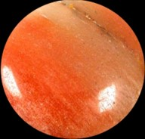
One of the 7 angels
“…one of the seven angels which had the seven vials full of the seven last plagues…”
The Lamb’s Wife = The Church, the righteous, the City of Enoch, the celestial city, or the kingdom in Revelation 21:11-27
See Revelation 15
Jasper=represents the glory of the celestial kingdom. These don’t decay. The stones have no impurities. They reflect light and are symbols of beauty.
Revelation 21:9-11

Slide 12
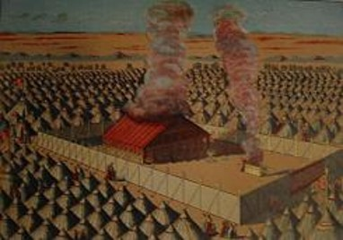
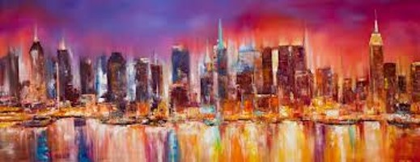
12 Gates and 12 Angels
3 to each side= named after the 12 tribes of Israel—the pattern of the encampment around the tabernacle.
Angels =guarded by sentinels
Levites are assigned as porters
They have charge of the treasures, serve as officers and judges.
See: 1 Chronicles 26:1-19
possible divine government
Wall of the City—in the past just the temples had a wall around them to separate the holy from the profane.
This whole celestial city will have a wall, a sanctuary
Revelation 21:12-13

Slide 13
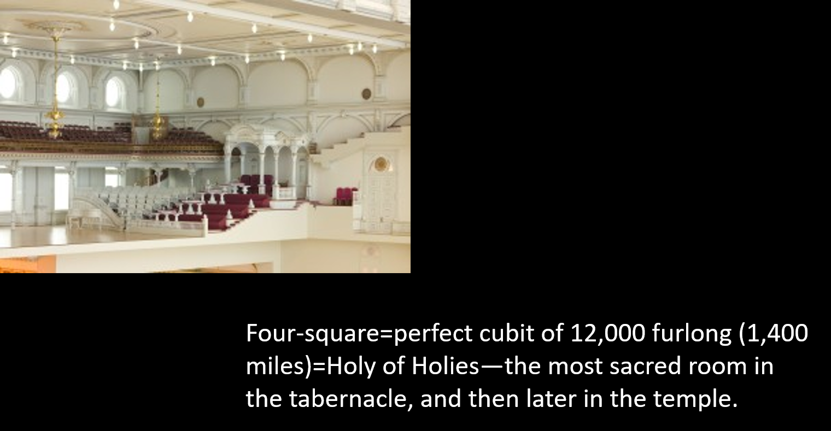
12 Foundation Stones
Name after the apostles of the Lord=Quorum
Golden reed to measure=this time not just the temple (like in Rev. 11) but the whole city and its inhabitants are measured.
1
2
3
Revelation 21:14-16

Slide 14
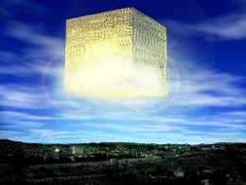
Cubic Shape
“Length, breadth, and height are equal= a celestial cube—a symbol of perfection and eternal stability, exactness, perfect and straight.
Hebrew tradition states that the universe is cubic in shape with the heavenly temple occupying a point exactly in the middle of the Cube.” (3)
Revelation 21:14-16

Slide 15
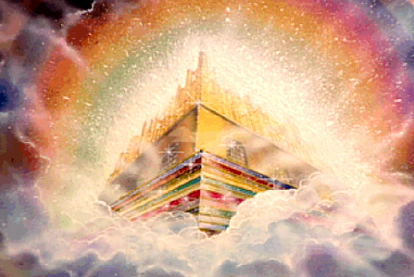
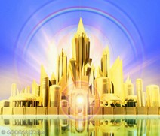
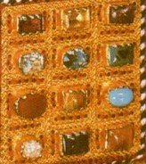
144,000 Cubits
Measurement of an angel
Rev. 11 signifies the area’s protection from judgment.
Golden Rod acts as a standard that demonstrates the city’s purity.
Wall of Jasper=The Light of the Urim and Thummim
12 stones=to beautify.
These however do not match the breastplates stones of the High Priests.
Revelation 21:17-20

Slide 16
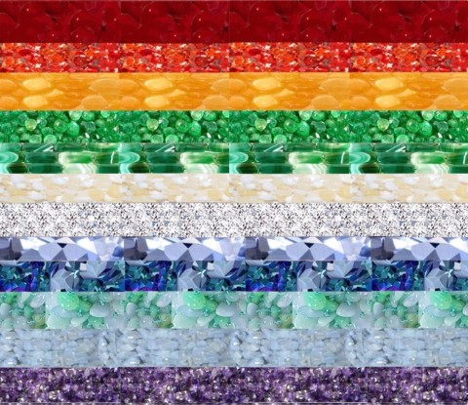
Stones Garnish City Wall
Jasper
Sapphire
Chalcedony
Emerald
Sardonyx
Sardius
Chrysolite
Beryl
Topaz
Chrysoprasus
Jacinth
Amethyst
Revelation 21:19

Slide 17
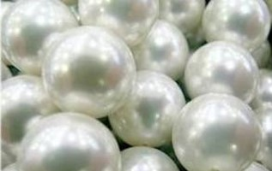
12 Pearls
A perfect pearl in the Mediterranean world was worth more than gold
Parable of the Pearl of Great Price
Matthew 13:45-46
Revelation 21:21

Slide 18
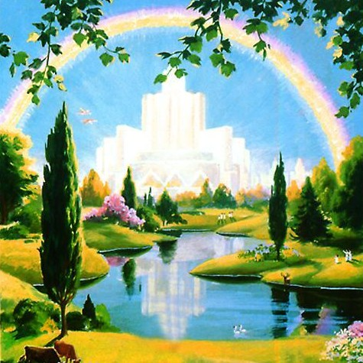
No Temple Therein
The whole of the celestial kingdom is a Temple
There is no need for temples at this point, all the work has been done.
The Temples on earth are symbols and types of the Eternal Holy of Holies.
The Saints will live in the real heaven not just the heaven on earth (temple).
“No need of sun or moon”= We will live in the glory of God’s presence
Revelation 21:22-23

Slide 19
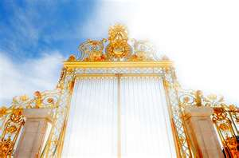
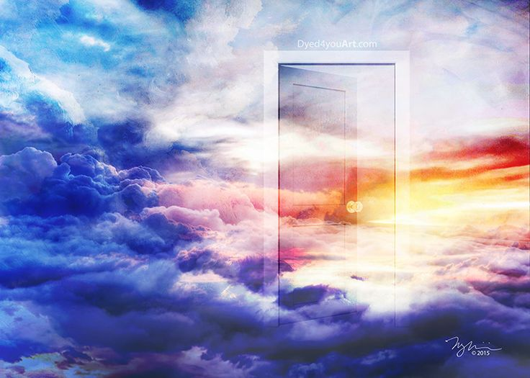
Gates Will Not Be Shut
There is no danger for the glory of God is there
No night= The eternal light is always on, no darkness
HOWEVER:
Anything that defileth= no unclean thing can enter into the kingdom
And no unclean thing can enter into his kingdom; therefore nothing entereth into his rest save it be those who have washed their garments in my blood, because of their faith, and the repentance of all their sins, and their faithfulness unto the end. 3 Nephi 27:19
Revelation 21:24-27

Slide 20
Frequently asked Questions
Do mortals actually die during the Millennium, after they’ve lived to be 100?
D&C 101:31
They actually die, but are immediately resurrected.
What happens at the end of the Millennium?
D&C 88:111-115 and Revelation 20:8
Many mortals on earth at the time reject the Savior, whom they know, and turn to wickedness. The end of the war, which began with the war in heaven, takes place. Usually referred to the battle of God and Magog. Michael (Adam) will gather armies of righteousness and the devil will gather his armies and the devil and the ‘hosts of hell’ will be defeated and cast out forever.
3. Are all people separate and single, except those who attain exaltation?
D&C 131:1-4, 132:15-32
Yes, “In the terrestrial and telestial world there will be no marriages. Those who enter there will remain separately and singly forever. (7)
4. What about the righteous who wanted to marry but died without getting a fair chance at marriage during mortality?
D&C 131:1-4, 132:19-20
They will be given the opportunity to marry happily and be sealed during the Millennium. (10)

Slide 21
5. After final judgment, can a person progress from one kingdom to another?
D&C 76:112 and 29:29
No. “After a person has been assigned to his place in the kingdom….he will never advance from his assigned glory to another.” (10)
6. When we become gods, will we use the same plan of salvation for our own spirit children
D&C 132:20
Yes, we will, according to the first Presidency Statement –1916
7. Will there be differences between resurrected bodies of celestials, terrestrials, telestials, etc.?
D&C 88:28-32 and 1 Corinthians 15:39-42
Yes. Celestial bodies will shine like the sun. Terrestrial will not shine like the sun, but they will be more glorious that the bodies of those who received the telestial glory. In both the Terrestrial and Telestial bodies there will be limitations. They will have no power to increase (have children) neither power to live as husbands and wives. Celestial will live in families and have the ‘continuation of seeds forever’

Slide 22
8. Will there be any besides Latter-day Saints on earth during the Millennium?
D&C 43:30
“There will be millions of people, Catholics, Protestants, Agnostics, Mohammedans, people of all classes and all beliefs, still permitted to remain upon the face of the earth, but they will be those who have lived clean lives, those who have been free from wickedness and corruption. All who belong, by virtue of their good lives…(7)
*Not all Latter-day Saints will be on earth during the Millennium.
9. What will daily life be like during the Millennium?
D&C 29:11
Mortality as such will continue. Children will be born, grow up , marry, advance to old age, and die…Crops will be planted, harvested, and eaten; industries will be expanded, cities built, and education fostered. Men will continue to care for their own need, handle their own affairs, and enjoy the full endowment of free agency. Dwell in peace…(2)

Slide 23
10. How old will mortals live to be during the millennium?
Isaiah 65:20
100 years old
11. Will Righteous mothers get to raise their children who died young?
D&C 137:10
“…the mother who laid down her little child, being deprived of the privilege, the joy,…of bringing it up to manhood or womanhood in this world, would after the resurrection, have all the joy…and even more than it would have been possible to have had in mortality, in seeing her child grow to the full measure of the stature of its spirit.” (6)
12. What about stillborn children?
D&C 137:10
“Although temple ordinances are not performed for stillborn children, no loss of eternal blessings or family unity is implied. The family may record the name of a stillborn child on the family group record followed by the word stillborn in parentheses” (11)

Slide 24
13. When a baby dies, is it still a baby or is it an adult in the spirit world
D&C 137:10
“When a baby dies, it goes back into the spirit world, and the spirit assumes its natural form as an adult, for we were all adults before we were born.
“When a child is raised in the resurrection, that spirit will enter the body and the body will be the same size as it was when the child died. It will then grow after the resurrection to full maturity to conform to the size of the spirit.
“If parents are righteous, they will have their children after the resurrection. Little children who die, whose parents are not worthy of an exaltation, will be adopted into families of those who are worthy.” (7)

Slide 25
“Obedience is the First Law of Heaven”
--Joseph Fielding Smith
Revelation 22
לא יהיה לך אלוקים אחר על פני

Slide 26
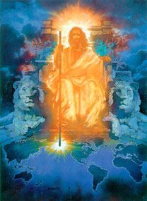
The Throne of God
Therefore are they before the throne of God, and serve him day and night in his temple: and he that sitteth on the throne shall dwell among them.
They shall hunger no more, neither thirst any more; neither shall the sun light on them, nor any heat.
For the Lamb which is in the midst of the throne shall feed them, and shall lead them unto living fountains of waters: and God shall wipe away all tears from their eyes.
Revelation 22:1; Revelation 7:15-17

Slide 27
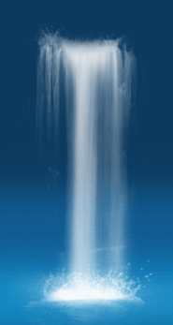
Pure River of Water
Living water—
The Love of God
1 Nephi 11:25
Joy—wells of salvation
Isaiah 12:3
“…if thou knewest the gift of God, and who it is that saith to thee, Give me to drink; thou wouldest have asked of him, and he would have given thee living water.”
John 4:10
Revelation 22:1

Slide 28
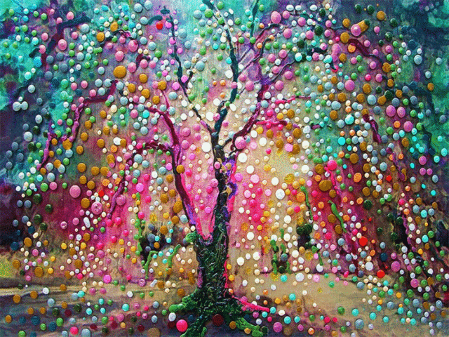
Tree of Life
The Love of God
1 Nephi 8:13
Fruit—the gospel--the benefits of the gospel are not seasonal rather continue constantly forever
1 Nephi 8:10
Midst of the street—the Celestial City—Celestial Glory
Revelation 20
Healing of nations=what the gospel can do for them
Revelation 22:2

Slide 29
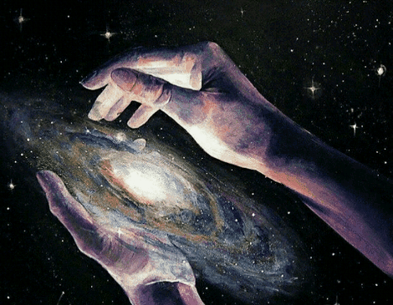
No More Curse
On the Earth
Genesis 3:17-18
The Kingdom will be celestial—
This earth will be Christ’s
D&C 130:9; 88:25
“…the earth abideth the law of a celestial kingdom, for it filleth the measure of its creation, and transgresseth no the law—”
D&C 88:25
Revelation 22:3

Slide 30
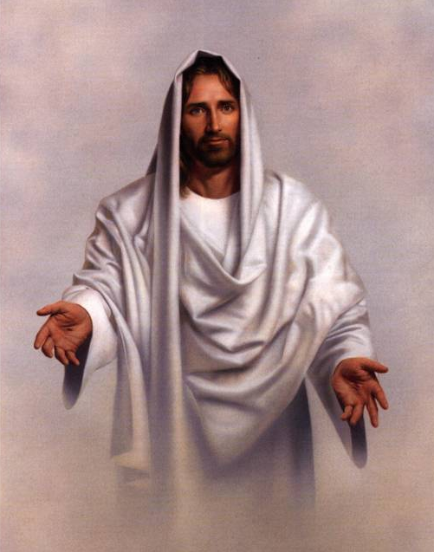
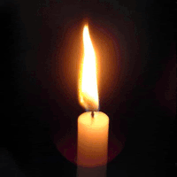
See His Face
The righteous have taken His name upon them and kept their covenants
Revelation 3:12
Therefore they will be with Him in celestial glory
God Giveth Light
There is no need for light
They will be Gods
Revelation 22:4-5

Slide 31
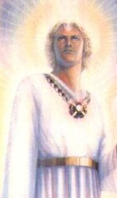
Angel Bears Testimony
“…These sayings are faithful and true; and the Lord God of the holy prophets sent his angel to shew unto his servants the things which must shortly be done.”
Revelation 22:6

Slide 32
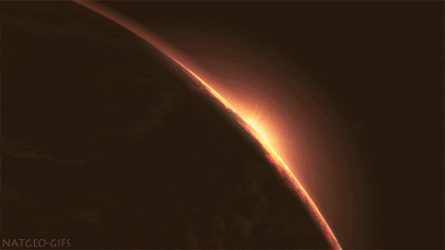
“I Come Quickly”
“Wherefore, stand ye in holy places, and be not moved, until the day of the Lord come; for behold, it cometh quickly, saith the Lord. Amen.”
D&C 87:8
Not “soon” but when the time is right. He will come suddenly upon the wicked as a thief in the night.
D&C 106:4-5
“Verily, I say unto you, I am Jesus Christ, who cometh quickly, in an hour you think not. Even so. Amen.”
D&C 51:20
Revelation 22:7

Slide 33
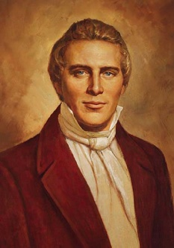
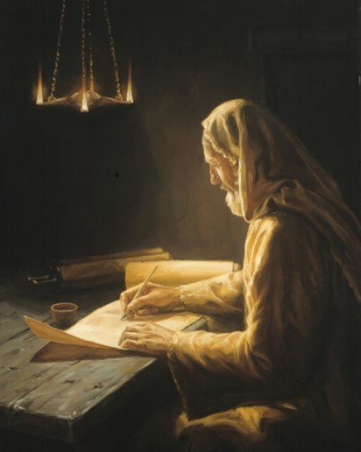
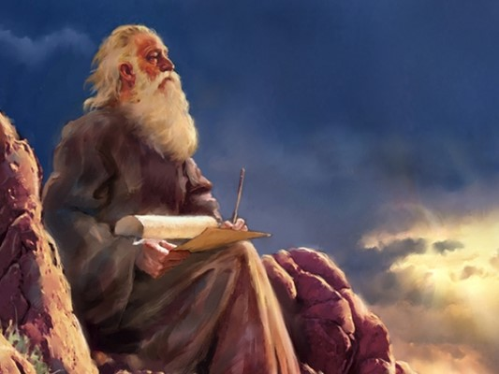
Thy Fellowservant
“…there are no angels who minister to this earth but those who do belong or have belonged to it. Hence, when messengers are sent to minister to the inhabitants of this earth…
…they are not strangers, but from the ranks of our kindred, friends, and fellow-beings and fellow-servants.”
Revelation 22:9
(9)

Slide 34
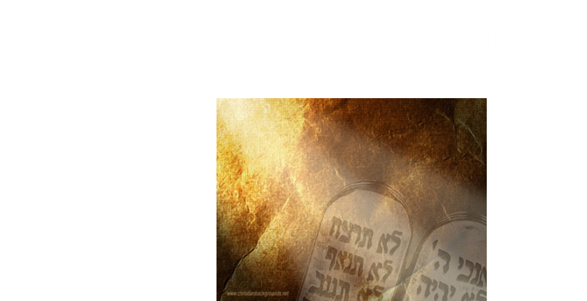
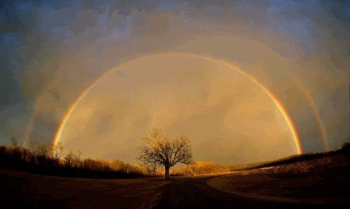
Blessed Are They…
Those who have right to the tree of life
Revelation 22:14

Slide 35
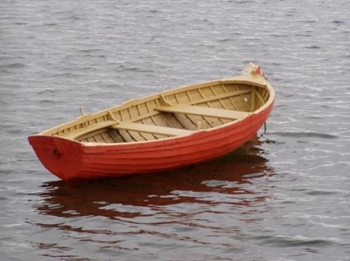
Stay in the Boat
In Minnesota Elder Russell M. Nelson, wife, and daughter were rowing a small boat on a lake. “After rowing far from shore, we stopped to relax and enjoy the tranquil scene. Suddenly, our little toddler lifted one leg out of the boat and started to go overboard, exclaiming, ‘Time to get out, Daddy!’
”Quickly we caught her and explained, ‘No, dear, it’s not time to get out; we must stay in the boat until it brings us safely back to land.’ …
“Similarly, we as children of our Heavenly Father may foolishly want to get ‘out of the boat’ before we arrive at destinations He would like us to reach…
“We are first to get ‘on the boat’ with Him. Then we are to stay with Him. And if we don’t get ‘out of the boat’ before we should, we shall reach His kingdom, where we will be lifted up to eternal life.”
(8)

Slide 36
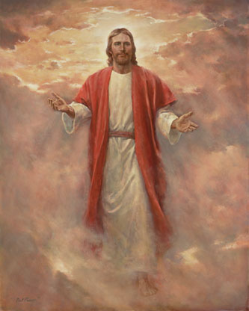
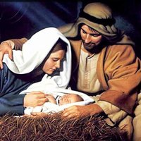
Jesus Sends Angel
To testify:
That He is the root and offspring of David
And He is the bright and morning Star=the Savior
Revelation 22:16

Slide 37
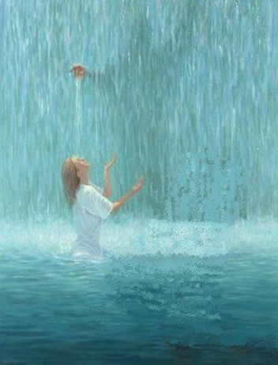
Come
And the Spirit (the Holy Ghost) and the bride (the righteous members of the Church):
Take of the living water freely
—an invitation for all to come
unto Christ
Revelation 22:17

Slide 38
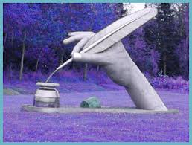
Changing or Corrupting Revelation
“…If any man shall add unto these things, God shall add unto him the plagues that are written in this book:
“And if any man shall take away from the words of the book of this prophecy, god shall take away his part out of the book of life, and out of the holy city, and from the things which are written in this book.”
Revelation 22:18-19

Slide 39
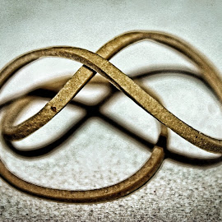
John’s Warning
Do not intentionally twist the meanings, delete doctrines, etc., from the book of Revelation.
The same message was given to Moses:
Deuteronomy 4:2
“Ye shall not add unto the word which I command you, neither shall ye diminish ought from it, that ye may keep the commandments of the LORD you God which I command you.”
Revelation 22:18-19

Slide 40
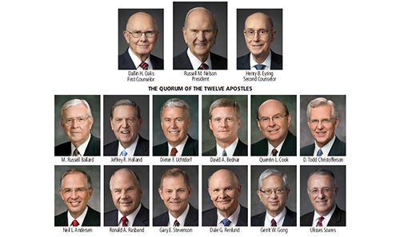
John Testifies
John addresses his readers, including you and me, with a tender blessing upon us.
All of Paul’s epistles have such a statement or blessing upon his readers at or near the end of the last chapter.
All living prophets testify at the end of their talks.
We should do likewise.
Revelation 22:20

Slide 41
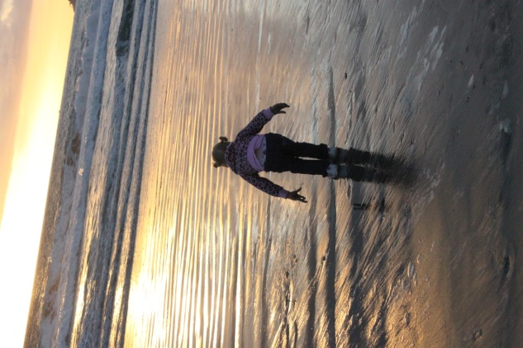
John Gives Us Hope
The great incentive to Repentance
The Savior will redeem them from our sins not in our sins.
Unto Salvation
It is a desire of faithful people to gain eternal salvation in the Kingdom of God.

Slide 42
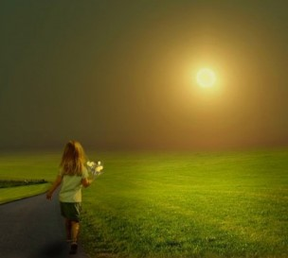
What Should I Hope For?
To keep receiving the mark of the beast (Rev. 20:4)
To be called to the ‘marriage supper’ of the Lamb (Rev. 19:9)
To overcome all things (Rev. 21:7)
To be resurrected in the morning of the first resurrection (Rev. 20:6)
For the coming of Christ (Rev. 22:20)

Slide 43
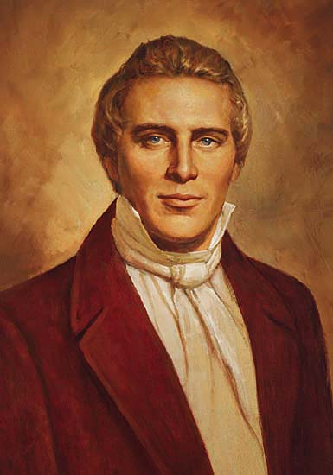
“ This is good doctrine. It tastes good. I can taste the principle of eternal life, and so can you. …I know that when I tell you these words of eternal life…you taste them, and I know that you believe them. You say honey is sweet, and so do I. I can also taste the spirit of eternal life. I know it is good…and rejoice more and more.”
--Joseph Smith

Slide 44
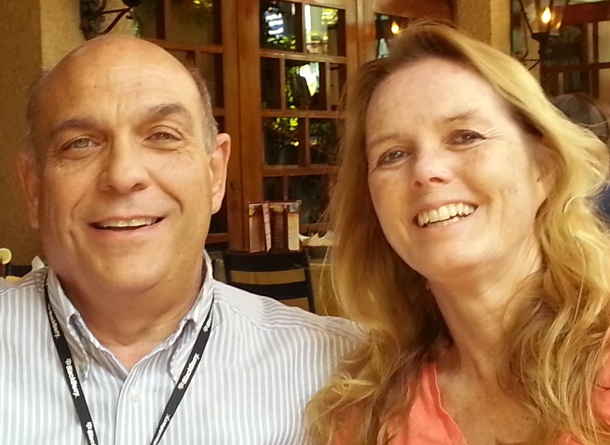
Amen
“The grace of our Lord Jesus Christ be with you all. Amen.”
Revelation 22:21
“I testify that these things I have learned this school year are true. I testify of Jesus as my Savior and through His Atonement I know I can return to Him someday.”
I want to thank my husband for encouraging me to pursue this challenge…
…and all the many seminary teachers who have dedicated their time in spreading the true gospel.

Slide 45
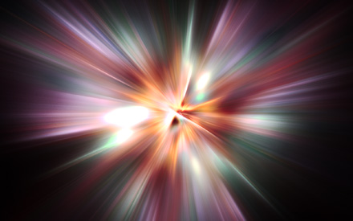
Sources:
Suggested Hymn: #284 If You Could Hie To Kolob
Video: He Is Risen! (6:23)
1. The Life and Teachings of Jesus Christ and his Apostles Page 469-470
2. Bruce R. McConkie “Doctrines of New Testament Commentary” 3:580-581Second death—3:583-584
During Millennium—”Mormon Doctrine” pp. 496-497
3. Matthew Brown “The Gate of Heaven” page 6
4. David J. Ridges “The Book of Revelation Made Easier”
5. First Presidency Message 1916 Improvement Era August 1916 page 942
6. Joseph F. Smith children raising “Gospel Doctrine” p. 453-454
Joseph Fielding Smith “Doctrines of Salvation” 2:56
Elder Russell M. Nelson conference Report April 1997 or Ensign May 1997
Joseph Smith “Teachings of Joseph Smith” page 355
President Spencer W. Kimball Ensign October 1979 The Importance of Celestial Marriage First Presidency Message
Church Handbook of Instructions
Notes from Lesley Meacham and Becky Davies Poway Institute
Presentation by ©http://fashionsbylynda.com/blog/

Slide 46
Statement #1
When Jesus Christ comes again and the Millennium begins, the earth will be changed to the condition it was in prior to the Fall of Adam and Eve. Before the Fall, the earth existed in a terrestrial, or paradisiacal, state (a state of paradise). After the Millennium, the earth will change again to a celestial state prepared for the presence of God. These changes may have been what John saw taking place when he “saw a new heaven and a new earth”
I Come Quickly Revelation 22:7:
The time is near-how near, no man knoweth: the day and the hour when the Son of Man shall come is a secret. In a revelation given to this Church, it is said that no man shall know until he comes; therefore we cannot expect to know the day nor the hour; but we know it is near at hand, and what a consolation it is. There may be men that will know within a year-that will have revelation to say within one or two years when the Lord shall appear. I do not know that there is anything against this.
But the great question is, brethren and sisters, Are we ready?-are we perfect enough for this day? Are we honest enough? and are we filled with integrity enough to be ready for the Saviour and his holy angels? Is there a sufficiency of union? Have we that firmness in our minds that we can stand in their presence-that we can look them in the eye and say that all is right? If we are pure, when we see a pure and holy being, clothed with all the glory of the heavens, surrounded with light that far outshines the sun at noonday, so much so that his eye discerns all things and pierces the inmost recesses of the heart,-when we can look him in the face, a thrill of joy will run through our bodies, and we shall be happy. Orson Pratt (Journal of Discourses, 26 vols. [London: Latter-day Saints' Book Depot, 1854-1886], 8: 49 - 50.)
Statement #2
The New Jerusalem that John saw coming down from heaven is the celestial city of God. This city will likely include the city of Enoch, which was translated and taken up to heaven. This “holy city” will descend and join the New Jerusalem, or Zion, that the Saints will have built on earth (see Moses 7:62–64).
Tree of Life Revelation 22:1-2:
"Note that the tree stands alone. It has no competition. The tree of good and evil has ceased to exist because the inhabitants of the city, knowing good from evil, have spurned all evil and eternally choose the good. In consequence the cherubim, placed to guard the tree of life, have been removed, allowing God's people to eat freely of the fruit. Jewish thought looked forward to the time when men would be free to partake of the wondrous tree.
"Following Ezekiel 47:12, the Seer notes that each month the tree produces a different type of fruit. John conveys the idea that the tree does not follow the normal course of budding, blossoming, fruit setting, and ripening, with one harvest a year. The crops grow continually. The entire image, as one scholar notes, 'expresses the absolute triumph of life over death.' The very leaves of the trees hold healing properties. Where it stands, not a single blade of sorrow or pain can be found. All nations are healed, that is, made whole and complete, through the power of the tree.
"But one must not overlook the meaning of the tree itself, for 'it is the love of God, which sheddeth itself abroad in the hearts of the children of men; . . . [which is] the most joyous to the soul' (1 Ne. 11:22-23). Thus, the tree and the water symbolize the same thing. The continuous flow of the water and the perpetual bearing of the tree emphasize the limitlessness of God's love. It flows from him forever and unconditionally. All who wish to partake may do so." (Richard D. Draper, Opening the Seven Seals: The Visions of John the Revelator [Salt Lake City: Deseret Book Co., 1991], 241-242.)
Alpha and Omega Revelation 22:13:
"Alpha is the first letter of the Greek alphabet, and omega is the last letter, thus verifying that Christ is the member of the Godhead who began the work of bringing 'to pass the immortality and eternal life' (Moses 1:39) of mankind upon this mortal earth and will be the one to conclude the events of this earth's plan of salvation. The Lord used the same Greek word designations in modern revelation (see D&C 19:1; D&C 38:1; D&C 45:7)." (Monte S. Nyman, "I Am Jesus Christ the Son of God," Ensign, Dec. 1999, 9)
Adding or Taking Away from the Scriptures Revelation 22:18:
A careful reading of each of these admonitions makes it clear that man is not to make changes in the revelations of the Lord: man is not to add to or take from the words of God. There is no indication or intimation that God could not, or would not, add to or take from; nor would any reasonable person with a belief in the divine powers of God consciously believe that God would be so restricted. Without question he would have the right and power to give additional revelation for the guidance of his children in any age and to add additional scripture. Howard W. Hunter ("No Man Shall Add to or Take Away," Ensign, May 1981, 64-65)

Slide 47
Stones Garnish City Wall
Jasper
Sapphire
Chalcedony
Emerald
Sardonyx
Sardius
Chrysolite
Beryl
Topaz
Chrysoprasus
Jacinth
Amethyst
Stones on the High Priest Breastplate
While the list of stones isn't completely clear due to differences in translations over the years, a common modern translation reads: "They fashioned the breastplate -- the work of a skilled craftsman. They made it like the ephod: of gold, and of blue, purple and scarlet yarn, and of finely twisted linen. It was square -- a span long and a span wide -- and folded double. Then they mounted four rows of precious stones on it.
First Row: Ruby Chrysolite Beryl
Second Row: Turquoise Sapphire Emerald
Third Row: Jacinth Agate Amethyst
Fourth Row: Topaz Onyx Jasper.
They were mounted in gold filigree settings. There were twelve stones, one for each of the names of the sons of Israel, each engraved like a seal with the name of one of the twelve tribes." (Exodus 39:8-14).

