Slide 1
Lesson 17
Feeding 5,000 and Walking on the Water
Matthew 14
Jesus answered them and said, Verily, verily, I say unto you, Ye seek me, not because ye saw the miracles, but because ye did eat of the loaves, and were filled.
John 6:26

Slide 2
Herod Antipas
He was the son of Herod the Great and Malthace and half brother Philip I
He was “the tetrach” = (in the Roman Empire) the governor of Galilee and Perea, being named by Augustus to the throne upon the death of his father in 4 BC
Antipas (New Testament term) was called to build his capital in Tiberias, on the Sea of Galilee
He married the daughter of King Aretas IV of Nabatea, but divorced her to marry Herodias
He took as his wife, Herodias, the wife of his half brother Philip I
He was reluctant to behead John the Baptist but compelled by Herodias’ daughter, Salome
He had a role in the trial of Jesus, but released him back to Pilate
He lived in Jerusalem and was anxious to be regarded as an orthodox Jew. He began a persecution of the Church and put James, the brother of John to death, Peter escaping by a miracle (Acts 12:1–23)
He was eaten by worms (Acts 12:23)
His son, Agrippa Ⅱ, was allowed by the Emperor Claudius to succeed to only a small part of his father’s dominions. (Acts 25:13)
He was the last of the Herods.
(2)

Slide 3
Unlawful Marriage
Herod the Great
Doris (m. 42 BC)
Mariamne I
Mariamne II (m. 24 BC)
Malthace (m. 23 BC)
Cleopatra (m. 22 BC)
Antipater
Alexander
Herod Philip I
Archelaus
Phillip II
Aristobulus
Herod Antipas
Herodias
Their pretended marriage was both adulterous and incestuous under Jewish law. (1)
Herod claimed Herodias his wife even though she was still legally married to Philip I who was her first husband.

Slide 4
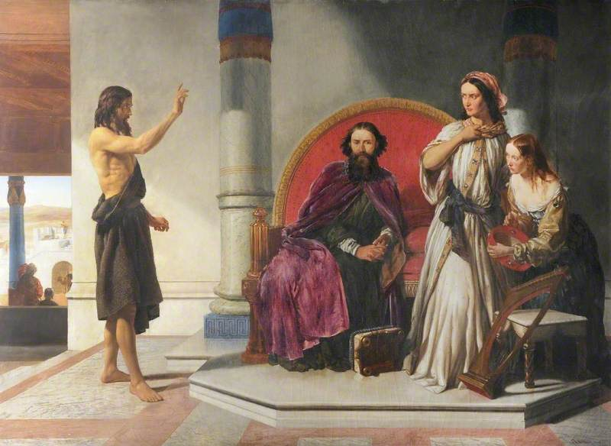
John Condemns Herod
Thou shalt not uncover the nakedness of thy brother’s wife: it is thy brother’s nakedness
Leviticus 18:16
For Herod himself had sent forth and laid hold upon John, and bound him in prison for Herodias’ sake, his brother Philip’s wife: for he had married her.
For John had said unto Herod, It is not lawful for thee to have thy brother’s wife.
Mark 6:17-18
John is sent to prison
Matthew 14:1-4

Slide 5
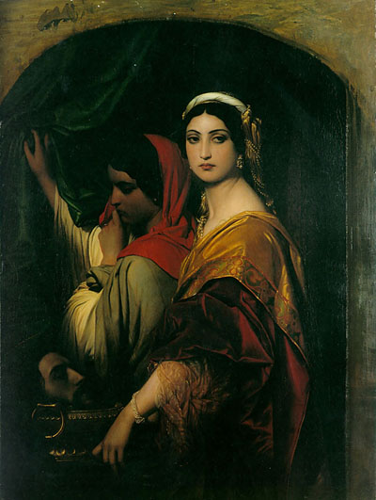
Herod’s Birthday
The king celebrated his birthday by a great feast…
Salome, daughter of Herodias and Philip I, came in and danced before the Herod’s company.
So enchanted were Herod and his guests that the king bade the damsel ask whatever she would, and he swore he would give it unto her, even though the gift were half of his kingdom.
Salome retired to consult her mother, Herodias, and returned with the demand:
“I will that thou give me by and by in a charger the head of John the Baptist.” Mark 6:23
And immediately the king sent an executioner, and commanded his head to be brought: and he went and beheaded him in the prison,
Mark 6:27
Matthew 14:6-11; Mark 6:21-28

Slide 6
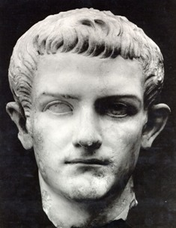
Sin Begets Sin
Often one evil act becomes father to another more wicked than the first.
Even though Herod feared and respected John as a just and holy man, yet, bound by the chains of his own adulterous and incestuous relationship with Herodias, he was unable to resist the pressure leading to the arrest, imprisonment, and murder of the Lord’s forerunner.
Even legal killings rank as murder. Though covered with the cloak of legality, they are morally and ethically indefensible; those who authorize them stand condemned before the eternal judgment bar.
Herod’s command to slay john classed the sin laden tyrant as a murderer
(3)

Slide 7
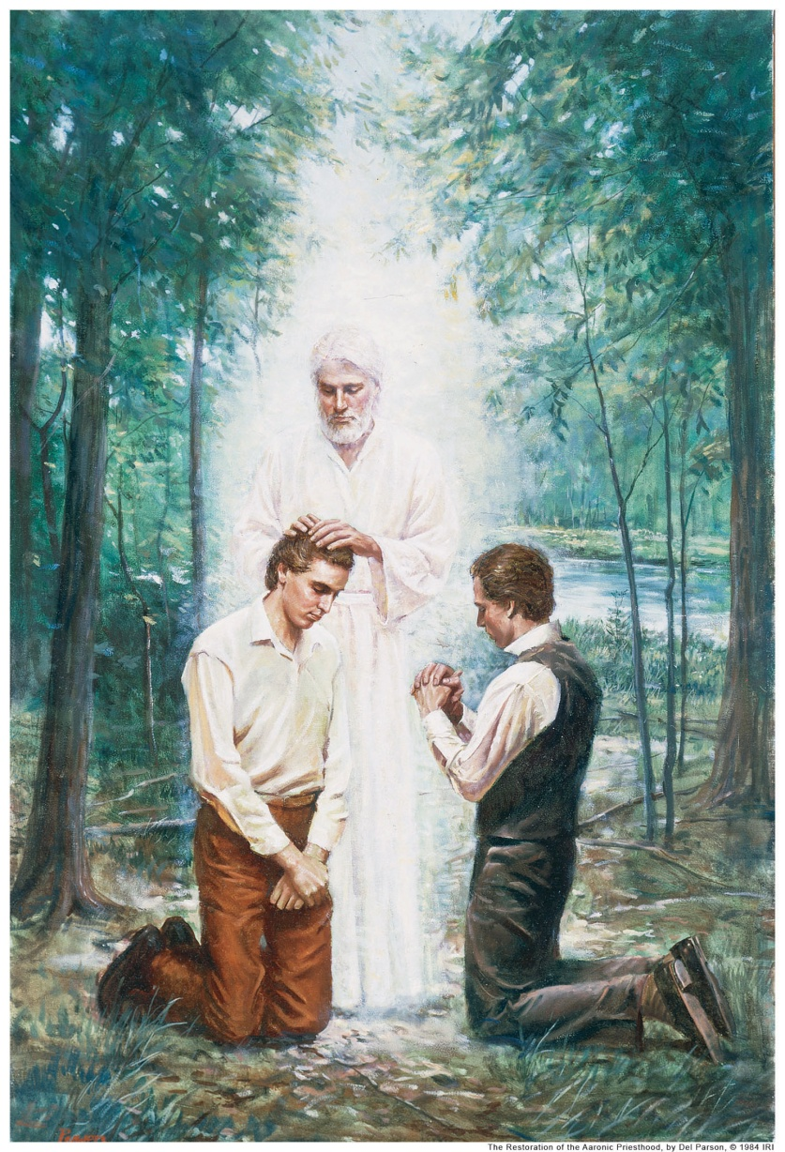
John’s Testimony
John wore the martyr’s crown and sealed his testimony with his own blood.
He was raised in glorious immortality, has ministered again among mortals, conferring that holy Levitical Order of which he held the keys in time’s meridian. (3)
(3)

Slide 8
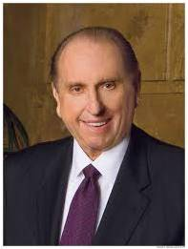
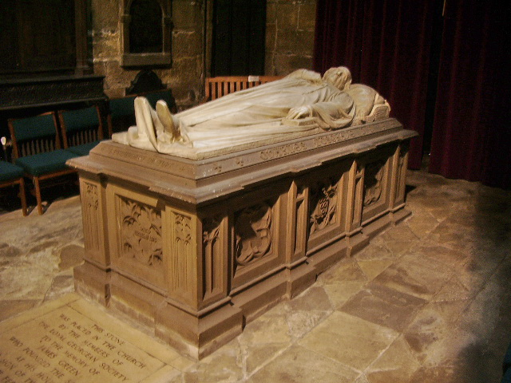
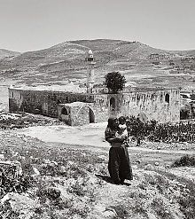
Disciples Take John’s Body
"The tomb in which his body was placed could not contain that body. Nor could the act of murder still that voice.
The current official place for the Catholic Church is the Shrine of Saint John the Baptiste (Nabi Yahya in Arabic) inside the Umayyad Mosque in Damascus;.
To the world we declare that at Harmony, Pennsylvania, on 15 May 1829, an angel, 'who announced himself as John, the same that is called John the Baptist in the New Testament' (D&C 13, section heading), came as a resurrected personage to Joseph Smith and Oliver Cowdery. . . .
The Aaronic Priesthood was restored to the earth.
"Thanks to that memorable event, I was given the privilege to bear the Aaronic Priesthood, as have millions of young men in these latter days.”)
Nabi Yahya Mosque in Sebastia, near Nablus, West Bank, the traditional burial site
Matthew 14:12
(4)

Slide 9
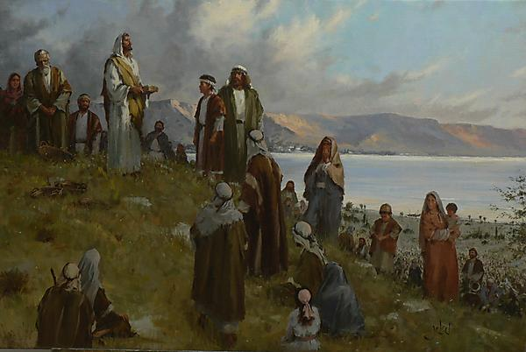
A Desert Place Apart
A solitary place
Upon hearing of John’s death, Jesus departed by ship to a desert place whereupon multitudes followed him.
“He brought reality to the word compassion. He showed us the way. He marked the path we should follow. Selfless service characterized His life. … The Savior’s entire ministry exemplified love of neighbor.”
By showing compassion for others even when we are experiencing sadness, we follow the example of Jesus Christ
Matthew 14:14; Mark 6:30-34; Luke 9:10; John 6:1-3
(4)

Slide 10
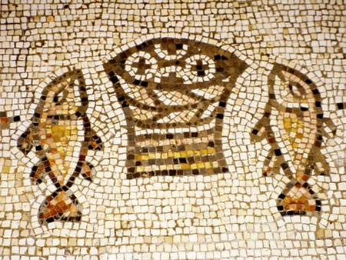
Give Ye Them To Eat
“five thousand men” meant five thousand males. (5)
Why did Jesus feed the 5,000?
They were hungry, fainting for want of temporal food, and there was none available for them. They had left their camps and villages to hear His word…temporal need.
A testimony and witness that He was the Son of God, the promised Messiah (John 6:14)
Jesus performed this miracle as a setting for one of his strongest and deepest recorded discourses—the Sermon on the bread of Life…so to provide temporal food to sustain mortal life, He provided the lesson that man must eat spiritually to gain eternal life. (3)
The mosaic is from the floor of a church built in the fifth century A.D. at the traditional site of the feeding of the five thousand.
Matthew 14:15-21; Mark 6:37; Luke 9:

Slide 11
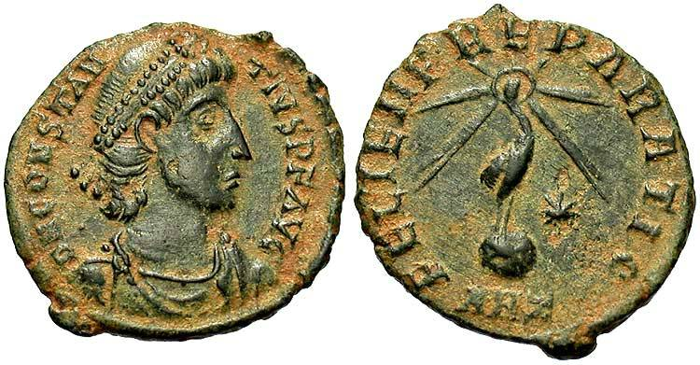
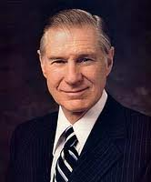
To Bless and Brake Bread
Shall we go and buy two hundred pennyworth of bread, and give them to eat? Mark 6:37
“two hundred pennyworth,” or two hundred denarii—roughly eight months’ wages for a common laborer.
“A major reason this church has grown from its humble beginnings to its current strength is the faithfulness and devotion of millions of humble and devoted people who have only five loaves and two small fishes to offer in the service of the Master.” (6)
Matthew 14:17; Mark 6:37; John 6:7

Slide 12
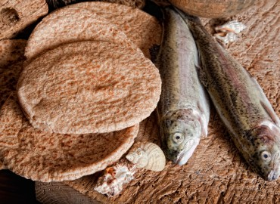
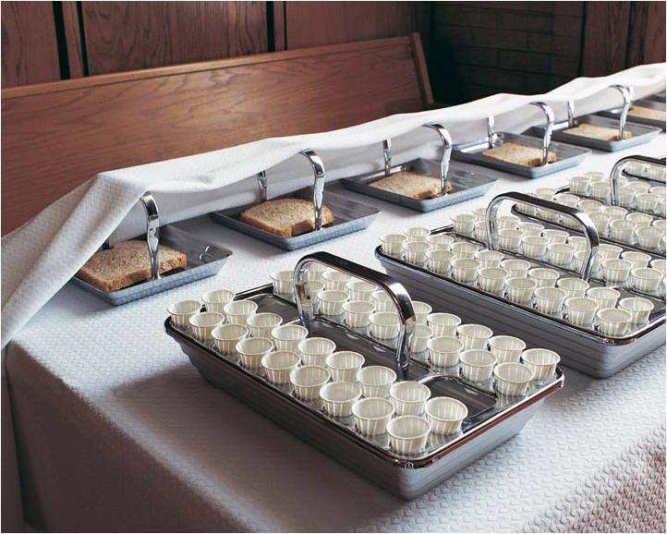
The Bread of Life
We eat food to stimulate our physical bodies. Without the partaking of food we would become weak and sickly, and fail physically. It is just as necessary, for our spiritual body, that we should partake of this sacrament and by it obtain spiritual food for our souls.
“We must come, however, to the sacrament table hungry. If we should repair to a banquet where the finest of earth’s providing may be had, without hunger, without appetite, the food would not be tempting, nor do us any good.
If we repair to the sacrament table, we must come hungering and thirsting for righteousness, for spiritual growth.” (7)
And they were filled
Matthew 14:20-21; John 6:22-58

Slide 13
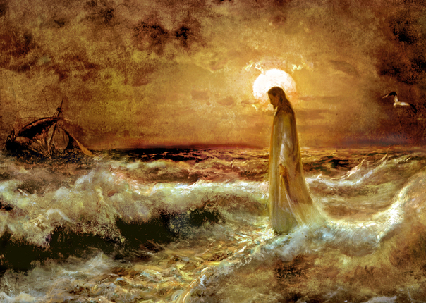
The Fourth Watch
The Romans divided the night hours into four watches, corresponding roughly to 6:00–9:00 p.m., 9:00 p.m.–midnight, midnight–3:00 a.m., and 3:00–6:00 a.m.
9
6
When the Savior came to the disciples in the fourth watch, they had been rowing all night against a contrary wind.
Matthew 14:22-25

Slide 14
The disciples had been on the ship roughly 9-12 hours
Who hath ascended up into heaven, or descended? who hath gathered the wind in his fists? who hath bound the waters in a garment? who hath established all the ends of the earth? what is his name, and what is his son’s name, if thou canst tell?
Proverbs 30:4
Thy way is in the sea, and thy path in the great waters, and thy footsteps are not known.
Psalms 77:19
Matthew 14:22-25

Slide 15
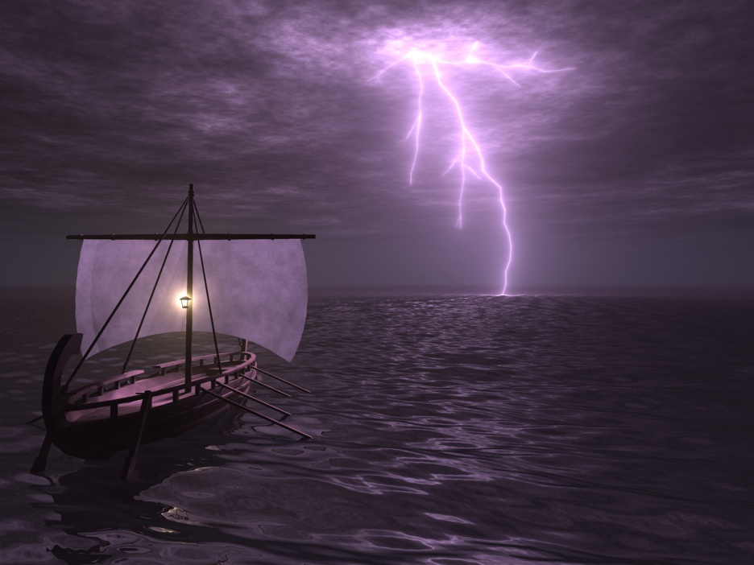
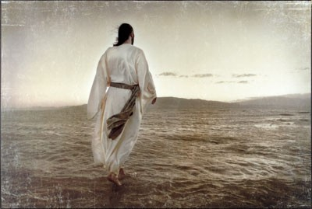
Coming To Our Aid
Could Jesus have spared the disciples from their struggles sooner?
What might have been the purpose of letting the disciples struggle for a time before they were delivered?
Even though God might not always spare us from struggles, He knows what we are experiencing and will, in His own time, come to our aid
Matthew 14:26; Mark 6:47-48

Slide 16
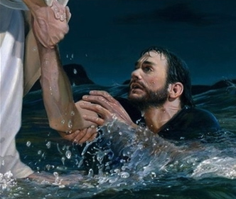
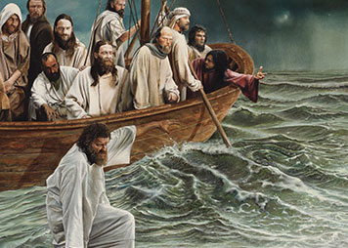
Peter’s Faith
"Peter's faith began to reach heights virtually without equal in the New Testament record. It so surged within him that upon the Lord's invitation, Peter once climbed down out of his fishing boat and 'walked on the water, to go to Jesus.’
That fact of faith has never been recorded of any other mortal man. If his faith faltered because of treacherous waves and adverse winds, 'perhaps we should take a few steps on [the] water' before ascending to the judgment seat.
Matthew 14:28-29

Slide 17
Fear
“This scriptural account reminds us that the first step in coming to Christ—or his coming to us—may fill us with something very much like sheer terror. It shouldn’t, but it sometimes does. One of the grand ironies of the gospel is that the very source of help and safety being offered us is the thing from which we may, in our mortal shortsightedness, flee.
For whatever the reason, I have seen investigators run from baptism,
I have seen elders run from a mission call,
I have seen sweethearts run from marriage, and I have seen young couples run from the fear of families and the future.
Too often too many of us run from the very things that will bless us and save us and soothe us. Too often we see gospel commitments and commandments as something to be feared and forsaken” (8)
Matthew 14:30

Slide 18
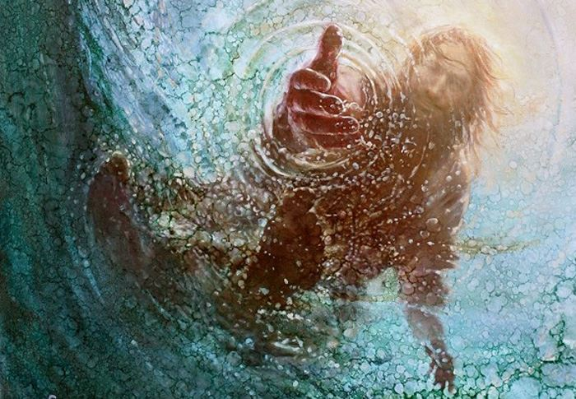
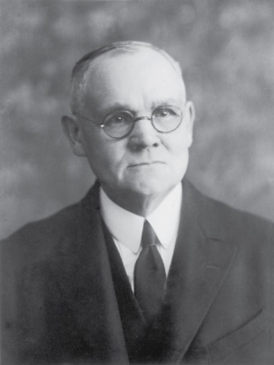
Lord Save Me
“Into every adult human life come experiences like unto the battling of the storm-tossed voyagers with contrary winds and threatening seas; oft times the night of struggle and danger is far advanced before succor appears; and then, too frequently the saving aid is mistaken for a greater terror.
[But,] as came unto [these disciples] in the midst of the turbulent waters, so comes to all who toil in faith, the voice of the Deliverer-'It is I; be not afraid' ' (1)
Matthew 14:28-29

Slide 19
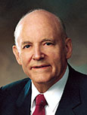
“It is my firm belief that if as individual people, as families, communities, and nations, we could, like Peter, fix our eyes on Jesus, we too might walk triumphantly over ‘the swelling waves of disbelief’ and remain ‘unterrified amid the rising winds of doubt.’
But if we turn away our eyes from him in whom we must believe, as it is so easy to do and the world is so much tempted to do, if we look to the power and fury of those terrible and destructive elements around us rather than to him who can help and save us, then we shall inevitably sink in a sea of conflict and sorrow and despair.”
Matthew 14:30-31

Slide 20
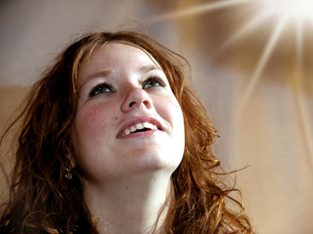
if we keep our eyes fixed on Jesus Christ and maintain our faith in Him, we will not be overcome by our fears and doubts
If we seek God’s help when our faith wanes, He can lift us from our fears and doubts
Matthew 14:30-31

Slide 21
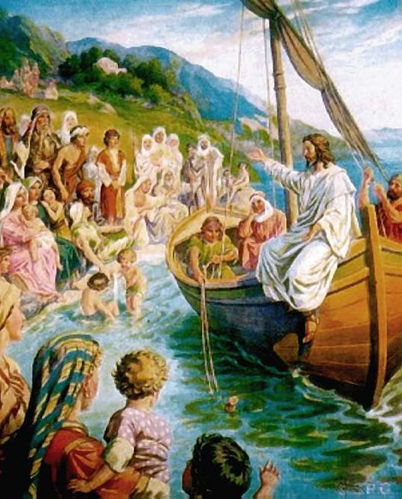
Next…
Capernaum
Besaida
Jesus and disciples reach the far shores of Galilee, into the land of Gennesaret
Gennesaret
Sea of Galilee
Tiberias
The people came to be healed by Jesus
Matthew 14:34-36

Slide 22
Sources:
Suggested Hymn: #266 The Time is Far Spent
Videos:
Daily Bread: Experience (3:13)
Tomorrow the Lord Will Do Wonders Among You (1:14)
Mountains to Climb (5:05)
James E. Talmage Jesus the Christ p. 253, 337
Bible Dictionary and Wikipedia
Bruce R. McConkie Doctrinal New Testament Commentary p. 339, excerpts from 343-344
Thomas S. Monson (LDS Church News, 1991, 01/19/91)
“The Way of the Master,” Ensign, May 1996, 51).
New Testament Institute Student Manual Chapter 12
President James E. Faust (“Five Loaves and Two Fishes,” Ensign, May 1994, 5–6).
Melvin J. Ballard … Crusader for Righteousness, pp. 132–33.)
Elder Jeffrey R. Holland (“Come unto Me” [Brigham Young University fireside, Mar. 2, 1997], 8; speeches.byu.edu
(See Richard Lloyd Anderson, "Simon Peter," Ensign, February 1975, pp. 47-49.)" (However Long and Hard the Road, 98.)
9. President Howard W. Hunter (“The Beacon in the Harbor of Peace,” Ensign, Nov. 1992, 19).)
Presentation by ©http://fashionsbylynda.com/blog/

Slide 23
The Herodian family were Idumeans by birth but had become converts to the Jewish faith. Their object was to found, under the protection of Rome, a semi-independent kingdom. By his marriage with Mariamne, Herod the Great allied himself with the family of the Maccabees, who had been for several generations the leaders of the patriotic party among the Jews. Herod was a successful ruler and was on terms of friendship with Augustus, the Roman Emperor. In order to gain favor with his subjects, with whom he was most unpopular, he rebuilt the temple at an immense cost.
His reign was disgraced by many acts of cruelty. In a fit of jealousy he had his wife, whom he dearly loved, put to death; later on he had her two sons, Alexander and Aristobulus, also murdered. In the same year in which he gave the order for the massacre of the infants at Bethlehem, he had Antipater, another of his own sons, put to death. A few months later Herod himself died. His kingdom was then divided between three of his sons: Archelaus, who received Judea, Idumea, and Samaria; Antipas, who had Galilee and Perea; and Philip, who had the northeast districts of Palestine. Bible Dictionary
To Buy Bread: Matthew14:17
The coinage in use was that of Rome, and the penny, or denarius, was the chief Roman silver coin. It was worth about fifteen to seventeen of our cents. Two hundred pennyworth of bread would have cost approximately thirty-two dollars. (See Smith, A Dictionary of the Bible, rev. ed., s.v. “Penny, Pennyworth.”)
The Sacrament---Bread of Life John 6:22-58
-To eat the flesh and drink the blood of the Son of God is, first, to accept him in the most literal and full sense, with no reservation whatever, as the personal offspring in the flesh of the Eternal Father; and, secondly, it is to keep the commandments of the Son by accepting his gospel, joining his Church, and enduring in obedience and righteousness unto the end. Those who by this course eat his flesh and drink his blood shall have eternal life, meaning exaltation in the highest heaven of the celestial world. Speaking of ancient Israel, for instance, Paul says: They “did all eat the same spiritual meat; And did all drink the same spiritual drink: for they drank of that spiritual Rock that followed them: and that Rock was Christ.” (1 Cor. 10:3–4.) The Life and Teaching of Jesus and His Apostles Course manual Rel. 211-212 Chapter 12
Herod’s Birthday Matthew 14:6
"Such feasts as this were not complete without entertainment, without something to feed the lusts and arouse the passions of those now gorged with food and half drunken with wine. Dancers, especially dancing women, were in great demand. Taking into account the sensuous nature of the Herods, the mean and vulgar demeanor of the military men, the adultery-centered proclivities of the chief priests; having in mind the depraved and vulgar displays Herod would have seen at Caesar's banquets; knowing of the perversions and sexual excesses found in all Oriental courts, and the loose and low moral standard of all the Gentiles and many of the Jews; being aware of all this...we have no difficulty envisioning the type of banquet entertainment that was presented at these kingly feasts." elder Bruce R. McConkie (The Mortal Messiah: From Bethlehem to Calvary, 2: 333.)
The Fourth Watch Matthew 14:24
“I know that [the Lord’s] tender mercies and His miracles, large and small, are real. They come in His way and on His timetable. Sometimes it is not until we have reached our extremity. Jesus' disciples on the Sea of Galilee had to toil in rowing against a contrary wind all through the night before Jesus finally came to their aid. He did not come until the ‘fourth watch,’ meaning near dawn. Yet He did come. (See Mark 6:45–51.) My testimony is that miracles do come, though sometimes not until the fourth watch” Sister Susan W. Tanner (“My Soul Delighteth in the Things of the Lord,” Ensign or Liahona, May 2008, 83).
Herod Stunned Matthew 14:9
"Herod is stunned [at the request for John's head]; he is plunged into sudden grief; his fawning friends are appalled...Antipas...feared to lose face with his nobles should he break his intemperate oath.
"'If a single touch of manliness had been left in him he would have repudiated the request as one which did not fall either under the letter or spirit of his oath, since the life of one cannot be made the gift to another; or he would have boldly declared that if such was her choice, his oath was more honoured by being broken than by being kept. But a despicable pride and fear of man prevailed over his better impulses. More afraid of the criticisms of his guests than of the future torment of such conscience as was left him, he immediately sent an executioner to the prison, and so at the bidding of a dissolute coward, and to please the loathly fancies of a shameless girl, the axe fell, and the head of the noblest of the prophets was shorn away.' (Farrar)" Elder Bruce R. McConkie (The Mortal Messiah: From Bethlehem to Calvary, 2: 334-5.)
Fear VS Faith Matthew 14:28-31
"Perhaps it was Peter's failure to keep his eye fixed on Jesus? Like the not fully committed plowman? Instead of looking straight ahead at Jesus, Peter looked around, computed the odds, and was terrified. As any of us would be! How does one ignore wind-whipped whitecaps?...But if we are willing to proceed with our eye upon Jesus Christ instead of upon all that might go wrong, or upon the waves pounding and swirling about us, if we 'go to Jesus' directly, knowing that He can save us, we will not be forsaken either. Even if we seem to be sinking, we are still to reach out to Him...Oh, the fierce interplay of faith and circumstance!...James said it well, didn't he? If we doubt, we become like those very waves, tossed by the wind! (James 1:6.)" Neil A. Maxwell (We Talk of Christ, We Rejoice in Christ, 18.)

Slide 24
Event | Matthew | Mark | Luke | John
John the Baptist Imprisoned by Herod | 14:3-5 | 6:17-20 | 3:19,20
Apostles Are Sent on Missions | 10:1, 5-42 | 6:7-13 | 9:1-6
Herod Antipas Has John the Baptist Beheaded | 14:6-12 | 6:21-29
The Twelve Apostles Return and Depart—Jesus is to Rest | 14:13 | 6:30-33 | 9:10 | 6:1, 2
Jesus Feeds 5,000 | 14:14-21 | 6:34-44 | 9:11-17 | 6:3-14
Jesus Departs to the Mountain to Avoid Being Made King | 14:22, 23 | 6:45, 46 |  | 6:15
Jesus Walks on Water | 14:24-33 | 6:47-52 |  | 6:16-21
Jesus Heals People of Gennesaret | 14:34-36 | 6:53-56
Herod Wonders if Jesus is John the Baptist Raised from Dead | 14:1, 2 | 6:14-16 | 9:7-9
Source: Horizontal Harmony of the Four Gospels by Thomas M. Mumford

