Slide 1
Lesson 18
Lesson For The Pharisees
Matthew 15
And said, Verily I say unto you, Except ye be converted, and become as little children, ye shall not enter into the kingdom of heaven.
Matthew 18:3

Slide 2
A young couple is preparing for marriage. They live in a place where it is widely accepted to participate in premarital sexual relations. Some people have told this couple that they are old-fashioned and odd because they are waiting to be married before engaging in sexual intimacy.
A young woman is encouraged by her friends to wear an inappropriate outfit to a school dance. The young woman knows that the outfit does not meet the Lord’s standards of modesty, even though it is generally accepted in her culture to wear outfits like it.
A young man belongs to a Latter-day Saint family that loves sporting events. When popular sporting events are shown on television, the family routinely sets aside family prayer, scripture study, family home evening, and Sunday Church meetings in order to watch the events.
Each scenario presents a conflict between obeying God’s commandments and acting according to traditions or customs.
What do these scenarios have in common?

Slide 3
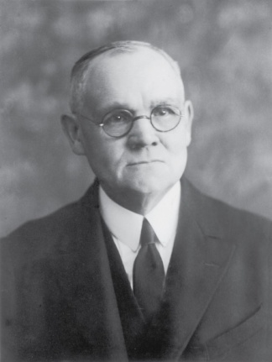
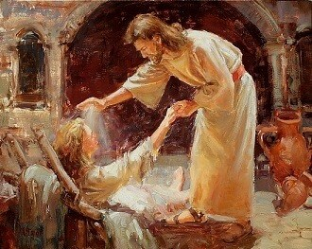
Previously…
Capernaum
Besaida
Jesus and his disciples reached the land of Gennesaret
Gennesaret
The word of the Lord’s presence there spread rapidly…the people flocked to Him, bringing their afflicted to receive of His beneficence by word or touch.
Tiberias
In the towns through which He walked, the sick were laid in the streets that the blessing of His passing might fall upon them; and many “besought him that they might touch if it were but the border of his garment; and as many as touched him were made whole.” (1)
Mark 6:56

Slide 4
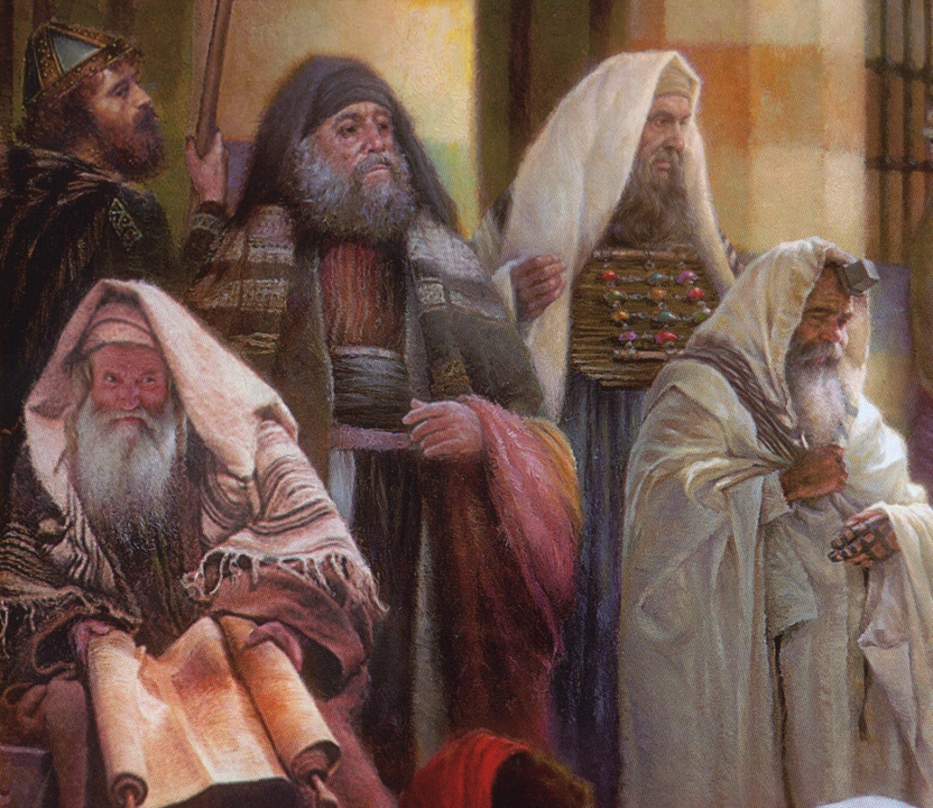
Tradition and Customs
The numerous washings required by Jewish custom in the time of Christ were admittedly incident to rabbinism and “the tradition of the elders” and not in compliance with the Mosaic law. (1)
Oral Law—sometimes called Traditions of the Fathers
The Pharisees clamed that Moses had received the law on Mount Sinai in two parts—one written and one oral. The written part made up the 5 books of Moses, which were accepted by all Jews…but according to the Pharisees another part of the law had also been given to Moses orally and had been handed down and preserved by the Pharisees and their predecessors. (2)
“Whenever written scripture failed to give clear instructions, the Pharisees appealed to the oral law….the Pharisees denied that God could ever change or add anything to the revelation given…(2)

Slide 5
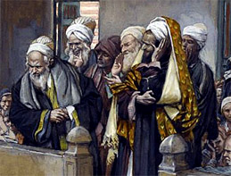
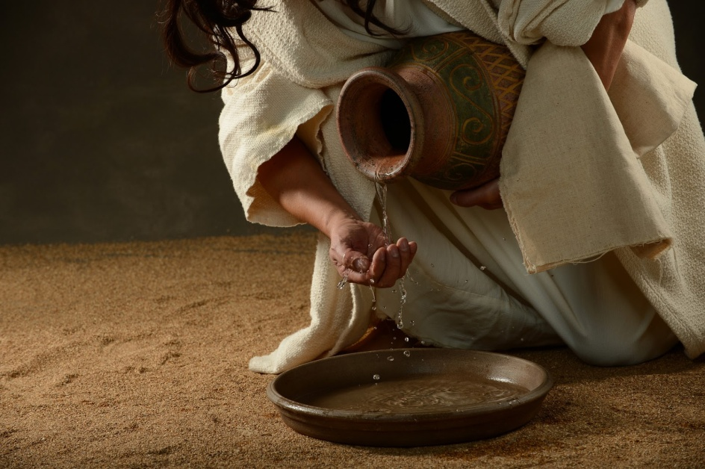
Failing to Wash
A ceremonial washing for the sake of ritual purity and does not refer to washing for sanitation.
The scribes and Pharisees try to discredit the disciples of Jesus by failing to wash before they ate.
Under the law of Moses, many aspects of daily life were divided into categories of “clean” and “unclean.” Uncleanness referred to being ceremonially or ritually unclean and did not mean that the person was either unsanitary or morally unclean, though ritually “unclean” persons were excluded from certain religious and social activities until they were purified. (3)
Matthew 15:1-2; Mark 7:1-3

Slide 6
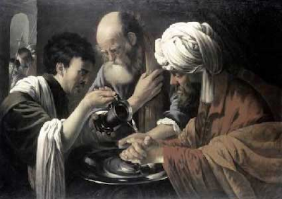
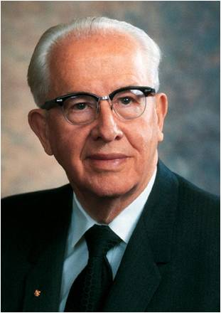
Inward Washing
Some seek only external washing, whereas they should be seeking internal renewal.
Mark lists inner evils:
Covetousness
Wickedness
Deceit
Lasciviousness
An evil eye
Pride
Foolishness
“The scriptures reveal that the Lord will save his greatest wrath and condemnation for those who outwardly appear religious but who are actually full of evil within.” (4)
Now I would that ye should remember that God has said that the inward vessel shall be cleansed first, and then shall the outer vessel be cleansed also.
Alma 60:23
“…as we cleanse the inner vessel, there will have to be changes made in our own personal lives, in our families, and in the Church. The proud do not change to improve, but defend their position by rationalizing. Repentance means change, and it takes a humble person to change.” (5)
Matthew 15:1-2; Mark 7

Slide 7
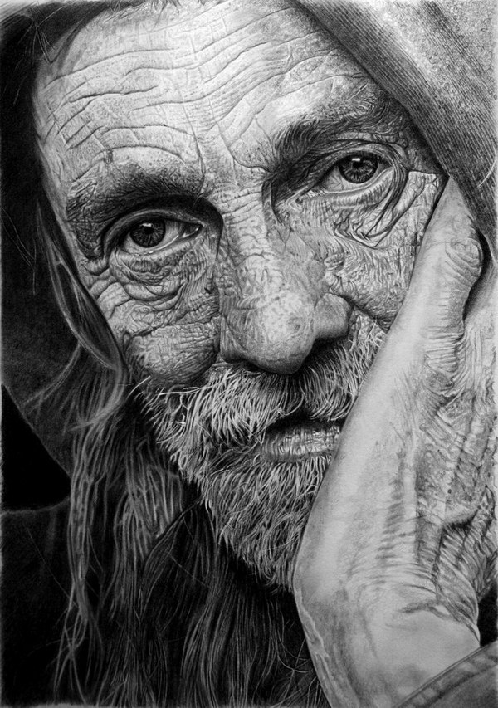
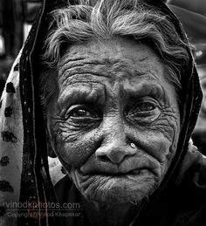
Honor Thy Father and Mother
Corban = that people “shall be free” of their obligation to take care of their aging parents by declaring that their money was reserved as a gift to God,…
However, Jesus taught that in doing so, they violated the commandment to honor one’s father and mother.
Matthew 15:5-6; Mark 7:10-12

Slide 8
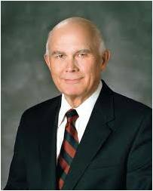
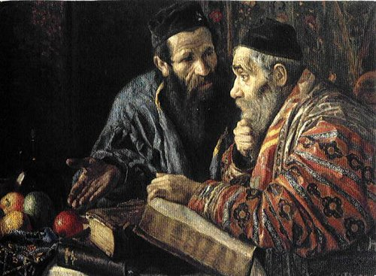
Traditions As An Excuse
Though they professed God with their mouths, their hearts were far from Him
“In contrast to the institutions of the world, which teach us to know something, the gospel of Jesus Christ challenges us to become something. …
“Jesus’ challenge shows that the conversion He required for those who would enter the kingdom of heaven was far more than just being converted to testify to the truthfulness of the gospel. …
“To testify is to know and to declare.
The gospel challenges us to be ‘converted,’ which requires us to do and to become.” (6)
If we desire to draw near to God, we must place His commandments above any traditions and customs we may have
Matthew 15:7-9; Mark 7:10-12

Slide 9
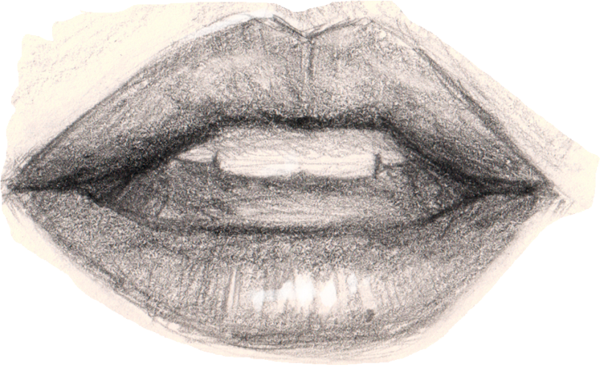
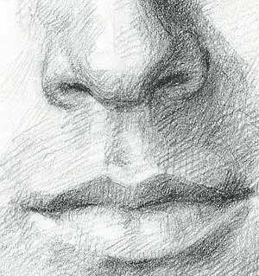
Defileth
His disciples not to concern themselves with the Pharisees, who were offended by His words
Stay out of the gutter in your conversation. Foul talk defiles the man who speaks it. (2)
"Church leaders have implored and pleaded with the Saints to use the right language.
President Spencer W. Kimball said, 'When we go to places of entertainment and mingle among people, we are shocked at the blasphemy that seems to be acceptable among them.
The commandment says, 'Thou shalt not take the name of the Lord thy God in vain.' (Exodus 20:7.)
Except in prayers and proper sermons, we must not use the name of the Lord. Blasphemy used to be a crime punishable by heavy fines. Profanity is the effort of a feeble brain to express itself forcibly.‘ (7)
Matthew 15:10-11

Slide 10
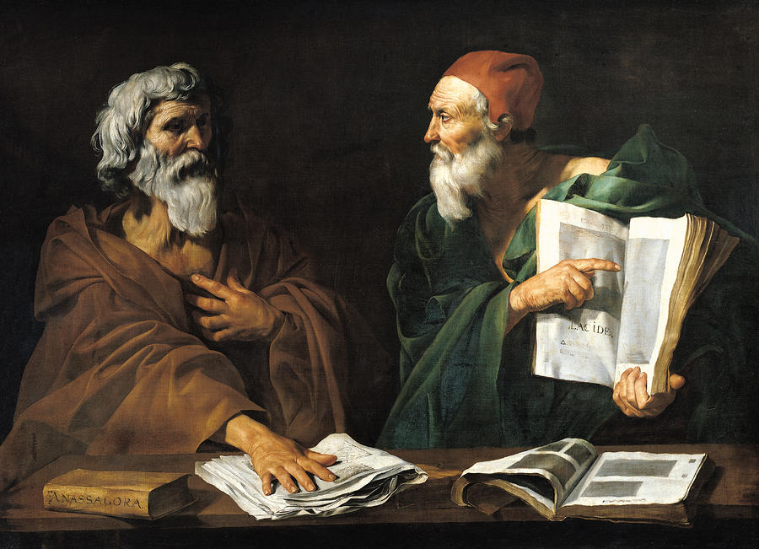
Every Plant
Do Not Buy Into Everything Someone Tells You!
"If you 'buy into' the philosophies of men, you may have your testimony repossessed. Your respect for moral law may go with it, and you will end up with nothing.” (8)
And everything that is in the world, whether it be ordained of men, by thrones, or principalities, or powers, or things of name, whatsoever they may be, that are not by me or by my word, saith the Lord, shall be thrown down, and shall not remain after men are dead, neither in nor after the resurrection, saith the Lord your God. D&C 132:13
Matthew 15:12-16

Slide 11
Laws of Man VS Laws of God
"The laws of man are never concerned about a person's desires or thoughts, in isolation. When the law inquires into a person's state of mind or intent, it only seeks to determine what consequence should be assigned to particular actions that person has taken.
"In contrast, the laws of God are concerned with spiritual things. Spiritual consequences are affected by actions, but they are also affected by desires or thoughts, independent of actions. Gospel consequences flow from the desires of our hearts...”
If we choose to entertain evil or inappropriate thoughts and desires, then those thoughts and desires will defile us
God judges us not only for our acts, but also for the desires of our hearts.
Matthew 15:17-20
(6)

Slide 12
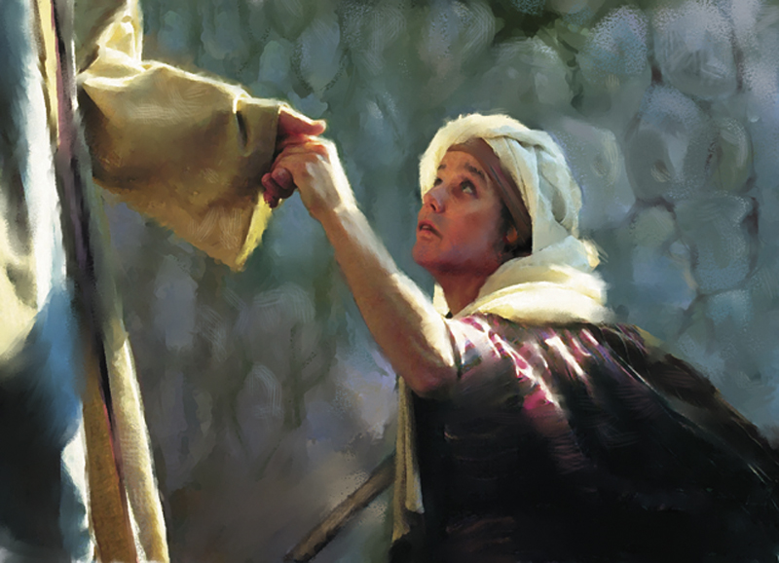
Woman of Canaan--Gentile
At a time when the gospel was being proclaimed to the Jews and not yet to the Gentiles.
O woman, great is thy faith: be it unto thee even as thou wilt. And her daughter was made whole from that very hour.
A Gentile woman recognized Jesus as the “Son of David,” the promised Messiah.
She did not take offense at Jesus’s words, but she humbly recognized that she was a beggar at Israel’s table.
The Greek word translated “dogs” referred to small dogs that could be household pets. Such pets would eat morsels of food given to them from the table or carelessly dropped.
Understanding the Savior’s distinction between Israel and Gentiles, the woman correctly pointed out that household pets were allowed to eat that which had been rejected.
Matthew 15:21-28
(3)

Slide 13
“When we have faith in the Lord Jesus Christ, we must have trust in him. We must trust him enough that we are content to accept his will, knowing that he knows what is best for us. …
As we exercise faith in Jesus Christ, we can receive blessings according to our righteous desires
“… Faith, no matter how strong it is, cannot produce a result contrary to the will of him whose power it is. … We cannot have true faith in the Lord without also having complete trust in the Lord’s will and in the Lord’s timing”
Matthew 15:27
(6)

Slide 14
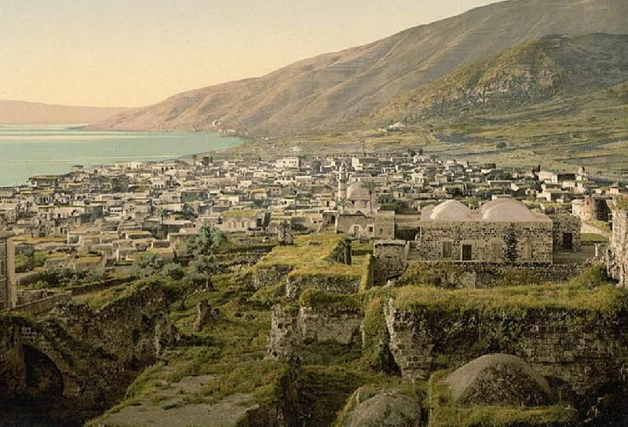
4,000 Fed
Jesus returned to Galilee. While He was there, over four thousand people gathered to Him, bringing with them people who were suffering from various physical ailments and disabilities.
The Savior healed them, and after the people spent three days with Him, He performed another miracle by feeding all of them with only seven loaves of bread and a few small fishes.
Matthew 15:29-39

Slide 15
Sources:
Suggested Hymn: #232 Let Us Oft Speak Kind Words
James E. Talmage Jesus the Christ p. 338, 340
Ed J. Pinegar, K. Douglas Bassett, Ted L. Earl Latter-day commentary on the New Testament p.192
New Testament Institute Student Manual Chapter 12
Larry Tippets Cleansing the Inner Vessel: The Process of Repentance Oct. Ensign 1992
President Ezra T. Benson Cleansing the Inner Vessel May 1986 Ensign
Elder Dallin H. Oaks (“The Challenge to Become,” Ensign, Nov. 2000, 32–33).
The Desires of Our Hearts," Ensign, June 1986, 64)
Faith in the Lord Jesus Christ,” Ensign, May 1994, 99, 100
7. Elder L. Tom Parry (Living with Enthusiasm, 116-17.)
8. Elder Boyd K. Packer Things of the Soul, 52
Presentation by ©http://fashionsbylynda.com/blog/

Slide 16
Washing Traditions: Matthew 15:1-2
Under certain conditions, successive washings were prescribed, in connection with which we find mention of “first,” “second” and “other” waters, the “second water” being necessary to wash away the “first water,” which had become defiled by contact with the “common” hands; and so further with the later waters. Sometimes the hands had to be dipped or immersed; at other times they were to be cleansed by pouring, it being necessary that the water be allowed to run to the wrist or the elbow according to the degree of supposed defilement; then again, as the disciples of Rabbi Shammai held, only the finger tips, or the fingers up to the knuckles, needed to be wetted under particular circumstances. Rules for the cleansing of vessels and furniture were detailed and exacting; distinct methods applied respectively to vessels of clay, wood, and metal. Fear of unwittingly defiling the hands led to many extreme precautions. It being known that the Roll of the Law, the Roll of the Prophets, and other scriptures, when laid away were sometimes touched, scratched, or even gnawed by mice, there was issued a rabbinical decree, that the Holy Scriptures, or any part thereof comprising as many as eighty-five letters (the shortest section in the law having just that number), defiled the hands by mere contact. Thus the hands had to be ceremonially cleansed after touching a copy of the scriptures, or even a written passage there from. James E. Talmage Jesus The Christ p. 366
Hand Washing of Today: Jewish Law
Washing of hands when one wakes from his sleep (known in Yiddish as נעגל וואַסער, negel vasser), poured out from a vessel three times, intermittently, over each hand. This washing is said to remove an evil spirit from one's fingers.
Washing of hands before prayer.
Washing of hands when one touches his privy parts, or the sweat from his body (excluding his face), or when one crops his fingernails[
Washing of hands when one leaves the latrine, lavatory or bathhouse
Washing of hands when one leaves a cemetery
Washing of hands before breaking bread served in one's supper, and only bread made from one of the five chief grains (wheat, cultivated barley, spelt, wild barley,[and oats)
Washing of hands after eating a meal where the salt of Sodom was served at that table
Washing of hands (practised by the Cohanim, or priests, of some communities) prior to going up to bless the people, as prescribed in the Sacerdotal Blessing
Washing of hands when, prior to eating, one dips a morsel of food within a liquid (e.g. water, honey, oil, etc.) which then clings to that morsel, with the one exception of fruits, seeing that they do not require hand washing.
In two of these hand washings, water is poured out over one's hands with the aid of a vessel, viz., 1) whenever one wakes from his sleep, and 2) before eating bread. These hand washings are nearly always accompanied with a special blessing prior to concluding the actual act of washing (see infra).
Although the minimal quantity of water needed to fulfill one's religious duty is 1/4 of a log (a liquid measure of capacity equal to the bulk or volume of one and half medium-sized eggs), and must be sufficient to cover at least the middle joints of one's fingers, water poured out in excess of this amount is considered praiseworthy in Jewish law. The hand washing made when one leaves the lavatory or latrine, or when one touches his privy parts, or sweat, may be done simply with running tap water (faucet).
The most developed and, perhaps, important of these washings is the washing of hands before eating bread. Such washing of hands is called in Hebrew, netilat yadayim, meaning "the lifting up of the hands." It is looked upon with such rigidity, that those who willfully neglect its practice are said to make themselves liable to excommunication, and bring upon themselves a state of scarcity, and are quickly taken out of the world. Wikipedia
Inward Cleansing:
1. Sexual impurity, which he calls “the plaguing sin of this generation.” The Prophet Joseph Smith called it “the source of more temptation, buffetings, and more difficulties … than any other.” (Ensign, May 1986, p. 4; Journal of Discourses, 8:55.)
2. Neglect of the scriptures, especially the Book of Mormon. Such neglect has brought the Church “under condemnation” and has caused a “scourge and judgment to be poured out upon the children of Zion.” (See Ensign, May 1986, p. 5; D&C 84:57–58.)
3. Pride, or wanting to be successful at any price. President Benson characterizes it as “self-will as opposed to God’s will.” (Ensign, May 1986, p. 7.) (5)
Corban Matthew 15:5:
"The practice referred to as 'corban' is that a son, if he were of independent age, could pledge his property to God, and thus it would not be available to be used to support needy parents, although the son could continue to use it for himself as long as he lived. Such a vow (which was permitted by the religious leaders) became more binding than the command of God, and hence the law of God was made 'of none effect' by the tradition.
"Having thus shown the delegation that they themselves were guilty of gross negligence and corruption far greater than eating with unwashed hands, Jesus then proceeded to explain that defilement that comes from within the heart is worse than defilement from the soil on one's outer body." (Robert J. Matthews, Studies in Scripture, Vol. 5: The Gospels, ed. by Kent P. Jackson and Robert L. Millet, 299.)

Slide 17
Dogs Eat of the Crumbs Matthew 15:27
“The rabbis often spoke of the Gentiles as dogs, e.g. ‘He who eats with an idolater is like one who eats with a dog.’ … ‘The nations of the world are compared to dogs.’ ‘The holy convocation belongs to you, not to the dogs.’ Yet Jesus in adopting the contemptuous expression slightly softens it. He says not ‘dogs,’ but ‘little dogs,’ i.e. household, favorite, dogs; and the woman cleverly catches at the expression, arguing that if the Gentiles are household dogs, then it is only right that they should be fed with the crumbs that fall from their masters’ table.” Edersheim, referring to the original text, says: “The term means ‘little dogs,’ or ‘house dogs.’” (1) p. 340
“The gospel (with all its healing powers and graces) was to be offered to the Jews before it went to the Gentiles. Jesus’ mortal ministry was with Israel, not with other nations. His healing of this or any Gentile person came by special dispensation because of great faith. Previously he had commanded the apostles to go only to the lost sheep of the house of Israel and not to preach the message of salvation to the Gentiles. (Matt. 10:5–6.) Certainly the course he followed in this instance was instructive to his disciples, tested the faith of the Gentile woman, taught that persistence and importunity in prayer will bring reward, and showed that greater faith is sometimes found among heathens than in the chosen lineage of Israel” Elder Bruce R. McConkie (Doctrinal New Testament Commentary, 3 vols. [1965–73], 1:371).
Gentiles of Great Faith Matthew 15:21-28:
Though a Gentile, the woman had great faith, yet the disciples asked Jesus to send her away. Instead, Jesus ministered to her. When the time came for the disciples to carry the gospel to the Gentiles (see Matthew 28:19–20), they could expect to find many individuals who, like this woman, were ready to receive their message. (30
Feeding the 4,000 Matthew 15:29-39:
“‘[The Savior] took the seven loaves and the fishes, and gave thanks, and brake them, and gave to his disciples, and the disciples to the multitude.’
“Notice that the Savior gave thanks for what they had—and a miracle followed: ‘And they did all eat, and were filled: and they took up of the broken meat that was left seven baskets full’ [see Matthew 15:32–38; italics added; see also Mark 8:1–8]. …
“Regardless of our circumstances, each of us has much for which to be grateful if we will but pause and contemplate our blessings. … To live with gratitude ever in our hearts is to touch heaven” President Thomas S. Monson (“The Divine Gift of Gratitude,” Ensign or Liahona, Nov. 2010, 88, 90).
A philosopher is someone who practices philosophy, which involves rational inquiry into areas that are outside of either theological dogma or science. The term "philosopher" comes from the Ancient Greek φιλόσοφος (philosophos) meaning "lover of wisdom". Its origination has been ascribed to the Greek thinker Pythagoras. Wikipedia

Slide 18
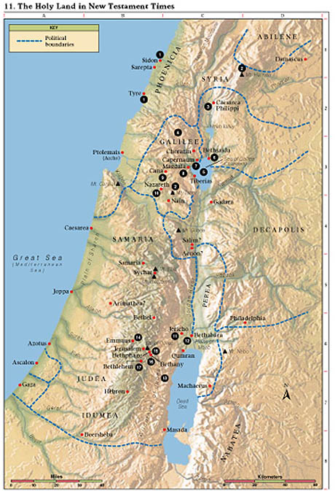
1. Tyre and Sidon Jesus compared Chorazin and Bethsaida to Tyre and Sidon (Matt. 11:20–22). He healed the daughter of a Gentile woman (Matt. 15:21–28).
2. Mount of Transfiguration Jesus was transfigured before Peter, James, and John, and they received the keys of the kingdom (Matt. 17:1–13). (Some believe the Mount of Transfiguration to be Mount Hermon; others believe it to be Mount Tabor.)
3. Caesarea Philippi Peter testified that Jesus is the Christ and was promised the keys of the kingdom (Matt. 16:13–20). Jesus foretold His own death and Resurrection (Matt. 16:21–28).
4. Region of Galilee Jesus spent most of His life and ministry in Galilee (Matt. 4:23–25). Here He gave the Sermon on the Mount (Matt. 5–7); healed a leper (Matt. 8:1–4); and chose, ordained, and sent forth the Twelve Apostles, of whom only Judas Iscariot was apparently not Galilean (Mark 3:13–19). In Galilee the risen Christ appeared to the Apostles (Matt. 28:16–20).
5. Sea of Galilee, later called Sea of Tiberias Jesus taught from Peter’s boat (Luke 5:1–3) and called Peter, Andrew, James, and John to be fishers of men (Matt. 4:18–22; Luke 5:1–11). He also stilled the tempest (Luke 8:22–25), taught parables from a boat (Matt. 13), walked on the sea (Matt. 14:22–32), and appeared to His disciples after His Resurrection (John 21).
6. Bethsaida Peter, Andrew, and Philip were born in Bethsaida (John 1:44). Jesus went away privately with the Apostles near Bethsaida. The multitudes followed Him, and He fed the 5,000 (Luke 9:10–17;John 6:1–14). Here Jesus healed a blind man (Mark 8:22–26).
7. Capernaum This was Peter’s home (Matt. 8:5, 14). In Capernaum, which Matthew called Jesus’ “own city,” Jesus healed a paralytic (Matt. 9:1–7; Mark 2:1–12), cured a centurion’s servant, healed the mother of Peter’s wife (Matt. 8:5–15), called Matthew to be one of His Apostles (Matt. 9:9), opened blind eyes, cast out a devil (Matt. 9:27–33), healed a man’s withered hand on the Sabbath (Matt. 12:9–13), gave the bread of life discourse (John 6:22–65), and agreed to pay taxes, telling Peter to get the money from a fish’s mouth (Matt. 17:24–27).
8. Magdala This was the home of Mary Magdalene (Mark 16:9). Jesus came here after feeding the 4,000 (Matt. 15:32–39), and the Pharisees and Sadducees requested that He show them a sign from heaven (Matt. 16:1–4).
9. Cana Jesus turned water into wine (John 2:1–11) and healed a nobleman’s son who was at Capernaum (John 4:46–54). Cana was also the home of Nathanael (John 21:2).
10. Nazareth The annunciations to Mary and Joseph took place in Nazareth (Matt. 1:18–25; Luke 1:26–38; 2:4–5). After returning from Egypt, Jesus spent His childhood and youth here (Matt. 2:19–23;Luke 2:51–52), announced that He was the Messiah, and was rejected by His own (Luke 4:14–32).
11. Jericho Jesus gave sight to a blind man (Luke 18:35–43). He also dined with Zacchaeus, “chief among the publicans” (Luke 19:1–10).
12. Bethabara John the Baptist testified that he was “the voice of one crying in the wilderness” (John 1:19–28). John baptized Jesus in the Jordan River and testified that Jesus is the Lamb of God (John 1:28–34).
13. Wilderness of Judea John the Baptist preached in this wilderness (Matt. 3:1–4), where Jesus fasted 40 days and was tempted (Matt. 4:1–11).
14. Emmaus The risen Christ walked on the road to Emmaus with two of His disciples (Luke 24:13–32).
15. Bethphage Two disciples brought Jesus a colt on which He began His triumphal entry into Jerusalem (Matt. 21:1–11).
16. Bethany This was the home of Mary, Martha, and Lazarus (John 11:1). Mary heard Jesus’ words, and Jesus spoke to Martha of choosing the “good part” (Luke 10:38–42); Jesus raised Lazarus from the dead (John 11:1–44); and Mary anointed Jesus’ feet (Matt. 26:6–13; John 12:1–8).
17. Bethlehem Jesus was born and was laid in a manger (Luke 2:1–7); angels heralded to the shepherds the birth of Jesus (Luke 2:8–20); wise men were directed by a star to Jesus (Matt. 2:1–12); and Herod slew the children (Matt. 2:16–18).

Slide 19
Event | Matthew | Mark | Luke | John
Conflict with Scribes and Pharisees over Cleanliness | 15:1-20 | 7:1-23
Jesus Heals a Gentile’s Daughter | 15:21-28 | 7:24-30
Jesus Returns to the Sea of Galilee and Heals Many | 15:29-31 | 7:31-37
Jesus Feeds 4,000 | 15:32-38 | 8:1-9
Jesus Goes to Magdala | 15:39 | 8:10
Source: Horizontal Harmony of the Four Gospels by Thomas M. Mumford

