Slide 2
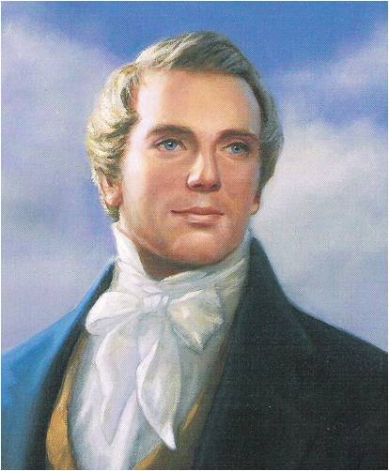
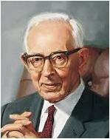
Foundation of the Church
“[The Doctrine and Covenants is] the foundation of the Church in these last days, and a benefit to the world, showing that the keys of the mysteries of the kingdom of our Savior are again entrusted to man”
Joseph Smith
“It is worth more to us than the riches of the earth”
Joseph Fielding Smith

Slide 3
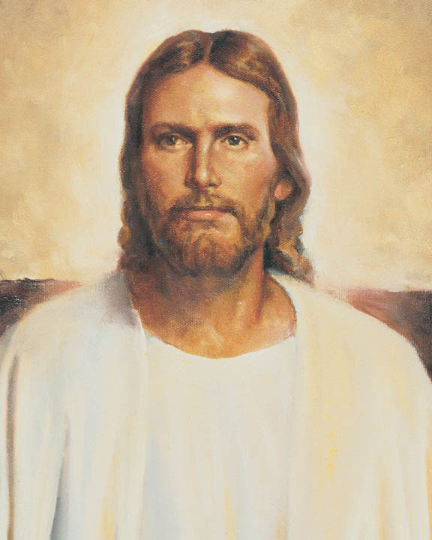
Truth and Revelation
Doctrine--- a fundamental, eternal truth of the gospel of Jesus Christ
Covenant--- a sacred agreement between God and His children; and revelation is communication from God to His children

Slide 4
What is in the D&C?
Doctrine and Covenants include:
The nature of the Godhead
Origin of man
Reality of Satan
Purpose of mortality
Necessity for obedience
Need for repentance
Workings of the Holy Spirit
How to pertain salvation
The destiny of the earth and future conditions of man
The 2nd Coming of Christ, His judgment and Resurrection
The nature of the family and eternal marriage
Also:
The gradual unfolding of the administrative structure of the Church is shown with the calling of bishops, the First Presidency, the Council of the Twelve, and the Seventy and the establishment of other presiding offices and quorums.
The testimony that is given of Jesus Christ—His divinity, His majesty, His perfection, His love, and His redeeming power

Slide 5
How Can I increase My Testimony?
“These words are not of men nor of man, but of me; wherefore, you shall testify they are of me and not of man;
For it is my voice which speaketh them unto you; for they are given by my Spirit unto you, and by my power you can read them one to another; and save it were by my power you could not have them;
Wherefore, you can testify that you have heard my voice, and know my words.”
D&C 18:34-36
By studying the revelations in the Doctrine and Covenants, we can strengthen our testimonies of Jesus Christ.
As we study the Doctrine and Covenants, we can hear the voice of the Savior.

Slide 6
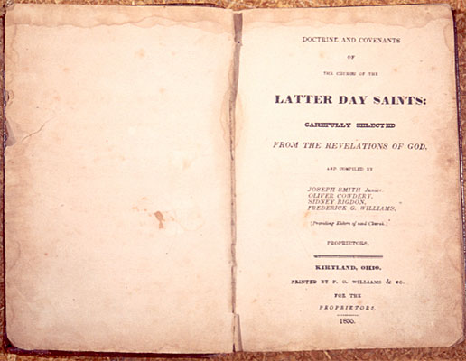
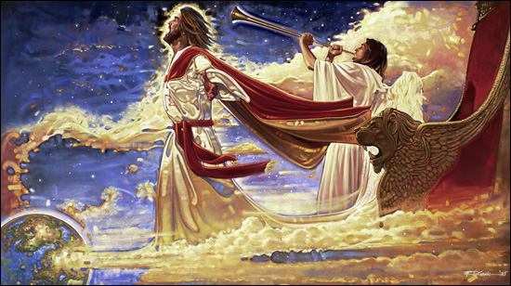
Through the Voice of Jesus Christ
Jesus Christ is the God of this world
The Doctrine and Covenants is unique because it is not a translation of an ancient document, but is of modern origin and was given of God through His chosen prophets for the restoration of His holy work and the establishment of the kingdom of God on the earth in these days.
In the revelations, one hears the tender but firm voice of the Lord Jesus Christ, speaking anew in the dispensation of the fulness of times; and the work that is initiated herein is preparatory to His Second Coming, in fulfillment of and in concert with the words of all the holy prophets since the world began.

Slide 7
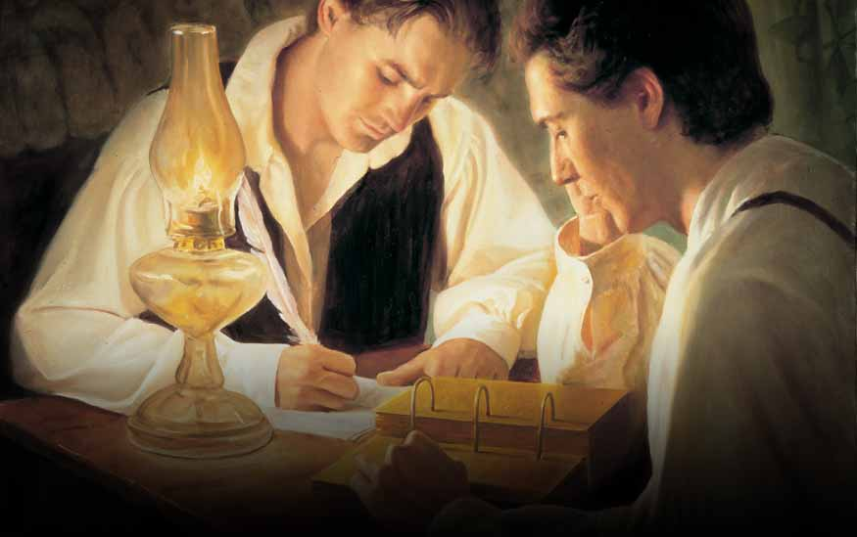
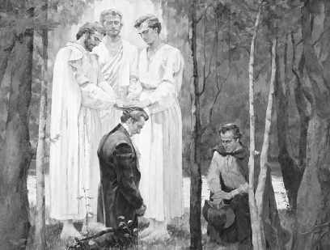
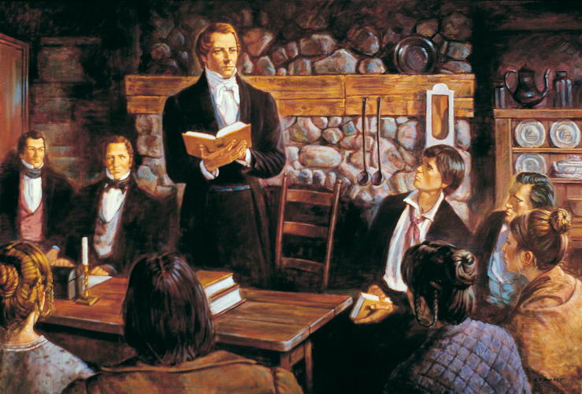
A Restoration of Divine Authority
In the course of time, Joseph Smith was enabled by divine assistance to translate and publish the Book of Mormon.
In the meantime he and Oliver Cowdery were ordained to the Aaronic Priesthood by John the Baptist in May 1829 (see D&C 13), and soon thereafter they were also ordained to the Melchizedek Priesthood by the ancient Apostles Peter, James, and John
(see D&C 27:12).
Other ordinations followed in which priesthood keys were conferred by Moses, Elijah, Elias, and many ancient prophets.
(see D&C 110; 128:18, 21).
These ordinations were, in fact, a restoration of divine authority to man on the earth. On April 6, 1830, under heavenly direction, the Prophet Joseph Smith organized the Church, and thus the true Church of Jesus Christ is once again operative as an institution among men, with authority to teach the gospel and administer the ordinances of salvation.
(See D&C 20 and the Pearl of Great Price, Joseph Smith—History 1.)

Slide 8
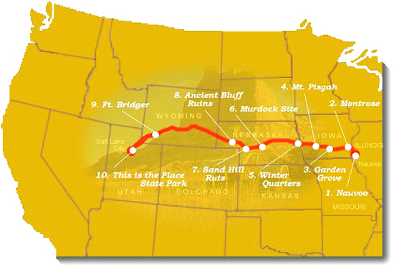
Real-life Situations—Real People
These sacred revelations were received in answer to prayer, in times of need, and came out of real-life situations involving real people.
The Prophet and his associates sought for divine guidance, and these revelations certify that they received it. In the revelations, one sees the restoration and unfolding of the gospel of Jesus Christ and the ushering in of the dispensation of the fulness of times.
The westward movement of the Church from New York and Pennsylvania to Ohio, to Missouri, to Illinois,
and finally to the Great
Basin of western America
and the mighty struggles
of the Saints in attempting
to build Zion on the earth
in modern times are also
shown forth in these revelations.
If we pray for help in our times of need, then the Lord will give us guidance.

Slide 9
Testimony of the Twelve
The Testimony of the Witnesses to the Book of the Lord’s Commandments, which commandments He gave to His Church through Joseph Smith, Jun., who was appointed by the voice of the Church for this purpose:
We, therefore, feel willing to bear testimony to all the world of mankind, to every creature upon the face of the earth, that the Lord has borne record to our souls, through the Holy Ghost shed forth upon us, that these commandments were given by inspiration of God, and are profitable for all men and are verily true.
We give this testimony unto the world, the Lord being our helper; and it is through the grace of God the Father, and His Son, Jesus Christ, that we are permitted to have this privilege of bearing this testimony unto the world, in the which we rejoice exceedingly, praying the Lord always that the children of men may be profited thereby.

Slide 10
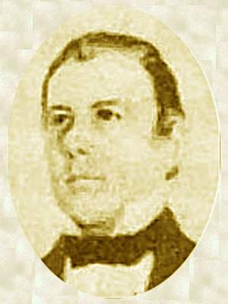
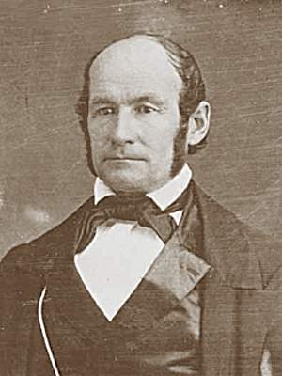
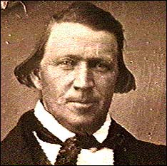
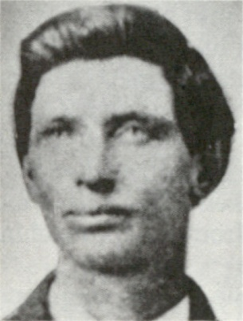
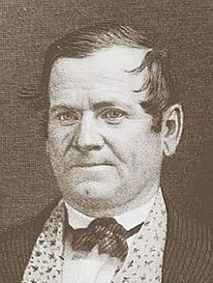
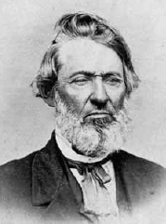
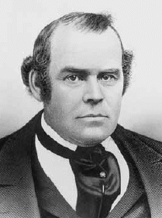
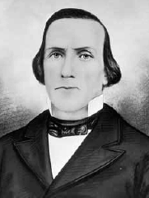
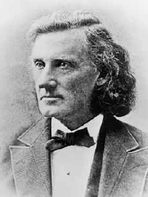
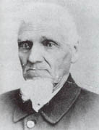
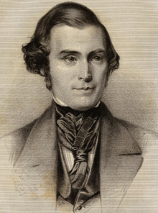
Thomas B. Marsh
Brigham Young
Heber C. Kimball
David W. Patten
The Twelve
Orson Hyde
William E. McLellin
Luke S. Johnson
Parley P. Pratt
John F. Boynton
Orson Pratt
Lyman E. Johnson
William Smith

Slide 11
The Eight Witnesses
"Be it known unto all nations, kindreds, tongues, and people, unto whom this work shall come: That Joseph Smith, Jun., the translator of this work, has shown unto us the plates of which hath been spoken, which have the appearance of gold; and as many of the leaves as the said Smith has translated we did handle with our hands; and we also saw the engravings thereon, all of which has the appearance of ancient work, and of curious workmanship. And this we bear record with words of soberness, that the said Smith has shown unto us, for we have seen and hefted, and know of a surety that the said Smith has got the plates of which we have spoken. And we give our names unto the world, to witness unto the world that which we have seen. And we lie not, God bearing witness of it." July 1829

Slide 12
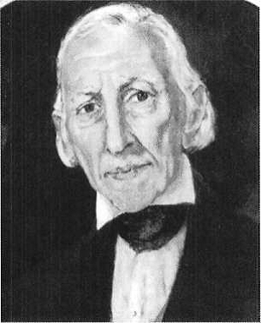
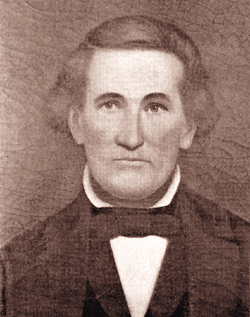
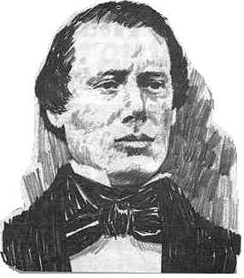
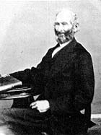
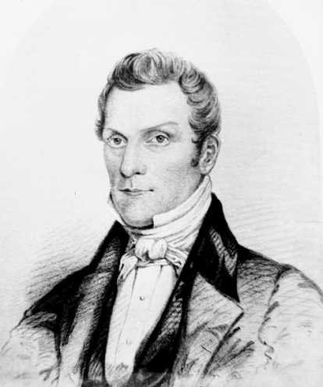
The Eight Witnesses
Joseph Smith, Sen.
Jacob Whitmer
John Whitmer
Samuel H. Smith
Hyrum Smith
Missing: Hirum Page, Christian Whitmer, and Peter Whitmer

Slide 13
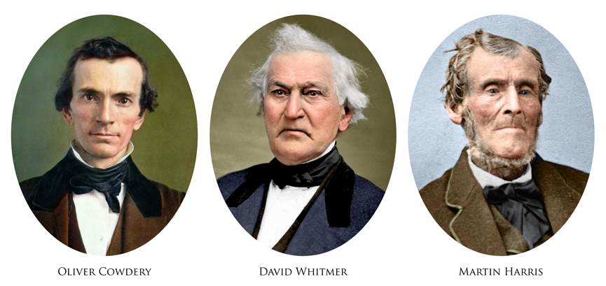
The Three Witnesses

Slide 14
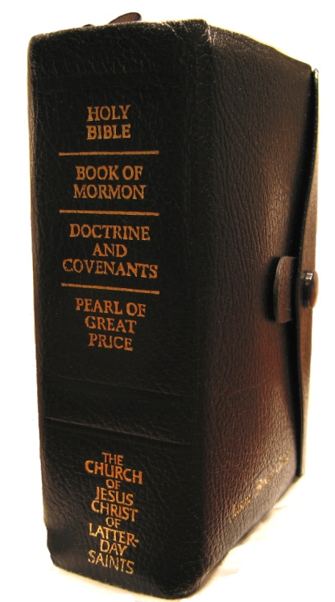
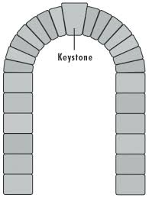
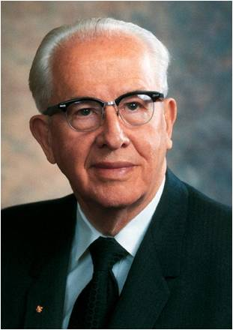
“The Book of Mormon and the Doctrine and Covenants are bound together as revelations from Israel’s God to gather and prepare His people for the second coming of the Lord. …
“The Book of Mormon and the Doctrine and Covenants testify of each other. You cannot believe one and not the other. …
“The Doctrine and Covenants is the binding link between the Book of Mormon and the continuing work of the Restoration through the Prophet Joseph Smith and his successors. …
“The Book of Mormon brings men to Christ. The Doctrine and Covenants brings men to Christ’s kingdom, even The Church of Jesus Christ of Latter-day Saints, ‘the only true and living church upon the face of the whole earth’ [D&C 1:30]. I know that.
“The Book of Mormon is the ‘keystone’ of our religion, and the Doctrine and Covenants is the capstone, with continuing latter-day revelation. The Lord has placed His stamp of approval on both the keystone and the capstone”
Ezra Taft Benson

Slide 15
Sources:
Related Video:
Overview of Church History (10:34)
Why Study the Doctrine and Covenants? (2:34)
Joseph Smith (Teachings of Presidents of the Church: Joseph Smith [2007], 194).
Joseph Fielding Smith (Doctrines of Salvation, comp. Bruce R. McConkie, 3 vols. [1954–56], 3:199).
Ezra Taft Benson (“The Book of Mormon and the Doctrine and Covenants,” Ensign, May 1987, 83).
Presentation by ©http://fashionsbylynda.com/blog/

Slide 16
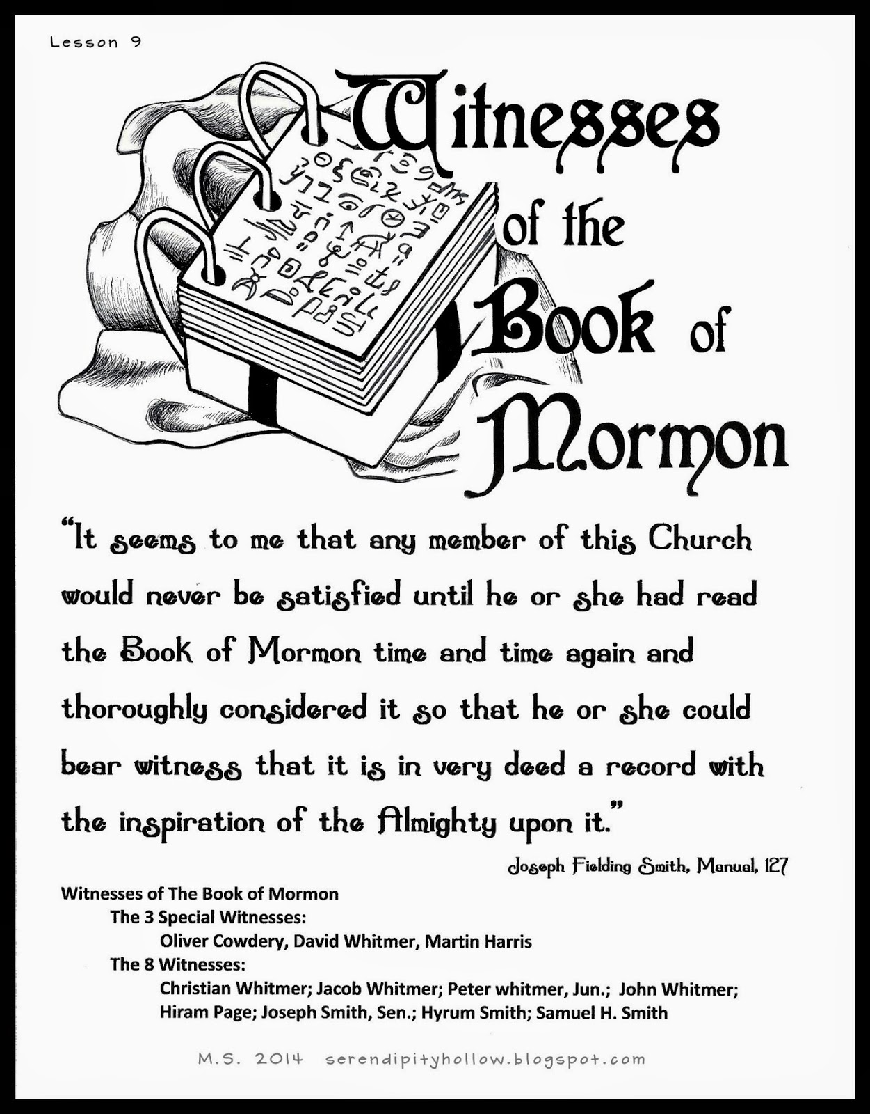
From revelation to publication: Different editions of the Doctrine and Covenants
In November 1831 the Prophet Joseph Smith met with elders in Hiram, Ohio. The group decided to compile and publish some of the revelations that the Prophet had received. They selected 65 revelations and titled the compilation the Book of Commandments. By the summer of 1833 most of the compilations had been printed, but a mob destroyed nearly all of the copies. As a result, very few copies exist today. Another edition was approved and published in 1835. This edition contained the Lectures on Faith (see the introduction to the Doctrine and Covenants) and 103 revelations. This edition, therefore, was the first with the title Doctrine (the lectures) and Covenants (the revelations). (See History of the Church, 2:243–251.)
A few more editions (each adding new revelations or making slight improvements to the organization) were printed periodically until 1981, when the Church published a new edition of the triple combination, in English, with expanded footnotes and cross-references and a new index. At that time, the Prophet Joseph Smith’s 1836 vision of the celestial kingdom and President Joseph F. Smith’s 1918 vision of the redemption of the dead, both canonized by the Church in 1976 and originally added to the Pearl of Great Price, were added to the Doctrine and Covenants as sections 137 and 138. The 1981 edition has 138 sections and two official declarations: the Manifesto, issued in 1890 by President Wilford Woodruff, and the declaration on priesthood, issued in 1978 by President Spencer W. Kimball. On March 1, 2013, the First Presidency announced a new edition of the English scriptures. Most of the adjustments that were made in this edition are in the study helps or the headings of the Doctrine and Covenants or entail minor spelling corrections to the text. (For more detailed information about the different editions, see the Revelations Correspondence Chart in “Corresponding Section Numbers in Editions of the Doctrine and Covenants, ”JosephSmithPapers.org/reference/library .)

