Slide 1
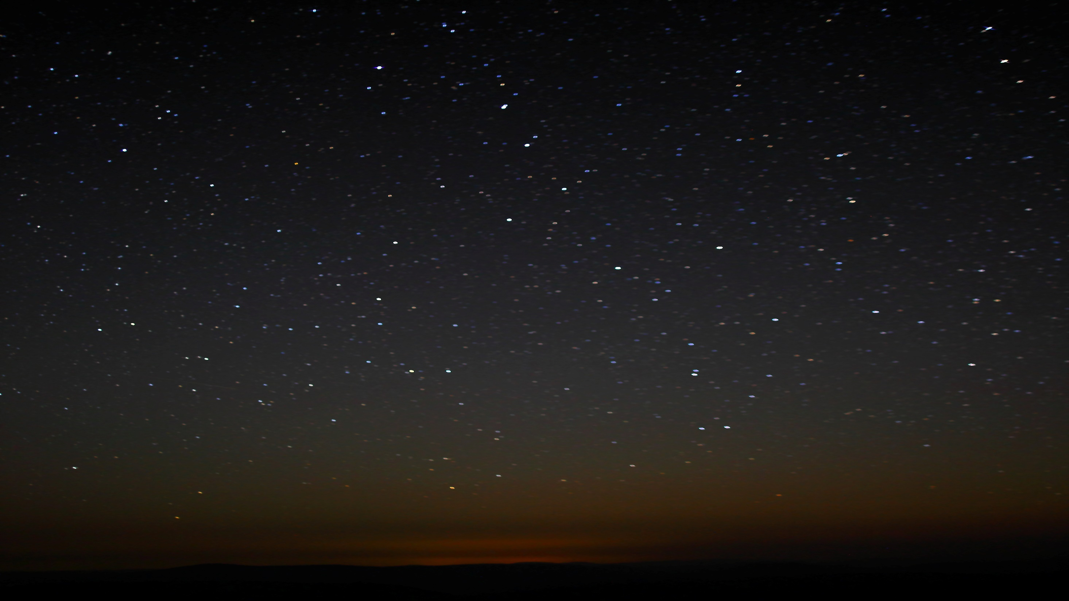
Lesson 2
The Plan of Salvation
“Life does not begin with birth, nor does it end with death.”
--Elder Russell M. Nelson
We lived as spirit children of our Father in Heaven before we were born on this earth.
Presentation by ©http://fashionsbylynda.com/blog/

Slide 2
Spirit Children
“We lived as spirit children of our Father in Heaven before we were born on this earth. We were not, however, like our Heavenly Father, nor could we ever become like Him and enjoy all the blessings that He enjoys without the experience of living in mortality with a physical body.
“God’s whole purpose—His work and His glory—is to enable each of us to enjoy all His blessings. He has provided a perfect plan to accomplish His purpose. We understood and accepted this plan before we came to the earth. …
“In order to progress and become like God, each of us had to obtain a body and be tested during a time of probation on the earth” (1)

Slide 3
In the “Real” Beginning
Where did we begin?
What were we?
What is intelligence made of?
How long did we exist as intelligences?
Then what happened?
We have always existed (D&C 93:33-35) (1)
Intelligences
We don’t really know—light and truth
There is no beginning (D&C 93:29)
We were born as spirit children
Man was also in the beginning with God. Intelligence, or the light of truth, was not created or made, neither indeed can be.
All truth is independent in that sphere in which God has placed it, to act for itself, as all intelligence also; otherwise there is no existence.
D&C 93:29-30

Slide 4
Pre-Existence
What is God like?
Does he have a body? What kind?
What institutes a spirit?
Is spirit made of actual matter?
Were we actually “born” to our Heavenly Parents?
Do all forms of life have spirits?
How long were we there?
Supreme and perfect in all ways… In the image of man
Body of flesh and bone filled with spirit
Intelligence and spirit body
All spirit is matter, but purer and finer (D&C 131:7-8)
Yes (Acts 17:28-29)
Yes (Moses 3:5,9)
Eons of time...we don’t know
For in him we live, and move, and have our being; as certain also of your own poets have said, For we are also his offspring.
Forasmuch then as we are the offspring of God, we ought not to think that the Godhead is like unto gold, or silver, or stone, graven by art and man’s device.
Acts 17:28-29
For thus saith the Lord that created the heavens; God himself that formed the earth and made it; he hath established it, he created it not in vain, he formed it to be inhabited: I am the Lord; and there is none else.
Isaiah 45:18
…there are many mysteries which are kept, that no one knoweth them save God himself… Alma 40:3

Slide 5
Man’s Pre-Existence
Did we know about the Plan of Salvation?
Whose plan was it?
What did we do there?
What did we look like?
Did we sin?
Did we repent?
Yes (Alma 13:3) (2)
Heavenly Father’s
Learned, associated one with another
Spiritual bodies look like physical bodies only finer (D&C 77:2)
Yes (Rev. 211-212 Institute Manual p. 336)
Yes…we were “born again” to mortality

Slide 6
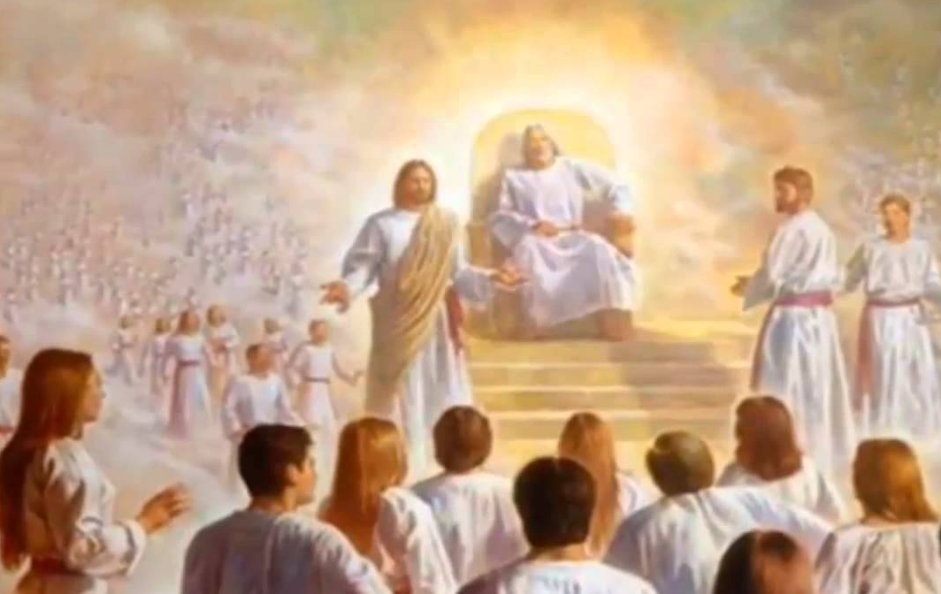
What Happened in the Pre-Existence?
What significant thing happened there?
What kind of a war was it?
Did anyone die?
What did we choose?
What was this time period called?
Where did we go?
Where did “they” go?
War in Heaven (3)
Words and ideology
Yes…spiritually (D&C 29:36)
Heavenly Father’s Plan
First estate
To earth in physical bodies
To earth as spirits (Rev. 12:4) (D&C 29:37-39) (4)
And there was war in heaven: Michael and his angels fought against the dragon; and the dragon fought and his angels.
Revelation 12:7

Slide 7
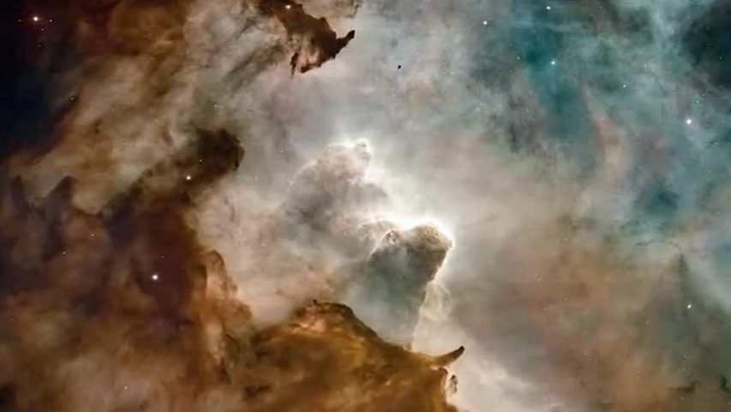
Heavenly Father’s Plan
Heavenly Father’s plan for our immortality and eternal life includes the Creation, the Fall, and the Atonement of Jesus Christ
Creation
Jesus Christ created the heavens and the earth under the direction of the Father. The earth was not created from nothing; it was organized from existing matter. Jesus Christ has created worlds without number.
The Creation of the earth was essential to God’s plan. It provided a place where we could gain a physical body, be tested and tried, and develop divine attributes.
We are to use the earth’s resources with wisdom, judgment, and thanksgiving
That by him, and through him, and of him, the worlds are and were created, and the inhabitants thereof are begotten sons and daughters unto God. D&C 76:24
And worlds without number have I created; and I also created them for mine own purpose; and by the Son I created them, which is mine Only Begotten.
Moses 1:33

Slide 8
Heavenly Father’s Plan
Heavenly Father’s plan for our immortality and eternal life includes the Creation, the Fall, and the Atonement of Jesus Christ
The Fall
In the Garden of Eden, God commanded Adam and Eve not to partake of the fruit of the tree of knowledge of good and evil; the consequence of doing so would be spiritual and physical death.
Spiritual death is separation from God.
Physical death is the separation of the spirit from the mortal body.
Because Adam and Eve transgressed God’s command, they were cast out from His presence and became mortal. Adam and Eve’s transgression and the resultant changes they experienced, including spiritual and physical death, are called the Fall.

Slide 9
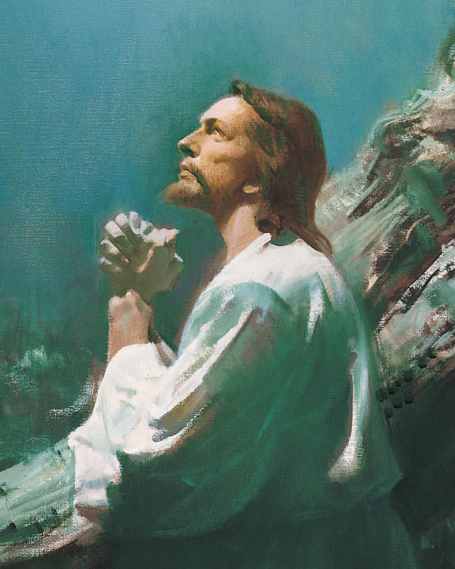
Heavenly Father’s Plan
Heavenly Father’s plan for our immortality and eternal life includes the Creation, the Fall, and the Atonement of Jesus Christ
The Atonement
His Atonement included His suffering for the sins of mankind in the Garden of Gethsemane, the shedding of His blood, His suffering and death on the cross, and His Resurrection from the tomb.
To atone is to suffer the penalty for sin, thereby removing the effects of sin from the repentant sinner and allowing him or her to be reconciled to God.
The Savior was able to carry out the Atonement because He kept Himself free from sin and had power over death. From His mortal mother, He inherited the ability to die. From His immortal Father, He inherited the power to take up His life again.
Jesus Christ was the only one capable of making a perfect atonement for all mankind.
See Luke 24:36–39; D&C 19:16–19; (21)

Slide 10
Adam and Eve and Birth
How did Adam and Eve get here?
Did they sin?
The Fall brought what?
How do we get to earth?
Did man/women evolve?
Brought here from another place
Transgression vs sin (2 Nephi 2:22-25) (5) (22)
Death (physical) and Hell (spiritual) (23)
We are born
No… Messages of First Presidency Vol. 4 pp. 205-206
I have said, Ye are gods; and all of you are children of the most High.
Psalms 82:6
Forasmuch then as we are the offspring of God, we ought not to think that the Godhead is like unto gold, or silver, or stone, graven by art and man’s device.
Acts 17:29

Slide 11
Mortality
What are our bodies comprised of?
Why did we need a body?
Why are we here?
Spirit and flesh and bone and blood
To be tested—cannot be of God without body
To work out our salvation (Abraham 3:25) (6)
Can we have our own Fall?
Can we be tempted beyond our ability to resist?
What is the most important thing we should be doing?
Yes…it brings spiritual death…Hell
No (1 Corinthians 10:13)
Repenting and changing
And the Lord God formed man of the dust of the ground, and breathed into his nostrils the breath of life; and man became a living soul.
Genesis 2:7

Slide 12
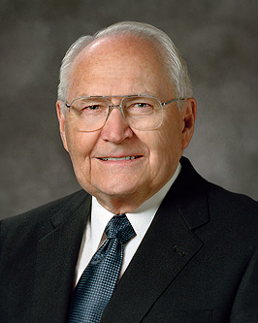
“We are now being tried and tested to see if we will do all the things the Lord has commanded us to do.
These commandments are the principles and ordinances of the gospel, and they constitute the gospel of Jesus Christ. Every principle and ordinance has a bearing upon the whole purpose of our testing, which is to prepare us to return to our Heavenly Father and become more like Him. …
“… Only through the gift of the Atonement and our obedience to the gospel can we return and live with God once again”
(2)

Slide 13
Earthly Life
What MUST we do while we’re here on earth to return home?
If we don’t do it here, can we do it later?
How?
Baptism, confirmation, priesthood, temple sealings
(D&C 49:15-17) (1 Corinthians 11:11) (7)
Yes
By proxy

Slide 14
Death
After we die where do our bodies go?
Where do our spirits go?
Will we see our bodies again?
When?
Into the dust (Genesis 3:19)
Spirit World
Yes
Before Judgment
Then shall the dust return to the earth as it was: and the spirit shall return unto God who gave it. Ecclesiastes 12:7

Slide 15
Spirit World
Do we return to the pre-existence again?
What do we call this new place?
Are we divided?
How?
How do we get into paradise?
What are the benefits of Paradise?
What does everyone do there?
Spirit World
No
Spirit World
Yes (D&C 88:20-32)
Prison, Paradise, or Hell
Baptism… living faithful to this covenant (D&C 138:30-35) (10)
Rest… no more tears
They learn, develop, preach the gospel, do God’s work and prepare for the Celestial World
The spirits of those who are righteous are received into a state of happiness, which is called paradise, a state of rest, a state of peace. Alma 40:11–12

Slide 16
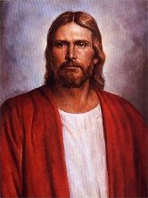
Spirit Prison
“…but God is faithful, who will not suffer you to be tempted above that ye are able; but will with the temptation also make a way to escape, that ye may be able to bear it. 1 Corinthians 10;13
Who goes to Spirit Prison?
Who goes to Hell?
Can we be tempted in the Spirit World?
Can we continue to be perfected after we die?
Those who need to hear the gospel (D&C 138:57)
Those who deny Christ ..they will suffer for their own sins. (D&C 19:16-19) (8)
No (1 Corinthians 10:13)
Yes… Not all problems are fixed in mortality—
Elder Oaks, Oct. 95 Gen. Conf. (9) (10)
But if they would not repent they must suffer even as I;
D&C 19:17

Slide 17
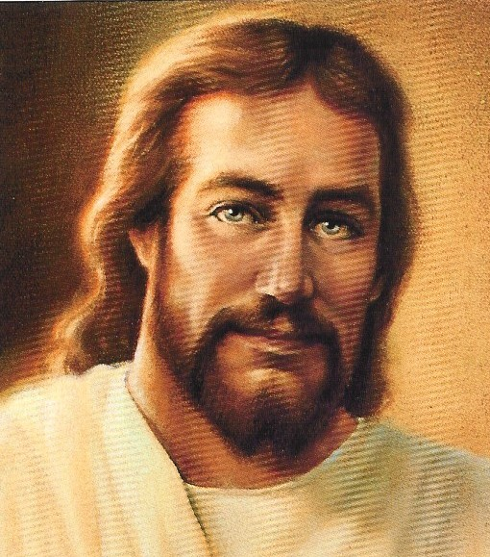
Resurrection and Judgment
What is the Resurrection?
Christ taught that there will be two resurrections, one for the just and one for the unjust. (12)
Resurrection
Final Judgment
Who is our judge?
Who is our attorney?
The Father has committed the keys of judgment to the Son.
(GDM) (13)
…and shall be brought and be arraigned before the bar of Christ the Son, and God the Father, and the Holy Spirit, which is one Eternal God, to be judged according to their works, whether they be good or whether they be evil. Alma 11:44
Jesus Christ
Everyone will appear before the Lord to be judged.
The spirit and the body shall be reunited again in its perfect form; both limb and joint shall be restored to its proper frame, even as we now are at this time; and we shall be brought to stand before God, knowing even as we know now, and have a bright recollection of all our guilt.
Alma 11:43

Slide 18
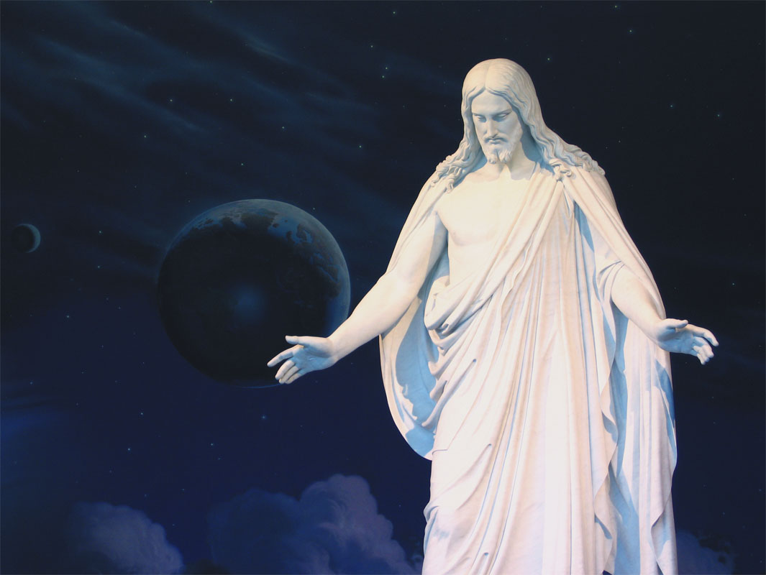
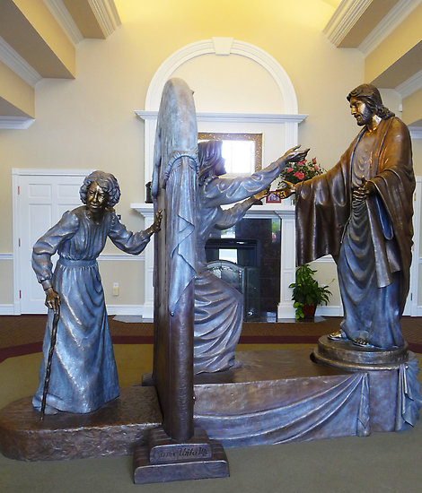
All Will Be Resurrected
Through grace, made available by the Savior’s atoning sacrifice, all people will be resurrected and receive immortality. The Atonement of Jesus Christ also makes it possible for us to receive eternal life.
And what is it that ye shall hope for? Behold I say unto you that ye shall have hope through the atonement of Christ and the power of his resurrection, to be raised unto life eternal, and this because of your faith in him according to the promise. Moroni 7:41
Jesus answered, Verily, verily, I say unto thee, Except a man be born of water and of the Spirit, he cannot enter into the kingdom of God. John 3:5
To receive this gift, we must live the gospel of Jesus Christ, which includes having faith in Him, repenting of our sins, being baptized, receiving the gift of the Holy Ghost, and enduring faithfully to the end

Slide 19
The Kingdoms
Celestial Kingdom
What are the kingdom’s names?
Celestial, Terrestrial, Telestial (outer darkness)
Who goes to the Celestial Kingdom?
Those who are baptized, faithful, clean (D&C 76:50-53) (13)
Who goes to the Terrestrial Kingdom?
Honorable, but did not receive the fullness of the gospel (D&C 76:71-89) (14)
Terrestrial Kingdom
Who goes to the Telestial Kingdom?
Liars, adulterers, murderers (D&C 76:103) (15)
Who goes to Outer darkness?
Those who deny the Holy Ghost
(D&C 76:31, 33, 35) (16)
Telestial Kingdom
How will the judgment be fair?
Outer Darkness
It will be the accumulation of all actions, thoughts, and the condition of our hearts

Slide 20
The Celestial, Terrestrial, and Telestial
How do we get in the Celestial Kingdom?
Celestial Kingdom
What happens in the highest degree of the Celestial Kingdom that doesn’t anywhere else?
What is the condition of the telestial and terrestrial Kingdoms?
Can a person progress from one kingdom to another?
Can they progress from low part of Celestial to upper part?
Those who die before 8 years of age, Those who are baptized, faithful, endowed, and sealed. Also those who have received their Calling and Election (17) (20)
Read: D&C 131—3 parts
Increase (have children) and creation of worlds
Those are separate and single forever (D&C 88:20-21) (18) (19)
Celestial Kingdom
Terrestrial Kingdom
No—D&C 29:29
No
Telestial Kingdom

Slide 21
Purpose For Life
“There are two purposes for life in mortality.
The first is that we might gain experiences that we could not obtain in any other way.
The second is to obtain tabernacles of flesh and bones.
Both of these purposes are vital to the existence of man.”
(2)
Having our spirits united with physical bodies allows us to grow and develop in ways that were not possible in the premortal life

Slide 22
Plan of Salvation
Pre-Existence
Celestial Kingdom
Resurrection
Final Judgment
Spirit World
Veil of Forgetfulness
Birth
Terrestrial Kingdom
Death
Earth
Life
Outer Darkness
Telestial Kingdom

Slide 23
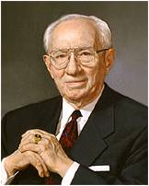
“[Jesus Christ’s] Atonement is the greatest event in human history.
There is nothing to compare with it. It is the most fundamental part of our Father’s plan for the happiness of His children.
Without it, mortal life would be a dead-end existence with neither hope nor future.”

Slide 24
Sources:
Suggested Hymn: #134 I Believe In Christ
Suggested Video: The Plan of Salvation (10:41) https://www.lds.org/media-library/video/2010-07-002-the-plan-of-salvation?lang=eng
Preach My Gospel: A Guide to Missionary Service [2004], 48, 49
2. Elder L. Tom Perry (“The Plan of Salvation,” Ensign or Liahona, Nov. 2006, 71).
3. President Gordon B. Hinckley (“Inspirational Thoughts,” Ensign ,Sept. 2007, 8
Question and answers (refer to slides 24-27 for sources
Elder Russell M. Nelson Doors of Death May 1992 Ensign
GDM—Gospel Doctrine Manual Chapter 32 The Resurrection and the Judgment
Doctrines of the Gospel Student Manual, (2000), 90–93 Chapter 33: Kingdoms of Glory and Perdition
Presentation by ©http://fashionsbylynda.com/blog/

Slide 25
1. The Lord Jesus Christ who created man and the earth has, from the creation, declared that we all originated in heaven. His teachings are that we were perfectly organized beings with spiritual bodies similar in form to our mortal bodies, but of finer material; that we were sons and daughters of God and came to the earth in these spirit bodies patterned after the spirit body of the Lord Jesus Christ…
The Origin of Man Elder George Q. Morris of the Council of the Twelve Apostles Conference Report October 1956, pp. 45-48
“The elements are eternal, and spirit and element inseparably connected receive a fullness of Joy.*** The elements are the tabernacle of god; yea, man is the tabernacle of God, even temples.” Teachings of the Prophet Joseph Smith, 352
5. Most Christian churches teach that the Fall was a tragedy, that if Adam and Eve had not partaken of the forbidden fruit, they and all their posterity could now be living in immortal bliss in the Garden of Eden. But truth revealed to latter-day prophets teaches that the Fall was not a tragedy—without it Adam and Eve would have had no posterity. Thus, the Fall was a necessary step in Heavenly Father’s plan to bring about the eternal happiness of His children.
After Adam and Eve partook of the fruit of the tree of knowledge of good and evil, their eyes were opened, and Eve expressed gladness at the opportunity their transgression made possible: “Were it not for our transgression we never should have had seed, and never should have known good and evil, and the joy of our redemption, and the eternal life which God giveth unto all the obedient” (Moses 5:11).
President Joseph Fielding Smith (1876–1972) said: “I never speak of the part Eve took in this fall as a sin, nor do I accuse Adam of a sin. … This was a transgression of the law, but not a sin … for it was something that Adam and Eve had to do!”
Even though Adam and Eve had not sinned, because of their transgression they had to face certain consequences, two of which were spiritual death and physical death. Physical death came to Adam and Eve at the end of their earthly lives, but spiritual death occurred as they were cast out of the Garden of Eden, being cut off from the presence of God.” Excerpts from The Fulness of the Gospel: The Fall of Adam and Eve June 2006 Ensign
2. “…that we were in reality the children of our Father and God; that we had a pre-existence in which we had learned many very important principles, connected with spiritual existence, before taking bodies of flesh and bones, which was also necessary to afford us a still greater experience. Now, in this plan that God has devised for the advancement of these intelligent beings—by passing them through various stages of existence, under different circumstances, and in different conditions…”
Journal of Discourse, Vol. 21, No. 23 (Pre-Existence, Etc., Orson Pratt, 1879-11-12)
6. A strong human spirit with control over appetites of the flesh is master over emotions and passions and not a slave to them. …Each day is a day of decision, and our decisions determine our destiny. One day each of us will stand before the Lord in judgment. We will each have a personal interview with Jesus Christ2 Nephi 9:41, 46 Mosiah 16:10 Elder Russell M. Nelson Decisions for Eternity October 2013 General Conf.
7. President Spencer W. Kimball explained, “Without proper and successful marriage, one will never be exalted” (Marriage and Divorce, Salt Lake City: Deseret Book Co., 1976, p. 24).
“No man who is marriageable is fully living his religion who remains unmarried” President Joseph F. Smith
(Gospel Doctrine, Salt Lake City: Deseret Book Co., 1939, p. 275).
3. “It is the old eternal battle that has been going on since the War in Heaven, spoken of in the book of Revelation. The forces of evil against the forces of good. We all exercise agency in the choices we make.” President Gordon B. Hinckley This Thing was Not Done in a Corner October 1996
8. An Unredeemed individual’s suffering for sin is known as hell, it means being subject to the devil and is described in scriptural metaphors as being in chins or a lake of fire and brimstone. 2 Nephi 2:27-29
4. The war rages today ever more fiercely. Satan is still the captain of the hosts of evil. He is still tempting us just as he did Moses, saying, “Son of man, worship me.” Moses 1;12 President James E. Faust The Enemy Within October 2000 Gen. Conf.
Although Satan and his followers have lost their opportunity to have a physical body, they are permitted to use their spirit powers to try to frustrate God’s plan. Elder Dallin H. Oaks 1993 October Gen. Conf.
9. Many of the most important deprivations of mortality will be set right in the Millennium, which is the time for fulfilling all that is incomplete in the great plan of happiness for all of our Father’s worthy children. We know that will be true of temple ordinances. I believe it will also be true of family relationships and experiences

Slide 26
10. Spiritual death is more likely when goals are unbalanced toward things physical. Paul explained this concept to the Romans: “If ye live after the flesh, ye shall die: but if ye through the Spirit do mortify the deeds of the body, ye shall live.” (Rom. 8:13.)
If physical death should strike before moral wrongs have been made right, opportunity for repentance will have been forfeited. Thus, “the [real] sting of death is sin.”
(1 Cor. 15:56.)
Even the Savior cannot save us in our sins. He will redeem us from our sins, but only upon condition of our repentance. We are responsible for our own spiritual survival or death. (See Rom. 8:13–14; Hel. 14:18; D&C 29:41–45.)Elder Russell M. Nelson Doors of Death May 1992 Ensign
13 (GDM). Rather than being a time of terror, the Judgment will be one of the greatest events in all of our existence if we pay the price of proper preparation and repentance.
O ye fair ones, how could ye have departed from the ways of the Lord! O ye fair ones, how could ye have rejected that Jesus, who stood with open arms to receive you! Moroni 6:17
Gospel Doctrine Manual
13. The Celestial Kingdom is the highest of the three kingdoms of glory. Those in this kingdom will dwell forever in the presence of God the Father and His Son Jesus Christ. This should be your goal: to inherit celestial glory and to help others receive that great blessing as well. Such a goal is not achieved in one attempt; it is the result of a lifetime of righteousness and constancy of purpose.
The celestial kingdom is the place prepared for those who have “received the testimony of Jesus” and been “made perfect through Jesus the mediator of the new covenant, who wrought out this perfect atonement through the shedding of his own blood” (D&C 76:51, 69). To inherit this gift, we must receive the ordinances of salvation, keep the commandments, and repent of our sins. For a detailed explanation of those who will inherit celestial glory, see Doctrine and Covenants 76:50-70; 76:92-96. LDS.org
11. Paradise is that part of the spirit world in which the righteous spirits who have departed from this life await the resurrection of the body. It is a condition of happiness and peace.
Those in spirit prison have the opportunity to learn the gospel of Jesus Christ, repent of their sins, and receive the ordinances of baptism and confirmation through the work we do in temples (see D&C 138:30-35). If they accept the gospel and their temple work has been done, they may enter paradise.
Paradise lds.org
“paradise of God must deliver up the spirits of the righteous, and the grave deliver up the body of the righteous; and the spirit and the body is restored to itself again, and all men become incorruptible, and immortal, and they are living souls.” (2 Ne. 9:13.) Elder Russell M. Nelson Doors of Death May 1992 Ensign
14. Terrestrial Kingdom
Those who inherit terrestrial glory will “receive of the presence of the Son, but not of the fulness of the Father. Wherefore, they are bodies terrestrial, and not bodies celestial, and differ in glory as the moon differs from the sun” (D&C 76:77-78). Generally speaking, individuals in the terrestrial kingdom will be honorable people “who were blinded by the craftiness of men” (D&C 76:75). This group will include members of the Church who were “not valiant in the testimony of Jesus” (D&C 76:79). It will also include those who rejected the opportunity to receive the gospel in mortality but who later received it in the postmortal spirit world (see Among those who inherit the terrestrial kingdom will be people who died without the law, spirits kept in prison. And those who reject the prophets in this life and then accept the gospel in the spirit world will inherit the terrestrial kingdom.
D&C 76:73–74; 138:32 and Doctrine and Covenants 76:71-80, 91, 97. Doctrines of the Gospel Student Manual, (2000), 90–93 chapter 33
12. Those being resurrected with celestial bodies, whose destiny is to inherit a celestial kingdom, will come forth in the morning of the first resurrection. Their graves shall be opened and they shall be caught up to meet the Lord at his Second Coming. They are Christ’s, the firstfruits, and they shall descend with him to reign as kings and priests during the millennial era.”
“… the afternoon of the first resurrection; it takes place after our Lord has ushered in the millennium. Those coming forth at that time do so with terrestrial bodies and are thus destined to inherit a terrestrial glory in eternity.” (McConkie, Mormon Doctrine, p. 640.)(Mormon Doctrine, p. 640.) Elder Bruce R. McConkie…Gospel Doctrine Manual Chapter 32
15. Telestial Kingdom
Those who profess to follow Christ or the prophets but willfully reject the gospel, the testimony of Jesus, the prophets, and the everlasting covenant will inherit the telestial kingdom (D&C 76:99–101).
The inhabitants of the telestial kingdom will include those who were murderers, liars, sorcerers, adulterers, and whoremongers—in general, the wicked people of the earth D&C 76:103;Revelation 22:15). These inhabitants of the telestial kingdom will have become clean through their suffering so that they can abide telestial glory.
The inhabitants of the telestial kingdom will be as innumerable as the stars (Doctrines of the Gospel Student Manual, (2000), 90–93 chapter 33

Slide 27
16. Perdition
Some people will not be worthy to dwell in any kingdom of glory. They will be called “the sons of perdition” and will have to “abide a kingdom which is not a kingdom of glory” (D&C 76:32; 88:24). This will be the state of “those who know [God's] power, and have been made partakers thereof, and suffered themselves through the power of the devil to be overcome, and to deny the truth and defy [God's] power” (D&C 76:31; see also D&C 76:30, 32-49).
20. “To be valiant in the testimony of Jesus is to bridle our passions, control our appetites, and rise above carnal and evil things. It is to overcome the world as did he who is our prototype and who himself was the most valiant of all our Father’s children. It is to be morally clean, to pay our tithes and offerings, to honor the Sabbath day, to pray with full purpose of heart, to lay our all upon the altar if called upon to do so.
“To be valiant in the testimony of Jesus is to take the Lord’s side on every issue. It is to vote as he would vote. It is to think what he thinks, to believe what he believes, to say what he would say and do what he would do in the same situation. It is to have the mind of Christ and be one with him as he is one with his Father” (Bruce R. McConkie, in Conference Report, Oct. 1974, 46; or Ensign, Nov. 1974, 35).
17. Persons who have lived good lives and received most of the ordinances of salvation but have failed to qualify for exaltation through eternal marriage will be saved in a lesser place in the celestial kingdom where there is no eternal increase (see D&C 131:1–4). Elder Dallin H. Oaks Oct. 1995 Gen. Conf.
18. “…we are our own judges of the place we shall have in the eternal world. Here and now in mortality, each one of us is having the opportunity of choosing the kind of laws we elect to obey. We are now living and obeying celestial laws that will make us candidates for celestial glory, or we are living terrestrial laws that will make us candidates for either terrestrial glory, or telestial law. The place we shall occupy in the eternal worlds will be determined by the obedience we yield to the laws of these various kingdoms during the time we have here in mortality upon the earth.”
21. Atonement of Christ:
“If there had been no atonement of Christ, there would be no resurrection, no breaking of the bands of death, no coming forth from the grave.
“If there had been no atonement, there would be no remission of sins; no return to the presence of God; no salvation of any sort, kind, or nature; no eternal life; no exaltation; no continuation of the family unit in eternity. …
“All things center in, revolve around, are anchored to, and are built upon the atoning sacrifice of the Lord Jesus Christ” Elder Bruce R. McConkie (“The Three Pillars of Eternity” [Brigham Young University devotional, Feb. 17, 1981], 2, 3; speeches.byu.edu).
19. The inhabitants of the telestial kingdom will suffer the wrath of God and be cast into hell until the end of the Millennium. Those in the telestial kingdom will receive the Holy Ghost through the ministration of those in the terrestrial kingdom.
Telestial glory surpasses all human understanding.
Those obedient to telestial laws will be resurrected with telestial bodies in the Second, or Last, Resurrection.
Those in the telestial kingdom will be servants of God, “but where God and Christ dwell they cannot come, worlds without end”
D&C 76---Mosiah 15:26; 2 Nephi 28:15 Doctrines of the Gospel Student Manual, (2000), 90–93

Slide 28
(22) The Fall of Adam:
“Just as a man does not really desire food until he is hungry, so he does not desire the salvation of Christ until he knows why he needs Christ.
“No one adequately and properly knows why he needs Christ until he understands and accepts the doctrine of the Fall and its effect upon all mankind” President Ezra Taft Benson (“The Book of Mormon and the Doctrine and Covenants,” Ensign, May 1987, 85).
(23) Consequences of the Fall:
“The fall of Adam brought temporal and spiritual death into the world, and the atonement of Christ ransomed men from these two deaths by bringing to pass the immortality and eternal life of man. This makes the fall as essential a part of the plan of salvation as the very atonement itself.
“There are, in fact, five things that came into being and continue to exist because of the fall. None of these things would have existed if there had been no fall, and all of them are essential parts of the divine plan of salvation. They are:
“1. Temporal death. This is the natural death; it occurs when body and spirit separate; it results in corruption and decay. Because of the atonement of Christ all men will be raised from corruption to incorruption, from mortality to immortality, thence to live everlastingly in a resurrected state.
“2. Spiritual death. This is death as pertaining to the things of the Spirit. It is death as pertaining to things of righteousness. It is to be cast out of the presence of the Lord. It is a way of life which is in opposition to that of the Father of us all. Because of the atonement, because the Lord Jesus bore our sins on conditions of repentance, we have power to gain eternal life, which is spiritual life, which is a life of righteousness, which is life in the presence of our God.
“3. Mortality. Mortal life comes because of the fall. If there had been no fall, there would be no mortal life of any sort on earth. Mortal life is life where there is death. Death must enter the world to bring mortality into being.
“4. Procreation. Before the fall there was no procreation. … Adam and Eve, in their Edenic state, could not have children, nor, as we shall see, could any form of life when first placed on the newly created paradisiacal earth.
“5. A probationary estate. We are here to be tried and tested, to see if we will believe the truths of salvation and keep the commandments while we walk by faith. After the fall men became carnal, sensual, and devilish by nature, and the plan of salvation calls upon them to put off these worldly snares and to put on Christ” Elder Bruce R. McConkie(“The Three Pillars of Eternity,” [Brigham Young University devotional, Feb. 17, 1981], 3–4; speeches.byu.edu).
Plan of Salvation Handout on the next page. Blank. Have students fill in the circles with pencil before lesson…see how well they know it. This is a very basic graph.

Slide 29
Plan of Salvation

Slide 30
The Resurrection
Doctrine and Covenants 88:86-102
Resurrection concludes and earth’s temporal existence ends
The morning of the first resurrection began with the resurrection of Christ and his righteous Saints
Second Coming
Millennium
Morning of the first resurrection continues
Afternoon of the first resurrection begins
Millennium concludes
First Resurrection (the just)
Second Resurrection (the unjust)
Members of the church of Jesus Christ who keep the commandments
Some who lived after Christ were resurrected
First Trump
Celestial Beings resurrected
Good people who do not obey the full law of Christ
Second Trump
Terrestrial Beings
All Mankind
Third Trump
Telestial Beings
Those who in mortality were evil and led lives of wickedness
Those who deny Christ and put him to open shame after having received his witness
Fourth Trump
Sons of Perdition
Doctrines of the Gospel Teacher Manual, (2011), 115–17 Chapter 32

