Slide 1
Lesson 20
Transfiguration
Matthew 17
As the dew of Hermon, and as the dew that descended upon the mountains of Zion: for there the Lord commanded the blessing, even life for evermore. Psalms 133:3

Slide 2
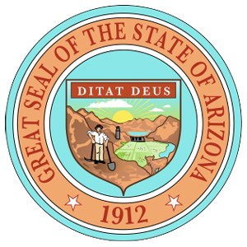
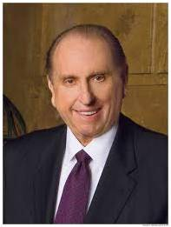
License To Drive
Arizona State
What does possessing a driver’s license authorize a person to do?
DRIVER LICENSE
ID: 061 225 456B
Yolonda Green
555 West 1st St
Sierra Vista, AZ 85650
DOB: 23-09-55
SEX: F EYES: BR HT:5.09
ISSUED: 06-10-2011 EXPIRES: 06-10-2031
CLASS C
Why is it important to have access to car keys in addition to having a driver’s license?
License To Preside
Just as those who hold driver’s licenses are authorized to drive, many men hold the authority of the priesthood.
But just as car keys enable a driver to operate only a particular vehicle, priesthood keys authorize an individual to operate or direct the work of God within a particular sphere.
The President of the Church holds and uses priesthood keys to preside over and direct all of the Lord’s work upon the earth.

Slide 3
Preparation
Matthew 16:19
The Lord promised to give Peter the keys of the kingdom, or the authority to direct God’s work on the earth.
At that time, Peter and each of the other Apostles had already been given priesthood authority, but they had not yet been given the keys of the kingdom.
Matthew 17:1-2

Slide 4
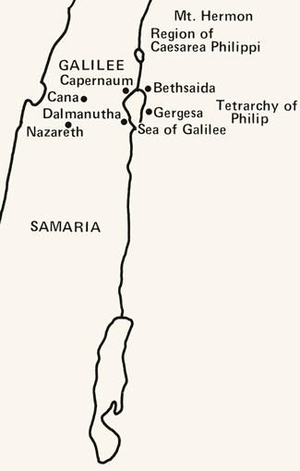
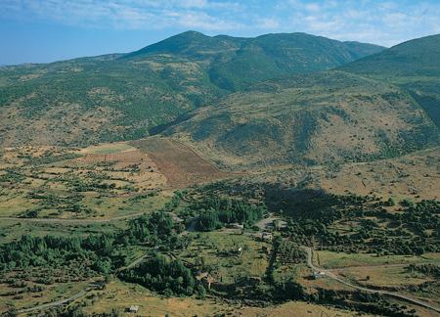
To A High Mountain
It is the highest point in Syria at 7,336 ft and the highest elevation in the Israeli-controlled territory.
Mount Hermon has seasonal winter and spring snow falls, which cover all three of its peaks for most of the year
Mount Hermon is also called the "snowy mountain," the "gray-haired mountain"
It is the highest permanently manned UN position in the world, known as "Hermon Hotel". (3)
Caesarea Philippi with Mount Hermon in the background. Mount Hermon is one of the plausible locations of the Transfiguration.

Slide 5
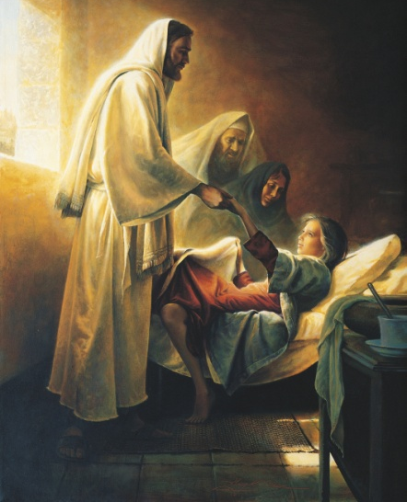
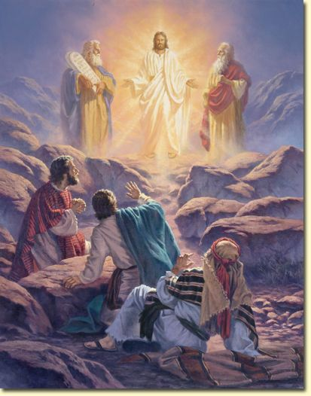
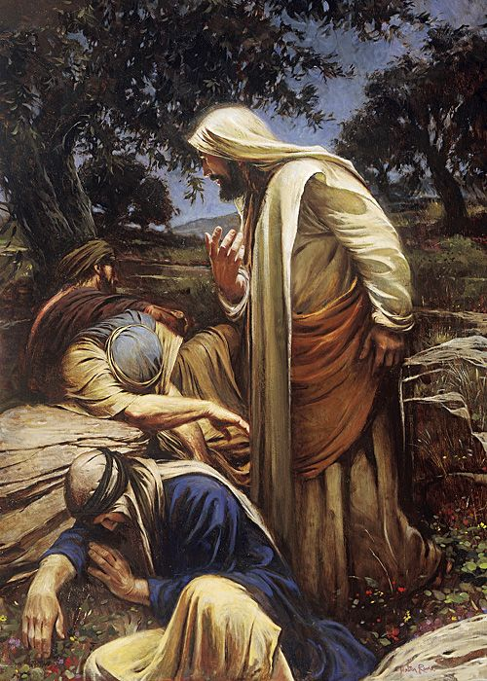
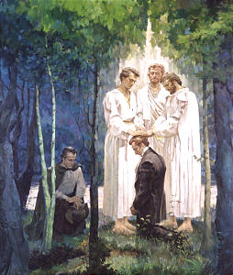
Peter, James, and John
They Alone
1. Were at the raising of Jairus’ daughter from the dead.
2. Beheld the glory and majesty of the transfigured Jesus.
3. Received from Him, and from Moses and Elijah the keys of the kingdom, being prohibited from so much as telling the others of the Twelve of these transcendent events until after our Lord’s resurrection.
4. Were taken to a spot in Gethsemane where they could behold his agony as he took upon himself the sins of the world.
5. The ones who came to Joseph Smith and Oliver Cowdery in this dispensation to confer priesthood and keys. (1)
Mark 5:22-24, 35-43; Mark 14:32-42; D&C 27:12-13; 128:20

Slide 6
Transfiguration
This occurred about a week after the promise made to Peter that he would receive the keys of the kingdom of heaven.
The Transfiguration occurred in about October, some six months before the death of Jesus.
The Savior, Moses, and Elias (Elijah) gave the promised keys of the priesthood to Peter, James, and John, which enabled these brethren to carry forth the work of the kingdom on the earth after the departure of Jesus. These keys were later given to all of the Twelve. (2)
“the condition of persons who are temporarily changed in appearance and nature—that is, lifted to a higher spiritual level—so that they can endure the presence and glory of heavenly beings” (4)
Matthew 17:1-9

Slide 7
Moses and Elias
“The Savior, Moses, and Elias [Elijah], gave the keys [of the priesthood] to Peter, James, and John, on the mount, when they were transfigured before him” (5)
Moses and Elijah appeared in the Kirtland Temple on April 3, 1836, to restore priesthood keys: Moses restored the keys of the gathering of Israel, and Elijah restored the keys associated with the sealing power.
These appearances in Kirtland provide a pattern for understanding what took place on the Mount of Transfiguration.
Matthew 17:3; D&C 110:11; D&C 110:13-16

Slide 8
Who Was Involved?
Matthew 17:5
Was transfigured on the mount
Appeared as a translated being on the mount and conferred the keys of the gathering of Israel on Peter, James, and John
God the Father
Spoke from the cloud, saying, “This is my beloved Son … ; hear ye him”
Appeared with God the Father in the Sacred Grove and in the Kirtland Temple
(JSH 1:17; D&C 110)
Matthew 17:2-8
keys of the sealing power
D&C 110:13-16
keys of the gathering of Israel
D&C 110:11
JSH 1:17
Spoke in the Sacred Grove, saying, “This is My Beloved Son. Hear Him!”
Were transfigured and received priesthood keys from angelic ministers
Matthew 17:1; 3-8
As angelic ministers, conferred the Melchizedek Priesthood and all its keys on Joseph Smith and Oliver Cowdery (JSH 1:72; D&C 27:12-13)
Appeared as a spirit on the mount (JST Mark 9:4)
(6)

Slide 9
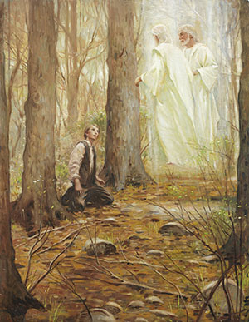
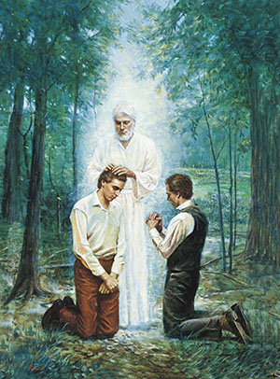
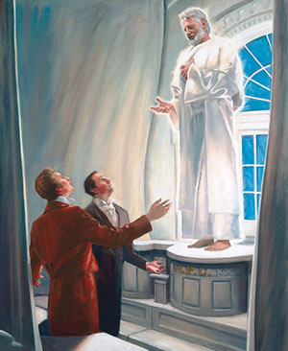
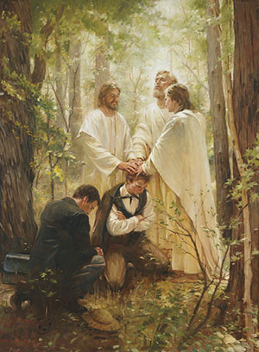
Priesthood is Restored in This Dispensation
A gospel dispensation is a period of time in which Heavenly Father dispenses priesthood authority, ordinances, and knowledge of His plan of salvation to people on the earth through His authorized servants.
John the Baptist restored the Aaronic Priesthood
In each dispensation, God confers priesthood keys upon His chosen servants so they can direct His work upon the earth
Peter, James, and John restore the Melchizedek Priesthood
Elijah restores sealing keys in the Kirtland Temple

Slide 10
Characteristics of Translated Beings
3 Nephi 28:7
3 Nephi 28:8, 39-40
3 Nephi 28:30
3 Nephi 28: 38
3 Nephi 28: 39
Translated beings “Never taste of death.”
At the Second Coming translated beings will be immediately changed to a resurrected condition.
They can appear and disappear like angels.
They suffer neither “pain nor sorrow’ except for the sins of the world.
Satan cannot tempt them.

Slide 11
Jesus
Melchizedek
Peter
James
John the Baptist
John
Aaronic
Peter, James, and John are ordained by the Savior
Mark 3:14
Matthew 16:19
Joseph Smith

Slide 12
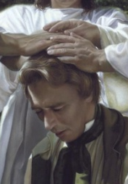
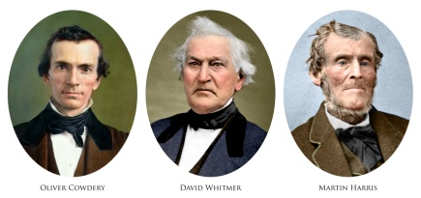
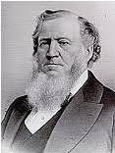
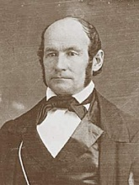
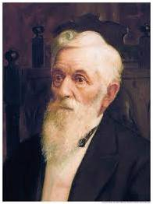
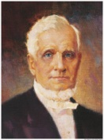
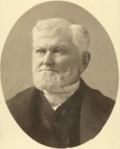
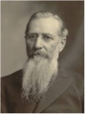
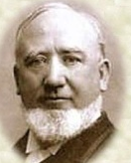
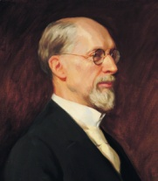
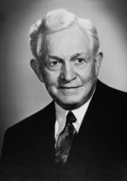
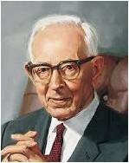
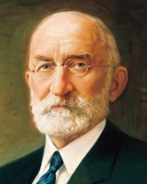
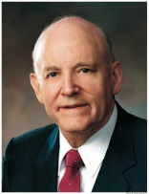
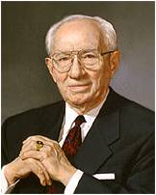
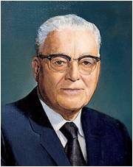
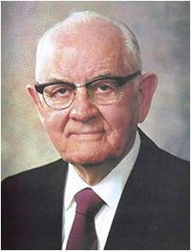
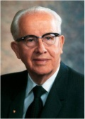
Joseph Smith
May 1829
The Three Witnesses
14 Feb 1835
Heber C. Kimball
14 Feb 1835
Brigham Young
14 Feb 1835
Lorenzo Snow
12 Feb 1849
John Taylor
19 Dec 1838
Wilford Woodruff
26 Apr 1839
Joseph F. Smith
01 Jul 1866
George Q. Cannon
26 Aug 1860
An Apostolic Authority Diagram
George Albert Smith
08 Oct 1903
David O. McKay
09 Apr 1906
Joseph Fielding Smith
07 Apr 1910
Heber J. Grant
16 Oct 1882
Howard W. Hunter
15 Oct 1959
Gordon B. Hinckley
05 Oct 1961
Thomas S. Monson
10 Oct 1963
Heber C. Kimball and George Q. Cannon were not Presidents of the Church but the line of authority went through them
Harold B. Lee
10 Apr 1941
Spencer W. Kimball
07 Oct 1943
Ezra Taft Benson
07 Oct 1943

Slide 13
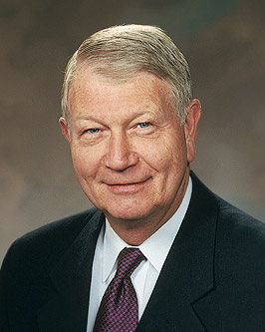
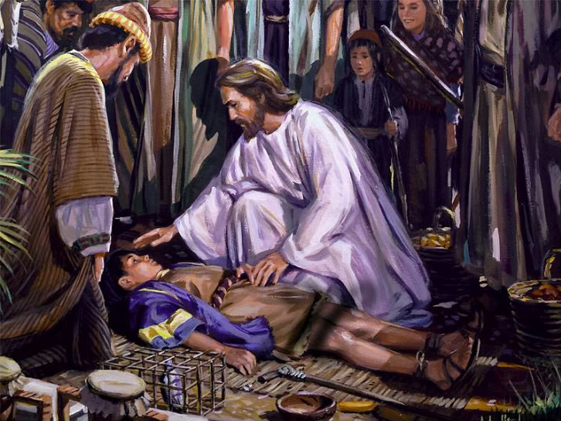
Faith as a Grain of Mustard Seed
A father brought his son to the Savior to be healed. After Jesus healed the child, He taught His disciples that some blessings can be obtained only by prayer and fasting. He also prophesied of His death and Resurrection.
Is it possible to move mountains?
“I have never witnessed the
removal of an actual mountain.
But because of faith, I have seen a mountain of doubt and despair removed and replaced with hope and optimism. Because of faith, I have personally witnessed a mountain of sin replaced with repentance and forgiveness. And because of faith, I have personally witnessed a mountain of pain replaced with peace, hope, and gratitude.” (7)
For the brother of Jared said unto the mountain Zerin, Remove—and it was removed. And if he had not had faith it would not have moved; wherefore thou workest after men have faith. Ether 12:30
Matthew 17:14-23

Slide 14
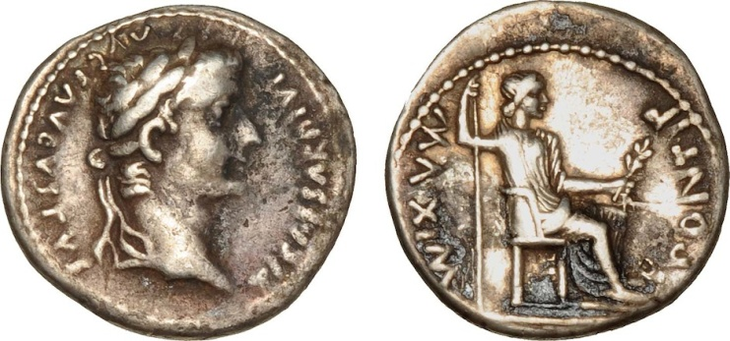
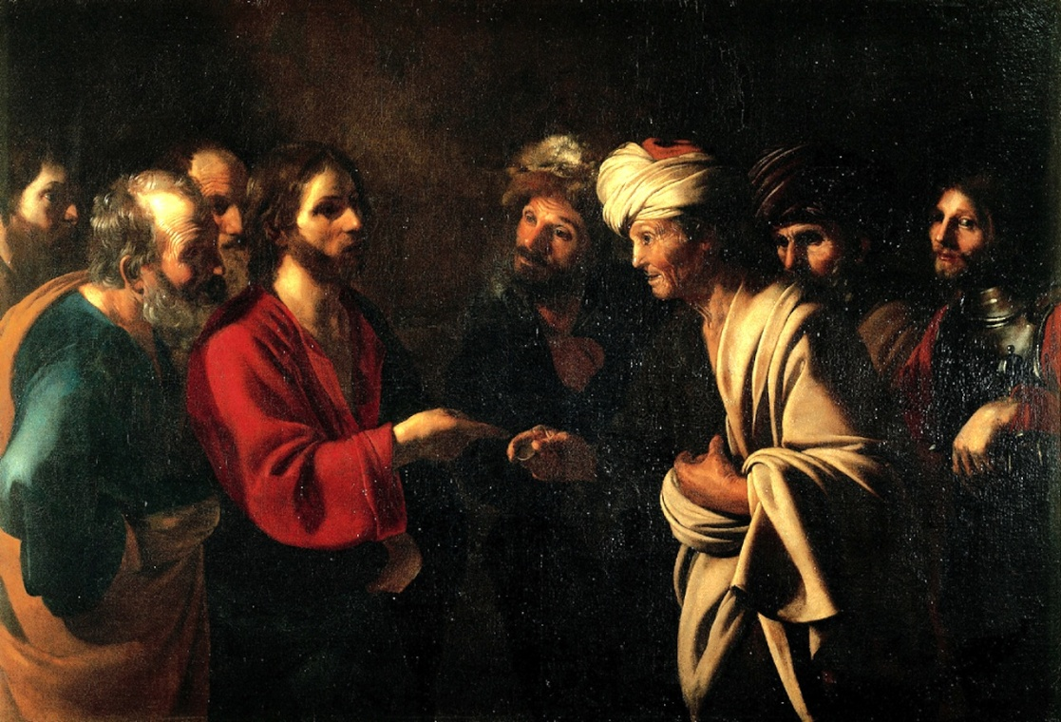
Tribute Money
Strangers = everyone in a kingdom who is not one of the king’s children.
The “strangers” must pay taxes, while the king’s children are exempt.
A Denarius from around the time of Jesus inscribed with the face of Caesar Tiberius.
The temple tax required of all Israelite males over the age of 20
This money was used to support the daily costs associated with the temple, such as the cost of incense, robes worn by the priests, and oil for the lamps. Jesus taught Peter that since the temple was His Father’s house .
Bartolomeo Manfredi, The Tribute Money, c. 1610-22
Jesus was exempt from the payment of this tax. However, aware that others would follow His example and not wanting to give any cause for offense, Jesus, with His divine foreknowledge, instructed Peter how to make provision for payment.
Matthew 17:24-26
(8)

Slide 15
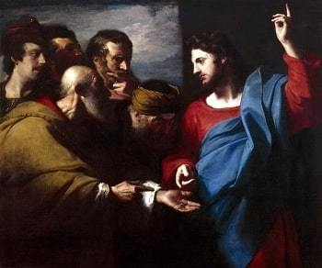
Lest We Offend
If He had not paid the tax, some Jews might have looked unfavorably upon Him and His followers and become less receptive toward the gospel message
We can follow the Savior’s example by avoiding actions that may cause others to stumble spiritually
Matthew 17:27
(8)

Slide 16
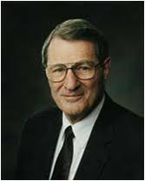
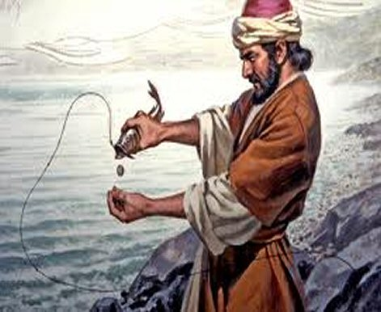
Money From a Fish
“[The Savior] told His disciples to go and catch a fish and they would find the requisite coin in there. …
A Denarius from around the time of Jesus inscribed with the face of Caesar Tiberius.
They did and the coin was just the right denomination to pay the tribute. We can’t comprehend the staggering omniscience, but it is there and it operates to bless each of our lives.”
Matthew 17:27
(9)

Slide 17
Sources:
Suggested Hymn: #4 Truth Eternal (Verse 2)
Video:
Where Are the Keys and Authority of the Priesthood?
Elder Bruce R. McConkie Doctrine of the New Testament Commentary 1:401:2
History of the Church 3:387
Wikipedia
Guide to Scriptures
Teachings of Presidents of the Church: Joseph Smith [2007], 105).
Chart adapted from D. Kelly Ogden and Andrew C. Skinner, Verse by Verse: The Four Gospels (2006), 343.
Elder Richard C. Edgley (“Faith—the Choice Is Yours,” Ensign or Liahona, Nov. 2010, 33).
New Testament Institute Student Manual Chapter 6
Elder Neal A. Maxwell (“We Can’t Comprehend the Capacity of God,” Church News, Feb. 22, 2003, 3).
Presentation by ©http://fashionsbylynda.com/blog/

Slide 18
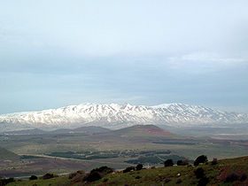
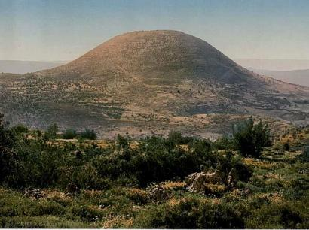
Peter, James, and John
“Why always these three and not various ones or even all of the Twelve. The plain fact is that Peter, James, and John were the First Presidency of the Church in their day. … by latter-day revelation we know that they held and restored ‘the keys of the kingdom, which belong always unto the Presidency of the High Priesthood’ (D&C 81:2), or in other words, they were the First Presidency in their day. (McConkie, DNTC, 1:401–2.)
James E. Talmage Jesus the Christ on the place of Transfiguration p. 376
“The mountain on which the Transfiguration occurred is neither named nor otherwise indicated by the Gospel-writers in such a way as to admit of its positive identification. Mount Tabor, in Galilee, has long been held by tradition as the site, and in the sixth century three churches were erected on its plateau-like summit, possibly in commemoration of Peter’s desire to make three tabernacles or booths, one each for Jesus, Moses, and Elijah. Later a monastery was built there. Nevertheless, Mt. Tabor is now rejected by investigators, and Mt. Hermon is generally regarded as the place. Hermon stands near the northerly limits of Palestine, just beyond Cæsarea Philippi, where Jesus is known to have been a week before the Transfiguration. Mark (9:30) distinctly tells us that after His descent from the mount, Jesus and the apostles departed and went through Galilee. Weight of evidence is in favor of Hermon as the Mount of Transfiguration, though nothing that may be called decisive is known in the matter.”
Possible Places of Transfiguration: Mount Hermon: Traditional
Hebrew: Har Hermon
In the Book of Enoch, Mount Hermon is the place where the Watcher class of fallen angels descended to Earth.
The Book of Chronicles also mentions Mount Hermon as a place where Epher, Ishi, Eliel, Azriel, Jeremiah, Hodaviah and Jahdiel were the heads of their families.
Hermon was said to have become known as "the mountain of oath" by Charles Simon Clermont-Ganneau *New Testament Instituted Student Manual suggests this is a possible place of the transfiguration.
Or Mount Tabor: (575 metres or 1,886 feet high) is the traditional location. The earliest identification of the Mount of Transfiguration as Tabor is by Origen in the 3rd century. It is also mentioned by St. Cyril of Jerusalem and St. Jerome in the 4th century.The Church of the Transfiguration is located atop Mount Tabor. It is later mentioned in the 5th century Transitus Beatae Mariae Virginis.
Mount Tabor battle between Barak under the leadership of the Israelite judge Deborah, and the army of Jabin commanded by Sisera Wikipedia
On the Mount of Transfiguration:
Joseph Smith taught that on the mount of transfiguration, Peter, James, and John were also transfigured. They saw a vision of the earth as it will appear in its future glorified condition (D&C 63:20–21). They saw Moses and Elijah, two translated beings, and heard the voice of the Father. The Father said, “This is my beloved Son, in whom I am well pleased; hear ye him” (Matt. 17:5).
An Elias: Matthew 17:3 (Elijah, forerunner, Restorer, A man in Abraham’s dispensation, or Jesus Chirst Himself
In Matthew’s account of the Savior’s transfiguration, the name Elias is used to mean the prophet Elijah. The Guide to the Scriptures explains that the name or title Elias has several different meanings in the scriptures:
“Elijah: Elias is the New Testament (Greek) form of Elijah (Hebrew), as in Matt. 17:3–4, Luke 4:25–26, and James 5:17. In these instances, Elias was the ancient prophet Elijah whose ministry is recorded in 1 and 2 Kings.
“Forerunner: Elias is also a title for one who is a forerunner. For example, John the Baptist was an Elias because he was sent to prepare the way for Jesus (Matt. 17:12–13).
“Restorer: The title Elias has also been applied to others who had specific missions to fulfill, such as John the Revelator (D&C 77:14) and Gabriel (Luke 1:11–20; D&C 27:6–7; 110:12).
“A man in Abraham’s dispensation: A prophet called Esaias or Elias who apparently lived in the days of Abraham (D&C 84:11–13; 110:12)” (Guide to the Scriptures, “Elias”; scriptures.lds.org).
The title Elias can also be applied to Jesus Christ Himself (see Joseph Smith Translation, John 1:28 [in the Bible appendix]). New Testament Institute Student Manual
Mount Hermon
Mount Tabor

Slide 19
Event | Matthew | Mark | Luke | John
The Transfiguration | 17:1-13 | 9:2-13 | 9:28-36
Demonic Boy Healed | 17:14-21 | 9:14-29 | 9:37-43
Jesus Again Foretells His Death and Resurrection | 17:22, 23 | 9:30-32 | 9:43-45
Tribute Money | 17:24-27 | 9:33
Transfigured Beings in the Scripture—The Guide to the Scriptures
Event | Scripture
They saw the god of Israel | Exodus 24:9-11
The skin of his face shone while he talked with god | Exodus 34:29 Mark 9:2-3
Jesus’ face did shine | Matthew 17:2 Mark 9:2-3
Israel could not stedfastly behold the face of Moses for the glory | 2 Corinthians 3:7
Abinadi’s face shown with exceeding luster | Mosiah 13:5-9
They were encircled about as if by fire | Helaman 5:23, 36, 43-45 3 Nephi 17:24 3 Nephi 19:14
They were as white as the countenance of Jesus | 3 Nephi 19:25
It did seem unto them like a transfiguration | 3 Nephi 28:15
No man has seen God in the flesh, except quickened by the Spirit | D&C 67:10-12
By the power of the Spirit our eyes were opened | D&C 76:12
The glory of God was upon Moses | Moses 1:2
I beheld the heavens open, and I was clothed upon with glory | Moses 7:3-4
Source: Horizontal Harmony of the Four Gospels by Thomas M. Mumford
Working By Faith Matthew 17:20
"We ask, then, what are we to understand by a man's working by faith? We answer-we understand that when a man works by faith he works by mental exertion instead of physical force. It is by words, instead of exerting his physical powers, with which every being works when he works by faith." Joseph Smith Lectures on Faith 7:3

Slide 20
D&C 27:12
Jesus Christ
Peter, James, and John
|
|
Joseph Smith
(May 1829)
|
|
The Three Witnesses
(14 Feb 1835)
|
_____________________|______________________
| |
Heber C Kimball Brigham Young
(14 Feb 1835) (14 Feb 1835)
| |
______|______ _________________________________|________________
| | | | | |
Lorenzo Snow John Taylor Wilford Woodruff Joseph F Smith George Q Cannon
(12 Feb 1849) (19 Dec 1838) (26 Apr 1839) (01 Jul 1866) (26 Aug 1860)
| |
_________________________________________| |
| | | |
George Albert Smith David O McKay Joseph Fielding Smith Heber J Grant
(08 Oct 1903) (09 Apr 1906) (07 Apr 1910) (16 Oct 1882)
| | |
| Thomas S Monson |
| (10 Oct 1963) |
________________________________| ______________________________|____
| | | | |
Howard W Hunter Gordon B Hinckley Harold B Lee Spencer W Kimball Ezra Taft Benson
(15 Oct 1959) (05 Oct 1961) (10 Apr 1941) (07 Oct 1943) (07 Oct 1943)
http://www.ldsfacts.net/propht12.htm

Slide 21
Mount of Transfiguration Summary: Matthew 17:
“(1) Jesus singled out Peter, James, and John from the rest of the Twelve; took them upon an unnamed mountain; there he was transfigured before them, and they beheld his glory. … [Peter] said they ‘were eyewitnesses of his majesty.’ (2 Pet. 1:16.)
“(2) Peter, James, and John, were themselves ‘transfigured before him’ [Teachings of Presidents of the Church: Joseph Smith(2007), 105], … thus enabling them to entertain angels, see visions and comprehend the things of God. …
“(3) Moses and Elijah—two ancient prophets who were translated and taken to heaven without tasting death, so they could return with tangible bodies on this very occasion, an occasion preceding the day of resurrection—appeared on the mountain; and they and Jesus gave the keys of the kingdom to Peter, James, and John [see Teachings: Joseph Smith, 105].
“(4) John the Baptist, previously beheaded by Herod, apparently was also present. …
“(5) Peter, James, and John saw in vision the transfiguration of the earth, that is, they saw it renewed and returned to its paradisiacal state—an event that is to take place at the Second Coming when the millennial era is ushered in. [D&C 63:20–21.]
“(6) It appears that Peter, James, and John received their own endowments while on the mountain. [See Joseph Fielding Smith, Doctrines of Salvation, comp. Bruce R. McConkie, 3 vols. (1954–56), 2:165.] … It also appears that it was while on the mount that they received the more sure word of prophecy, it then being revealed to them that they were sealed up unto eternal life. (2 Pet. 1:16–19; D&C 131:5.)
“(7) Apparently Jesus himself was strengthened and encouraged by Moses and Elijah so as to be prepared for the infinite sufferings and agony ahead of him in connection with working out the infinite and eternal atonement. [See James E. Talmage, Jesus the Christ, 3rd ed. (1916), 373.] …
“(8) Certainly the three chosen apostles were taught in plainness ‘of his death, and also his resurrection’ [Joseph Smith Translation, Luke 9:31 (in Luke 9:31, footnote a)]. …
“(9) It should also have been apparent to them that the old dispensations of the past had faded away, that the law (of which Moses was the symbol) and the prophets (of whom Elijah was the typifying representative) were subject to Him whom they were now commanded to hear.
“(10) Apparently God the Father, overshadowed and hidden by a cloud, was present on the mountain” Elder Bruce R. McConkie (Doctrinal New Testament Commentary, 3 vols. [1965–73], 1:399–401).
Why John the Baptist was included in the Mount of Transfiguration: Mark 9:3 (Mark 9:4 footnote a):
Joseph Smith Translation, Mark 9:3 (in Mark 9:4, footnote a), indicates that John the Baptist, who had been martyred but not yet resurrected, also appeared on the Mount of Transfiguration. Elder Bruce R. McConkie of the Quorum of the Twelve Apostles suggested a reason why John the Baptist was present:
“It is not to be understood that John the Baptist was the Elias who appeared with Moses to confer keys and authority upon those who then held the Melchizedek Priesthood, which higher priesthood already embraced and included all of the authority and power John had held and exercised during his ministry. Rather, for some reason that remains unknown—because of the partial record of the proceedings—John played some other part in the glorious manifestations then vouchsafed to mortals. Perhaps he was there, as the last legal administrator under the Old Covenant, to symbolize that the law was fulfilled and all old things were done away, thus contrasting his position with that of Peter, James, and John who were then becoming the ‘first’ legal administrators of the New Kingdom” Bruce R. McConkie (Doctrinal New Testament Commentary, 3 vols. [1965–73], 1:404).

