Slide 1
Lesson 21
Become As Little Children
Matthew 18
For the natural man is an enemy to God, and has been from the fall of Adam, and will be, forever and ever, unless he yields to the enticings of the Holy Spirit, and putteth off the natural man and becometh a saint through the atonement of Christ the Lord, and becometh as a child, submissive, meek, humble, patient, full of love, willing to submit to all things which the Lord seeth fit to inflict upon him, even as a child doth submit to his father.
Mosiah 3:19

Slide 2
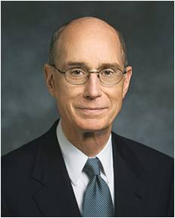
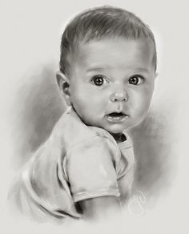
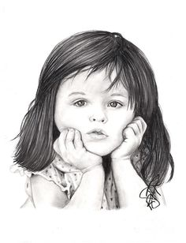
Become Like Little Children
Jesus Christ emphasized that greatness in the kingdom of heaven is achieved by being converted and humbling oneself as a little child. (1)
“To be like a child is not to be childish. It is to be like the Savior, who prayed to His Father for strength to be able to do His will and then did it. Our natures must be changed to become as a child” (2)

Slide 3
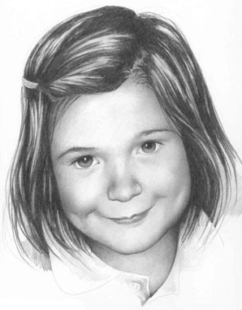
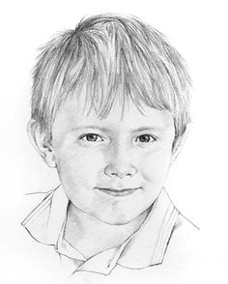
What are the characteristics of the little children?
Matthew 18:1-4
Margaret Scanlan
Betty Warren

Slide 4
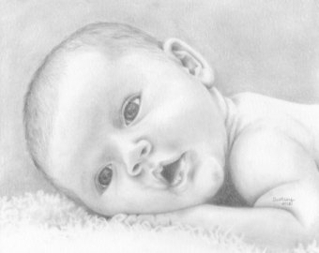
Trait
Innocence
Children are born innocent and free from sin

Slide 5
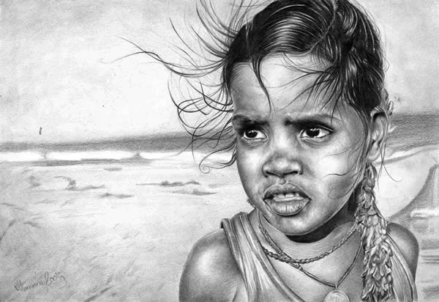
Trait
Humility
Children are not proud or arrogant

Slide 6
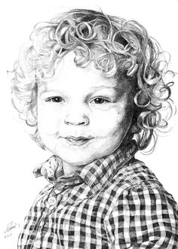
Trait
Teachable
Anna Gilhespy
Children do not have to see to believe
Irina Krivoruchko

Slide 7
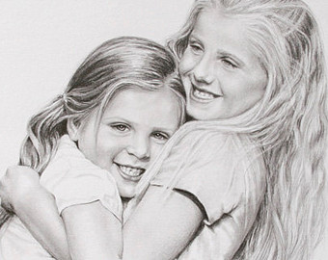
Trait
Love and forgiveness
Children forget anger and are soon friends again

Slide 8
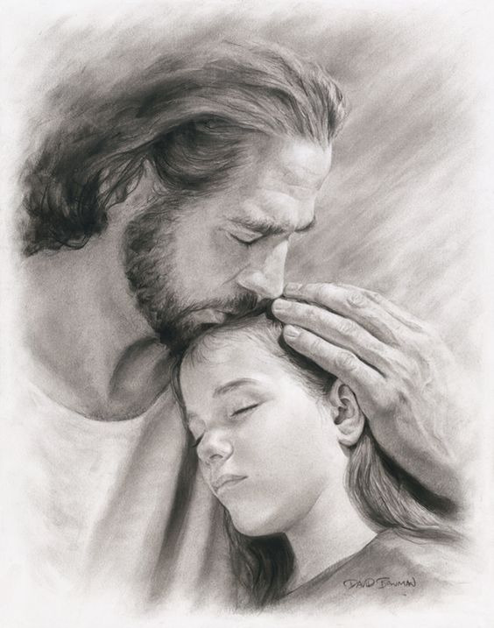
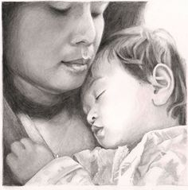
Trait
Dependence on parents
Children trust their parents and their Heavenly Father

Slide 9
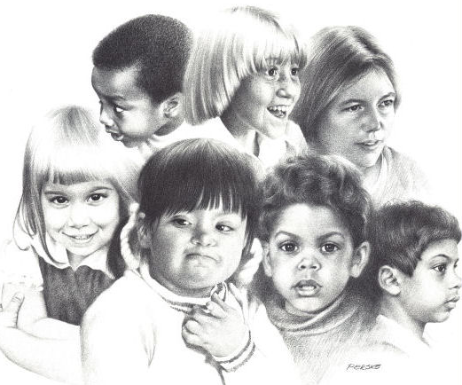
Trait
Lack of prejudice
Children more easily accept differences such as race and physical disabilities

Slide 10
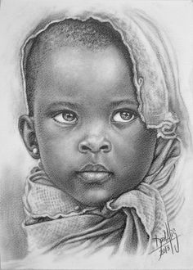
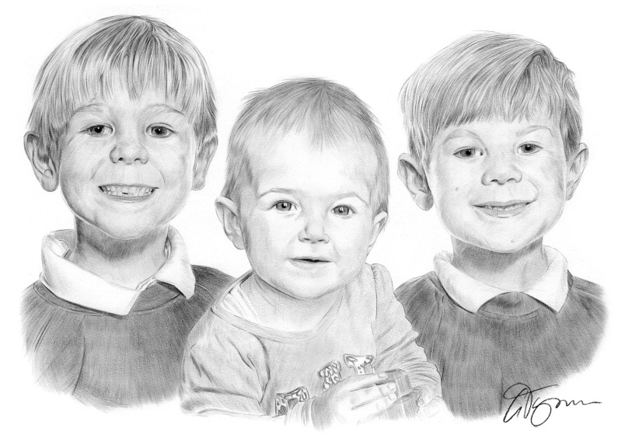
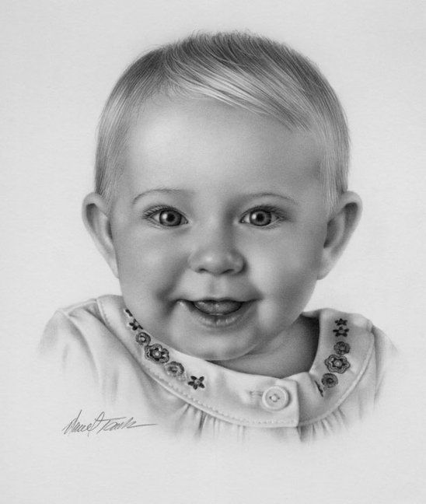
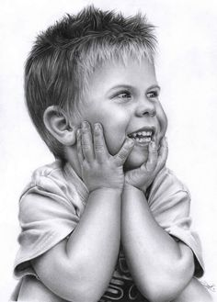
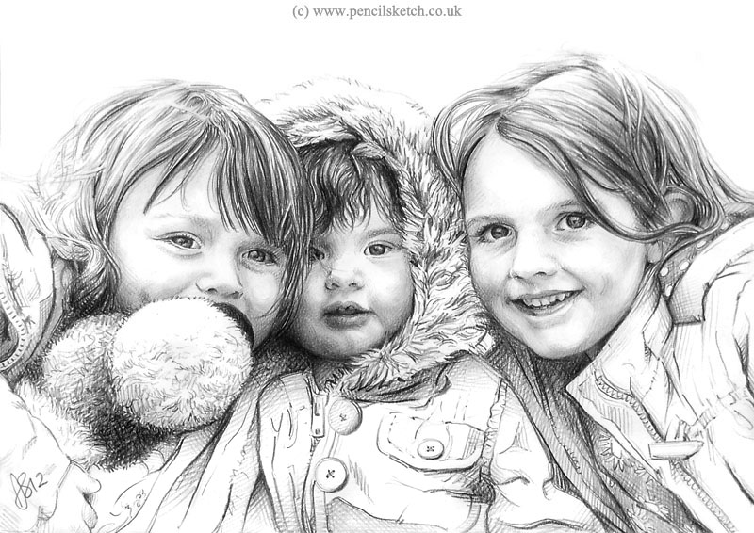
Gary Tymon
Darrel Tank
“How serious is it or harm the children of our Father in Heaven?”
Matthew 18:6

Slide 11
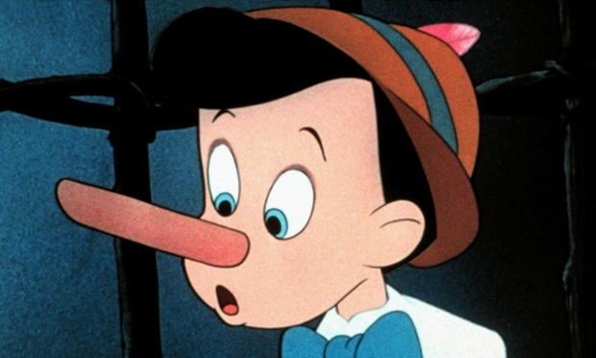
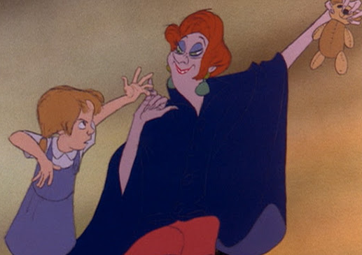
Offences
Which one of these would be the hardest to forgive?
Being betrayed by a friend
Having something stolen
Being lied to

Slide 12
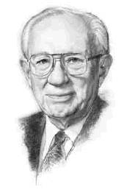
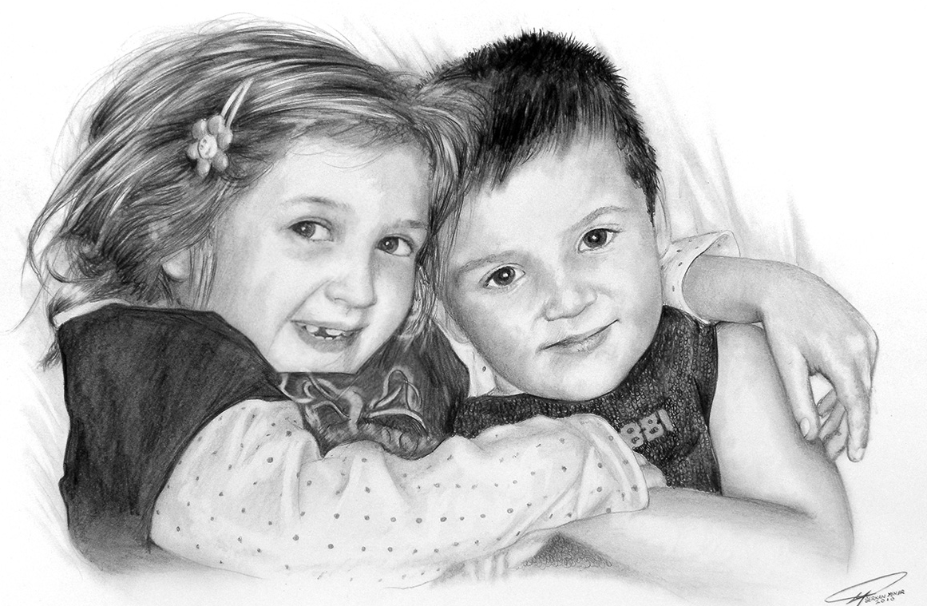
Who Shall Offend Them
"My plea-and I wish I were more eloquent in voicing it-is a plea to save the children. Too many of them walk with pain and fear, in loneliness and despair.
Children need sunlight. They need happiness. They need love and nurture. They need kindness and refreshment and affection.
Every home, regardless of the cost of the house, can provide an environment of love which will be an environment of salvation." (3)
Serkan Yener
Matthew 18:6-7

Slide 13
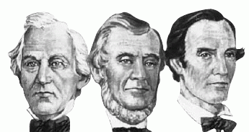
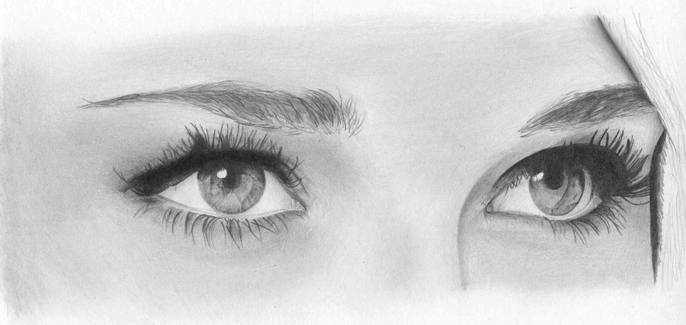
Law of Witness
The foundation of this law, which required that two or three witnesses establish or decide certain matters.
One witness shall not rise up against a man for any iniquity, or for any sin, in any sin that he sinneth: at the mouth of two witnesses, or at the mouth of three witnesses, shall the matter be established.
Deuteronomy 19:15
Matthew 18:16

Slide 14
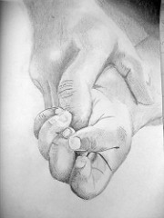
Law of Forgiveness
70 X 7 = Putting no limit on how many times we need to forgive
From latter-day revelation, we learn that the Lord does not expect us to endlessly forgive those who willfully and without repentance trespass against us.
Those who have offended us and asked for forgiveness, we are to forgive 490 times. Those who have offended us and won't repent, we are to expected to forgive three-fold but not 490 times.
The Doctrine and Covenants clearly teaches that our enemies who repent not should be forgiven three times, but on the fourth. (4)
But if he trespass against thee the fourth time thou shalt not forgive him, but shalt bring these testimonies before the Lord; and they shall not be blotted out until he repent and reward thee four-fold in all things wherewith he has trespassed against thee.
D&C 98:44
Matthew 18:16-17 D&C 98:23-48

Slide 15
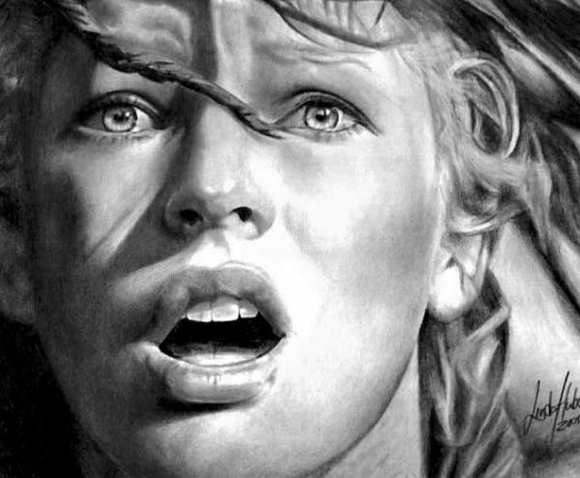
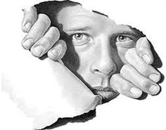
Forgiving With All Our Hearts
“A common error is the idea that the offender must apologize and humble himself to the dust before forgiveness is required. Certainly, the one who does the injury should totally make his adjustment, but as for the offended one, he must forgive the offender regardless of the attitude of the other. Sometimes men get satisfactions from seeing the other party on his knees and grovelling in the dust, but that is not the gospel way.” (6)
Linda Huber
“For if ye forgive men their trespasses, your heavenly Father will also forgive you:
“But if ye forgive not men their trespasses, neither will your Father forgive your trespasses.” (Matt. 6:14–15.)
Henry Ward Beecher expressed the thought this way: “I can forgive but I cannot forget is another way of saying I cannot forgive.”
Antonio Canova
Matthew 18:16-17

Slide 16
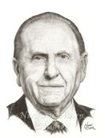
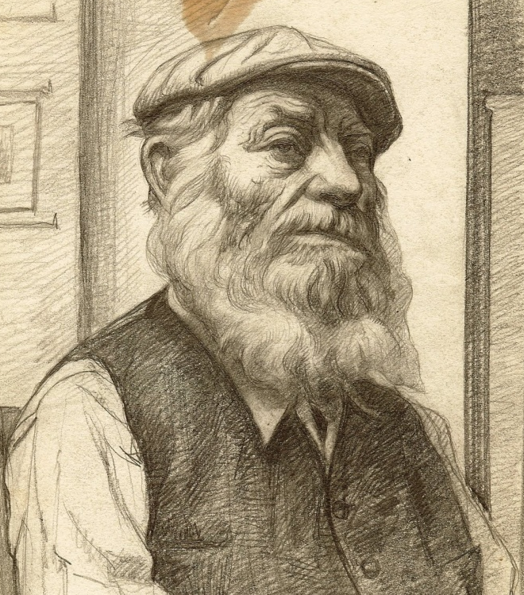
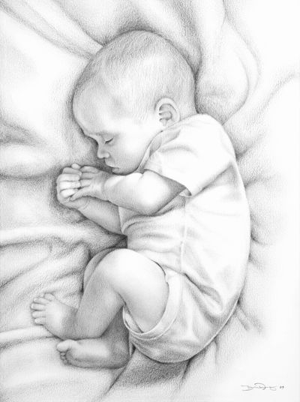
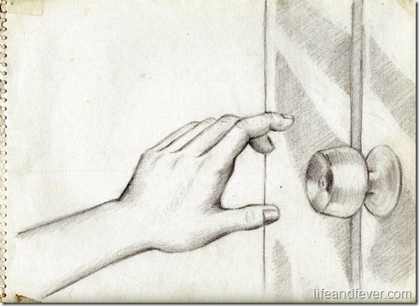
The Cabinet Maker
“[The] father was a cabinetmaker and fashioned a beautiful casket for the body of his precious child. The day of the funeral was gloomy, thus reflecting the sadness they felt in their loss. As the family walked to the chapel, with Father carrying the tiny casket, a small number of friends had gathered. However, the chapel door was locked. The busy bishop had forgotten the funeral. Attempts to reach him were futile. Not knowing what to do, the father placed the casket under his arm and, with his family beside him, carried it home, walking in a drenching rain” (6)
Would it be difficult to forgive the bishop?

Slide 17
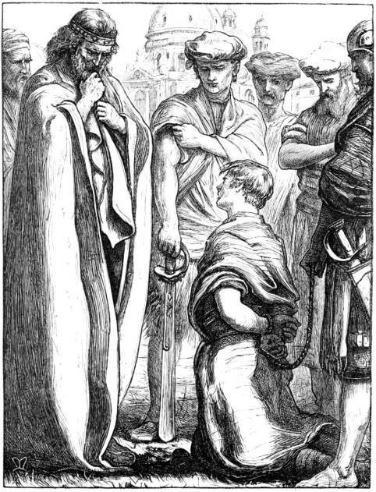
The Unmerciful Servant
King and Servant
In Jesus’s day “10,000 talents equaled 100,000,000 denarii [Roman currency]. One denarius was a typical day’s wage for a common laborer.”
King = Heavenly Father
Servant = Us
Fellowservant = Those who have offended us.
Servant and his fellowservant
100 pence was about 4 months worth of work
It would take 300,000 years to earn 10,000 talents assuming he worked 300 days a year
The Servant was to go into service and his family to pay the debt
The servant cast his fellowservant into prison until the dept was paid
The king was merciful and forgave his debts.
“One day, all of us will be called to account for our lives. Withholding forgiveness from others who have wronged us will prevent us from receiving the forgiveness we desperately need.” (7)
Matthew 18:23-35

Slide 18
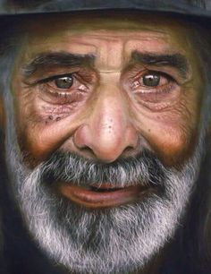
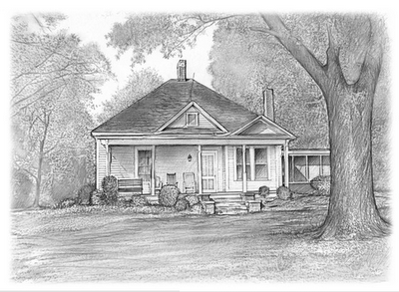
The Cabinet Maker—Cont.
“If the family were of a lesser character, they could have blamed the bishop and harbored ill feelings. When the bishop discovered the tragedy, he visited the family and apologized. With the hurt still evident in his expression, but with tears in his eyes, the father accepted the apology, and the two embraced in a spirit of understanding” (6)

Slide 19
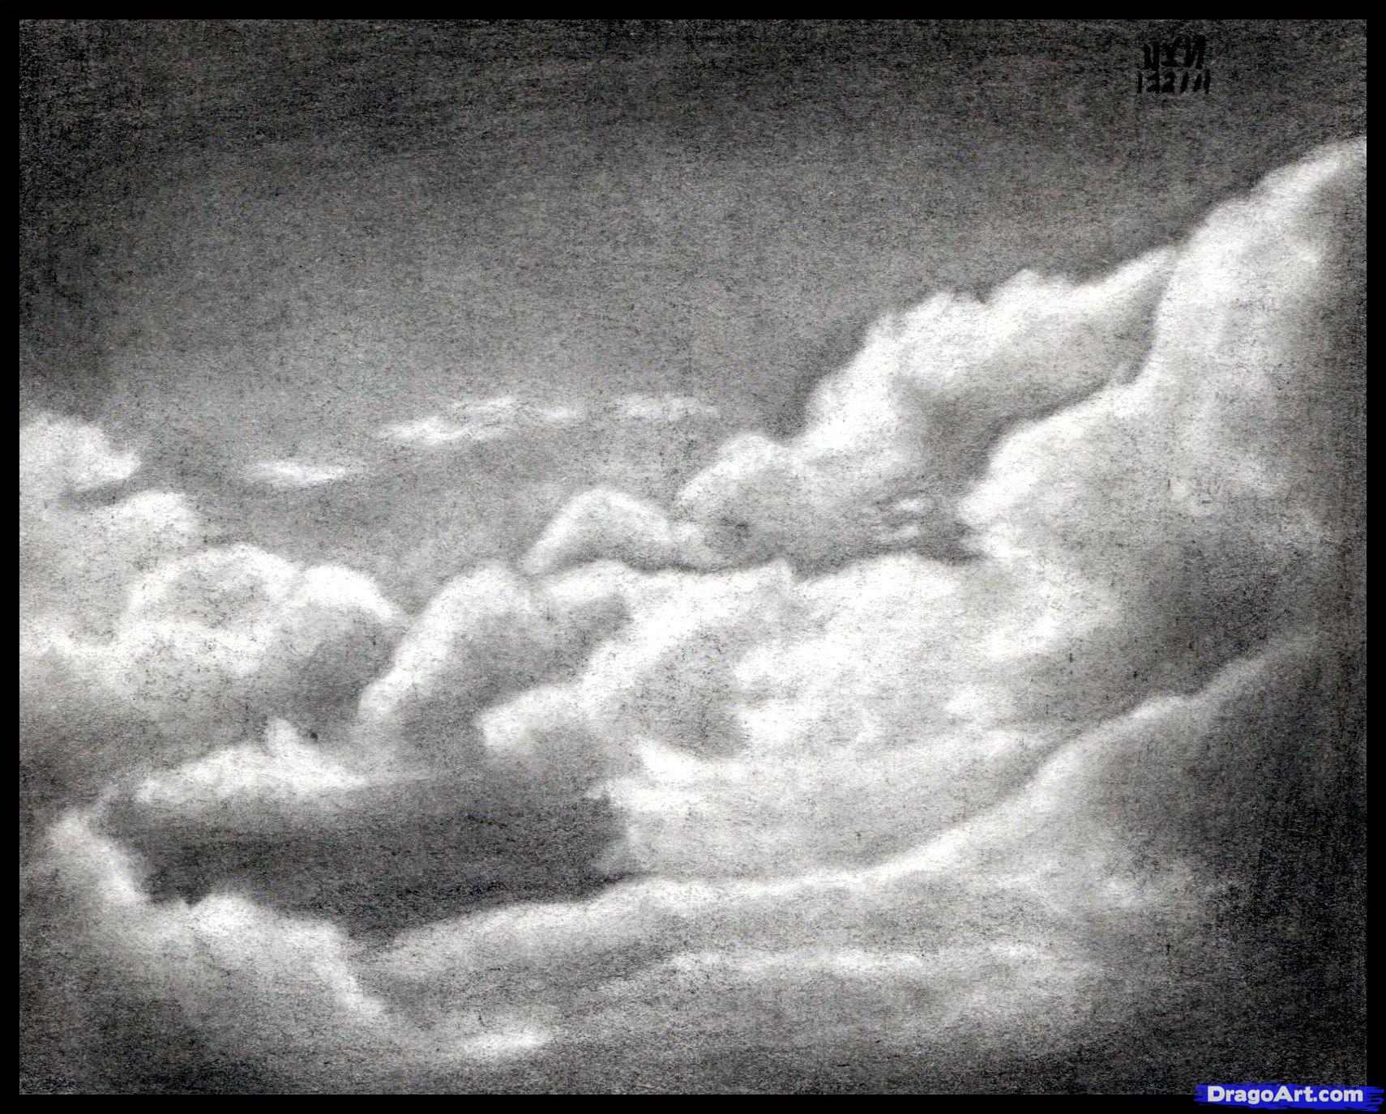
“Remember, heaven is filled with those who have this in common: They are forgiven. And they forgive”
(8)

Slide 20
Sources:
Suggested Hymn: #130 Be Thou Humble
Video:
“Forgiveness: My Burden Was Made Light” (8:24)
New Testament Institute Student Manual Chapter 6
President Henry B. Eyring (“As a Child,” Ensign or Liahona, May 2006, 15).
Gordon B. Hinckley (Ensign, November 1994, 54)
Gospeldoctrine.com
President Spencer W. Kimball Chapter 9: Forgiving Others with All Our Hearts
President Thomas S. Monson “Hidden Wedges,” Ensign, May 2002, 19
John Bytheway Of Pig, Pearls, and Prodigals p. 53-55
President Dieter F. Uchtdorf(“The Merciful Obtain Mercy,” Ensign or Liahona, May 2012, 77).
Presentation by ©http://fashionsbylynda.com/blog/

Slide 21
Event | Matthew | Mark | Luke | John
Discourse on Humility, Service, and Forgiveness | 18:1-35 | 9:33-50 | 9:46-50

Slide 22
Little Children Matthew 18:6
"The innocence with which children come into the world is one of the awesome responsibilities of all who, in any way, influence their lives. And to see such unstained innocence neglected or abused, or exposed to evil or unwholesome influence, or warped by bad example, or by false teaching-or by failure to teach-is a sobering concern.
"There are many who have responsibility for teaching children: parents, teachers, friends, anyone who in any way enters their lives, including the makers and promoters of products, of policies; creators of entertainment, and the whole community, publicly and privately. And children in their innocence have a right to be protected from exploitation and from evil influence." Richard l. Evans (Conference Report, April 1969, Afternoon Meeting 73-74.)
Forgiveness Matthew 18:16-17
Rabbinism called upon the offender to initiate a course of reconciliation with his brother and specified that forgiveness should not be extended more than three times to any offender. His soul as yet not afire with the Holy Spirit, Peter asked a question that, as he must have then supposed, assumed a far more liberal rule than that imposed by the Rabbis. ‘Lord, how oft shall my brother sin against me, and I forgive him? till seven times?’ Jesus answered: ‘I say not unto thee, Until seven times: but, Until seventy times seven,’ meaning there is no limit to the number of times men should forgive their brethren” Elder Bruce r. McConkie (The Mortal Messiah: From Bethlehem to Calvary, 4 vols. [1979–81], 3:91).
Innocent Children Matthew 18:11 Infant Baptism
"The question of the innocence of children was also a matter that arose in discussions between the Christians and the Jews in the meridian of time. Paul emphasized that the law of circumcision and 'the tradition [should] be done away, which saith that little children are unholy; for it was had among the Jews' (D&C 74:6). Joseph Smith's translation of the Bible is a witness that Jesus had taught concerning the innocent status of children. 'Take heed that ye despise not one of these little ones,' the Master said, 'for I say unto you, That in heaven their angels [spirits] do always behold the face of my Father which is in heaven. For the Son of man is come to save that which was lost and to call sinners to repentance; but these little ones have no need of repentance, and I will save them' (JST Matthew 18:10-11; italics added; compare JST Matt. 19:13)."
"During the period of the Great Apostasy (after the first century of the Christian era) the doctrine of infant baptism again reared its ugly head.
Elder James E. Talmage has written, 'There is no authentic record of infant baptism having been practiced during the first two centuries after Christ, and the custom probably did not become general before the fifth century; from the time last named until the Reformation, however, it was accepted by the dominant church organization.' Elsewhere Elder Talmage observed: 'Not only was the form of the baptismal rite radically changed [during the time of the Apostasy], but the application of the ordinance was perverted. The practice of administering baptism to infants was recognized as orthodox in the third century and was doubtless of earlier origin. In a prolonged disputation as to whether it was safe to postpone the baptism of infants until the eighth day after birth-in deference to the Jewish custom of performing circumcision on that day-it was generally decided that such delay would be dangerous, as jeopardizing the future well-being of the child should it die before attaining the age of eight days, and that baptism ought to be administered as soon after birth as possible.'"(Robert L. Millet, The Power of the Word: Saving Doctrines from the Book of Mormon, 252.)
Forgiveness Matthew 18:16-17
A variation of this theme is being taught here by the Savior. If you have tried to privately resolve a conflict and have been rejected, the case should be brought before witnesses and then the elders of the Church for resolution (see DC 42:88-89). This gives the individual three chances to reconcile differences. If the person is unrepentant, the Lord does not expect us to forgive him-he may be considered as a 'heathen man and a publican.' While not meant to detract from the importance of forgiveness, this doctrine is reassuring to those who have been repeatedly violated. The Lord does not expect us to be forever trampled upon. His saints are not to be the doormats of the world. The Lord taught us that we should turn the other cheek (Matt 5:39), but he didn't give us 490 cheeks to turn.
Gospeldoctrine.com
“We need to recognize and acknowledge angry feelings. It will take humility to do this, but if we will get on our knees and ask Heavenly Father for a feeling of forgiveness, He will help us. The Lord requires us ‘to forgive all men’ [D&C 64:10] for our own good because ‘hatred retards spiritual growth’ [Orson F. Whitney, Gospel Themes(1914), 144]. Only as we rid ourselves of hatred and bitterness can the Lord put comfort into our hearts. …
“… When tragedy strikes, we should not respond by seeking personal revenge but rather let justice take its course and then let go. It is not easy to let go and empty our hearts of festering resentment. The Savior has offered to all of us a precious peace through His Atonement, but this can come only as we are willing to cast out negative feelings of anger, spite, or revenge. For all of us who forgive ‘those who trespass against us’ [Joseph Smith Translation, Matthew 6:13], even those who have committed serious crimes, the Atonement brings a measure of peace and comfort” (James E. Faust, “The Healing Power of Forgiveness,” Ensign or Liahona, May 2007, 69).

