Slide 1
Lesson 23-24
Jesus’ Last Week
Matthew 21-22:1-14
Including:
The Triumphal Entry
Cleansing the Temple
Cursing a Fig Tree
Parable of Two Sons
Parable of Wicked Husbandman
Parable of King’s Wedding

Slide 2
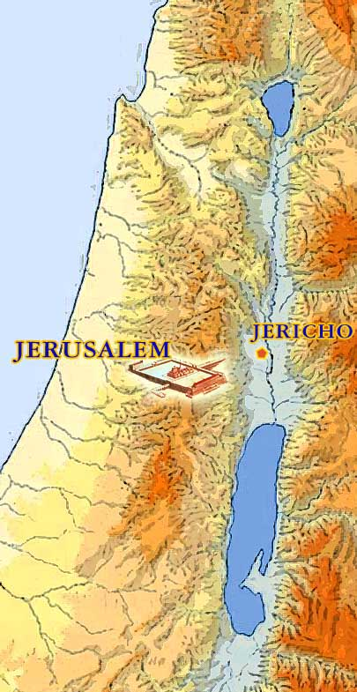
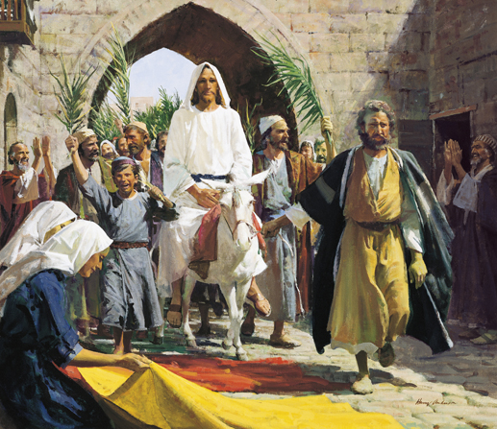
The Triumphal Entry
5 days before the Savior’s Crucifixion—During the Observance of Passover
A multitude of people followed Jesus and His Apostles as they traveled to Jerusalem from Jericho
Prophecy Fulfilled:
Rejoice greatly, O daughter of Zion; shout, O daughter of Jerusalem: behold, thy King cometh unto thee: he is just, and having salvation; lowly, and riding upon an ass, and upon a colt the foal of an ass. Zechariah 9:9
…and his dominion shall be from sea even to sea, and from the river even to the ends of the earth.
Zechariah 9:10
Matthew 21:1-11

Slide 3
“A colt tied, whereon yet never man sat”
Horse is a symbol of war
Donkey = Peace
The owners of the colt readily permitted the two brethren to take him, and it is assumed they also were disciples (1)
Zechariah 9:9; Matthew 21:2-7; Mark 11:2-7; John 12:14-15

Slide 4
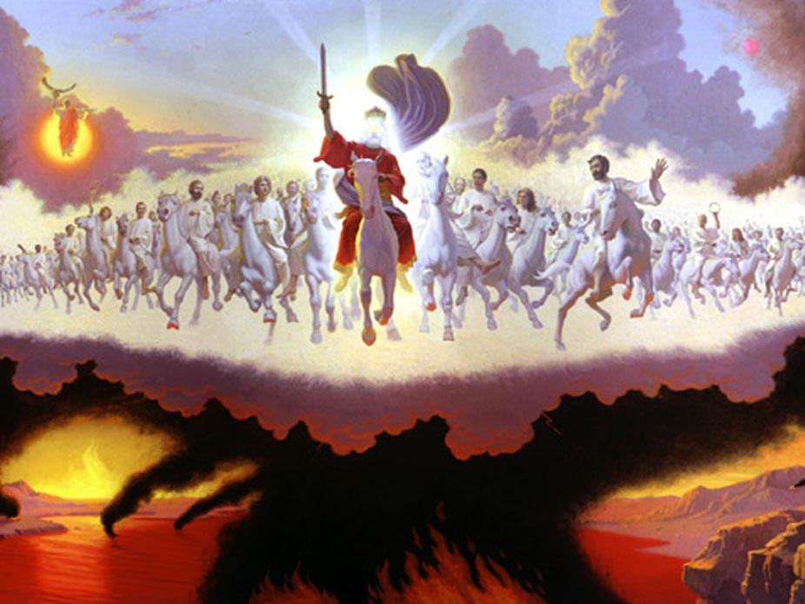
At Jesus' Second Coming
And I saw heaven opened, and behold a white horse; and he that sat upon him was called Faithful and True, and in righteousness he doth judge and make war. Revelation 19:11
Jesus will return to earth in great power and glory. As a symbol of His glory, the book of Revelation describes Him coming to earth on a “white horse,” rather than on the ass that He rode into Jerusalem. (2)
Matthew 21:1-11

Slide 5
“They spread their clothes in the way”
Only kings and conquerors received such an extraordinary token of respect.
Then they hasted, and took every man his garment, and put it under him on the top of the stairs, and blew with trumpets, saying, Jehu is king.
2 Kings 9:13
Matthew 21:8 ; Luke 19:36; Mark 1:8

Slide 6
“Took branches of palm trees, and went forth to meet him”
Token of Victory and Triumph
Matthew 21:8; Mark 11:8; John 12:13

Slide 7
Hosanna
Hosanna to the Son of David: Blessed is he that cometh in the name of the Lord”
All the city was moved:
These people recognized Christ as the long-awaited Messiah
Hosanna = Save Now
Save now, I beseech thee, O Lord: O Lord, I beseech thee, send now prosperity. Psalms 118:25
Matthew 21:9-10

Slide 8
“If these should hold their peace, the stones, would immediately cry out”
Jesus’ right to be called the Christ(3)
Luke 19:40; John 12:19

Slide 9
Cleansing the Temple
How were some people treating God’s house?
The visitors who came to Jerusalem to celebrate the Passover needed to purchase animals to offer as sacrifices in the temple as part of their worship.
Even though this business was necessary and served a good purpose, handling it where and how the merchants did was disrespectful and irreverent.
The house of the Lord is a sacred place, and He desires that we treat it with reverence
Moneychangers exchanged Roman and other currencies for temple currency so the animals could be purchased, and other merchants sold the animals.
Moneychangers and merchants were more interested in making a financial profit than in worshipping God and helping others to do so.
Matthew 21:12-16

Slide 10
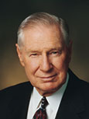
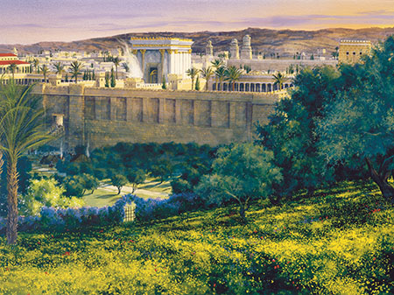
“The Lord has provided many avenues by which we may receive [His] healing influence.
I am grateful that the Lord has restored temple work to the earth.
It is an important part of the work of salvation for both the living and the dead. Our temples provide a sanctuary where we may go to lay aside many of the anxieties of the world.
Our temples are places of peace and tranquility. In these hallowed sanctuaries God ‘healeth the broken in heart, and bindeth up their wounds.’
As we attend the temple, the Lord can heal us

Slide 11
Matthew 21:18-19 and Mark 21:11-12
“The leaves are commencing to show on the fig tree”
President Spencer W. Kimball
Signs and wonders shall take place in the last days.
There shall arise false Christs, and false Prophets and they shall deceive the very elect.
The Lord said: “Peace shall be taken from the earth, and the devil shall have power over his own dominion.” D&C 1:35
For in those days shall be affliction, such as was not from the beginning of the creation which God created unto this time, neither shall be. Mark 13:19
All things shall be in commotion…men’s hearts shall fail them;…fear shall come upon all people.
D&C 88:91
The saints also shall hardly escape; nevertheless, I, the Lord, am with them.
D&C 63:34
And the Lord shall have power over his saints, and shall reign in their midst, and shall come down in judgment upon the world. D&C 1:37
Unto you it shall be given to know the signs of the times and the signs of the coming of the Son of Man
D&C 68:11
(4)

Slide 12
What is to Happen When Christ Comes Again?
The Church of Jesus Christ is never again to be taken from the earth.
The Holy Ghost and the priesthood of God will continue to be on the earth.
There shall be in the last days living prophets and living apostles chosen and called by Jesus Christ.
The Lord promised, “My disciples shall stand in holy places, and shall not be moved” D&C 45:32
This gospel of the kingdom shall be preached in all the world for a witness unto all nations; and then shall the end come. Matt. 24:14
“ Of Judah and Jerusalem in the last days the Lord promised, “Then will the Father gather them together again, and five unto them Jerusalem for the land of their inheritance…And it shall come to pass that the time cometh, when the fulness of my gospel shall be preached unto them; and they shall believe in me, that I am Jesus Christ the Son of God.”
3 Nephi 20:30-31
“And they shall learn the parable of the fig tree, for even now already summer is nigh.” D&C 35:15-16
(4)

Slide 13
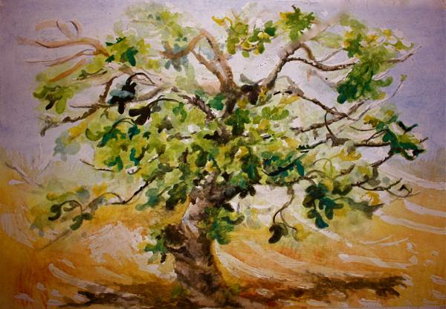
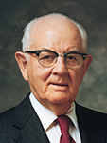
Deceived By Appearance--Hypocrisy
The leaves on the fig tree indicated that it should have had fruit, but it did not. With its misleading appearance, the tree symbolized hypocrisy.
One reason the Savior may have cursed the fig tree was to teach His disciples about the corrupt religious leaders of the Jews.
“…the unproductive tree was cursed for its barrenness. What a loss to the individual and to humanity if the vine does not grow, the tree does not bear fruit, the soul does not expand through service! One must live, not merely exist; he must do, not merely be; he must grow, not just stagnate. We must use our talents in behalf of our fellowmen, rather than burying them in the tomb of a self-centered life.” (6)
Matthew 21:18-19

Slide 14
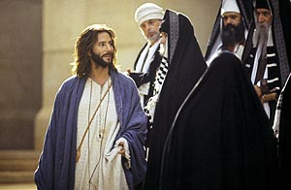
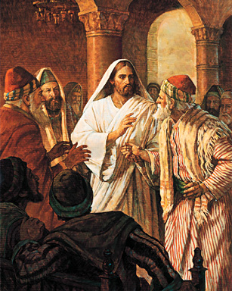
Approaching The Savior
Jewish leaders approached the Savior in the temple and questioned the authority by which He had made His triumphal entry into Jerusalem and cleansed the temple.
The Savior responded by asking them whether the baptism (or ministry) of John the Baptist had been commissioned by God or by man.
These leaders would not answer the Savior’s question for fear of condemning themselves or offending people who accepted John as a prophet.
The Savior said He would not answer their questions either and then related three parables that illustrate the actions of the corrupt Jewish leaders.
Matthew 21:18-19

Slide 15
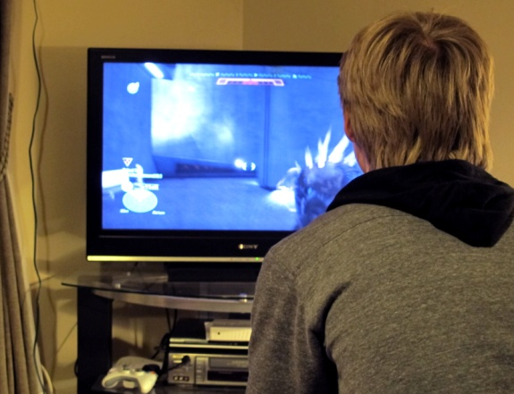
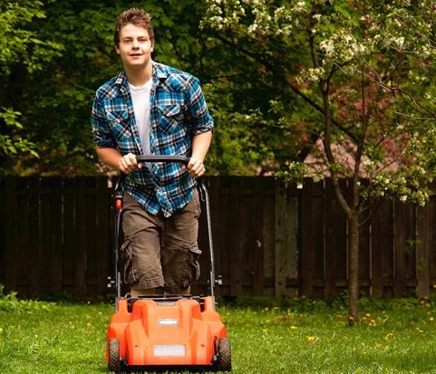
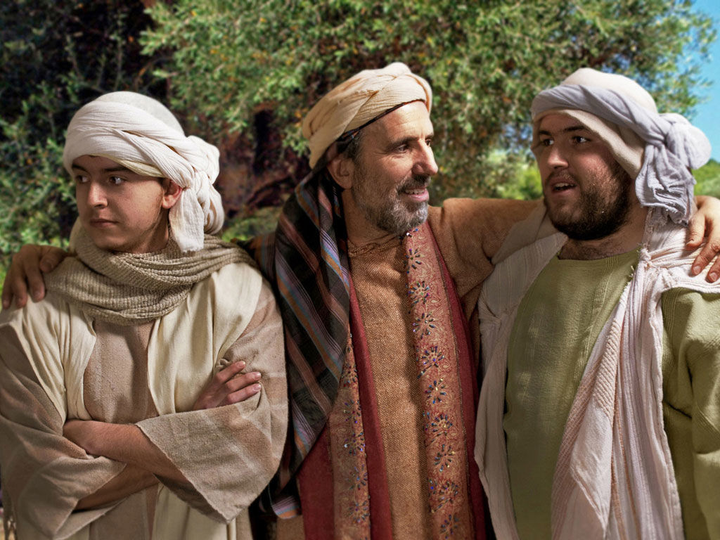
Parable of the Two Sons
“A Father approaches his boys and asks, “Son, will you mow the lawn?” “No, Dad.”
“How about you, son?” “Yeah, I’ll do it.”
Two hours later, the son who said no changed his mind and mowed the lawn, and the son who said yes didn’t budge. Sound familiar? (8)
“The Father of the sons is God himself who offers employment in his earthly vineyard to all his children. The first son, who initially refused to labor in his Father’s vineyard but later repented and served him, is symbolical of the publicans and harlots who repented of their early sins and became faithful servants in their Father’s cause. …
“The second son, who willingly accepted an assignment in the vineyard but then failed to render the appointed labors, is symbolical of the Jewish leaders who professed to be about their Father’s business but were in fact letting the vineyard degenerate. … (1)
Matthew 21:28-31

Slide 16
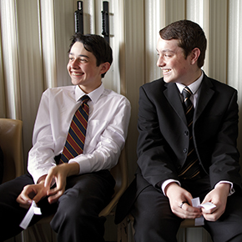
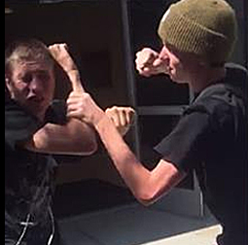
Pretending
To enter the kingdom of God, we must obey our Heavenly Father and repent of our sins rather than only saying or pretending that we obey Him
A young man often tells his parents that he is attending Church activities when he actually goes to a friend’s house instead. When he is around Church leaders and instructors, he talks and acts as though he keeps Heavenly Father’s commandments, but outside of those settings he knowingly breaks many of the commandments.

Slide 17
Pretending
To enter the kingdom of God, we must obey our Heavenly Father and repent of our sins rather than only saying or pretending that we obey Him
A young woman gossips with her friends about several girls in her school but pretends to be friendly to these girls when they are around. She regularly attends church and partakes of the sacrament, but during the meetings she often sends her friends text messages containing criticisms of those around her.

Slide 18
The Parable of the Wicked Husbandmen
Matthew 21:33-46
Luke 20:9-18
Mark 12:1-12

Slide 19
Far country = Heaven
Husbandmen = people of the world
Vineyard = the world
Matthew 21:33
A Certain Man = Heavenly Father

Slide 20
Servants = prophets, Apostles, those who preach the gospel of Jesus Christ
Matthew 21:34-35

Slide 21
Matthew 21:36

Slide 22
His Son = Jesus Christ
Matthew 21:37

Slide 23
Matthew 21:38

Slide 24
Cast and killed = rejected Jesus Christ, crucified Him, and rejected the gospel
Matthew 21:39

Slide 25
Taken and given to other nations = Destroy vineyard and give to others
Matthew 21:40-43

Slide 26
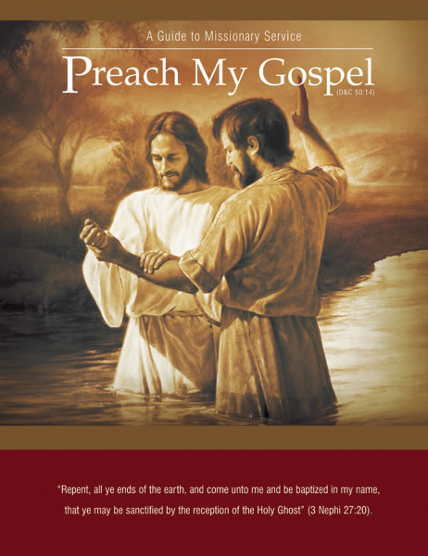
Message from Preach My Gospel
People have repeatedly chosen to reject the Gospel of Jesus Christ.
Messages that have been reveled to His servants such as Adam, Noah, Abraham, and Moses have also been rejected.
If we continue to reject His gospel the Lord will withdraw His kingdom and establish His Gospel to those who will listen.

Slide 27
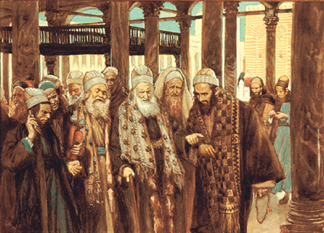
Fear of the People’s Reaction
The chief priests and Pharisees became angry when they realized that the wicked husbandmen in the parable represented them.
However, they refrained from laying hands on the Savior because they feared the people’s reaction if they did so.
Matthew 21:45-46

Slide 28
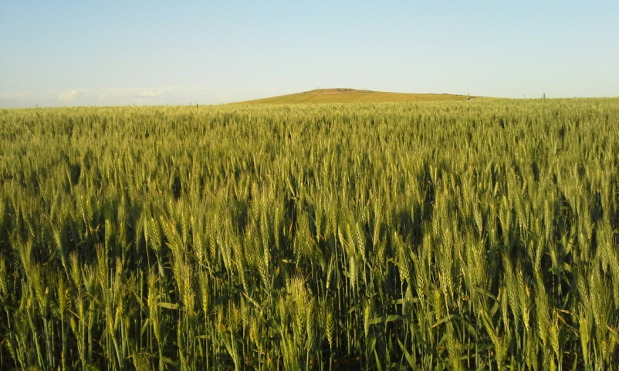
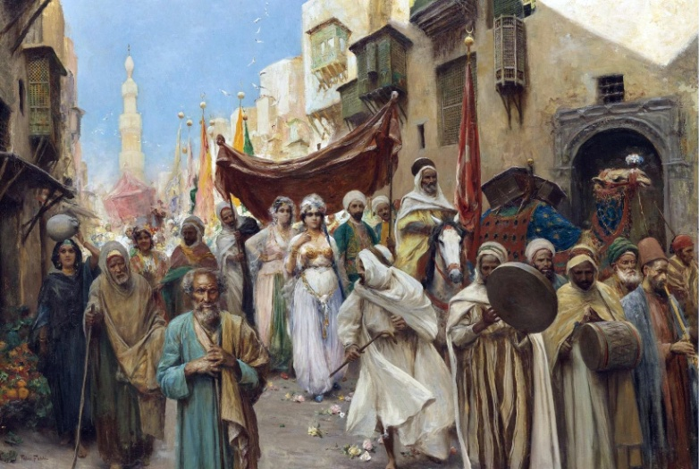
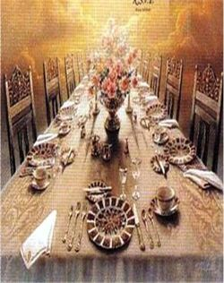
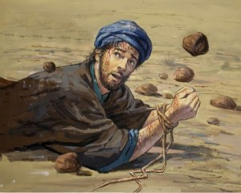
Parable of the Marriage of the King’s Son
Bridegroom = Savior
Kingdom of God = Bride
Those invited = the covenant people of the Lord
But they refused to come = their own choice not to participate
When the second bidding came, some “made light” of the invitation = “made light of the servants who brought the invitations” and left to go to their farms and merchandise
Those who remained were more cruel and acted with violence by slaying the servants.
The king responded by destroying the murderers and burning their city.
Matthew 22:2-14
(8)

Slide 29
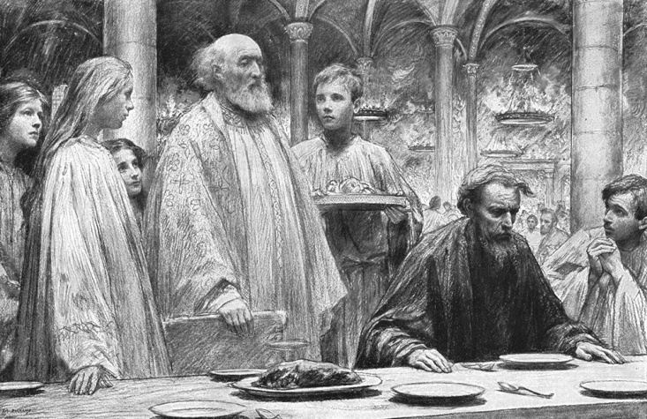
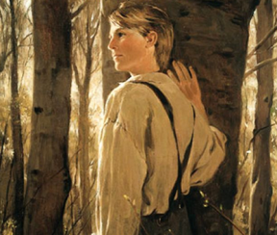
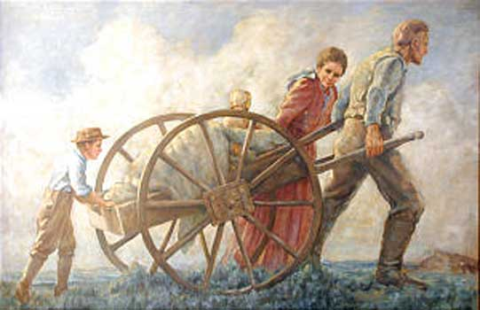
Those Who Accepted The Invitation
New invitations were extended to those in the highways = Gentiles (To all the world)
The Kingdom was take from the Jews and given to others
For all those who desire to feast
Those who are not wearing the “wedding garment”
The man had not put on the garment that was offered to him = willfully refused– wanted to be a part of kingdom but refused to comply with the standards
Cast out = outer darkness
Matthew 22:2-14; Mark 16:15
(8)

Slide 30
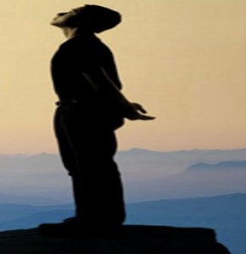
Warning To Those Who Are “Undressed”
Hold thy peace at the presence of the Lord God: for the day of the Lord is at hand: for the Lord hath prepared a sacrifice, he hath bid his guests.
8 And it shall come to pass in the day of the Lord’s sacrifice, that I will punish the princes, and the king’s children, and all such as are clothed with strange apparel. Zephaniah 1:7-8
I will greatly rejoice in the Lord, my soul shall be joyful in my God; for he hath clothed me with the garments of salvation, he hath covered me with the robe of righteousness, as a bridegroom decketh himself with ornaments, and as a bride adorneth herself with her jewels. Isaiah 61:10
Not everyone who acknowledges the Savior, is called, and accepts the invitation to be part of the kingdom will be prepared and worthy to dwell eternally with Him and Heavenly Father.
The wedding garment we should be seeking is righteousness, which we cannot obtain without Christ and obedience to his gospel. (8)
Matthew 22:11-12

Slide 31
"And so it is, as the millennial day approaches, that the servants of the Lord go forth, inviting all men, Jew and Gentile alike, to come to 'the supper of the Lamb,' to 'make ready for the Bridegroom,' to come to 'a feast of fat things,' and 'of wine on the lees well refined,' to come to 'a supper of the house of the Lord, well prepared, unto which all nations shall be invited.'
And it shall yet come to pass that those who accept the invitation and come to the feast, but who do not wear the approved wedding garments and are not clothed in the robes of righteousness, shall be cast into outer darkness. In that day only the pure and the clean shall feast at the eternal table." (1)

Slide 32
Summary of Jesus’ Teachings Mathew 21-22:1-14
Matthew 21:18-22
Matthew 21:23-27
Matthew 21:28-32
Matthew 21:22-46
Matthew 22:1-14
All things are possible to those who ask God with faith.
Jesus and John the Baptist acted with God’s authority.
Through repentance we can serve our Heavenly Father.
Those who reject the prophets and Jesus Christ will be destroyed.
The Lord will accept those who follow Him willingly and correctly.

Slide 33
Sources:
Suggested Song: Hosanna Children’s Songbook #66
Video:
“Nine Ways to Use Technology to Share Your Beliefs” (2:02),
Elder Bruce R. McConkie Doctrinal New Testament Commentary p. 1:578-579, 589-590 and The Millennial Messiah: The Second Coming of the Son of Man, 354
New Testament Student Institute Manual Chapter 7
Hugh B. Brown (The Eternal Quest [Salt Lake City: Bookcraft, 1956], 392.)
“The Leaves Are Commencing to Show on the Fig Tree” Bernard P. Brockbank April 1976 Gen. Conf.
” Elder James E. Talmage (Jesus the Christ, 3d ed. [1916], 526).
Spencer W. Kimball President Kimball Speaks Out, 44.)
President James E. Faust (Ps. 147:3.)” (“Spiritual Healing,” Ensign, May 1992, 7).
John Bytheway of Pigs, Pearls, and Prodigals p. 67
Presentation by ©http://fashionsbylynda.com/blog/

Slide 34
Ritual During King Saul’s Time: Mattew 21:2-7
During the time of the monarchy in ancient Israel, following the enthronement of King Saul, the Jews held annual reenthronement rituals that featured a king riding into Jerusalem upon a donkey. The rider approached Jerusalem from east of the city, through the Mount of Olives and the Kidron Valley, and then came to the temple.
These rituals looked forward to the time when the Messiah would come to His people in this same way. Thus, at a time when Jerusalem was flooded with Jews, Jesus entered Jerusalem in a manner that demonstrated He was the Messiah, the King of Israel. Riding on a donkey also showed that Jesus came as a peaceful and “lowly” Savior, not as a conqueror upon a warhorse. New Testament Institute Student Manual Chapter 7
Reaction to cleansing the temple Matthew 21:15
"The chief priests were the guardians of the temple and, in fact, guardians (as they supposed) of the whole structure of Jewish religion. They glutted themselves on the profits from temple business, and so the temple was not just the source of their favored social position (which they coveted so jealously) but also the source of their incomes-more, their fortunes. . . .
The anger of the chief priests and scribes was raging against Him; but it was impotent. They had decreed His death, and had made repeated efforts to take him, and there he sat within the very area over which they claimed supreme jurisdiction, and they were afraid to touch Him because of the common people, whom they professed to despise yet heartily feared-'for all the people were very attentive to hear him.' (JTC, pp. 528-29.)" (Daniel H. Ludlow, A Companion to Your Study of the Doctrine and Covenants, 2: 147 - 148.)
Hosanna Matthew 21:9
Save now. The word is taken from Ps. 118:25, one of the Psalms of the Hallel. The chanting of this psalm was connected at the Feast of Tabernacles with the waving of palm branches; hence the use of the word by the multitudes at our Lord’s triumphal entry into Jerusalem (Matt. 21:9, 15; Mark 11:9–10; John 12:13). Bible Dictionary
Hosanna is a Hebrew word that “means ‘please save us’ and is used in praise and supplication. … At the Lord’s triumphal entry into Jerusalem, the multitudes cried ‘Hosanna’ and spread palm branches for Jesus to ride upon, thus demonstrating their understanding that Jesus was the same Lord who had delivered Israel anciently
Barren Fig Tree Matthew 21:18-19
"Why did Jesus curse the fruitless fig tree? Unique among our Lord's miracles, this manifestation of divine power teaches a number of great truths:
"(1) By exercising his power over nature, Jesus was testifying in language written in the earth itself that he was Lord of all. As the Lord Jehovah he had in times past created all things in heaven and on earth; now, though tabernacled in mortal clay, he possessed the same eternal powers over life, death, and the forces of nature. By using these powers-as he had before done in calming the tempest, multiplying loaves and fishes, walking on the water, healing multitudes, and raising the dead-he was leaving a visible and tangible witness of his own divine Sonship.
"(2) Though Jesus had come to bless and save, yet he had the power to smite, destroy, and curse. 'It must needs be, that there is an opposition in all things' ("#2 ne. 2:112 Ne. 2:11); if blessings are born of righteousness, their opposite, curses, must come from wickedness. True gospel ministers seek always to bless, yet curses attend rejection of their message. 'Whomsoever you bless I will bless, and whomsoever you curse I will curse, saith the Lord.' ("D&C 132:47D. & C. 132:47.) It is fitting that Jesus should leave a manifestation of his power to curse, and the fact that he chose, not a person, but a tree, is an evident act of mercy.
"(3) Withering and dying at Jesus' command, the fruitless fig tree stands as a type and a shadow of what shall befall hypocrites..." Bruce R. McConkie (Doctrinal New Testament Commentary, 1: 582.)
Lurking Pharisees: Luke 19:40
"Agents of the scribes and Pharisees who were lurking in the crowd were disturbed and scandalized as the jubilant multitude shouted in harmony: 'Blessed be the King that cometh in the name of the Lord,. . .glory in the highest.' (Luke 19:38.) To their learned ears and suspicious hearts such words of adulation to an impostor were bordering on blasphemy, and they admonished Jesus to rebuke his disciples, but instead he justified their enthusiasm by saying: 'I tell you that, if these should hold their peace, the stones would immediately cry out.' (Luke 19:40.) This was an assertion of his right to be called the Christ. All who read the story must be moved by the matchless, majestic courage of the man. He could have turned back to the home of Lazarus and Mary and Martha, his usual abiding place in Bethany. But he voluntarily chose to do his Father's will to bring to pass the immortality and eternal life of man...And so began the most eventful week in history.“ Hugh B. Brown (The Eternal Quest [Salt Lake City: Bookcraft, 1956], 392.)

Slide 35
Matthew 21:7-11 Social Media
The following instruction can help students further understand the truth that as we publicly acknowledge and speak about Jesus Christ, we can help others develop a desire to know more about Him.
“Social media channels are global tools that can personally and positively impact large numbers of individuals and families. And I believe the time has come for us as disciples of Christ to use these inspired tools appropriately and more effectively to testify of God the Eternal Father, His plan of happiness for His children, and His Son, Jesus Christ, as the Savior of the world; to proclaim the reality of the Restoration of the gospel in the latter days; and to accomplish the Lord’s work” Elder David A. Bednar (“To Sweep the Earth as with a Flood” [address given at BYU Campus Education Week, Aug. 19, 2014], LDS.org).
Providing a Garment Matthew 22:11-12
Weren’t the wedding guests pulled in from off the streets? The custom for a wealthy host was to provide the appropriate wedding garments for his guests. The man who ‘had not on a wedding garment” did not lack for one but willfully refused to put it on.” Jay A. and Donald W. Parry (Understanding the Parables) 228-229
Temple Clothing—Clothing of Covenants:
Today, the clothing worn in the temple symbolizes clothing ourselves in covenants, righteousness, and purity in preparation for entering into God’s presence. We cannot participate in the great “marriage supper” of the Son of God unless we have accepted and put on the protective clothing of His Atonement (see Revelation 19:8–9)
Parable of the King’s Sons Wedding or Royal Wedding Feast Matthew 22:1-14
Joseph Smith: …we find the kingdom of heaven likened unto a king who made a marriage for his son. That this son was the Messiah will not be disputed, since it was the kingdom of heaven that was represented…and that the Saints, or those who are found faithful to the Lord, are the individuals who will be found worthy to inherit a seat at the marriage supper, is evident from the sayings of John in the Revelation where he represents the sound which he heard in heaven to be like a great multitude, or like the voice of mighty thunderings, saying, the Lord God Omnipotent reigneth. …for the marriage of the Lamb is come, and His wife hath made herself ready. And to her was granted that she should be arrayed in fine line, clean and white: For the fine linen is the righteousness of Saints (Rev. 9:7-9) Teachings, 63
Parable of the Marriage of the King’s Son: Matthew 22:1-14
"In this Parable of the Marriage of the King's Son, sometimes called the Parable of the Royal Marriage Feast, Jesus teaches these truths: (1) His own divine Sonship; (2) the impending destruction of Jerusalem; (3) the rejection of the Jewish remnant of the covenant race; (4) the gospel call to the Gentiles; and (5) that those who answer the gospel call will not be chosen for salvation unless they put on (the robes of righteousness.) Compare Luke 14:16-24.
"Deity himself is the king in the parable; Jesus, his offspring and heir, is the king's son; and those first invited to 'the marriage of the Lamb' (D. & C. 58:11) are the chosen and favored hosts of Israel to whom the gospel had been offered in ages past. 'The remnant' who rejected the later invitation with violence and murder were Jewish descendants of ancient Israel; and it was their city, Jerusalem, which was violently destroyed." Elder Bruce R. McConkie (Doctrinal New Testament Commentary, 1: 597.)
Rejecting the Gospel Matthew 22:5
“All who reject the gospel are not damned to the same degree. Those who simply turn to their farms and merchandise, thereby putting temporal things ahead of spiritual, are denied the filling satisfaction of the feast, while those who persecute and murder the King’s servants are by him condemned to an awful destruction.” Bruce R. McConkie Doctrinal New Testament Commentary 1:598
Outer Darkness Matthew 22: 1-14
“Ancient banquets were usually held at night in rooms which were brilliantly lighted, and anyone who was excluded from the feast was said to be cast out of the lighted room into “the outer darkness” of the night. …This expression “outer darkness” takes on new meaning, when it is realized what a dread the Oriental has for the darkness of the night. In the East, a lamp is usually kept burning all night. To sleep in the dark as the Westerner usually does, would be a terrible experience to the Oriental. Because of this fear of darkness, the Savior could have chosen no more appropriate words than “outer darkness” to represent the future punishment of the unrighteous.” Fred H. Wight Manners and Customs, 62-63

Slide 36
Last Week of Jesus’ Life
Event | Matthew | Mark | Luke | John
Triumphal Entry into Jerusalem and Return to Bethany | 21:1-11 | 11:1-11 | 19:29-44 | 12:12-19
Jesus Curses a Fig Tree | 21:18, 19 | 11:12-14
Second Cleansing of the Temple | 21:12-16 | 11:15-18 | 19:45-48
Return to Bethany | 21:17 | 11:19 | 21:37
Seeing Withered Fig Tree, Faith, Prayer and Forgiveness | 21:20-22 | 11:20-26
By What Authority? | 21:23-27 | 11:27-33 | 21:38, 20:1-8
Parable of the Two Sons | 21:28-32
Parable of the Wicked Husbandmen | 21:33-46 | 12:1-12 | 20:9-19
Parable of the marriage of the King’s Son | 22:1-14
Question about Paying Tribute to Caesar | 22:15-22 | 12:13-17 | 20:20-26
Marriage and Resurrection | 22:23-33 | 12:18-27 | 20:27-39
“Which is the Great Commandment in the Law?” | 22:41-46 | 12:35-37 | 20:41-44
“What Think Ye of Christ/ Whose Son is He?” | 22:41-46 | 12:35-37 | 20:41-44

Slide 38
