Slide 1
Lesson 25
Jesus Taught At the Temple
Matthew 22:15-46
Let no man break the laws of the land, for he that keepeth the laws of God hath no need to break the laws of the land.
D&C 58:21

Slide 2
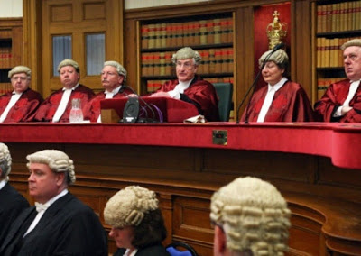
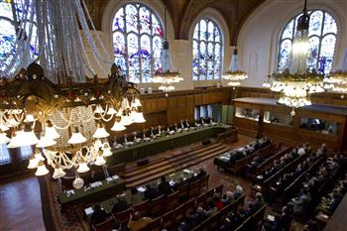
Laws of the Land
What are some important laws the government has established in our society?
Why are they are important?
A poll tax, a tax instituted in A.D. 6 = A poll tax, also known as a head tax or capitation, is a tax of a uniform, fixed amount applied to an individual in accordance with the census (as opposed to a percentage of income, or any proxy for ability-to-pay).
Head taxes were important sources of revenue for many governments from ancient times until the 19th century.
(2)
Matthew 22:17

Slide 3
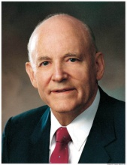
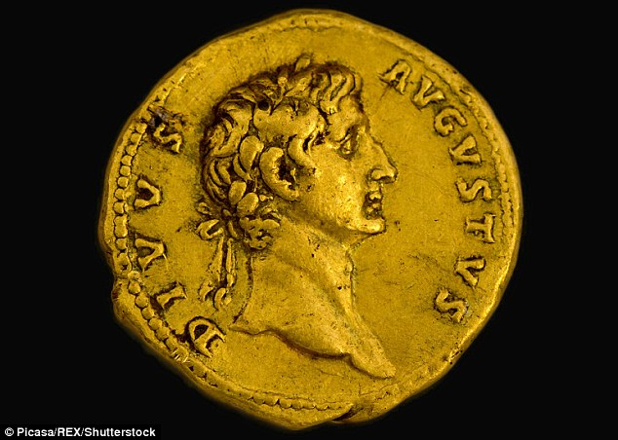
Why Tempt Ye Me?
Is it lawful to give tribute unto Cæsar, or not?
“If he had said, ‘Yes, pay the tax,’ he would have been called a traitor. It would have driven a wedge between him and his followers and created rebellion. If his answer had been, ‘No, it is not lawful to pay the tax,’ they would have delivered him into the hands of Rome on the charge of treason.”
“The wisdom of [the Savior’s] answer defines the limitations of dual sovereigns and defines the jurisdiction of the two empires of heaven and earth.
The image of monarchs stamped on coins denotes that temporal things belong to the temporal sovereign.
The image of God stamped on the heart and soul of a man denotes that all its facilities and powers belong to God and should be employed in his service.”
(1)
Matthew 22:17

Slide 4
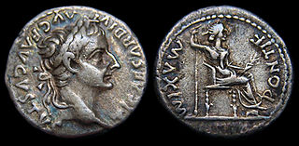
Tribute Penny
It is usually thought that the coin was a Roman denarius with the head of Tiberius.
Caesar = a title
The inscription reads “Ti[berivs] Caesar Divi Avg[vsti] F[ilivs] Avgvstvs” (“Caesar Augustus Tiberius, son of the Divine Augustus”), claiming that Augustus was a god.
The reverse shows a seated female, usually identified as Livia depicted as Pax (Roman goddess of peace)
Matthew 22:17-21
(2)

Slide 5
Obligations To Laws
Render therefore unto Cæsar the things which are Cæsar’s; and unto God the things that are God’s.
Render = an obligation to obey civil laws, such as the law to pay taxes.
The Lord expects us to be good citizens and obey the laws of the land
We believe in being subject to kings, presidents, rulers, and magistrates, in obeying, honoring, and sustaining the law.
Article of Faith 12
Matthew 22:21

Slide 6
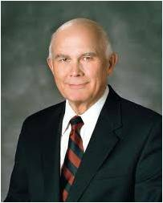
“Some Latter-day Saints are confused over the content, purposes, and procedures of the two kinds of laws that apply to them, the laws of God and the laws of man.
"The divinely directed pattern in this dispensation is clear. It is one of dual jurisdiction.
The children of God in every nation are subject to one authority that establishes and administers the laws of God and to another group of authorities who establish and administer the laws of man.”
(3)
Matthew 22:21

Slide 7
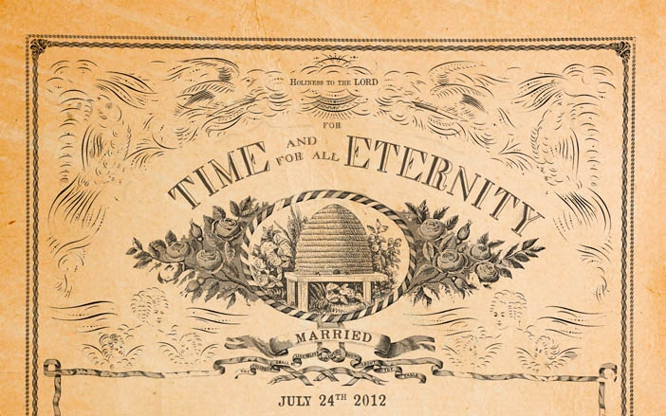
A Question of Marriage
Sadducees = did not believe in resurrection
“The Savior’s words do not state that marriages will not exist after the Resurrection, but that marriages will not be performed after the Resurrection: “In the resurrection there will be no marrying nor giving in marriage; for all questions of marital status must be settled before that time.”
Read D&C 137:15-17
The Lord revealed that marriage can be eternal only if it is entered into according to His law, performed by one who has authority, and sealed by the Holy Spirit of Promise.
D&C 137:19
Matthew 22:23-31
(4)

Slide 8
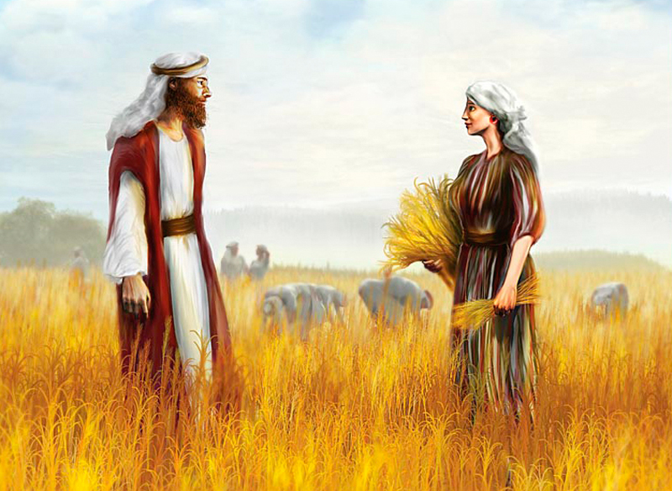
Levirate Marriage
Sadducees intentionally misapplied an Old Testament custom that was designed to provide for widows
If brethren dwell together, and one of them die, and have no child, the wife of the dead shall not marry without unto a stranger: her husband’s brother shall go in unto her, and take her to him to wife, and perform the duty of an husband’s brother unto her.
And it shall be, that the firstborn which she beareth shall succeed in the name of his brother which is dead, that his name be not put out of Israel.
Deuteronomy 25:5-6
Boaz and Ruth
The custom of a widow marrying her deceased husband’s brother or sometimes a near heir. The word has nothing to do with the name Levi or the biblical Levites but is so called because of the Latin levir, meaning “husband’s brother,” connected with the English suffix -ate, thus constituting levirate.
Matthew 22:23-28
(5)

Slide 9
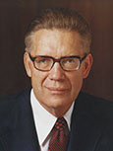
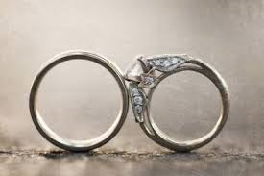
“ Jesus Christ] is not denying but limiting the prevailing concept that there will be marrying and giving in marriage in heaven.
He is saying that as far as ‘they’ (the Sadducees) are concerned, that as far as ‘they’ (‘the children of this world’) are concerned, the family unit does not and will not continue in the resurrection. …
“‘Therefore, when they [those who will not, do not, or cannot live the law of eternal marriage] are out of the world they neither marry nor are given in marriage’
“That is, there is neither marrying nor giving in marriage in heaven for those to whom Jesus was speaking; for those who do not even believe in a resurrection, let alone all the other saving truths.”
For in the resurrection they neither marry, nor are given in marriage, but are as the angels of God in heaven.
Matthew 22:23-30
(6)

Slide 10
Those who are not sealed by priesthood authority to their spouses in mortality or through proxy ordinances in temples will not be married in the world to come
Matthew 22:29-30

Slide 11
2 Great Commandments
Judaism teaches that the law of Moses contains 613 commandments.
“To love God with all your heart, soul, mind, and strength is all-consuming and all-encompassing. It is no lukewarm endeavor. It is total commitment of our very being—physically, mentally, emotionally, and spiritually—to a love of the Lord.
Leviticus 19:18
Thou shalt not avenge, nor bear any grudge against the children of thy people, but thou shalt love thy neighbour as thyself:
Deuteronomy 6:5
And thou shalt love the Lord thy God with all thine heart, and with all thy soul, and with all thy might.
If we truly love God and love our neighbor as ourselves, we will strive to keep all of God’s commandments
Matthew 22:41-46
(7)

Slide 12
Doctrinal Mastery
Master, which is the great commandment in the law?
Jesus said unto him, Thou shalt love the Lord thy God with all thy heart, and with all thy soul, and with all thy mind.
This is the first and great commandment.
And the second is like unto it, Thou shalt love thy neighbour as thyself.
Matthew 22: 36-39

Slide 13
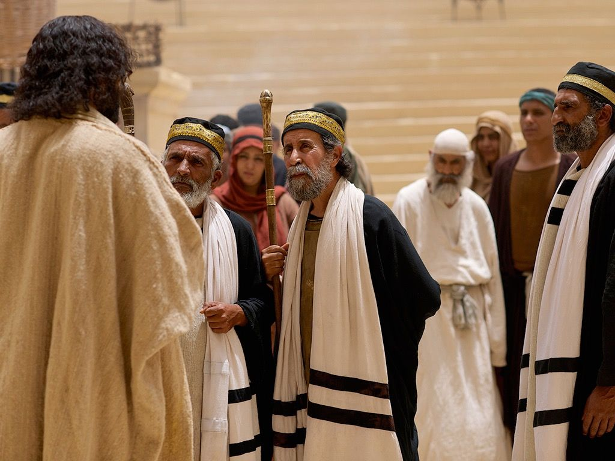
What Think Ye?
Most Jews knew that Christ, or the Messiah, would be a descendant of King David.
The Pharisees believed the Messiah would be crowned king of Israel and help them defeat foreign enemies (such as Rome) and receive their freedom, as King David had done previously.
Jesus taught the Pharisees that according to their own scriptures, Christ was more than just the son of David—He was also the Son of God. Or, as later revealed to John the Beloved, Christ is both “the root and the offspring of David”
He is both David’s Lord and his descendant.
I Jesus have sent mine angel to testify unto you these things in the churches. I am the root and the offspring of David, and the bright and morning star.
Revelation 22:16

Slide 14
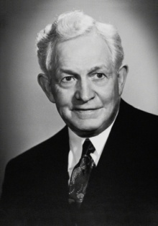
“What you sincerely in your heart think of Christ will determine what you are, will largely determine what your acts will be. No person can study this divine personality, can accept his teachings without becoming conscious of an uplifting and refining influence within himself.”
(8)

Slide 15
Matthew 22:15-22
Matthew 22 23-33
Matthew 22:34-40
Matthew 22:41-46
We should serve God and obey the Law of the land.
The Resurrection is real. Those who aren’t sealed won’t be married in the Resurrection.
The great commandment is to love God, The second great commandment is to love others.
Jesus Christ is the Son of God.

Slide 16
Sources:
Suggested Hymn: #308 Love One Another
Howard W. Hunter Conference Report, Apr. 1968, 64–65).
Wikipedia
Elder Dallin H. Oaks (The Lord's Way, 210.)
James E. Talmage Jesus the Christ p. 548
Bible Dictionary
Elder Bruce R. McConkie Doctrinal New Testament Commentary, 3 vols. [1965–73], 1:606
Ezra Taft Benson (“The Great Commandment—Love the Lord” Ensign, May 1988
President David O. McKay (in Conference Report, Apr. 1951, 93).
Presentation by ©http://fashionsbylynda.com/blog/

Slide 17
Tribute Coin Matthew 22:17
However, it has been suggested that denarii were not in common circulation in Judaea during Jesus' lifetime and that the coin may have instead been an Antiochan tetradrachm bearing the head of Tiberius, with Augustus on the reverse. Another suggestion often made is the denarius of Augustus with Caius and Lucius on the reverse, while coins of Julius Caesar, Mark Antony and Germanicusare all considered possibilities.
A similar episode occurs in the Gospel of Thomas(verse 100), but there the coin in question is gold.
Tiberius a Roman Emperor from 14 AD to 37 AD. Born Tiberius Claudius Nero, a Claudian, Tiberius was the son of Tiberius Claudius Nero and Livia Drusilla. His mother divorced Nero and married Octavian later known as Augustus, in 39 BC, making him a step-son of Octavian.
Livia Drusilla (Classical Latin: LIVIA•DRVSILLA, LIVIA•AVGVSTA) (30 January 58 BC – 28 September 29 AD), also known as Julia Augusta after her formal adoption into the Julian family in AD 14, was the wife of the Roman emperor Augustus throughout his reign, as well as his adviser. She was the mother of the emperor Tiberius, paternal grandmother of the emperor Claudius, paternal great-grandmother of the emperor Caligula, and maternal great-great-grandmother of the emperor Nero. She was deified by Claudius who acknowledged her title of Augusta. Wikipedia
Sadducees (Jewish Religious Sects)
The Sadducees were an aristocratic, priestly class of Jews and influential in the temple and the Sanhedrin.
Their name derived from the high priest Zadok, since the sons of Zadok were the most worthy to minister to the Lord in the temple.
They originated when the wealthier elements of the population united during the Hellenistic (Greek culture around 200 B.C.) period.
They held to older doctrines and always opposed the Pharisees, both politically and religiously.
Although both groups believed in the Pentateuch (Torah), the Pharisees accepted the oral law while the Sadducees refused to accept anything not written in the Torah.
Strict Sadducees questioned the existence of the spirit and the concept of punishments and rewards in a life after death, and denying the doctrine of the physical resurrection
They represented the worldly minded aristocrats, and interested in maintaining their own privileged position.
Both John the Baptist and Jesus strongly denounced the Sadducees, who were also unpopular with the common people.
Their strength was in their control of the temple, and when it was destroyed in 70 A.D. they ceased to exist as a viable political or religious force among the Jews.
Victor L. Ludlow January 1975 Ensign and Bible dictionary
Image of Caesar Matthew 22:21
"One may draw a lesson if he will, from the association of our Lord's words with the occurrence of Caesar's image on the coin. It was that effigy with its accompanying superscription that gave special point to His memorable instruction, 'Render therefore unto Caesar the things which are Caesar's.' This was followed by the further injunction: 'and unto God the things that are God's.' Every human soul is stamped with the image and superscription of God, however blurred and indistinct the line may have become through the corrosion or attrition of sin; and as unto Caesar should be rendered the coins upon which his effigy appeared, so unto God should be given the souls that bear His image. Render unto the world the stamped pieces that are made legally current by the insignia of worldly powers, and give unto God and His service, yourselves-the divine mintage of His eternal realm." James E. Talmage (Jesus the Christ, 506)

Slide 18
Levirate Marriage Matthew 22:23-28
A widow with no surviving children faced problems – no support/ no way to carry on the line of the husband and important for a link to property.
The Book of Ruth shows this principle of levirate marriage in action. Ruth could have married a relative closer than Boaz, but he declined—the son of Ruth and Boas is Obed, grandfather of King David.
The Best Measuring Stick Matthew 22:41-46
"If you or I were there, we might then have asked, 'Master, how might we best show our love?' Perhaps we would have heard the words, 'He that hath my commandments, and keepeth them, he it is that loveth me.' (John 14:21.) Or, 'If ye love me, keep my commandments.' (John 14:15.)
"Another question: 'How might I best show my love for my fellowmen?' And the words of King Benjamin could well apply: 'When ye are in the service of your fellow beings ye are only in the service of your God.' (Mosiah 2:17.) Service is the best measuring stick of love." President Thomas S. Monson (Be Your Best Self, 193-194.)
The Great Commandment Matthew 22:35-40
“The breadth, depth, and height of this love of God extend into every facet of one’s life. Our desires, be they spiritual or temporal, should be rooted in a love of the Lord. Our thoughts and affections should be centered on the Lord. …
“Why did God put the first commandment first? Because He knew that if we truly loved Him we would want to keep all of His other commandments. …
“We should put God ahead of everyone else in our lives.
“When Joseph was in Egypt, what came first in his life—God, his job, or Potiphar’s wife? When she tried to seduce him, he responded by saying, ‘How then can I do this great wickedness, and sin against God?’ (Genesis 39:9). … When Joseph was forced to choose, he was more anxious to please God than to please his employer’s wife. When we are required to choose, are we more anxious to please God than our boss, our teacher, our neighbor, or our date? …
“If someone wants to marry you outside the temple, whom will you strive to please—God or a mortal? … You should qualify for the temple. Then you will know that there is no one good enough for you to marry outside the temple. If such individuals are that good, they will get themselves in a condition so that they too can be married in the temple.
“We bless our fellowmen the most when we put the first commandment first” (7)
What think Ye? Matthew 22:41-46
“Jesus the Christ is the Son of David in the physical way of lineage. … But while Jesus was born in the flesh as late in the centuries as the ‘meridian of time’ He was Jehovah, Lord and God, before David, Abraham, or Adam was known on earth” James E. Talmage (Jesus the Christ, 3rd ed. [1916], 552).

